Slide 1
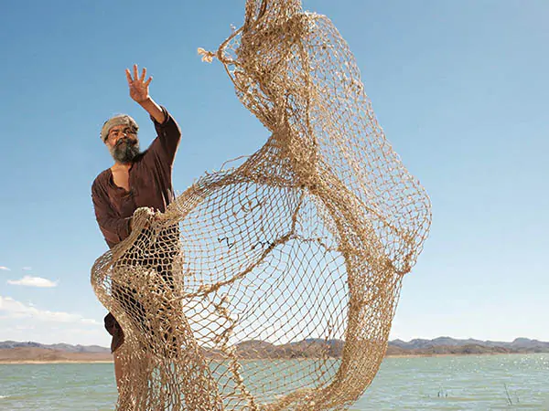
Parable of the Dragnet
Matthew
13:47-50
Seventh Parable

Slide 2
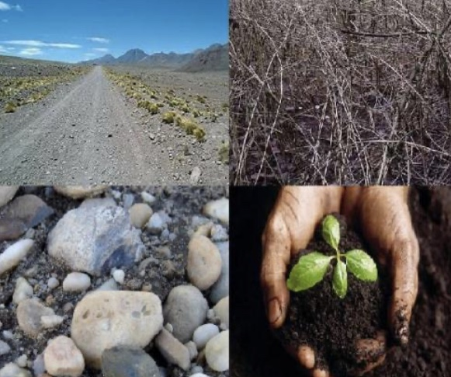
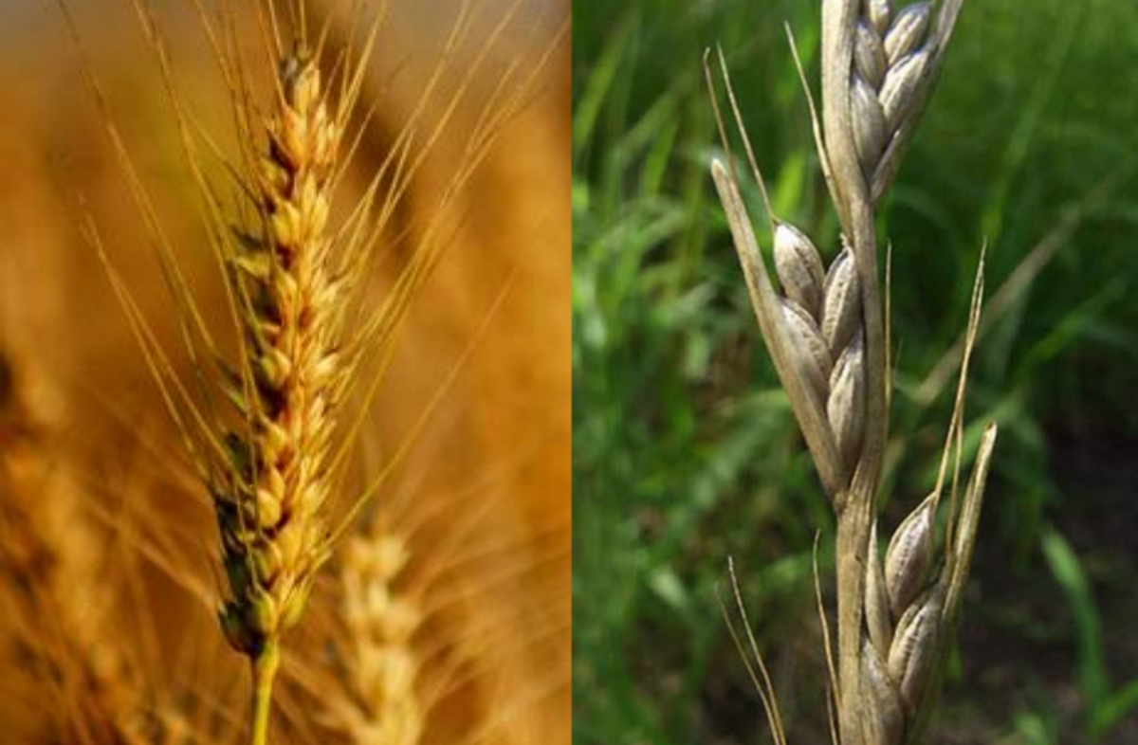
2 Parables describe the Nature of the Kingdom
The parable of the Soils
Wheat and the Tares

Slide 3
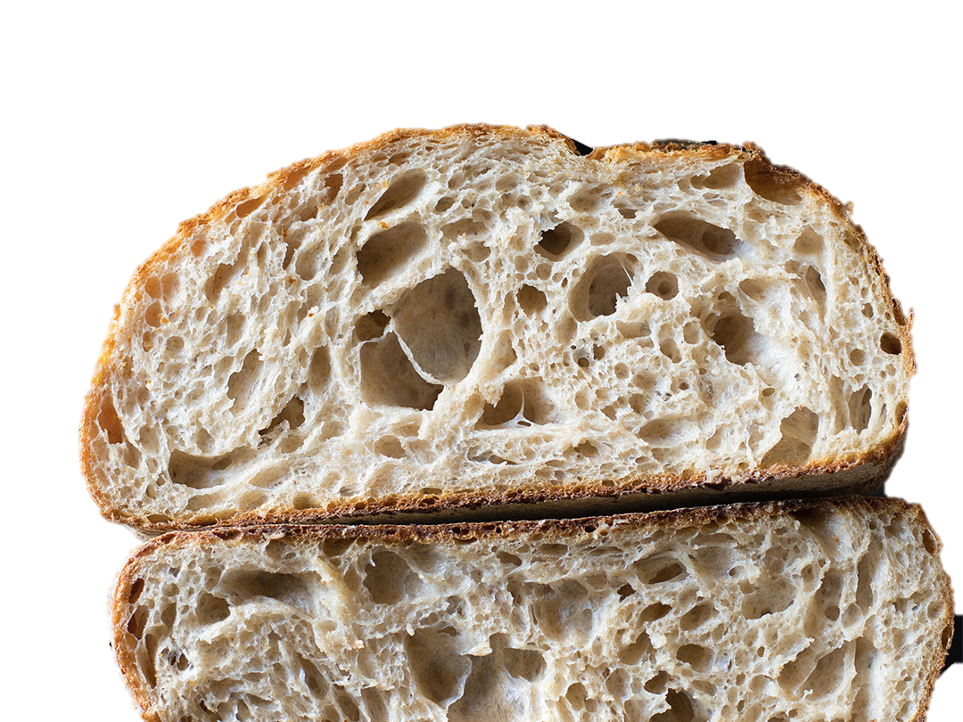

2 Parables describe the Power of the Kingdom
The parable of the Mustard seed
The parable of the leaven

Slide 4
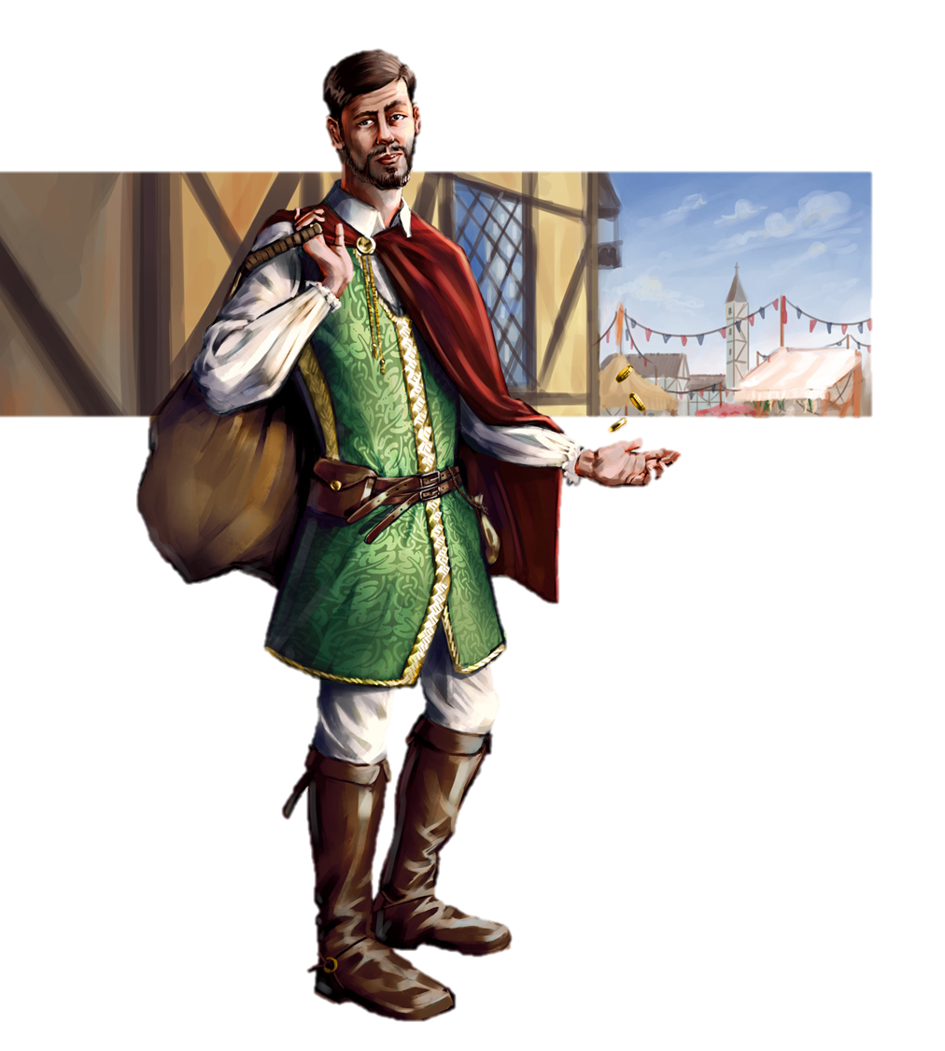


Appropriation or Entering
of the Kingdom
The
Parable of the Treasure
Parable of the Merchant

Slide 5
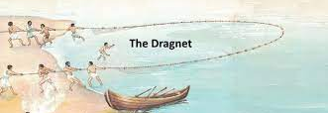
Judgement of the Kingdom
Seventh Parable: Parable of the Dragnet

Slide 6
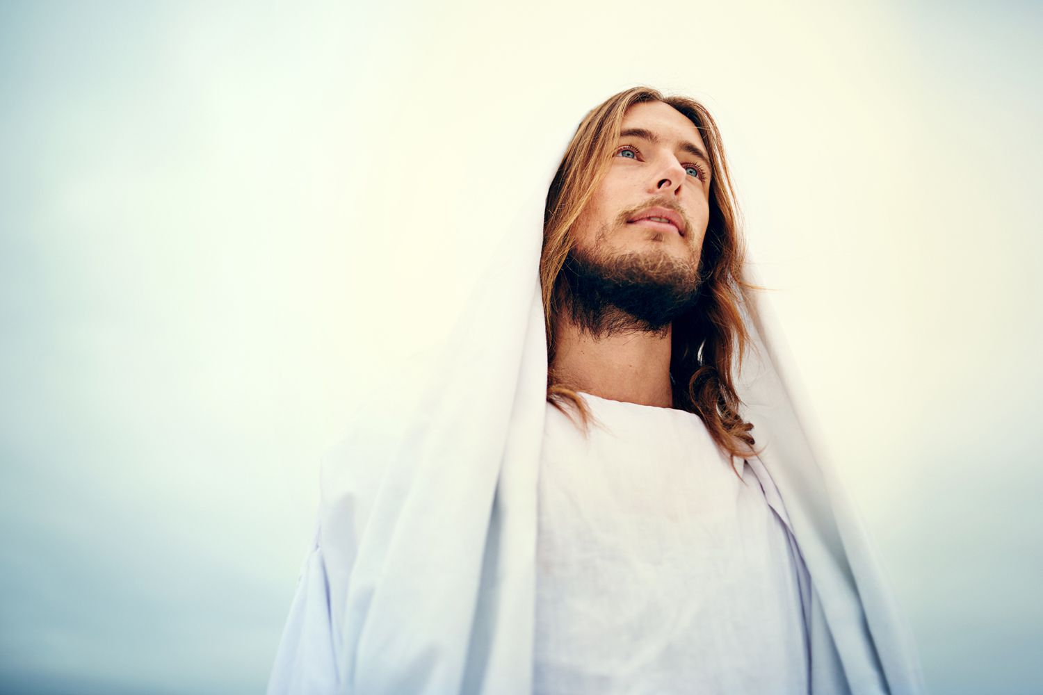

Jesus Christ spoke about Hell more than anyone else.

Slide 7
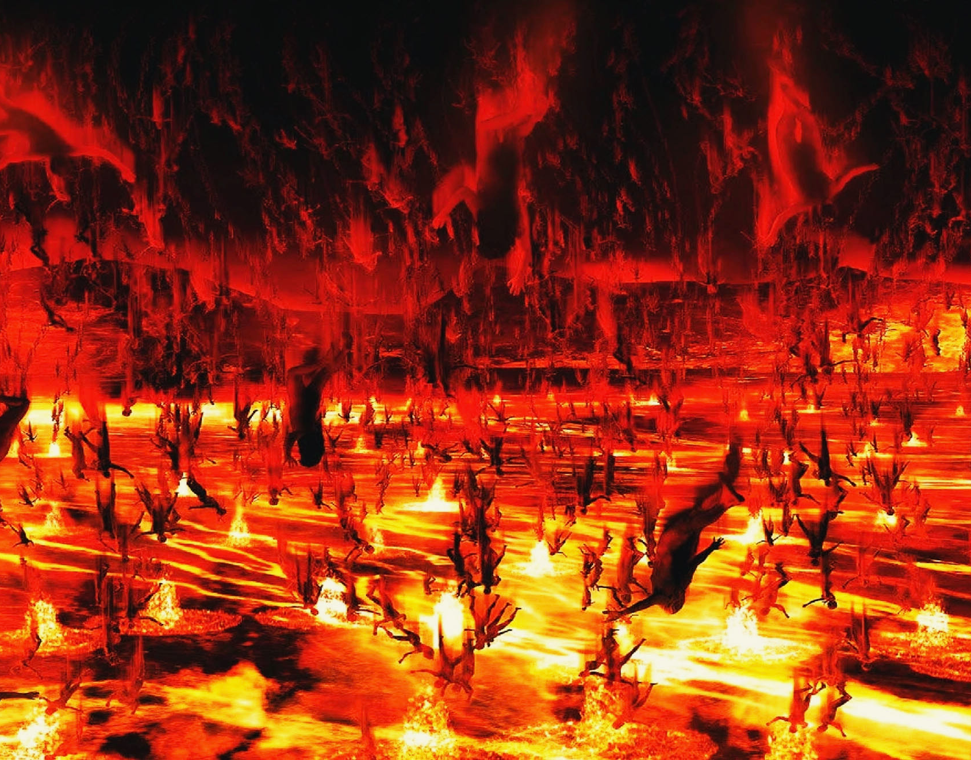
Matthew 23:33

Slide 8

Matthew 17:27
Fishing hook

Slide 9

Matthew 4:18
Using the Net

Slide 10
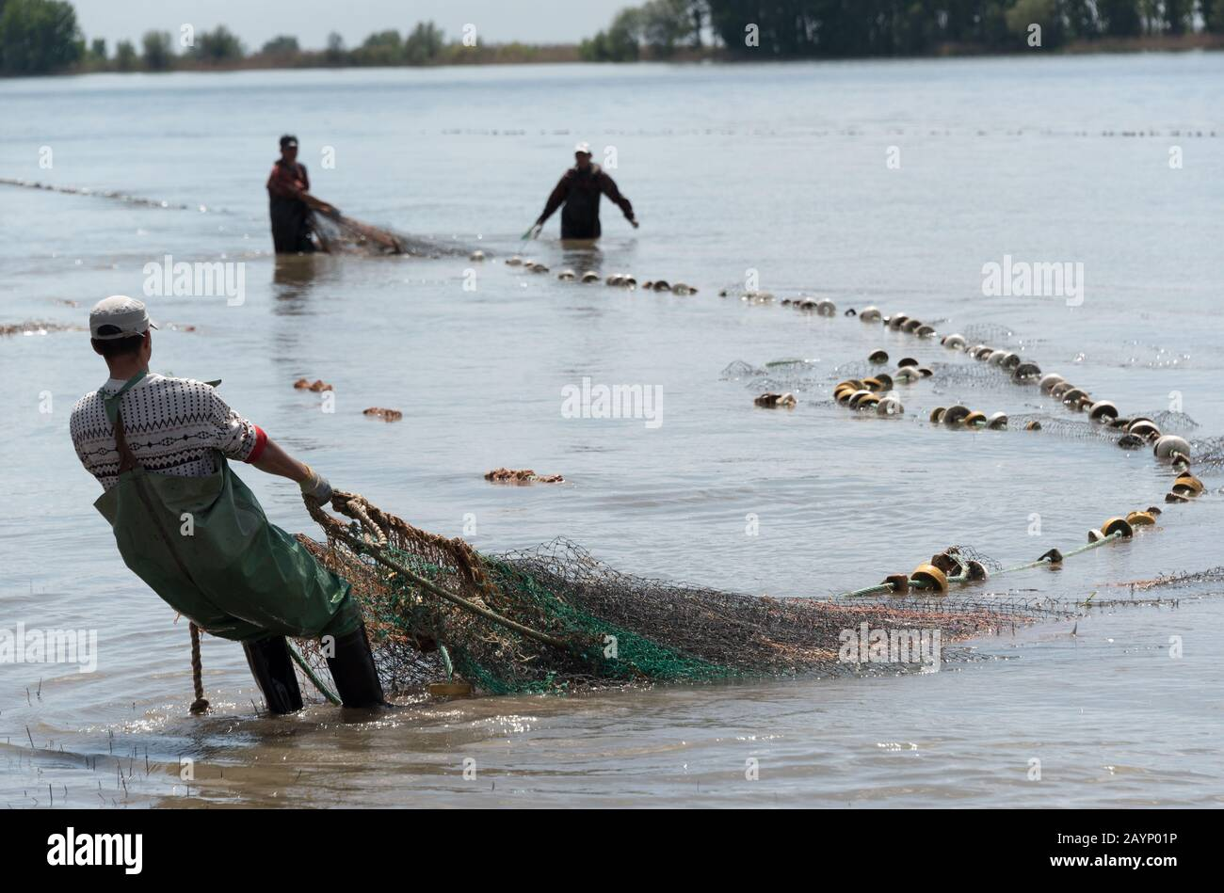
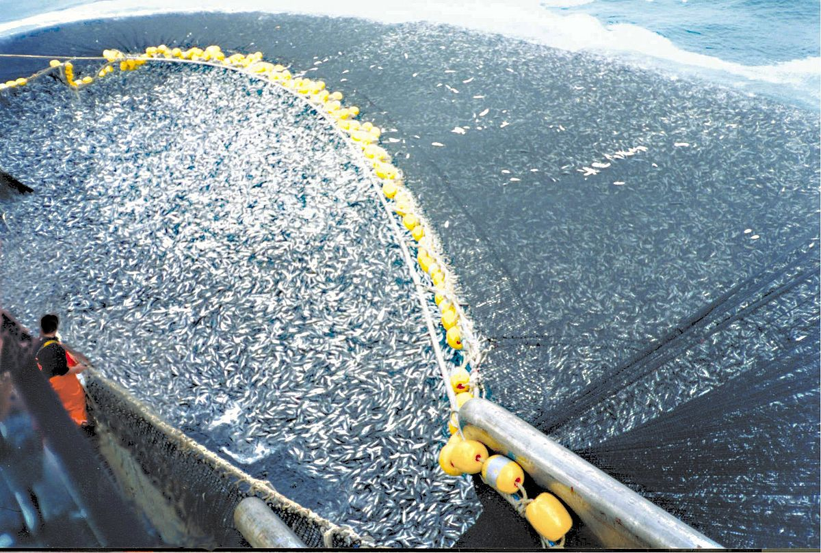
Matthew 13:47
Large dragnet

Slide 11
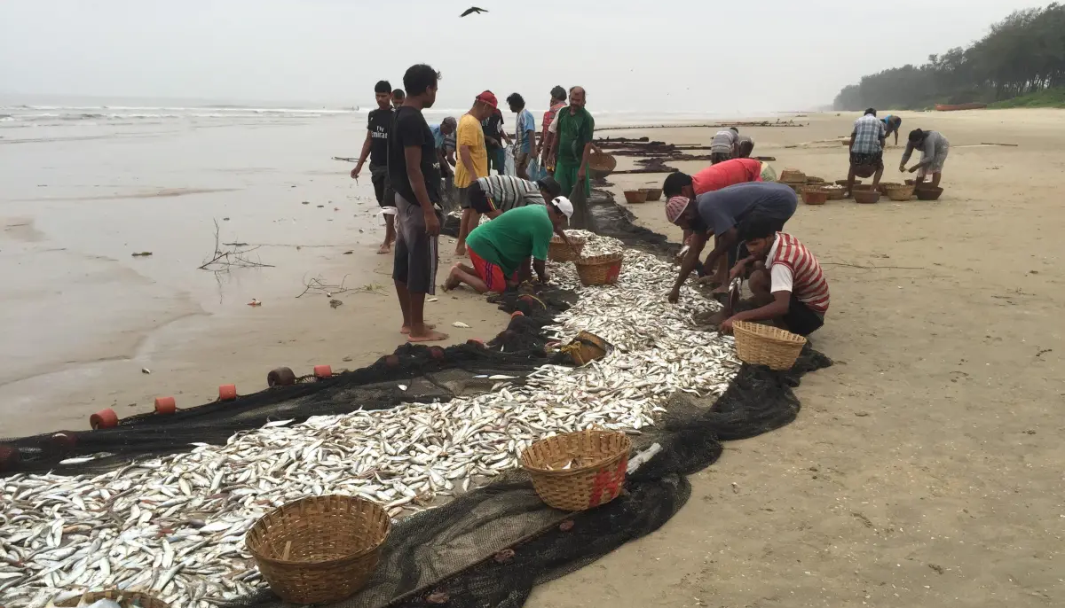
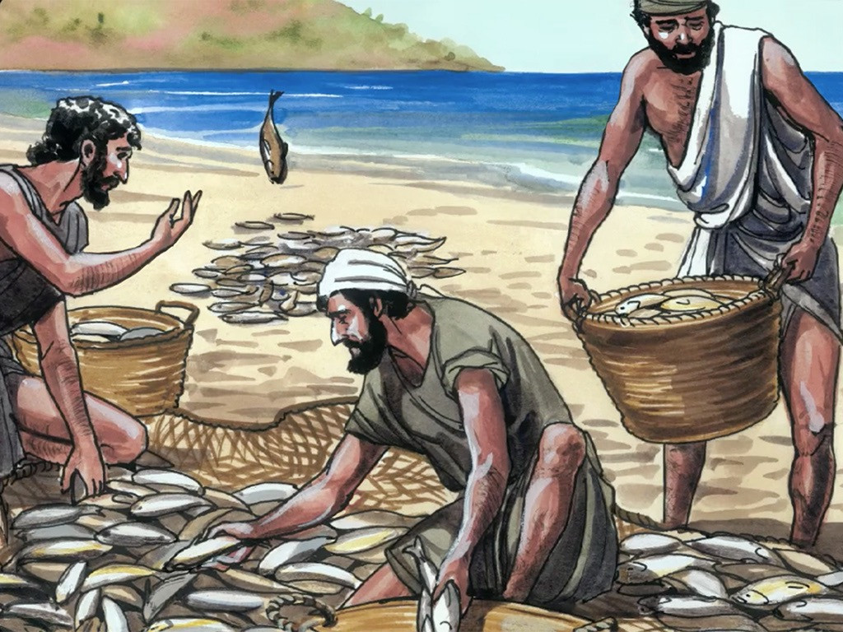
Matthew 13:48

Slide 12
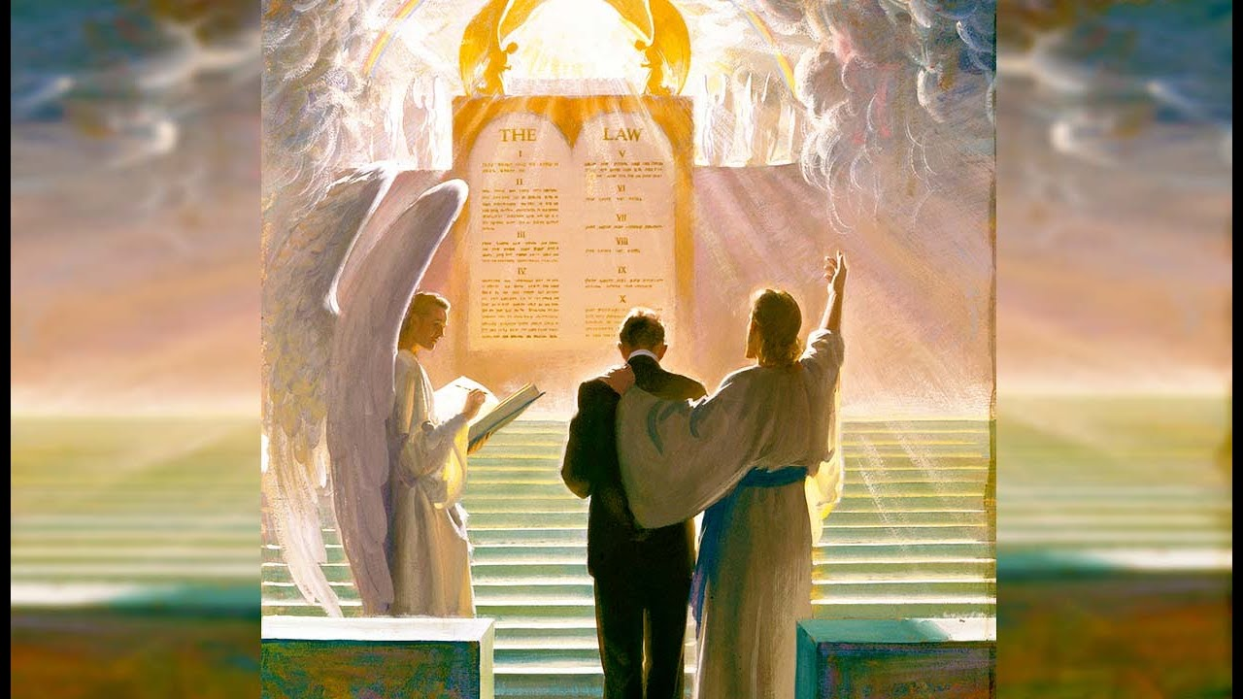
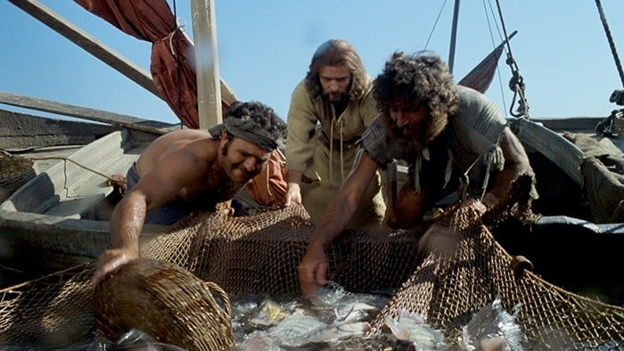
Matthew 13:49
Separation is inevitable and its ultimate!

Slide 13
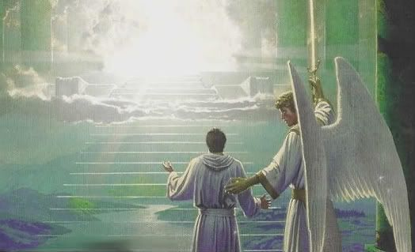
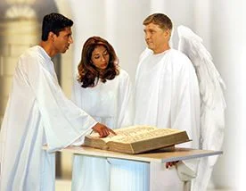
Matthew 13:41
Angels are the separators

Slide 14
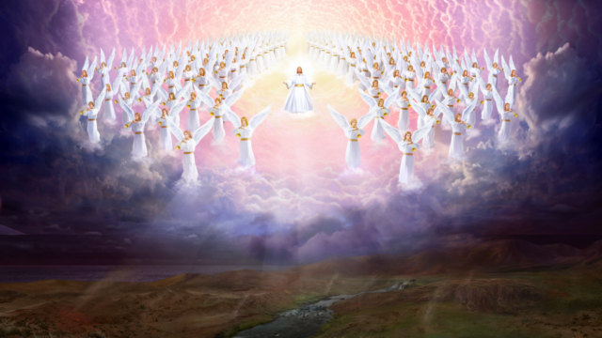
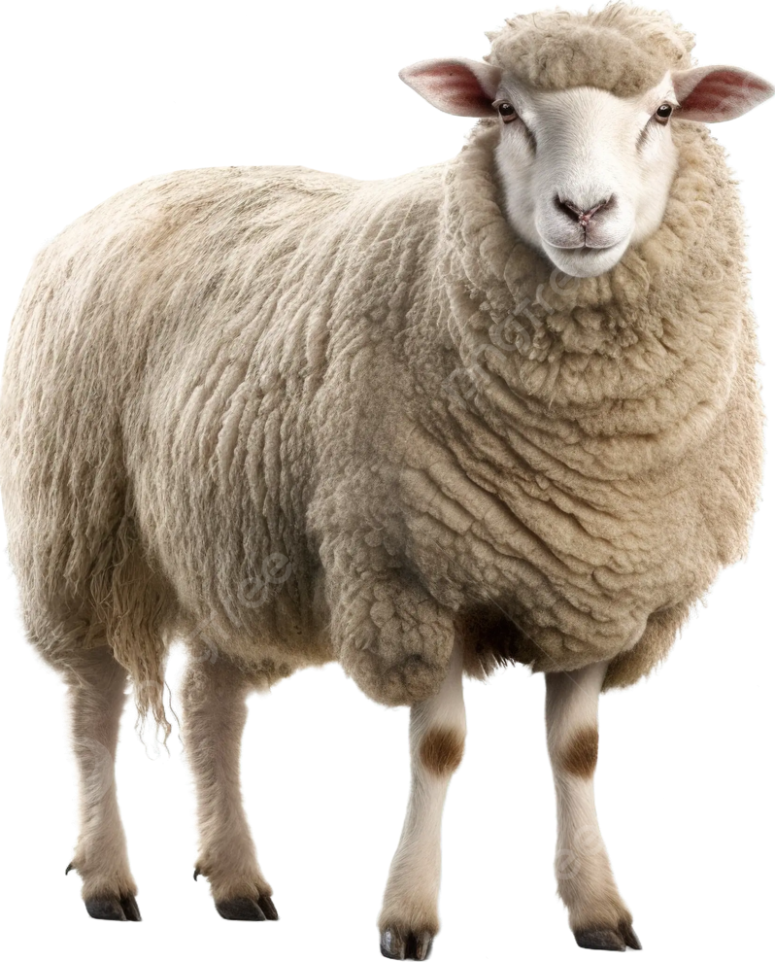
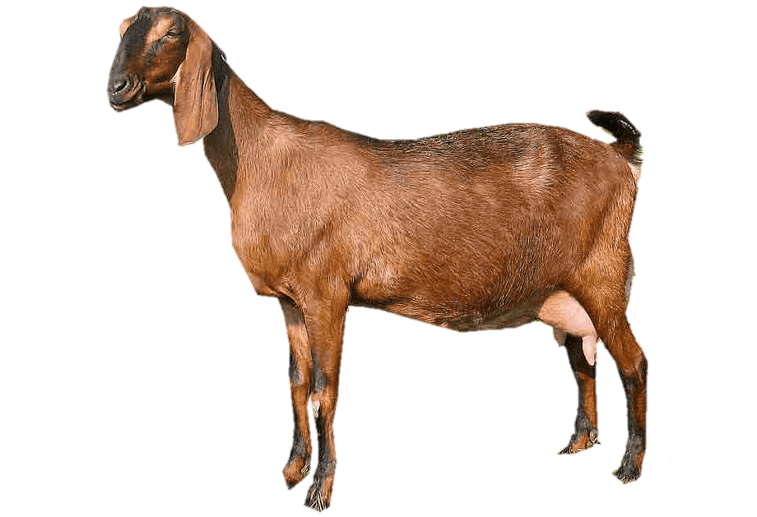

Matthew 25:31-34

Slide 15
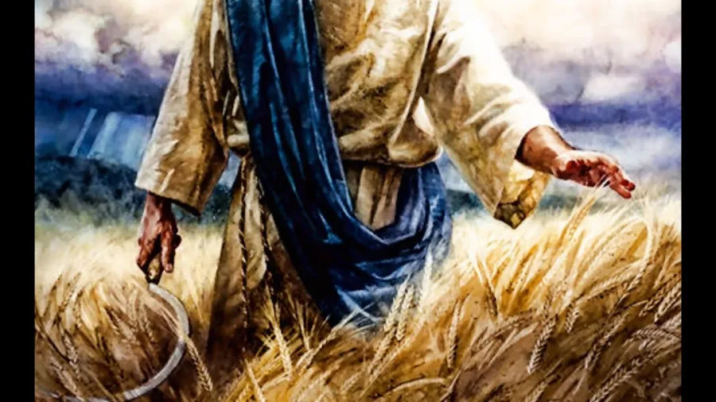
Revelation 14

Slide 16


Ezekiel
18:23

Slide 17


2 Peter 3:9

Slide 18
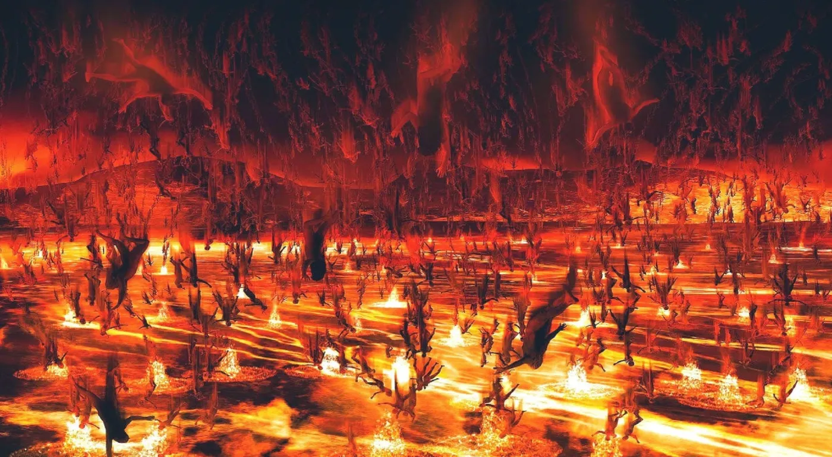

Matthew 13:50

Slide 19

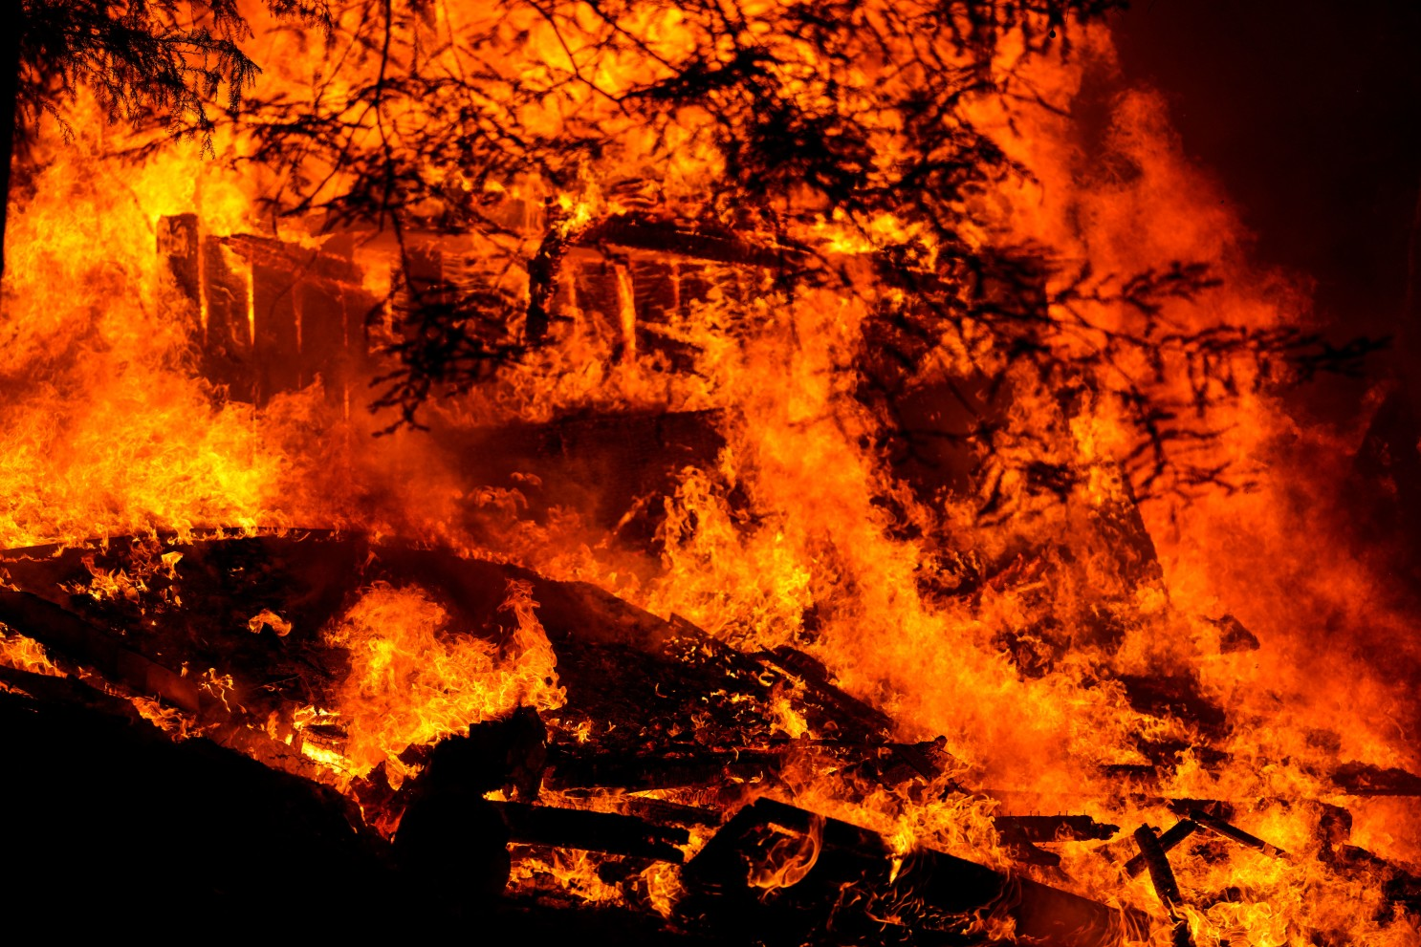
Matthew 5:22,29-30,
Matthew 7:27,
Matthew 8:12,
Matthew 11:20,
Matthew 12:36,
Matthew 18:9,
Matthew 21:41,
Matthew chapter 23 full of it.
Matthew chapter 24 and 25 all the parables are about Hell.

Slide 20
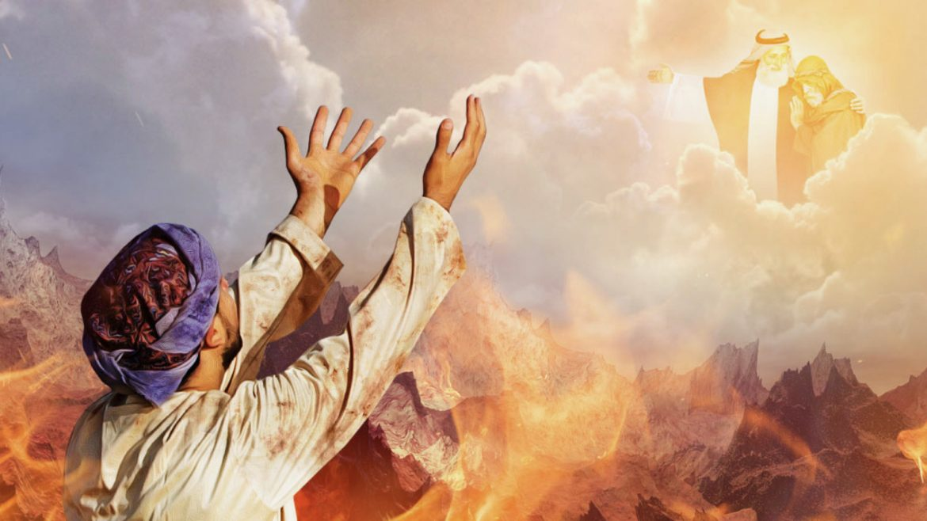
Luke 16:24
Place of unrelieved torment

Slide 21

Matthew 13:42

Slide 22
Matthew 8:12

Slide 23
Luke 13:28

Slide 24
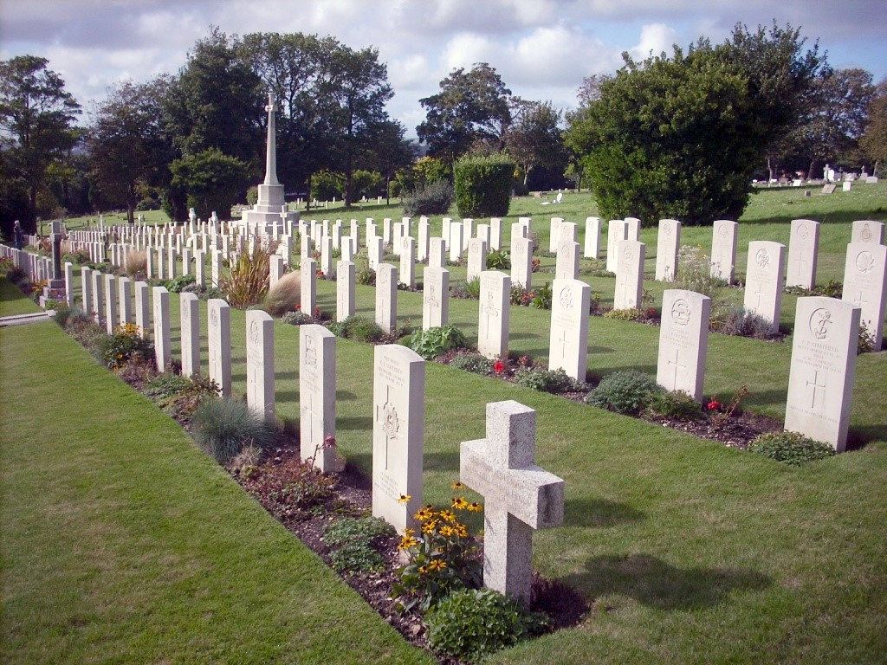
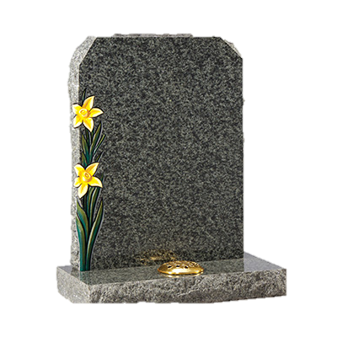
John 5:28-29
Unrelieved torment for body and soul

Slide 25
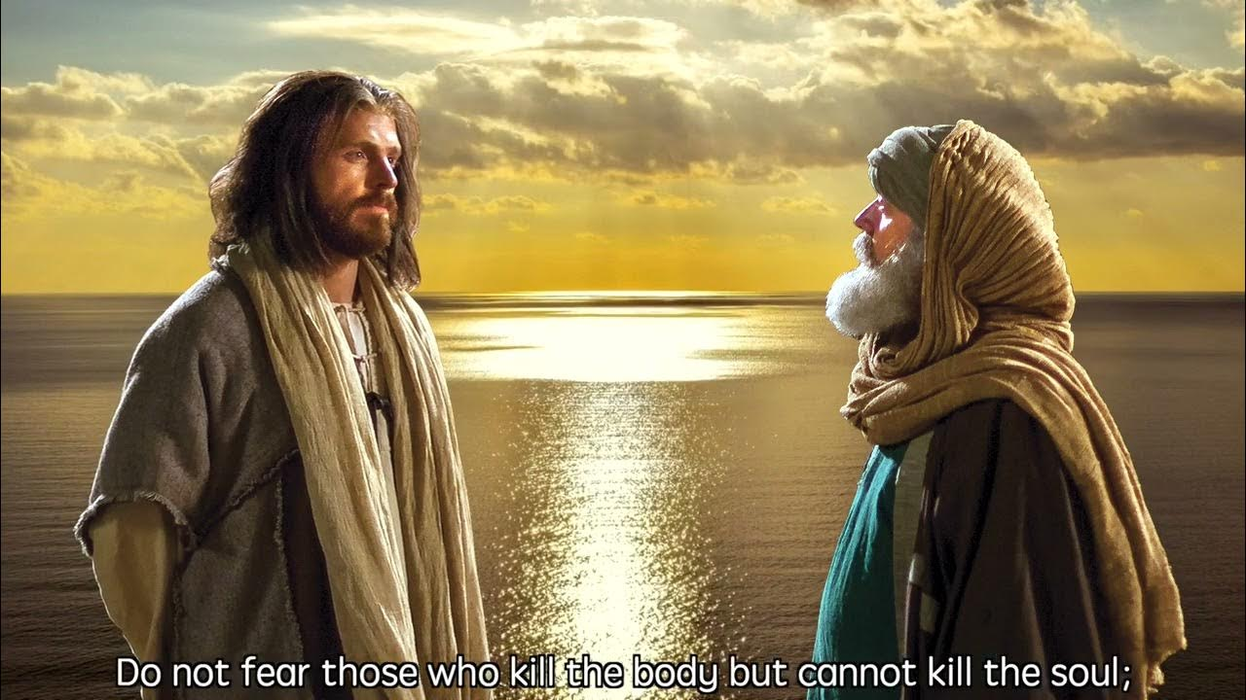
Matthew 10:28

Slide 26
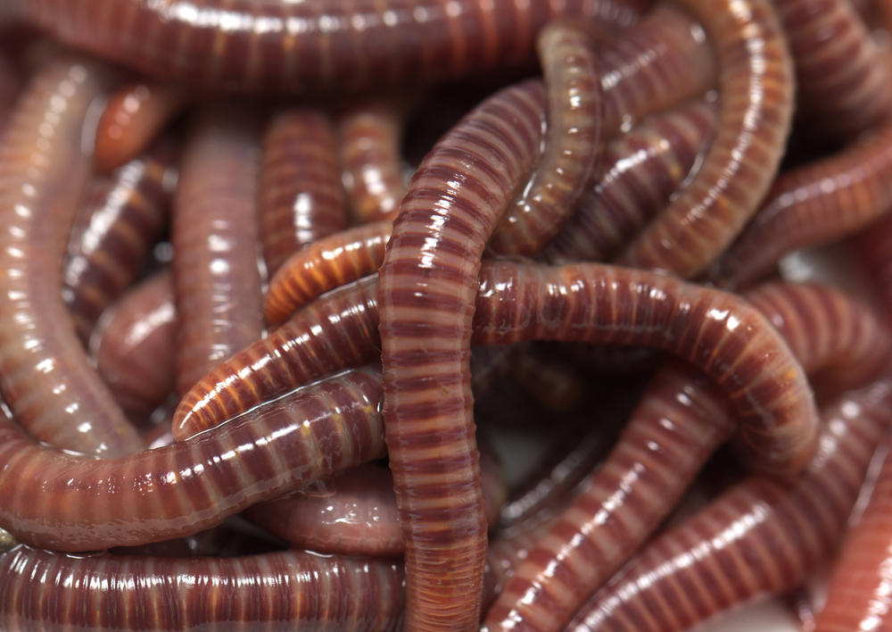
The worm does not die
The fire is not quenched
Mark 9:43-44

Slide 27


Hebrews 10:29
Level of torment varies

Slide 28
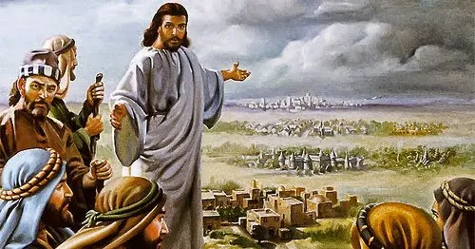
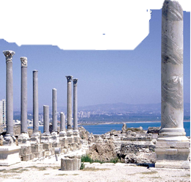
Matthew 11:22

Slide 29

Luke 12:47-48

Slide 30

Matthew 25:46
Torment of body and soul endlessly

Slide 31
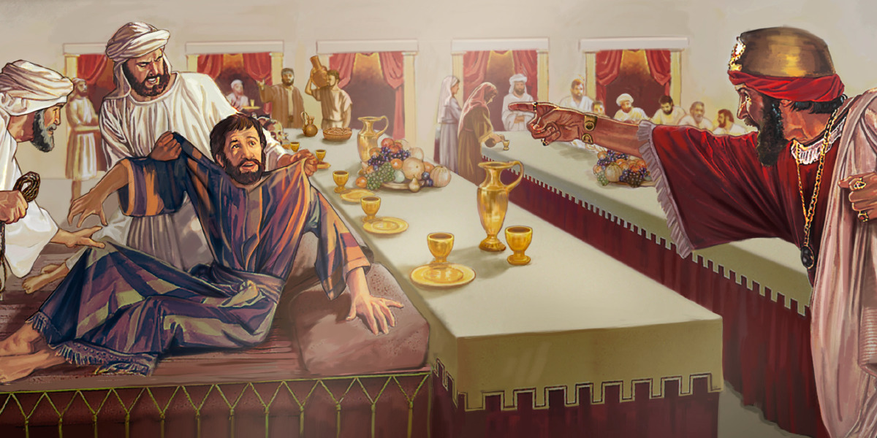
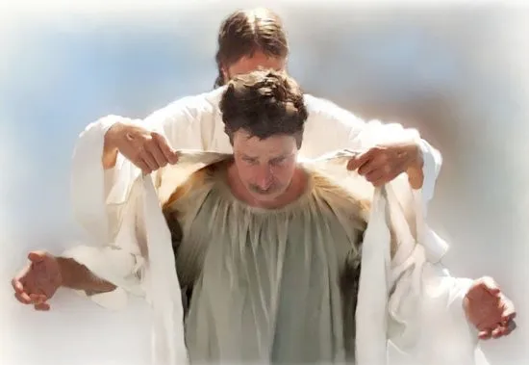
Matthew 22:1-14

Slide 32
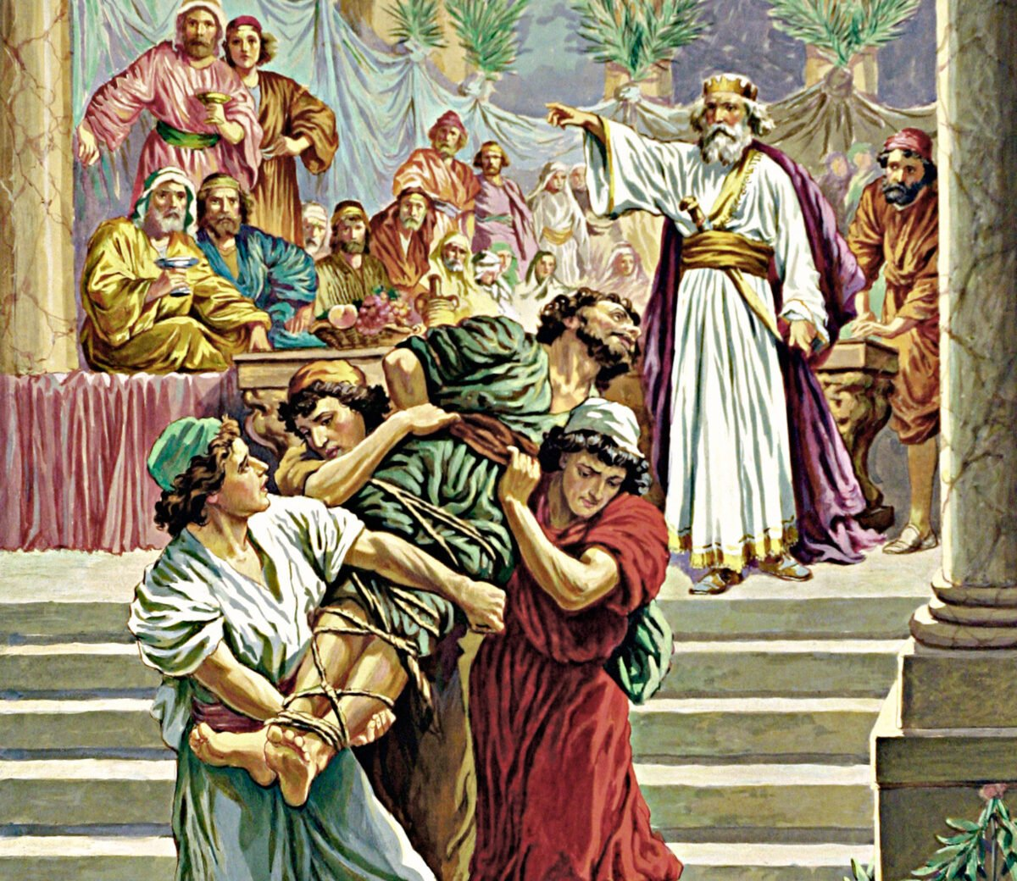
Matthew 22:12-13

Slide 33

2 Corinthians 5:11
We have a tremendous responsibility

