Slide 1
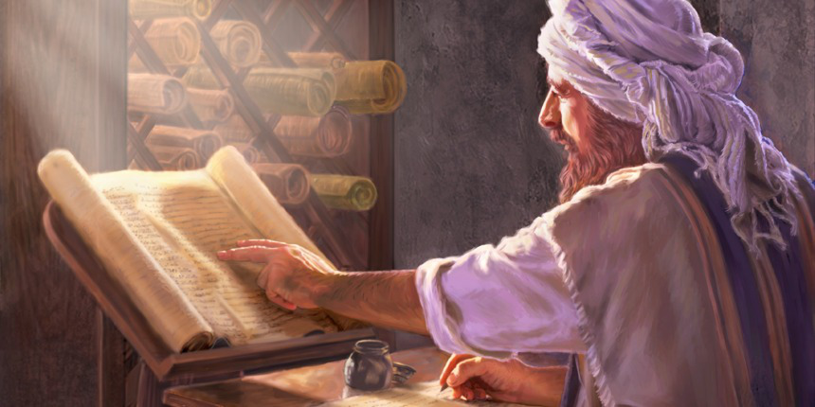
Parable of the Scribe
Eighth Parable
Matthew 13:51-52

Slide 2
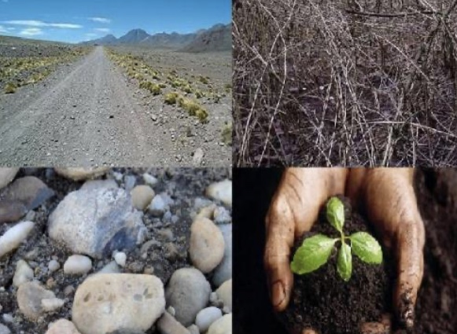
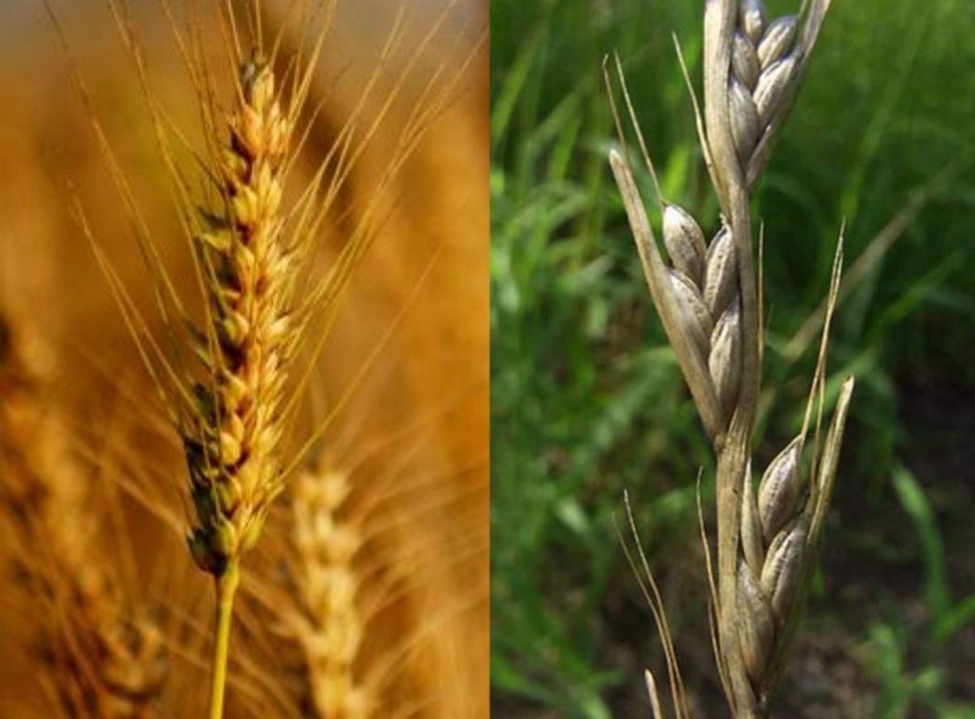
2 Parables describe the Nature of the Kingdom
The parable of the Soils
Wheat and the Tares

Slide 3
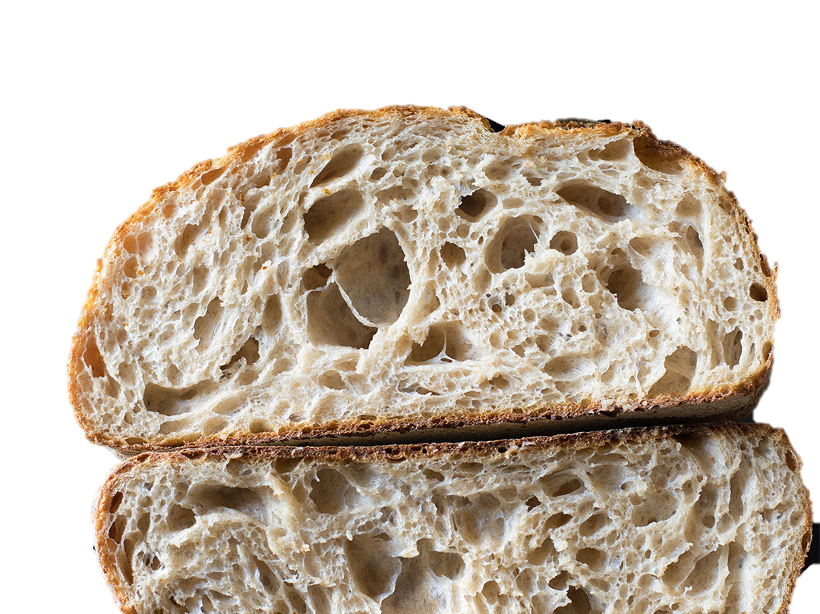
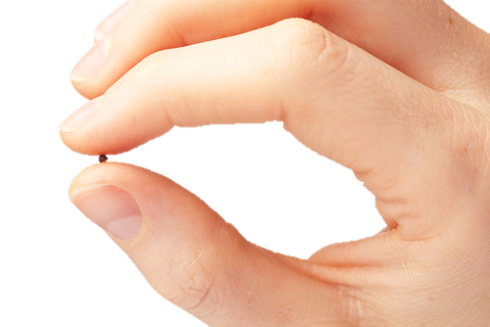
2 Parables describe the Powerof the
Kingdom
The parable of the Mustard seed
The parable of the leaven

Slide 4

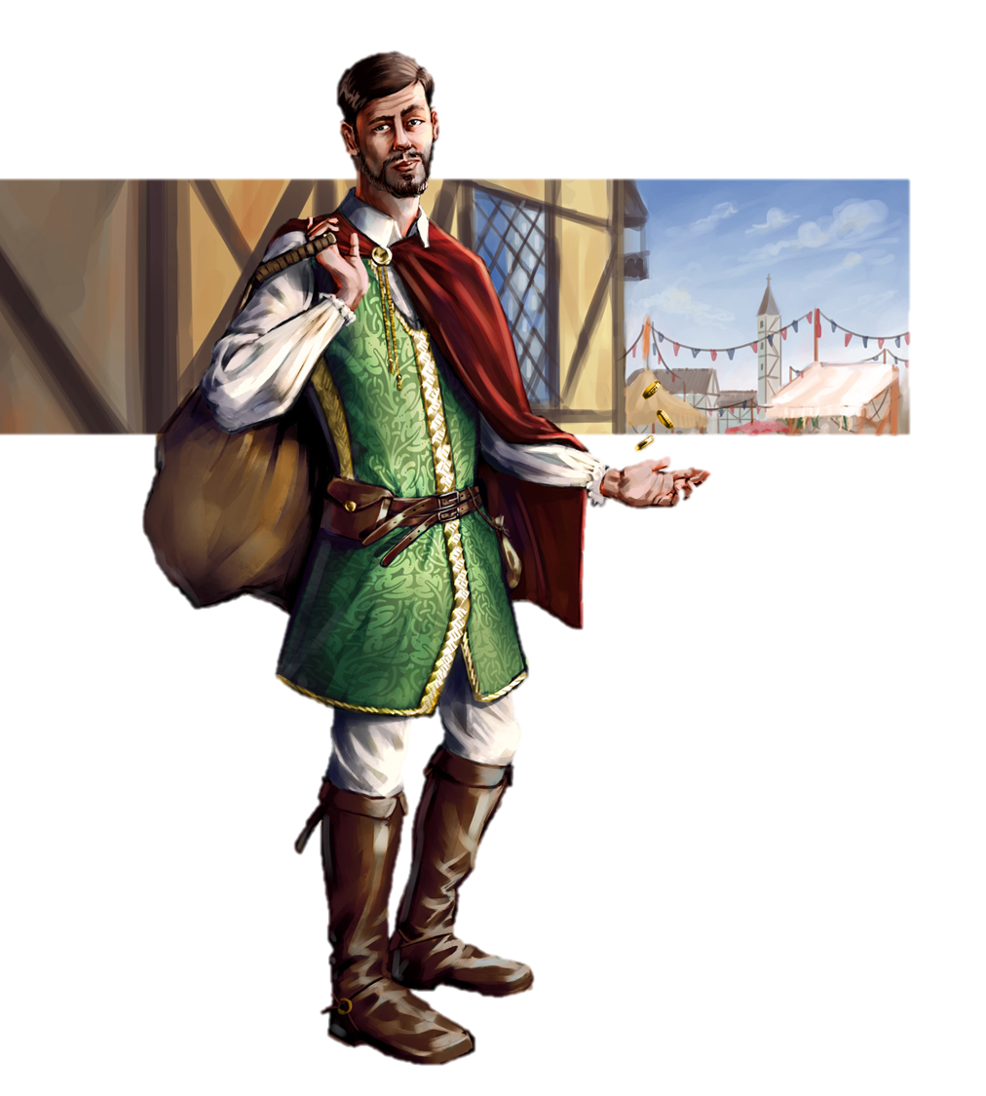

Appropriation (Entering)
of the Kingdom
The
Parable of the Treasure
Parable of the Merchant

Slide 5
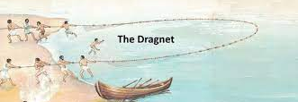
Judgement of the Kingdom
Seventh Parable: Parable of the Dragnet

Slide 6
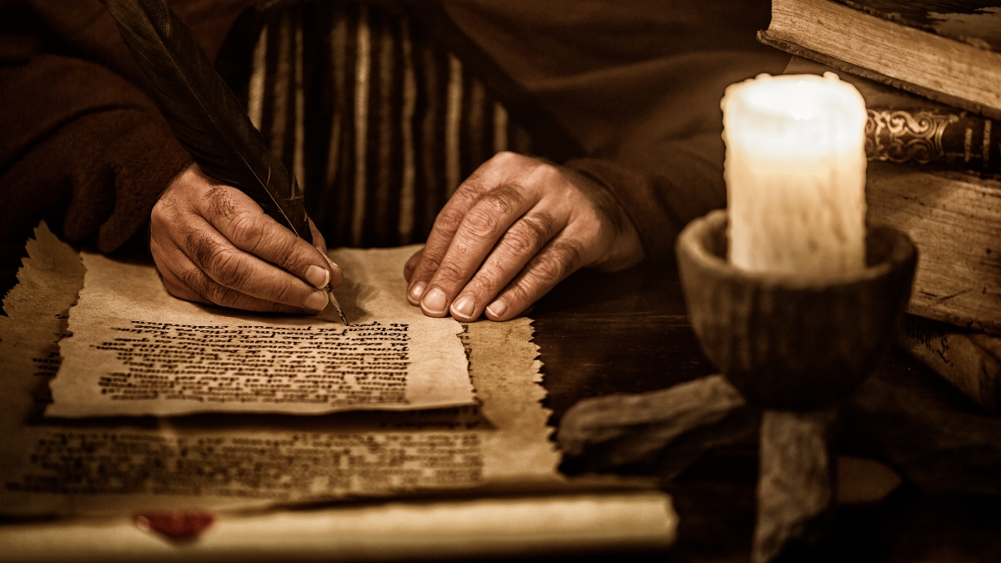
EIGTH Parable: Responsibility

Slide 7

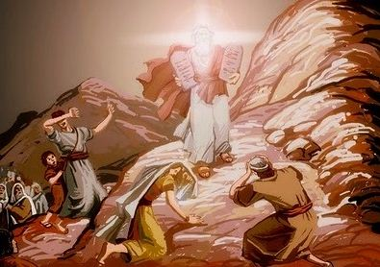
2 Corinthians 3:13-14

Slide 8
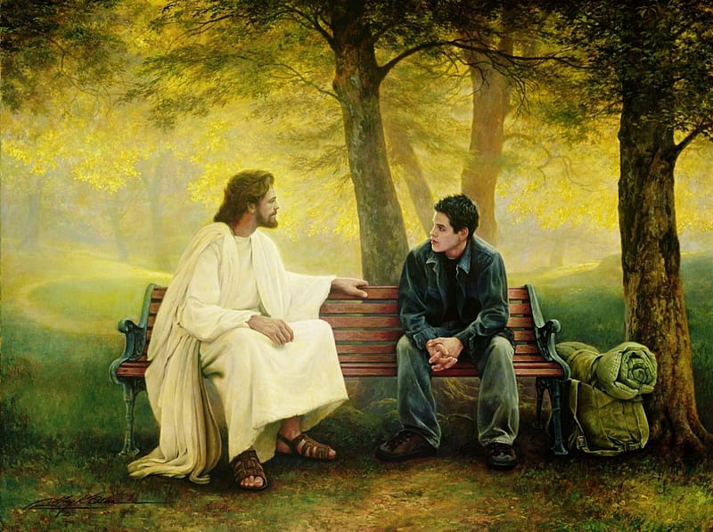

2 Corinthians 3:15-18

Slide 9
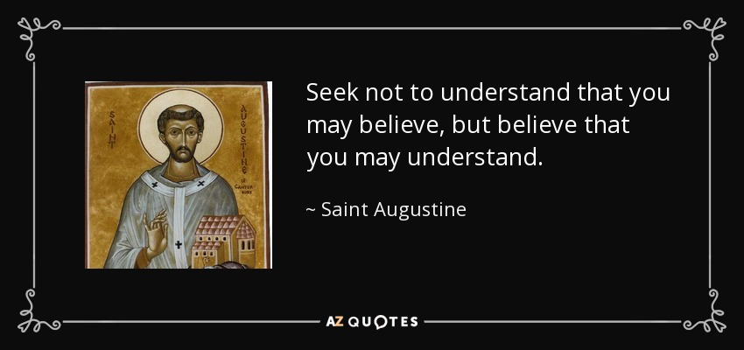


Slide 10
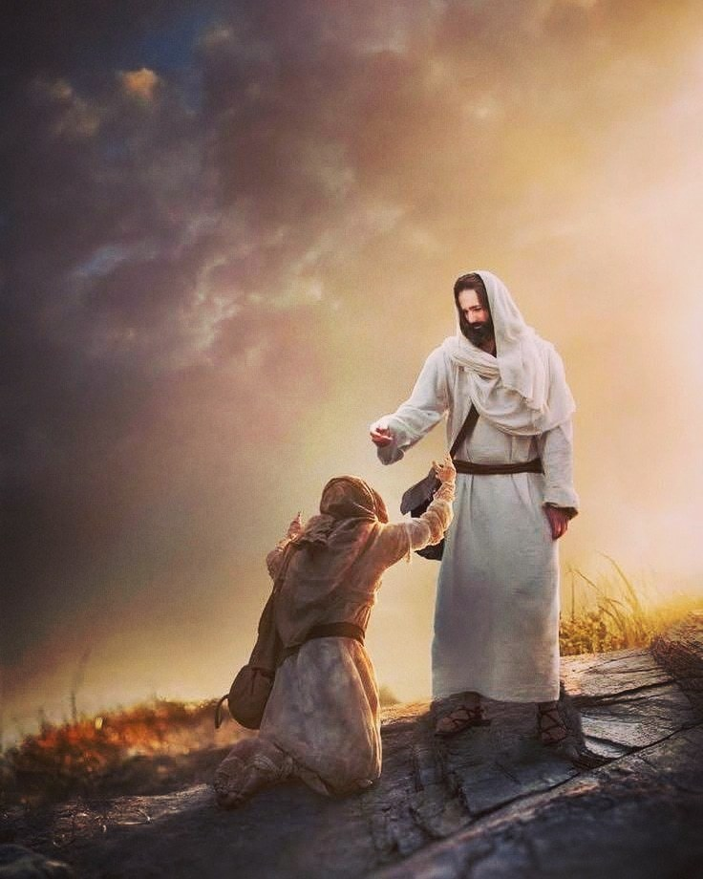
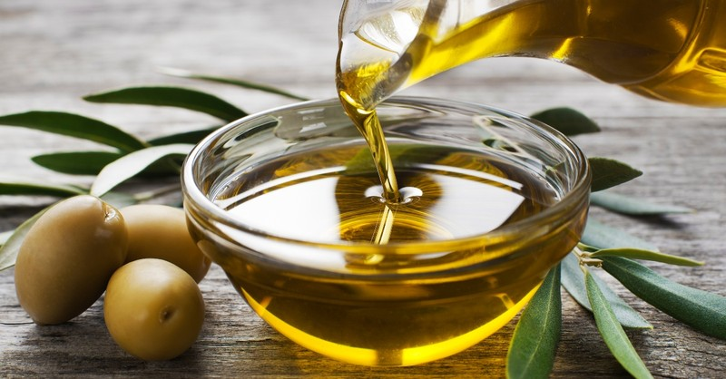
1 John 2:27

Slide 11
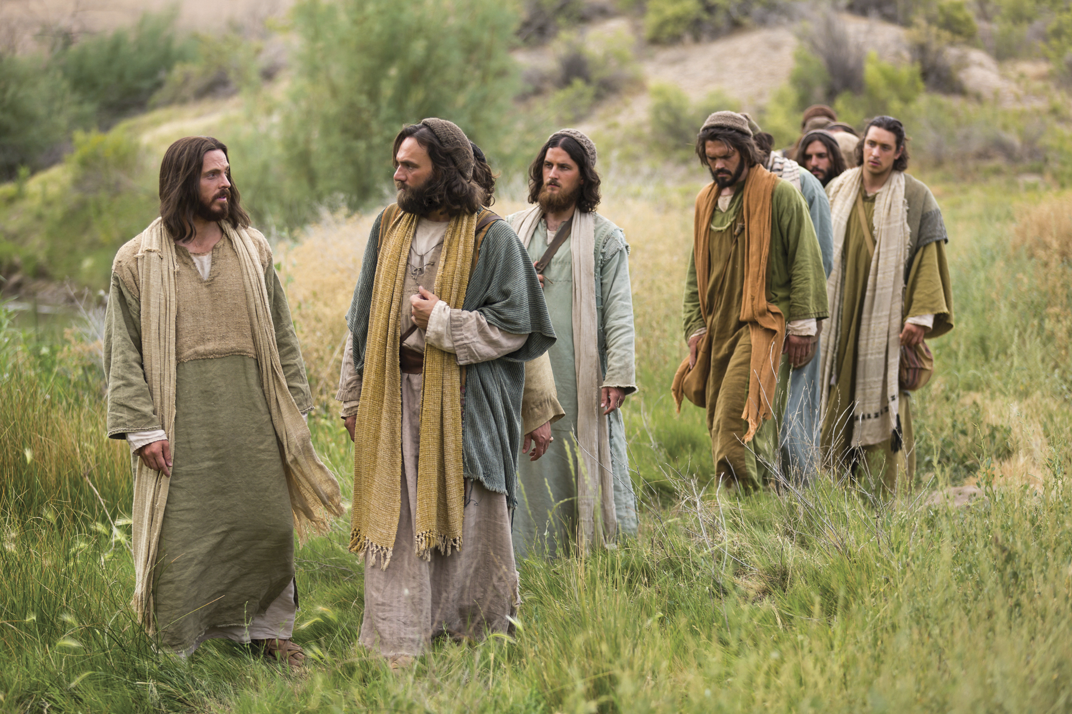
Jesus calls his disciples scribes

Slide 12
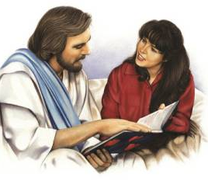
Be an eager learner. (Receive)
Matthew 13:51

Slide 13
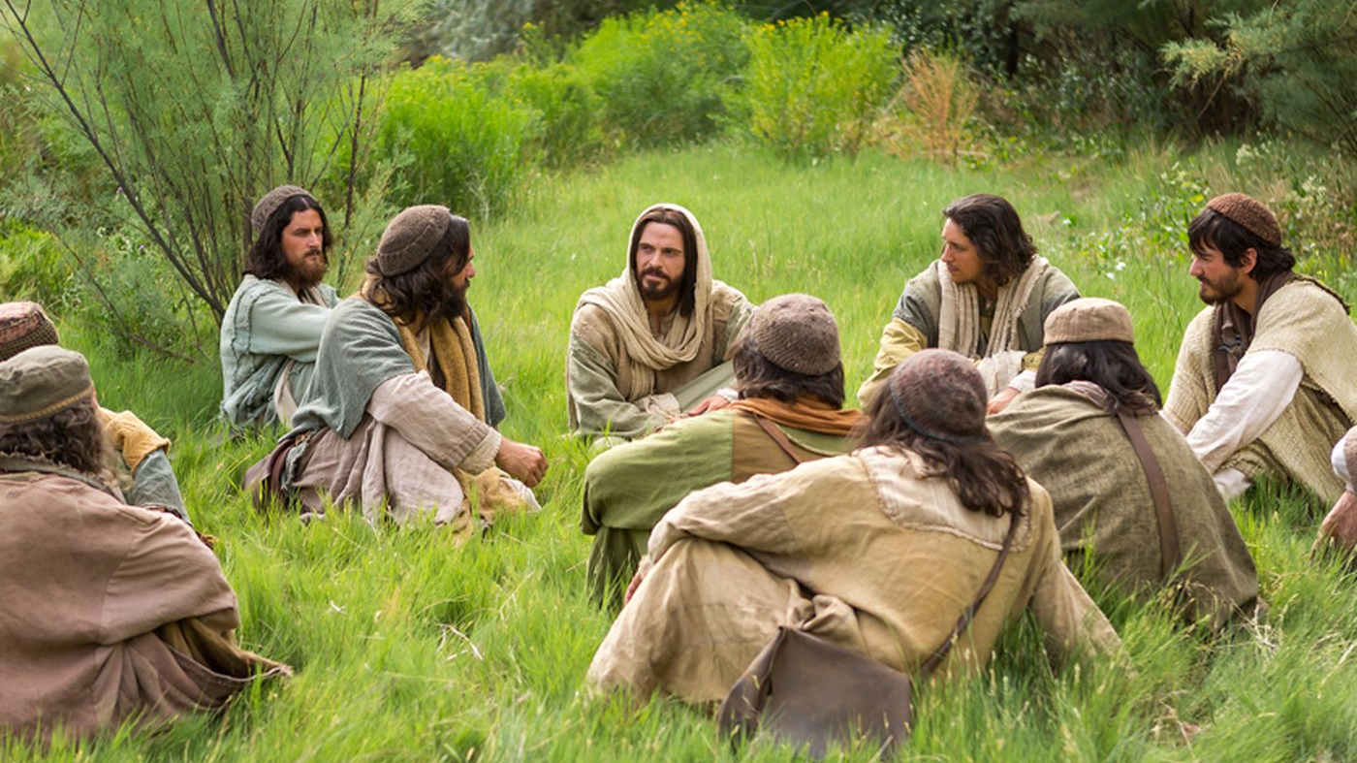
Matthew 13:10

Slide 14
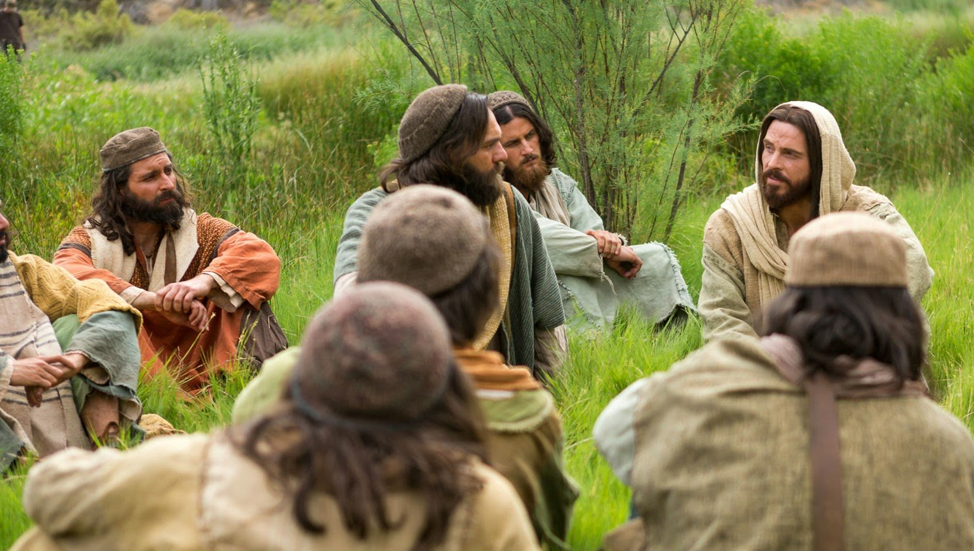
Matthew 13:11-15

Slide 15
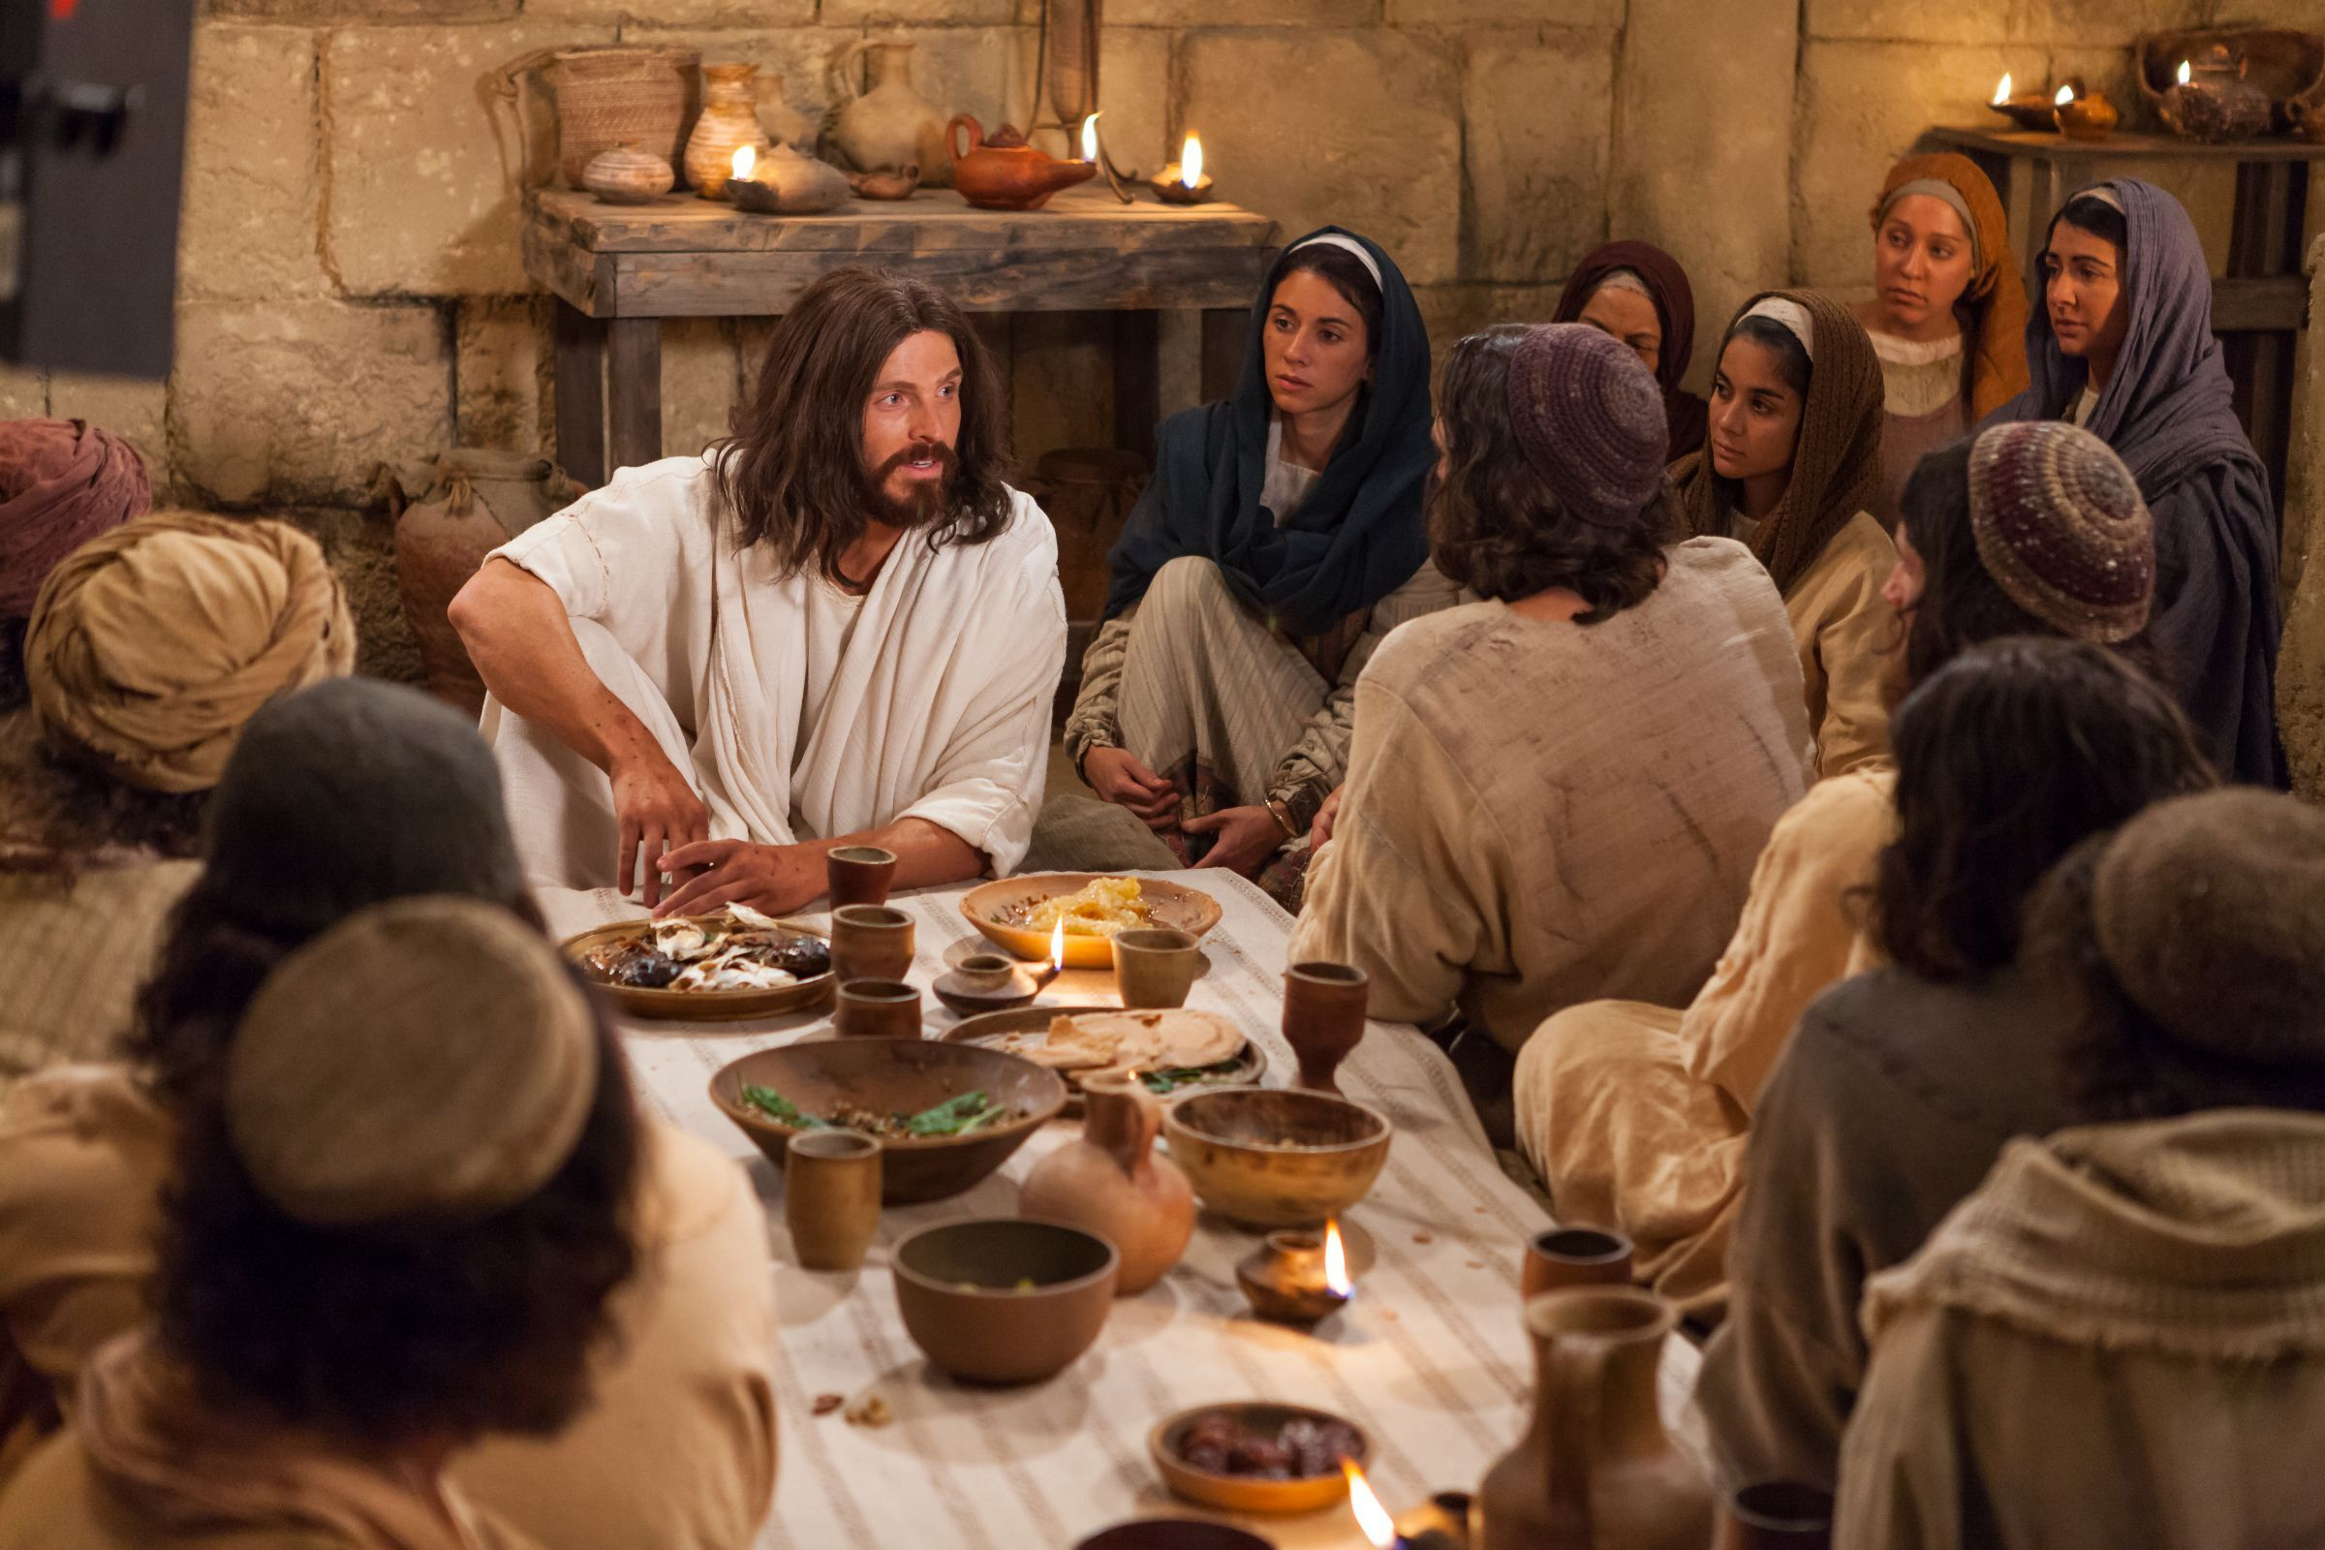
Matthew 13:36

Slide 16


“Have you understood all these things?”

Slide 17
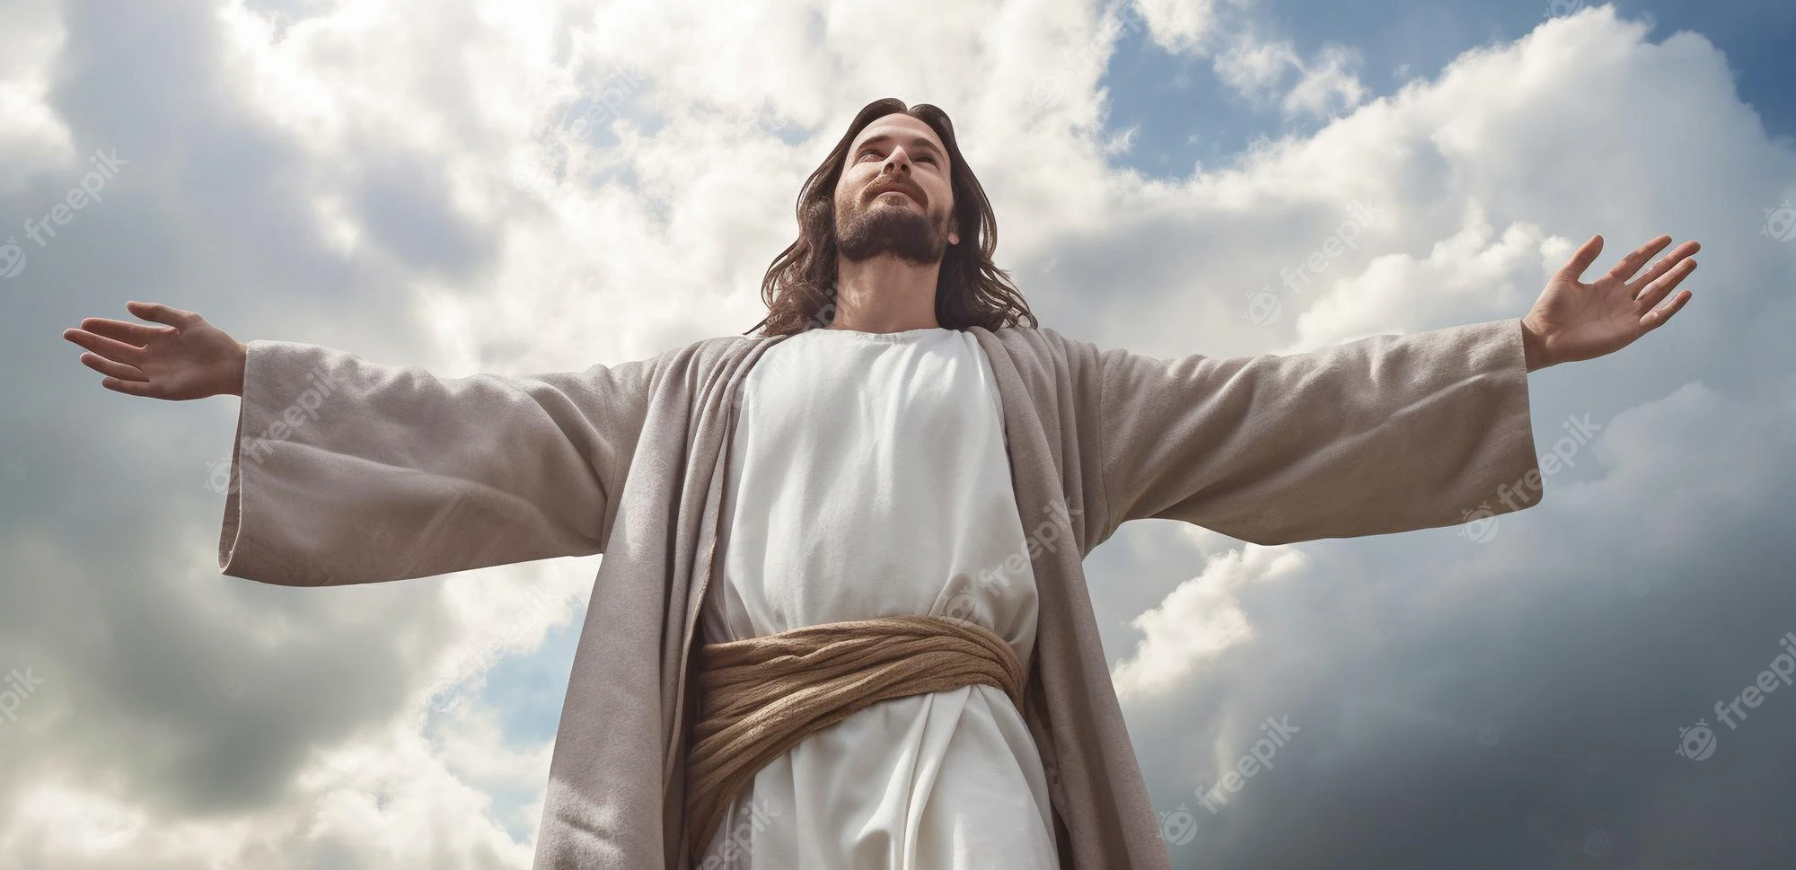
1 John 5:20

Slide 18
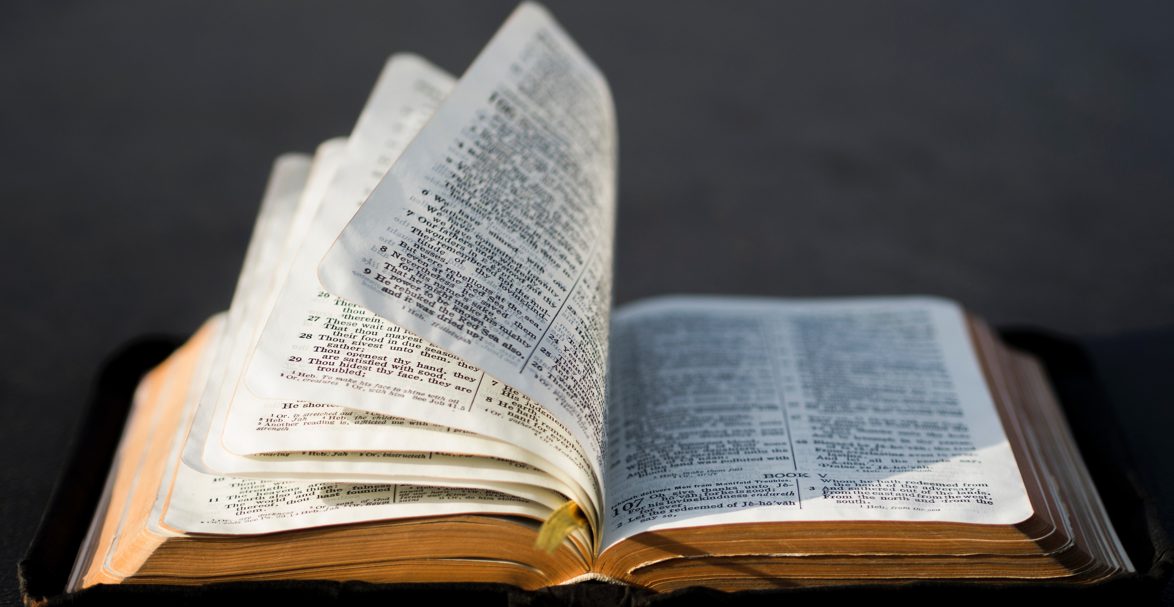
Matthew 24:35 Mark 13:31 Luke 21:33
"Heaven and earth shall pass away, but my word shall never pass away,"

Slide 19

Matthew 13 :52
Study to be a Scribe. (Retain)

Slide 20
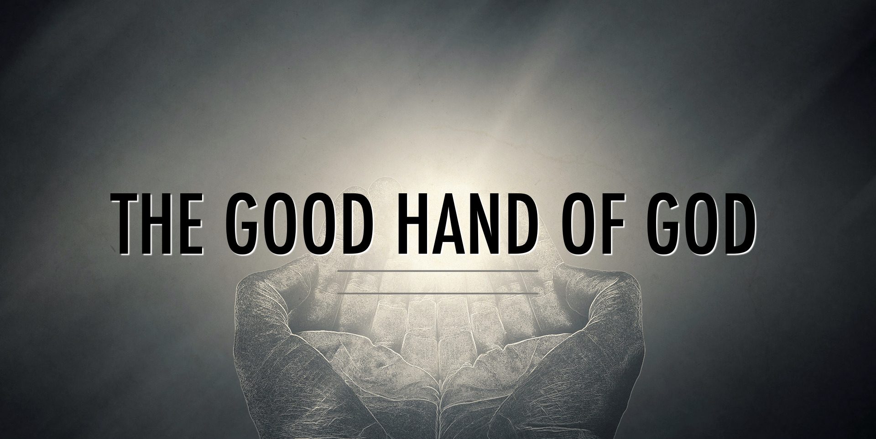
Ezra 7:6

Slide 21
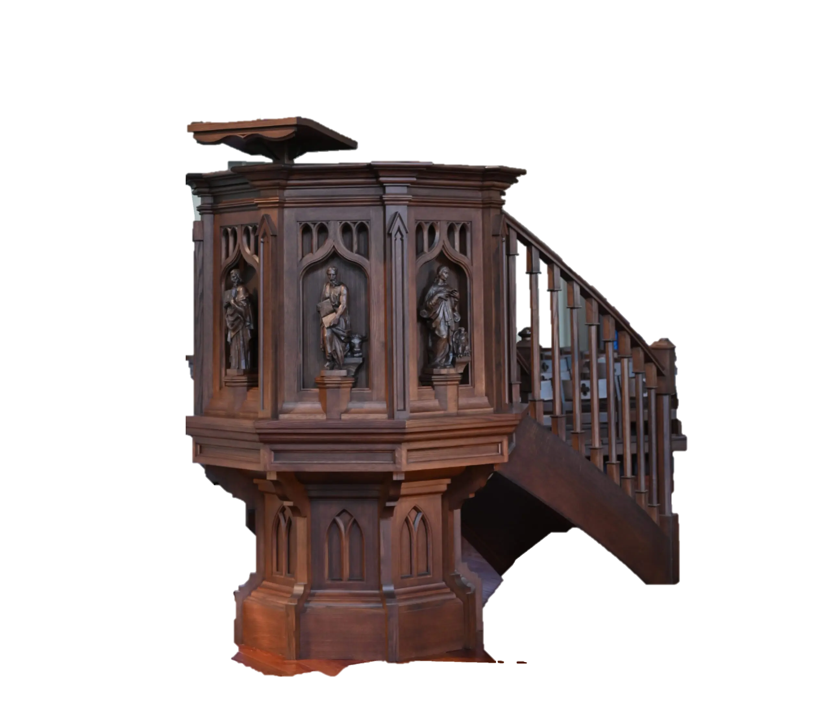
Nehemiah 8th Chapter
Pulpit of wood was built for Nehemiah

Slide 22
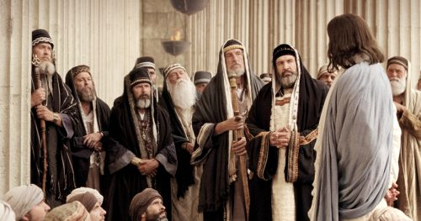
Mark 11:27-28

Slide 23
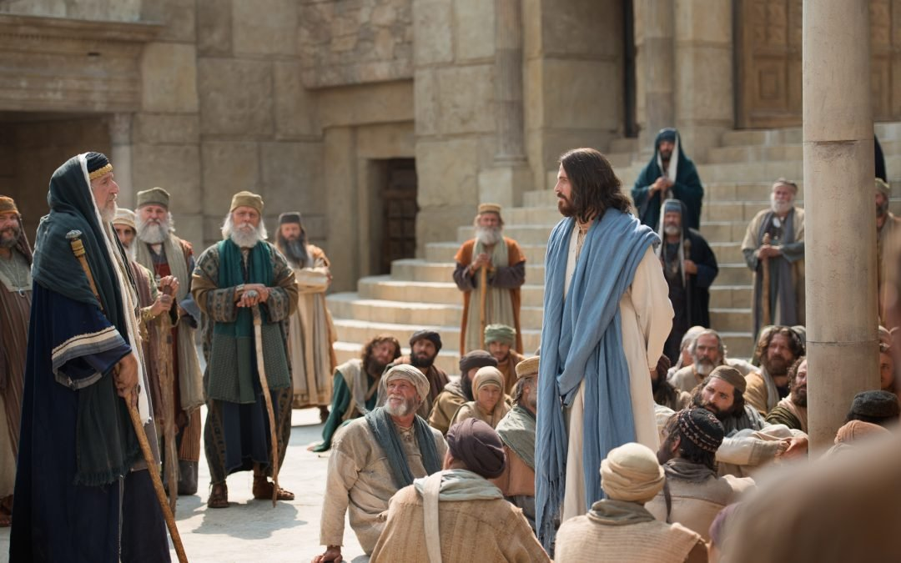
Luke 11: 52-54

Slide 24

Hebrews 5:11-14
“dull of hearing”

Slide 25

Hebrews 6:1

Slide 26
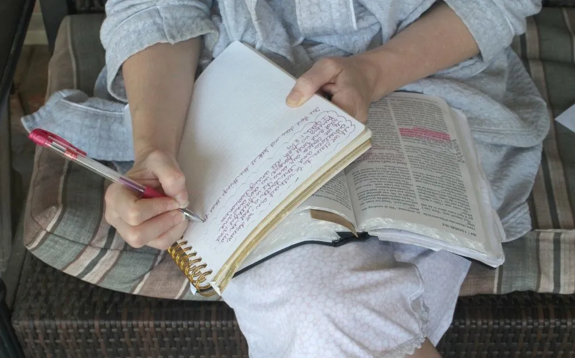
Jesus wants us to “major in Bible”

Slide 27

Jesus wants us to “major in Bible”
truths of the kingdom!
go beyond a mere 'superficial' understanding
pursue a godly 'scholarliness' about it
please our Lord by seeking to be good 'scribes instructed in the kingdom of heaven'

Slide 28
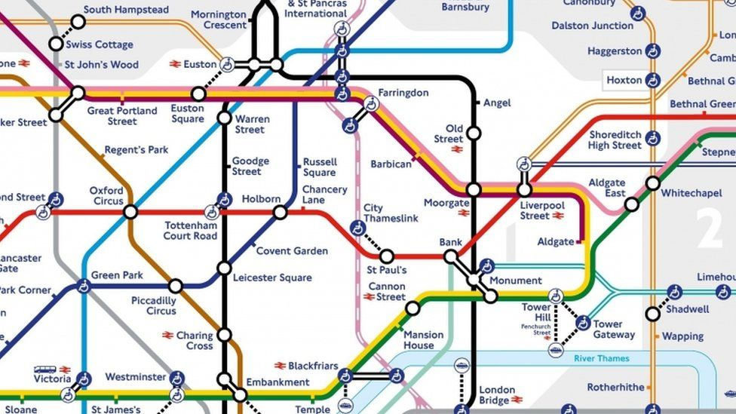

Matthew 13 :52
Share the truth as a house holder. (Radiate)

Slide 29


New truths become added to their store of knowledge.
Old truths become fresh and alive to them in the light of the new.

Slide 30
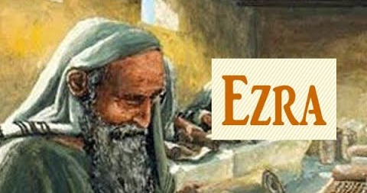
The Bible tells us that he was a skilled scribe (Ezra 7:6).

Slide 31
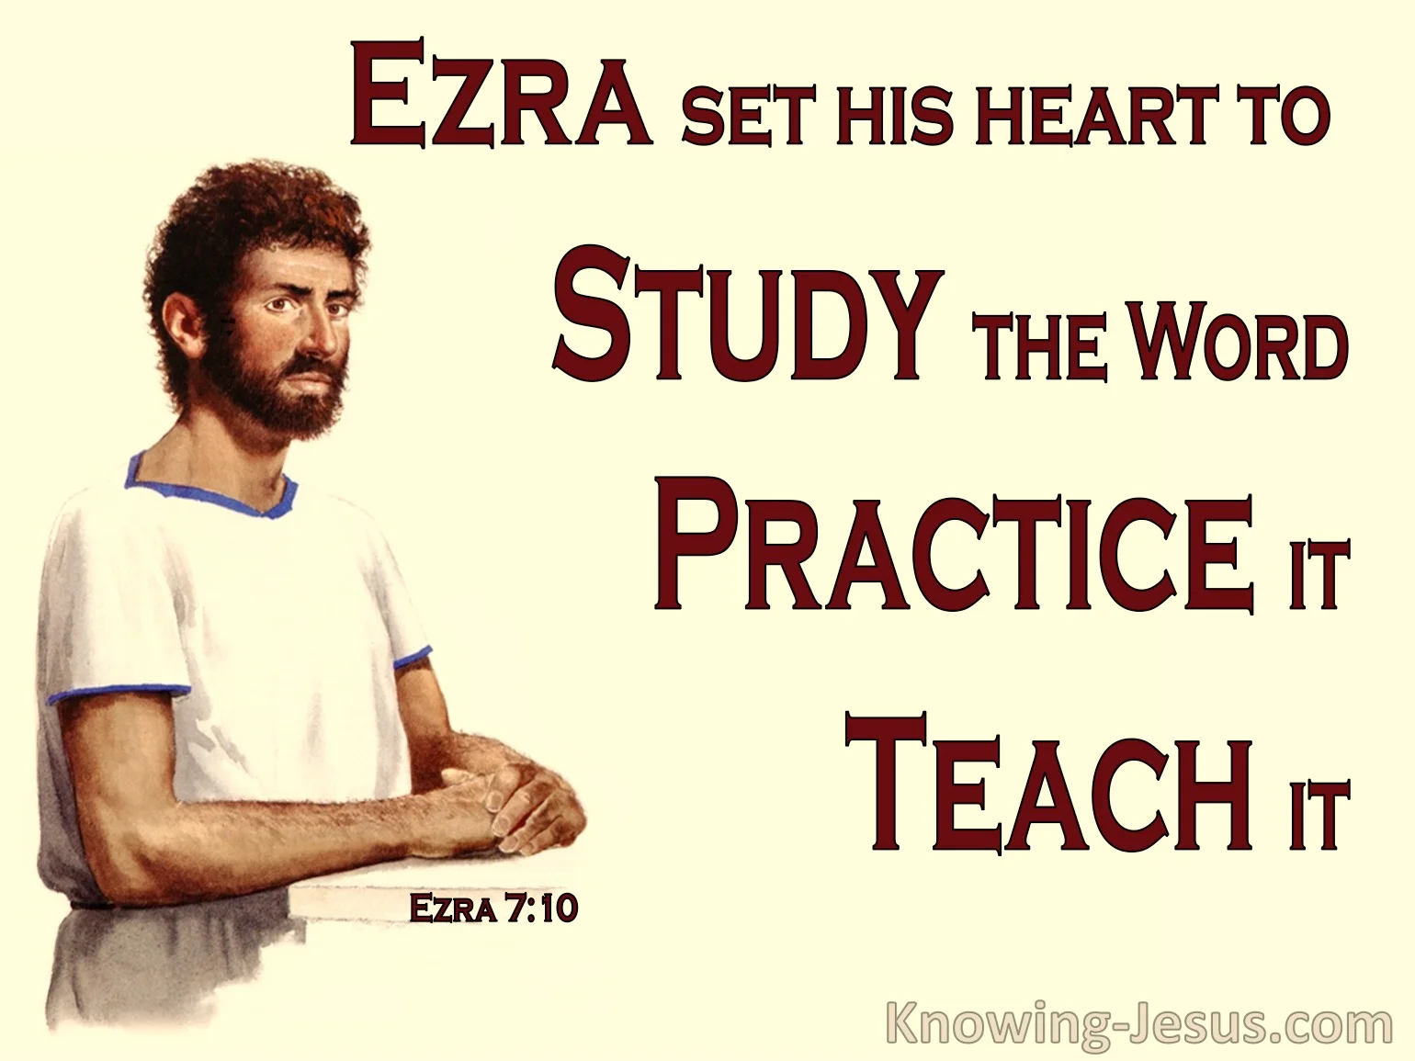
Ezra 7:10

Slide 32
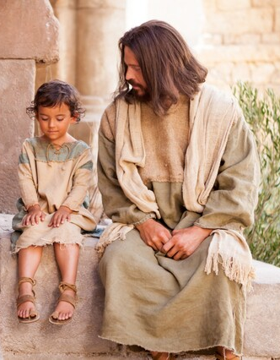



Jesus wants us to think carefully about how we,
Receive them,
Retain them,
Radiate them.
“SEEK” truth from Him
“DO” what the truth says
Radiate the truth by “TEACHING” them to others

