Slide 1


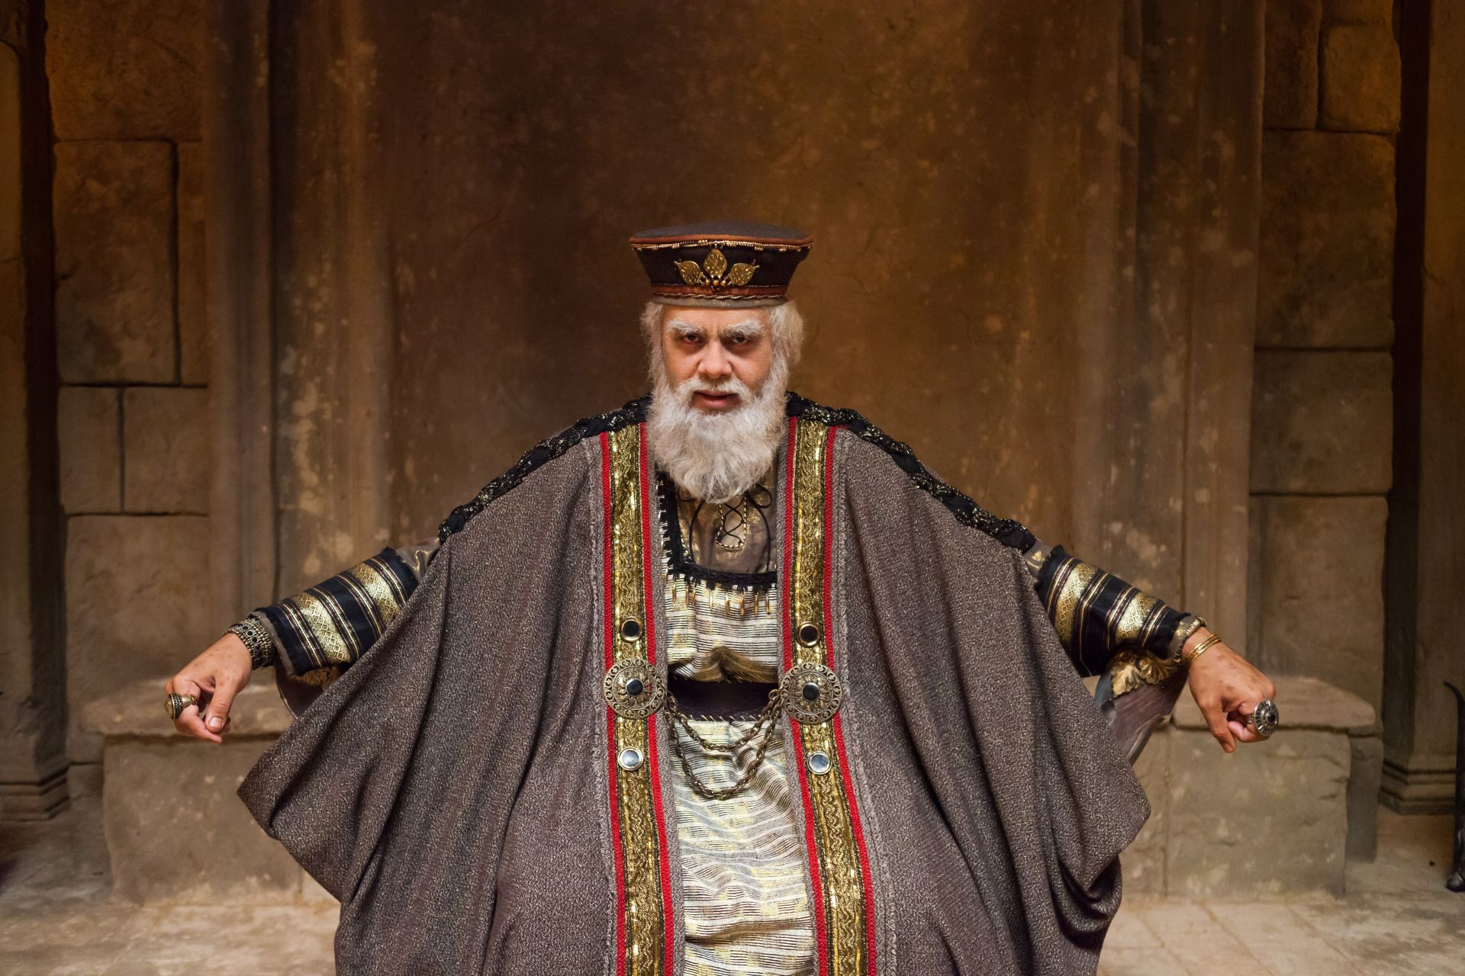
2nd Response to Jesus - Fear!
Matthew 14:1-12

Slide 2



Matthew 13:1-53

Slide 3
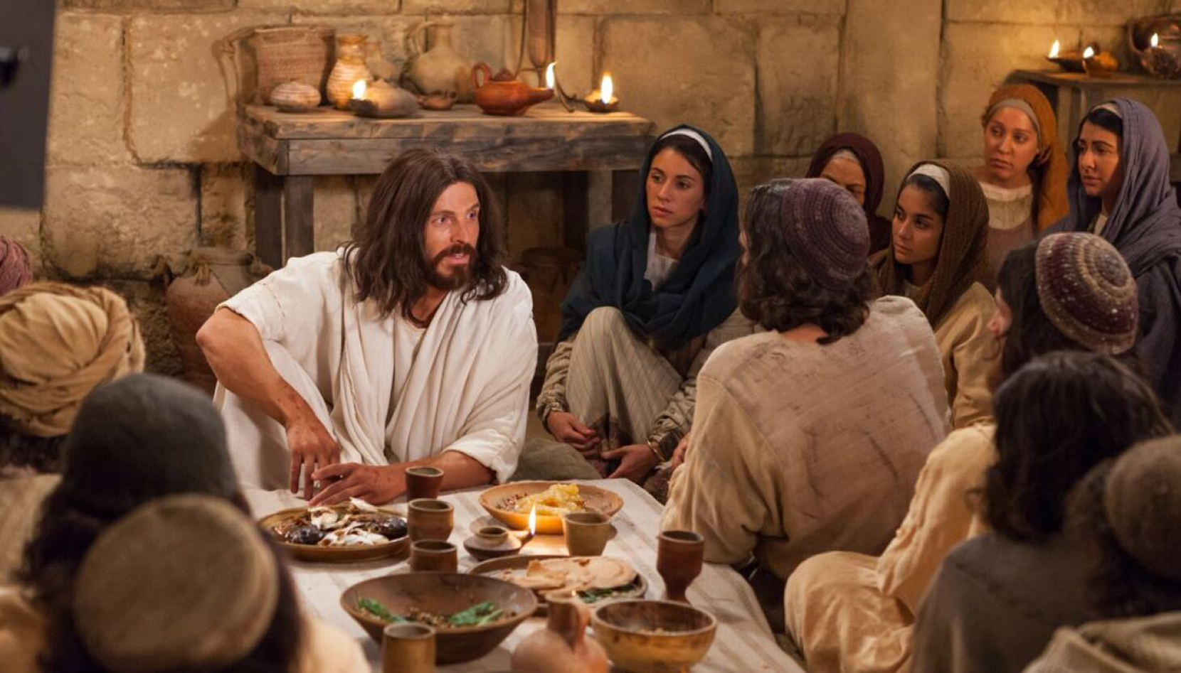
From Matthew 13:53 till Matthew 16:12, eight incidents in the life of our Lord Jesus Christ

Slide 4
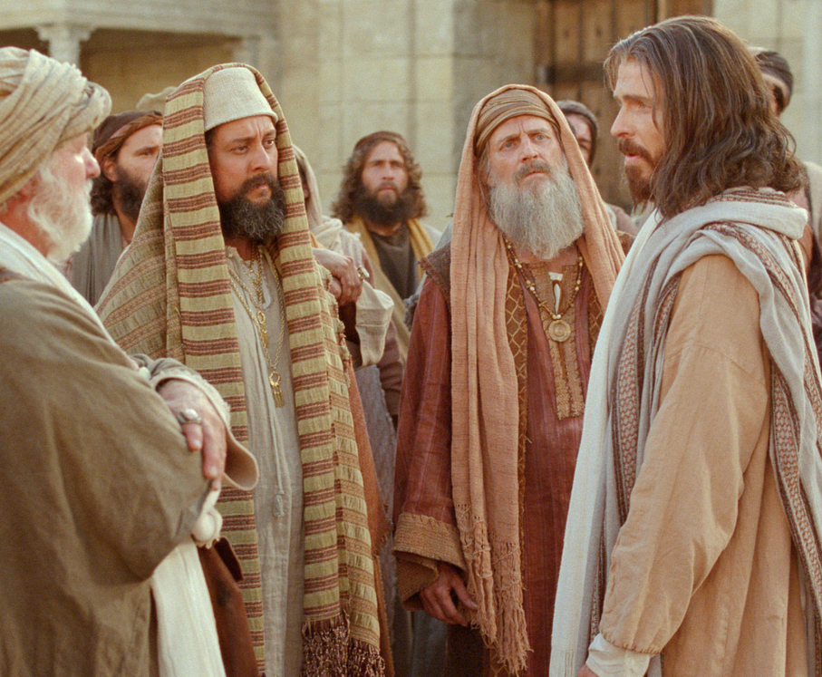

1st Response to Jesus Unbelief!
2Nd Response is Fear that Forfeit’s Christ!

Slide 5
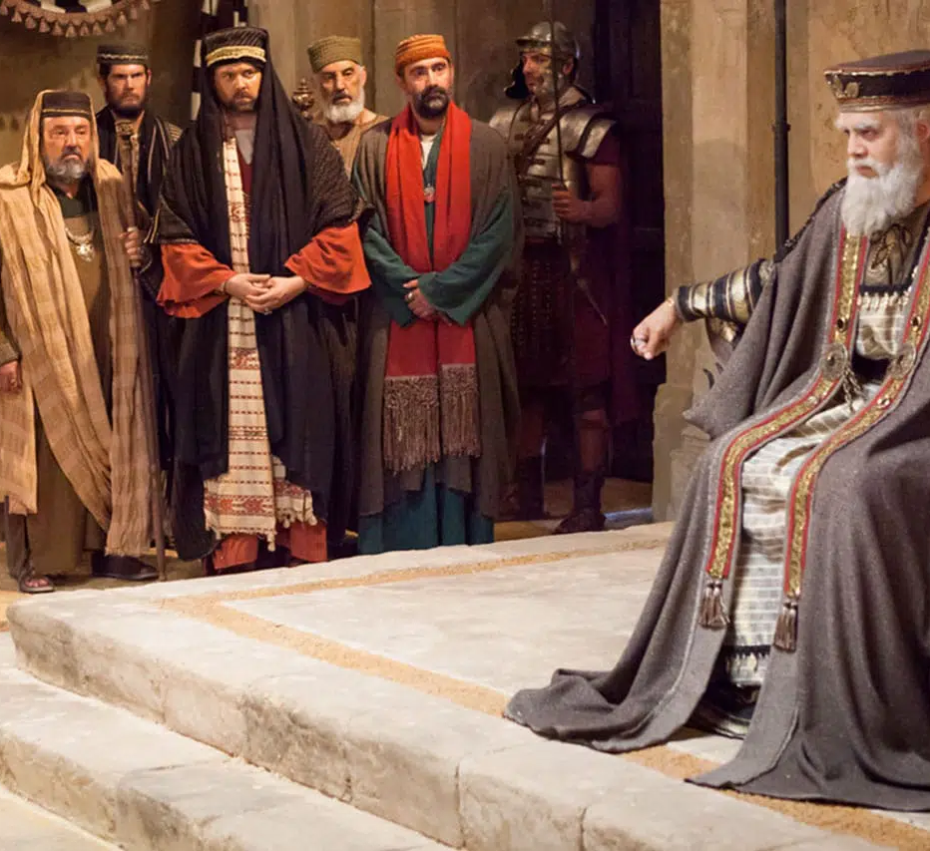
Matthew 14, Luke 9 and Mark 6 parallel perspectives to make this story full.
Verses 1-2 talks about their reaction.
Verses 3-12 is the flashback of what has happened

Slide 6
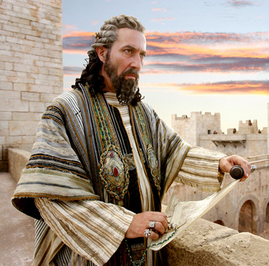
V 1, At that time Herod the tetrarch heard the report about Jesus
Kairos, “a general season.”
Tetrarch “a ruler of a fourth part.”
V 9, he is called “king.”

Slide 7
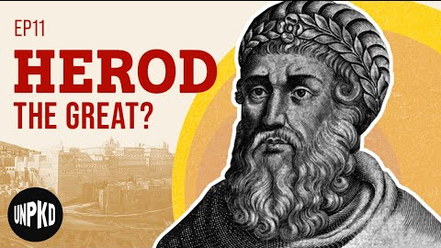
was an Idumean. He was a descendant of Esau. He was an Arab.

Slide 8
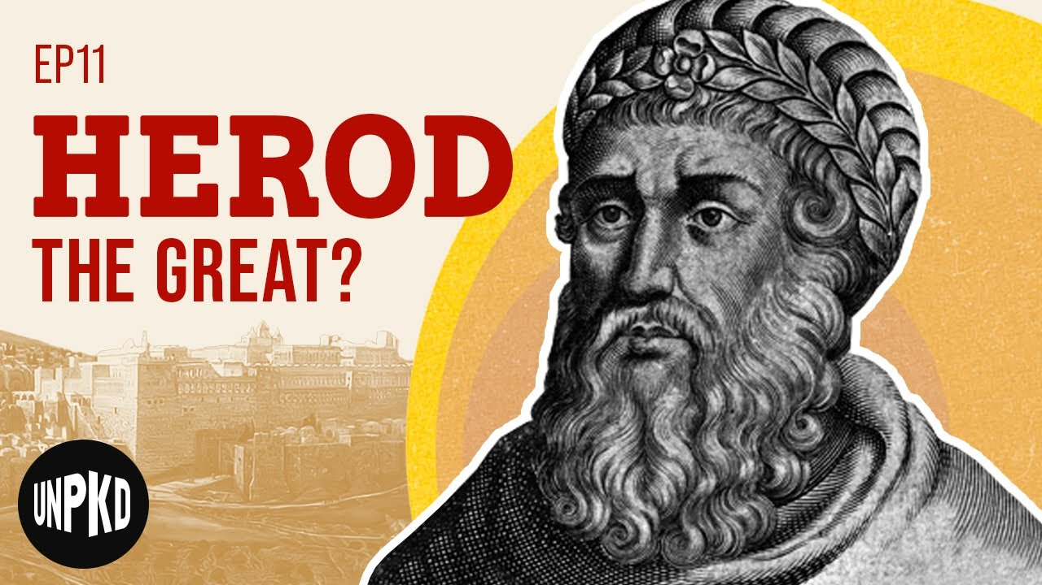
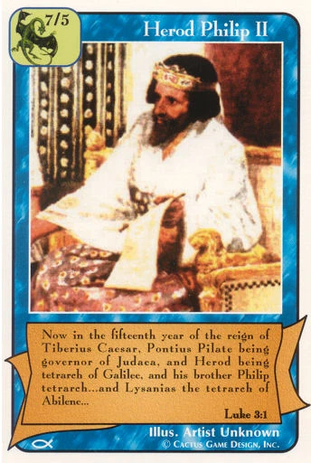
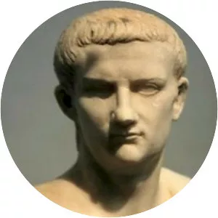
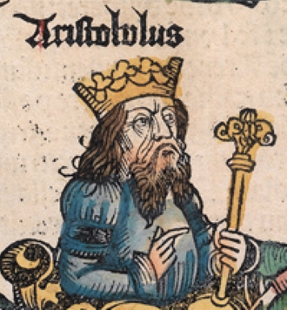
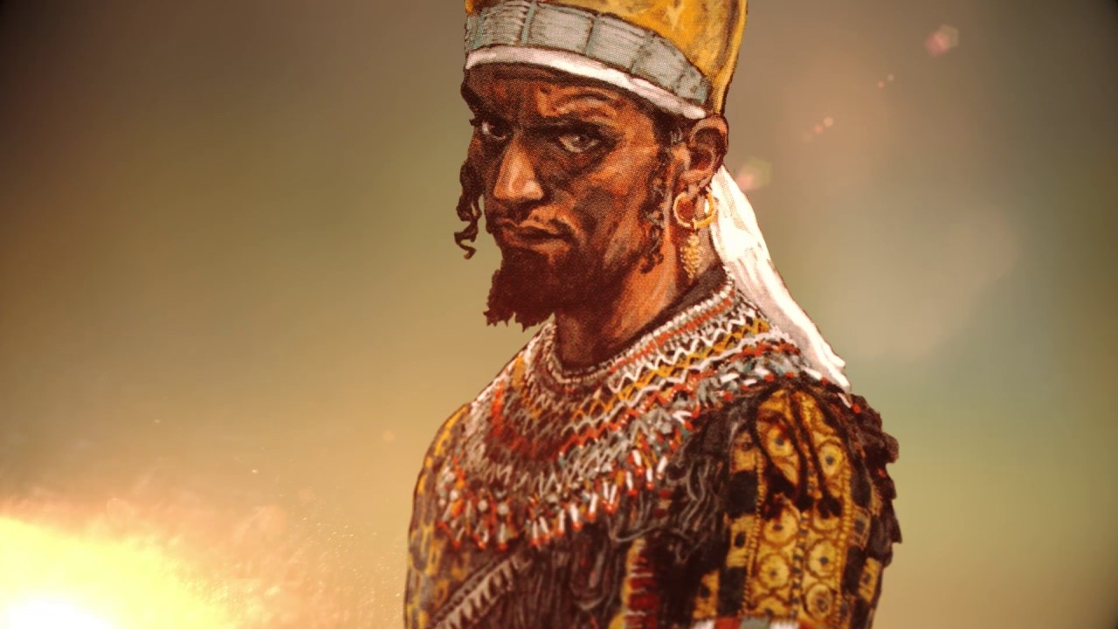
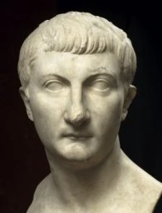

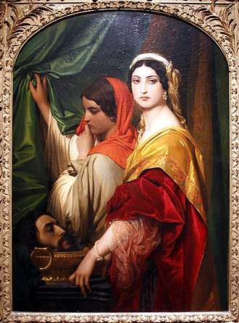
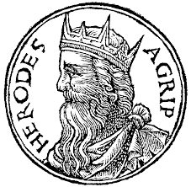
Herod the Great Family Tree
He tried to Kill JESUS
Herod the Great
CHILDREN
Herod Philip
Herod Archelaus
Aristobulus
Herod Antipas
Philip the Tetrarch
GRAND CHILDREN
Herodias
Herod Agrippa I

Slide 9
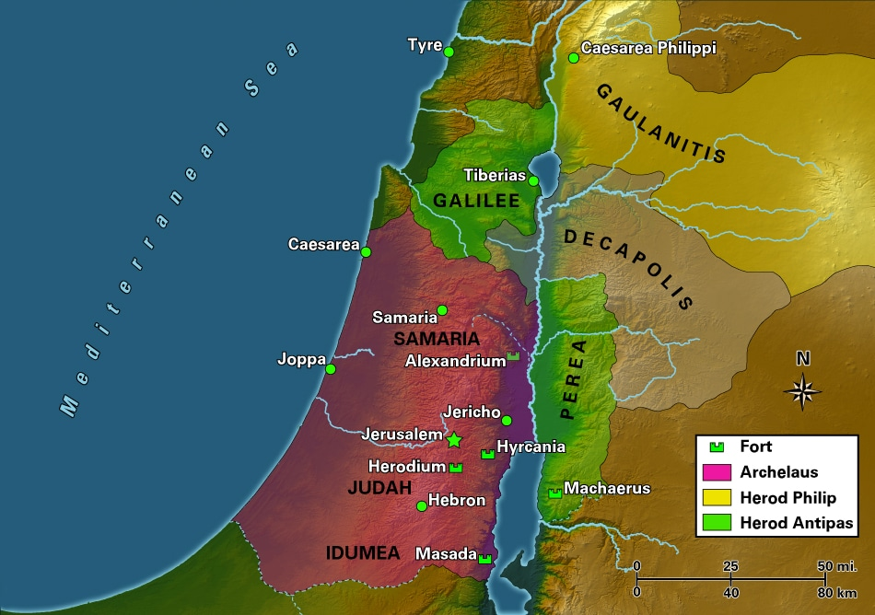
Herod Family Territory
Philip the Tetrarch
Herod Antipas
Herod Archelaus

Slide 10
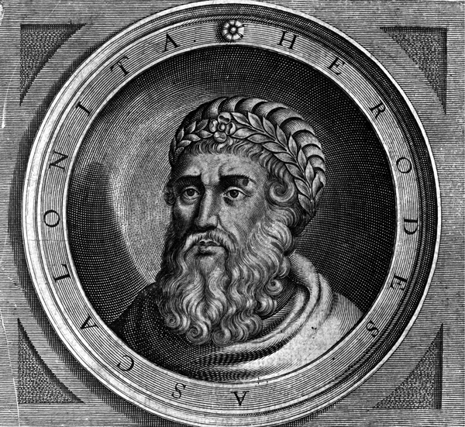
Herod the Great,
Matthew 2
Herod Antipas,
Matthew 14
Herod Agrippa I,
Acts 12
Herod Agrippa II
Acts 26

Slide 11
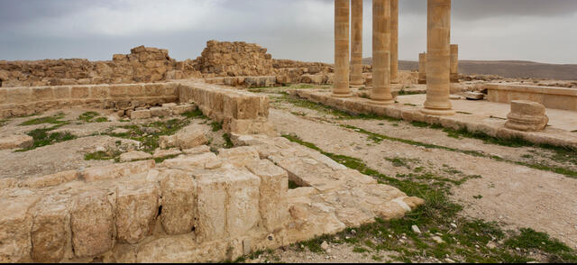
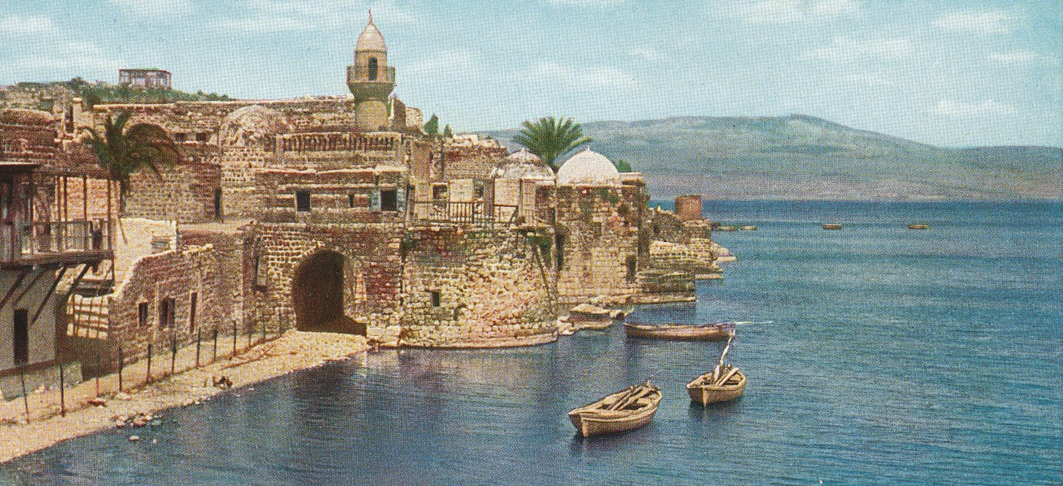
Herod Antipas is in his thirty-second year of rule. who ruled Galilee and the area during the ministry of our Lord Jesus Christ.
Machaerus
Tiberius

Slide 12
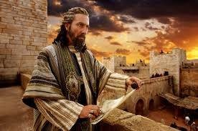
It is approximately 2 years since our Lord’s baptism.
For almost 2 years have gone by and then Herod heard the fame of Jesus

Slide 13
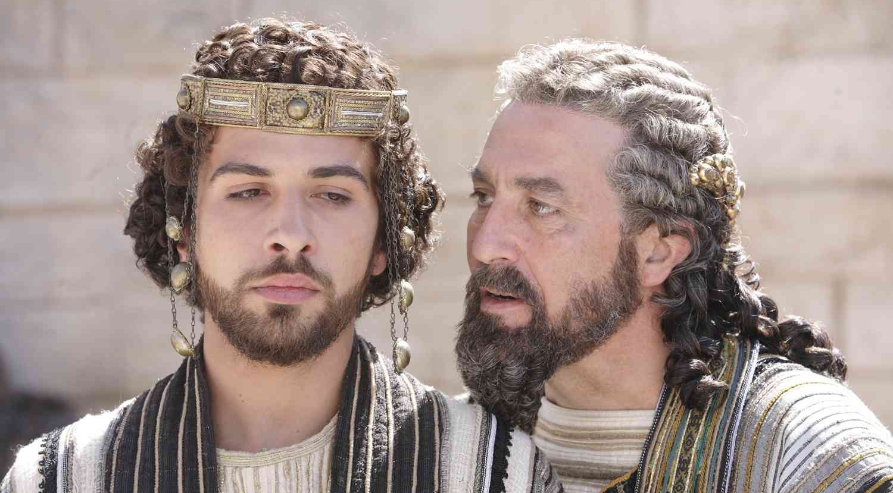
V 2, and said to his servants, “This is John the Baptist; he is risen from the dead, and therefore these powers are at work in him.”

Slide 14




Slide 15

Luke 1:17

Slide 16
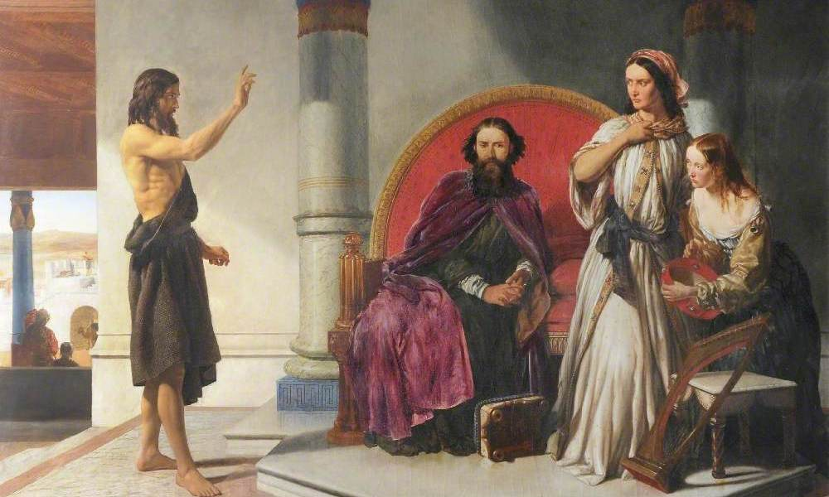
V 3-4, For Herod had laid hold of John and bound him, and put him in prison for the sake of Herodias, his brother Philip’s wife. ⁴ Because John had said to him, “It is not lawful for you to have her.”

Slide 17
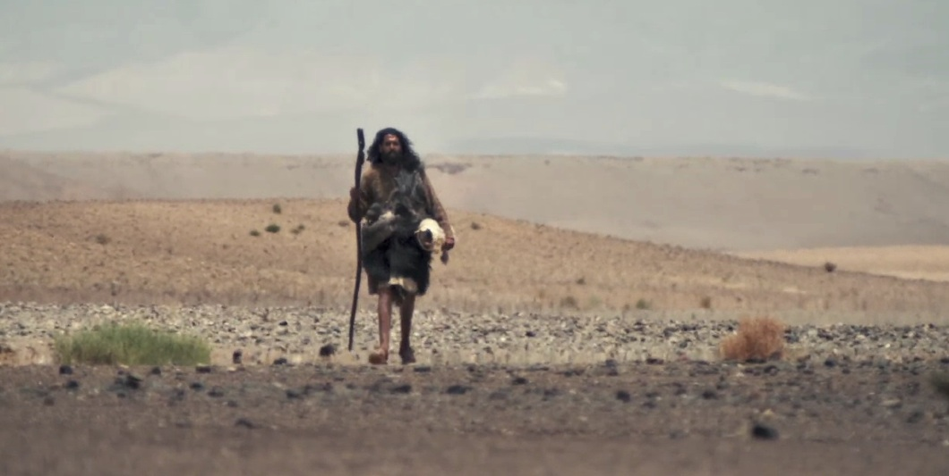
Matthew 11:11

Slide 18
Luke 1

Slide 19
He was a descendant of Esau, ruling the sons of Jacob, which put him in a very difficult position.
He was evil.
He was immoral.
He was shameless.
He was hen-pecked, pushed around by an overbearing woman.
He was troubled but refused to obey.
Herod Antipas

Slide 20
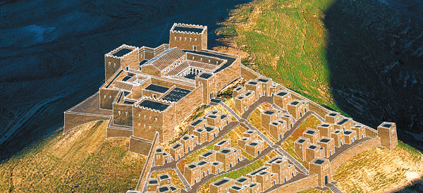
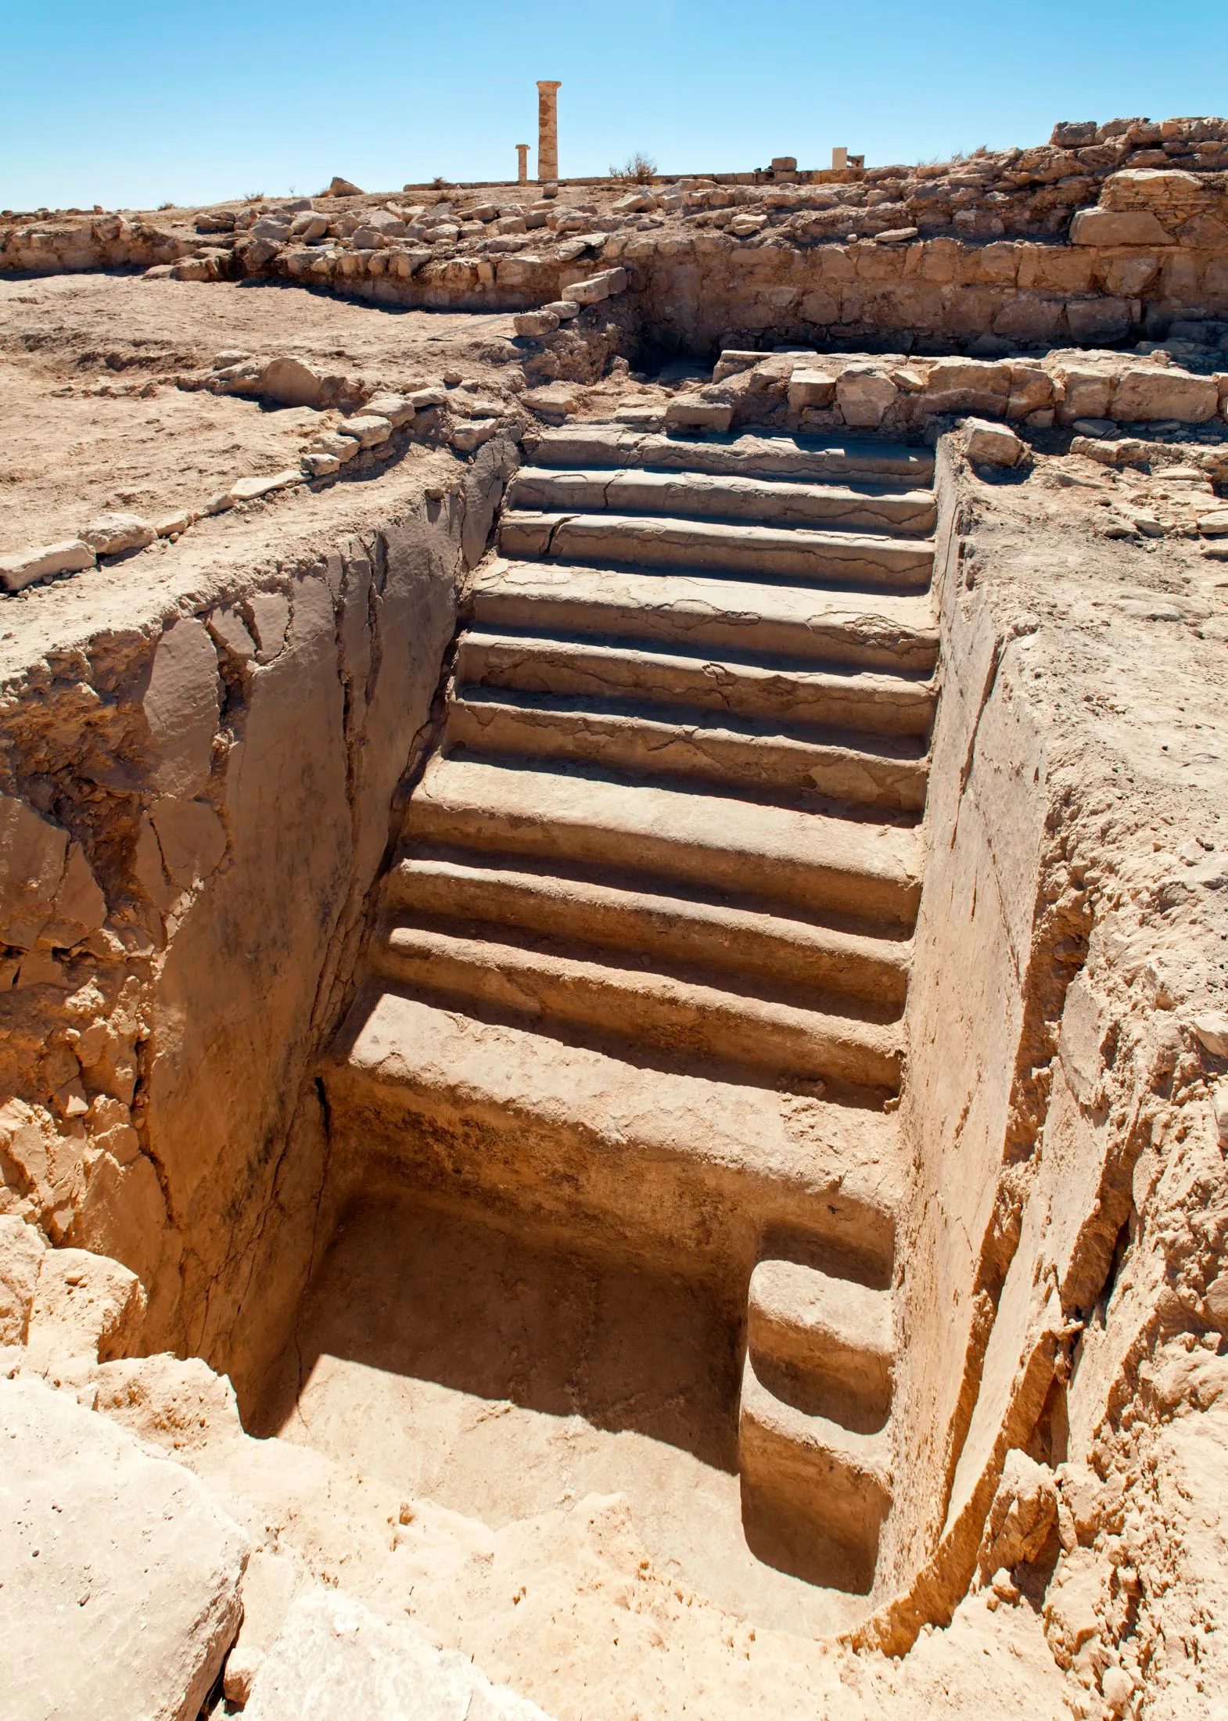
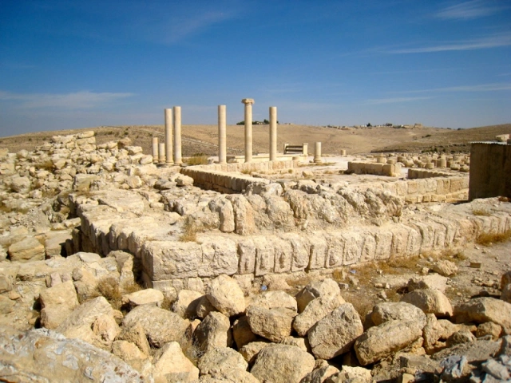
Machaerus

Slide 21
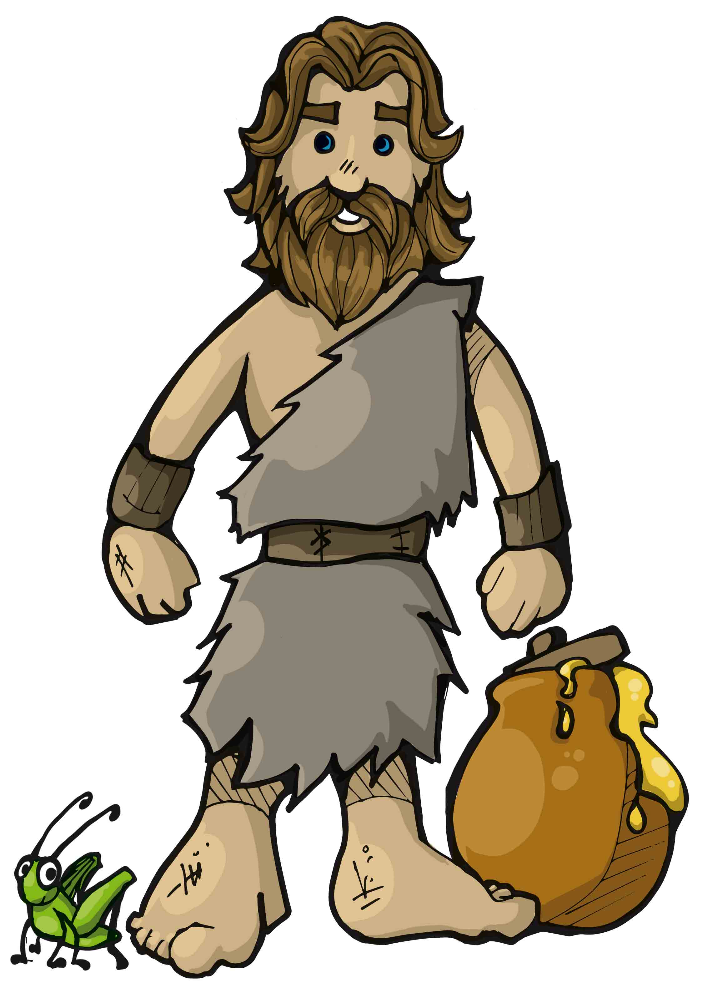

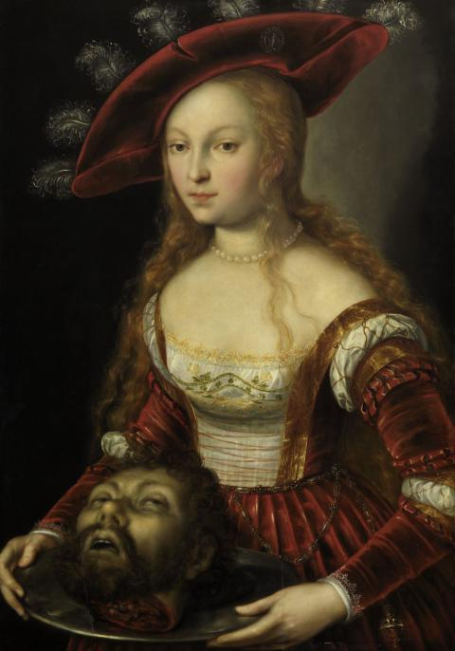
Herodias Divorce and Marriage
John the Baptist’s
Rebuked this Marriage
Herod the Great
CHILDREN
Herod Philip
Aristobulus
Herod Antipas
GRAND CHILDREN
Herodias
Herod Agrippa I
GREAT GRAND CHILDREN
Salome

Slide 22
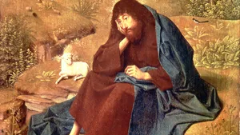
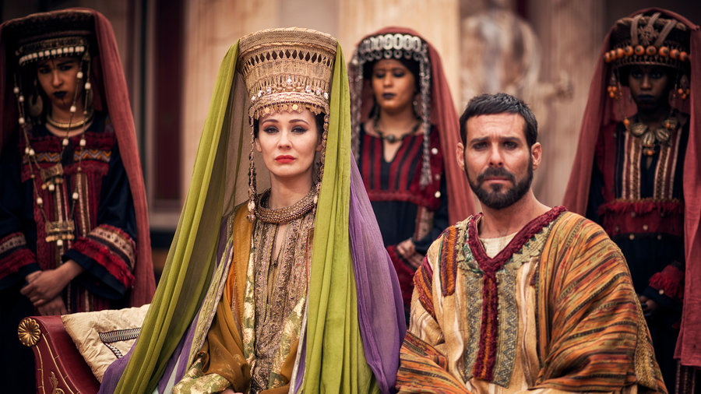
King Aretas
Nabatean Arabia Kingdom
Herod the Great
King Aretas
CHILDREN
Herod Philip
Aristobulus
Herod Antipas
Phasaelis
GRAND CHILDREN
Herodias
Herod Agrippa I
GREAT GRAND CHILDREN
Salome

Slide 23

Christ confronted it,
Stephen confronted it,
Paul confronted it,
Peter confronted it,
John the Baptist confronted it

Slide 24
V 5, And although he wanted to put him to death, he feared the multitude, because they counted him as a prophet.

Slide 25
Mark 6:20

Slide 26
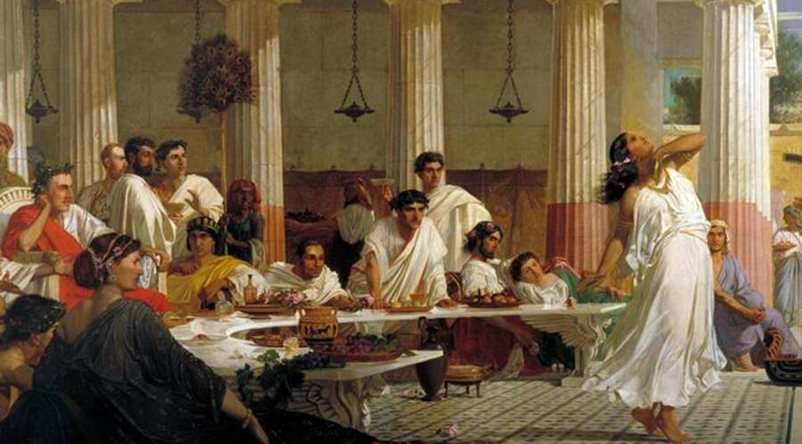
V6, But when Herod’s birthday was celebrated, the daughter of Herodias danced before them and pleased Herod.

Slide 27
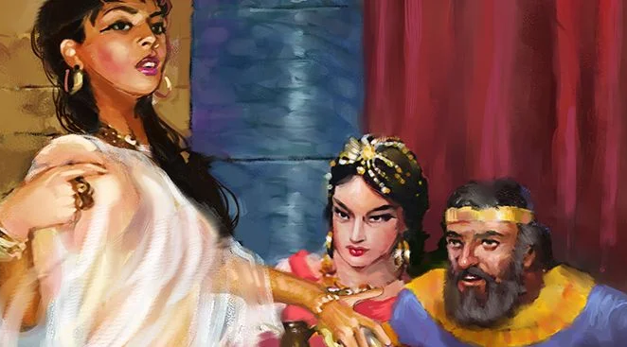
V7, Therefore he promised with an oath to give her whatever she might ask.

Slide 28
Mark 6:23

Slide 29
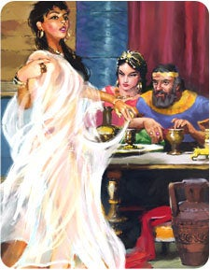
V 8, So she, having been prompted by her mother, said, “Give me John the Baptist’s head here on a platter.”

Slide 30
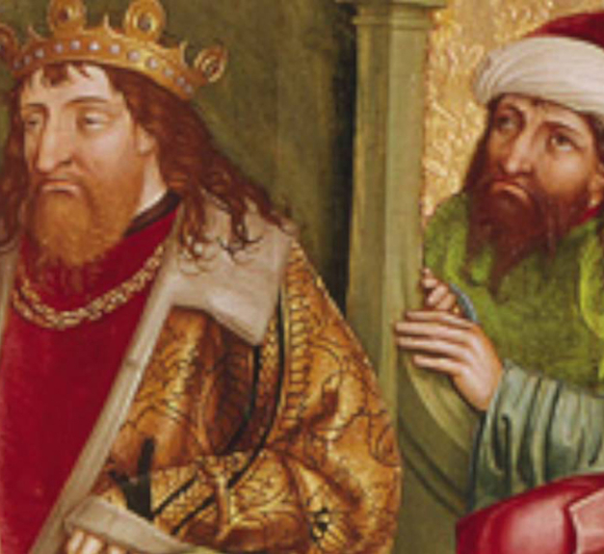
V 9, And the king was sorry; nevertheless, because of the oaths and because of those who sat with him, he commanded it to be given to her.

Slide 31
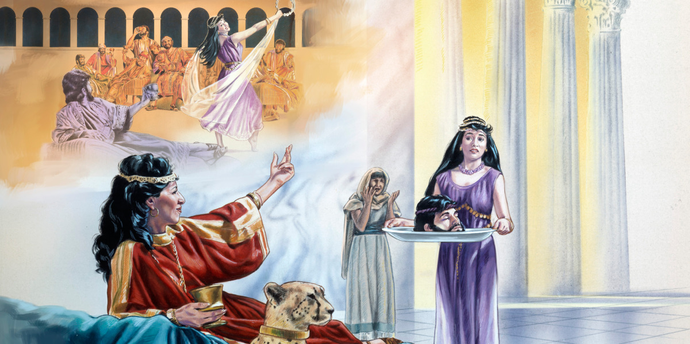
V 10-11, So he sent and had John beheaded in prison. ¹¹ And his head was brought on a platter and given to the girl, and she brought it to her mother.

Slide 32
He was afraid to lose his throne.
He was afraid of John.
He was afraid of his wife.
He was afraid of the people around him.

Slide 33
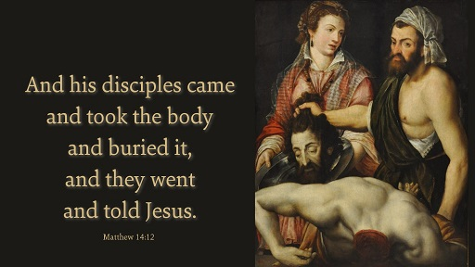
Matthew 14:12

Slide 34

V13, When Jesus heard it, He departed from there by boat to a deserted place by Himself. But when the multitudes heard it, they followed Him on foot from the cities.

Slide 35
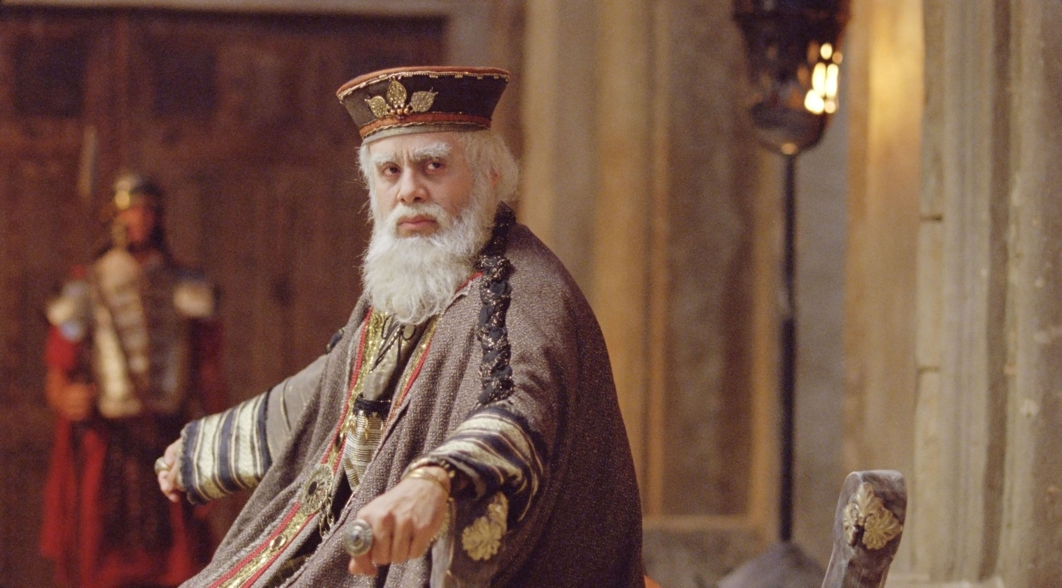
Luke 9:9

Slide 36
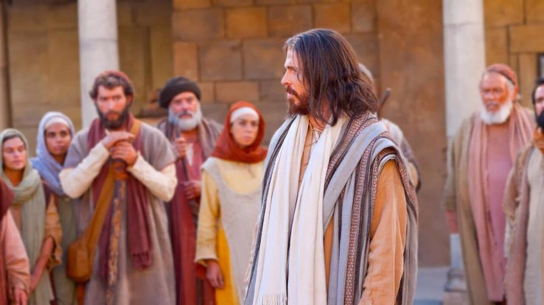
Luke 13:32-33

Slide 37
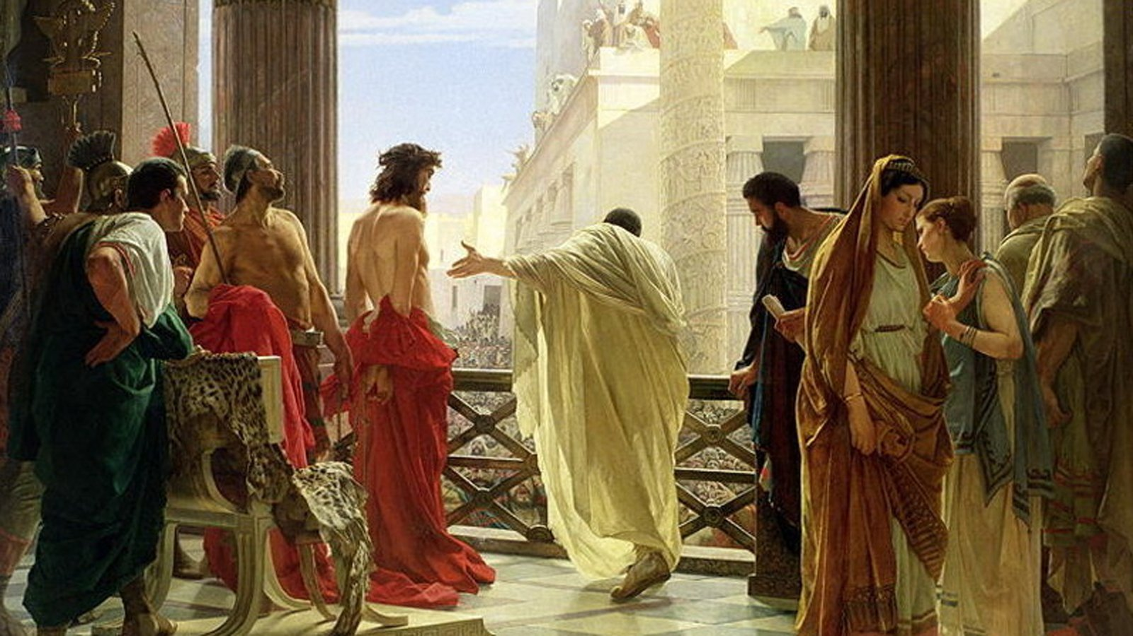
Luke 23:6-8

Slide 38
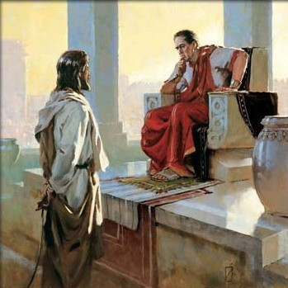
Luke 23:9

Slide 39
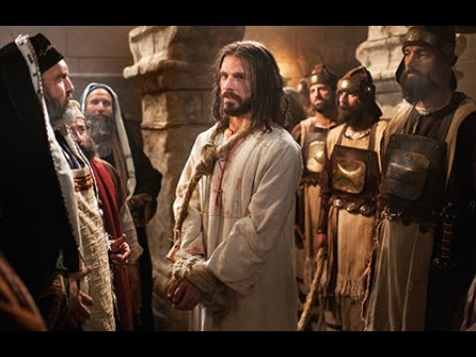
Luke 23:10-12

Slide 40

Herod rejected Christ, and Christ rejected Herod.
Hard, stony ground.
For fear of a woman,
Fear of a reputation,
Fear of his peers,
Fear of his throne,

Slide 41
Herod rejected Christ, and Christ rejected Herod.
A day will come when you ask the questions and get NO answers.

