Slide 1
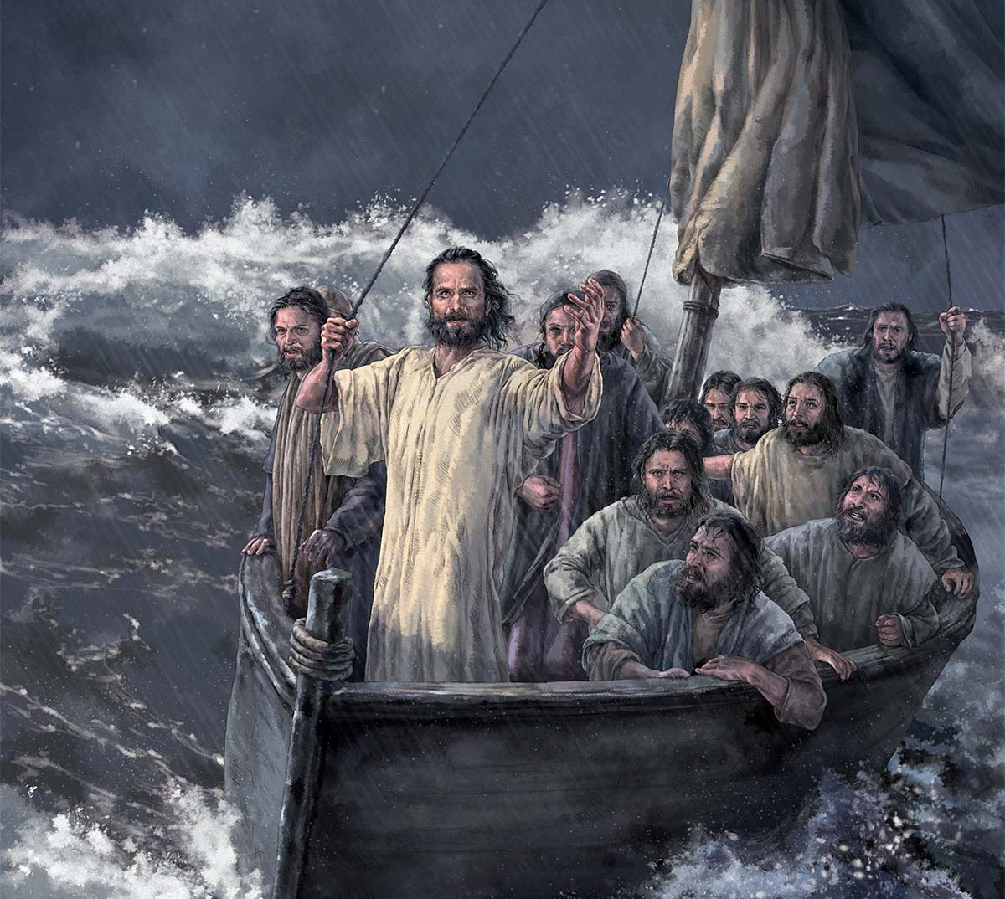
3rd Response to Jesus - Faith for materials!
Matthew 14:13-21

Slide 2
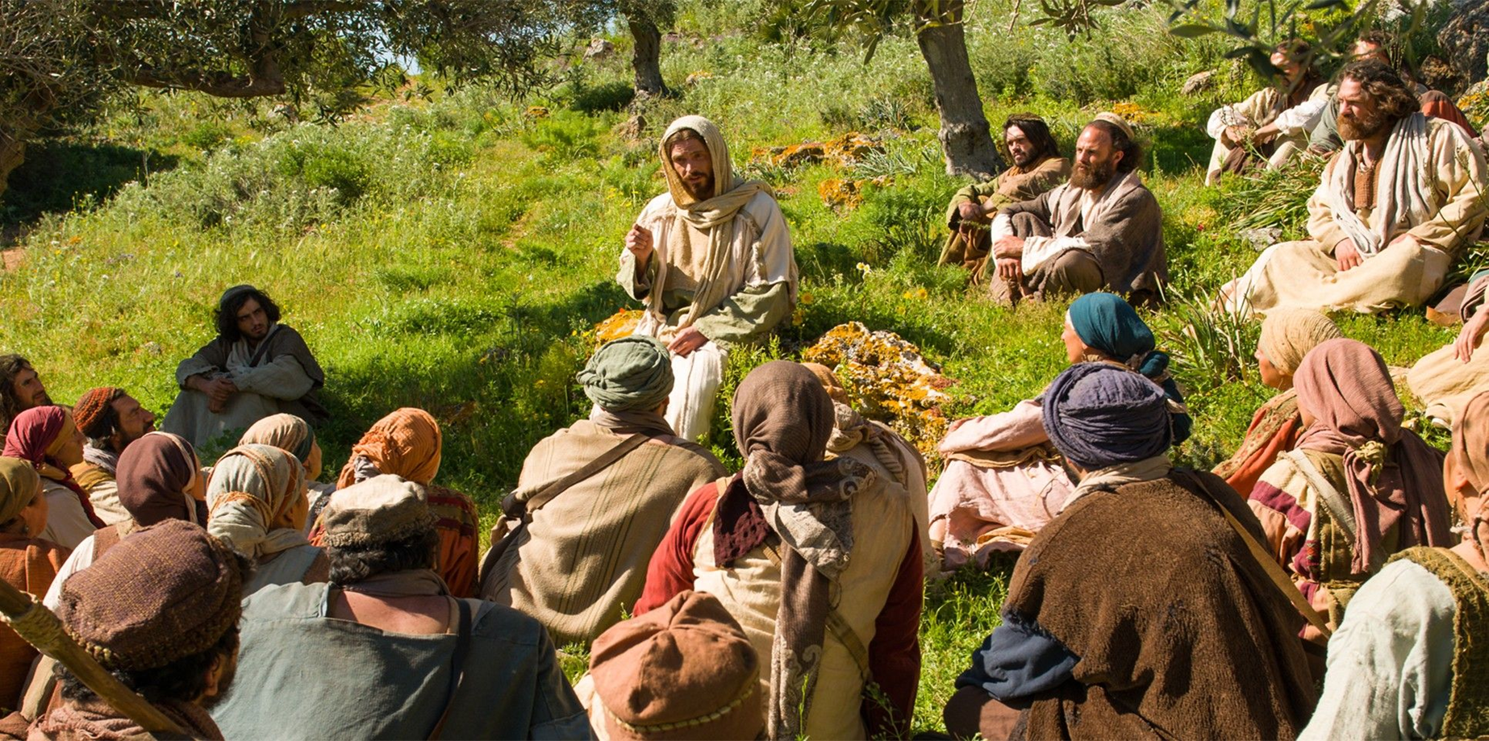
Matthew Chapter 13- Kingdom Parables were spoken

Slide 3
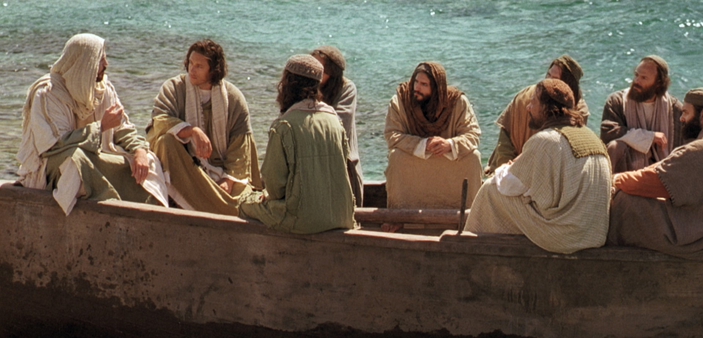
Matthew Chapter 13:53 till 16:12
Eight incidents in the life of our Lord

Slide 4
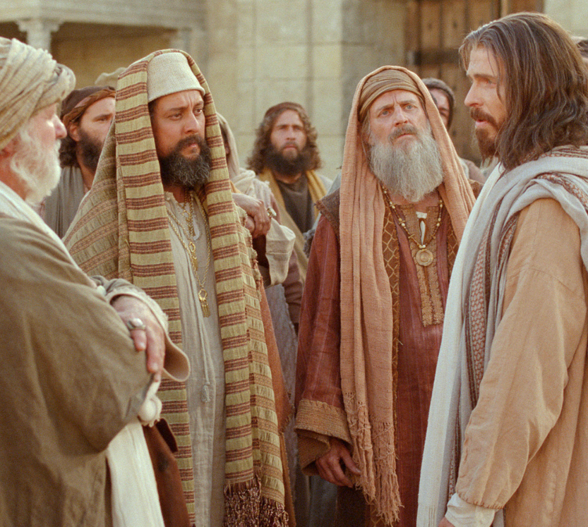
1st Response to Jesus
Matthew 13:53-58
Unbelief!

Slide 5
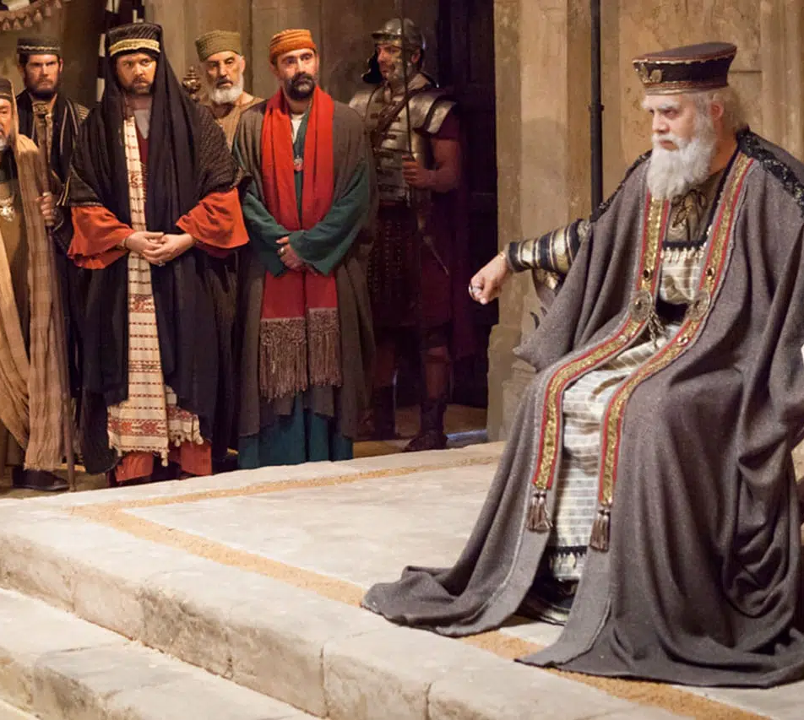
2nd Response to Jesus
Matthew 14:1-12
Fear!

Slide 6
3rd Response to Jesus
Matthew 14:13-21
Faith for
materials!

Slide 7
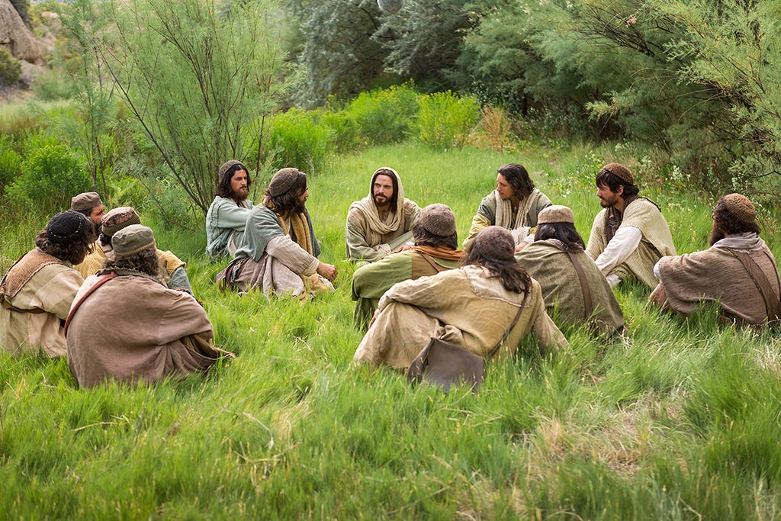
Same incident is recorded in
Mark 6:30-34 Luke 9:10-17 John 6:1-14

Slide 8
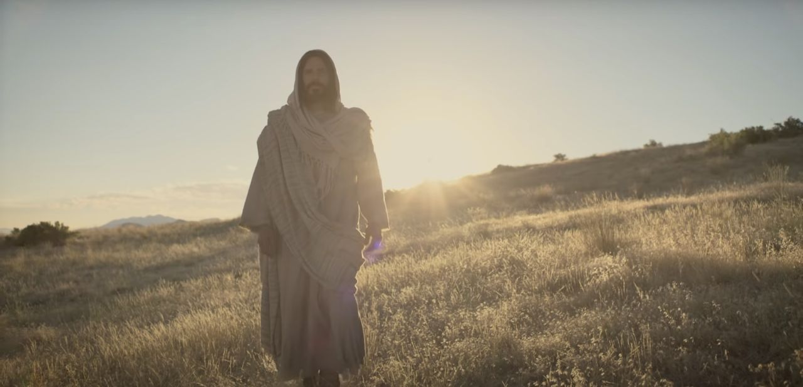
Matthew Chapter 14:13- Jesus wants alone time with God.
“He departed from there.”

Slide 9
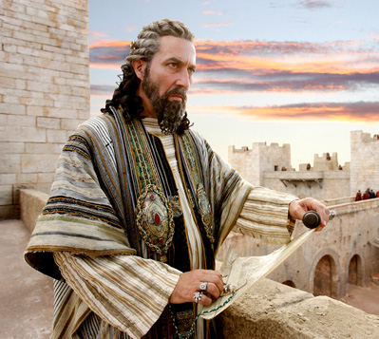
Was Jesus afraid of Herod?

Slide 10
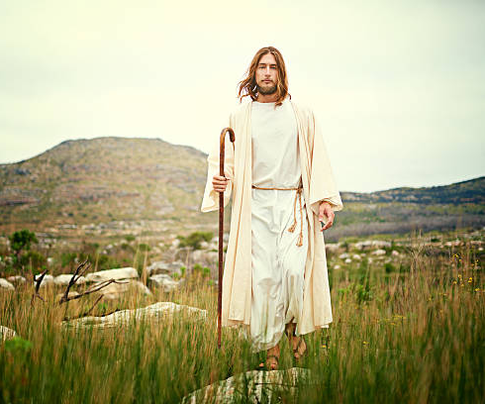
Matthew Chapter 14:13- Jesus wants alone time with God.
He needed
Rest.
Solitude with Father.
Time to contemplate the meaning of the death of John the Baptist.
The cross loomed imminent in the future.

Slide 11
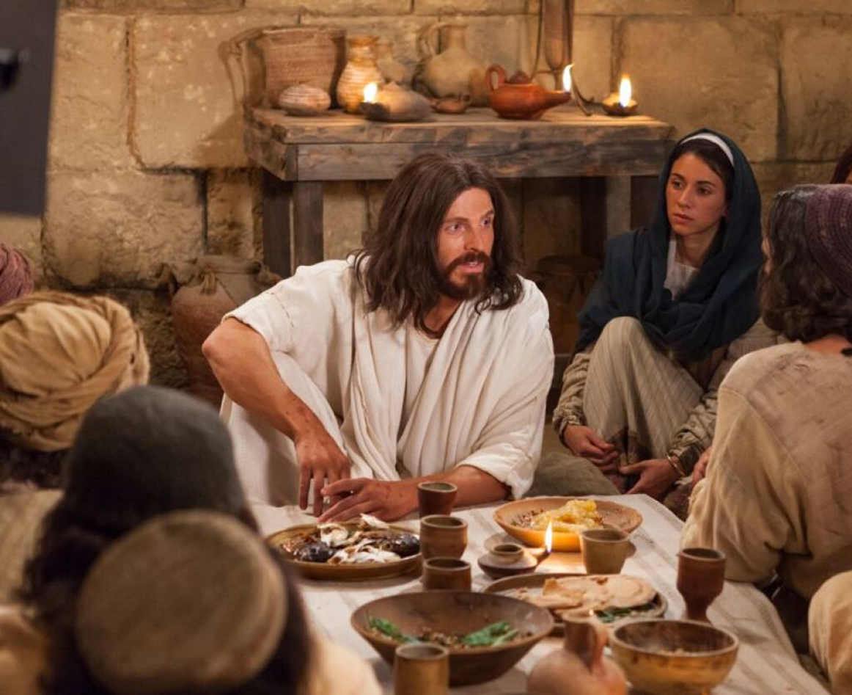
Matthew Chapter 14:13- Jesus wants alone time with God.
It was time for
Fellowship with His disciples
Disciples to report to Him
Debriefing on the mission
Preparation for what was now ahead of them

Slide 12
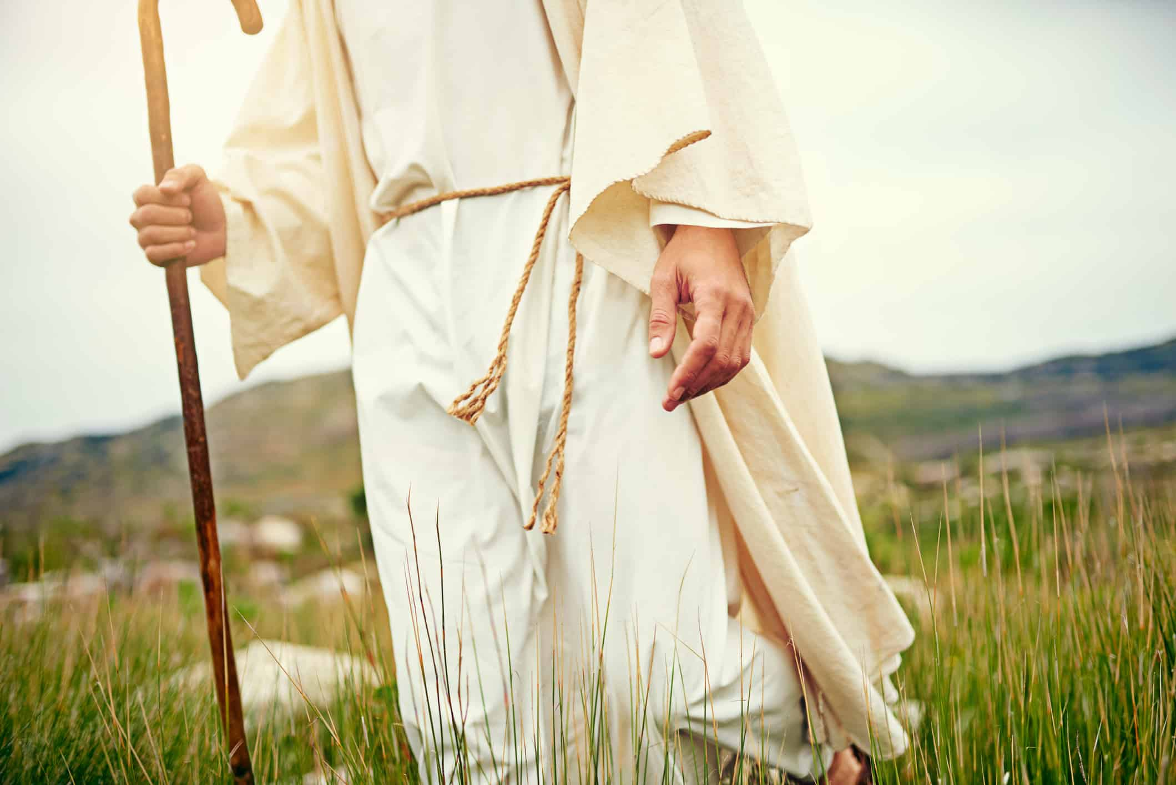
Matthew Chapter 14:13- Jesus wants alone time with God.
Jesus sought a private, secret place. The crowd was constantly watching Him
“He departed from there.”

Slide 13
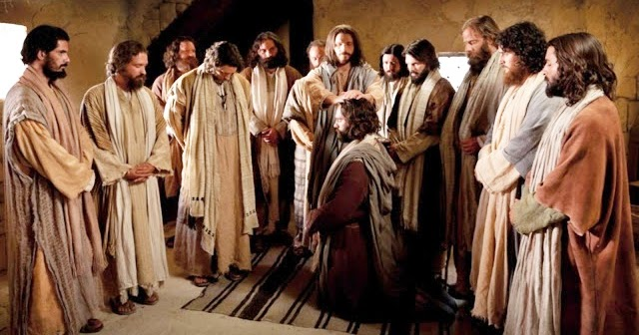
Luke 9:10
Apostles report to Jesus, then He took them and went aside privately into a deserted place

Slide 14
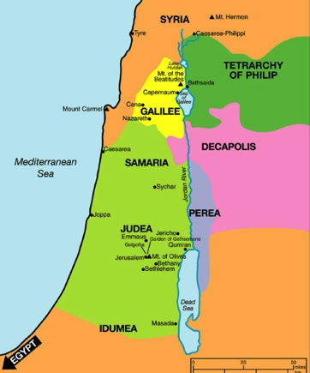
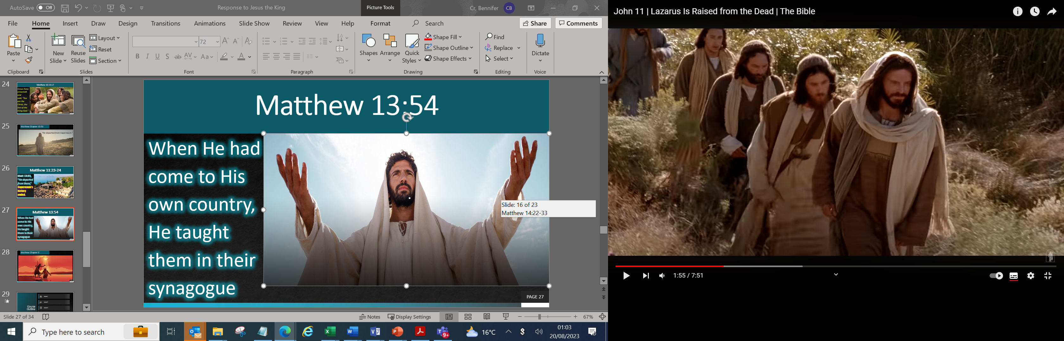
Luke 9:10
Bethsaida Julia
Bethesda

Slide 15
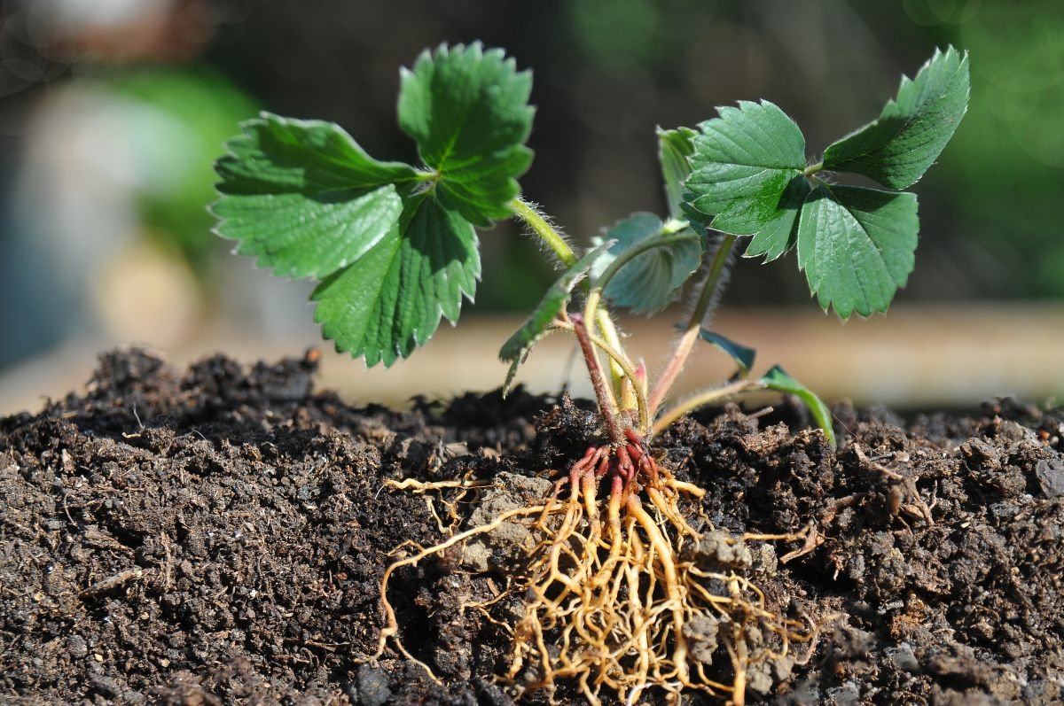
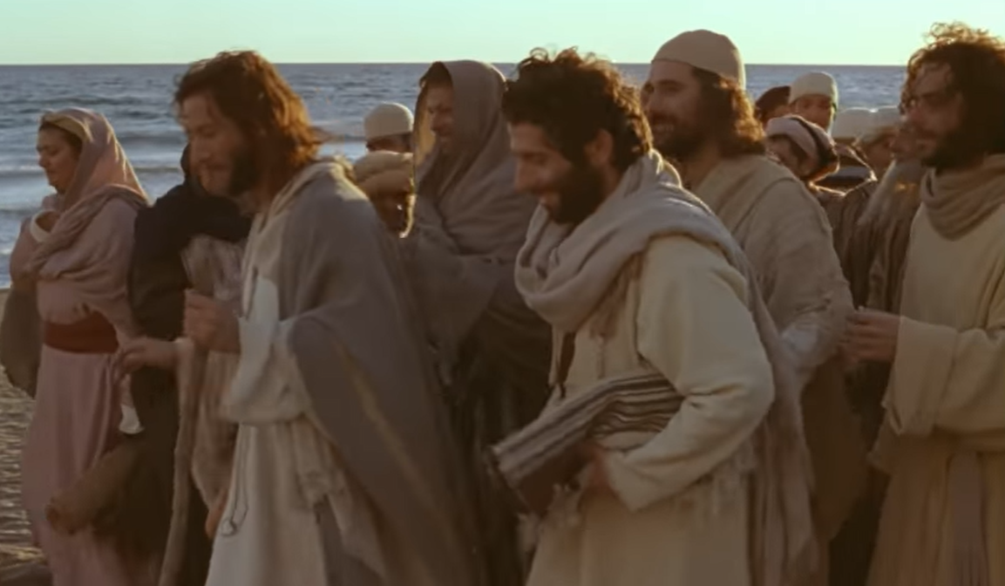
Matthew 14:13-14
Shallow Soil
Multitudes followed Him

Slide 16
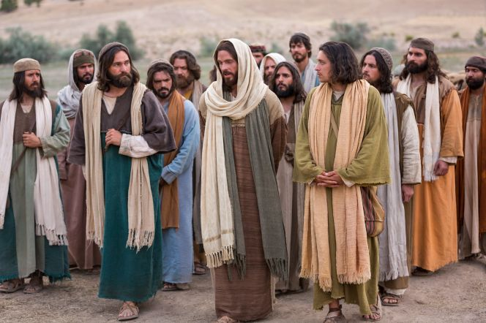
John 6:2-4
Shallow Soil
Multitudes followed Him

Slide 17
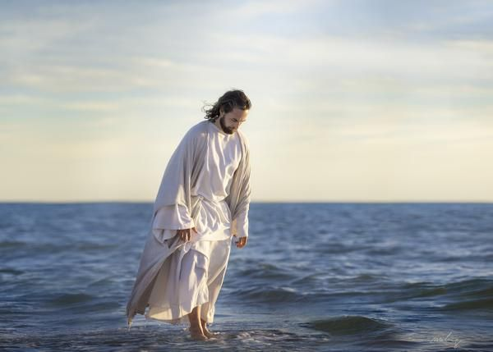
They were
Totally self-centred.
Self-indulgent.
Following Him for the healings
Wanting to pull off a revolution and throw out their oppressors.
To establish a dream land.

Slide 18
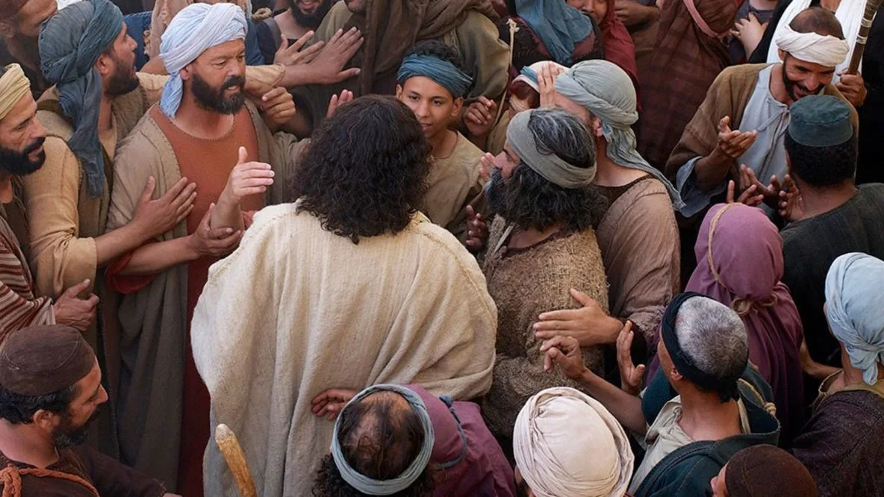
Matthew Chapter 14:14- Jesus moved with compassion
Christ Mercy

Slide 19
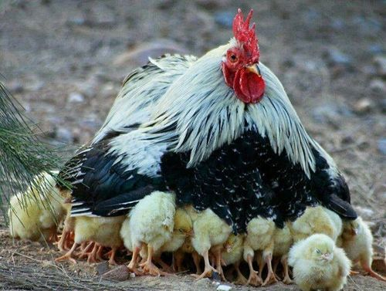
Matthew
23:37

Slide 20
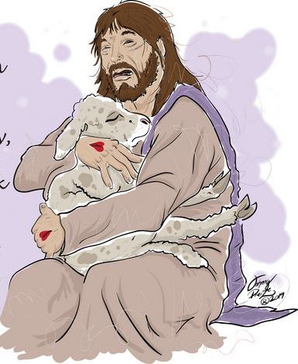
Jeremiah 13:17

Slide 21
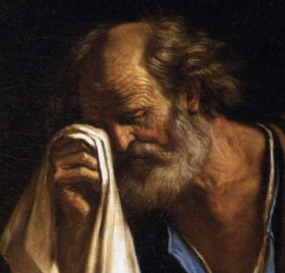
2 Corinthians chapter 11

Slide 22
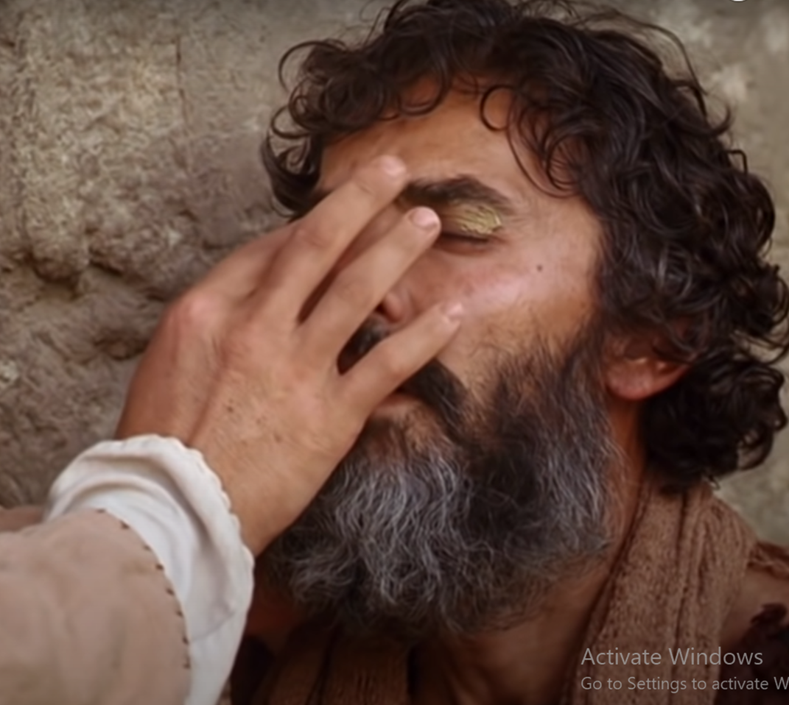
Psalms
146:8-9

Slide 23
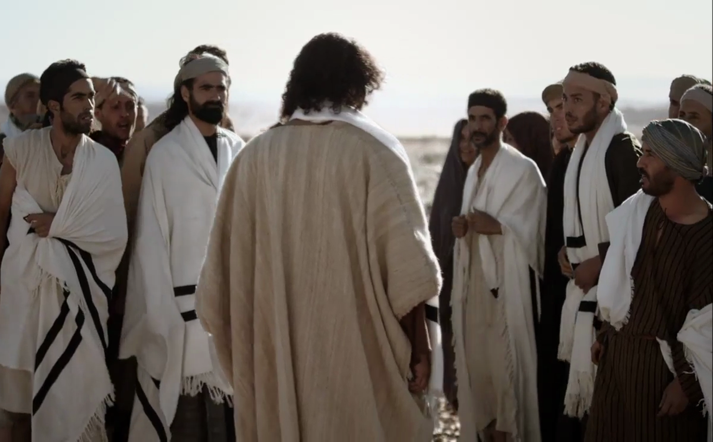
Matthew 14:15
Disciples were concerned

Slide 24
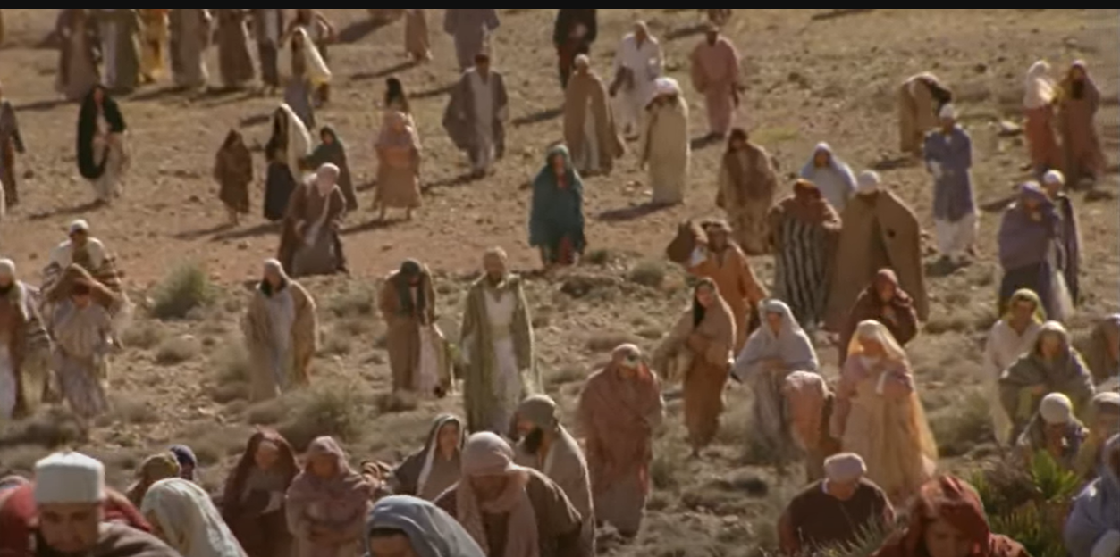
John 6:5

Slide 25
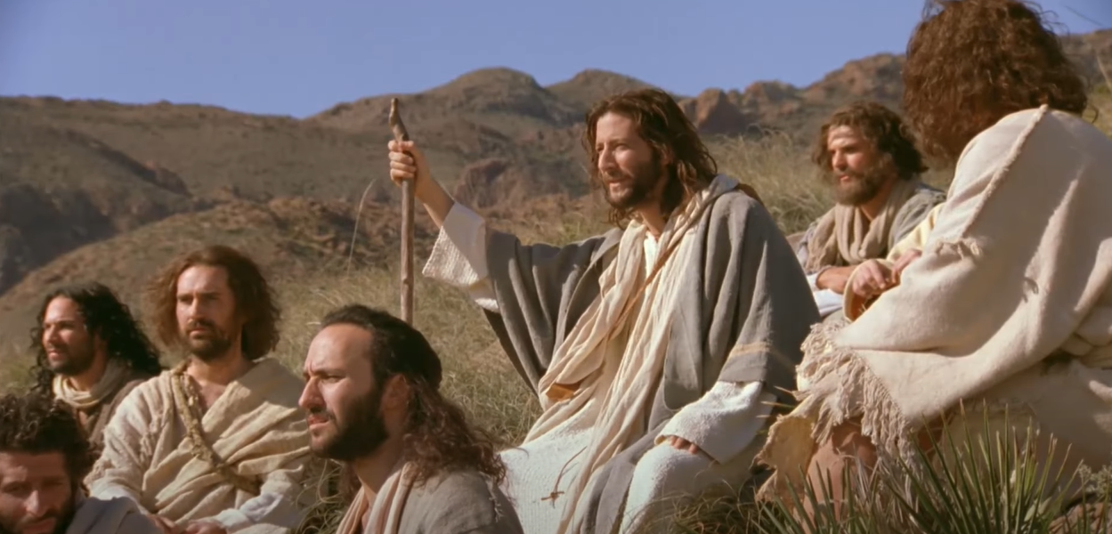
Philip was from that area and would have known the resources

Slide 26
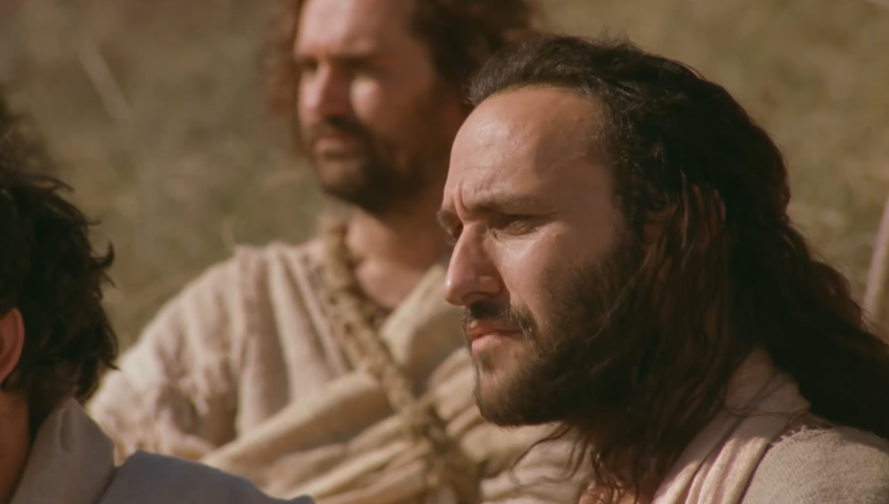
John 6:6, But this He said to test him, for He Himself knew what He would do.

Slide 27
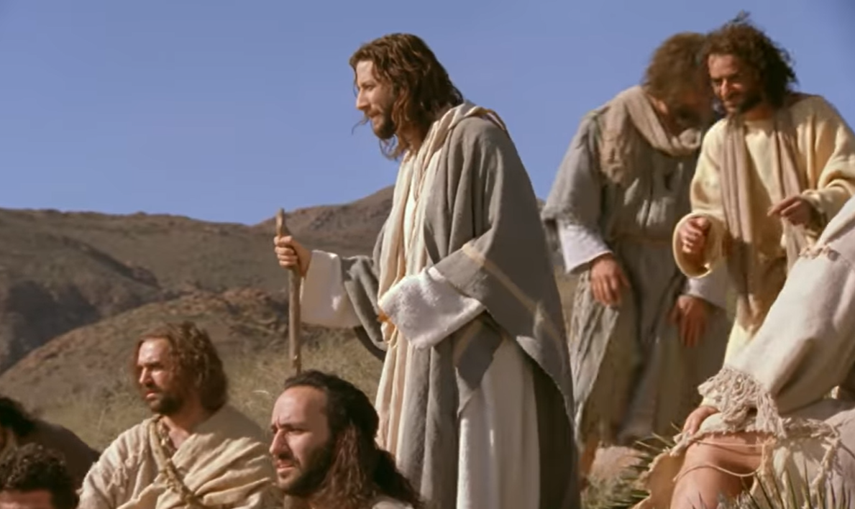
John 14:8-10, Philip said to Him, “Lord, show us the Father, and it is sufficient for us.”

Slide 28
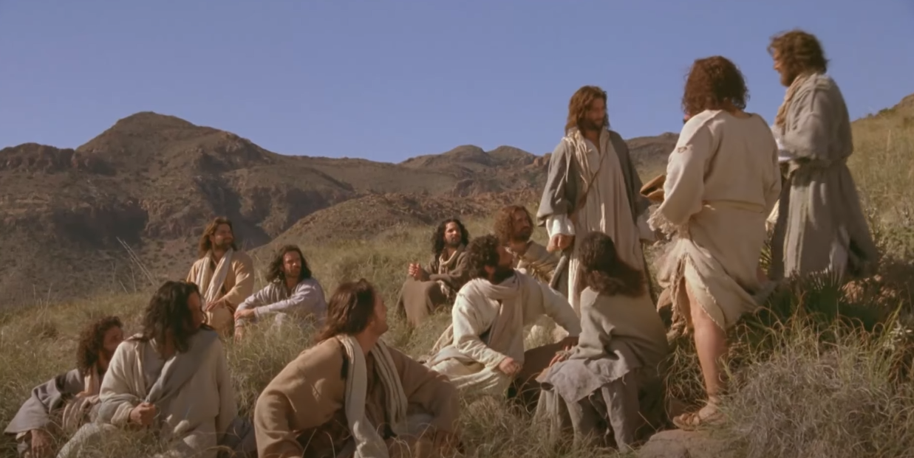
John 6:7, “Two hundred denarii worth of bread is not sufficient for them,

Slide 29
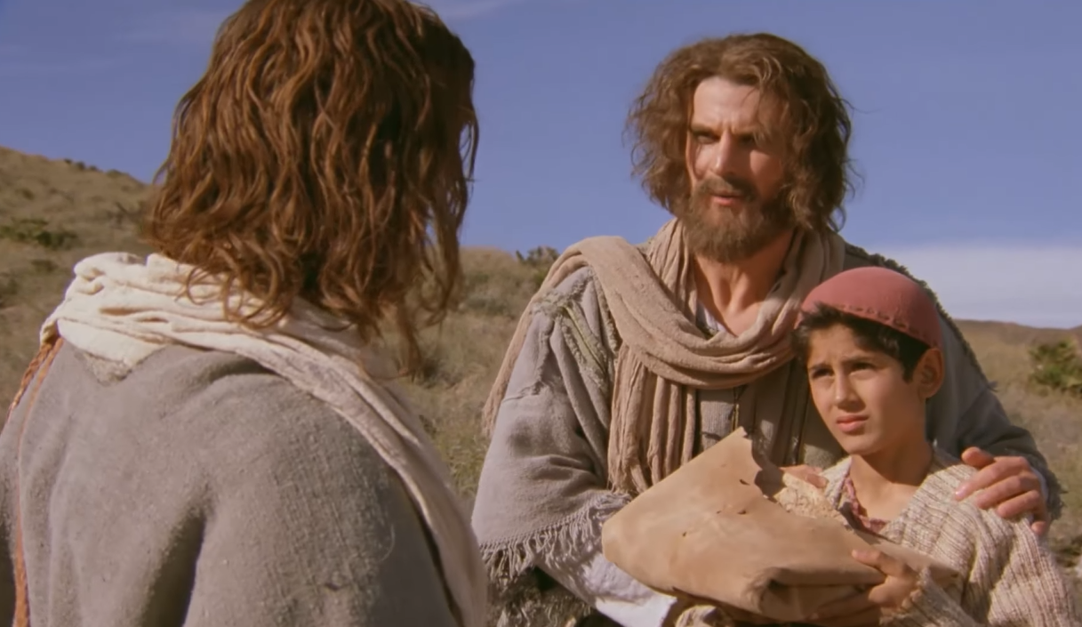
John 6:8-9, One of His disciples, Andrew, Simon Peter’s brother, said to Him

Slide 30
Matthew 14:15
The Jews had two evenings:
3 PM to 6 PM,
and other was
6 PM to 9 PM.

Slide 31
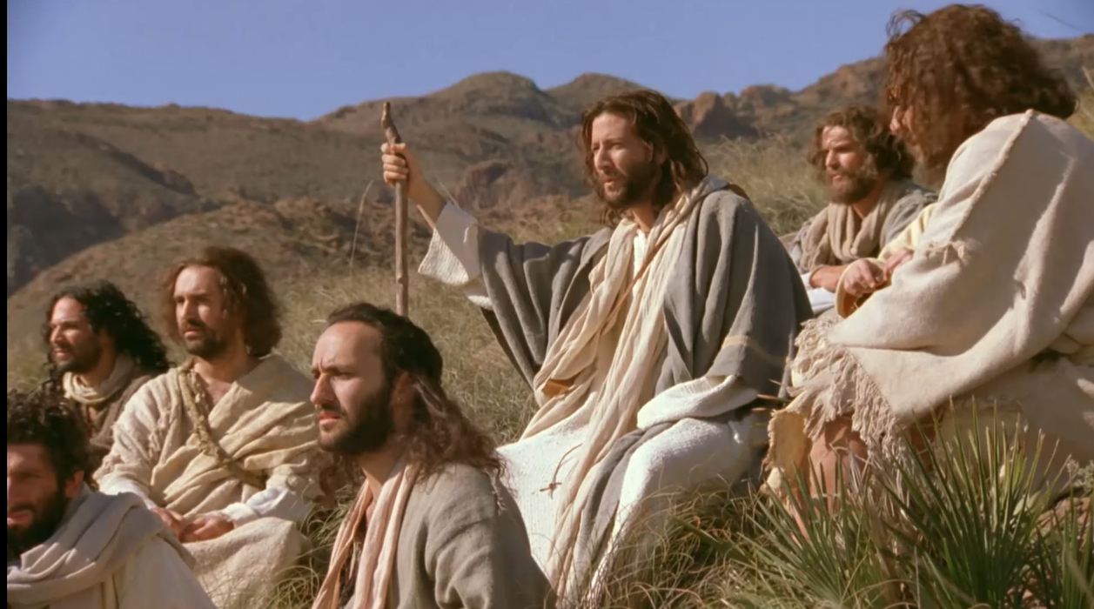
Matthew 14:16

Slide 32
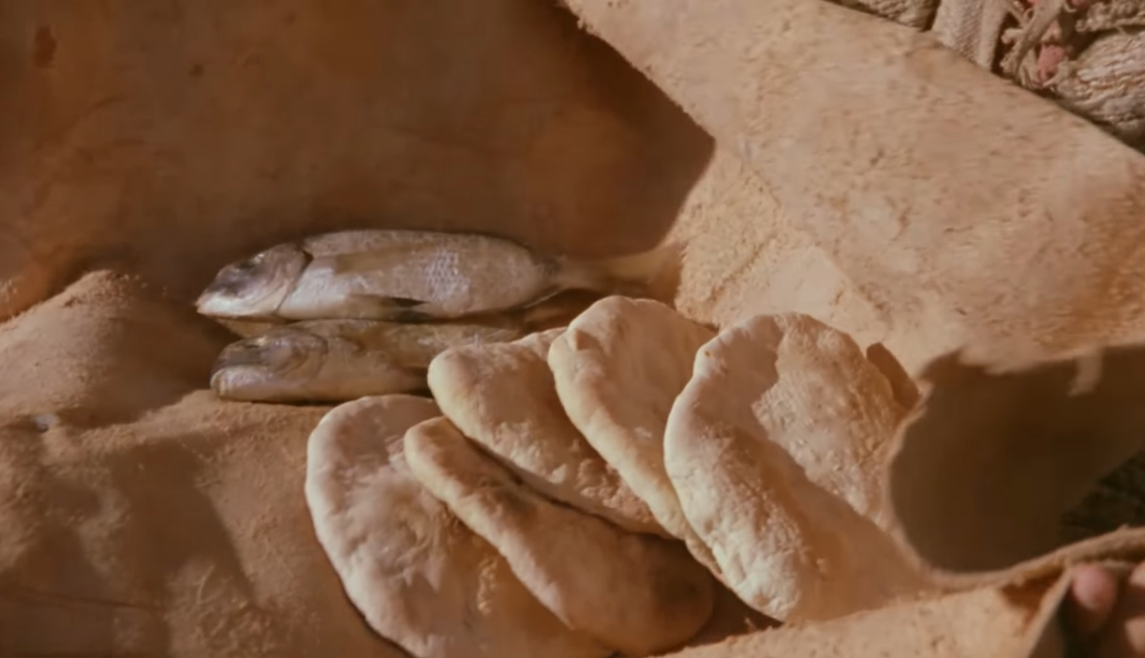
Matthew 14:17

Slide 33
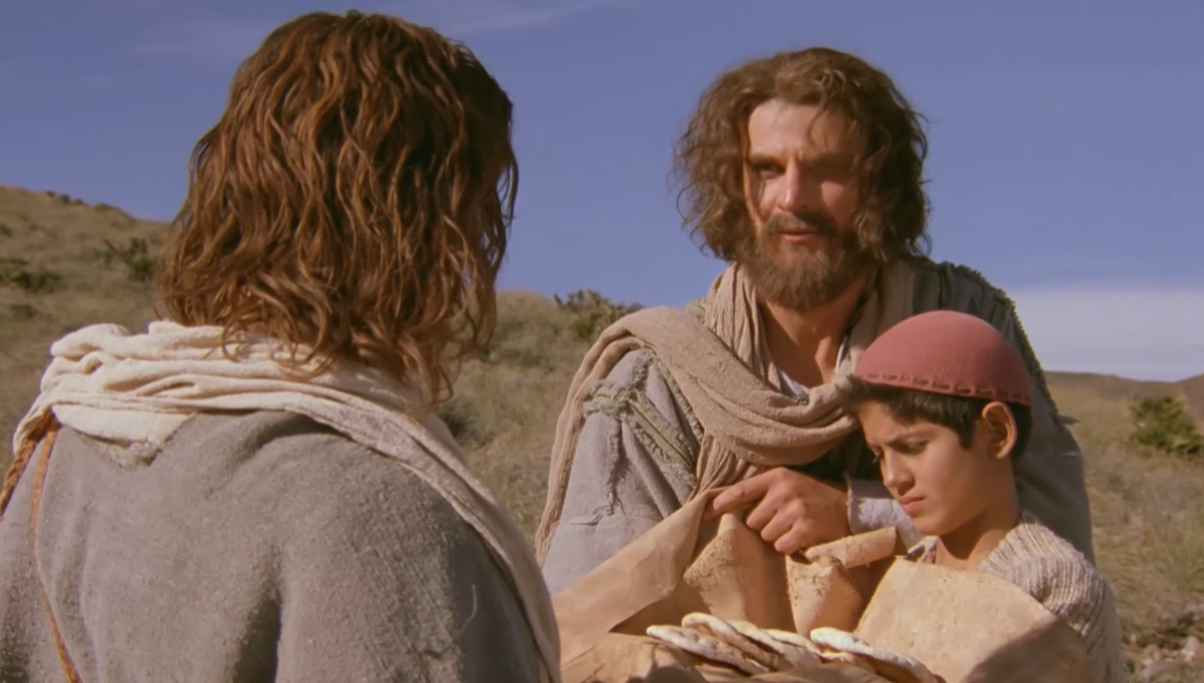
Matthew 14:18
Divine power

Slide 34
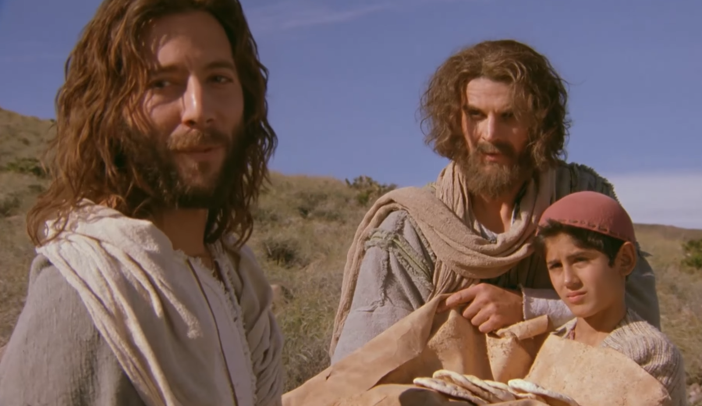
Matthew 14:19
Divine power

Slide 35
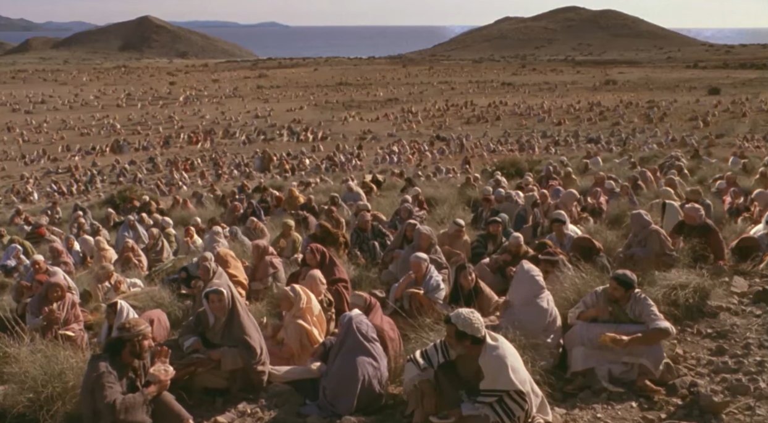
Mark 6:39-40
Divine power

Slide 36
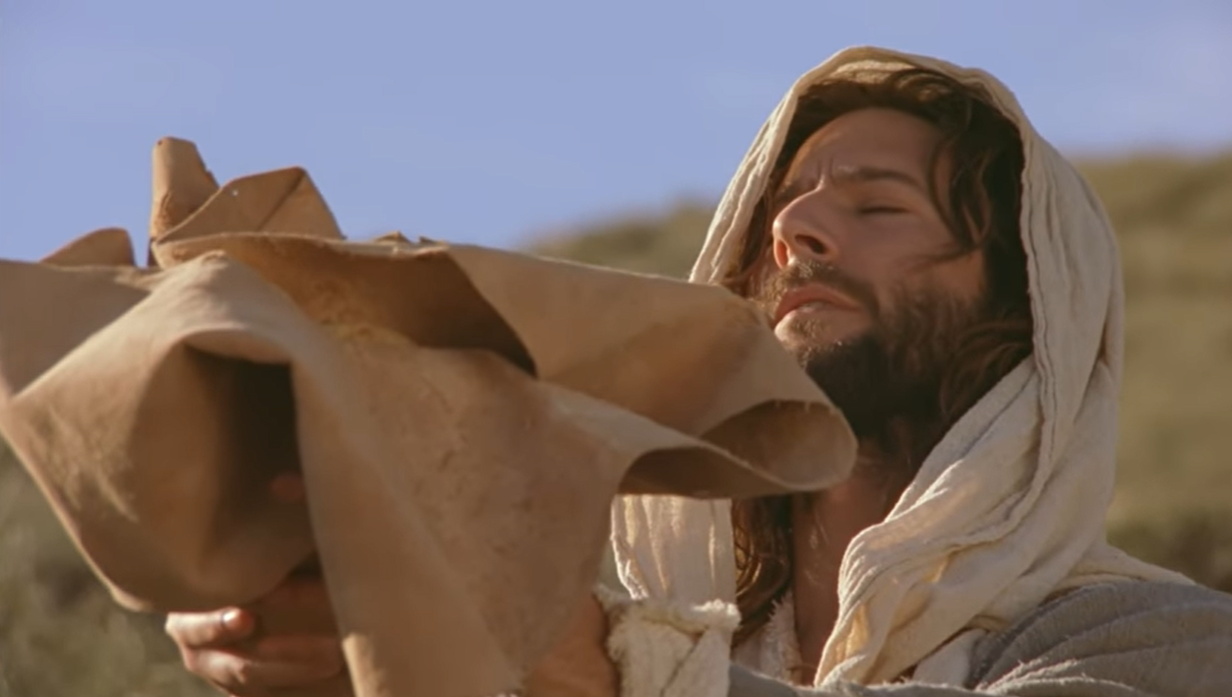
Matthew 14:19
Divine power

Slide 37
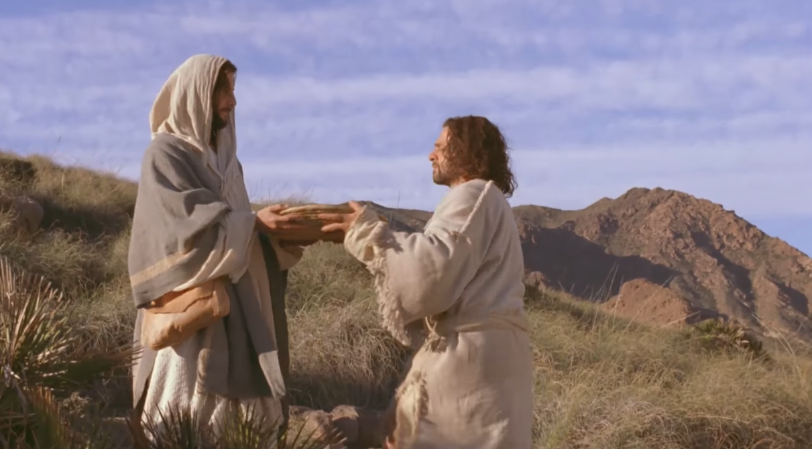
John 6:11
Divine power

Slide 38
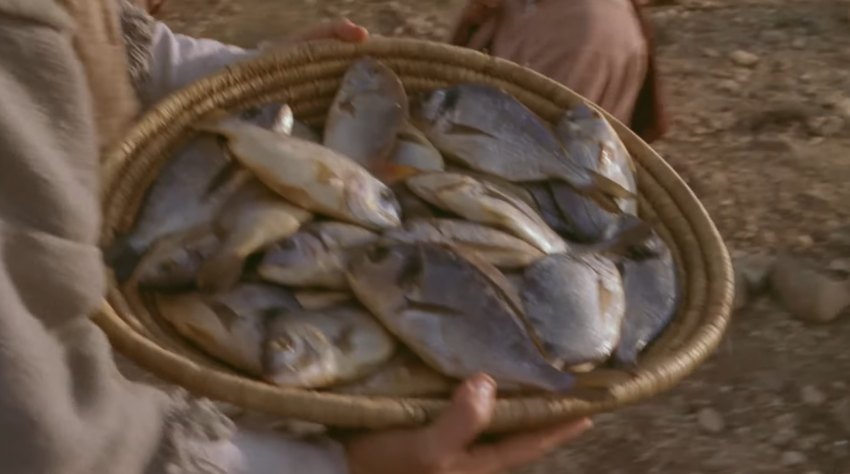
Matthew 14:20
Divine power

Slide 39

Matthew 14:21
Divine power

Slide 40
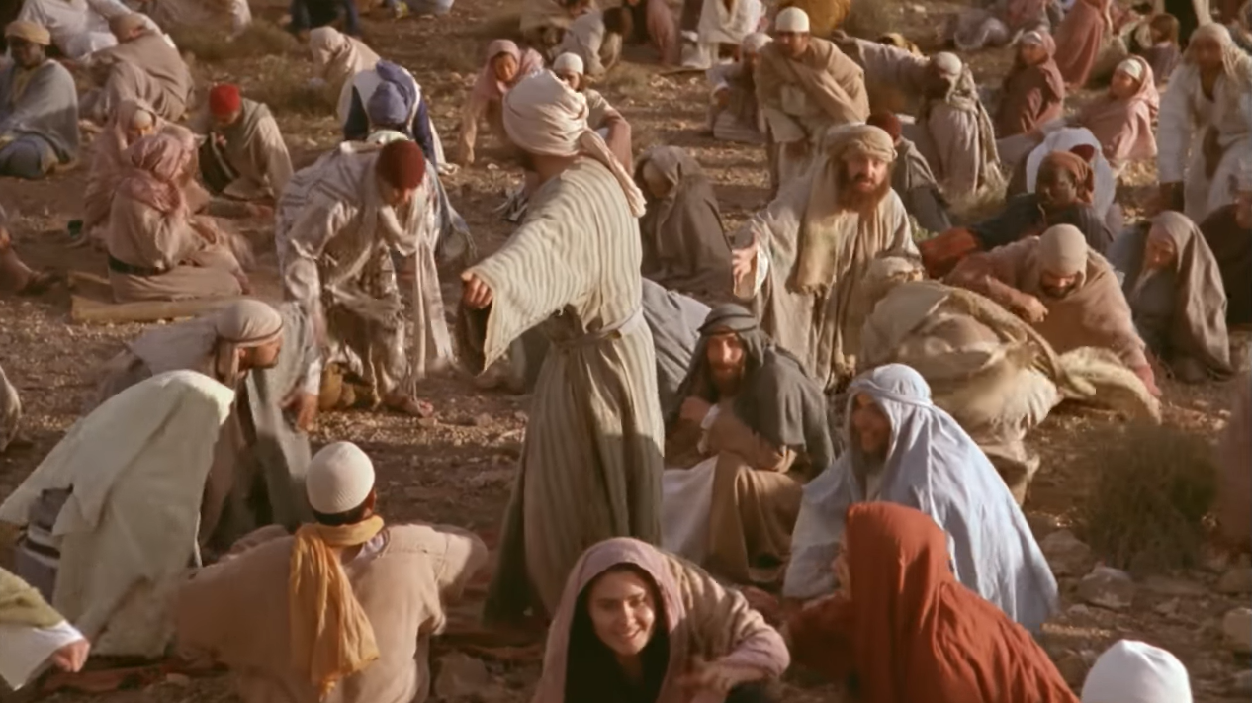
John 6:15
Divine power

Slide 41
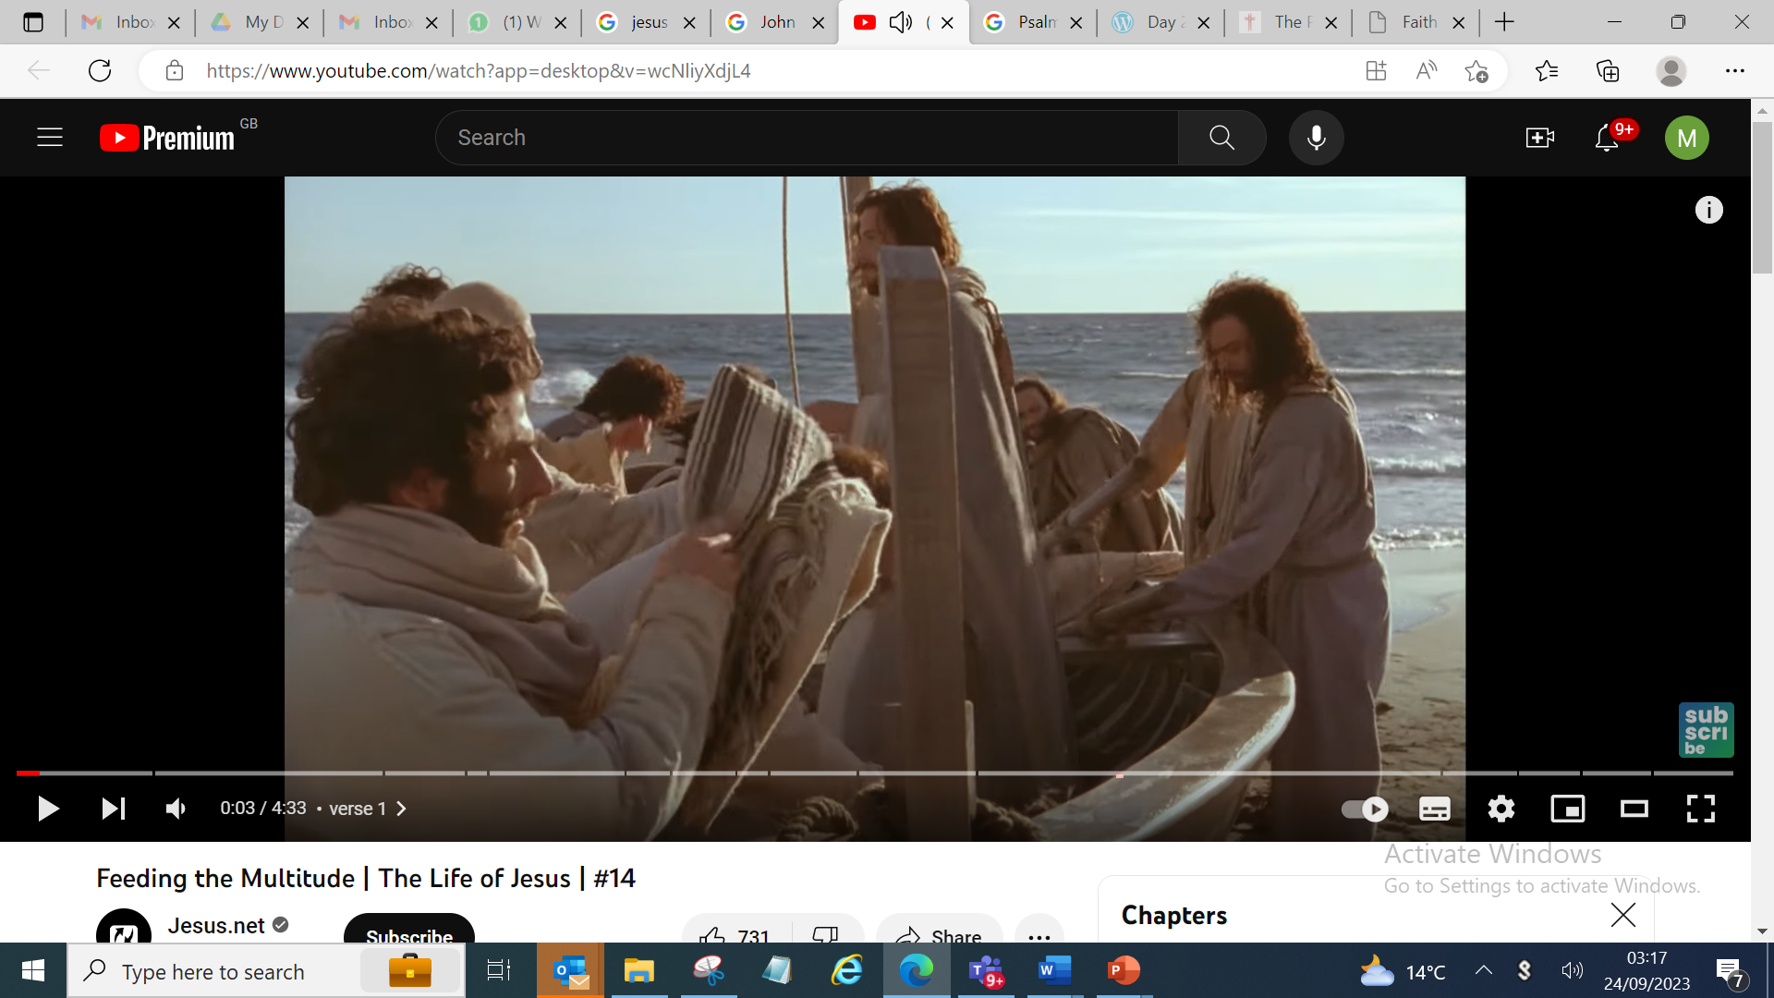
Matthew 14:22
Divine power

Slide 42
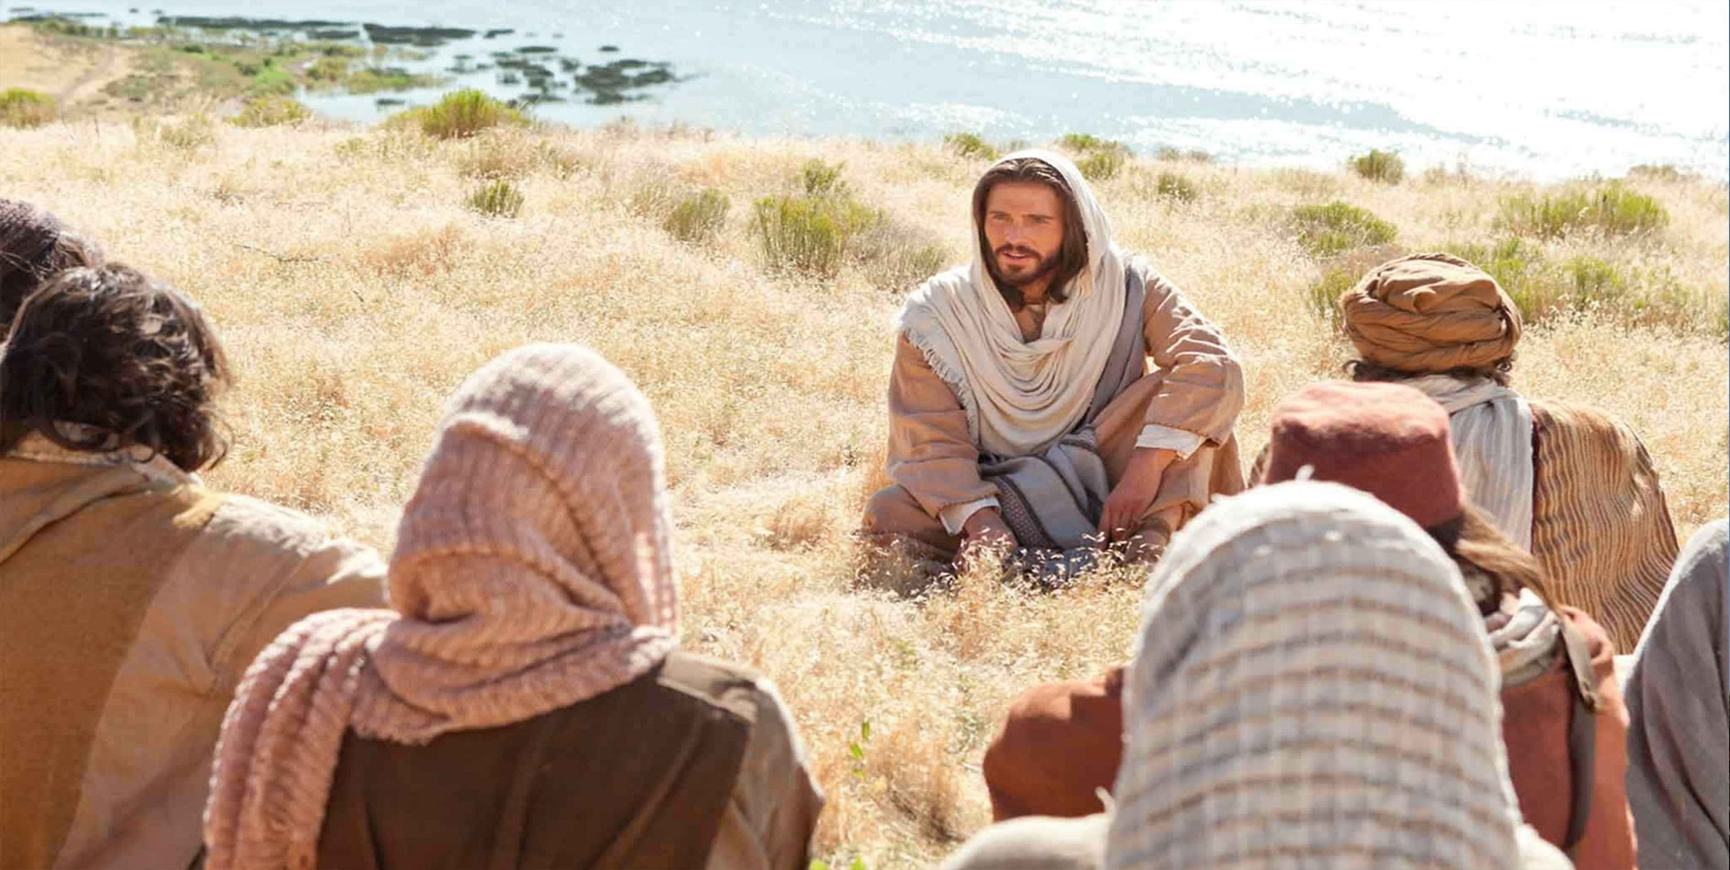
John 6:28-29
Third response

Slide 43
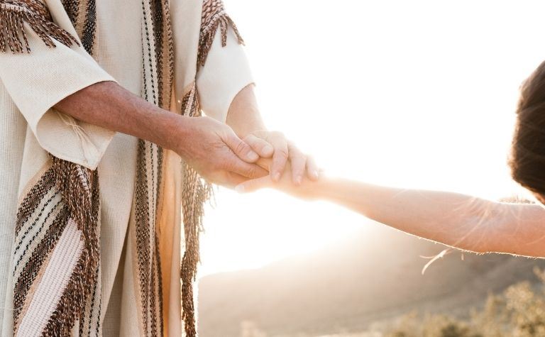
John 6:37
All that the Father gives Me will come to Me, and the one who comes to Me I will by no means cast out.
Third response

Slide 44
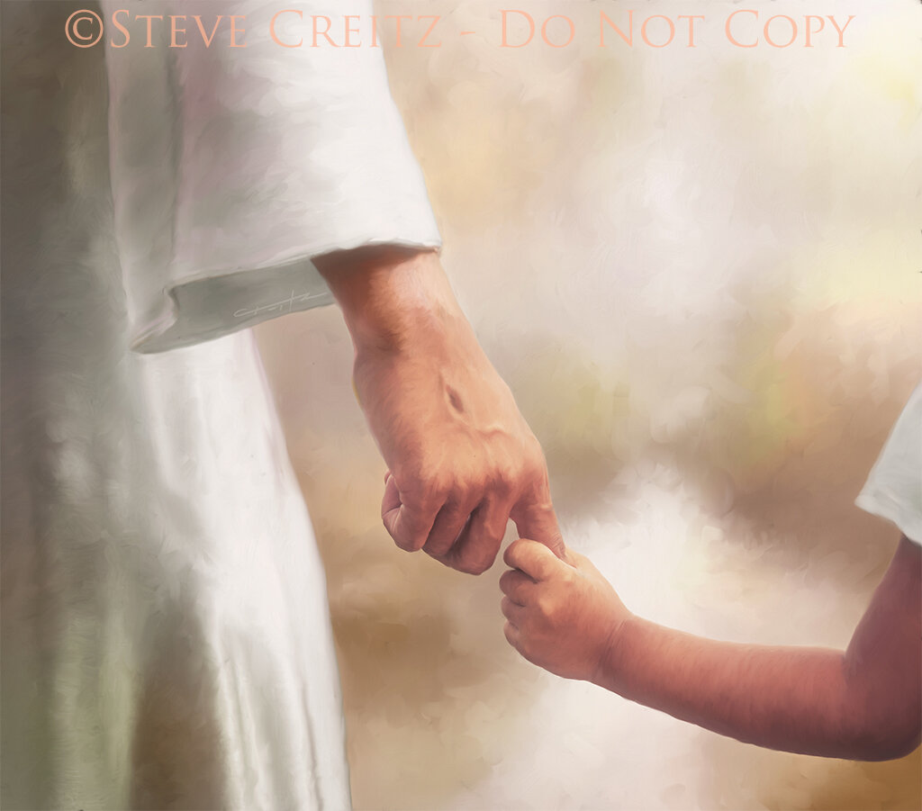
John 6:44
No one can come to Me unless the Father who sent me
draws him; and I will raise him up at the last day.
Third response

Slide 45
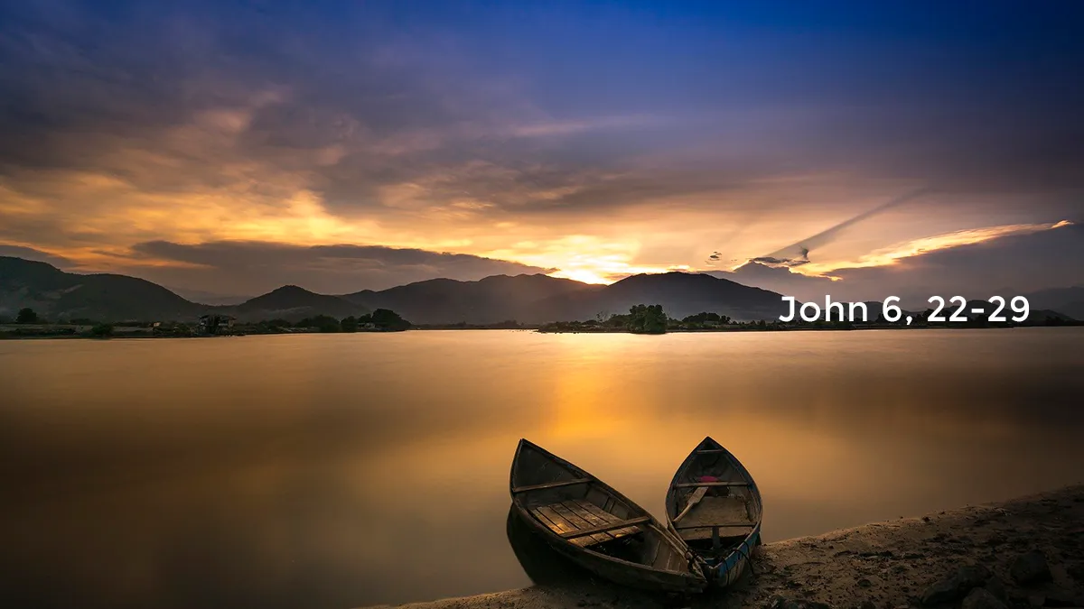
John 6:22-27
Third response

Slide 46
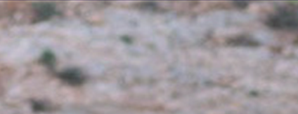
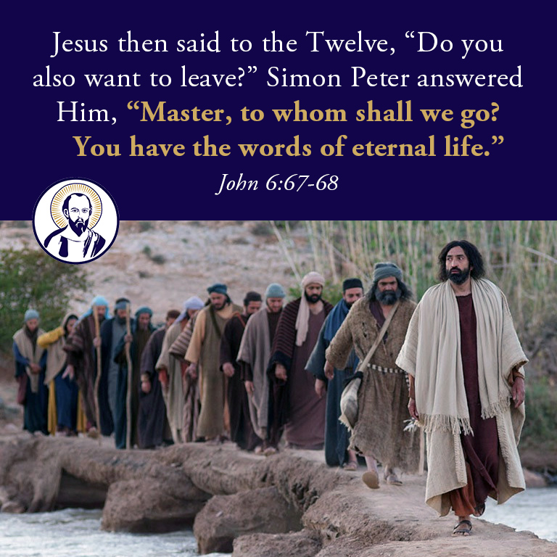
John 6:66
Third response

Slide 47
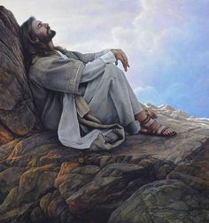
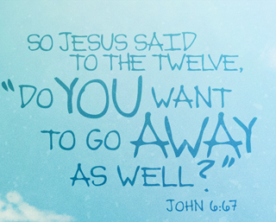
John 6:67-69

Slide 48
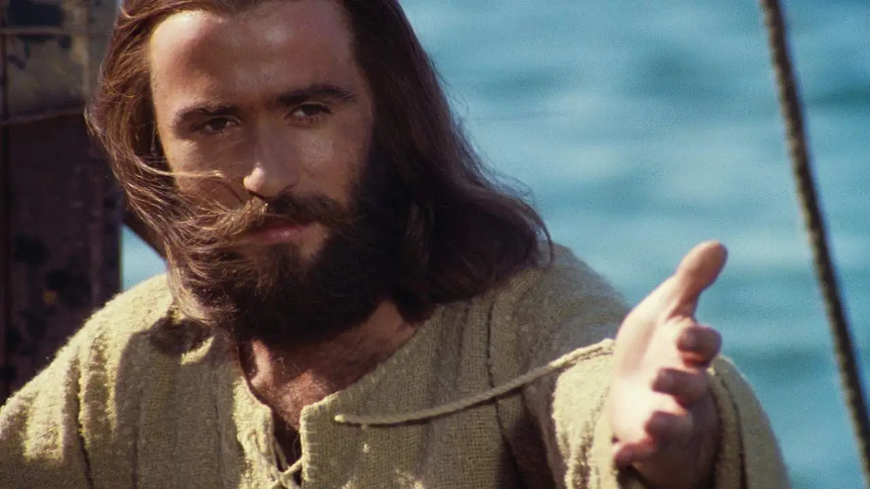
Application for those who decide to follow Jesus.

Slide 49
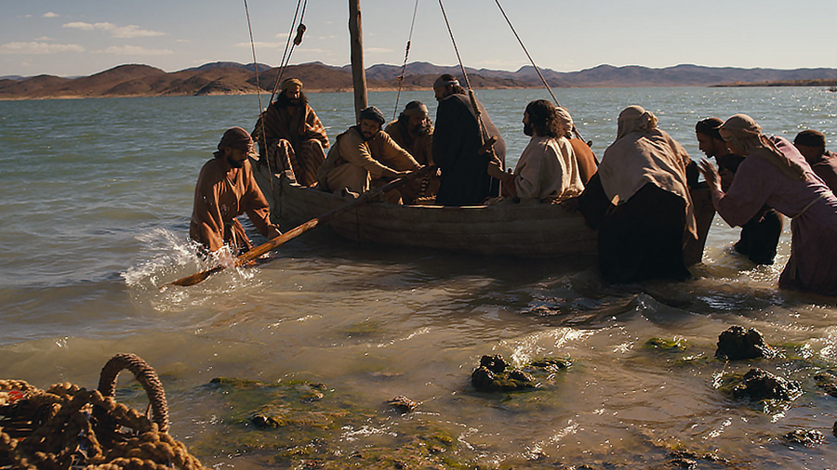
1. Withdraw from needless danger.

Slide 50

2. Seek rest and solitude

Slide 51

3. Spend quality time with those who work with you.

Slide 52

4. Show compassion those who are in need

Slide 53

5. Not just physical but spiritual needs.

Slide 54

6. Learn to obey when you don’t understand.

Slide 55

7. Be orderly.

Slide 56

1 Corinthians 14:40
Let all things be done decently and in order.

Slide 57

8. Stewardship

Slide 58

9. God is Generous.

Slide 59

10.Look out for others not for yourself.

Slide 60

Matthew 10:10

Slide 61

11. Trust God for the impossible.

Slide 62

12. God wants you to be the channel of blessing

Slide 63

Are you an already committed disciple?

