Slide 1
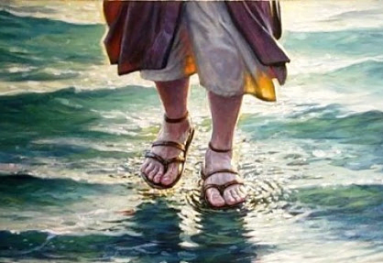
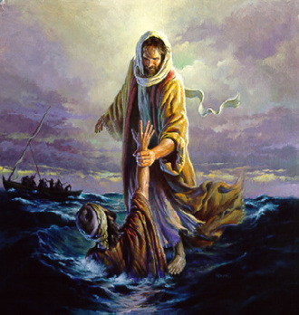
Brush
4th Response to Jesus-
Greatest Discovery of mankind- Jesus is God!
Matthew 14:22-33

Slide 2
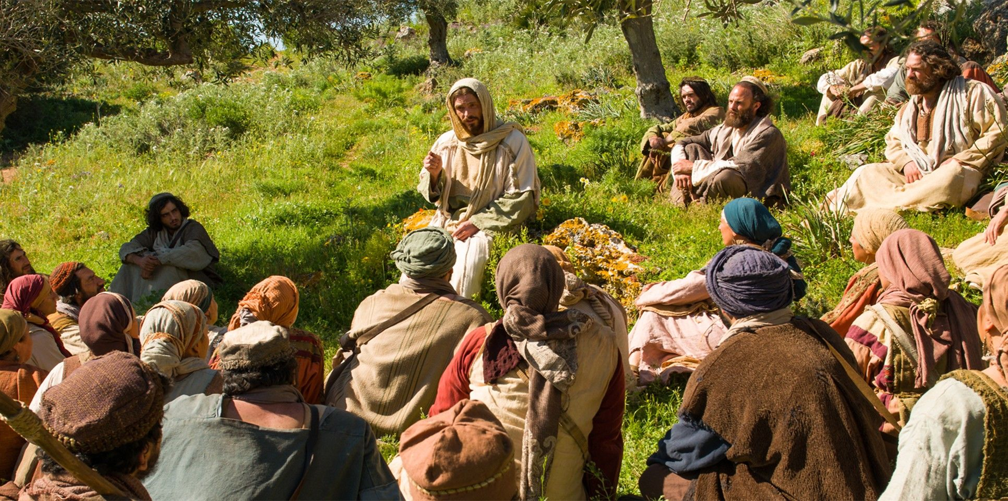
Matthew Chapter 13- Kingdom Parables were spoken

Slide 3
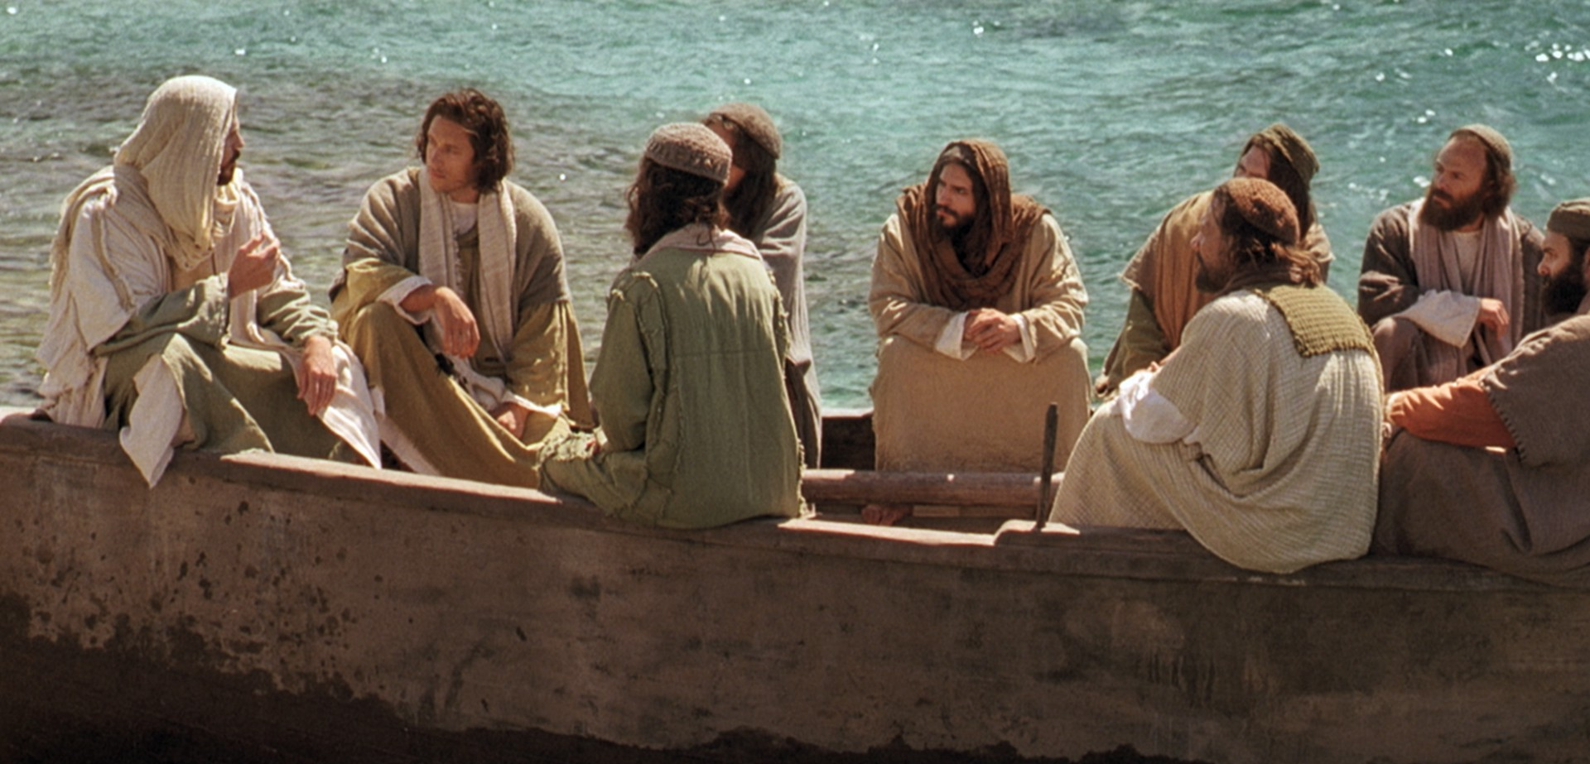
Matthew Chapter 13:53 till 16:12
Eight incidents in the life of our Lord

Slide 4
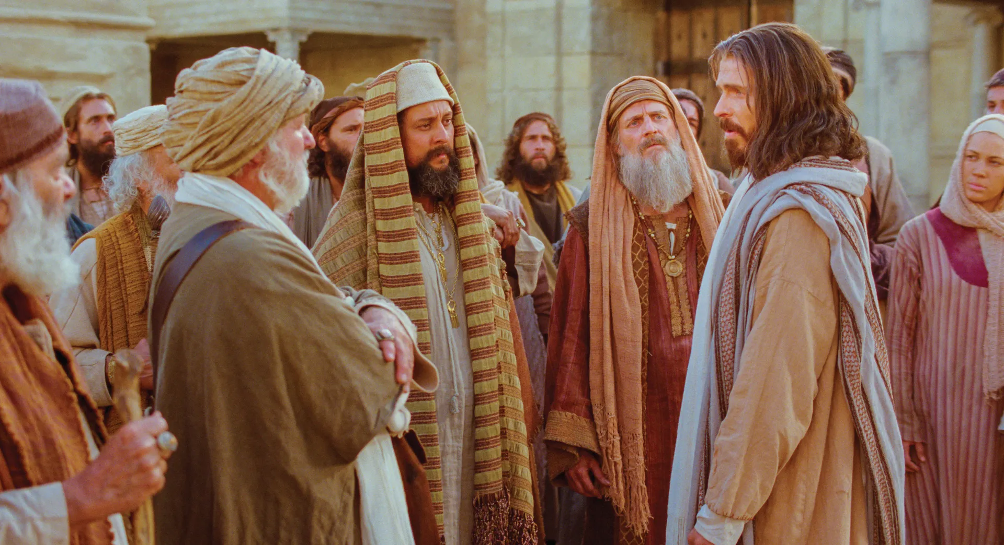
1st Response to Jesus
Matthew 13:53-58
Unbelief!

Slide 5
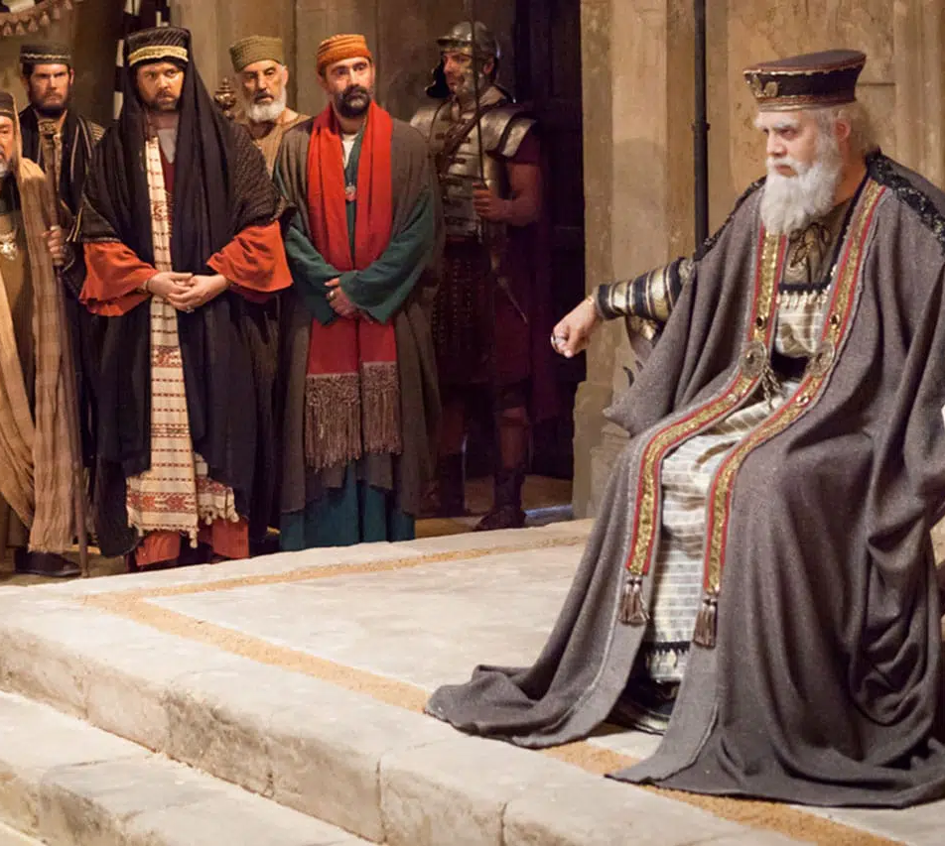
2nd Response to Jesus
Matthew 14:1-12
Fear!

Slide 6
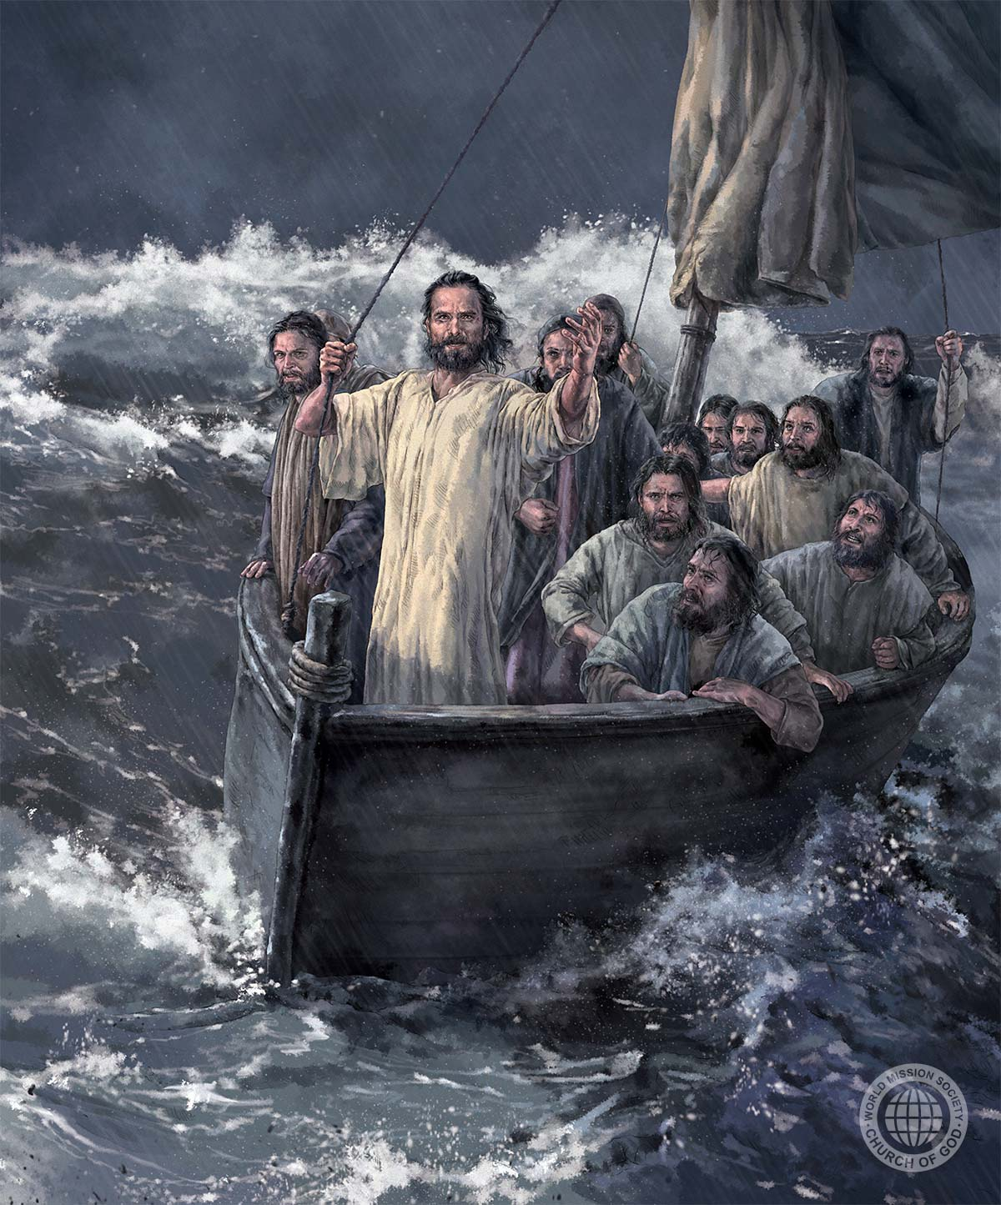
3rd Response to Jesus
Matthew 14:13-21
Faith for
materials!

Slide 7
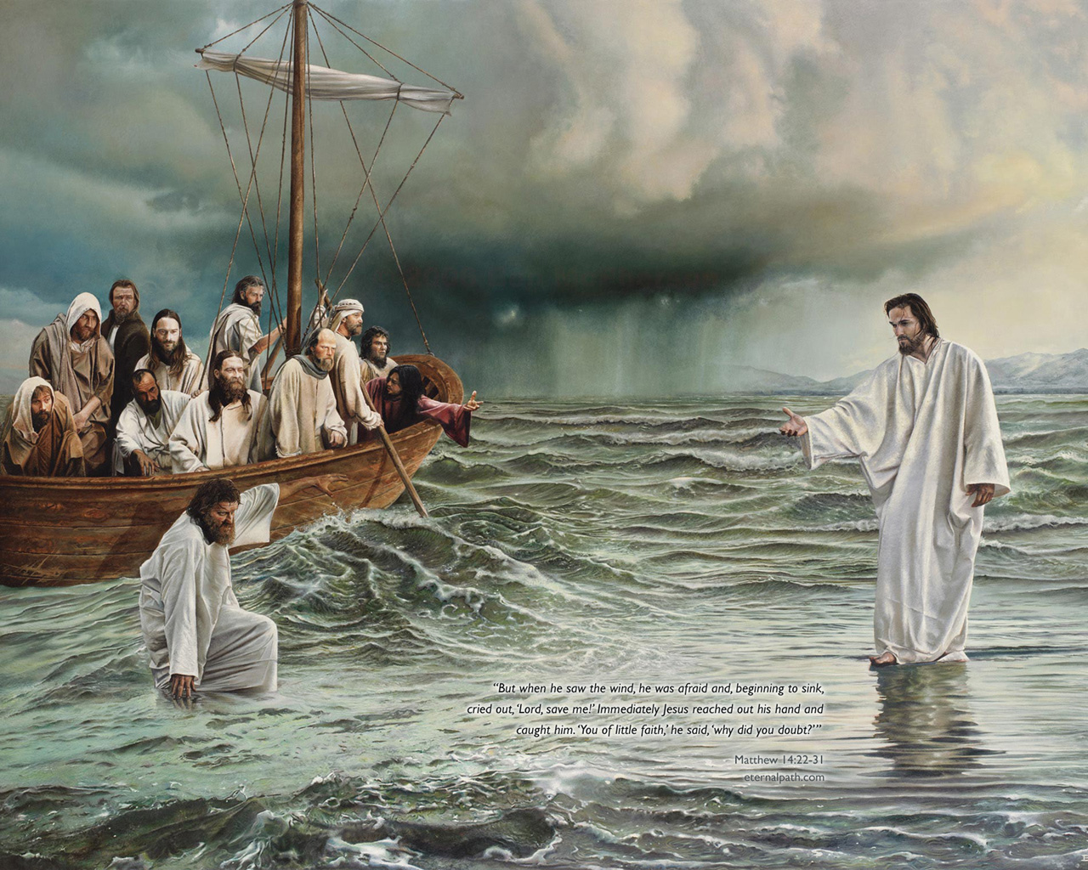
Agenda
“Truly
You are the Son of God.”
Matthew 14:33

Slide 8
Brush
4th Response to Jesus-
Greatest Discovery of mankind- Jesus is God!
Matthew 14:22-33

Slide 9
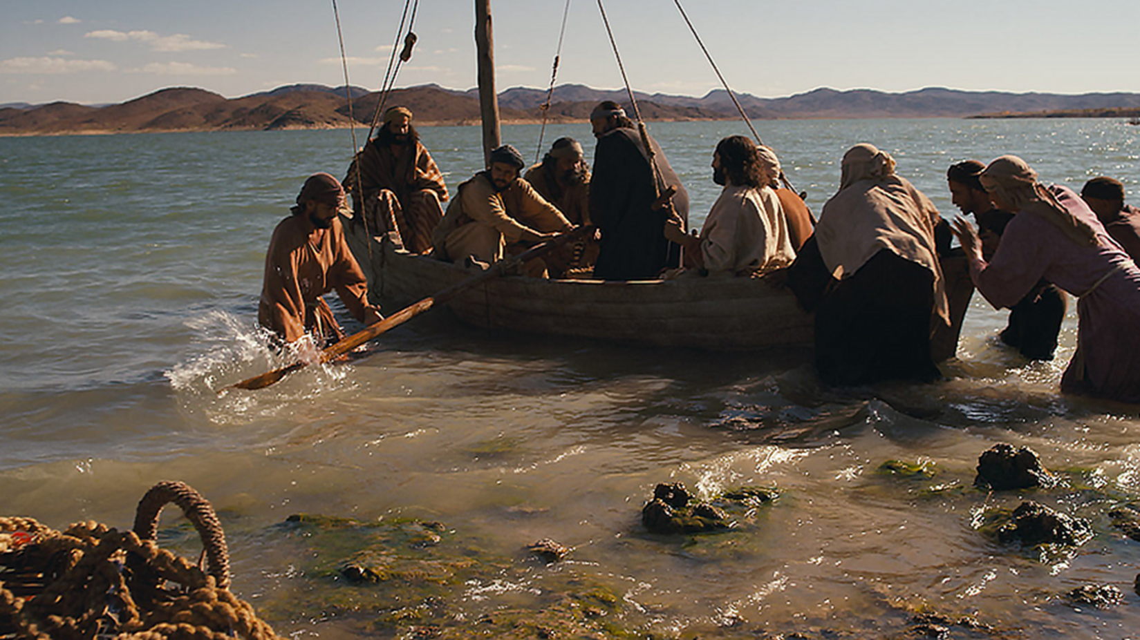
Agenda
Divine
Authority
Matthew 14:22

Slide 10
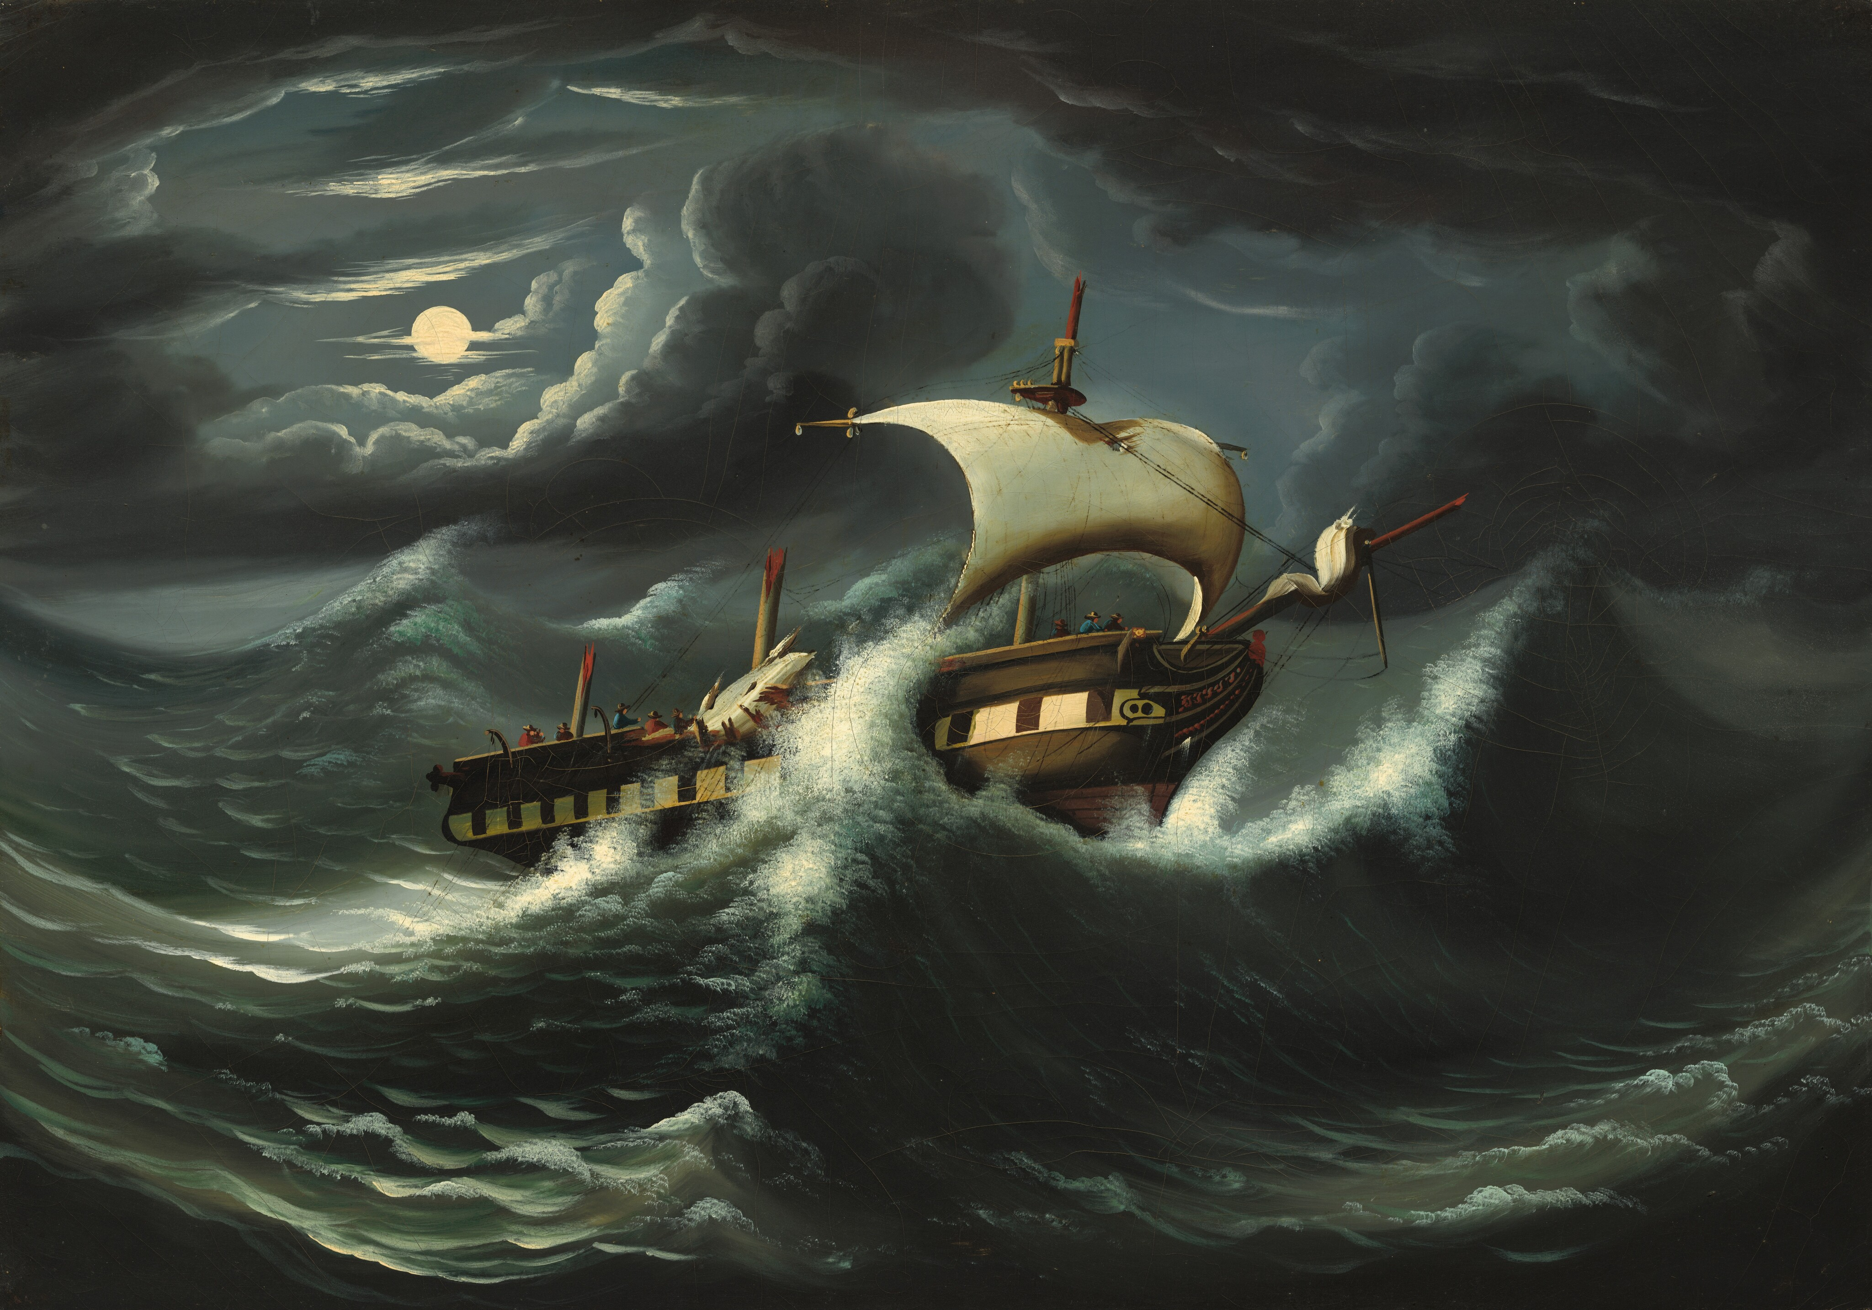
Agenda
2.Divine knowledge
Matthew 14:24

Slide 11
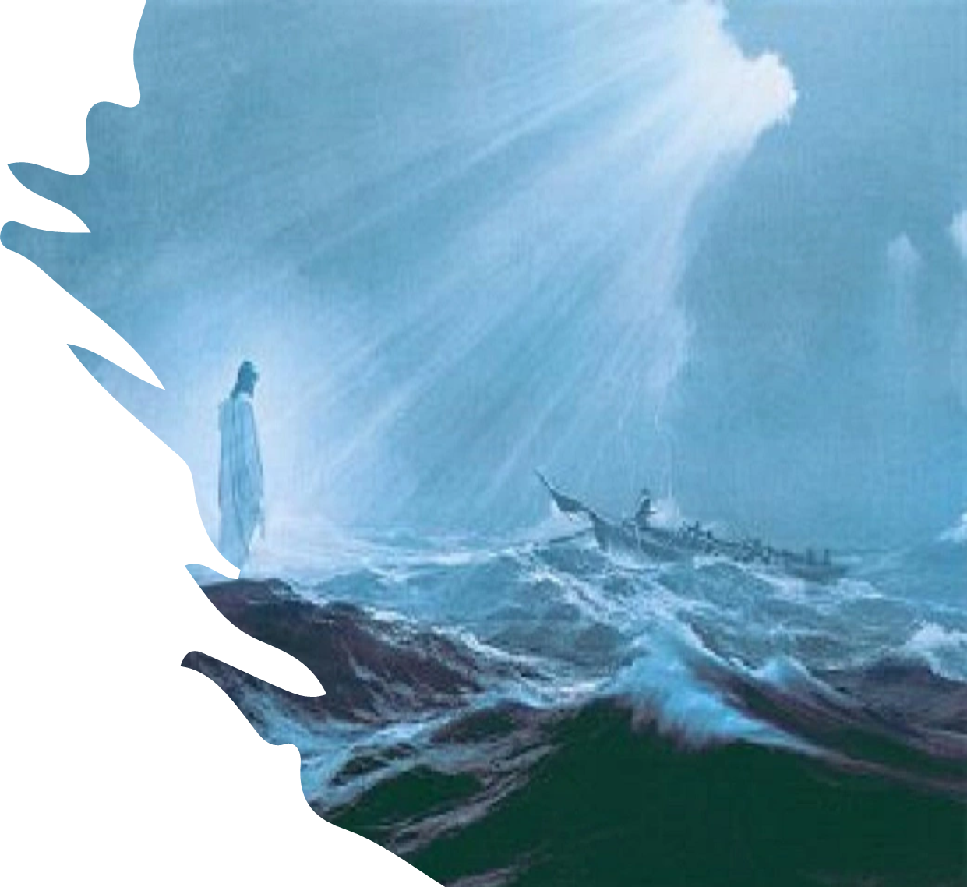
Agenda
3.Divine Protection

Slide 12
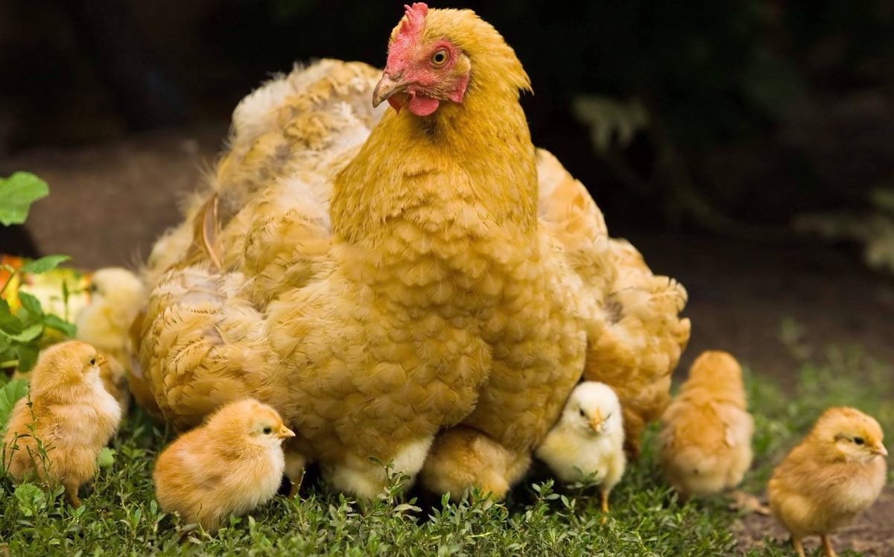
Because You defend them; Let those also who love Your name Be joyful in You.
Psalm 5:11

Slide 13
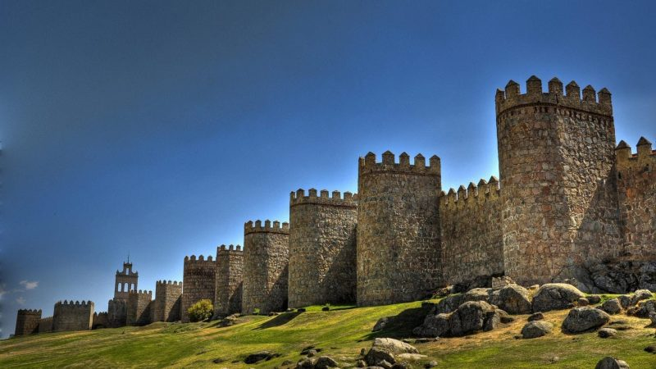
Agenda
The LORD is a refuge for the oppressed, a stronghold in times of trouble
Psalm 9:9

Slide 14

Agenda
The LORD is my rock, my fortress and my deliverer;
Psalm 18:2

Slide 15
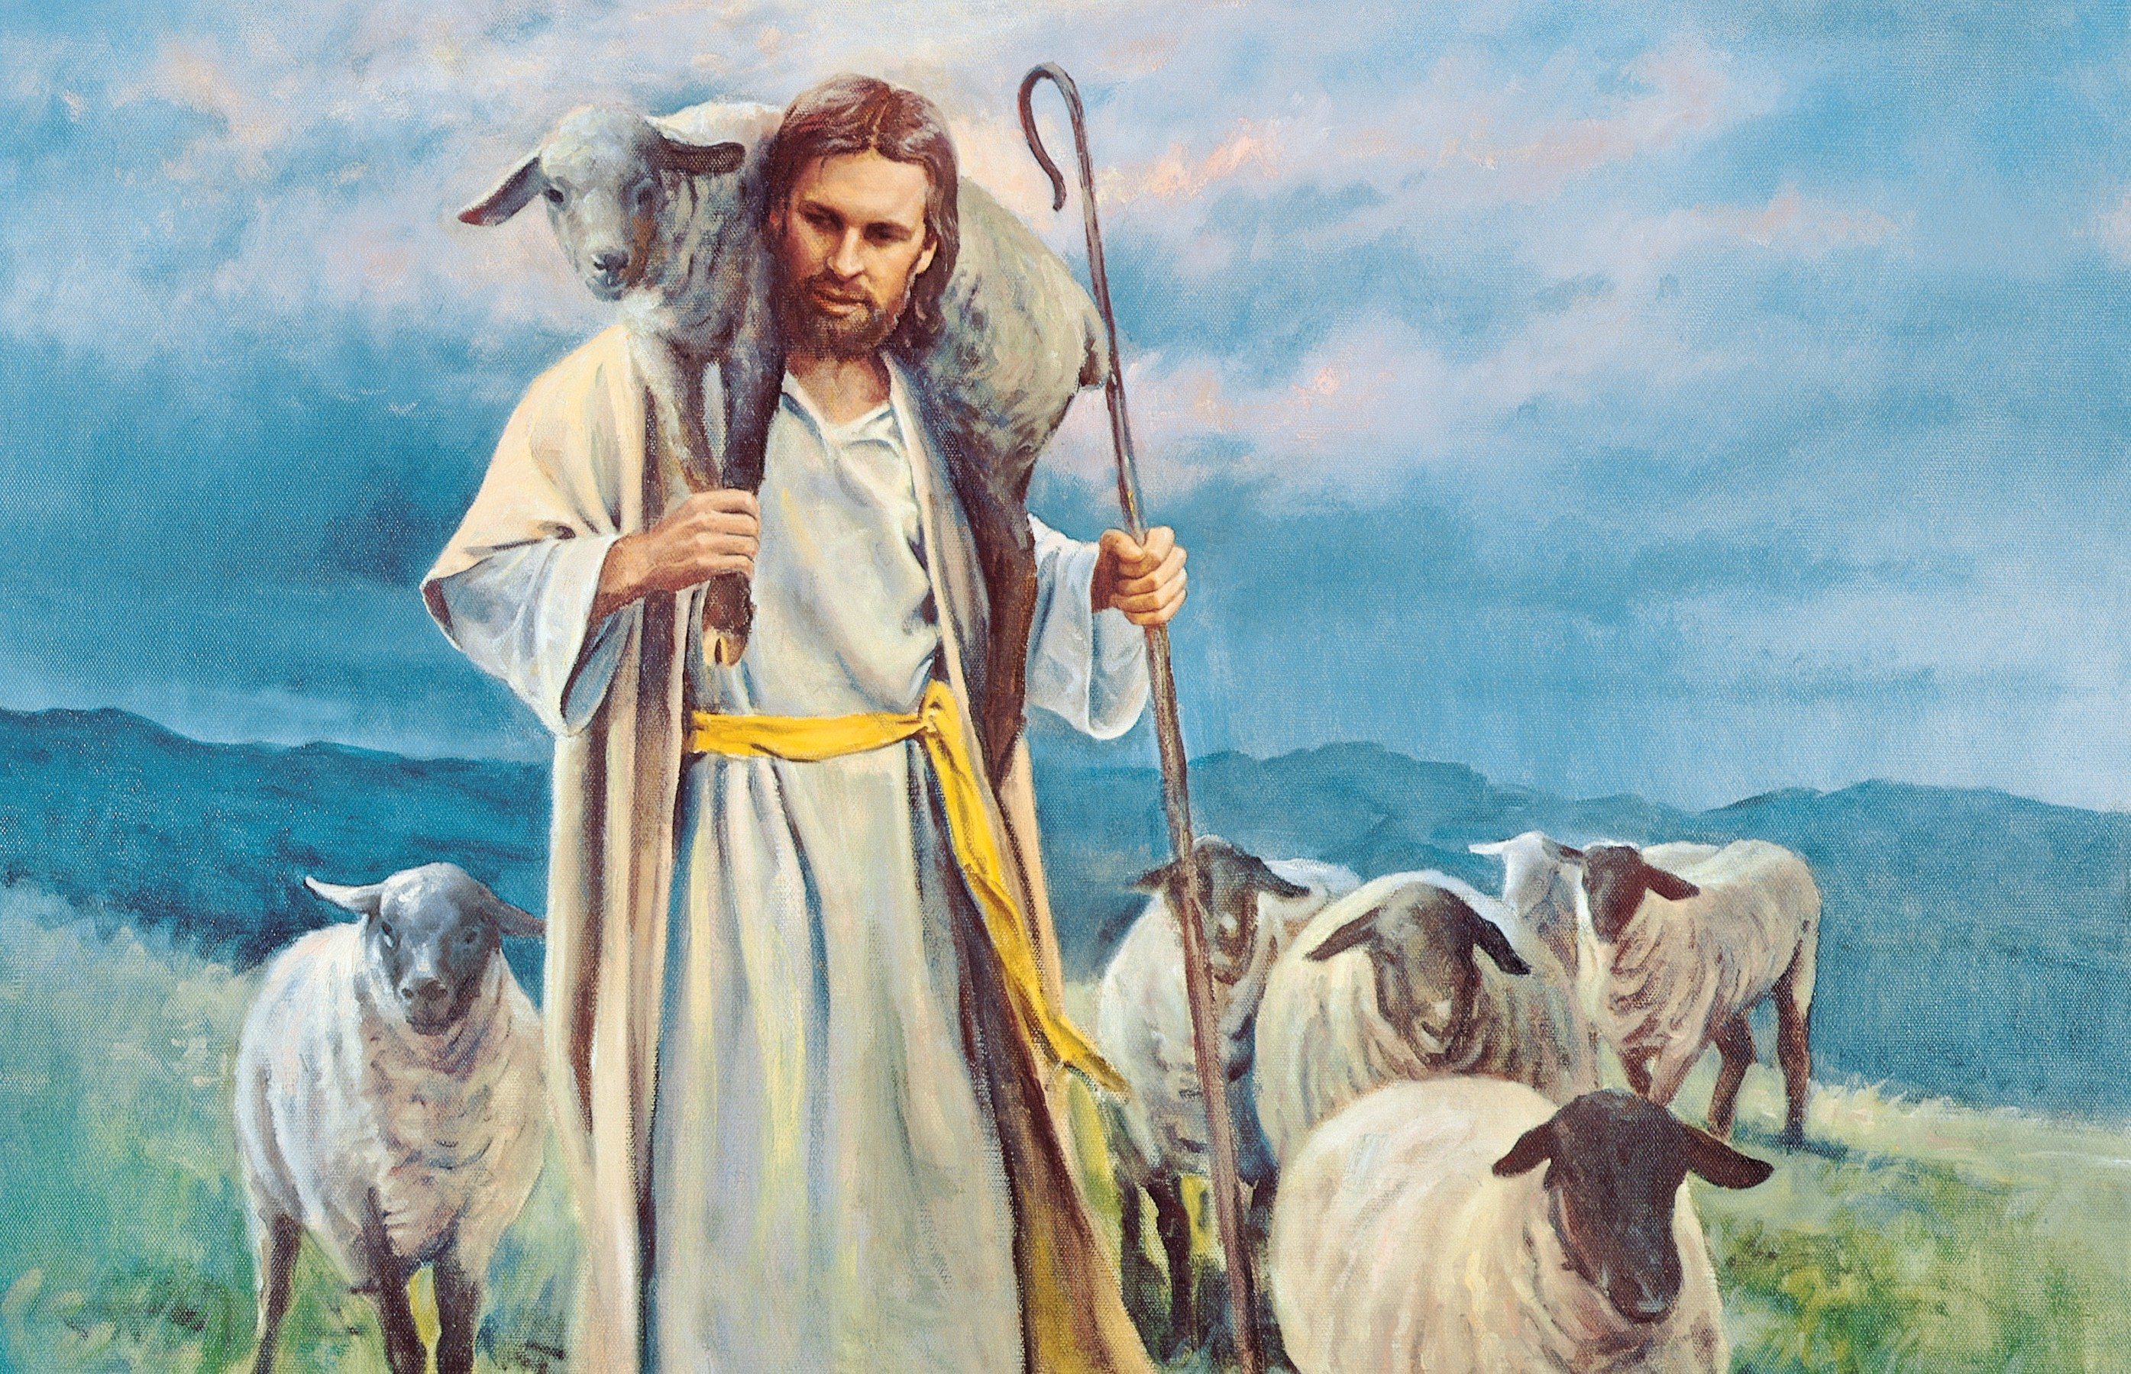
Agenda
...I will fear no evil, for you are with me; your rod and your staff comfort me
Psalm 23:4

Slide 16

He only is my rock and my salvation; he is my defence; I shall not be greatly moved
Psalm 62:2

Slide 17


Psalm 89:1

Slide 18
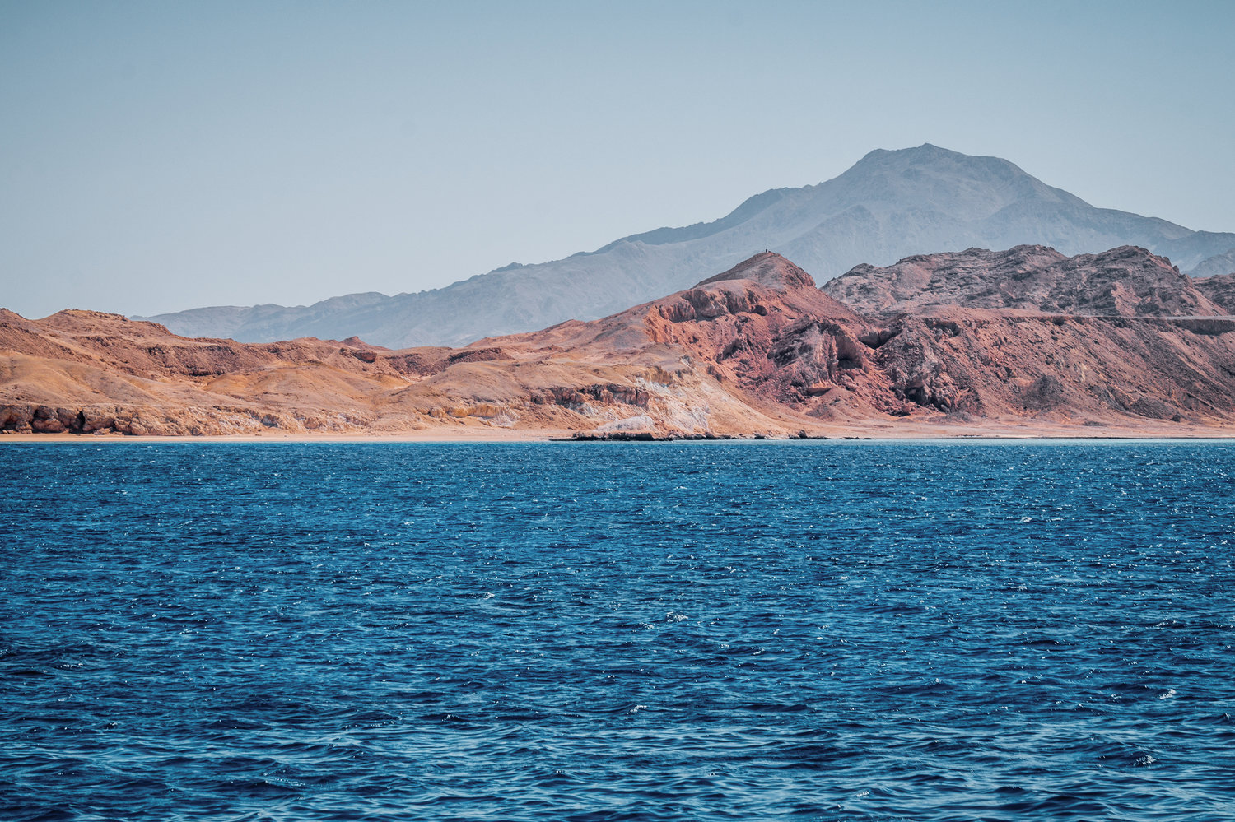
Agenda
Jesus made the disciples get into the boat and go on ahead of him to the other side
Matthew 14:22,

Slide 19
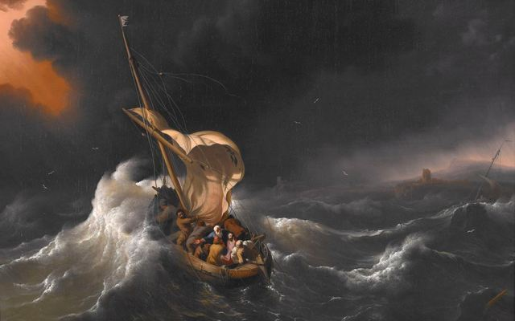
Agenda
Disciples took the only boat and they know Jesus isn’t going to come as there isn’t any boat

Slide 20
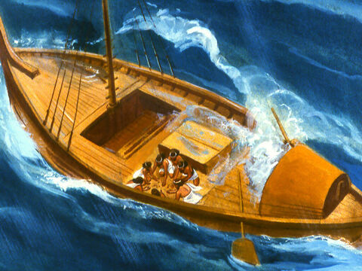

God’s love poured out
It doesn’t matter what the
storm
opposition
anxiety of heart

Slide 21
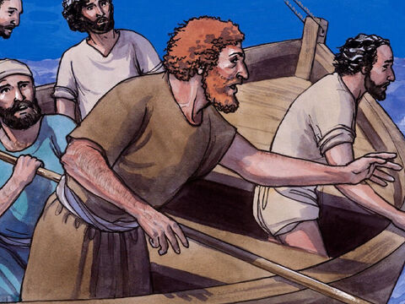
They were in the middle
They knew that the Lord was not there
They were at the end of their extremity
There was no other boat available

Slide 22
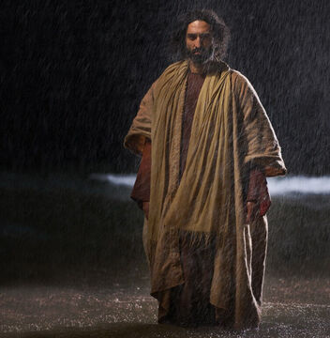
When the disciples saw him walking on the lake, they were terrified. “It’s a ghost,” they said, and cried out in fear.
Matthew 14:26

Slide 23
Agenda
When they had rowed about three or four miles, they saw Jesus approaching the boat, walking on the water; and they were frightened.
John 6:19,

Slide 24
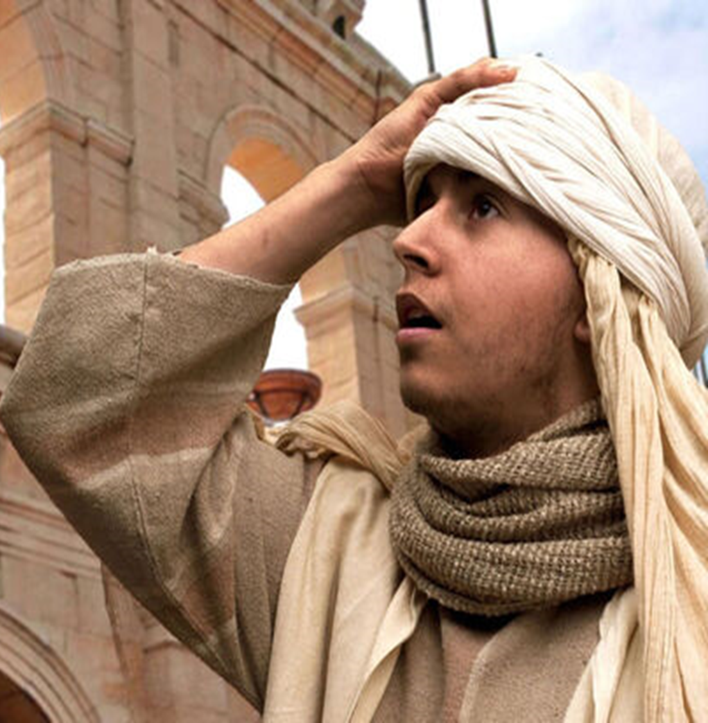
Agenda
Panicking
Weary
Disillusioned
Discouraged
Hopeless

Slide 25
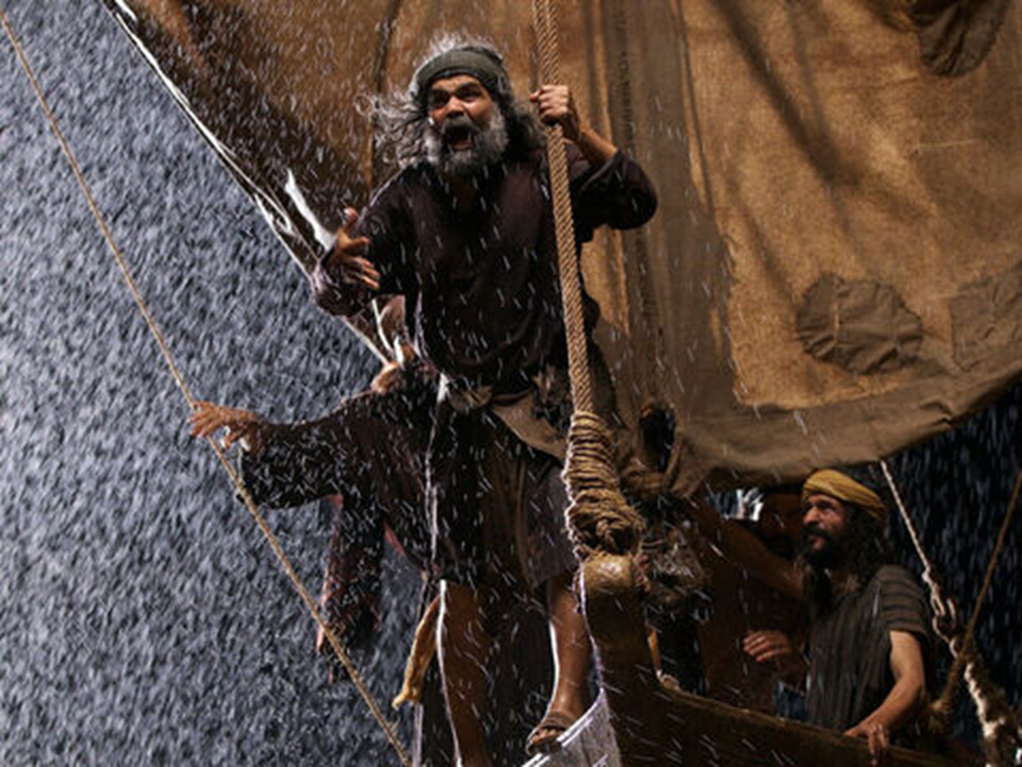
Agenda
They were
troubled....
Matthew 14: 26

Slide 26
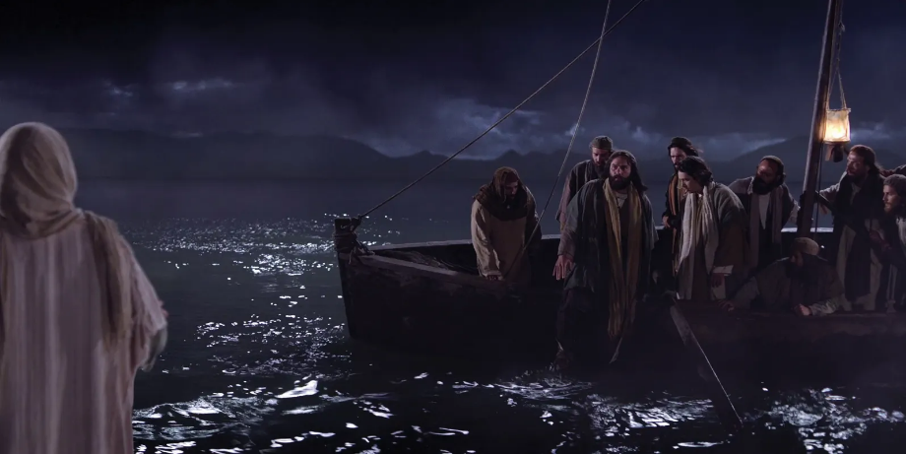
Now about the fourth watch of the night He came to them, walking on the sea,
Psalm
Mark 6:48

Slide 27
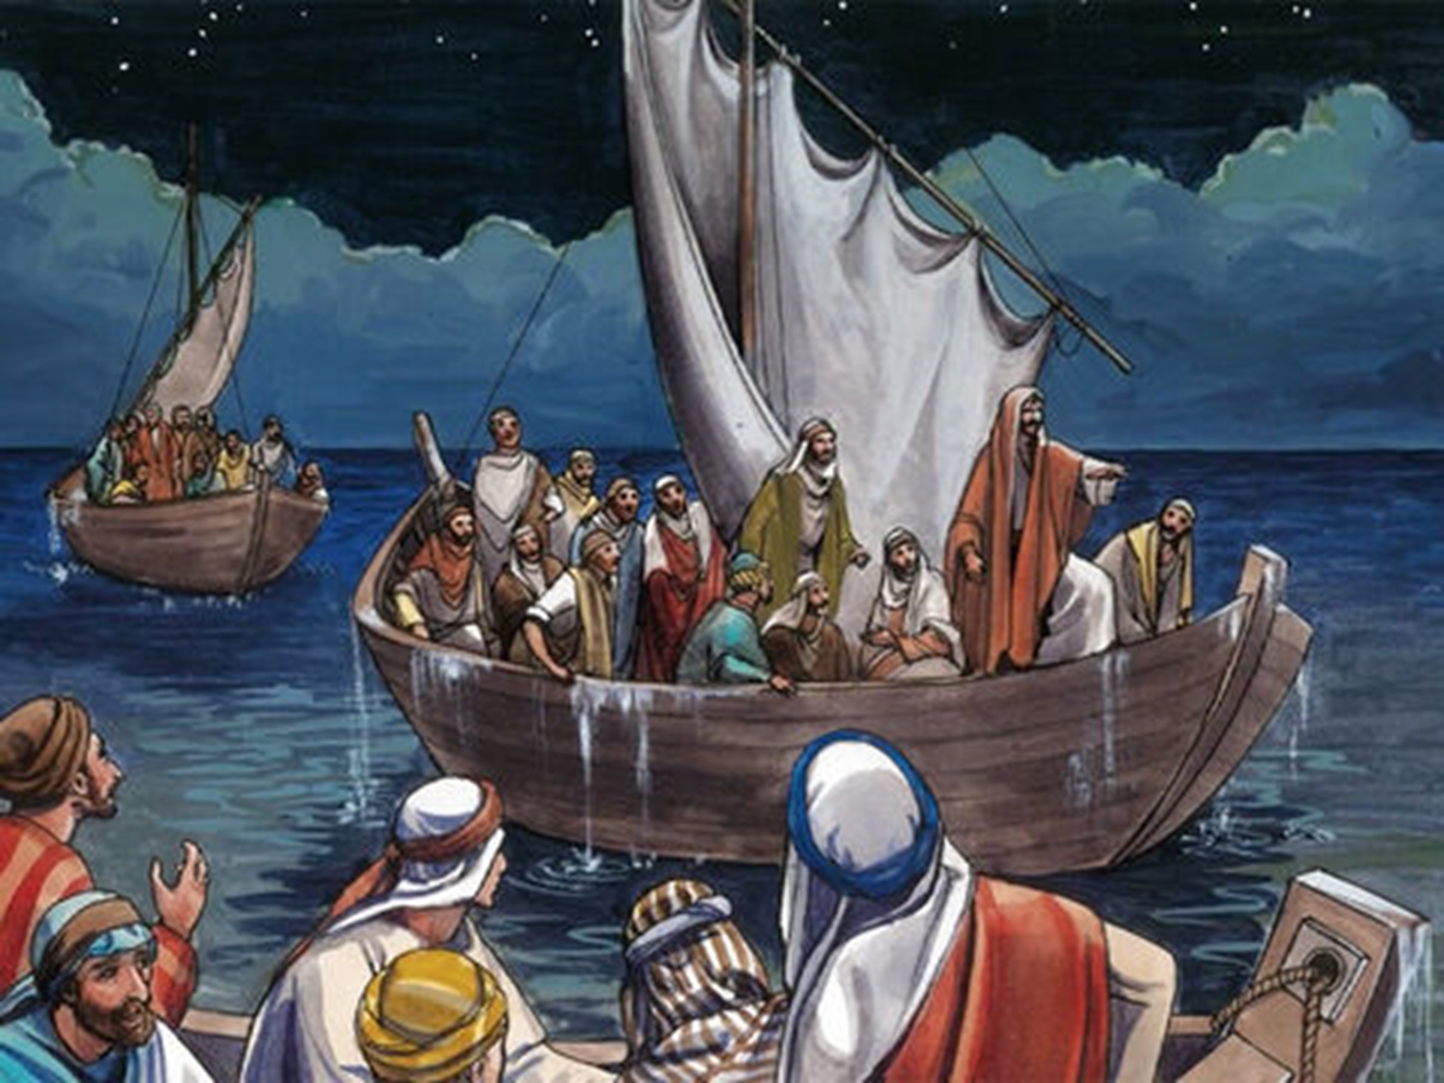
Agenda
Then they drew near to the village where they were going,
Luke 24:28

Slide 28
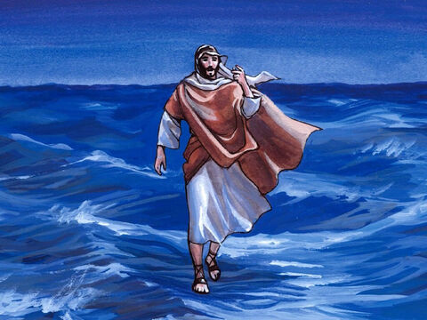
Agenda
It is I; do not be afraid.”
Matthew 14: 27

Slide 29
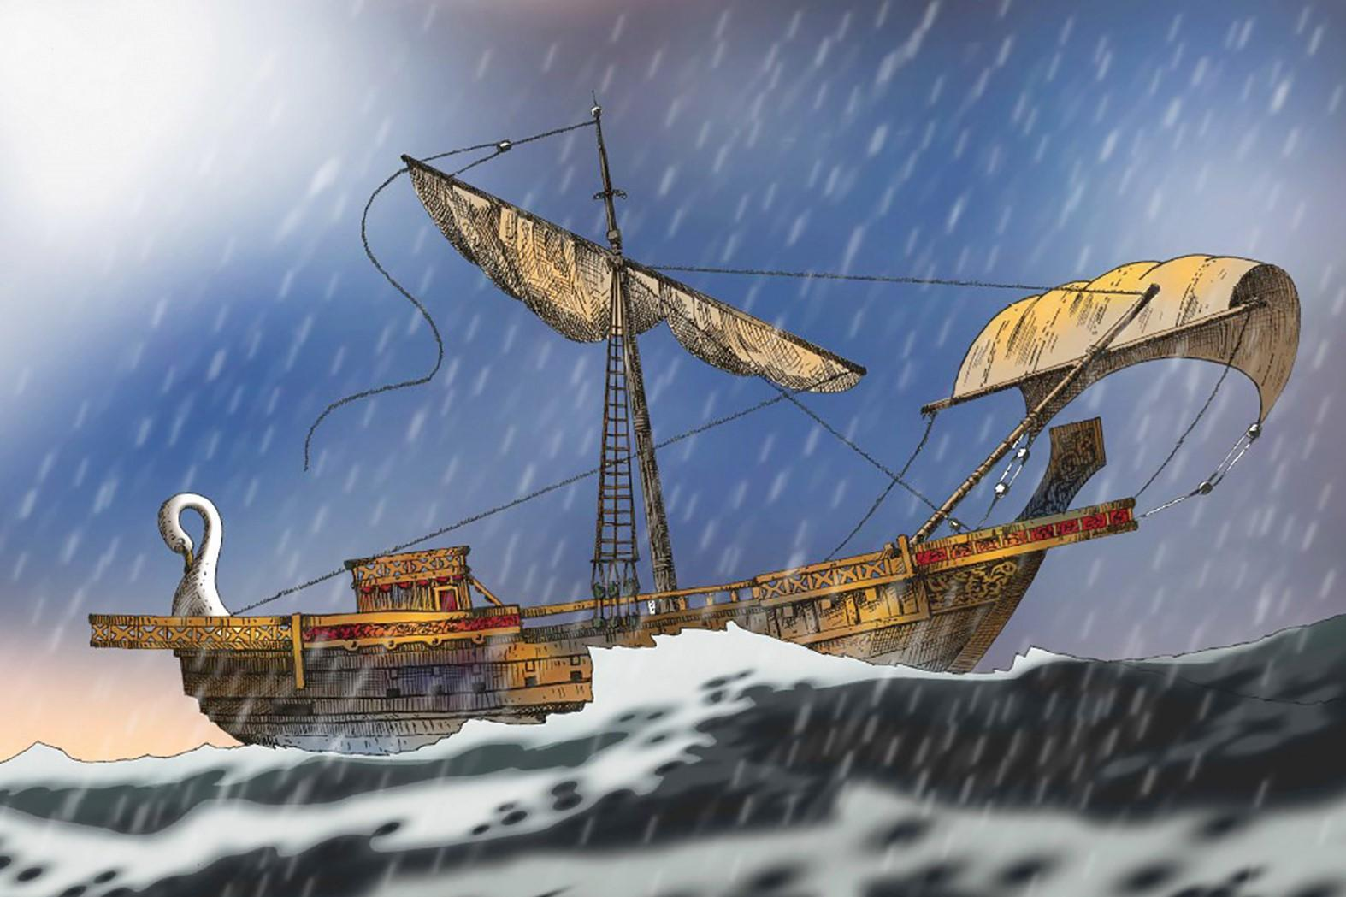
Agenda
The crew had jettisoned the cargo
Acts 27

Slide 30
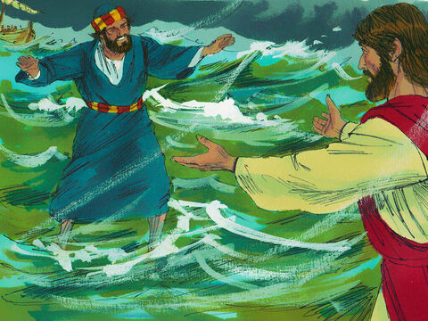
Agenda
4.Divine Love
Matthew 14:28-29

Slide 31
Agenda
Beloved, let us love one another
1 John 4:7

Slide 32
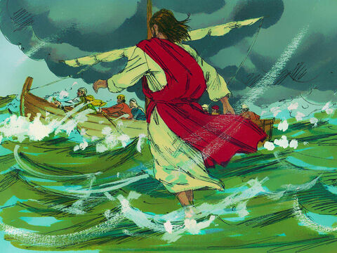
LOVE
Uninfluenced
Unending
Unchanging
Infinite, perfect, eternal, holy, and gracious

Slide 33
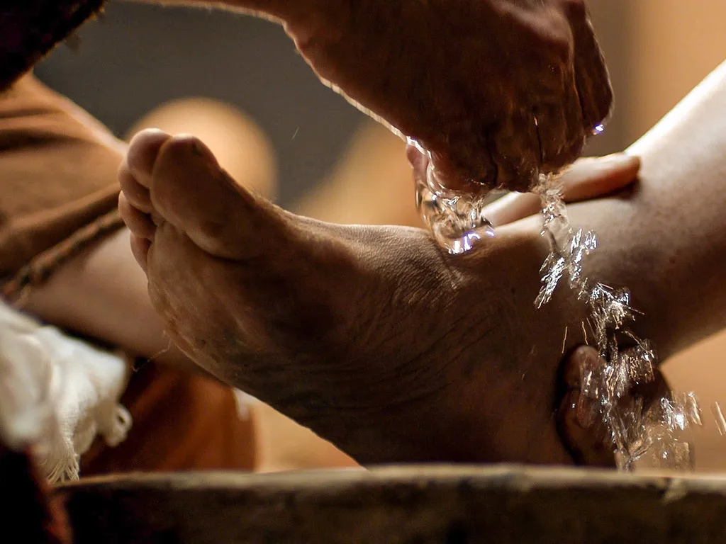
Agenda
“Lord, are You washing my feet?”
John 13:6-9

Slide 34

And when Peter had come down out of the boat, he walked on the water to go to Jesus.
Matthew 14:29

Slide 35
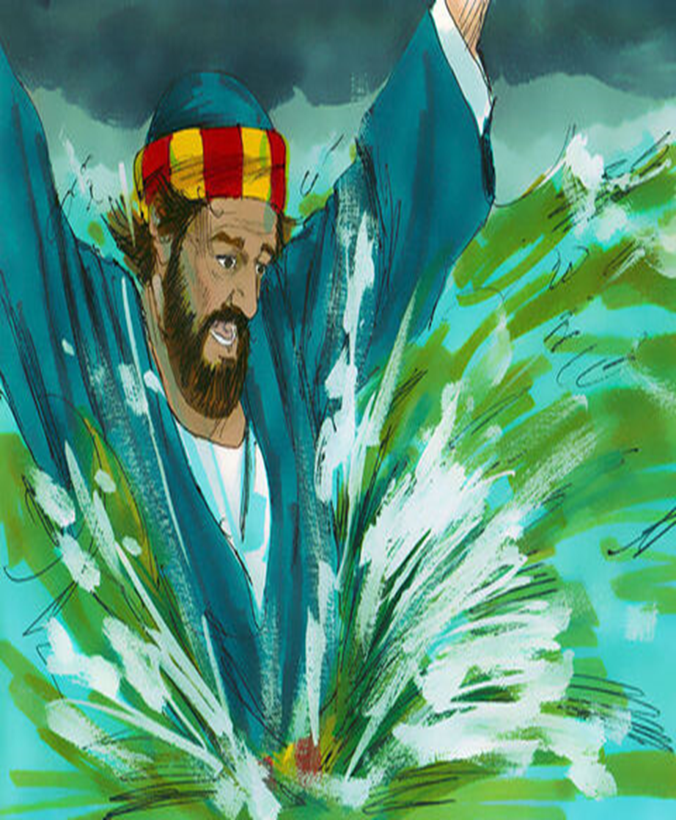
Agenda
“Lord, save me!”
Matthew 8:30

Slide 36
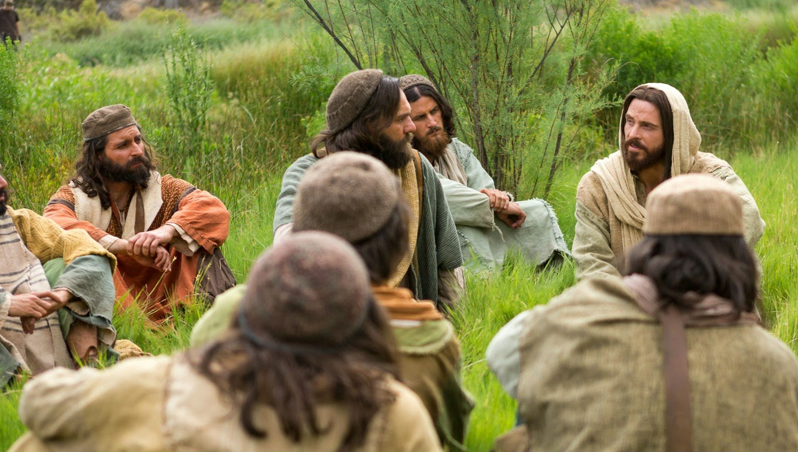
Agenda
count it all joy when you fall into various trials
James 1:3-4

Slide 37
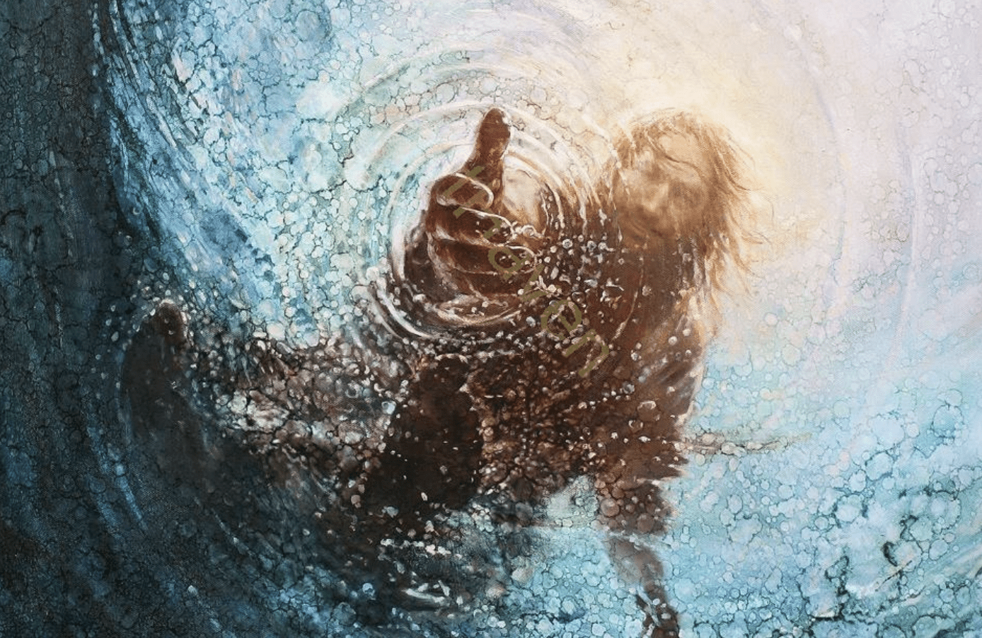
Agenda
“O you of little faith, why did you doubt?”
Matthew
8:31

Slide 38

Faith
Matthew
17:20

Slide 39

though it is tested by fire, may be found to praise, honour, and glory at the revelation of Jesus Christ
1 Peter
1:6-9

Slide 40
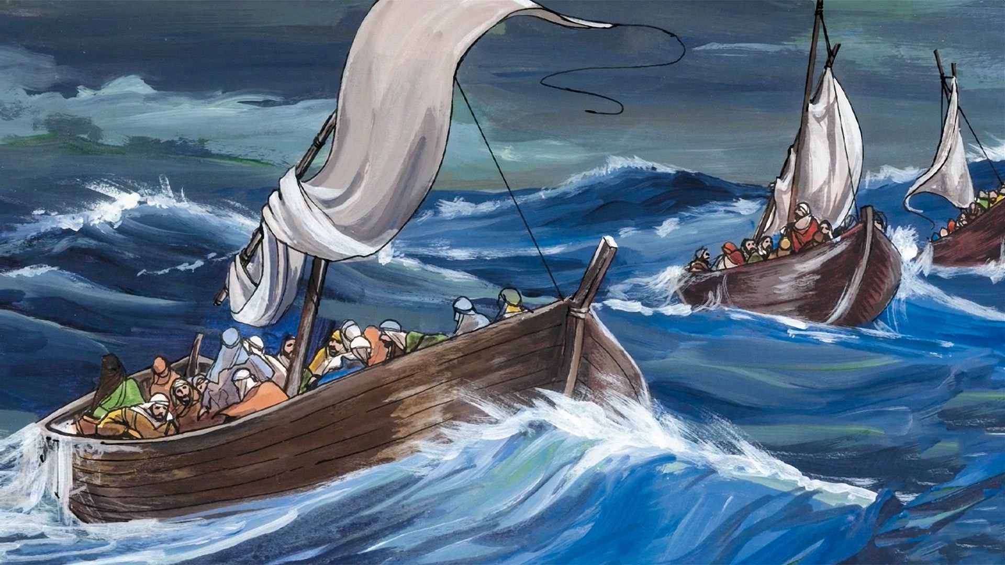
Agenda
5.Divine Power
And When they got into the boat, the wind ceased
Matthew 14:32

Slide 41
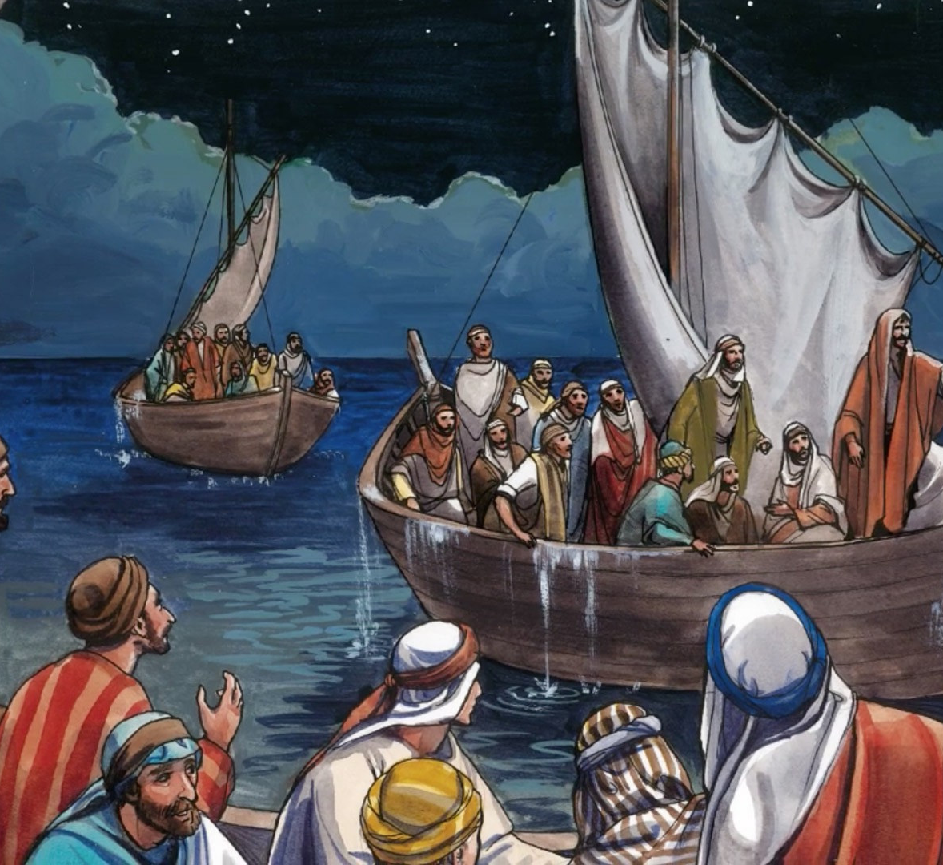
Agenda
Then they willingly received Him into the boat, and immediately the boat was at the land where they were going
John 6:21

Slide 42
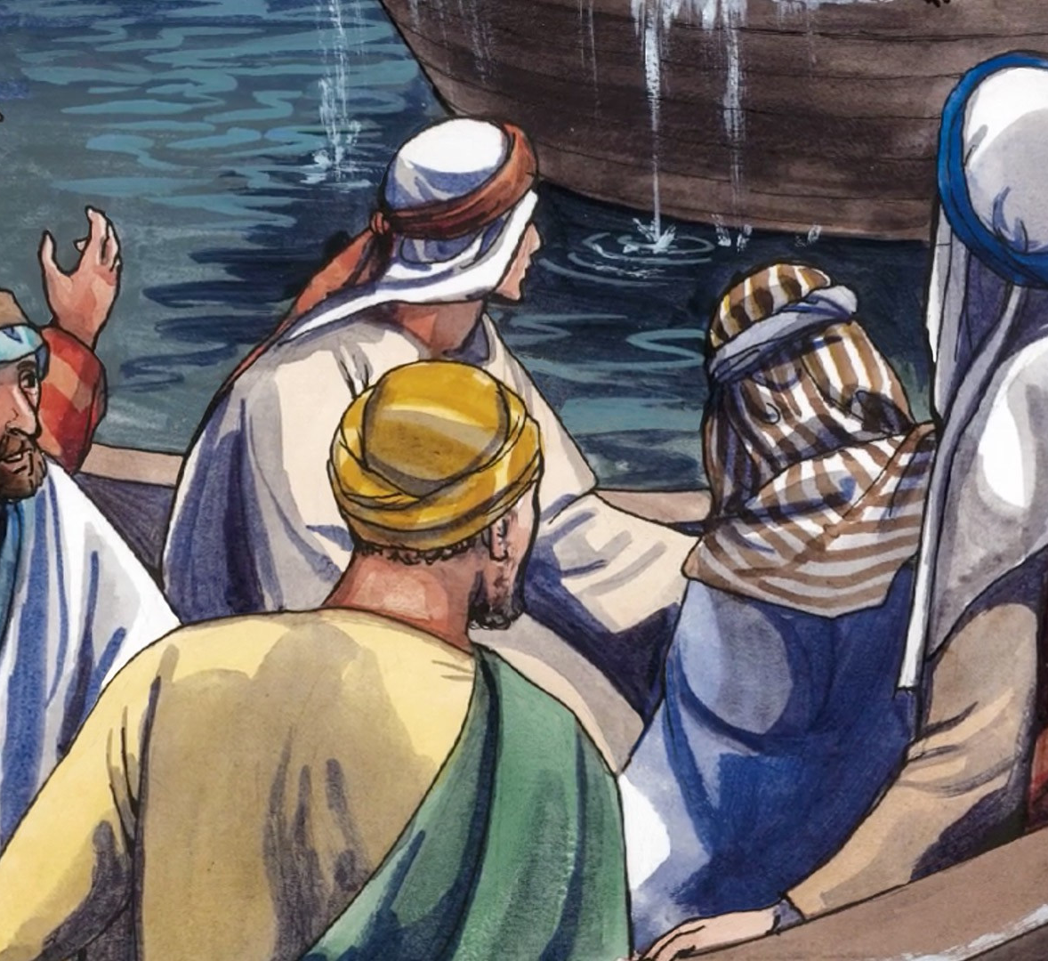
Agenda
Then He went up into the boat to them, and the wind ceased. And they were greatly amazed in themselves beyond measure, and marvelled.
Mark 6:51

Slide 43

Agenda
God has spoken once, Twice I have heard this: That power belongs to God.
Psalm 62:11

Slide 44
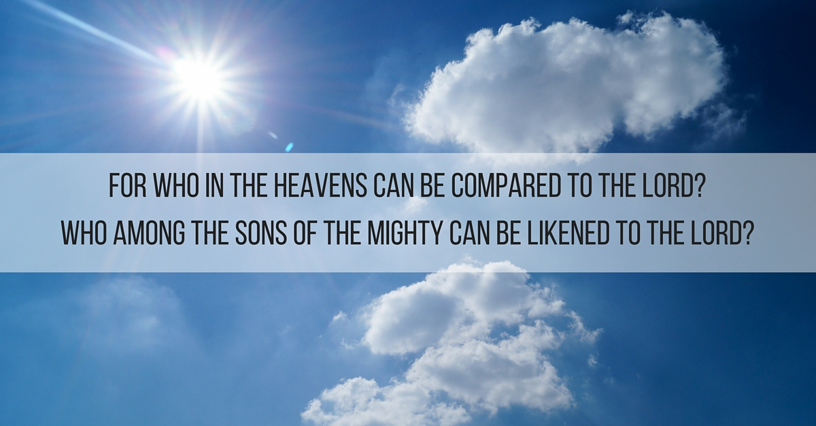
Psalm 89:6

Slide 45
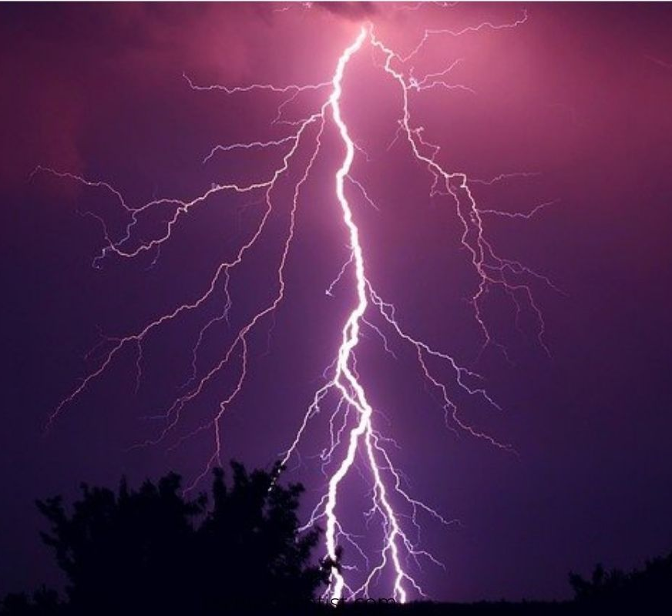
Agenda
Indeed these are the mere edges of His ways, And how small a whisper we hear of Him! But the thunder of His power who can understand?”
Job 26:14

Slide 46
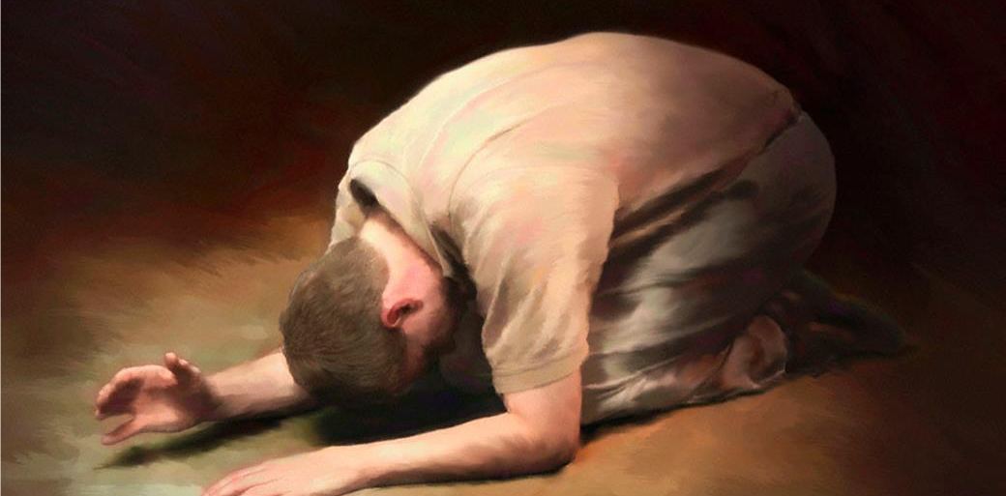
What is the message to you?
WORSHIP HIM

Slide 47
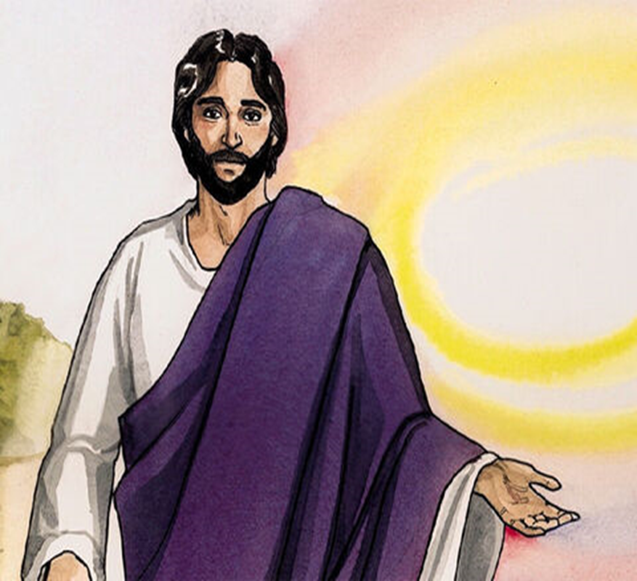
Agenda
“They that were in the boat overwhelmed with the
affirmation that this was the Son of God.”
Matthew:14 :33

Slide 48
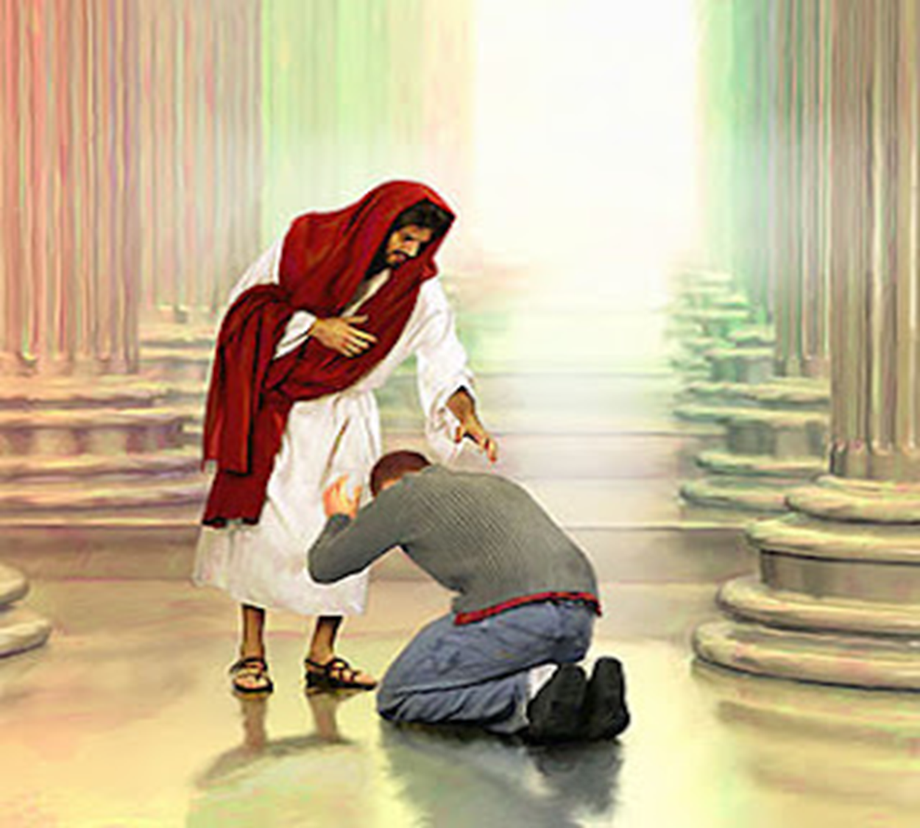
The word “worship”-proskuneō, - to bow, to kiss toward.

Slide 49
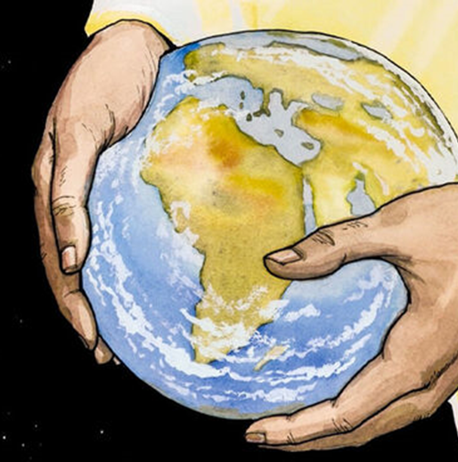
Agenda
every tongue should confess that Jesus Christ is Lord,
Philippians
2:9-11.

Slide 50
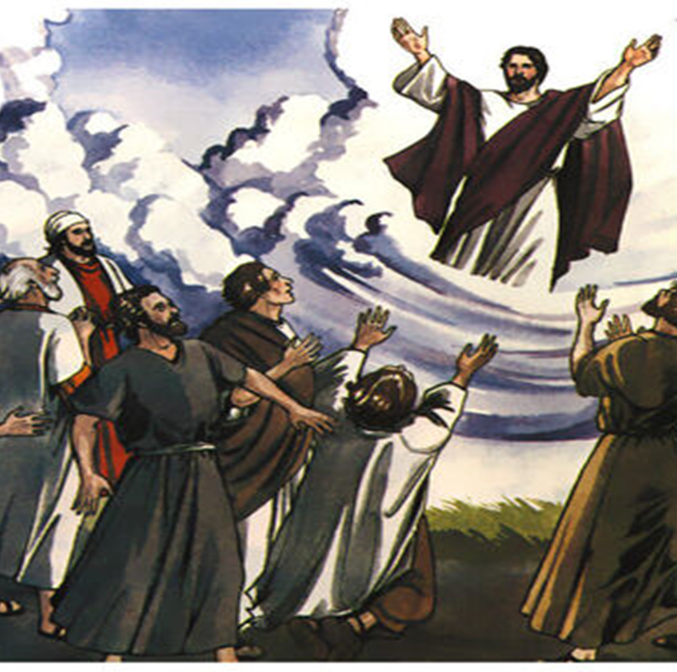
Agenda
‘Your way was in the sea, Your path in the great waters, And Your footsteps were not known’.
Psalm 77:19

Slide 51
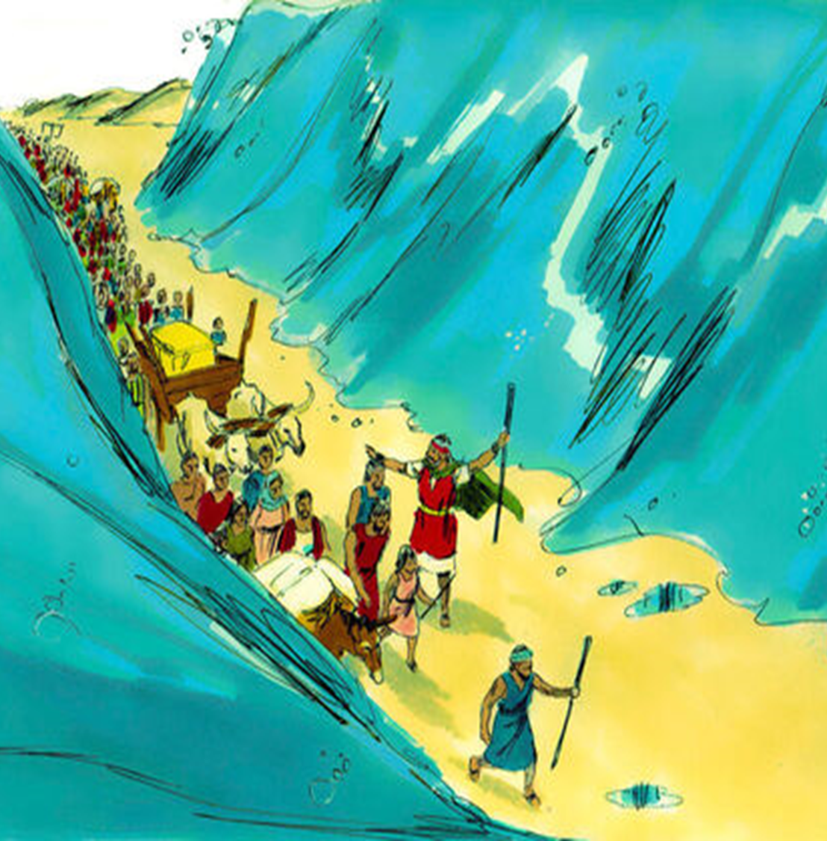
Agenda
You walked through the sea with Your horses,
Through the heap of great waters.
Habakkuk 3:15

Slide 52
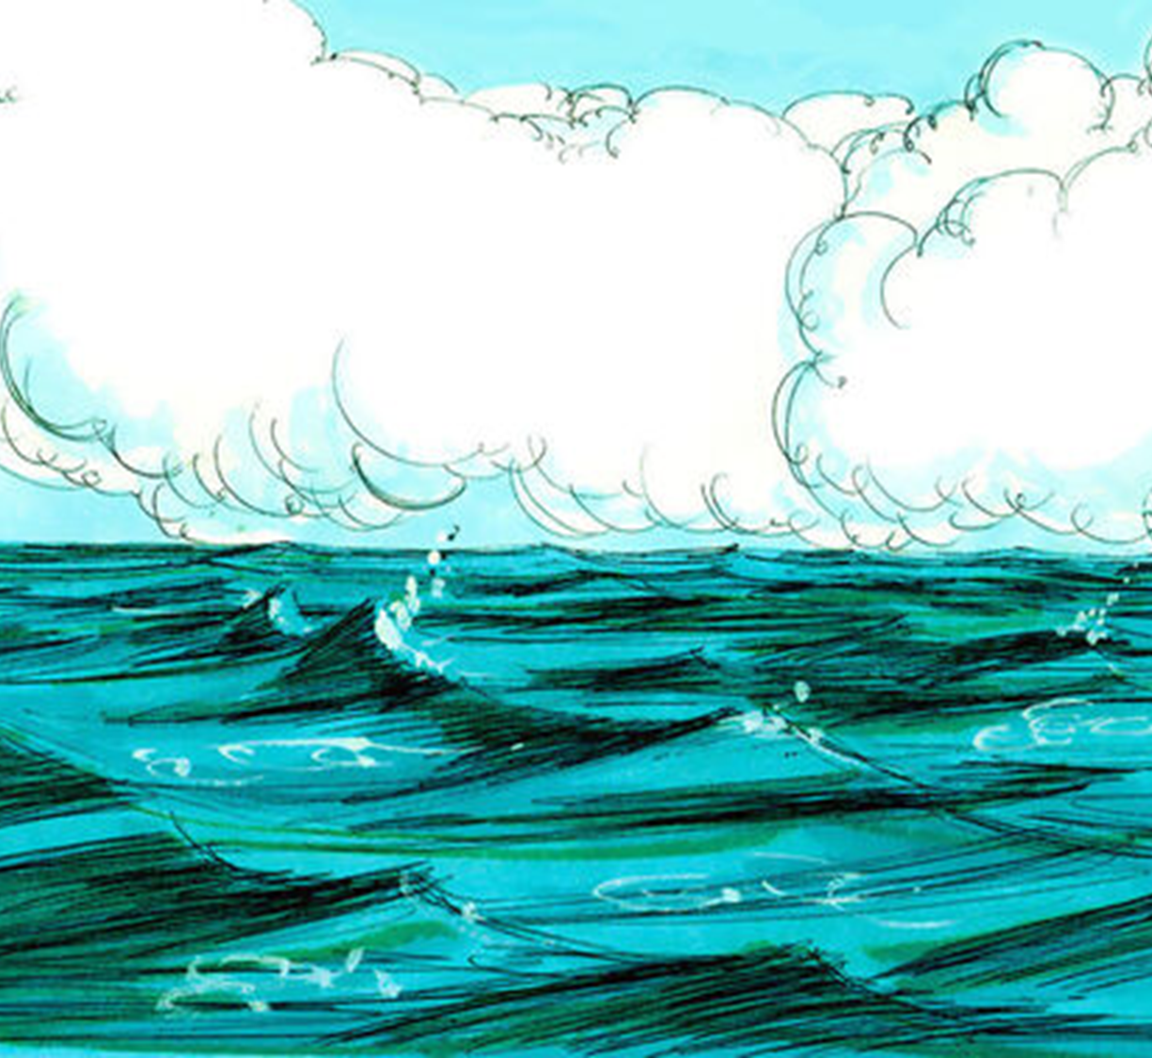
Agenda
He alone spreads out the heavens, And treads on
the waves of the sea
Job 9:8

