Slide 1
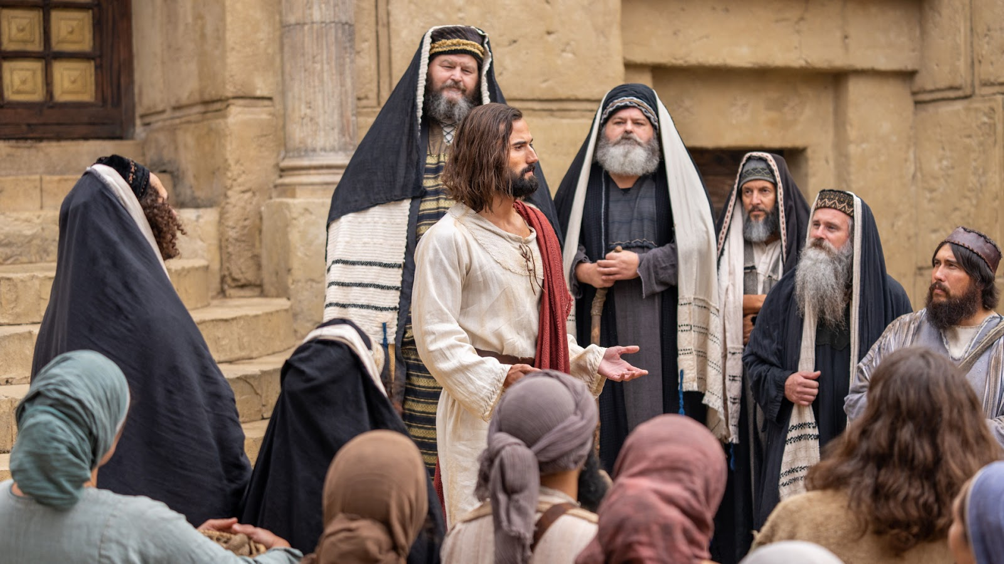
Brush
5th Response to Jesus-
Hard Soil- Vain Worship!
Matthew 14:34 - 15:1-9

Slide 2
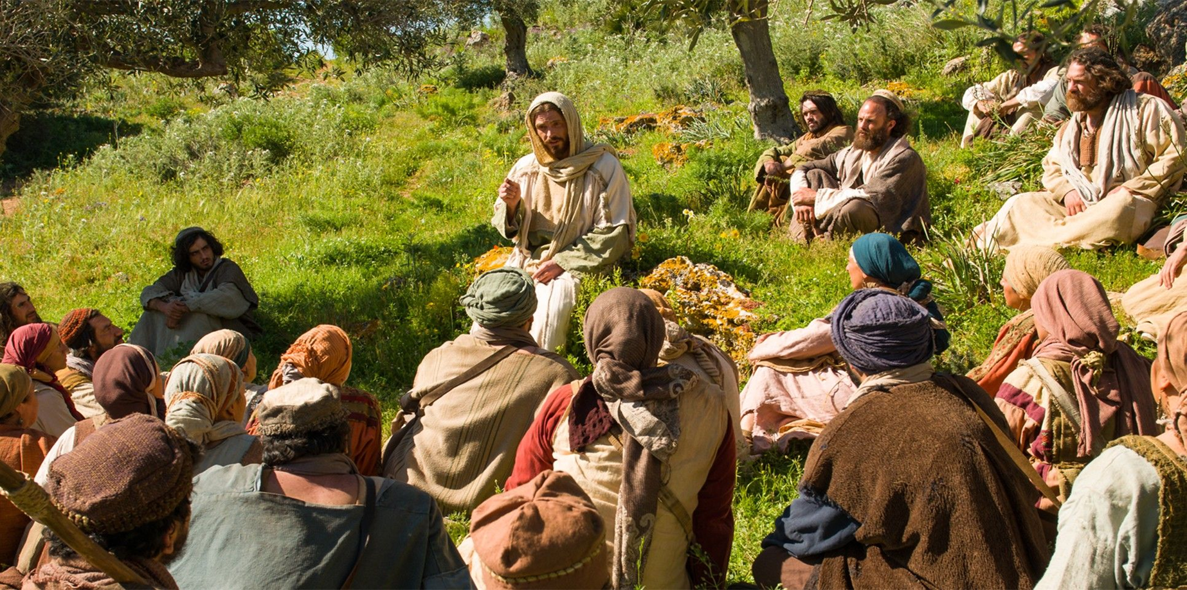
Matthew Chapter 13- Kingdom Parables were spoken

Slide 3
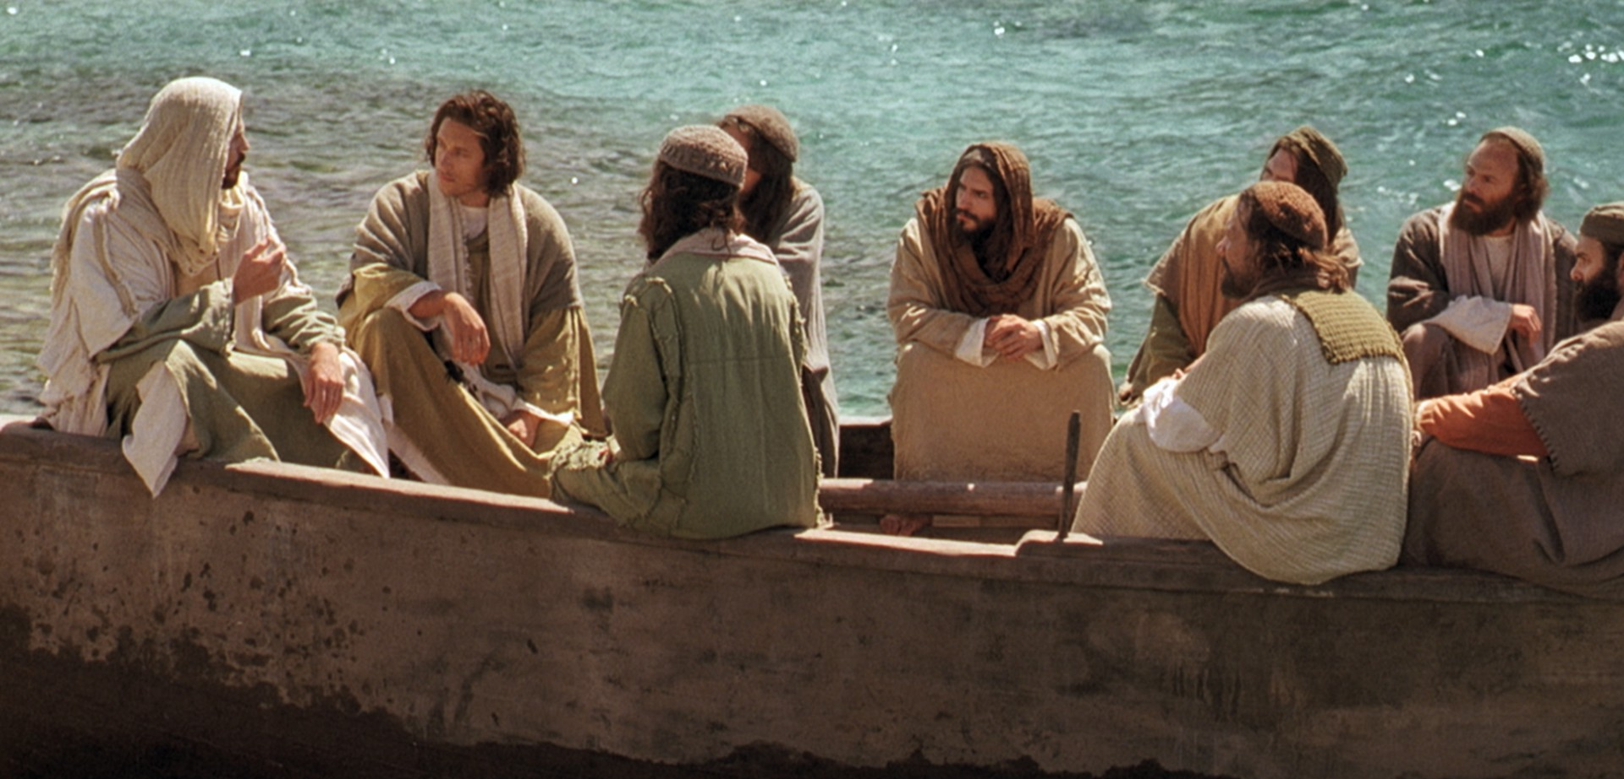
Matthew Chapter 13:53 till 16:12
Eight incidents in the life of our Lord

Slide 4
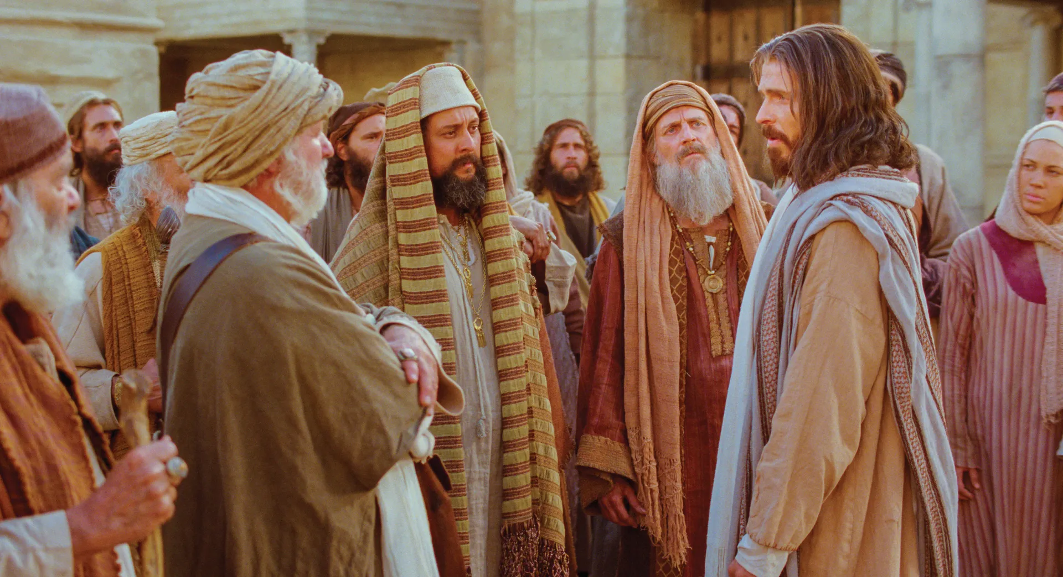
1st Response to Jesus
Matthew 13:53-58
Unbelief!

Slide 5
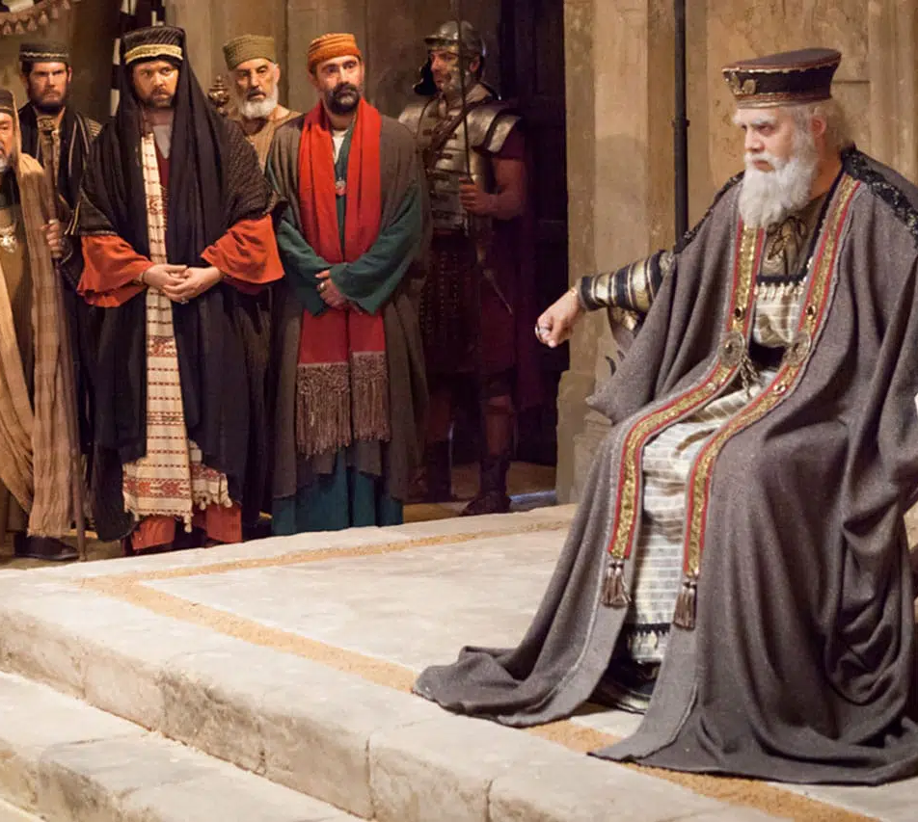
2nd Response to Jesus
Matthew 14:1-12
Fear!

Slide 6
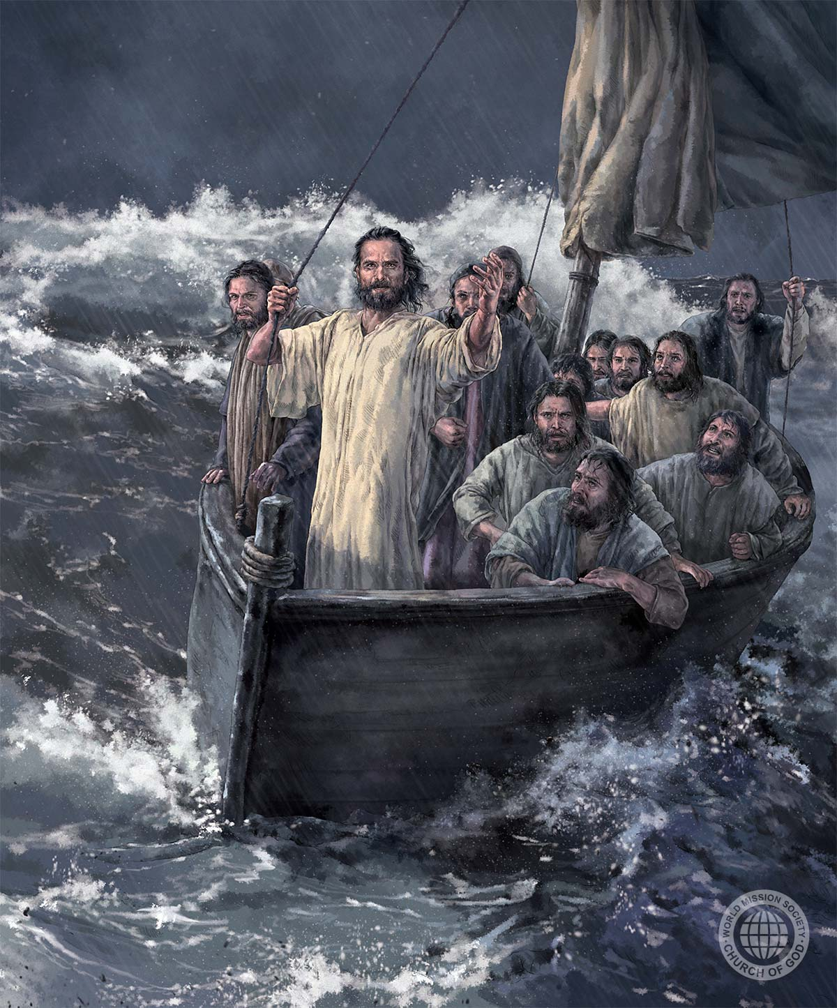
3rd Response to Jesus
Matthew 14:13-21
Faith for
materials!

Slide 7
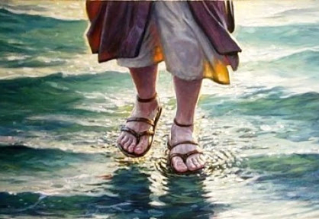
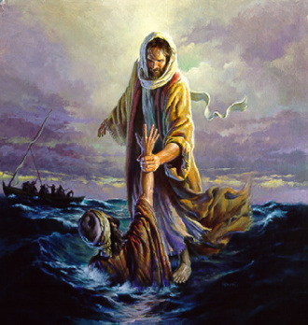
Brush
4th Response to Jesus-
Greatest Discovery of mankind- Jesus is God!
Matthew 14:22-33

Slide 8
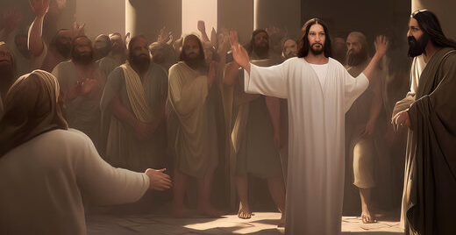
Forced him to be a KING
But Jesus rejected their shallow, self-centred, indulgent ambition

Slide 9
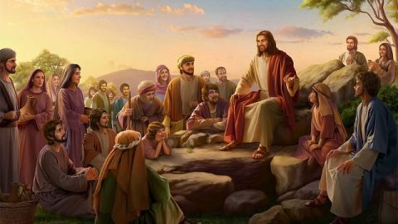
Matthew 16:21

Slide 10
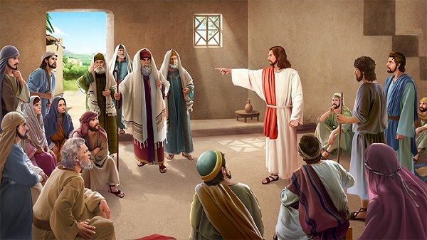
LORD CONFRONTS them

Slide 11
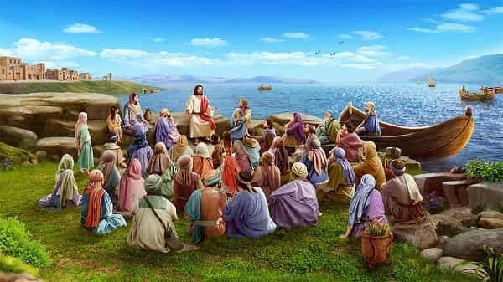
The Compassionate Healer
Matthew 14:34

Slide 12
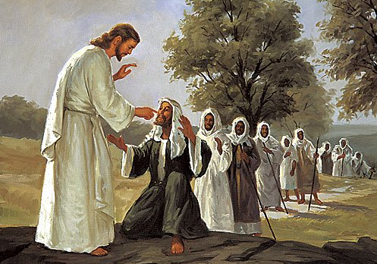
The Compassionate Healer
Matthew 14:35

Slide 13
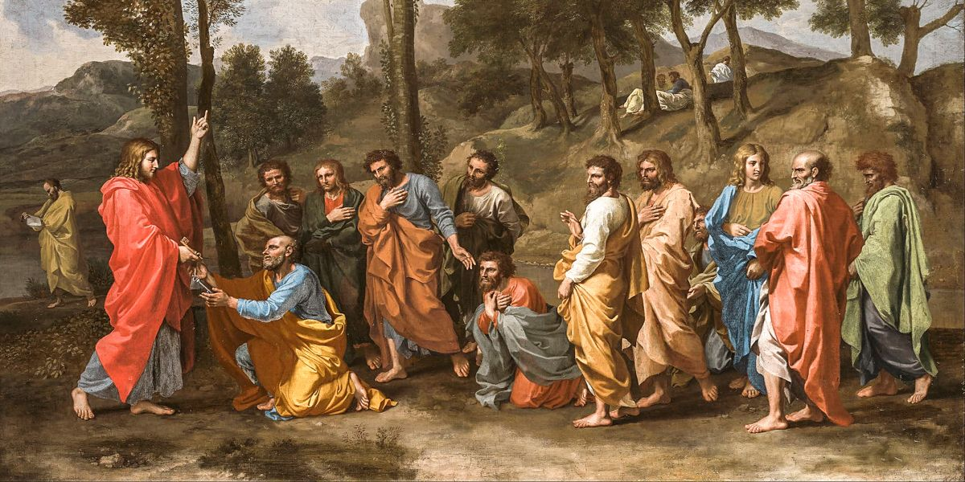
The Compassionate Healer
Matthew 14:36

Slide 14
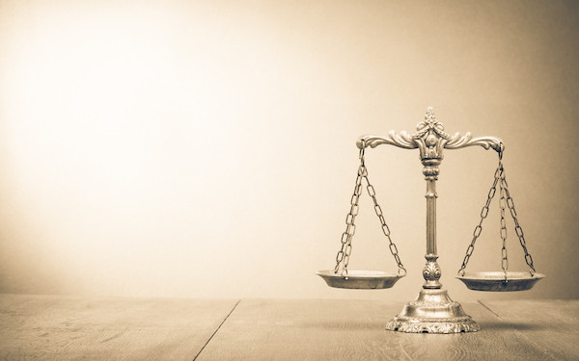
Condemning Judge
Matthew 15:1

Slide 15
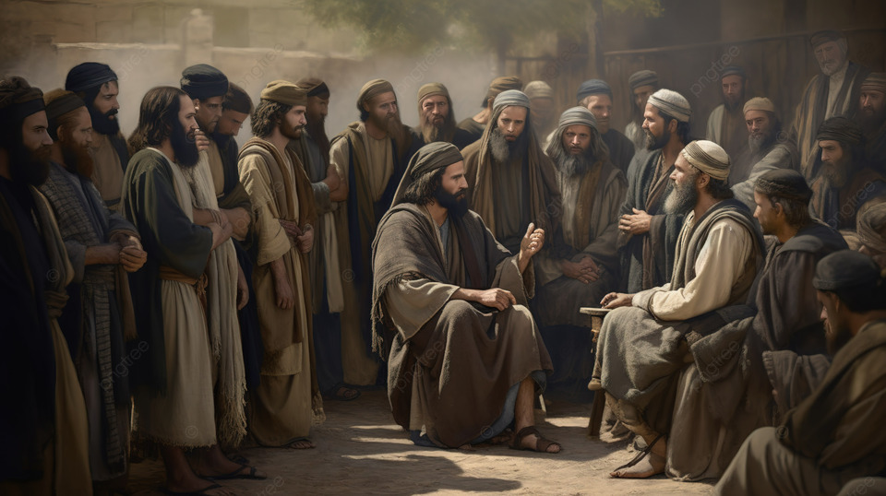
Matthew 12:14

Slide 16
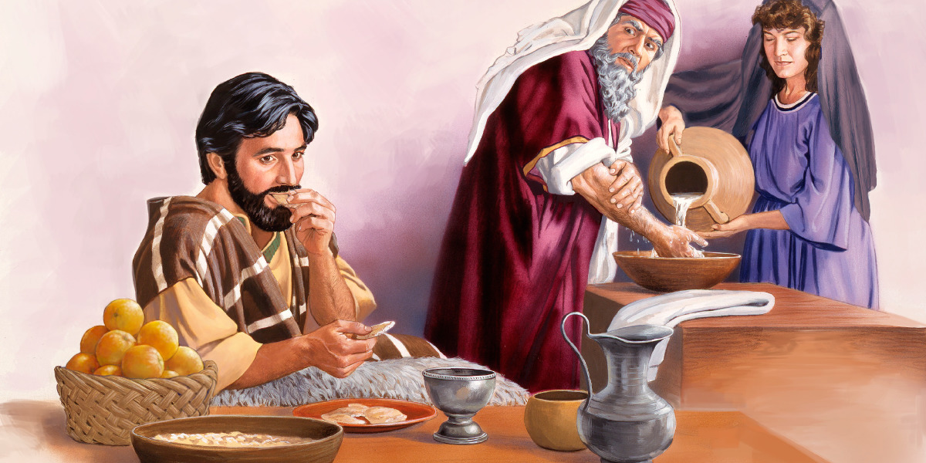
Matthew 15: 2

Slide 17
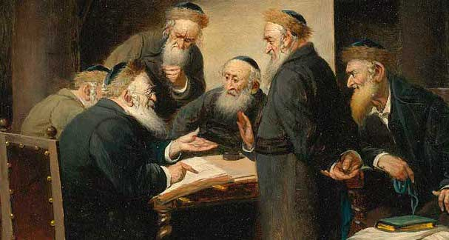
TALMUD
The Talmud is the codification of Jewish law

Slide 18

The job of the scribe was to,
• Collect,
• Collate,
• Propagate,
• Interpret,

Slide 19
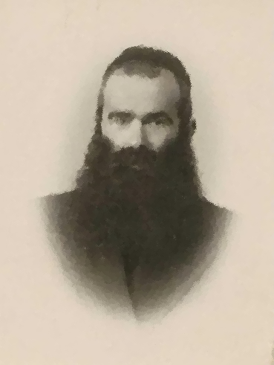
200 A.D., Rabbi Yehudah

Slide 20
Mishnah - explain the law of God, needed to be explained.
Gemara - commentary on the tradition
Gemara
Mishnah
TALMUD

Slide 21
There are six main sections.
Matthew 15: 2

Slide 22
In the Old Testament
Exodus 19
Leviticus 15, 16, and 17

Slide 23
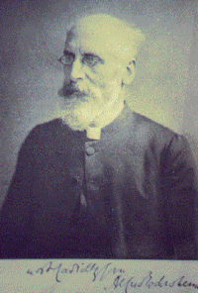
EDERSHEIM - The Great Jewish Scholar

Slide 24
Matthew 15: 3

Slide 25

There are six main sections.
Matthew 15: 4

Slide 26

EXODUS 20:12

Slide 27

EXODUS 21:17

Slide 28

Matthew 15: 5

Slide 29

Mark 7:11

Slide 30
Mark says it Corban.
  Corban means offering.
  Doron means gift.
Anyone who says to his father or his mother, “Corban,” or, “dōron”, surely does not have to honour his father.

Slide 31
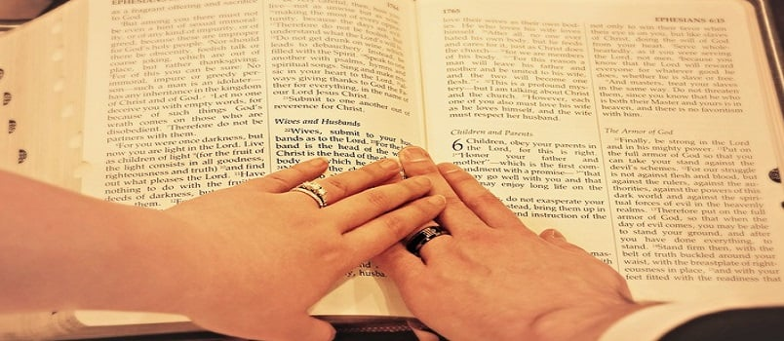
Numbers 30:2

Slide 32
True religion is all bound up in one basic word, “obeying” the commandments of God from the heart.

Slide 33
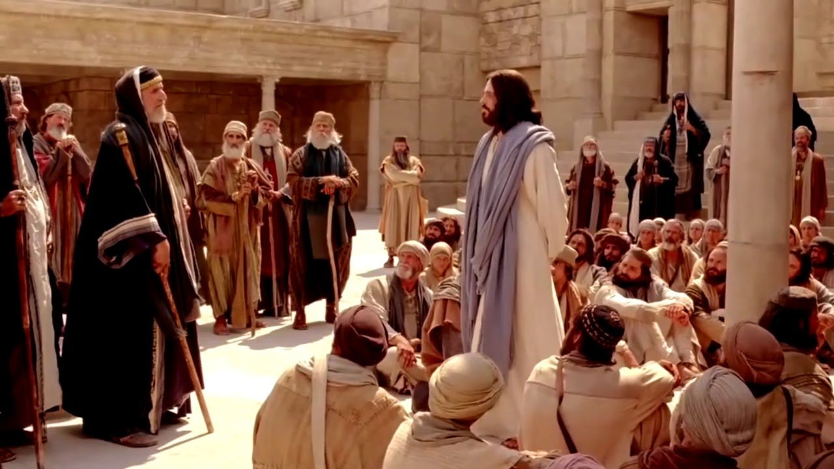
Matthew 15: 7-9

Slide 34

Isaiah 29:13

Slide 35
Hypocrisy
“There are ten parts of hypocrisy in the world: nine at Jerusalem, and one everywhere else.”
nine in the Church, and one everywhere else.

Slide 36
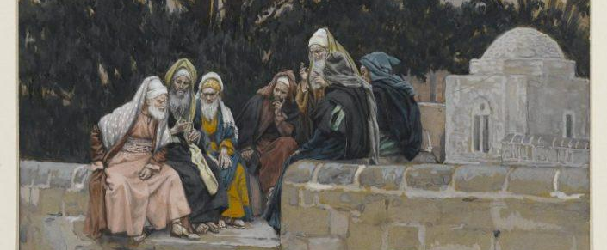
Matthew 23:27

Slide 37

Exodus 20:7

Slide 38
Isaiah 1:13-18
God wants to cleanse your hearts.
God wants to wash you on the inside.
God will not otherwise tolerate your empty, vain worship.

Slide 39
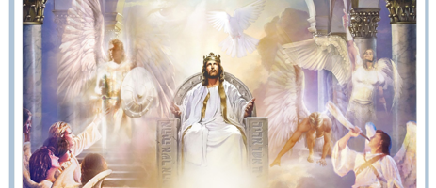
Isaiah 66:1-2

Slide 40
God indicts them for their false religion.
Isaiah 66:3

Slide 41
Isaiah 66:5
God wants genuine worshippers.

Slide 42
Amos - 5:21-27

Slide 43
Malachi 1:7-8

Slide 44
Proverbs 15:8
Empty and hypocritical worship is intolerable to God.

Slide 45
Ezekiel 36:26
God’s going to take away the stony heart and put a heart of flesh

Slide 46
Matthew 5:20
The kind of righteousness that Jesus Christ demanded was that of the heart.

Slide 47

Examine Your Heart
Do you love Jesus Christ with all your heart, soul, mind, and strength?
Do you long to be with Him?
Do you long to be in His presence?
Do you long to be like Him?
Do you long to obey Him from the heart?

Slide 48
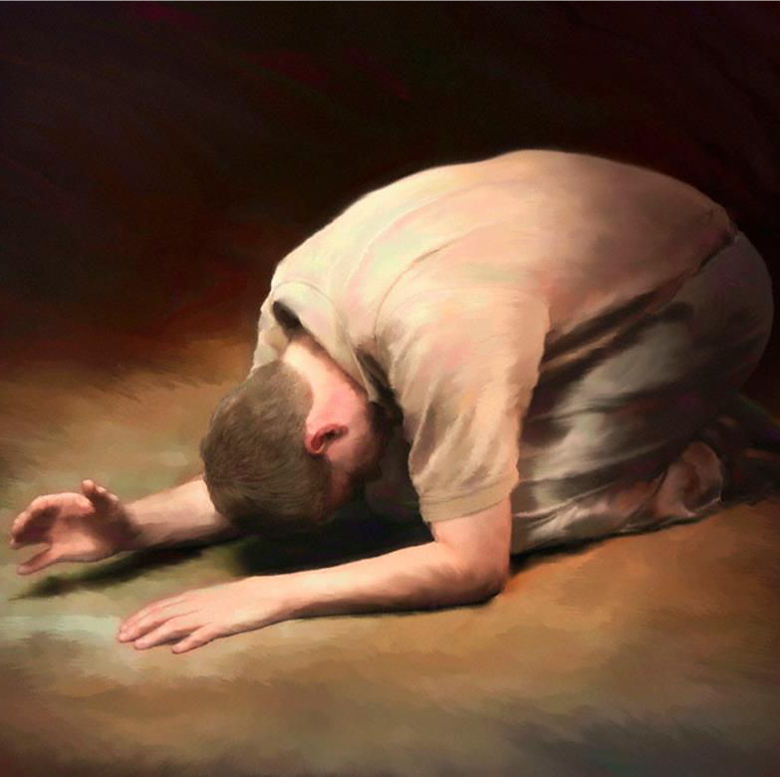
If you are going through the motions, God help you, because tradition/ceremony is a damning thing.

