Slide 1

Man’s Tradition & God’s
Matthew
15:10-20
Commandement

Slide 2
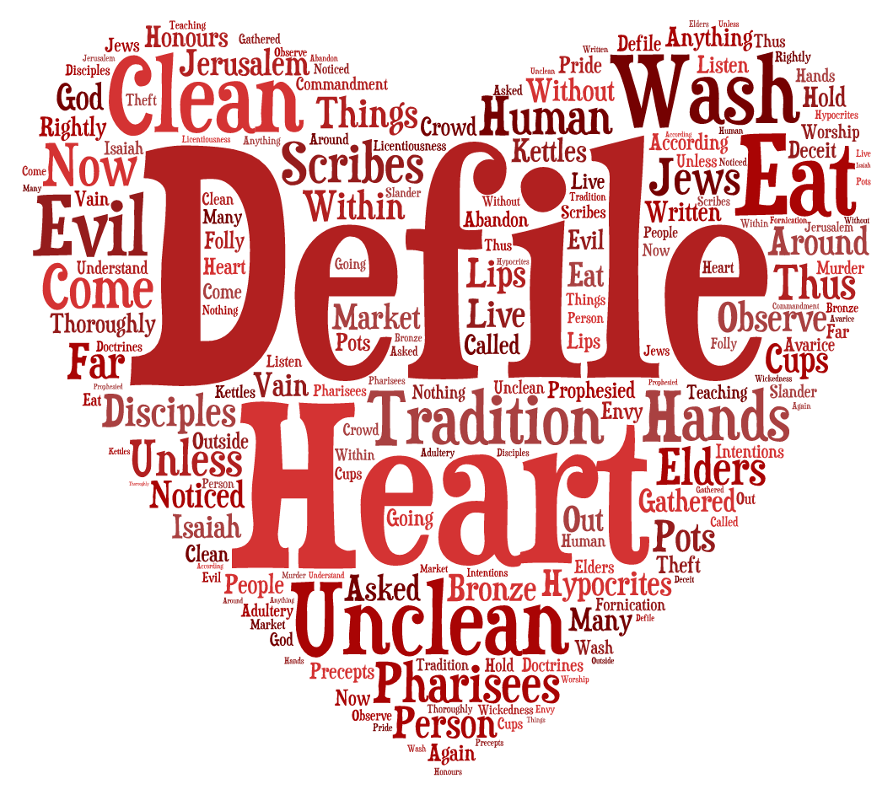
“defile” = “pollute”
Greek, koinoō
, Hebrew, Chalal

Slide 3

Psalms119:1 Blessed are the undefiled in the way, Who walk in the law of the Lord!

Slide 4

James 1:27
Pure and undefiled religion before God and the Father is this: to visit orphans and widows in their trouble, and to keep oneself unspotted from the world.

Slide 5


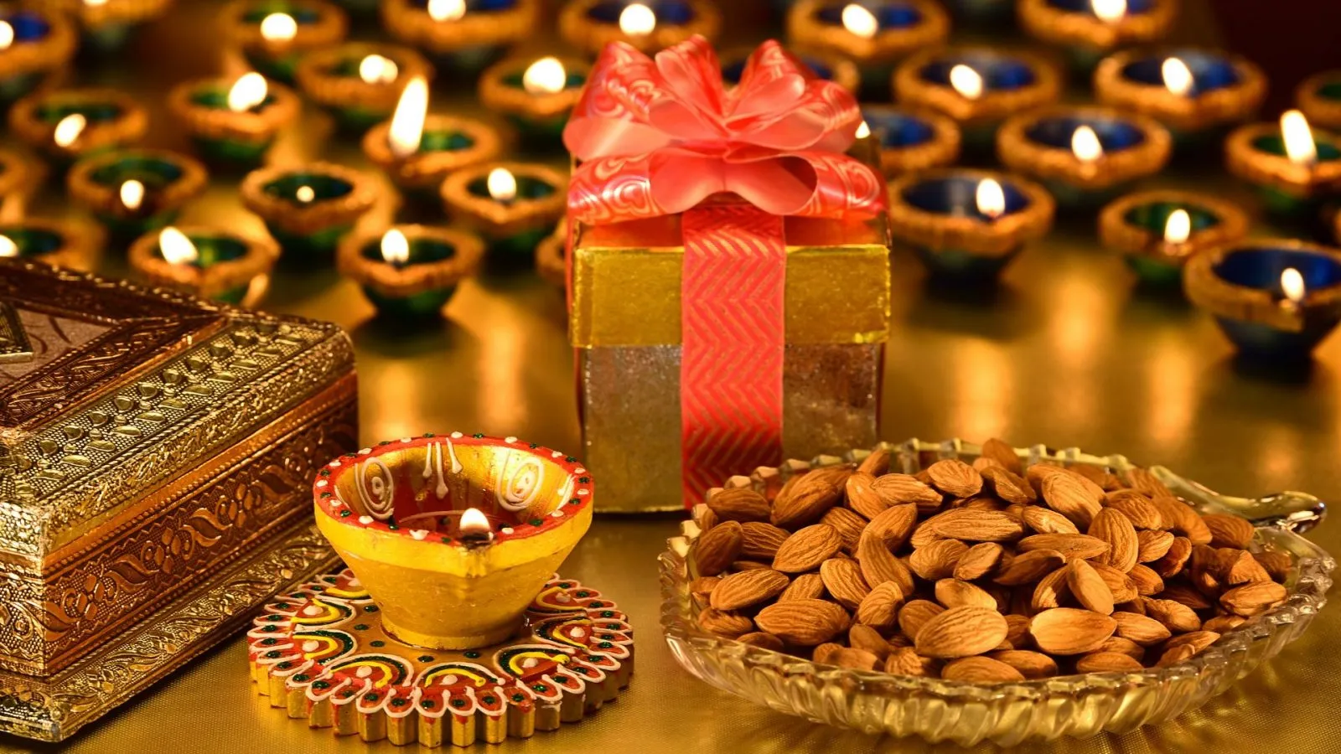
1 Corinthians 8:7
However, there is not in everyone that knowledge; for some, with consciousness of the idol, until now eat it as a thing offered to an idol; and their conscience, being weak, is defiled.

Slide 6

Hebrews 12:15
looking carefully lest anyone fall short of the grace of God; lest any root of bitterness springing up cause trouble, and by this many become defiled;

Slide 7
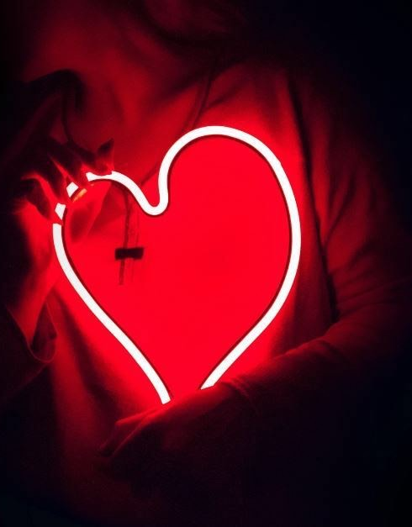
1 Corinthians 3:16-17
Do you not know that you are the temple of God and that the Spirit of God dwells in you? If anyone defiles the temple of God, God will destroy him. For the temple of God is holy, which temple you are.

Slide 8

Revelation 3:4
You have a few names even in Sardis who have not defiled their garments; and they shall walk with Me in white, for they are worthy.

Slide 9
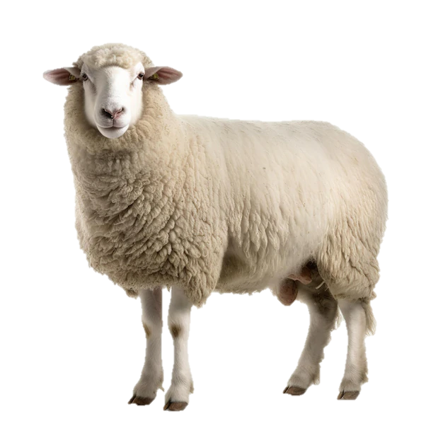
Follow the Lamb
Revelation 14:4
These are the ones who were not defiled with women, for they are virgins. These are the ones who follow the Lamb wherever He goes. These were redeemed from among men, being firstfruits to God and to the Lamb.

Slide 10

Revelation 21:27
But there shall by no means enter it anything that defiles, or causes an abomination or a lie, but only those who are written in the Lamb’s Book of Life.

Slide 11

Hebrews 7:26
For such a High Priest was fitting for us, who is holy, harmless, undefiled, separate from sinners, and has become higher than the heavens;

Slide 12

Daniel 1:8
But Daniel purposed in his heart that he would not defile himself with the portion of the king’s delicacies,

Slide 13

God calls us to an unpolluted, undefiled, pure, and holy life

Slide 14
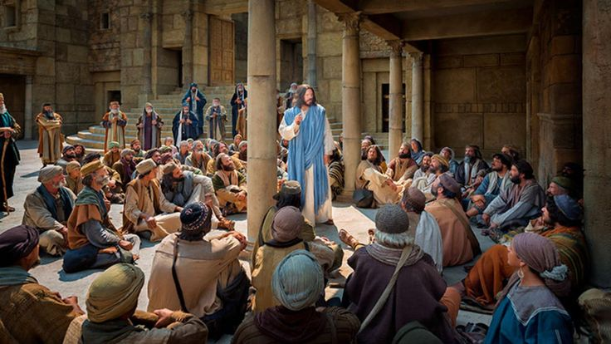
Principle detailed
Matthew 15:10

Slide 15
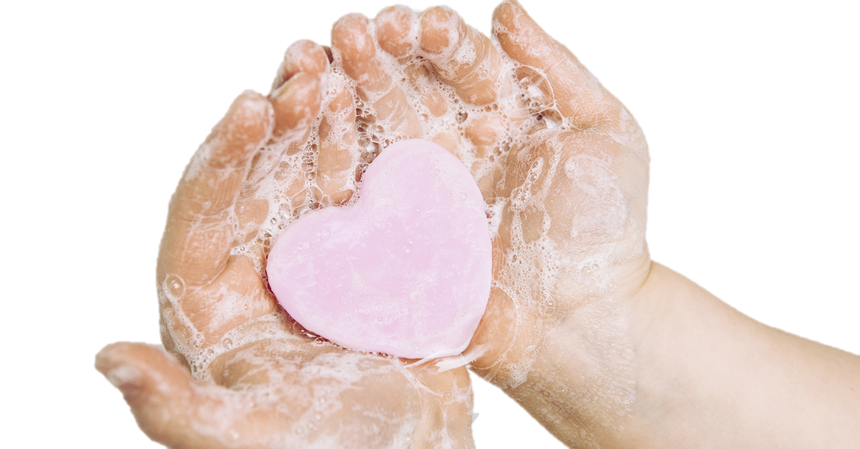
Matthew 15:1-9
They had confronted Jesus
V 2, “Why do Your disciples transgress the tradition of the elders? For they do not wash their hands when they eat bread.
V 6, then he need not honour his father or mother.’ Thus you have made the commandment of God of no effect by your tradition.
Jesus says, “Now listen and understand.”

Slide 16
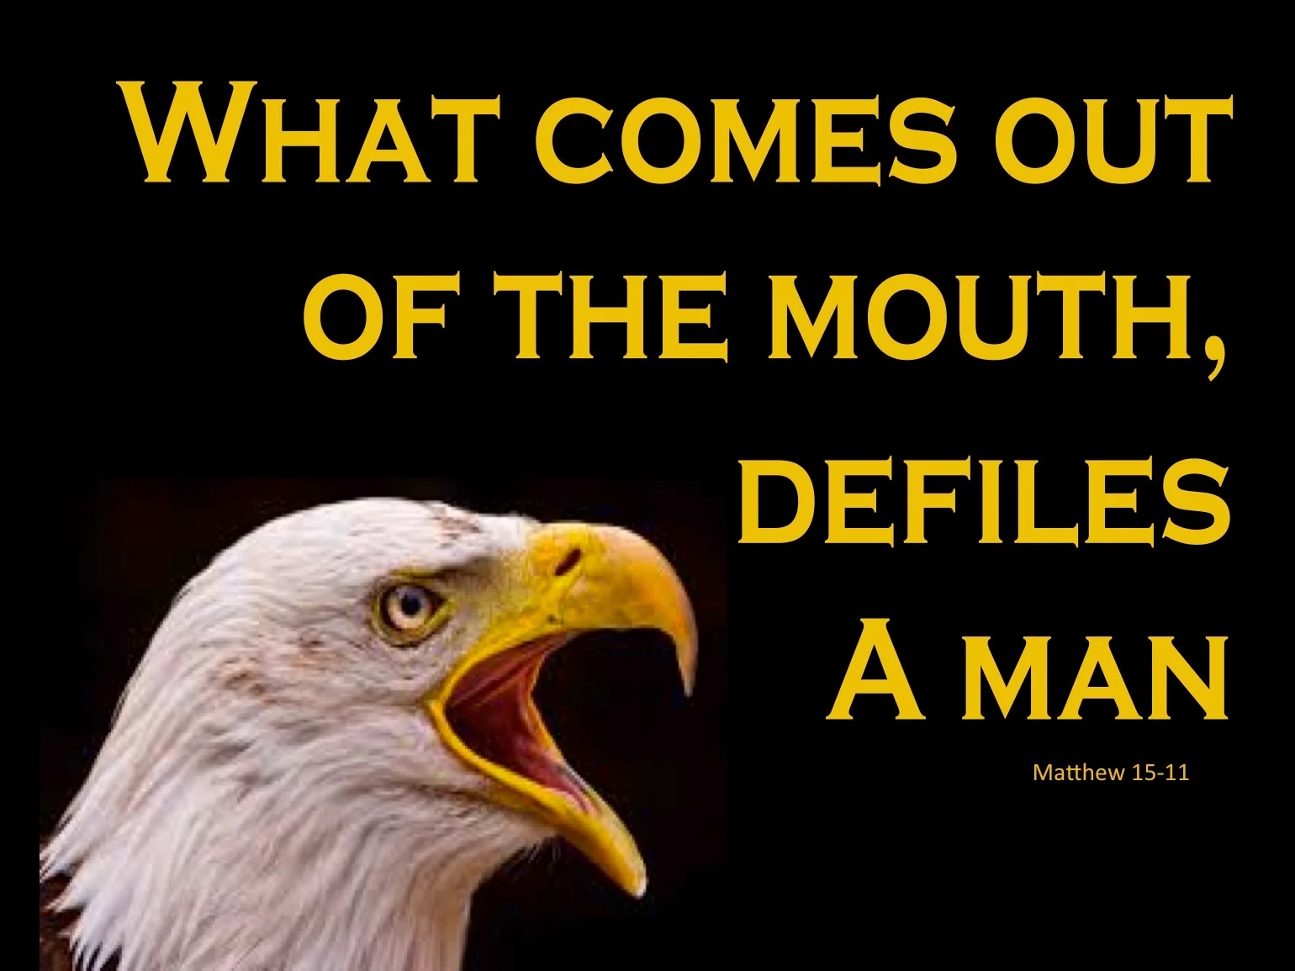
Agenda
Principle Explained
Matthew 15:11

Slide 17
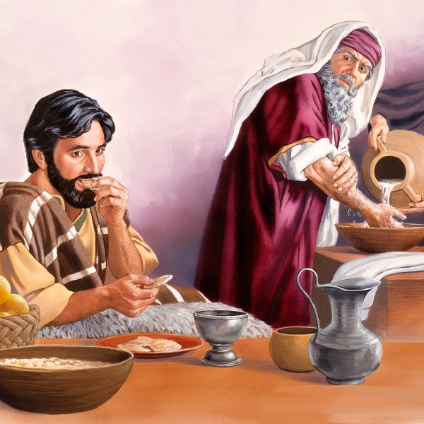
Agenda
Jesus is saying pollution and defilement,
is not a physical issue, it is a spiritual one.
is not a ritual matter, it is a moral one.

Slide 18

1 Samuel 16:7

Slide 19

Agenda
There is nothing that enters a man from outside which can defile him; but the things which come out of him, those are the things that defile a man.
Mark 7:15

Slide 20
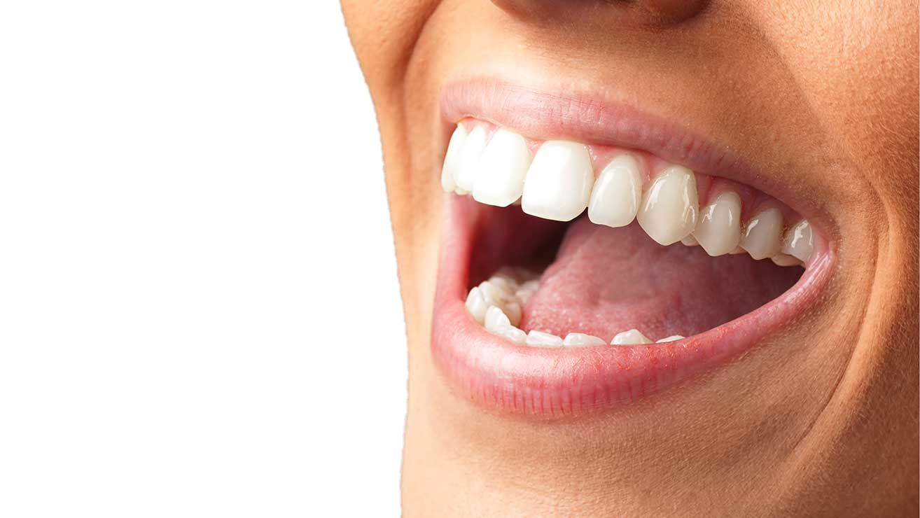
Your mouth is the dominant revealer of internal pollution.

Slide 21
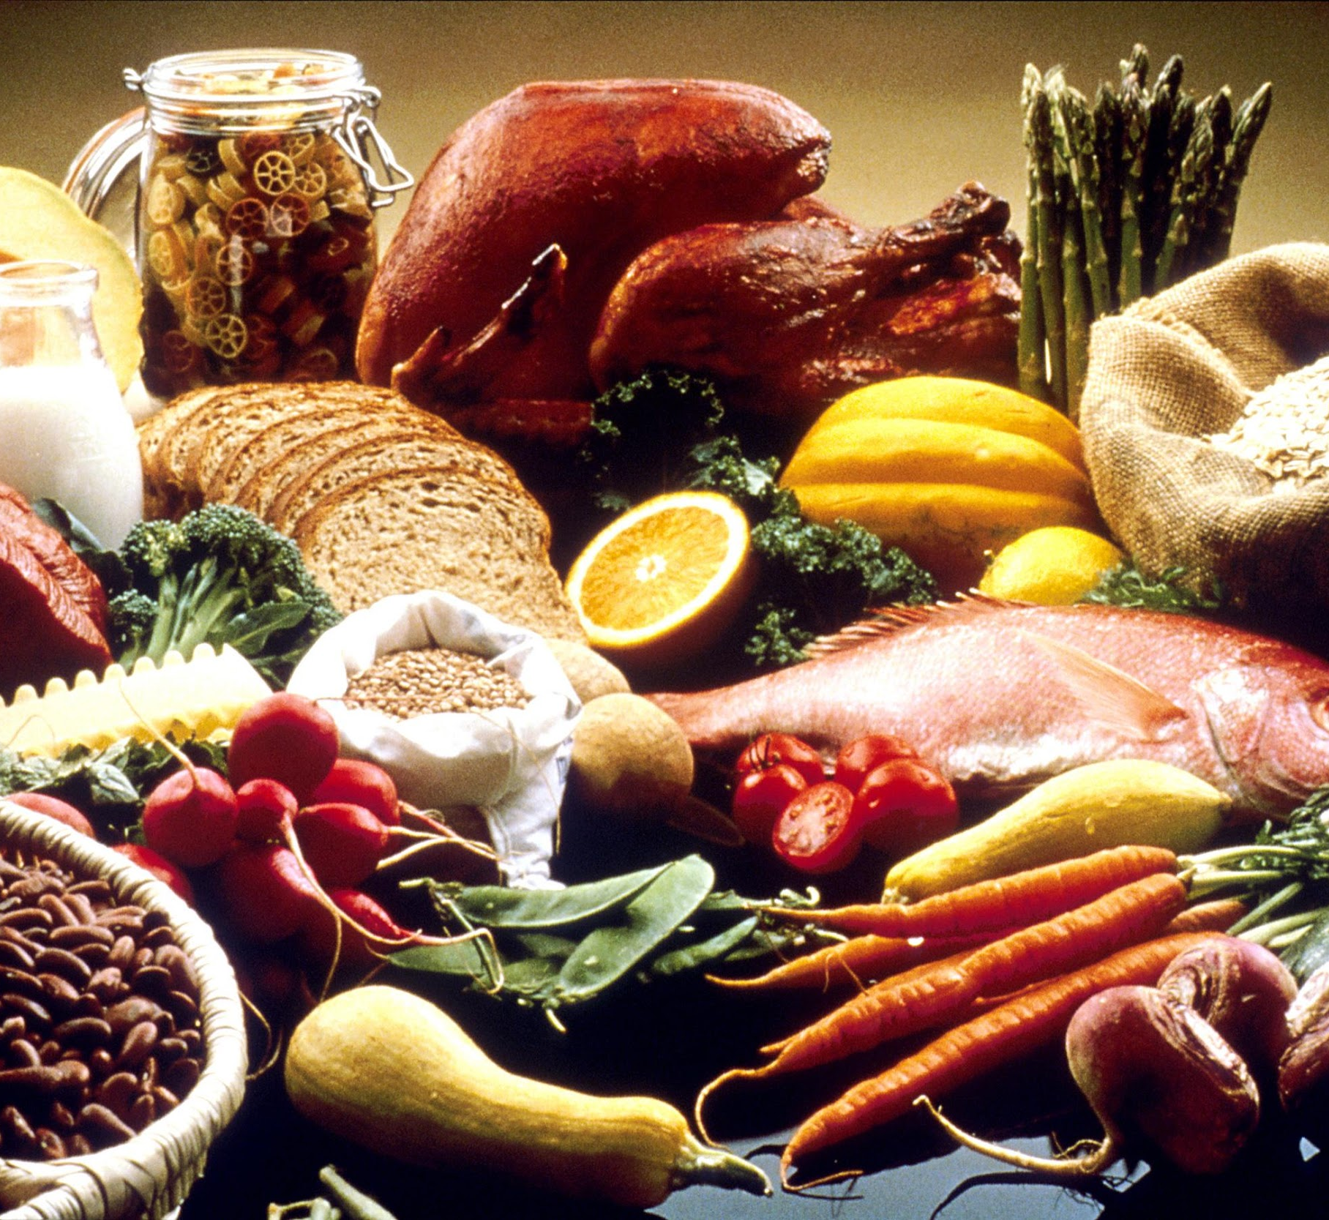
Agenda
it does not enter his heart but his stomach, and is eliminated, thus purifying all foods
Mark 7:19

Slide 22
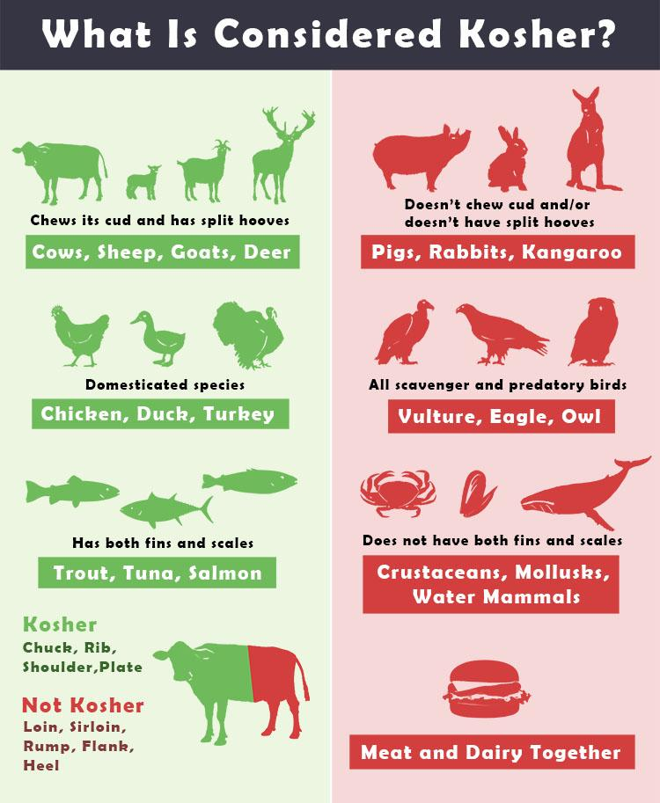
THERE IS NO MORE KOSHER

Slide 23
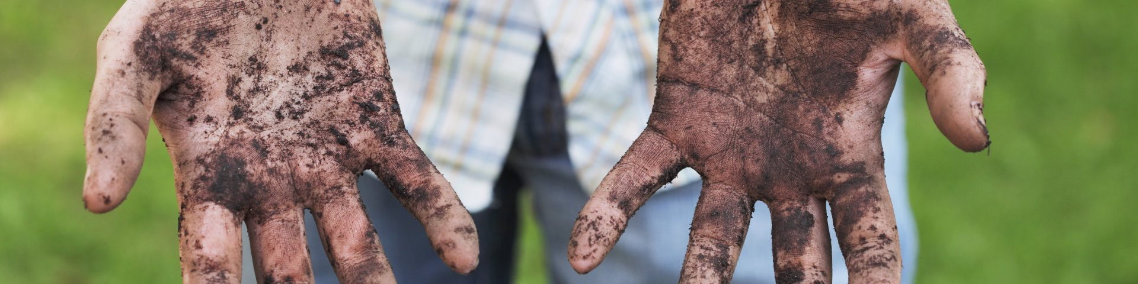
Leviticus 11
Leviticus 17
Leviticus 22
Leviticus 15
Leviticus 21
Leviticus 22
God want you to come to worship Him spiritually only when your heart is pure.

Slide 24

Circumcise yourselves to the Lord, And take away the foreskins of your hearts, You men of Judah and inhabitants of Jerusalem, Lest My fury come forth like fire, And burn so that no one can quench it, Because of the evil of your doings
Jeremiah 4:4

Slide 25
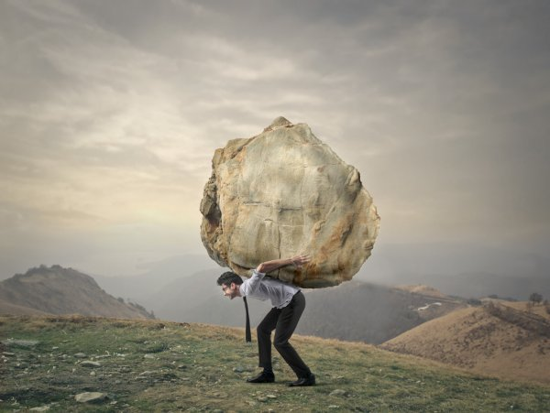
Agenda
For they bind heavy burdens, hard to bear, and lay them on men’s shoulders; but they themselves will not move them with one of their fingers
Matthew 23:4

Slide 26
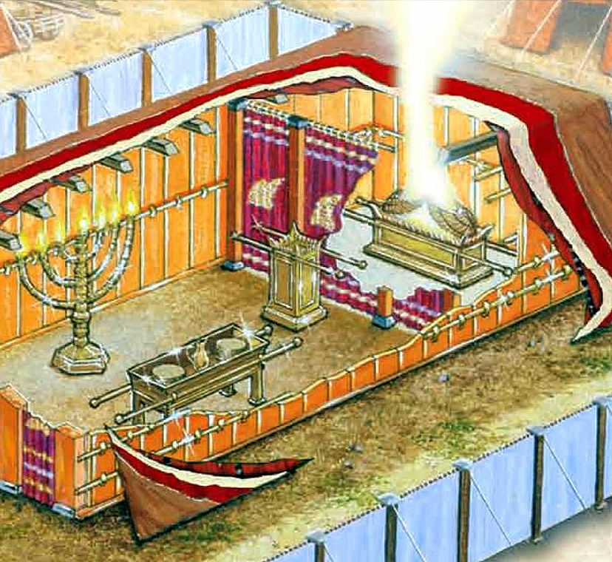
Agenda
who serve the copy and shadow of the heavenly things, as Moses was divinely instructed when he was about to make the tabernacle. For He said, “See that you make all things according to the pattern shown you on the mountain
Hebrews 8:5

Slide 27
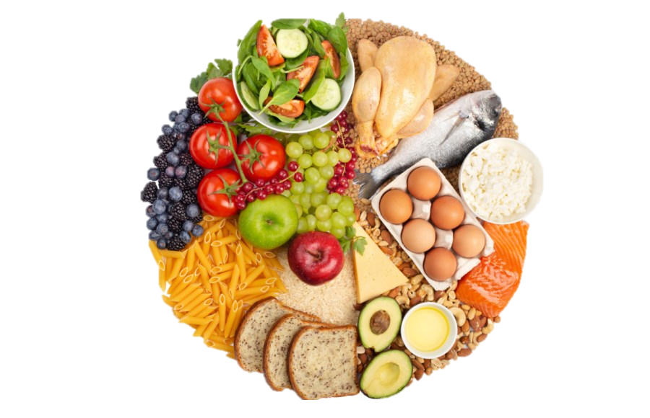
Agenda
It was symbolic for the present time in which both gifts and sacrifices are offered which cannot make him who performed the service perfect in regard to the conscience, concerned only with foods and drinks, various washings, and fleshly ordinances imposed until
the time of reformation.
Hebrews 9:9-10

Slide 28

Hebrews
10:1

Slide 29
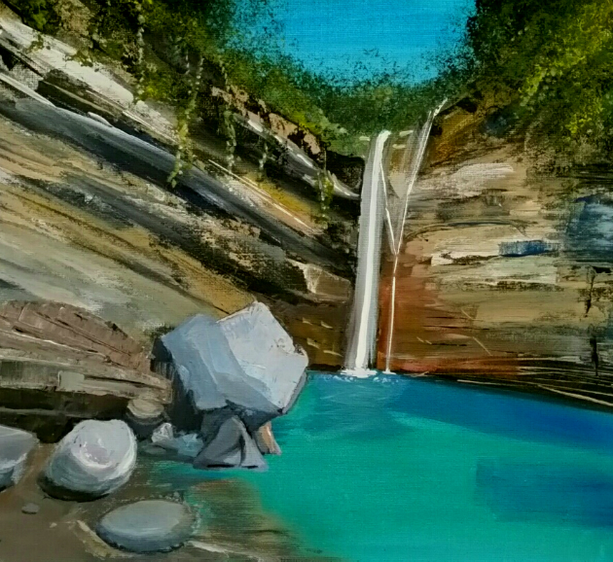
Agenda
let us draw near with a true heart in full assurance of faith, having our hearts sprinkled from an evil conscience and our bodies washed with pure water
Hebrews 10:22

Slide 30





Repentance from Dead Works
Faith in Christ
The Doctrine of Baptisms
The Laying on of Hands
The Resurrection of the Dead
Eternal Judgement
Hebrews 6:1-2

Slide 31
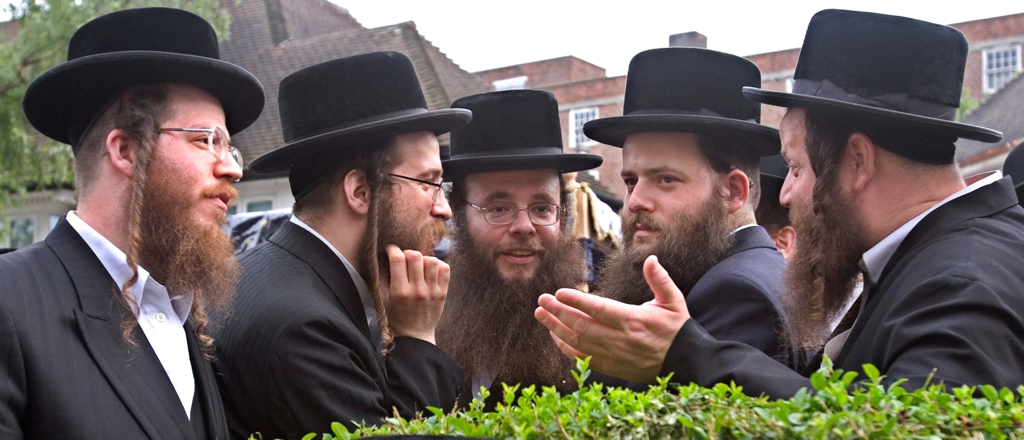
Hebrews 5:12- 6:8

Slide 32
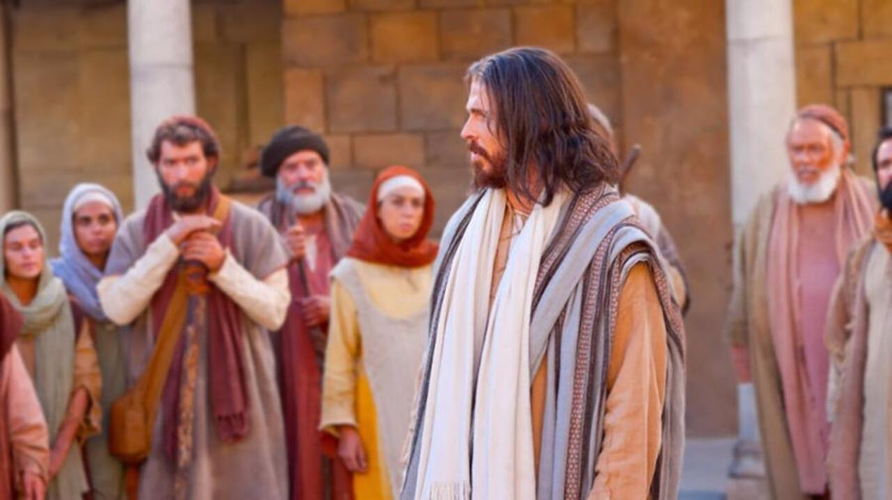
Agenda
Do not think that I came to destroy the Law or the Prophets. I did not come to destroy but to fulfil
Matthew 5:17

Slide 33
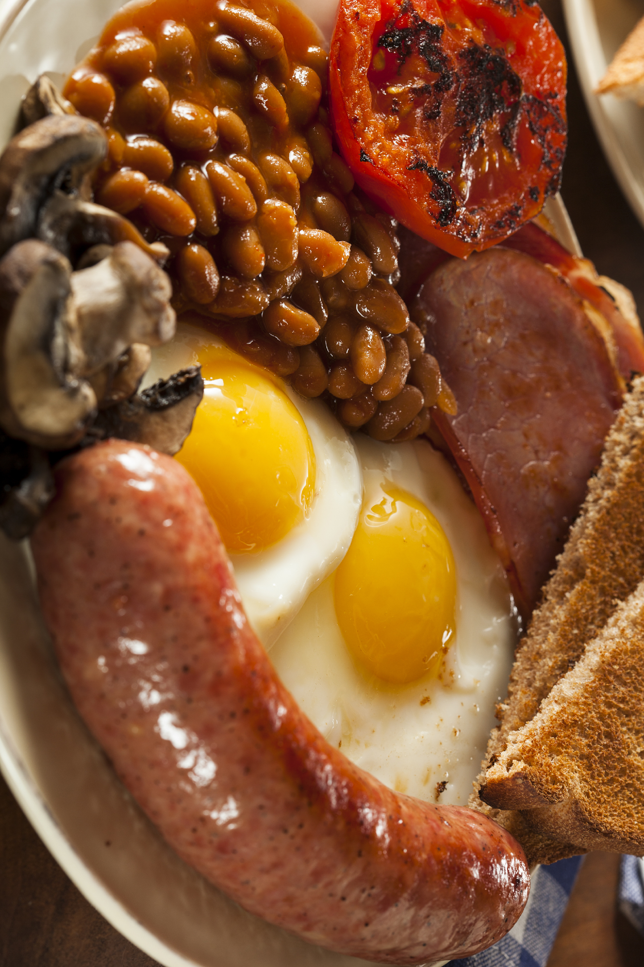
because it does not
enter his heart but his stomach, and is eliminated, thus
purifying all foods?”
Mark 7:19

Slide 34

But those things which proceed out of the mouth come from the heart, and they defile a man.
Matthew 15:18

Slide 35
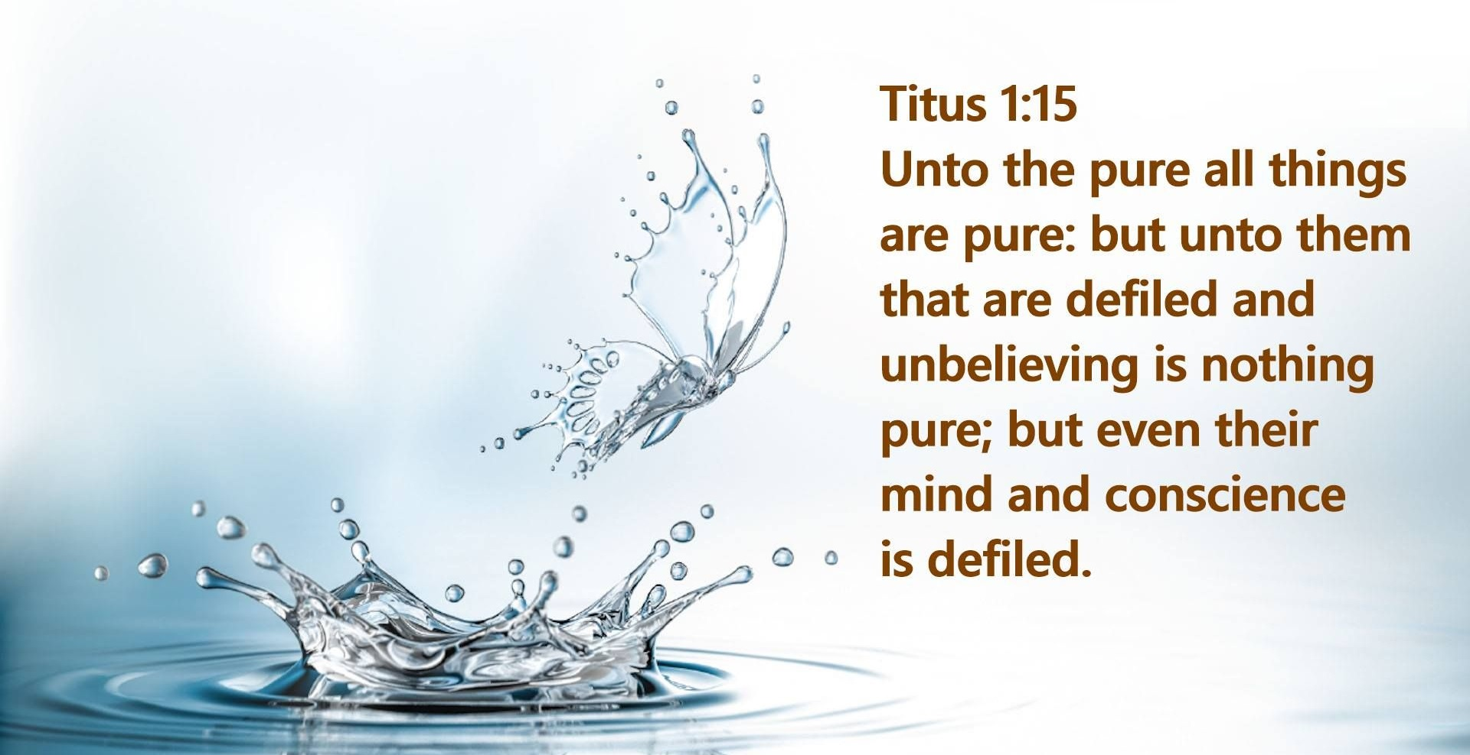

Titus 1:15

Slide 36
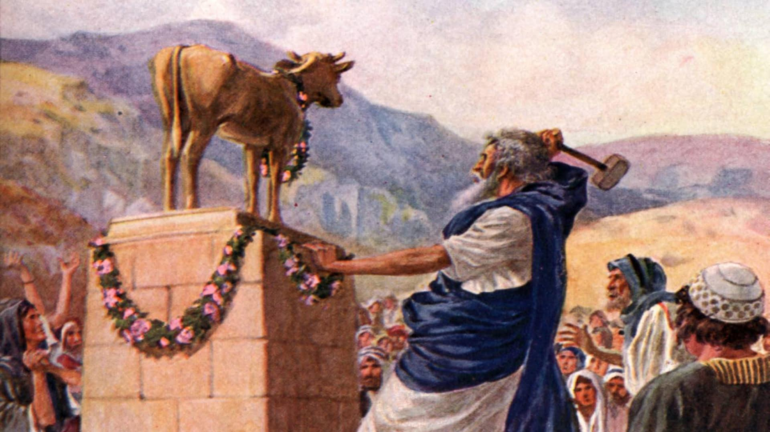
Agenda
However, there is not in everyone that knowledge; for some, with consciousness of the idol, until now eat it as a thing offered to an idol; and their conscience, being weak, is defiled
1 Corinthians 8:7

Slide 37

Agenda
looking carefully lest anyone fall short of the grace of God; lest any root of bitterness springing up cause trouble, and by this many become defiled
Hebrews 12:15

Slide 38
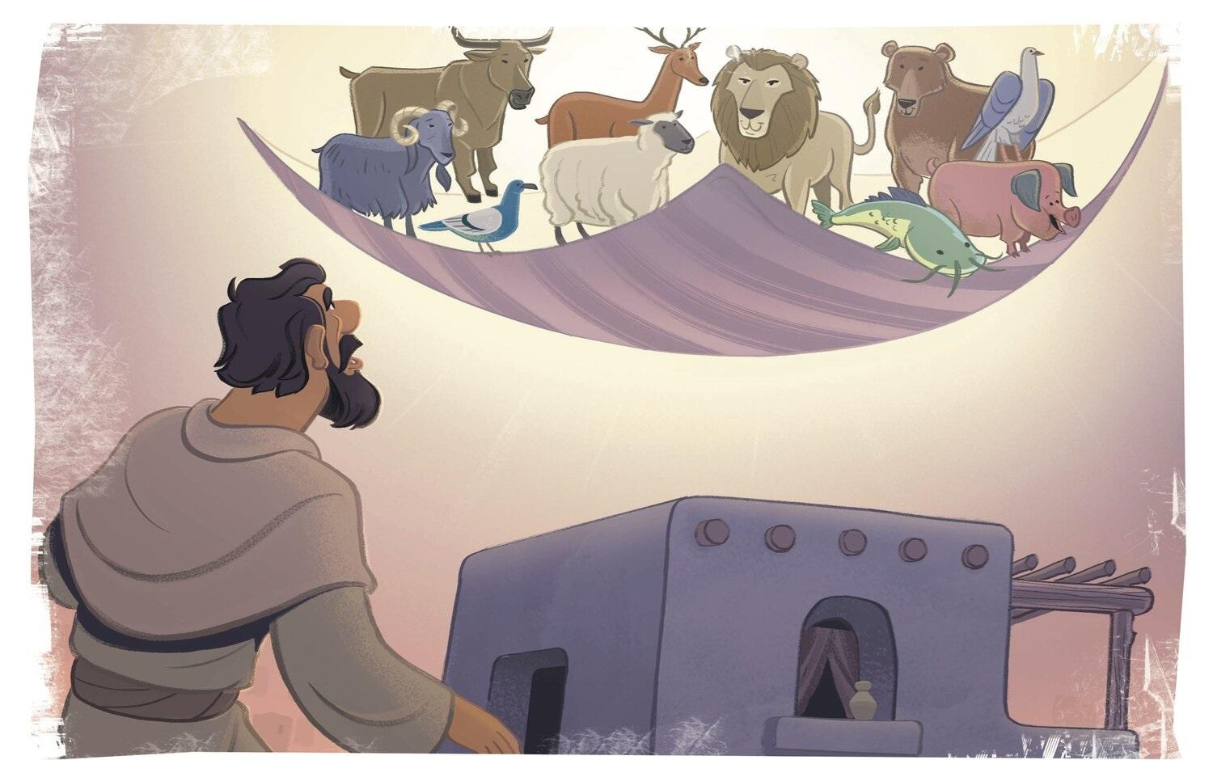
Acts 10 – Peter’s Vision

Slide 39
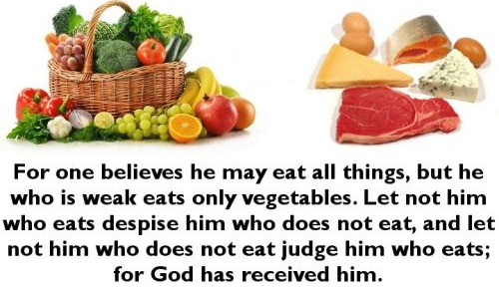
Romans 14:2-3

Slide 40

14 I know and am convinced by the Lord Jesus that there is nothing unclean of itself; but to him who considers anything to be unclean, to him it is unclean. 15 Yet if your brother is grieved because of your food, you are no longer walking in love. Do not destroy with your food the one for whom Christ died
Romans
14:14-15

Slide 41

Do not destroy the work of God for the sake of food. All things indeed are pure
Romans
14:20

Slide 42
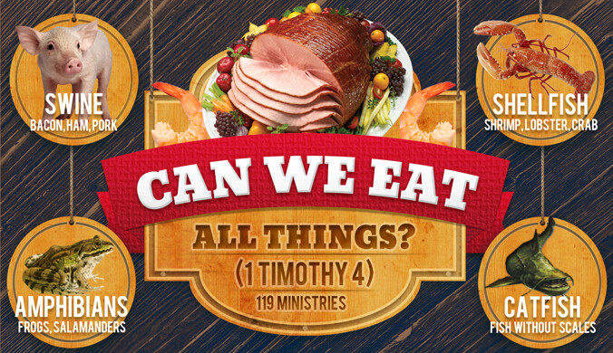
1 Timothy 4:3-5
For every creature of God is good, and nothing is to be refused if it is received with thanksgiving; 5 for it is sanctified by the word of God and prayer.

Slide 43
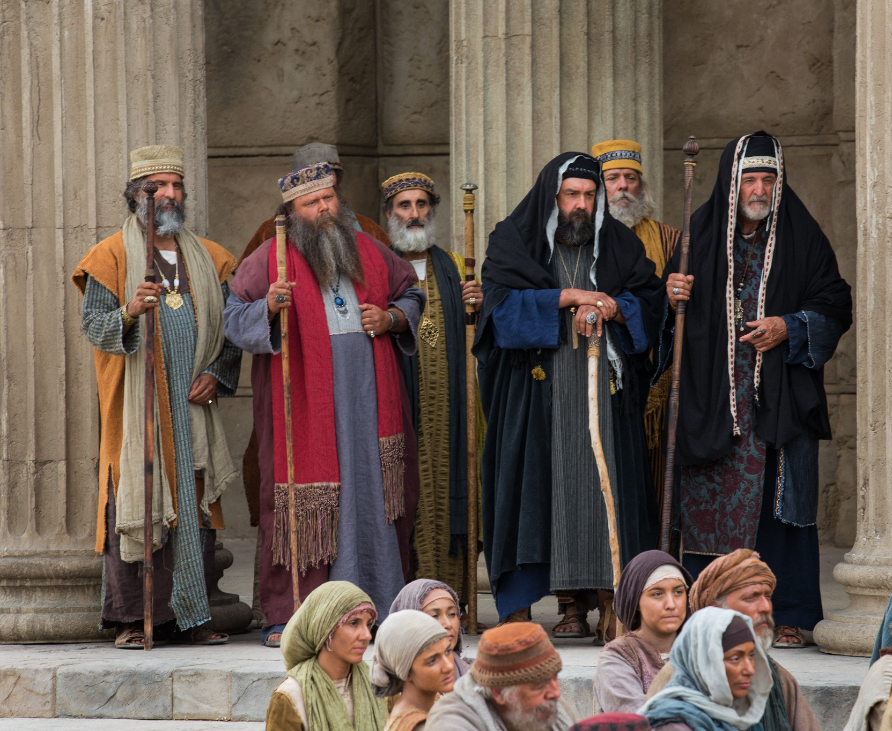
Principle Violated

Slide 44
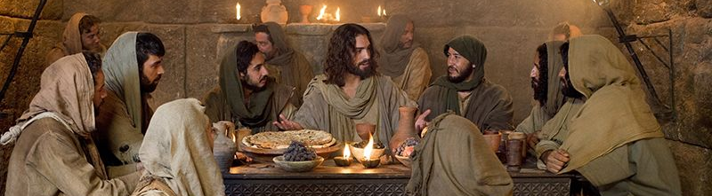
Do You know that the Pharisees were offended when they heard this saying
Matthew 15:12

Slide 45
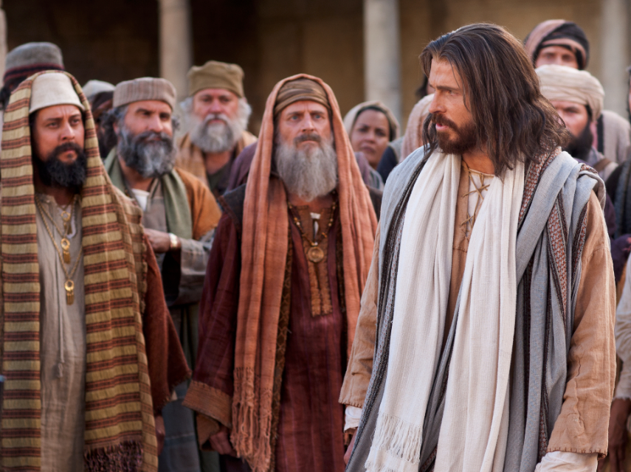
Matthew 23, the Lord called them, Hypocrites…
Devouring widows’ houses.
Shutting up the Kingdom of God
Blind guides, fools, blind
Paying tithes of little herbs and omitting justice, faith, and mercy
Swallowing camels and straining at gnats
Cleaning the outside of the cup
White washed tombs.

Slide 46
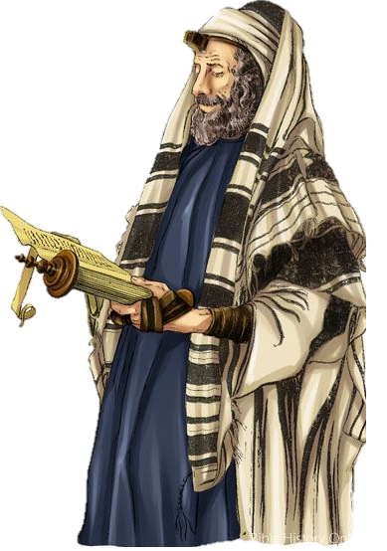
God and Rabbis, studied the Halacha (Jewish law) and made decisions
God wore a prayer shawl and phylacteries (a small box containing the law of God)
God spent three hours playing with Leviathan, a dragon
God came to Egypt, He got defiled and had to be purged by Aaron
God went to the burial of Moses, He touched Moses. So, He bathed in a fire to purge Himself.
roared like a lion, His tears caused earthquakes.

Slide 47

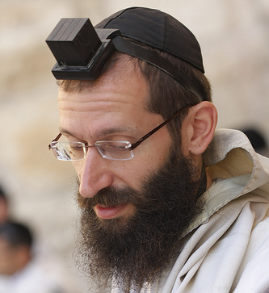
Pylacteries
Halacha

Slide 48
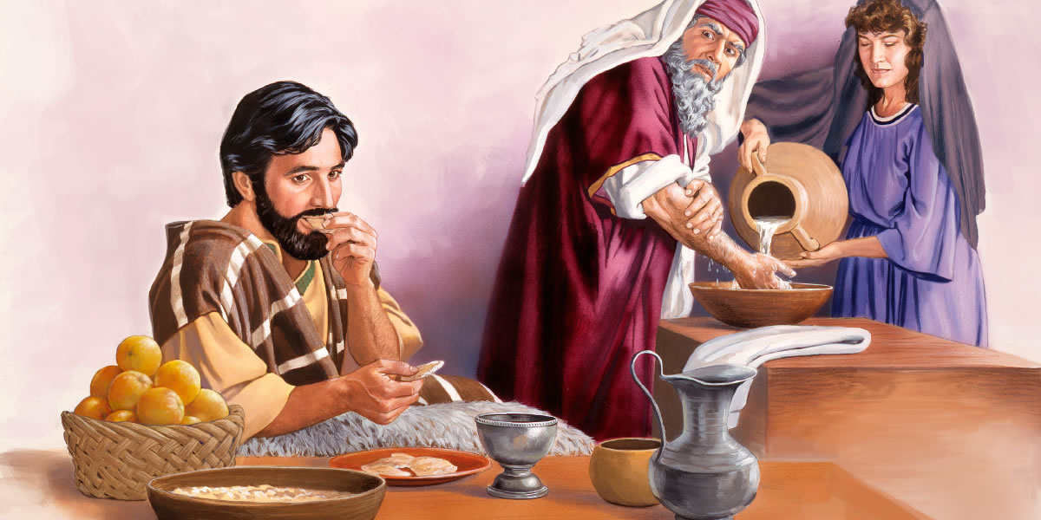
Luke 11: 37 - 44

Slide 49
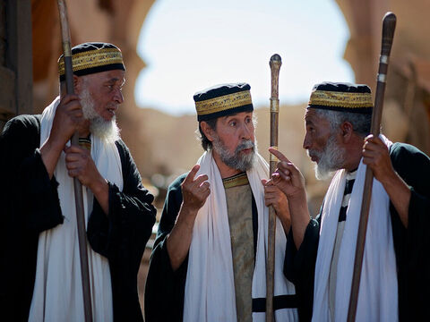
They were offended
Matthew
15:12

Slide 50

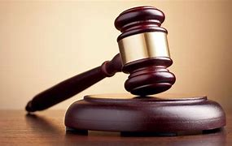
Offended by the truth?
…you could be a hypocrite!!
And destined for JUDGEMENT

Slide 51

“Every plant which My heavenly Father has not planted will be uprooted.
Matthew 15:13

Slide 52
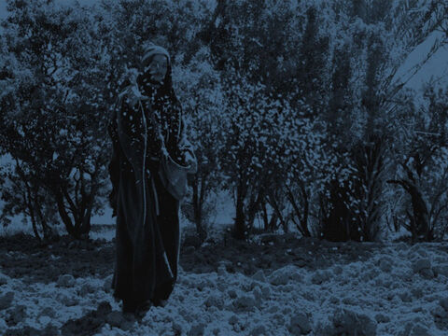
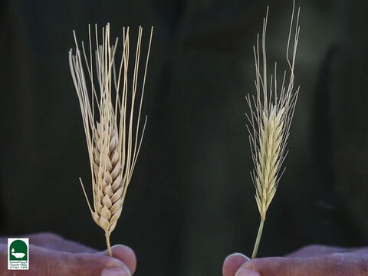
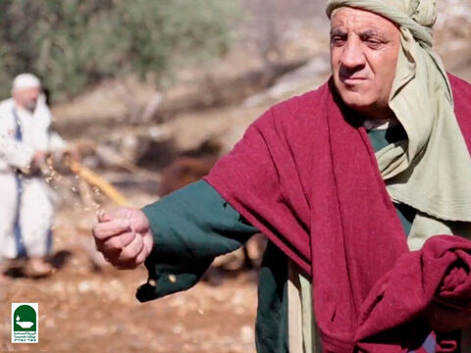
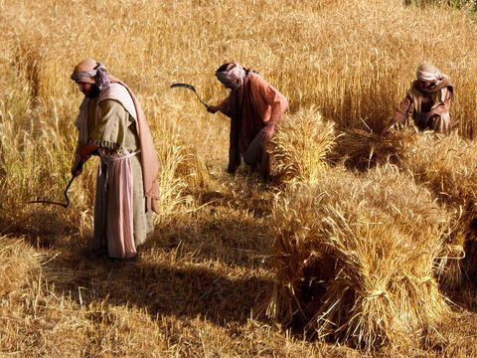
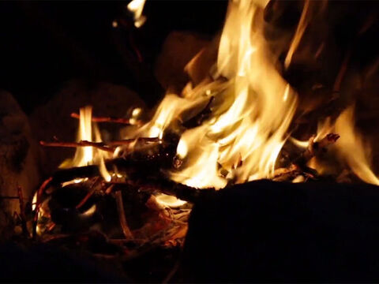
Matthew
13:37-39

Slide 53
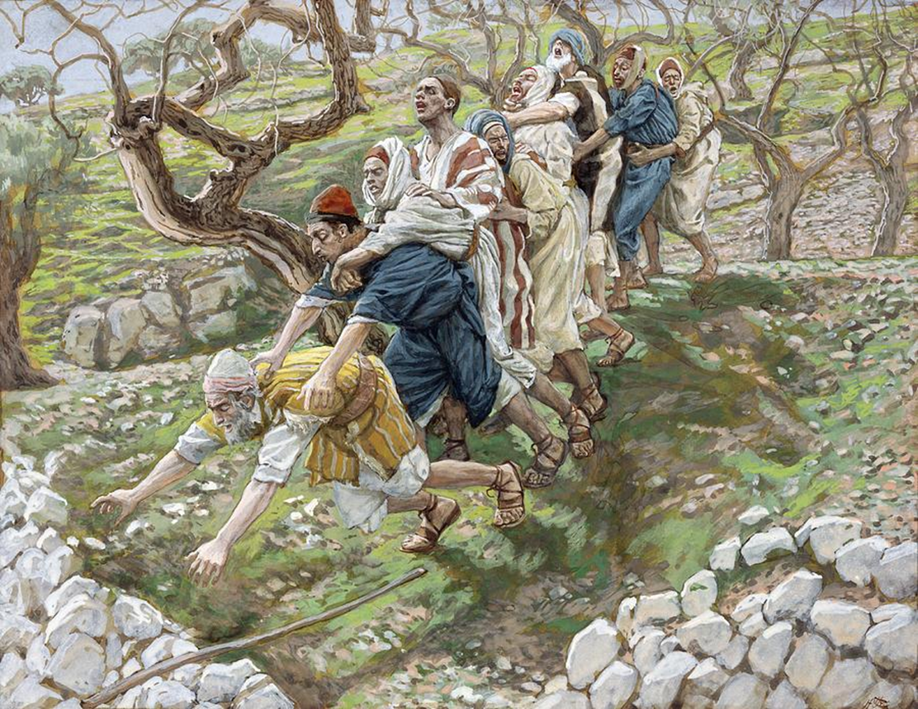
They are blind leaders of the blind. And if the blind leads the blind, both will fall into a ditch.”
Matthew 15:14

Slide 54
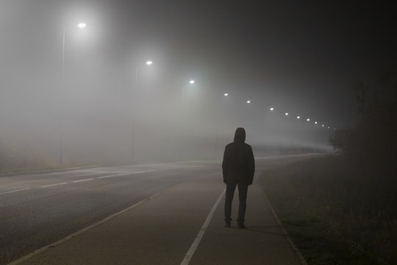
Hosea 4:17
Ephraim is joined to idols, Let him alone.

Slide 55


God cannot tolerate hypocrisy
So stay You away

Slide 56
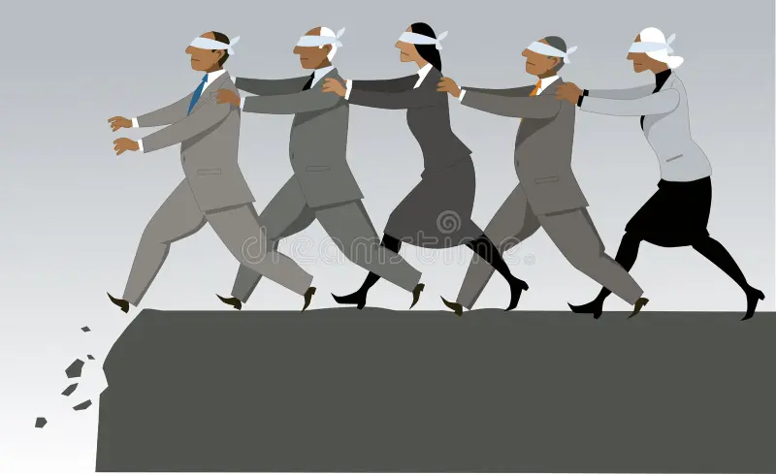
Matthew 15:14
…blind leaders of the blind. And if the blind leads the blind,
both will fall into a ditch

Slide 57
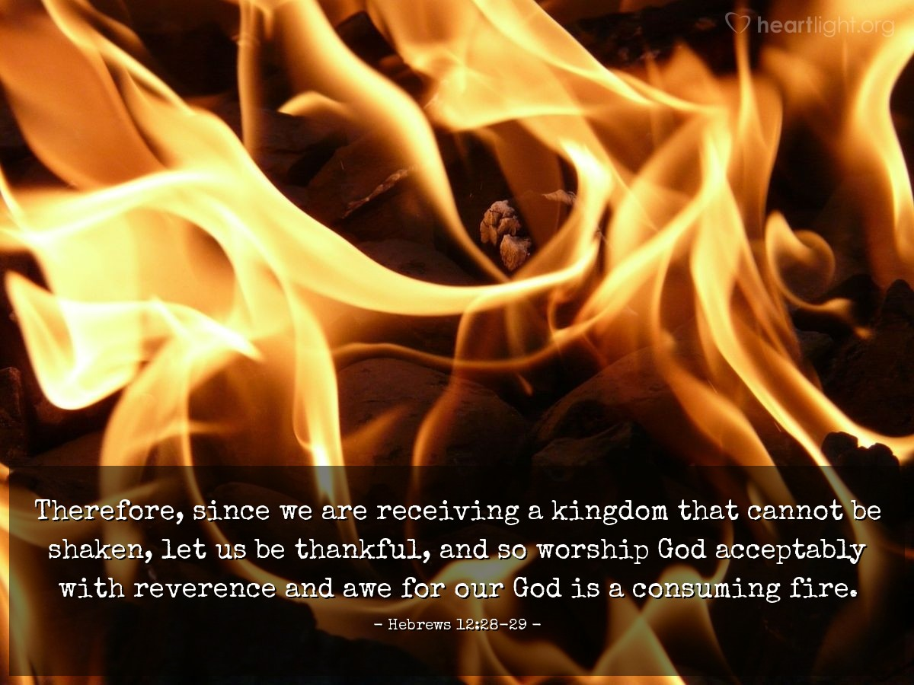
Jude 1: 23 Pulling them out of fire, hating even the garments spotted by fire

Slide 58

1 Timothy Purge yourself from these influences

Slide 59
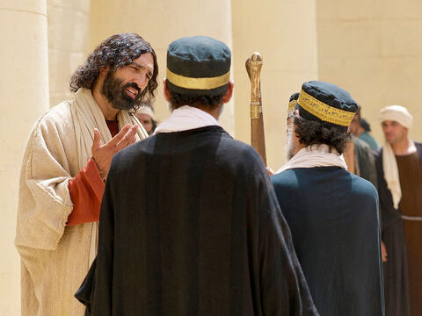
and are confident that you yourself are a guide to the blind, a light to those who are in darkness
Romans 2:19

Slide 60

Don’t go near them
Don’t expose yourself to hypocrites
Don’t expose yourself to people preaching false religion in the name of Christianity

Slide 61
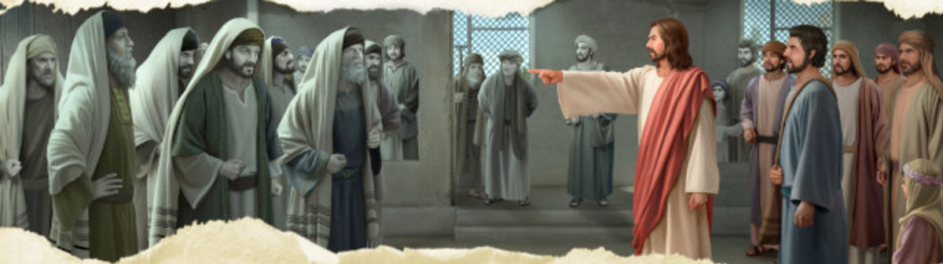
Woe to you, scribes and Pharisees, hypocrites! For you travel land and sea to win one proselyte, and when he is won, you make him twice as much a son of hell as yourselves
Matthew 23:15

Slide 62
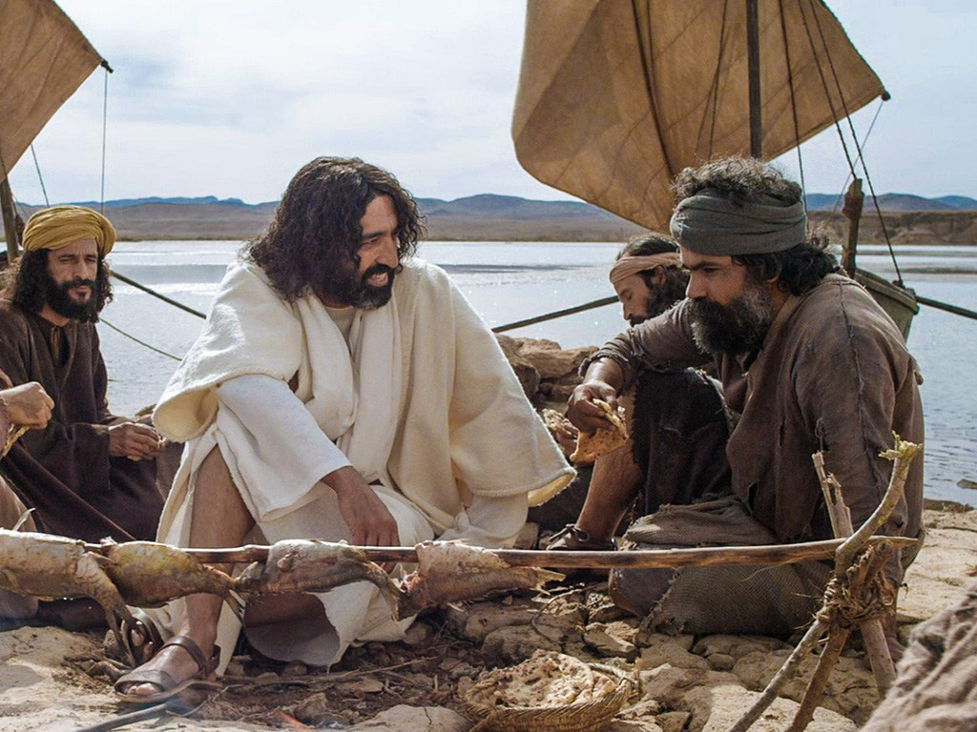
Then Peter answered and said to Him, “Explain this parable to us.”
Principle explained
Matthew 15:15

Slide 63

It wasn’t that they couldn’t understand what He meant.
It was just they couldn’t accept it.

Slide 64
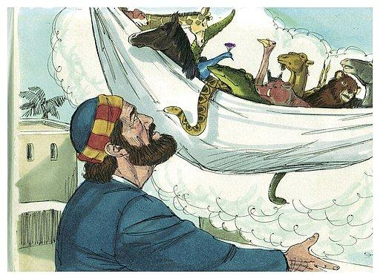
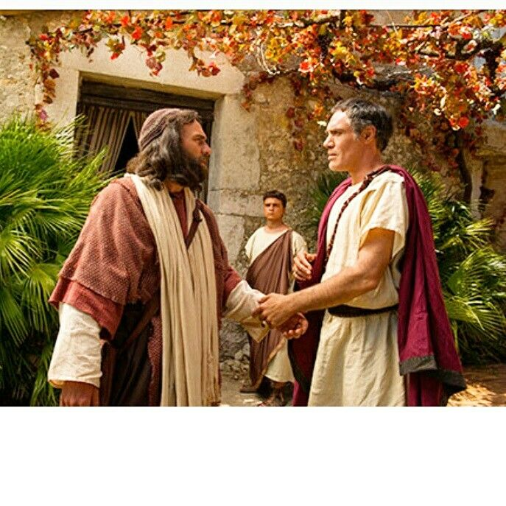
Peter’s Vision
Acts 10
Gentile Convert

Slide 65
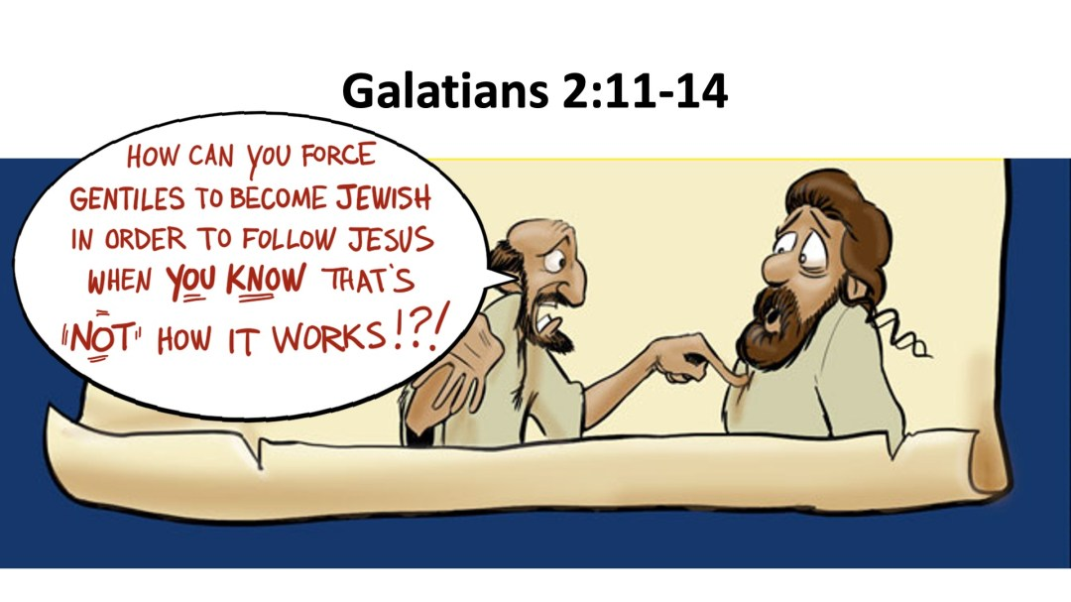

Slide 66
Matthew
15:16-18
So Jesus said, “Are you also still without understanding?
Mark mentioned, “out of the man” - come forth from the heart and they pollute the man.

Slide 67
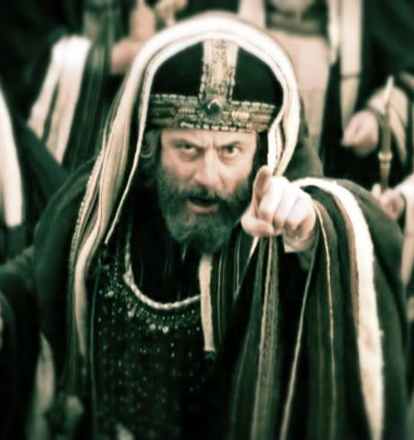
Matthew :15:19
For out of the heart proceed evil thoughts, murders, adulteries, fornications, thefts, false witness, blasphemies.

Slide 68
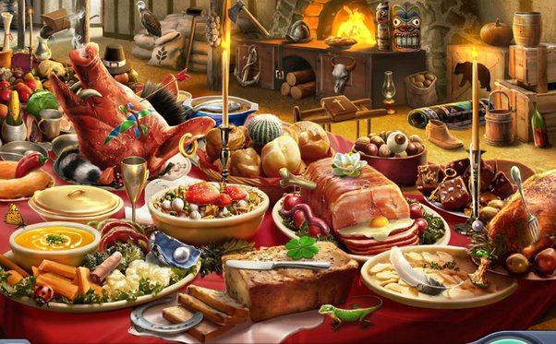
These are the things which defile a man, but to eat with unwashed hands does not defile a man.”
Matthew
15 :20

Slide 69
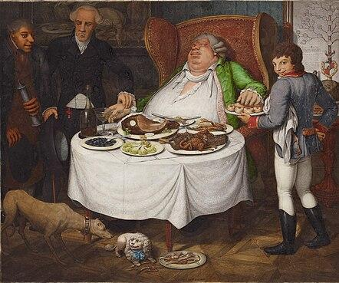
One of them, a prophet of their own, said, “Cretans are always liars, evil beasts, lazy gluttons.” ¹³ This testimony is true. Therefore, rebuke sharply, that they may be sound in the faith, them
Titus 1:12-13

Slide 70

Matthew 5:8
Blessed are the pure in heart, For they shall see God.

Slide 71


The prayer of every individual should be,
“Lord, purify my heart.”

Slide 72

How does He do it ?
Only one way can our hearts be purified, and that is by faith in the Lord Jesus Christ who purifies the heart, who washes away the sin.

