Slide 1
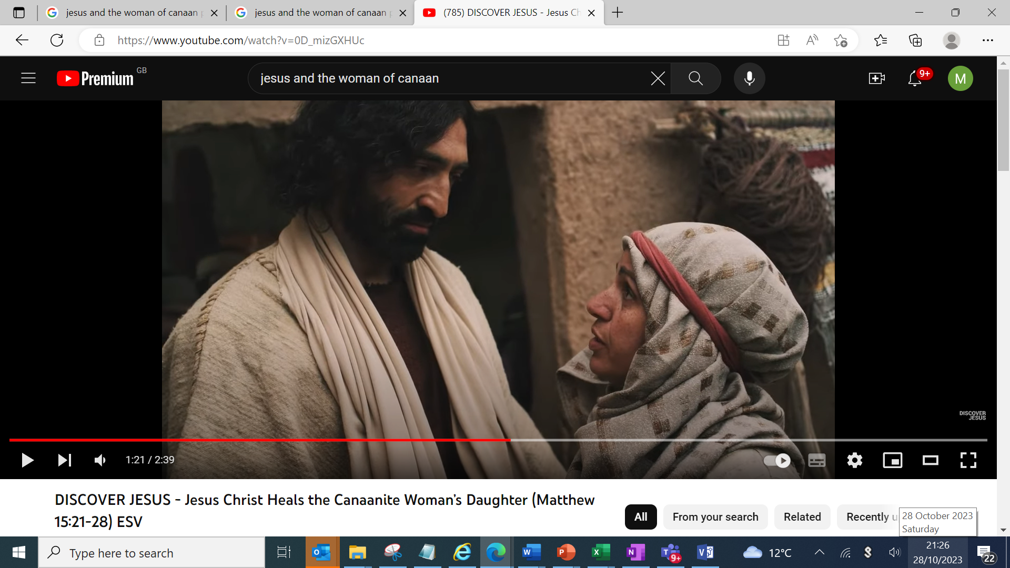
6th Response
to Jesus-
Good Soil-
Mega Faith!
Matthew 15:21-29

Slide 2
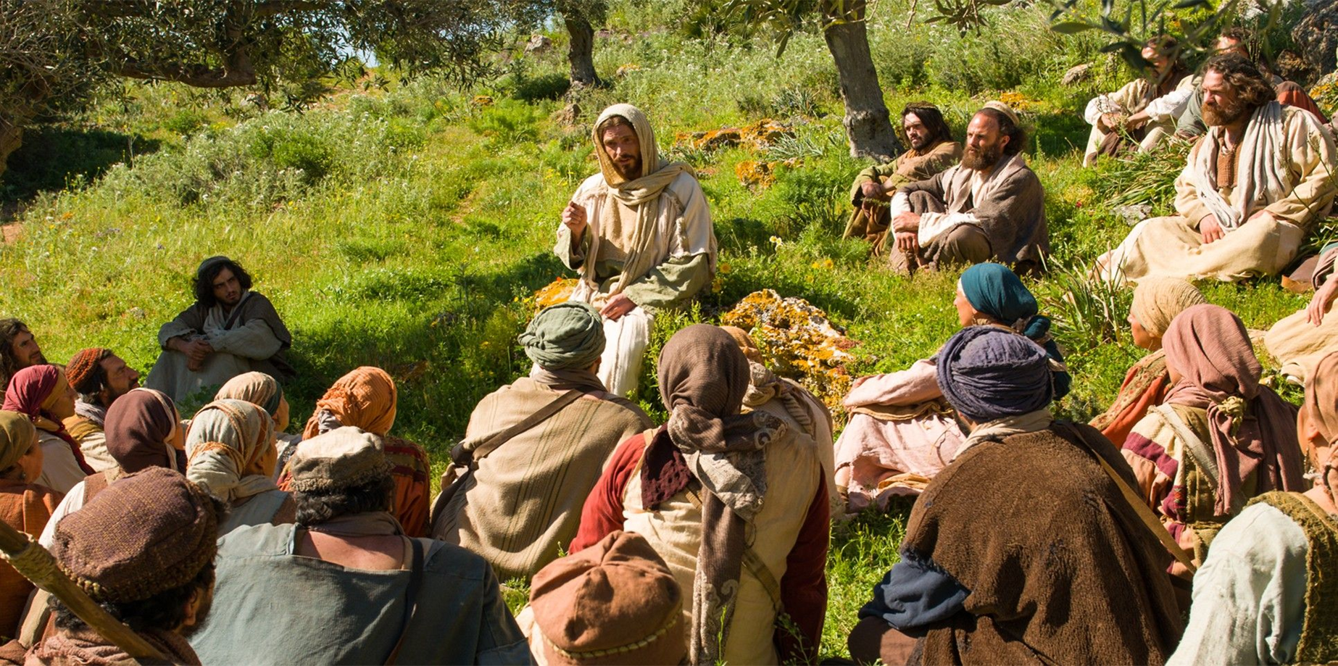
Matthew 13- Kingdom Parables spoken

Slide 3
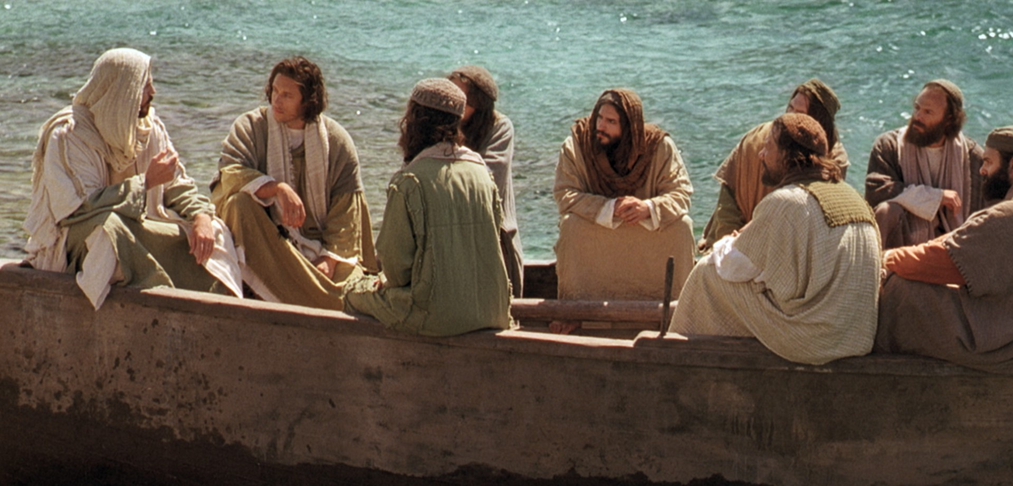
Matthew Chapter 13:53 till 16:12
Eight incidents in the life of our Lord

Slide 4
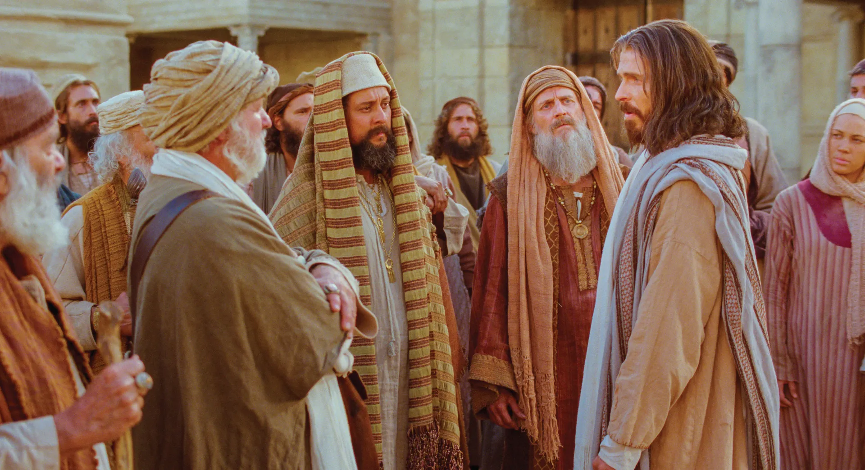
1st Response to Jesus
Matthew 13:53-58
Unbelief!

Slide 5
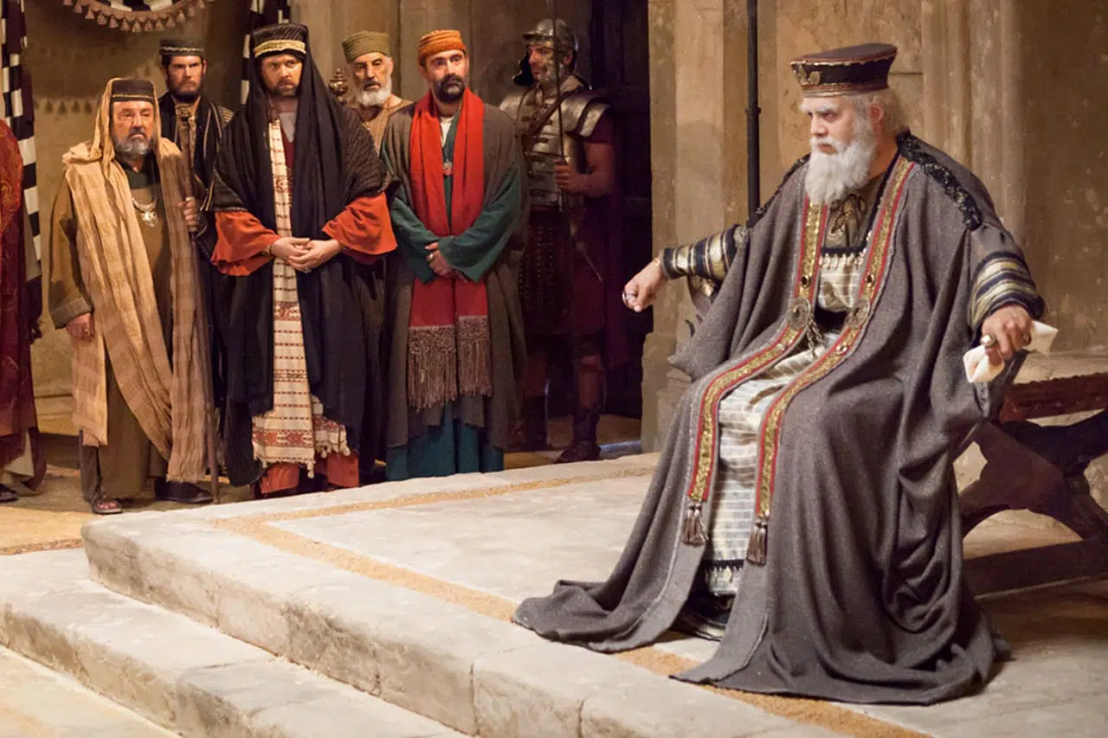
2nd Response to Jesus
Matthew 14:1-12
Fear that Forfeit’s Christ!

Slide 6
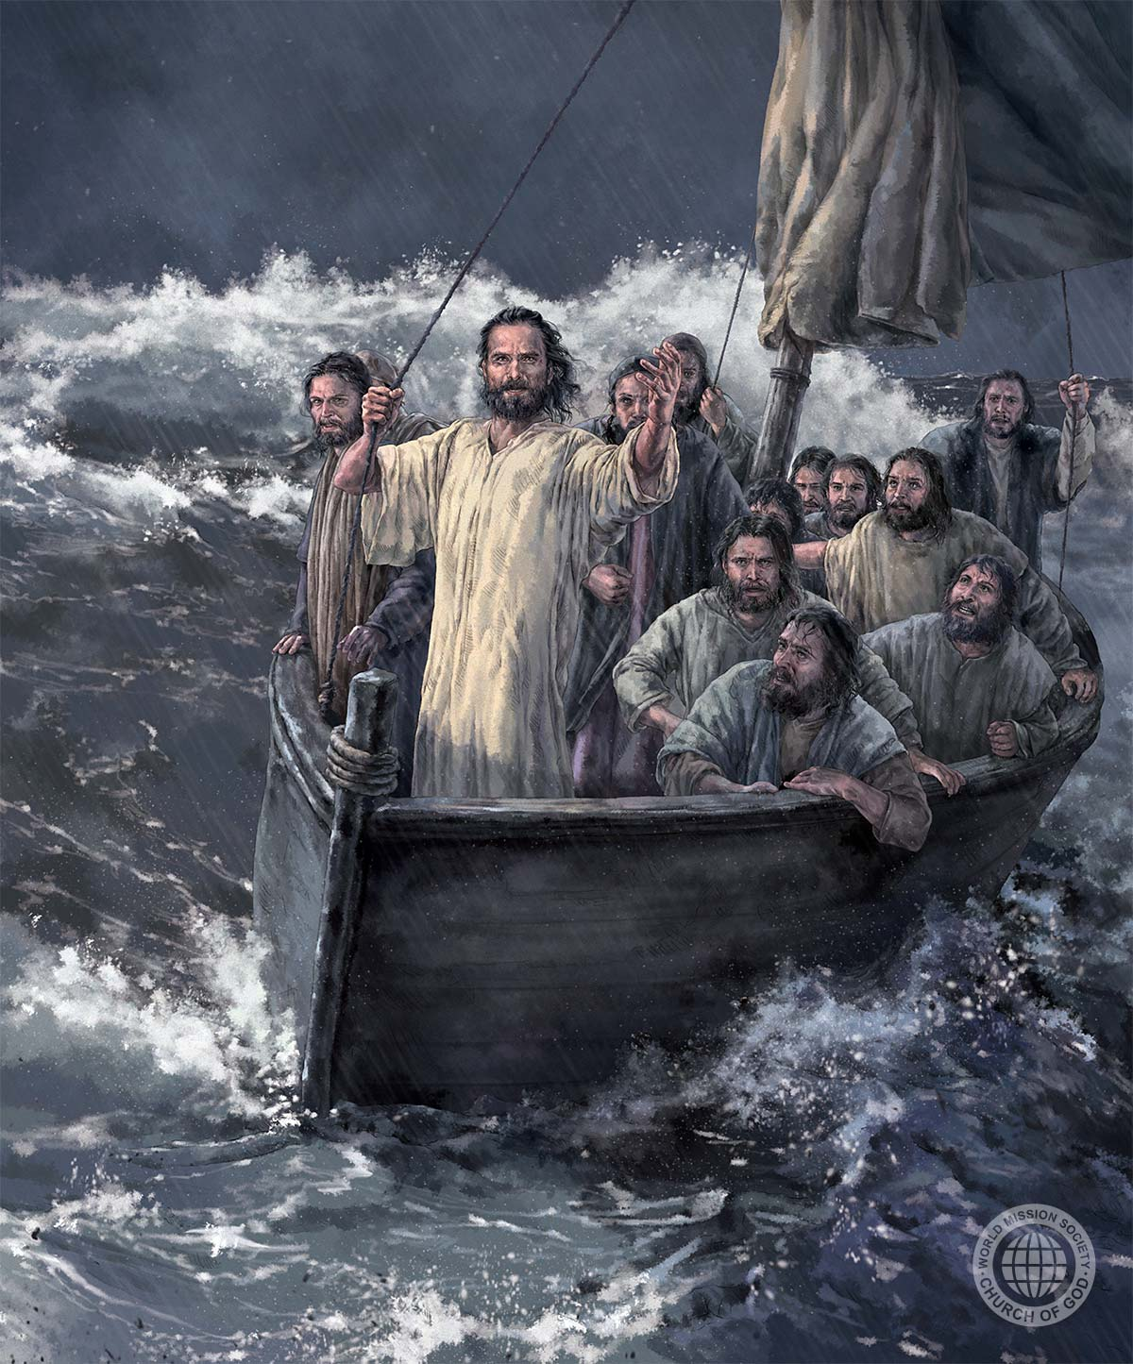
3rd Response to Jesus
Matthew 14:13-21
Faith for
materials!

Slide 7
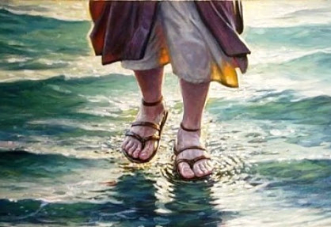
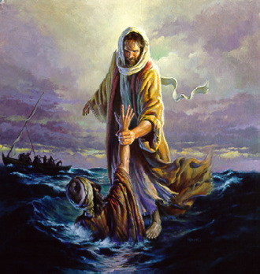
Brush
4th Response to Jesus
Greatest Discovery of mankind- Jesus is God!
Matthew 14:22-33

Slide 8
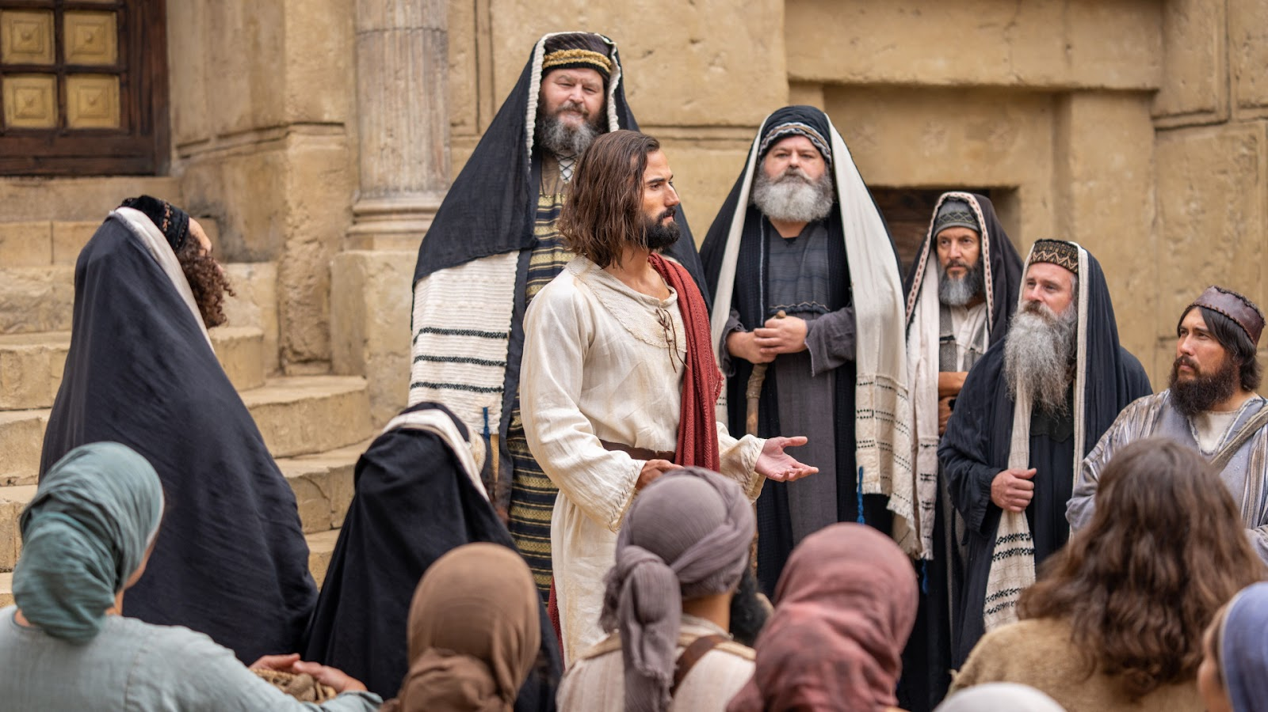
5th Response to Jesus-
Hard Soil- Vain Worship!
Matthew
14:34 - 15:1-9

Slide 9
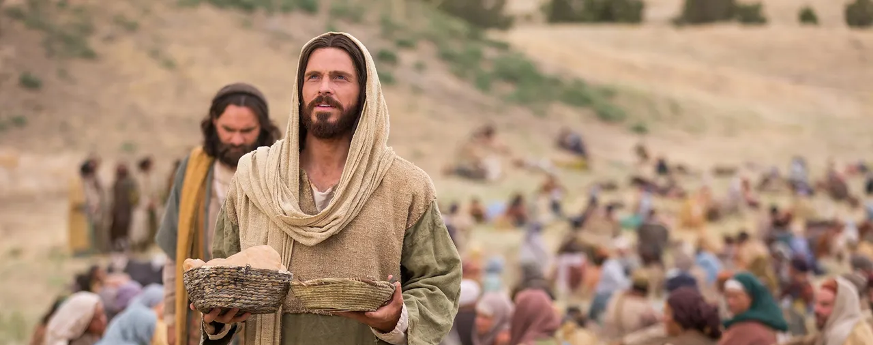
Lord had fed the 5,000.
His popularity reached the peak.

Slide 10

Jesus left Galilee…
Jealous hatred of Herod
Far-reaching ministry
Force Him to be a King
Scribes and Pharisees
were confronting Him

Slide 11
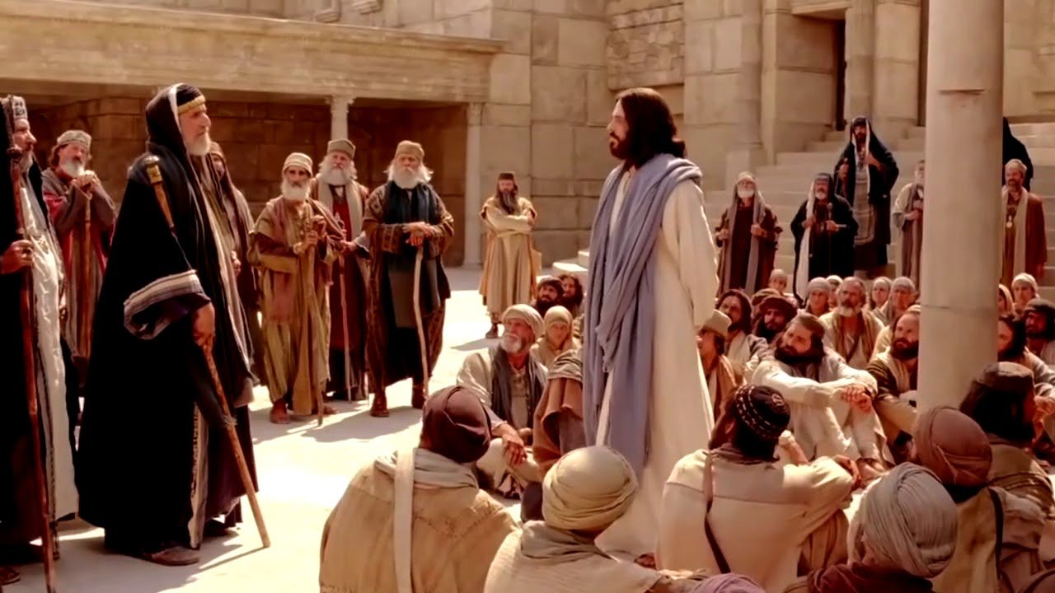
Matthew 15: 1-20

Slide 12
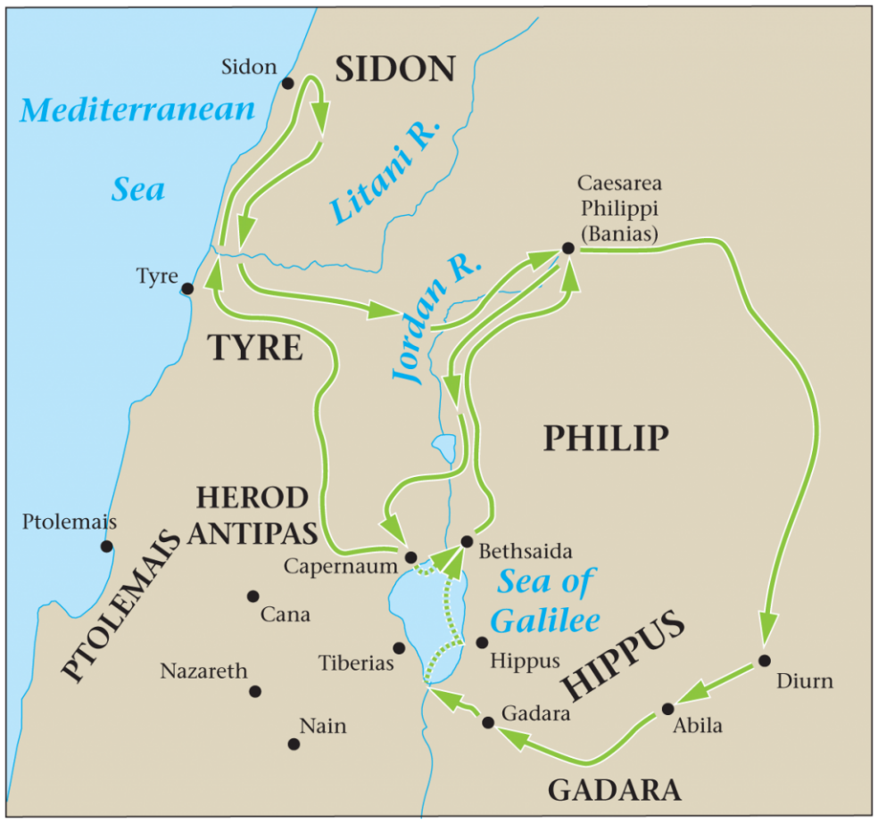
Matthew
15:21
Then Jesus went out from there and departed to the region of Tyre and Sidon.

Slide 13
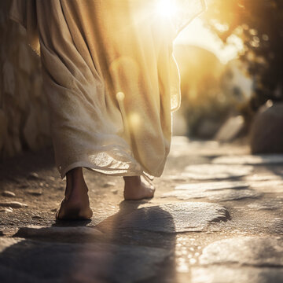
^{Deliberate withdrawal}
^{Not out of fear}
^{Time alone with the 12 men}
Time for preparing them for the cross
^{Preparation for the mission}
Pressure off the frenzied situation

Slide 14

Notorious History!
31 And it came to pass, as though it had been a trivial thing for him to walk in the sins of Jeroboam the son of Nebat, that he took as wife Jezebel the daughter of Ethbaal, king of the Sidonians; and he went and served Baal and worshiped him.
1 Kings 16:31

Slide 15
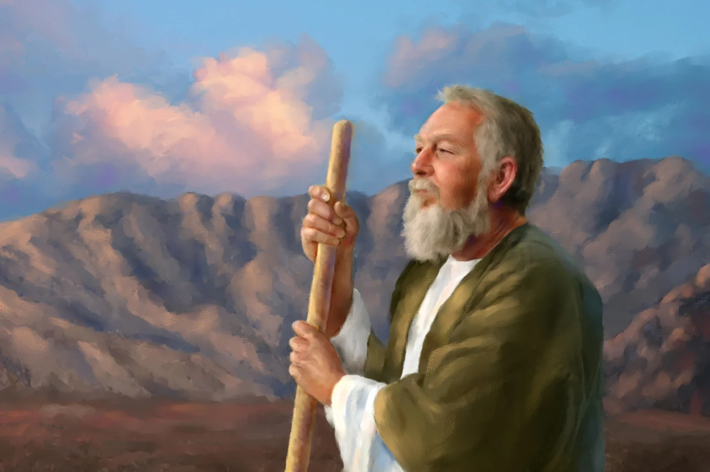
The great prophets of the Old Testament
^{Jeremiah 27 : 1-11}
^{Ezekiel 26 : 3-21}
^{Ezekiel 28 : 1-10}

Slide 16
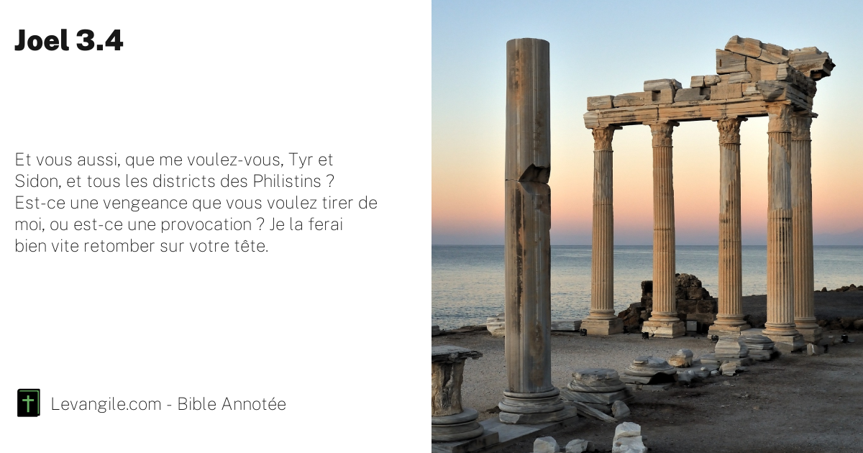
“Indeed, what have you to do with Me, O Tyre and Sidon, and all the coasts of Philistia?
Joel 3:4-6

Slide 17


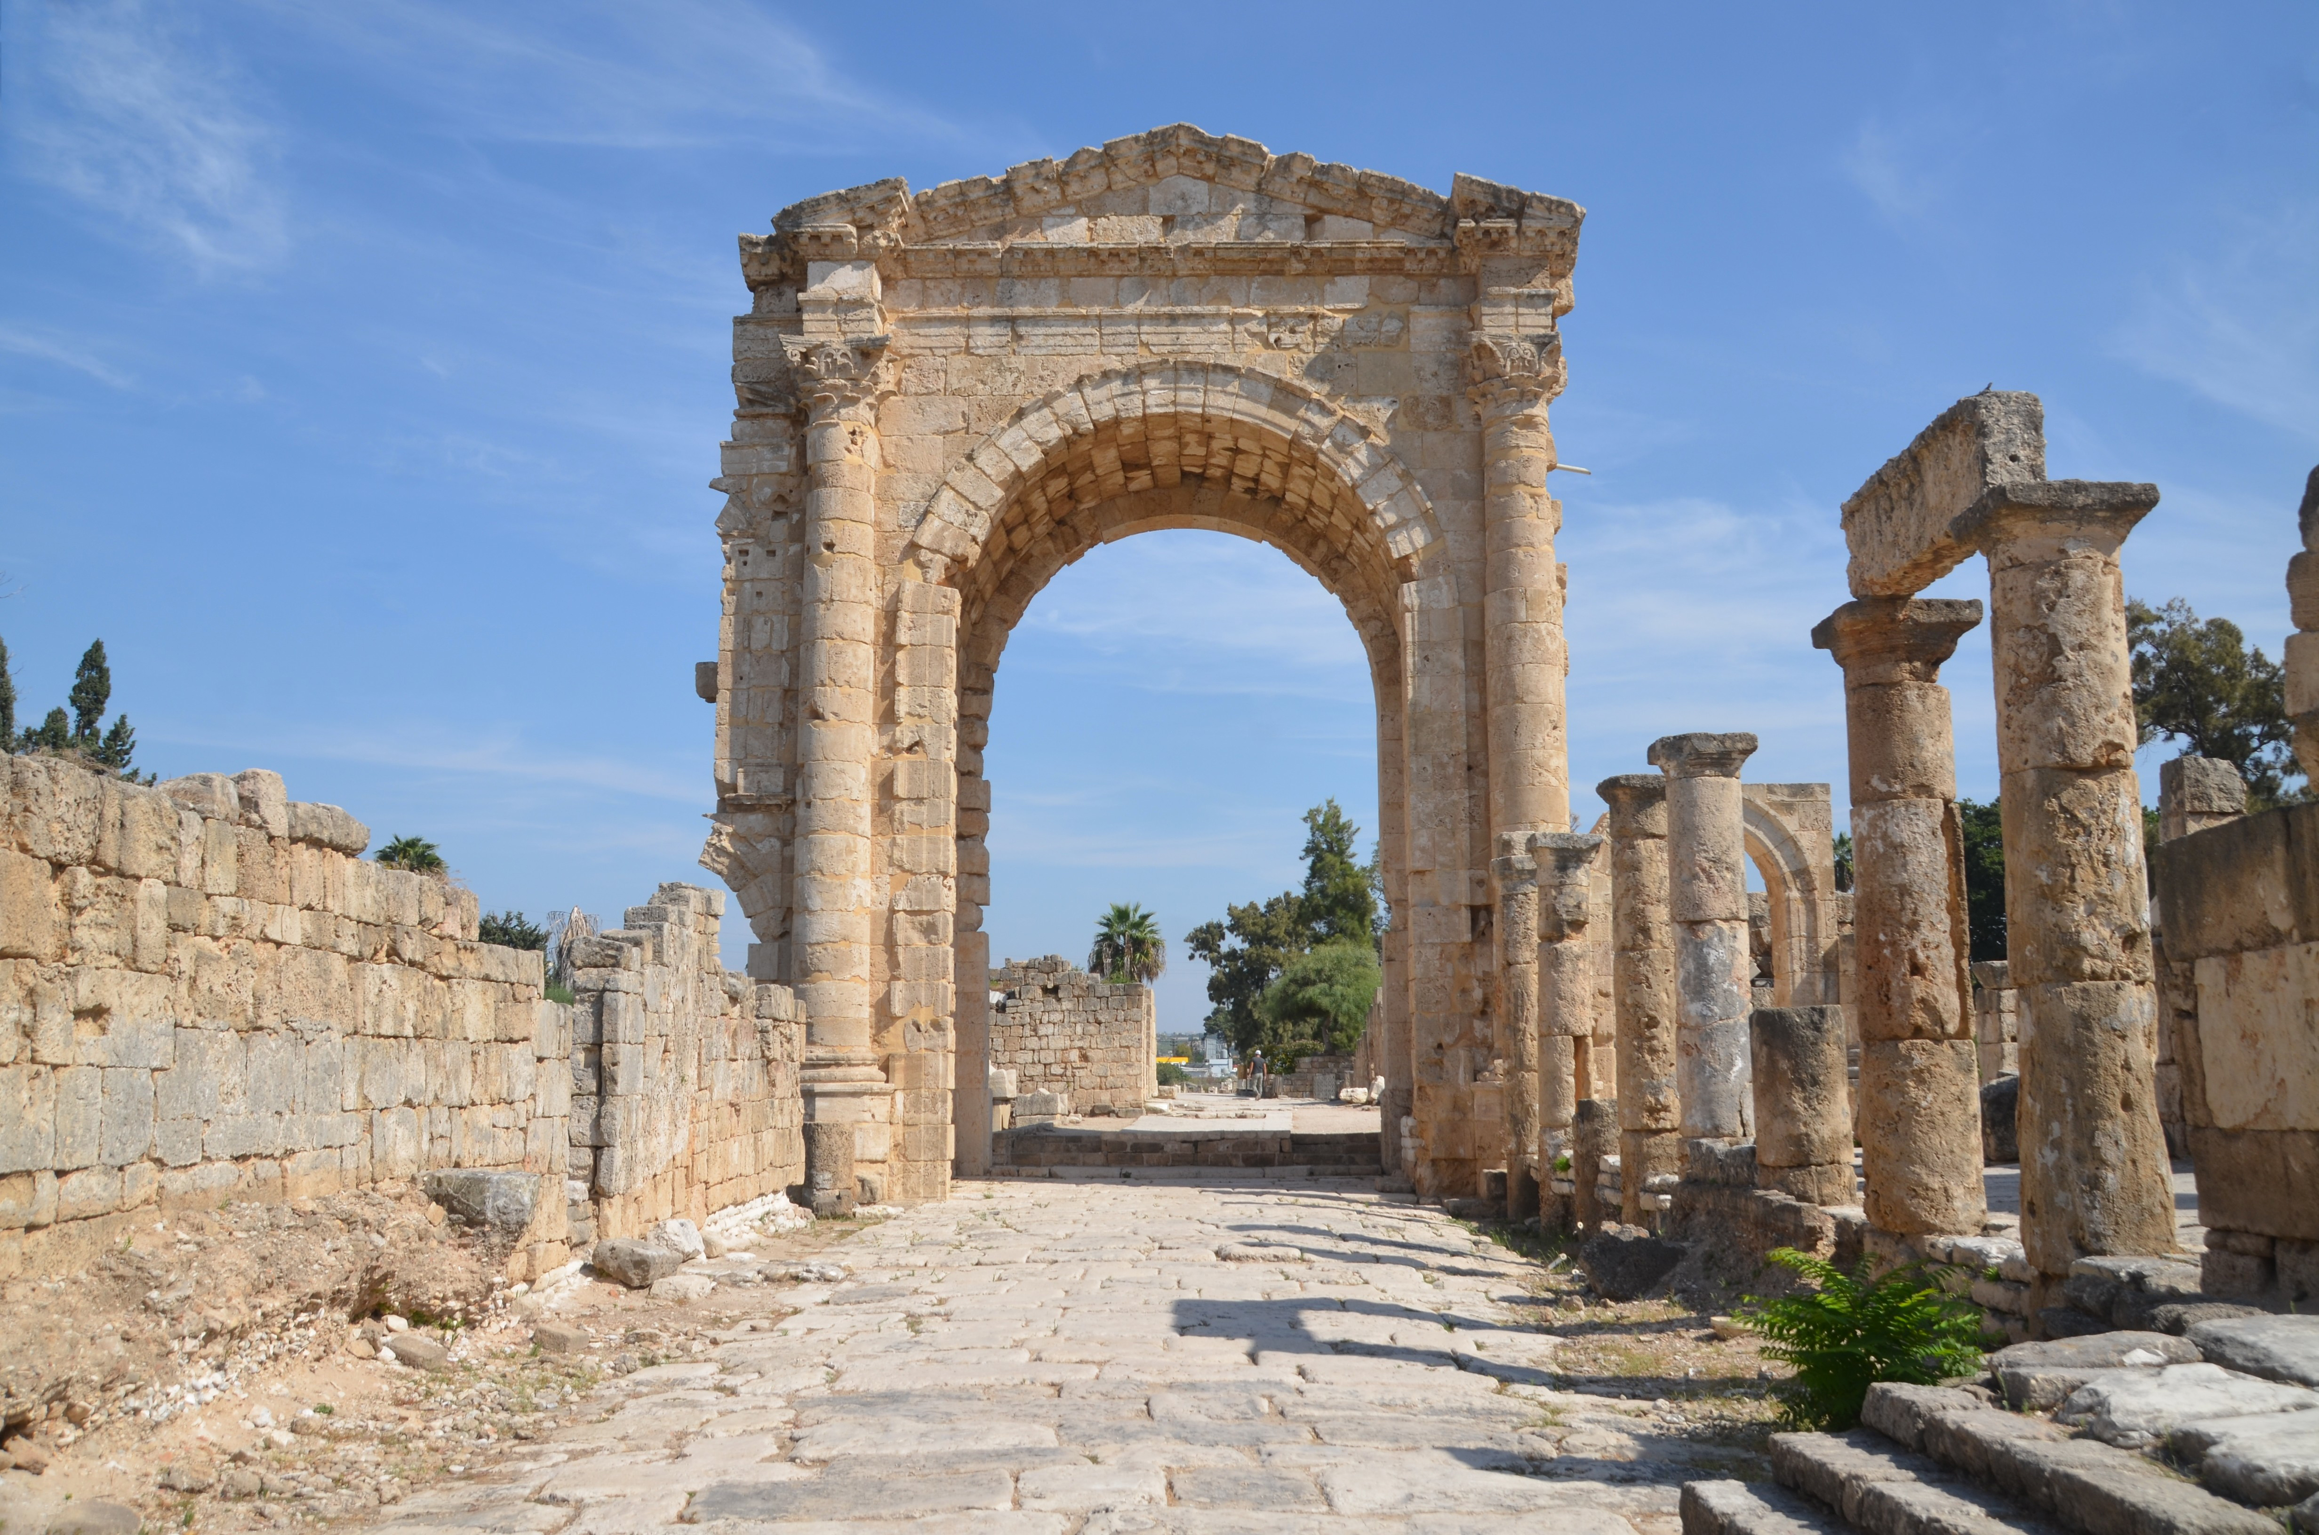
Thus says the Lord: “For three transgressions of Tyre, and for four,
Amos 1:9-10

Slide 18
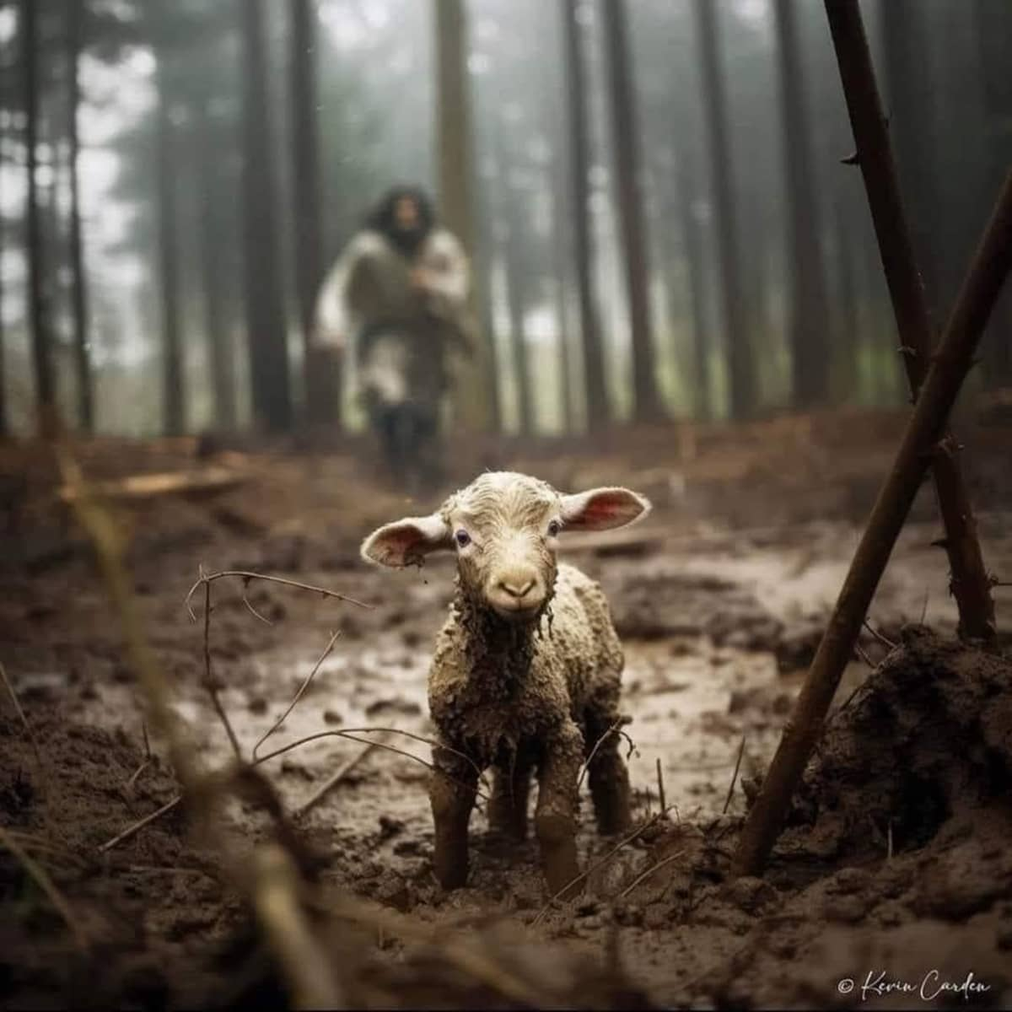
“I was not sent except to the lost sheep of the house of Israel.”
Matthew 15:24

Slide 19

24 From there He arose and went to the region of Tyre and Sidon. And He entered a house and wanted no one to know it, but He could not be hidden.
Mark 7:24

Slide 20
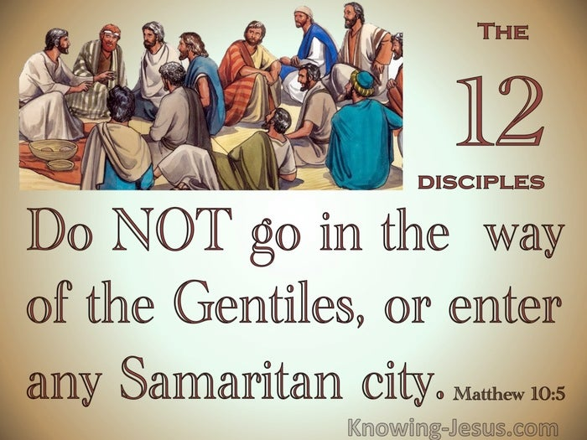
Matthew 10:5-6

Slide 21
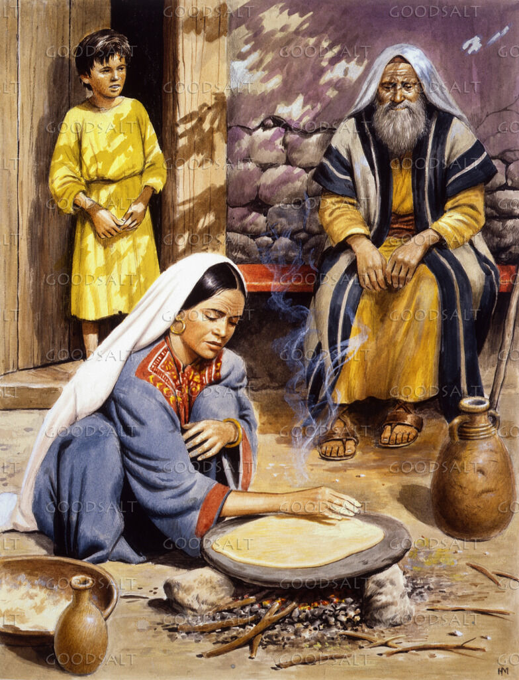
1 Kings 17
He needed solace and comfort and provision; the Lord sent him to house of a widow of Zarephath.

Slide 22
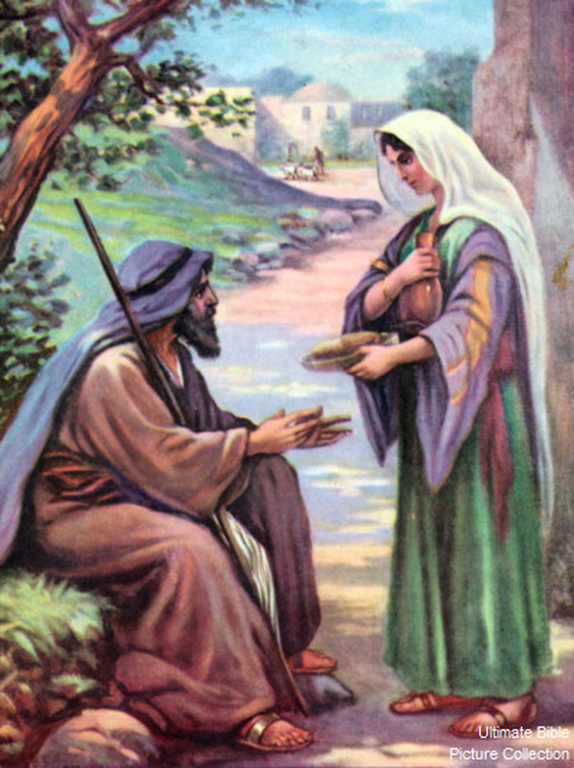
1 Kings 17:8-9
“Arise, go to Zarephath, which belongs to Sidon, and dwell there. See, I have commanded a widow there to provide for you.”

Slide 23
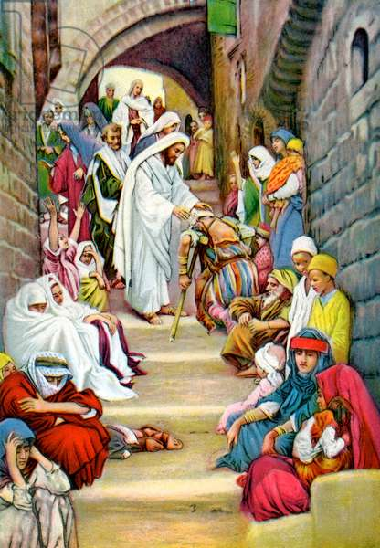
Matthew 4:24
They brought to Him all sick people who were afflicted with various diseases and torments, and those who were demon-possessed, epileptics, and paralytics; and He healed them.

Slide 24
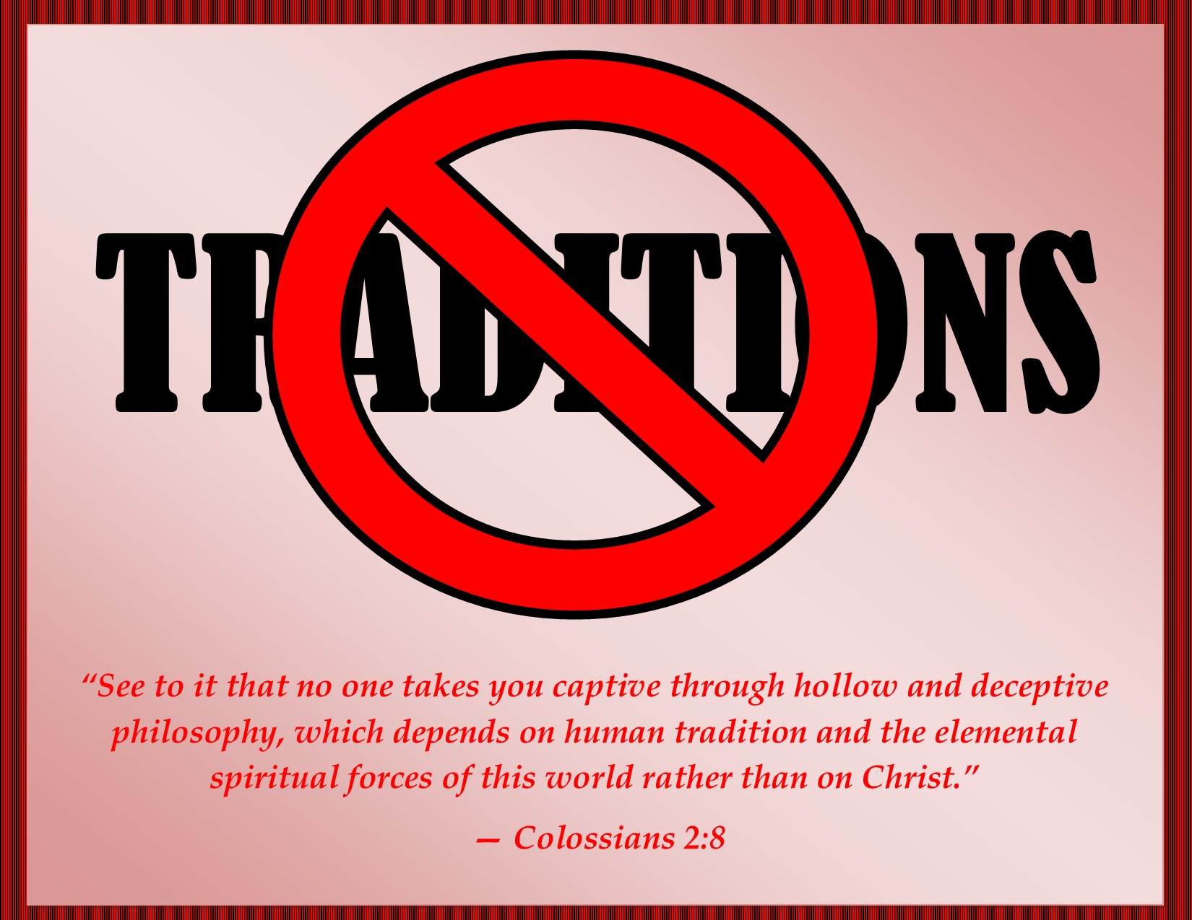
Mark 3:8
A great multitude, when they heard how many things He was doing, came to Him

Slide 25
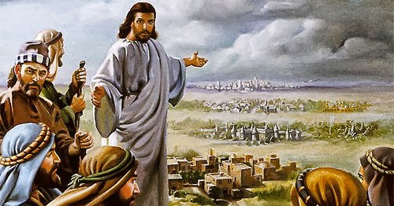
Matthew 11:21-23
“Woe to you, Chorazin! Woe to you, Bethsaida!

Slide 26
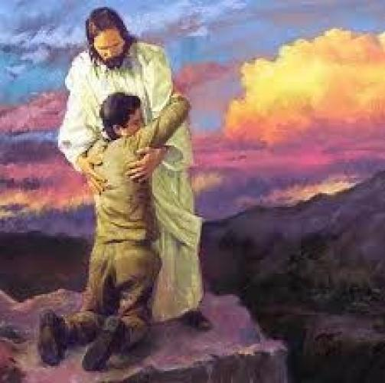
John 6:37
All that the Father gives Me will come to Me, and the one who comes to Me I will by no means cast out.

Slide 27

Matthew 11:28
Come to Me, all you who labour and are heavy laden, and I will give you rest.

Slide 28
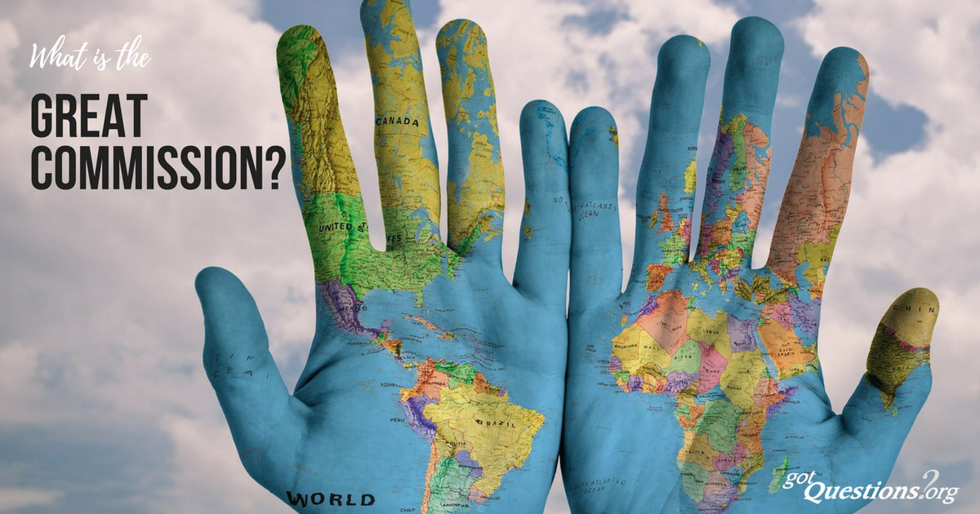

Matthew 28:19

Slide 29
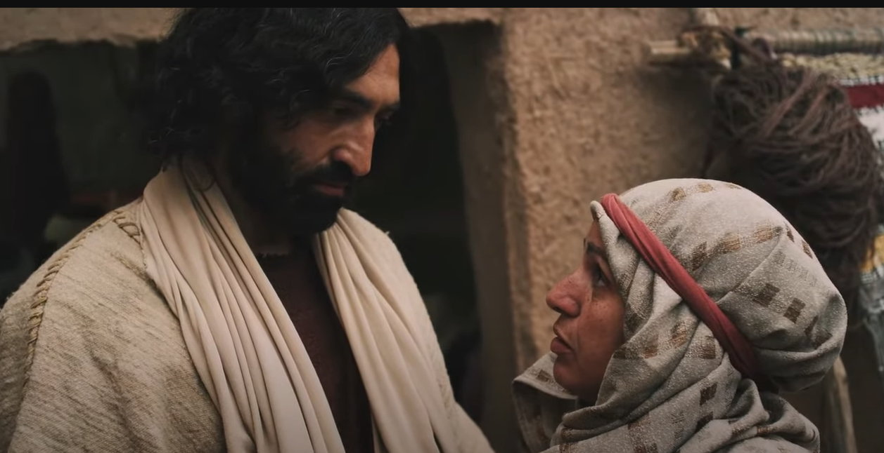
Matthew 15:22
Canaanite Woman

Slide 30

Deuteronomy 7:1-5
The Lord your God delivers them over to you, you shall conquer them and utterly destroy them

Slide 31
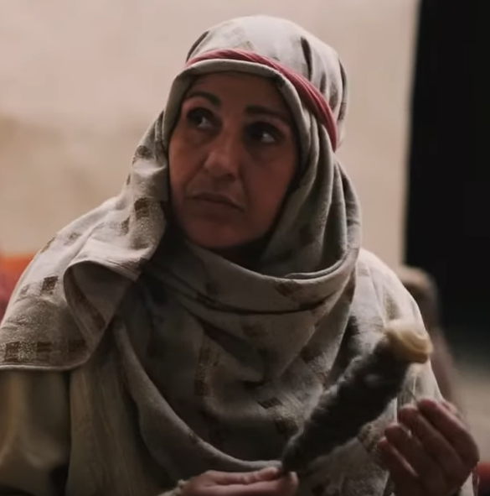
Canaanite Woman
Outside the covenant
An outcast.
A sinner & from a people of sinners.
No right to the covenant.
No worthiness to ask anything of our Lord.
A perfect example of a sinner who comes without right, without privilege, without worthiness to embrace by faith Jesus Christ.

Slide 32
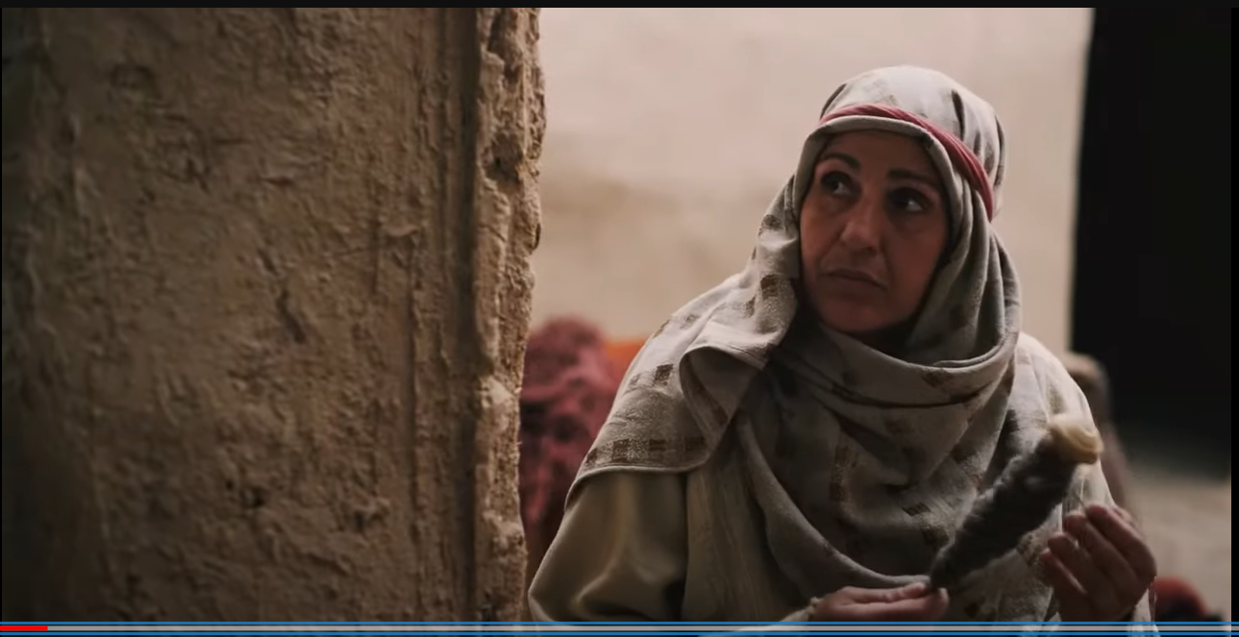
Mega Faith Characteristics
1
Right
Person

Slide 33
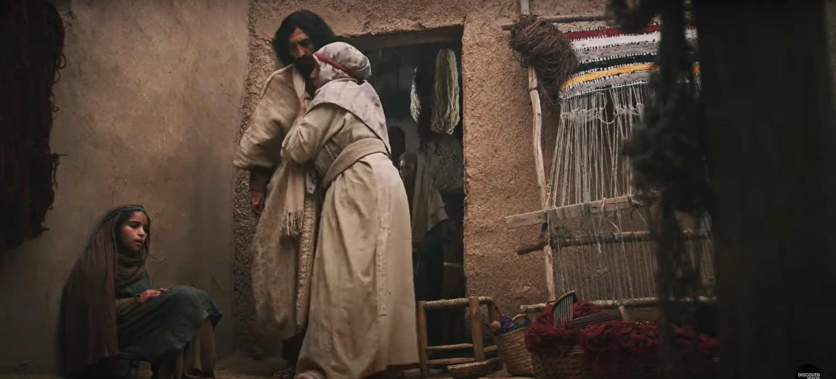
Matthew 15:22

Slide 34


1 Thessalonians 1:9
how you turned to God from idols to serve the living and true God,

Slide 35


Acts 4:12

Slide 36

Acts 3:16
Through Faith

Slide 37

Acts 20:21
Repentance toward God and faith toward our Lord Jesus Christ

Slide 38

Hebrews 12:2
the Author
and Finisher of our Faith,

Slide 39
Turning from sin to God,
Turning from idols to God.
2
Repentant

Slide 40
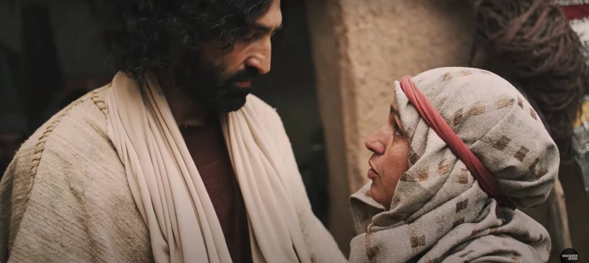
Matthew 15:22

Slide 41
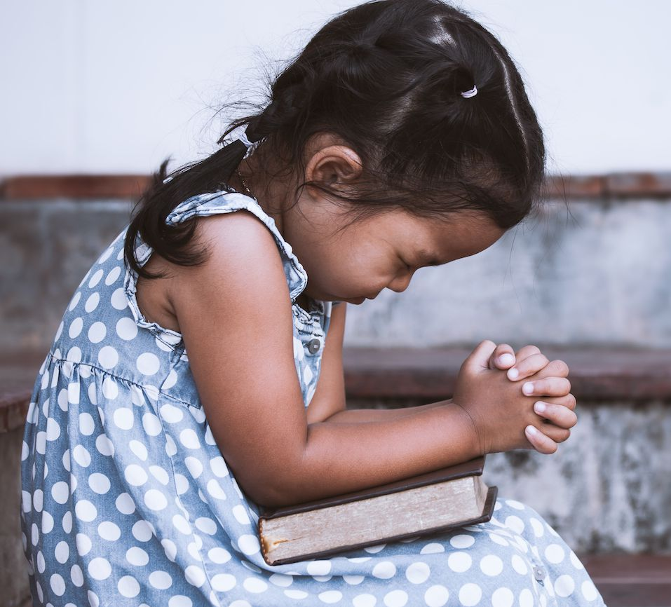
Psalm 51:1-2
Have mercy upon me, O God, According to Your lovingkindness;

Slide 42

Exodus 34:6-7
“The Lord, the Lord God, merciful and gracious, longsuffering, and abounding in goodness and truth, ⁷ keeping mercy for thousands, forgiving iniquity and transgression and sin, by no means clearing the guilty, visiting the iniquity of the fathers upon the children and the children’s children to the third and the fourth generation.”

Slide 43
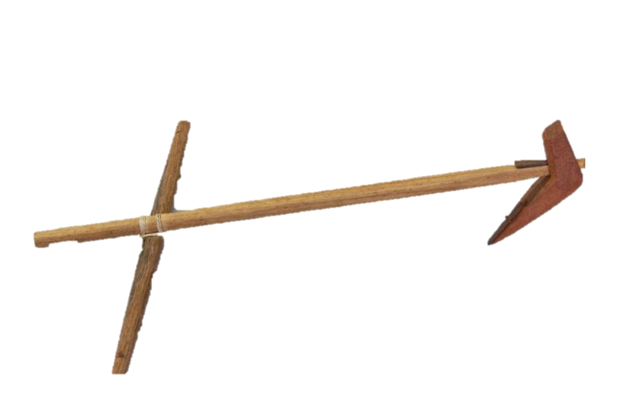

Repentance
Repentance is the inseparable companion of faith
Faith

Slide 44
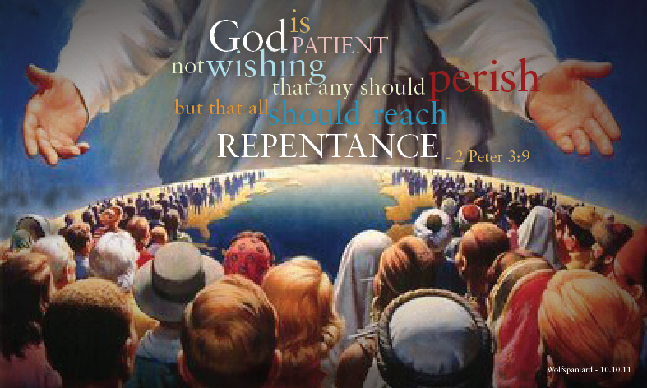
2 Peter 3:9

Slide 45

Romans 2:4
the goodness of God leads you to repentance

Slide 46
Lord, sovereign deity,
Son of David promised Messiah, Saviour.
3
Reverent

Slide 47
Matthew 15:22

Slide 48

Matthew 8:2

Slide 49
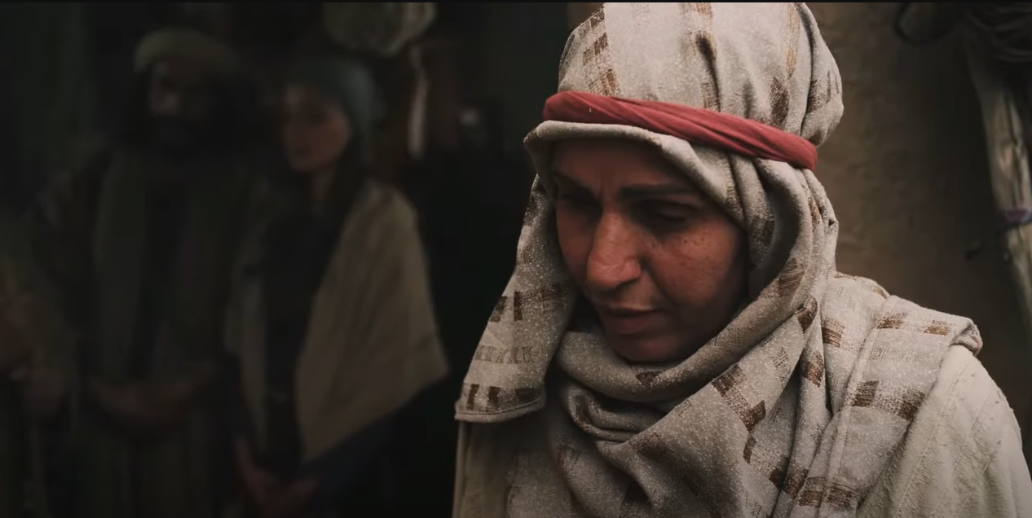
Matthew 15:23
4
Persistent

Slide 50
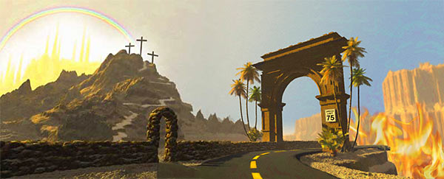
Matthew 7
Jesus said the gate is narrow and few there be that find it.

Slide 51

Luke 13:24
Strive to enter through the narrow gate, for many, I say to you, will seek to enter and will not be able.

Slide 52
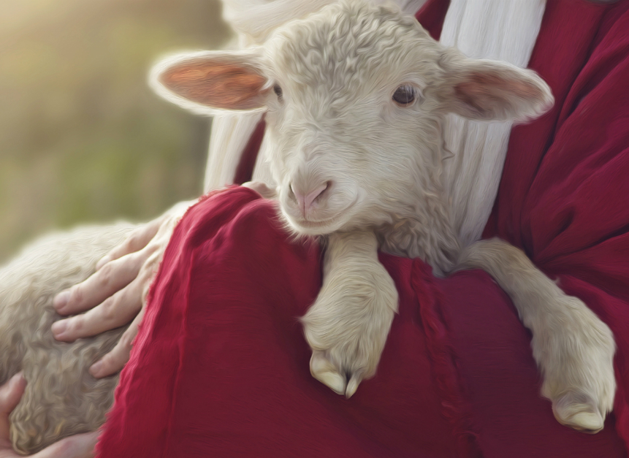
Matthew 15:24
Why would Jesus ever say that?

Slide 53
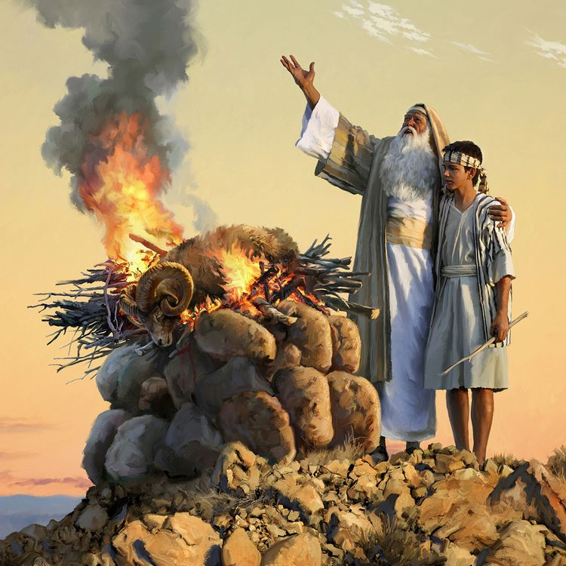
Acts 3:25-26
saying to Abraham, ‘And in your seed all the families of the earth shall be blessed.’

Slide 54
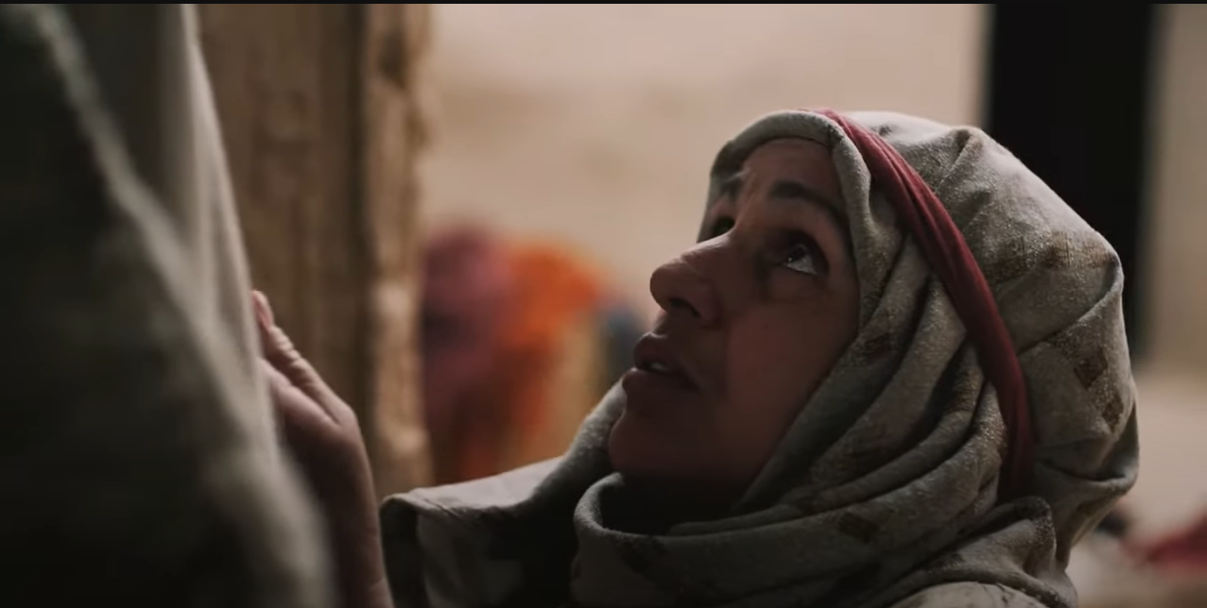
Matthew 15:25
5
Humble

Slide 55
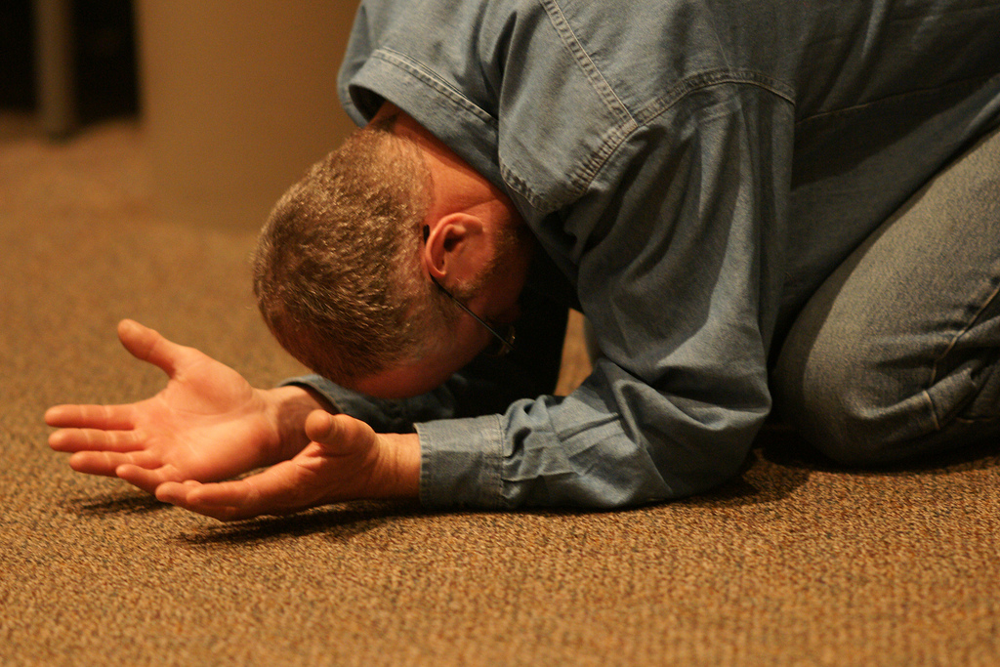
Proskuneō
Worship is always accepted by the Lord.
We see in Matthew
chapter 8,
chapter 9,
chapter 14,
chapter 18,
chapter 28,

Slide 56
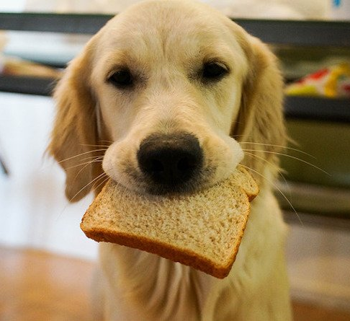
Matthew 15:26
“It is not good to take the children’s bread and throw it to the little dogs.”

Slide 57

Matthew 7:6
Do not give what is holy to the dogs

Slide 58
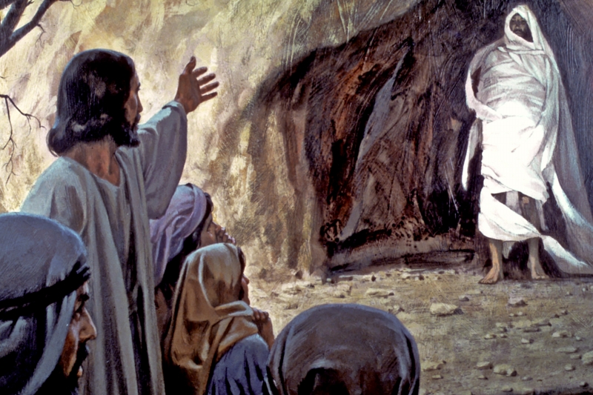
John 11:14-15
Why did Jesus wait?

Slide 59

Matthew 15:27

Slide 60
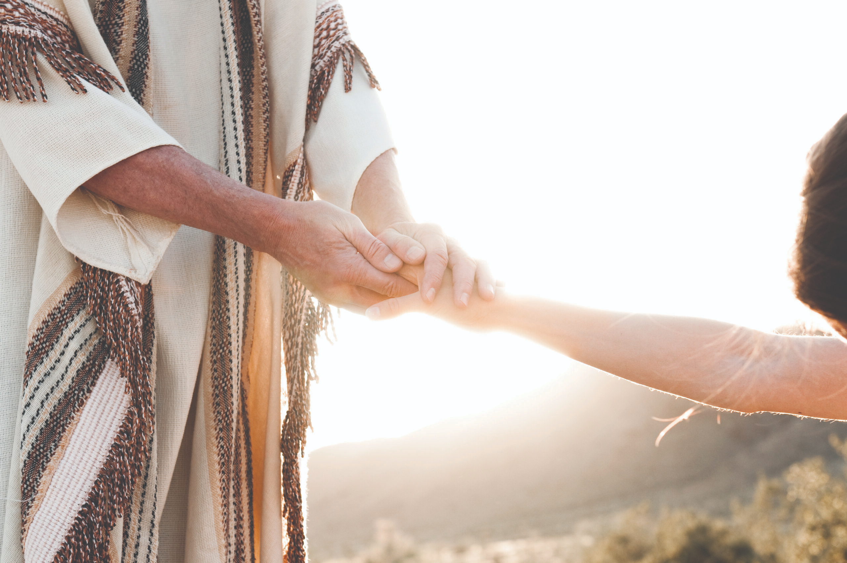
Matthew 15:28
“O woman, great is your faith! Let it be to you as you desire.”

Slide 61
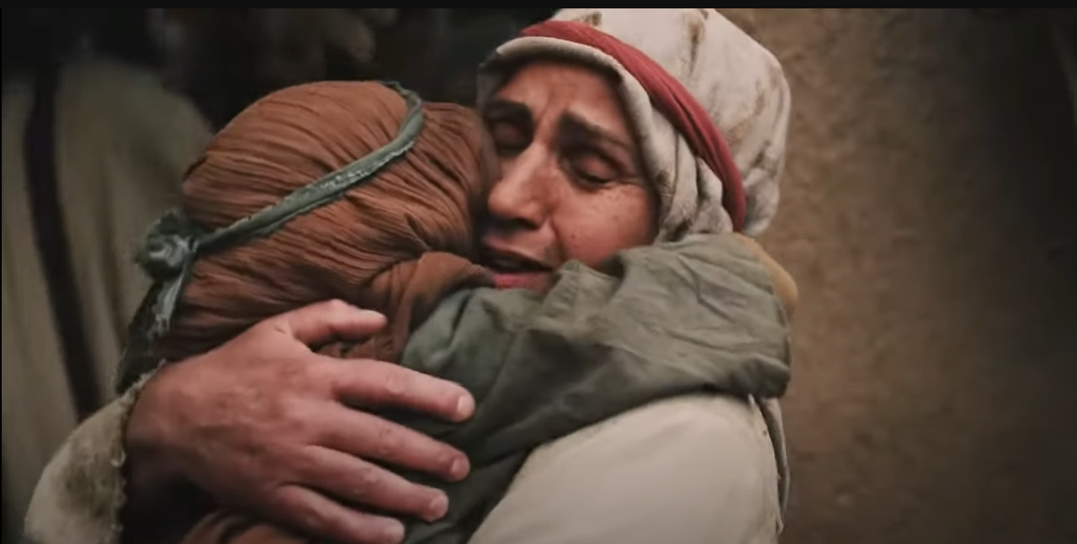
Mark 7:29-30
And when she had come to her house, she found the demon gone out

Slide 62
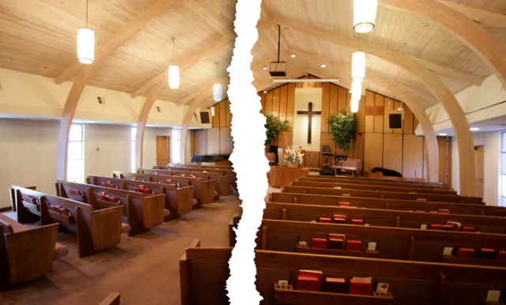
No difference inside the Church
let there not be any division, We are all one family.

Slide 63


Willing to embrace people!
let our church be a welcoming church

