Slide 1


Slide 2


7th Response to Jesus
Wayside Soil- Faith for Physical!
Matthew 15:29-39

Slide 3

Matthew 15:29-39
Feeding the Four Thousand

Slide 4
Matthew Chapter 13
Kingdom Parables were spoken.

Slide 5
Matthew 13:53 till Matthew 16:12,
Eight Incidents

Slide 6
Matthew 13:53 till Matthew 16:12,
Eight Incidents
1st response: Matthew 13:53-58 - Unbelief!
2nd response: Matthew 14:1-12 Fear that Forfeit’s Christ!
3rd response: Matthew 14:12-21 Faith for only materials!
4th response: Matthew 14:22-33 Jesus is Lord.
5th Response: Matthew 14:36-15:20 Vain Worship.
6th Response: Matthew 15:29-39 Mega Faith- Good Soil.

Slide 7
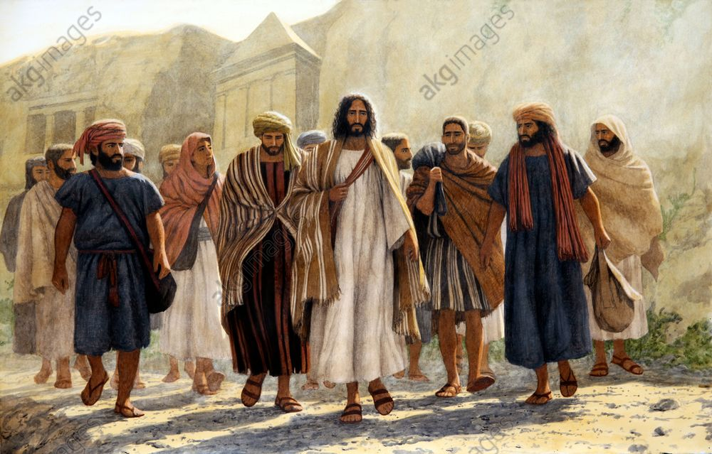
BA C K G R O U N D

Slide 8
Matthew 15:29
Jesus departed from there, skirted the Sea of Galilee, and went up on the mountain and sat down there.

Slide 9
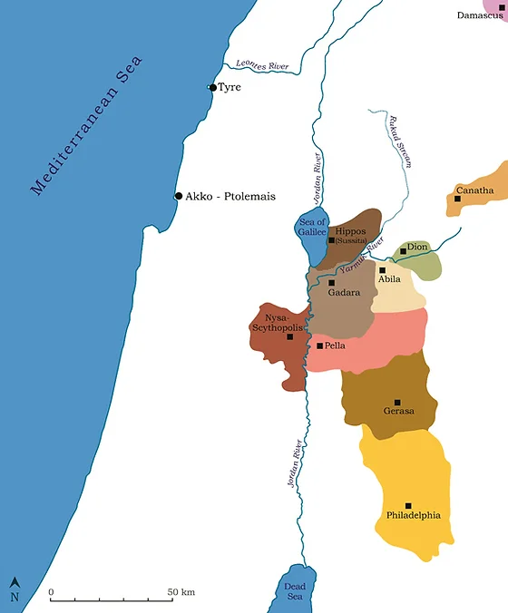

Slide 10
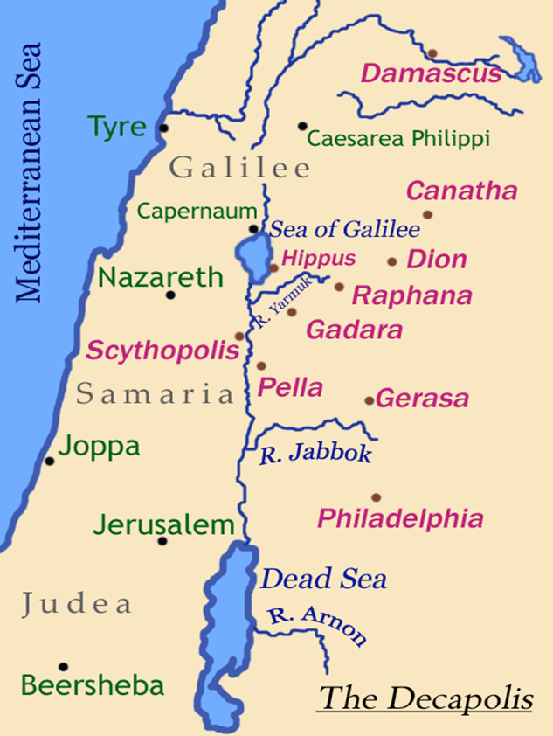

Slide 11
Matthew 15:29
Jesus departed from there, skirted the Sea of Galilee, and went up on the mountain and sat down there.

Slide 12
Matthew 14:19,
TIME GAP
Then He commanded the multitudes to sit down on the grass.

Slide 13
Matthew 14:19,
TIME GAP
Then He commanded the multitudes to sit down on the grass.
Matthew 15:35,
So He commanded the multitude to sit down on the ground.

Slide 14
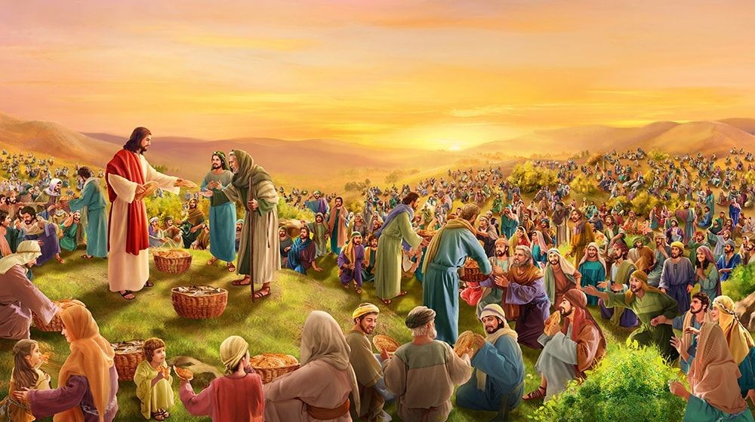
summer

Slide 15
Acts 10
“You are not going to believe this, but the same thing that happened to us happened to the gentiles.”

Slide 16
Our Lord ended each phase of His ministry with a feeding.
Ended the ministry in Galilee with the feeding of the 5,000.
Ended the ministry in the gentile area with the feeding of the 4,000.
Ended the Judean ministry before His death on the cross with the feeding of His own in the upper room, and the Lord always leaves people fed.

Slide 17
Decapolis
Decapolis is on the southeast edge of the Sea of Galilee.

Slide 18
Decapolis
Decapolis is on the southeast edge of the Sea of Galilee.
GADARA

Slide 19
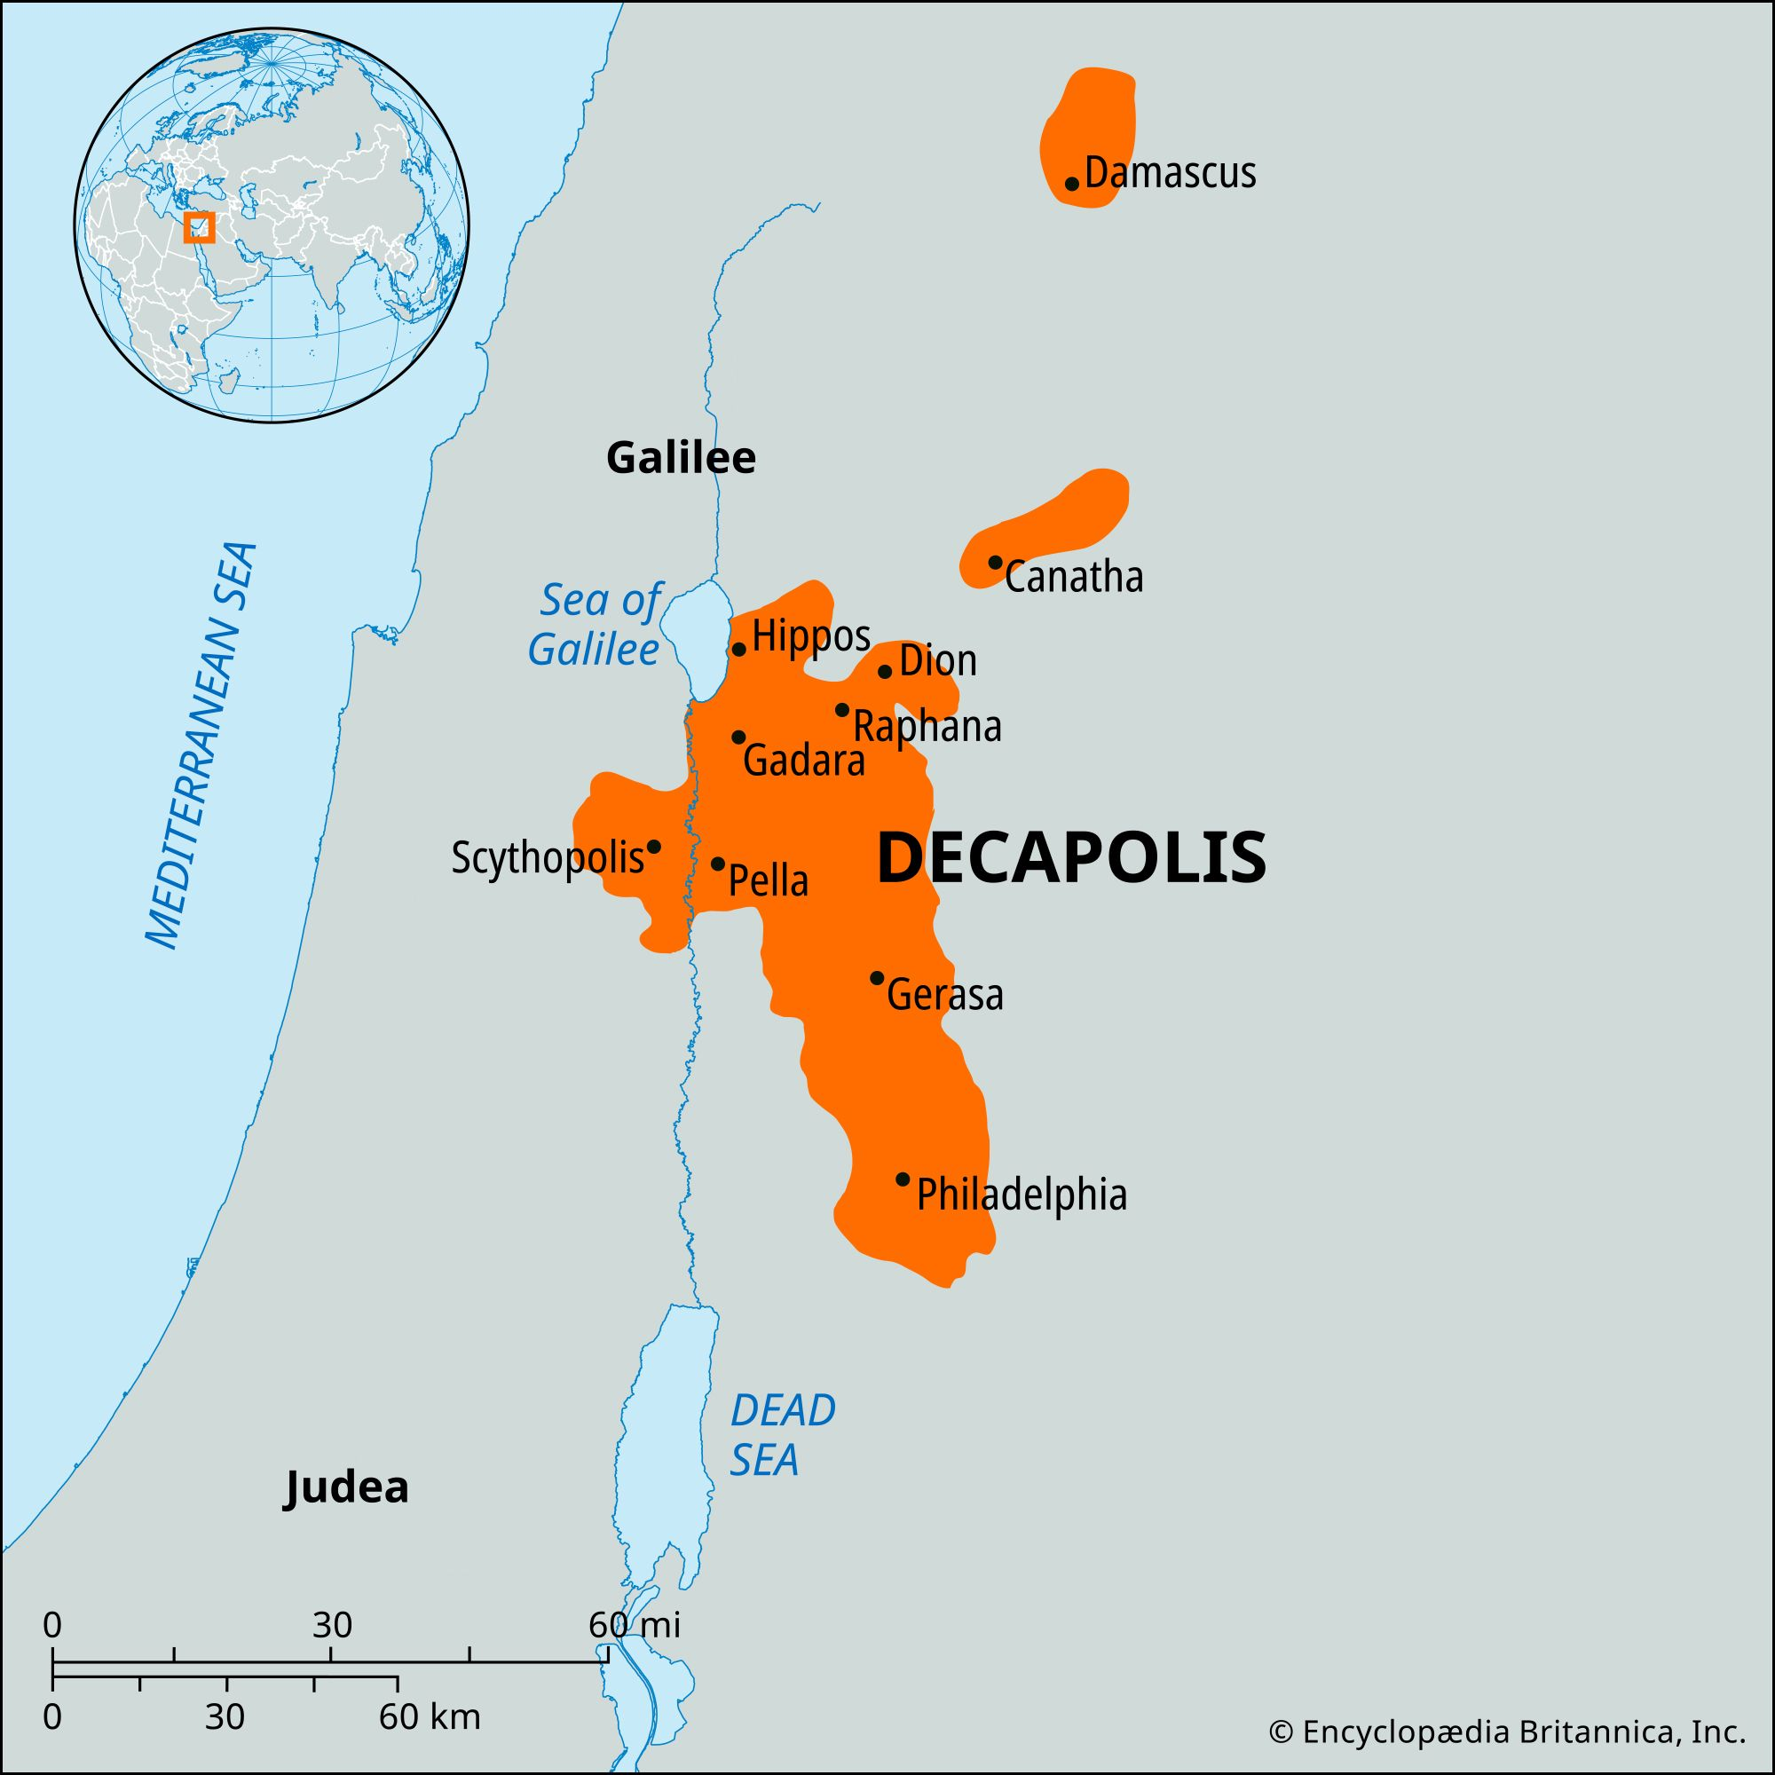

Deka is ten,
Polis is city.

Slide 20
Decapolis
Wedged in between two territories under Jewish domination
One controlled by Philip the tetrarch
Other controlled by Herod Antipas.
In the middle was this wedge called Decapolis.

Slide 21
Matthew 4:25,
Great multitudes followed Him—from Galilee, and from Decapolis, Jerusalem, Judea, and beyond the Jordan.

Slide 22
Matthew 15:30
Then great multitudes came to Him, having with them the lame, blind, mute, maimed, and many others; and they laid them down at Jesus’ feet, and He healed them.

Slide 23
KULLOS
If they didn’t have an arm, He gave them one.
If they didn’t have a leg, He gave them one.
If they were missing an ear, He gave them one.
If they had lost a finger, He gave them one.

Slide 24
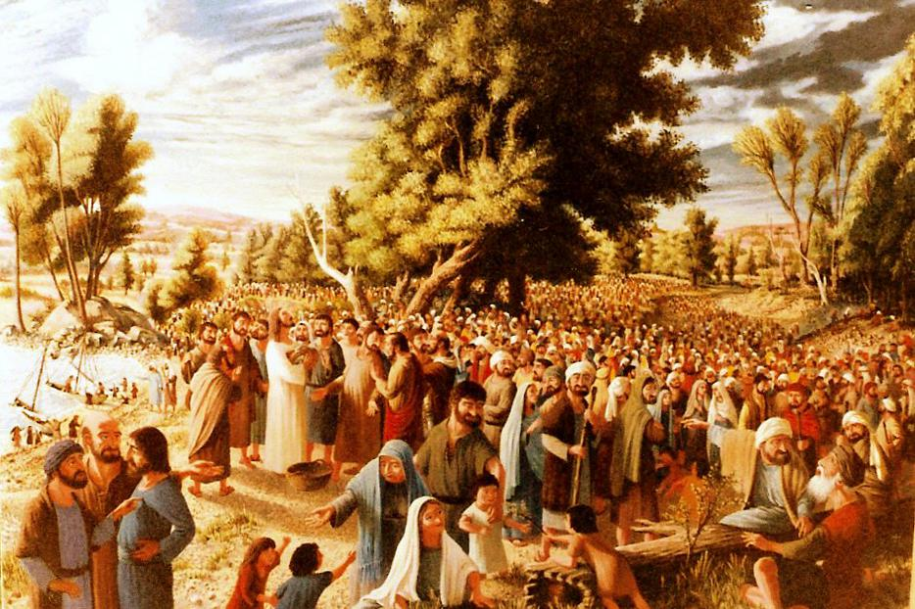
They were all throwing these people at His feet.

Slide 25
Matthew 15:31
So the multitude marvelled when they saw the mute speaking, the maimed made whole, the lame walking, and the blind seeing; and they glorified the God of Israel.

Slide 26
Mark 7:37
And they were astonished beyond measure, saying, “He has done all things well. He makes both the deaf to hear and the mute to speak.”

Slide 27
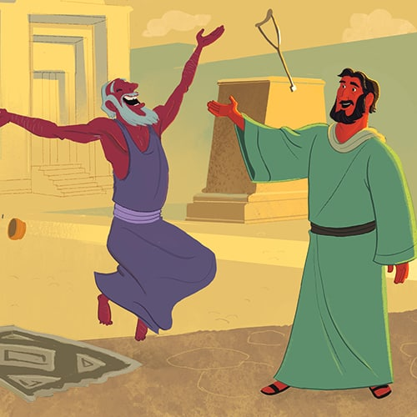
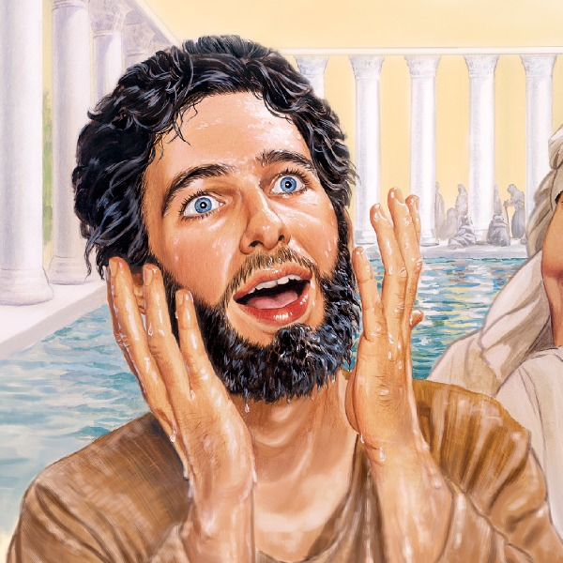
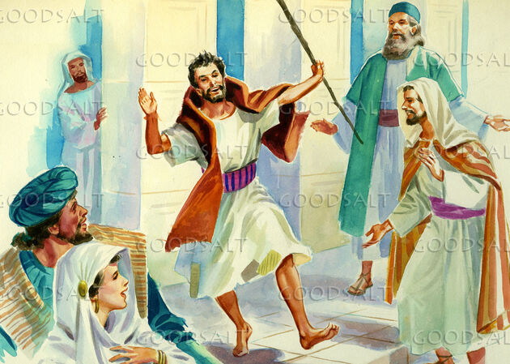
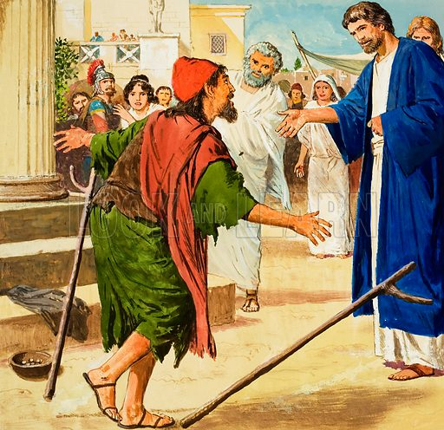
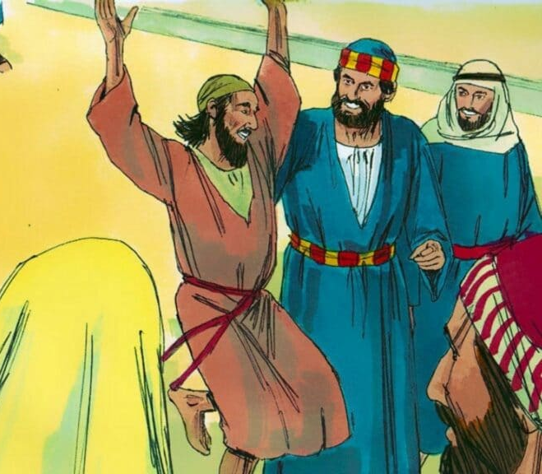
Astonished
Marvelled

Slide 28
Matthew 15:31
And they glorified the God of Israel.

Slide 29
Matthew 9:8,
Now when the multitudes saw it, they marvelled and glorified God, who had given such power to men.

Slide 30
What does it mean to glorify God?
Luke 5:25-26,
25 Immediately he rose up before them, took up what he had been lying on, and departed to his own house, glorifying God.
26 And they were all amazed, and they glorified God and were filled with fear, saying, “We have seen strange things today!”

Slide 31
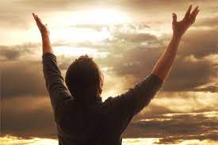
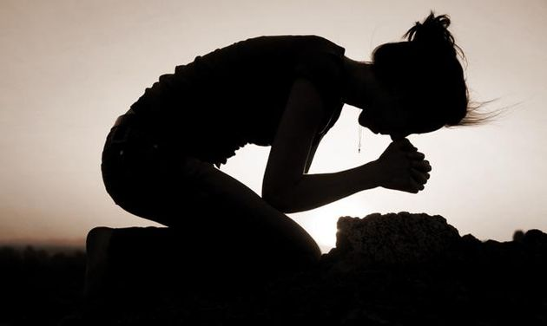
What does it mean to glorify God?
Glorifying God in this context is a combination of
PRAISE & FEAR.

Slide 32
Matthew 15:32
Now Jesus called His disciples to Himself and said, “I have compassion on the multitude, because they have now continued with Me three days and have nothing to eat. And I do not want to send them away hungry, lest they faint on the way.”

Slide 33
Understand the compassion of God
I can understand Him giving a leg to a man without a leg.
I can understand Him giving eyes to one who doesn’t see.
I can understand Him giving a tongue and a voice to one who can’t speak.
But I can’t see Him getting too uptight about a guy who hasn’t eaten for three days.

Slide 34
Psalms 37:25,
I have been young, and now am old; Yet I have not seen the righteous forsaken, Nor his descendants begging bread.
Jesus said, “if My Father takes care of the grass and the lilies, don’t you think He will take care of you?”

Slide 35
Matthew 15:32
“I will not send them away fasting, lest they faint in the way.”

Slide 36
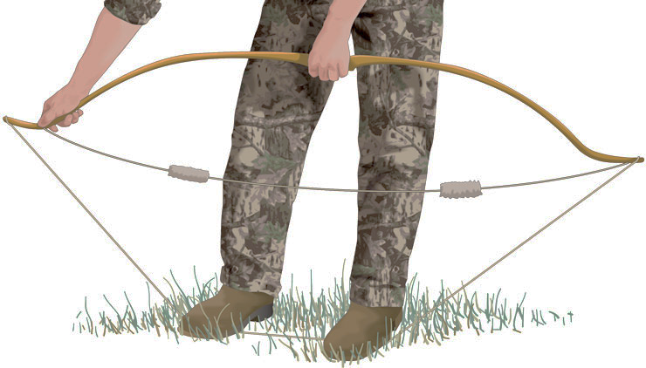
Faint means Collapse
Lord says, “I’m not going to let them collapse on the way home.”

Slide 37
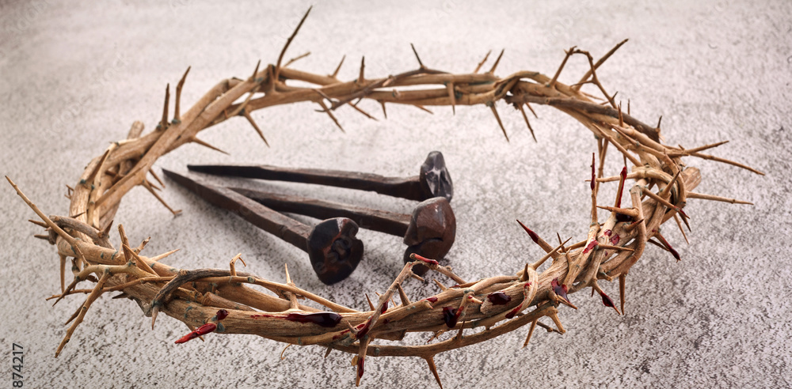
GOD got bigger things than that, surely but that’s the extent of the
Infinite Heart Of God.

Slide 38
Matthew 15:33
Then His disciples said to Him, “Where could we get enough bread in the wilderness to fill such a great multitude?”

Slide 39
Matthew 15:34
Jesus said to them, “How many loaves do you have?” And they said, “Seven, and a few little fish.”

Slide 40
Matthew 15:35,36
35 So He commanded the multitude to sit down on the ground.
36 And He took the seven loaves and the fish and gave thanks, broke them and gave them to His disciples; and the disciples gave to the multitude.

Slide 41
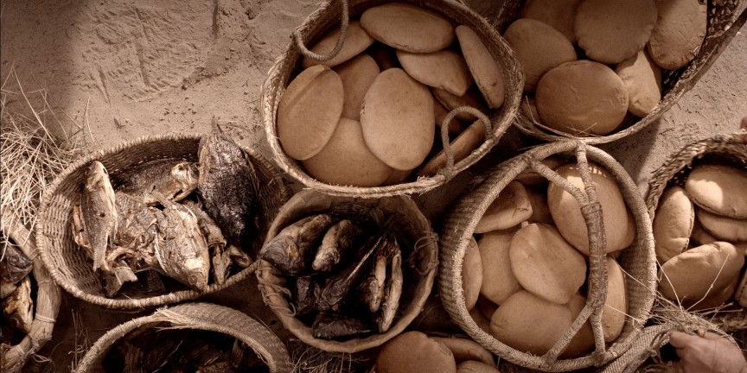
Jesus was just creating it right out of His own hands.

Slide 42
Matthew 15:37
“They did all eat, and they were filled.”

Slide 43
The first feeding had how many baskets?
Twelve, one for each disciple.
Here you have S E V E N .
Why the difference?

Slide 44
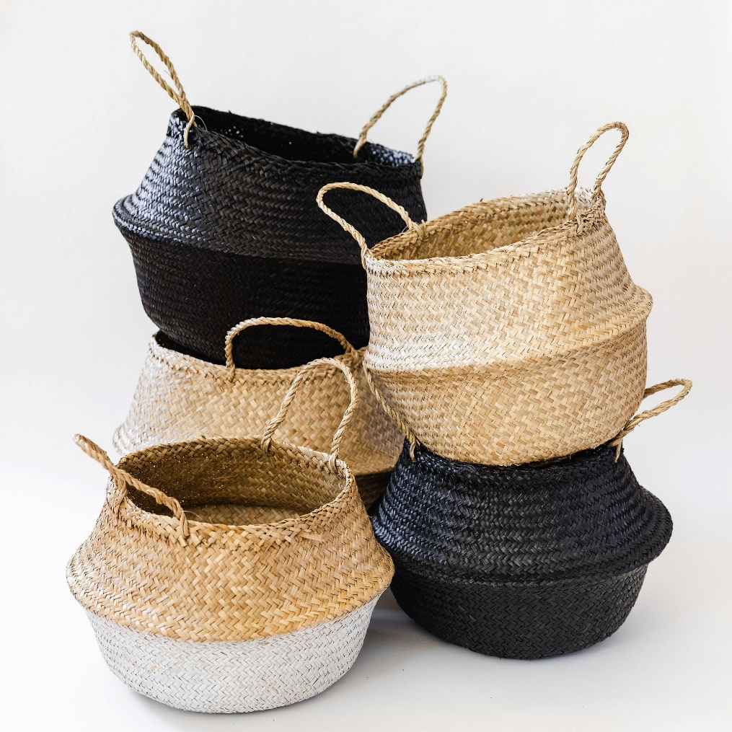
Matthew 14:20,
Basket Greek word is Kophinos.

Slide 45
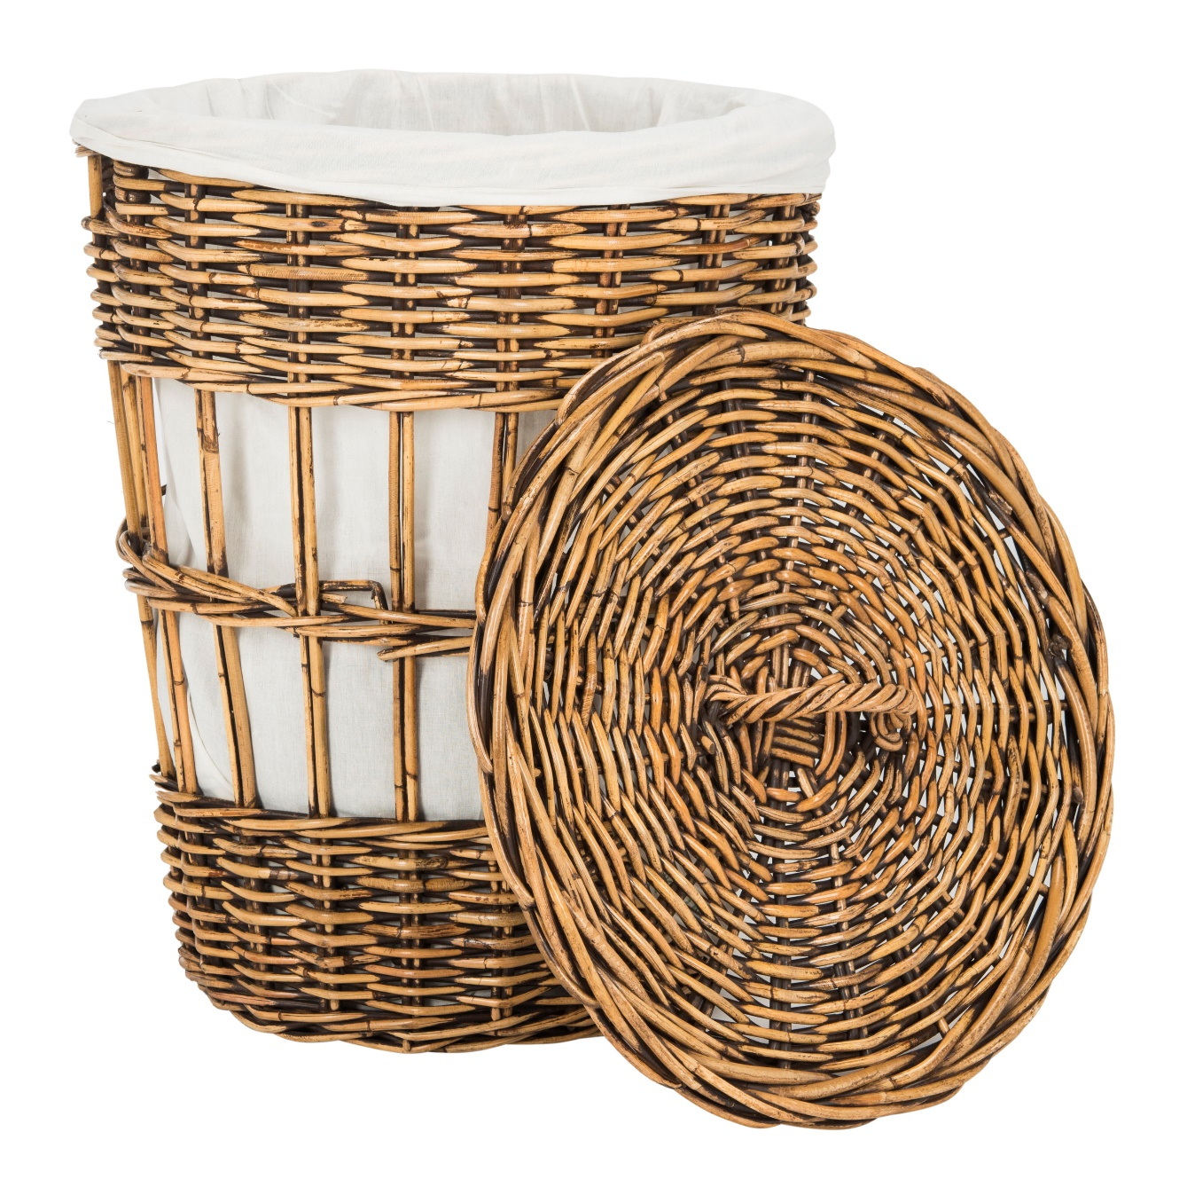
Greek word is Spuris

Slide 46
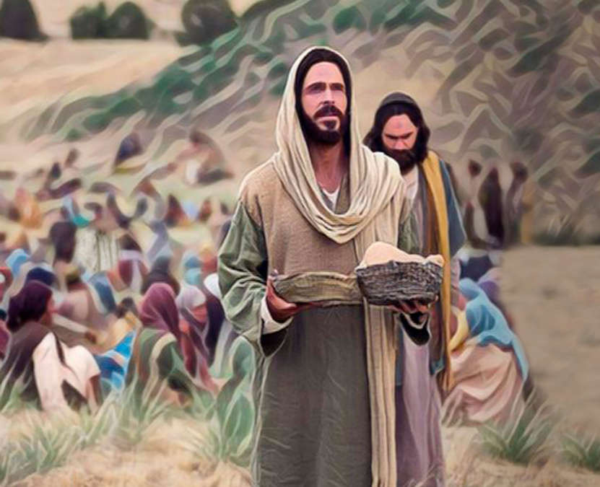
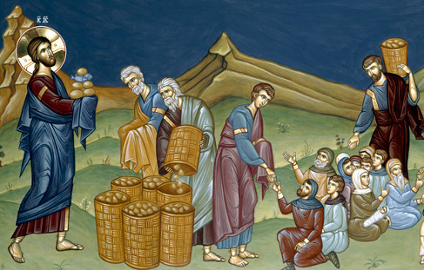
Feeding of the 5,000 Feeding of the 4,000
Kophinos Spuris
Jewish baskets Gentile basket

Slide 47
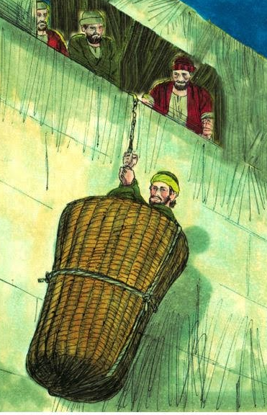
Acts 9:25
Then the disciples took him by night and let him down through the wall in a large basket.

Slide 48
Matthew 15:38,39
38, Now those who ate were four thousand men, besides women and children.
39, And He sent away the multitude, got into the boat, and came to the region of Magdala.

Slide 49
The divine power of Jesus Christ.
He is the Creator God.
It is God alone who can create, and here He is creating limbs, creating eyes, creating tongues, re-creating bodies, creating fish and bread.

Slide 50
2. Goal of all ministries is to worship God.
Everything is to redound to the praise and the glory of God. That is the goal of all ministry.

Slide 51
2. Goal of all ministries is to worship God.
2 Corinthians 4:15,
“Carry the message and be thankful that the abundant grace might, through the thanksgiving of many, redound to the glory of God.”

Slide 52
2. Goal of all ministries is to worship God.
John 4:23-24,
23 But the hour is coming, and now is, when the true worshipers will worship the Father in spirit and truth; for the Father is seeking such to worship Him.
24 God is Spirit, and those who worship Him must worship in spirit and truth.”

Slide 53
3. Dependence on divine resources.

Slide 54
3. Dependence on divine resources.
James 1:17
Every good gift and every perfect gift is from above, and comes down from the Father of lights, with whom there is no variation or shadow of turning.

Slide 55
4. Divine supply.
Lord says, “Give me what you got. It isn’t enough, but I will multiply it and make it enough.”

Slide 56
5. Lord needs waiters.
It’s GOD who creates, and we deliver.
That’s the basic principle on which we live in this life.

