Slide 1
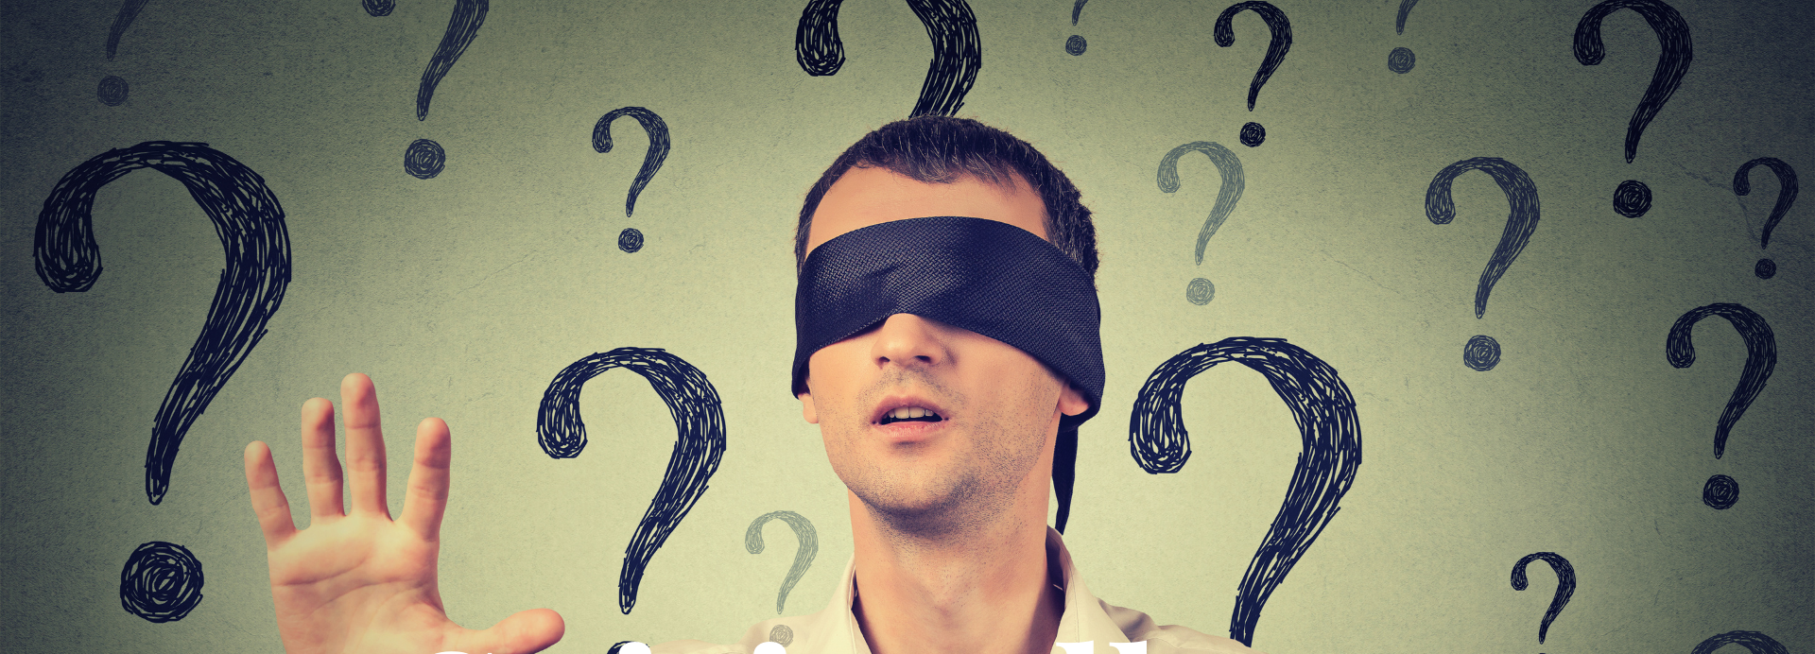

^{Blind can see}
Matthew 16:5-12

Slide 2
⁵ Now when His disciples had come to the other side, they had forgotten to take bread. ⁶ Then Jesus said to them, “Take heed and beware of the ^{[a]}leaven of the Pharisees and the Sadducees.”
⁷ And they reasoned among themselves, saying, “It is because we have taken no bread.”
⁸ But Jesus, being aware of it, said to them, “O you of little faith, why do you reason among yourselves because you^{[b]}have brought no bread? ⁹ Do you not yet understand, or remember the five loaves of the five thousand and how many baskets you took up? ¹⁰ Nor the seven loaves of the four thousand and how many large baskets you took up? ¹¹ How is it you do not understand that I did not speak to you concerning bread?—but to beware of the ^{[c]}leaven of the Pharisees and Sadducees.” ¹² Then they understood that He did not tell them to beware of the leaven of bread, but of the ^{[d]}doctrine of the Pharisees and Sadducees.
Matthew 16:5-12

Slide 3

Blind to spiritual reality
^{Non-Christian or Christian}
Christ-rejecter or Christ-receiver
^{Know God or don’t know God}

Slide 4

2 Kinds of people
^{The blind who will never see}
The blind who will be made to see

Slide 5

4 characteristic of the blind who never see
^{Seek fellowship with darkness}
^{They trouble the light}
They plunge into deeper darkness
^{Abandoned by the Lord}

Slide 6
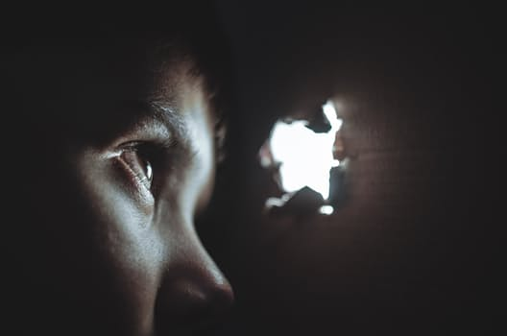
4 characteristic of the blind who are made to see
^{Seek the light}
^{Trouble the darkness}
^{Receive greater light}
^{Taught by the Lord}

Slide 7
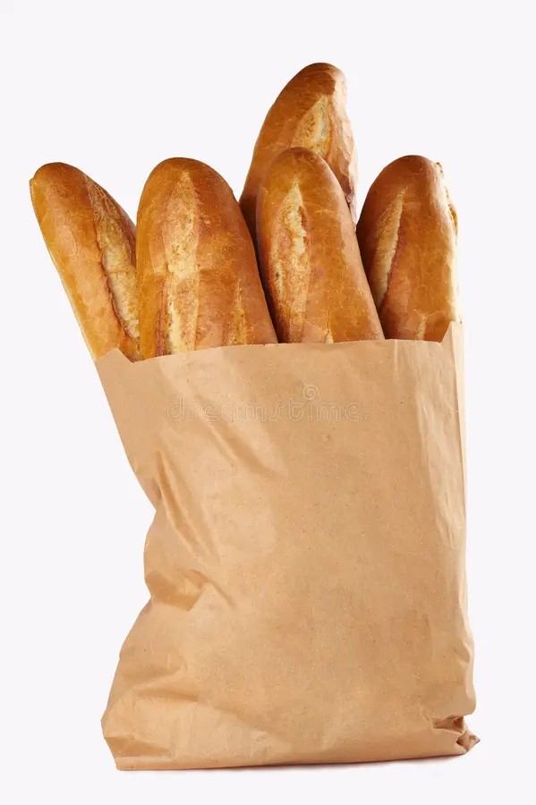
1. Seek the light
Now when His disciples had come to the other side, they had forgotten to take bread.
Matthew 16:5

Slide 8
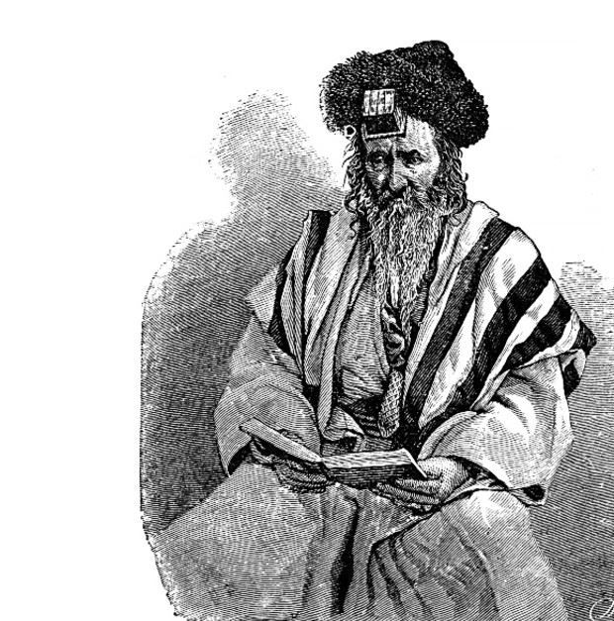
Sadducees
^{They were the aristocracy.}
^{They were the brain trust.}
^{They were the leadership.}
^{They were the rulership.}
They were to be respected and revered.

Slide 9
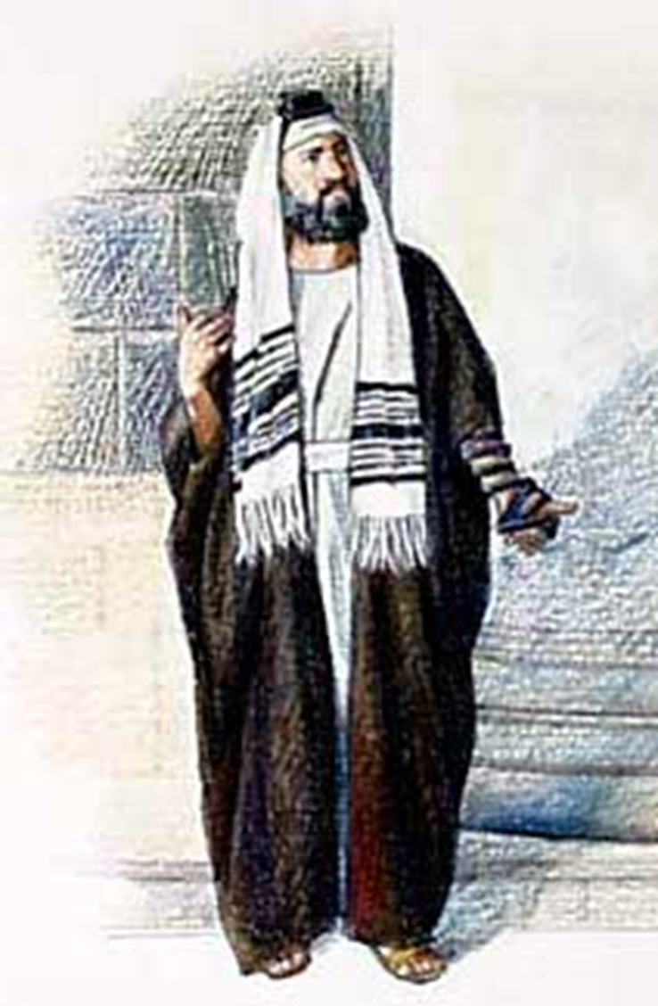
Pharisee
^{Interpreters of the law.}
^{Religious traditionalists.}
^{Legalists.}
^{Mingling among the people.}
^{Demanded respect of people.}

Slide 10
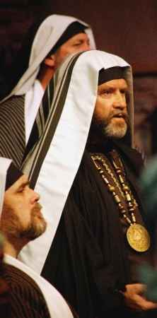
Identify with the darkness (system)
^{VS}
^{Follow the light}
Disciples at crossroads

Slide 11
¹³ And you will seek Me and find Me, when you search for Me with all your heart. ¹⁴ I will be found by you, says the Lord, and I will bring you back from your captivity; I will gather you from all the nations and from all the places where I have driven you, says the Lord, and I will bring you to the place from which I cause you to be carried away captive.
Jeremiah 29:13-14

Slide 12

Seeking heart
Disciple, mathētēs means learners.
^{Learners.}
^{Following to be taught.}
^{Sought to know the truth.}
He was not a light to be seen, He was a light to be followed!

Slide 13

The Lord is my light and my salvation;
Whom shall I fear?
The Lord is the strength of my life;
Of whom shall I be afraid?
Psalms 27:1

Slide 14
⁶⁶ From that time many of His disciples went back and walked with Him no more. ⁶⁷ Then Jesus said to the twelve, “Do you also want to go away?”⁶⁸ But Simon Peter answered Him, “Lord, to whom shall we go? You have the words of eternal life. ⁶⁹ Also we have come to believe and know that You are the Christ, the Son of the living God.”
John 6:66-69

Slide 15
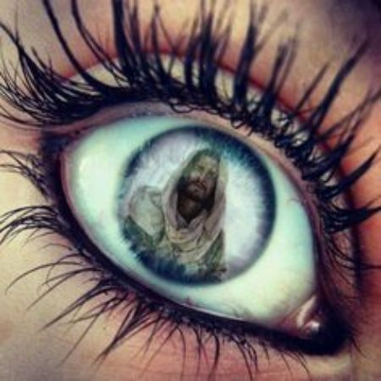
Psalm 119:18
Open my eyes, that I may see Wondrous things from Your law.

Slide 16
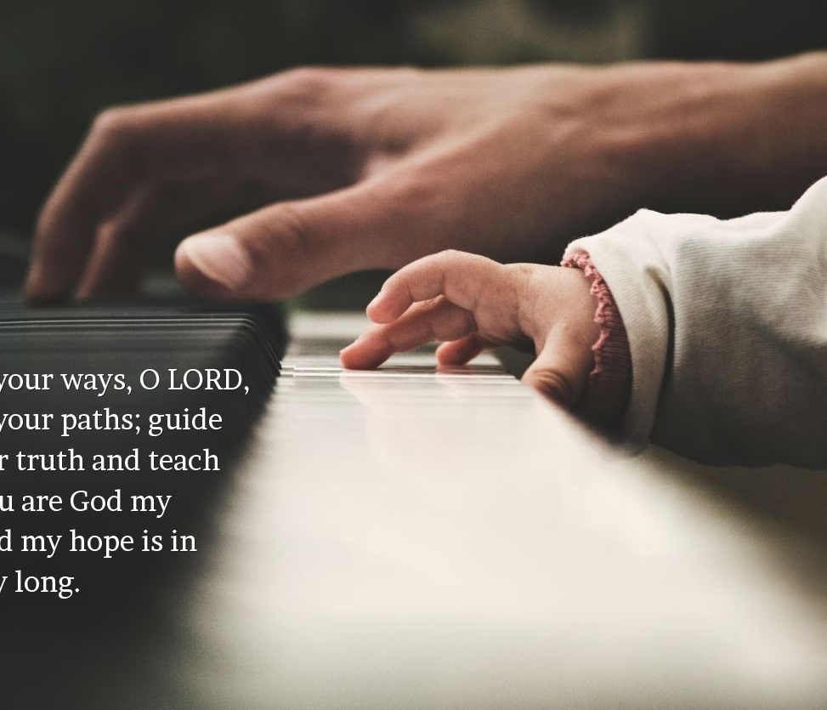
Psalm 119:33
Teach me, O Lord, the way of Your statutes,
And I shall keep it to the end.

Slide 17

Psalm 119:36
Incline my heart to Your testimonies,
And not to covetousness.

Slide 18
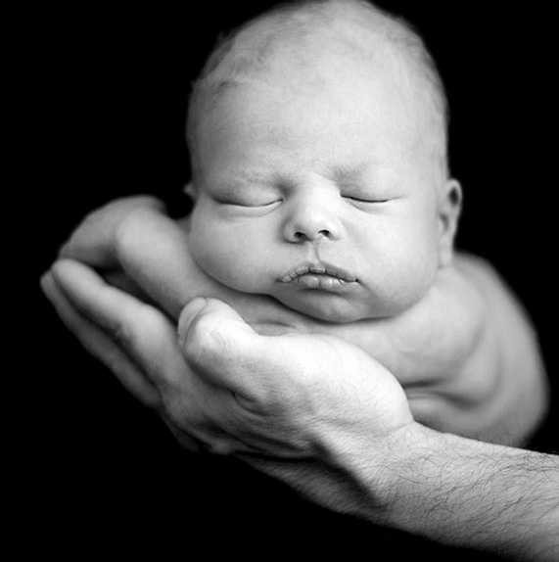
Psalm 119:73
Your hands have made me and fashioned me;
Give me understanding, that I may learn Your commandments.

Slide 19

2. Trouble the darkness
They turned their back on those who brought them only deeper darkness.

Slide 20
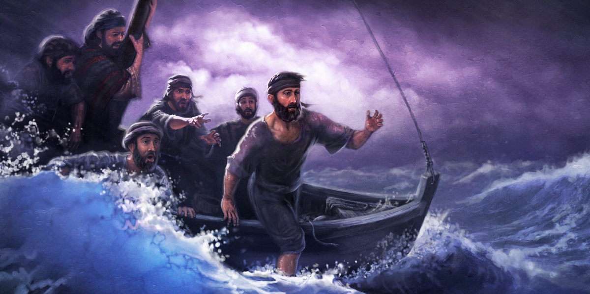
Oh you little faith!
^{Matthew 8}
^{Matthew 14}
^{Matthew 15}
^{Matthew 16}

Slide 21
¹⁰ And the disciples came and said to Him, “Why do You speak to them in parables?”¹¹ He answered and said to them, “Because it has been given to you to know the mysteries of the kingdom of heaven, but to them it has not been given. ¹² For whoever has, to him more will be given, and he will have abundance; but whoever does not have, even what he has will be taken away from him.¹³ Therefore I speak to them in parables, because seeing they do not see, and hearing they do not hear, nor do they understand.
Matthew 13:10-17

Slide 22
¹⁴ And in them the prophecy of Isaiah is fulfilled, which says: ‘Hearing you will hear and shall not understand, And seeing you will see and not perceive; ¹⁵ For the hearts of this people have grown dull. Their ears are hard of hearing, And their eyes they have closed, Lest they should see with their eyes and hear with their ears, Lest they should understand with their hearts and turn, So that I should heal them.’ ¹⁶ But blessed are your eyes for they see, and your ears for they hear; ¹⁷ for assuredly, I say to you that many prophets and righteous men desired to see what you see, and did not see it, and to hear what you hear, and did not hear it.
Matthew 13:10-17

Slide 23
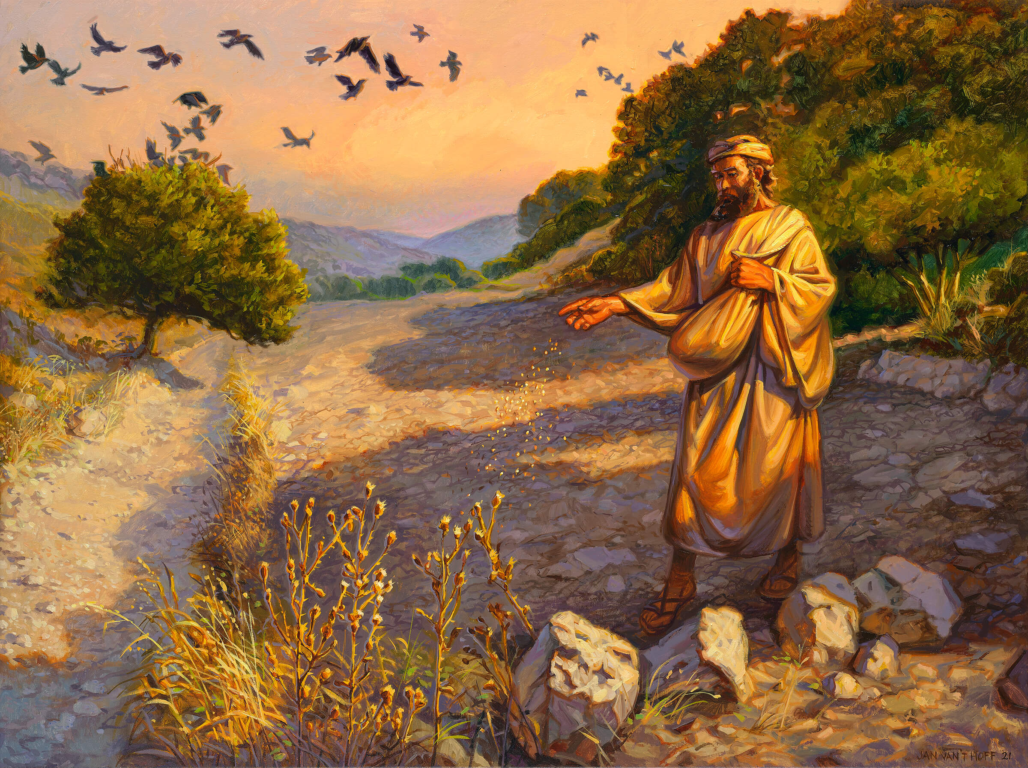
Matthew 13:18
Jesus says, “Hear therefore the parable of the Sower” and explains it to them.

Slide 24
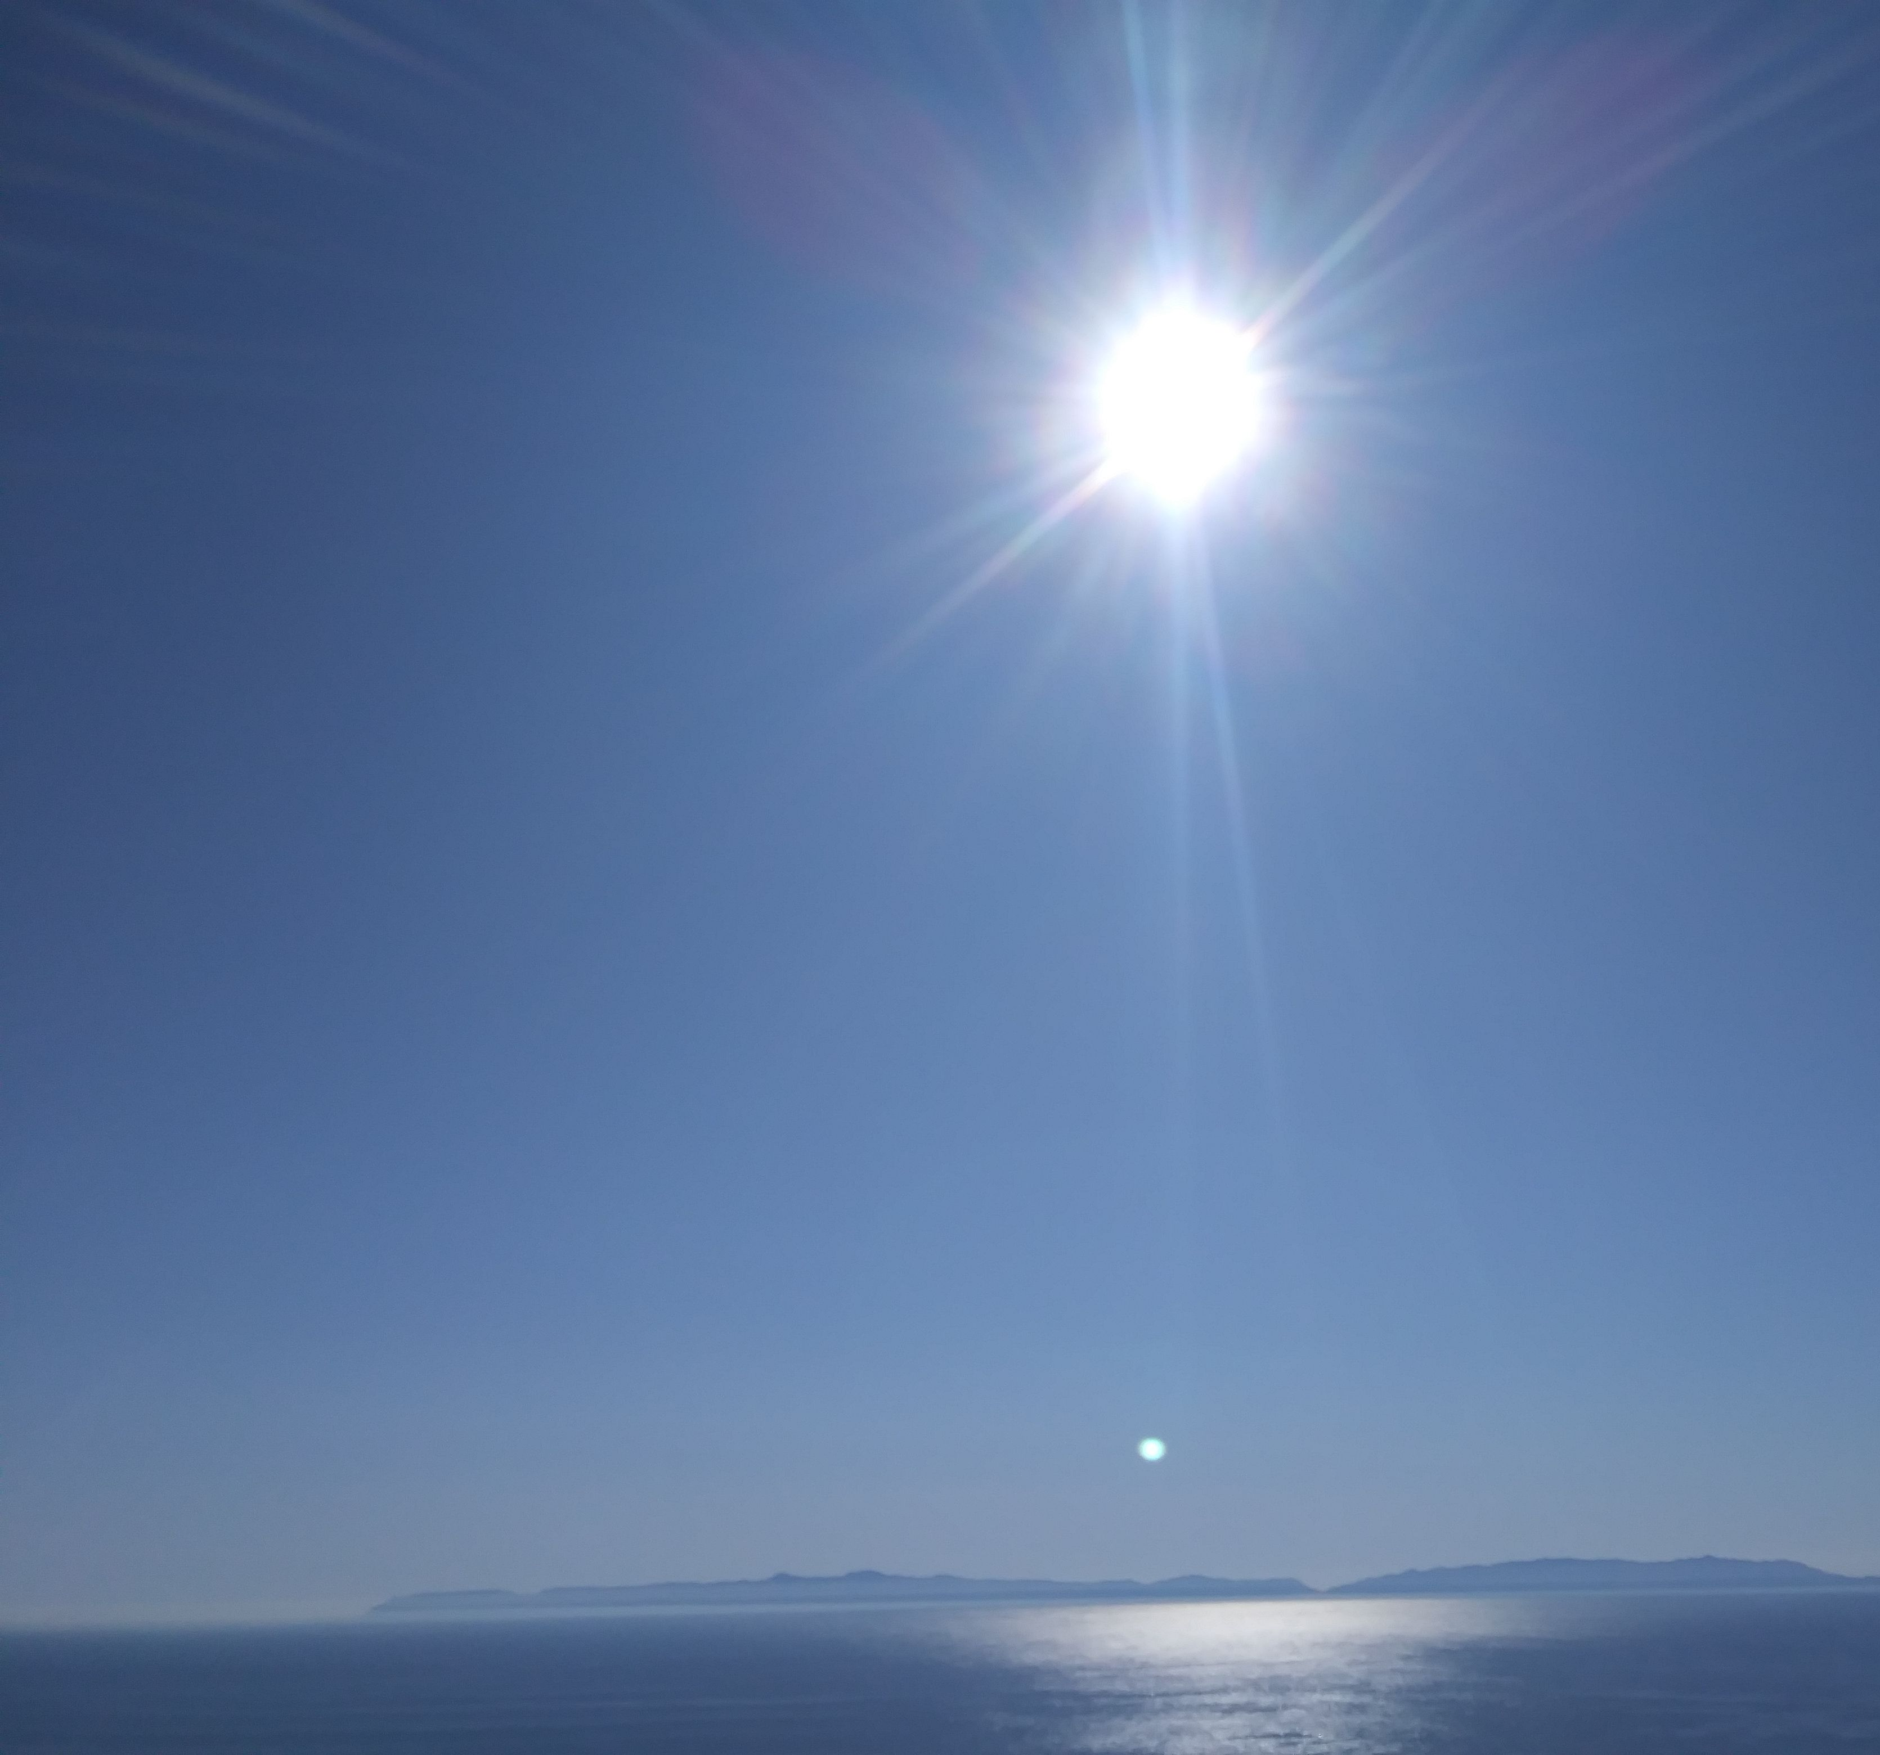
3. Receive greater light
Jesus taught them and He knew they were dependent on that teaching.

Slide 25
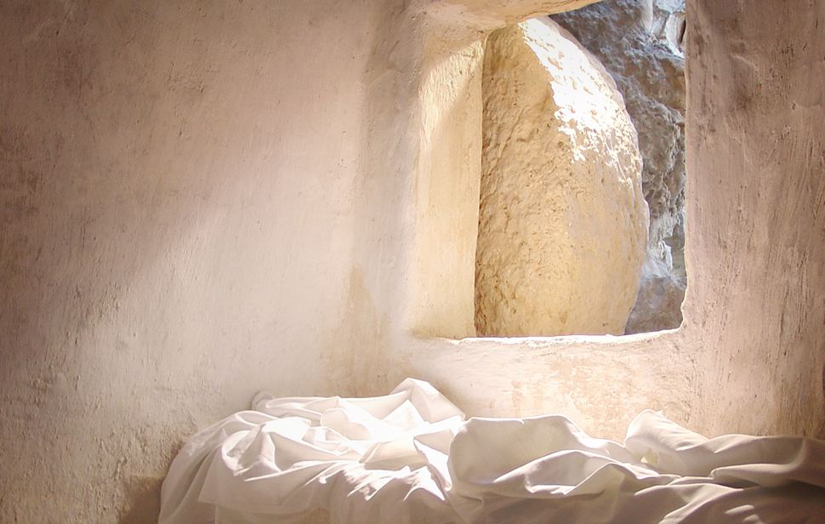
Acts 1:3
³ to whom He also presented Himself alive after His suffering by many infallible proofs, being seen by them during forty days and speaking of the things pertaining to the kingdom of God.

Slide 26
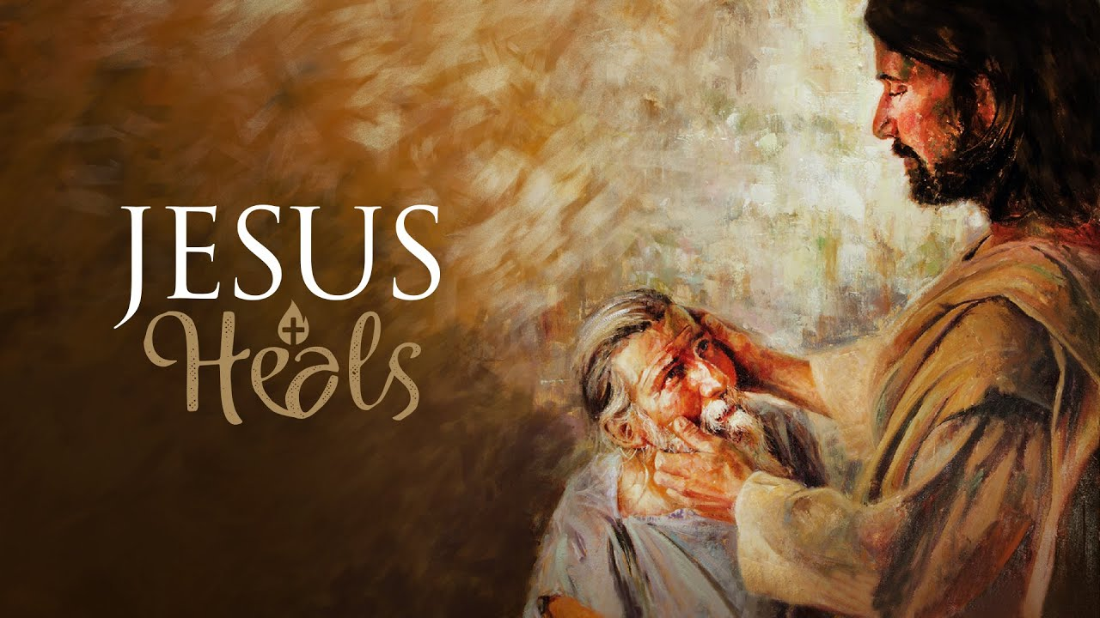
Jesus just kept opening their eyes, letting them see.
Jesus kept opening their ears, letting them hear.
Jesus kept opening their heart, letting them understand.

Slide 27
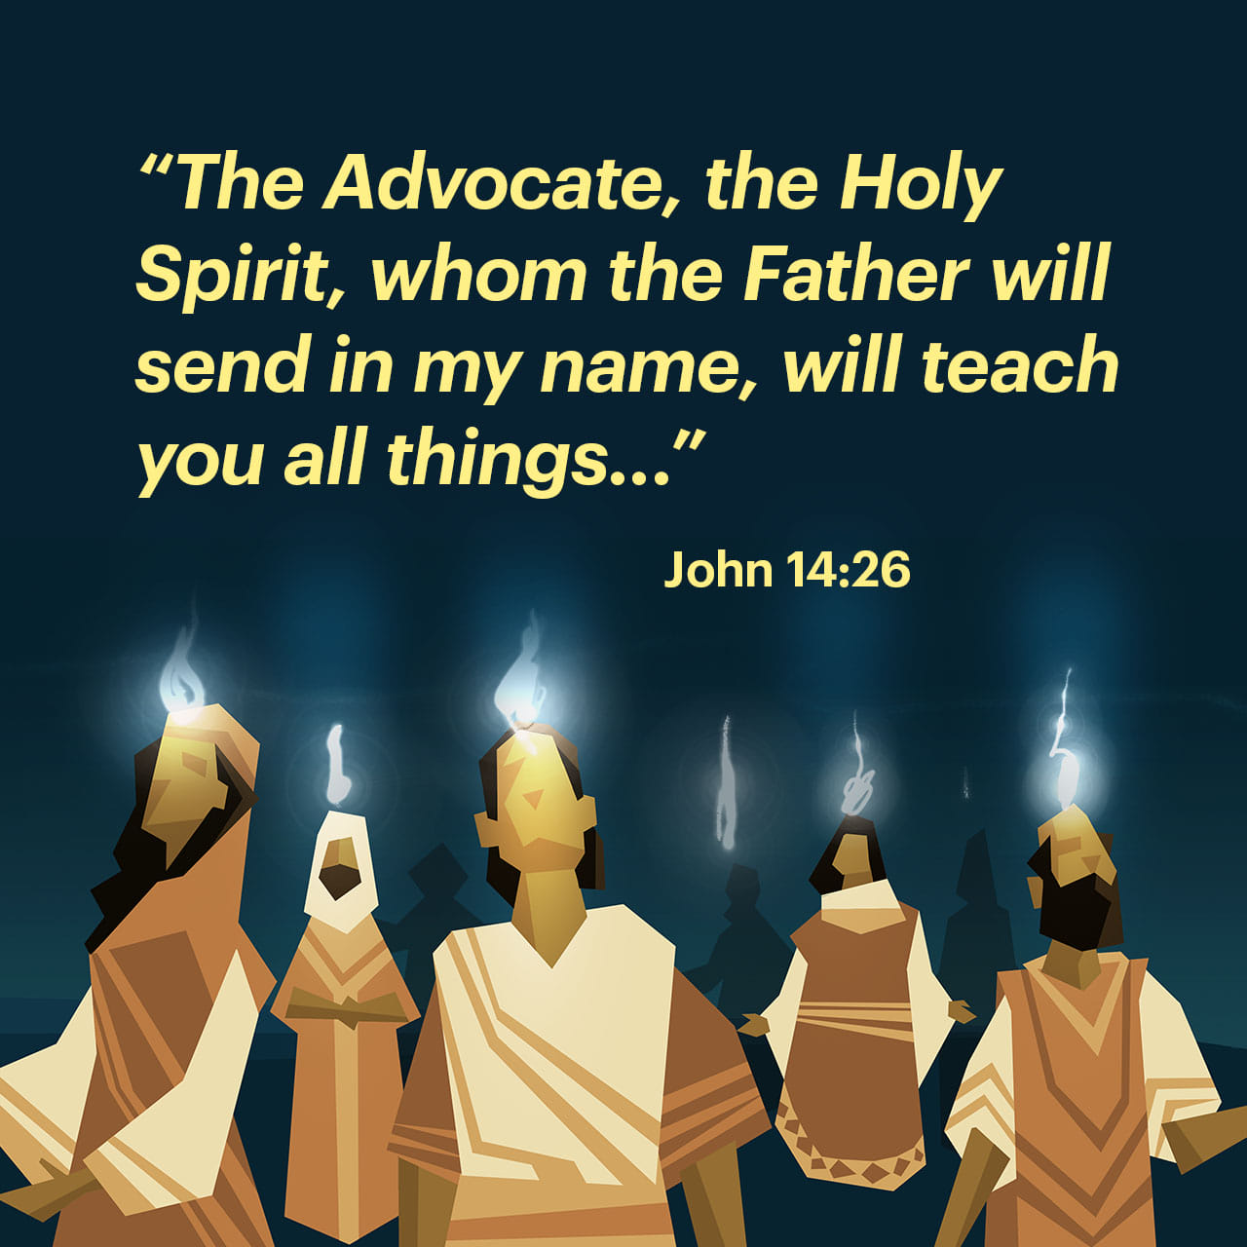
John 14:26
²⁶ But the Helper, the Holy Spirit, whom the Father will send in My name, He will teach you all things, and bring to your remembrance all things that I said to you.

Slide 28
¹² “I still have many things to say to you, but you cannot bear them now. ¹³ However, when He, the Spirit of truth, has come, He will guide you into all truth; for He will not speak on His own authority, but whatever He hears He will speak; and He will tell you things to come.
John 16:12-13

Slide 29

1 John 2:20
²⁰ But you have an anointing from the Holy One, and you know all things.

Slide 30
²⁷ But the anointing which you have received from Him abides in you, and you do not need that anyone teach you; but as the same anointing teaches you concerning all things, and is true, and is not a lie, and just as it has taught you, you will abide in Him.
1 John 2:27

Slide 31
⁴ And my speech and my preaching were not with persuasive words of human wisdom, but in demonstration of the Spirit and of power, ⁵ that your faith should not be in the wisdom of men but in the power of God.
1 Corinthians 2:4-5

Slide 32
⁵ For our gospel did not come to you in word only, but also in power, and in the Holy Spirit and in much assurance, as you know what kind of men we were among you for your sake.
1 Thessalonians 1:5

Slide 33
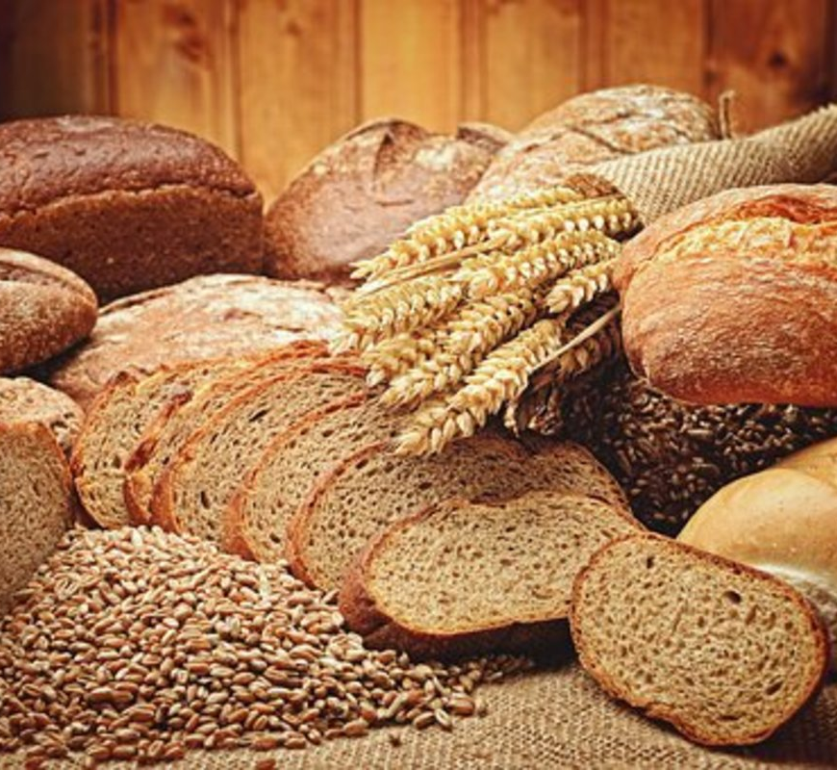
Matthew 16:5
⁵ Now when His disciples had come to the other side, they had forgotten to take bread.

Slide 34
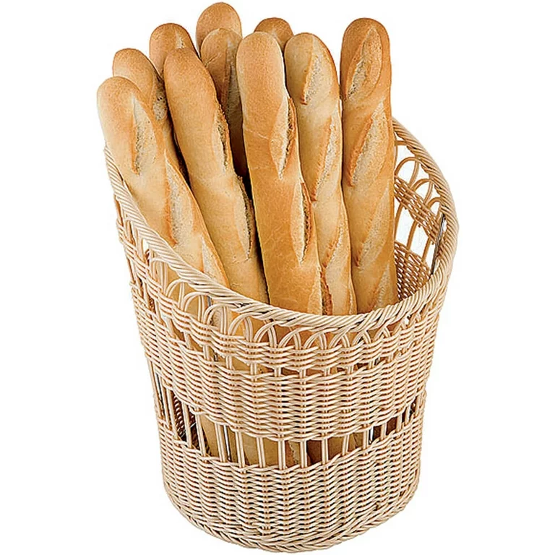
Mark 8:14
¹⁴ Now the disciples had forgotten to take bread, and they did not have more than one loaf with them in the boat.

Slide 35
In the last few weeks,
5000 men plus women and children in the Jewish area.
4000 men plus women and children in the gentile area of Decapolis.
They get to the other side and say,
”we don’t have any bread”

Slide 36
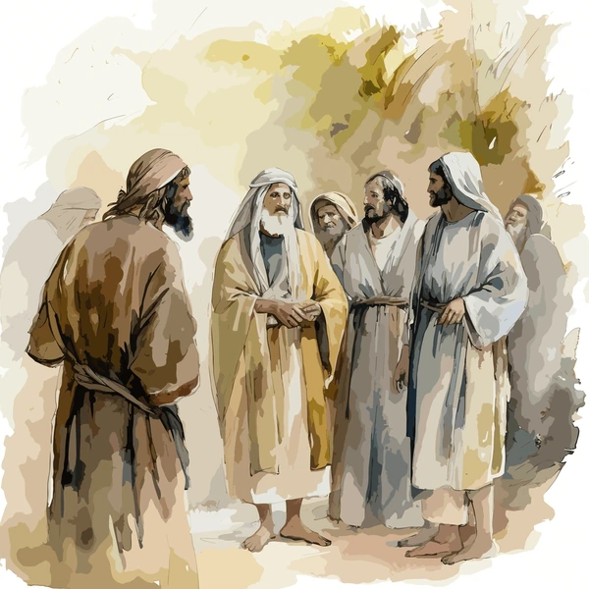
How you make a disciple?
^{Reproduce a disciple.}
^{Build to maturity.}
^{Walking through life.}
Interpreting life in terms of spiritual significance.
Interpreting life on a divine level.

Slide 37
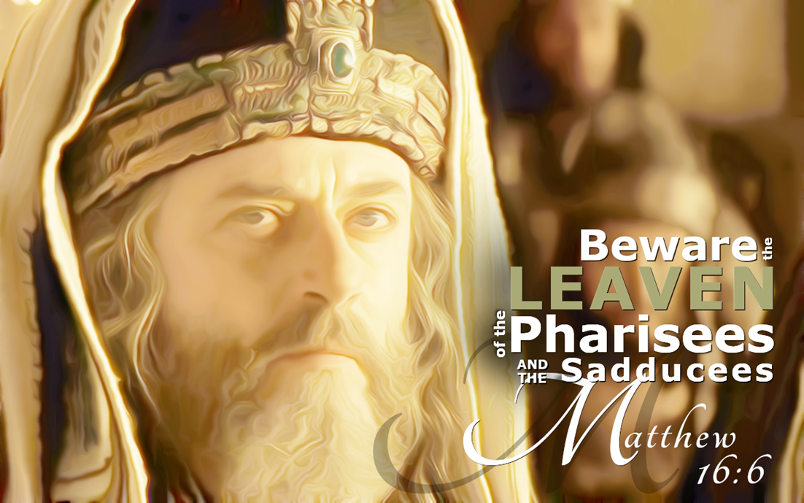
Matthew 16:6
⁶ Then Jesus said to them, “Take heed and beware of the leaven of the Pharisees and the Sadducees.”

Slide 38
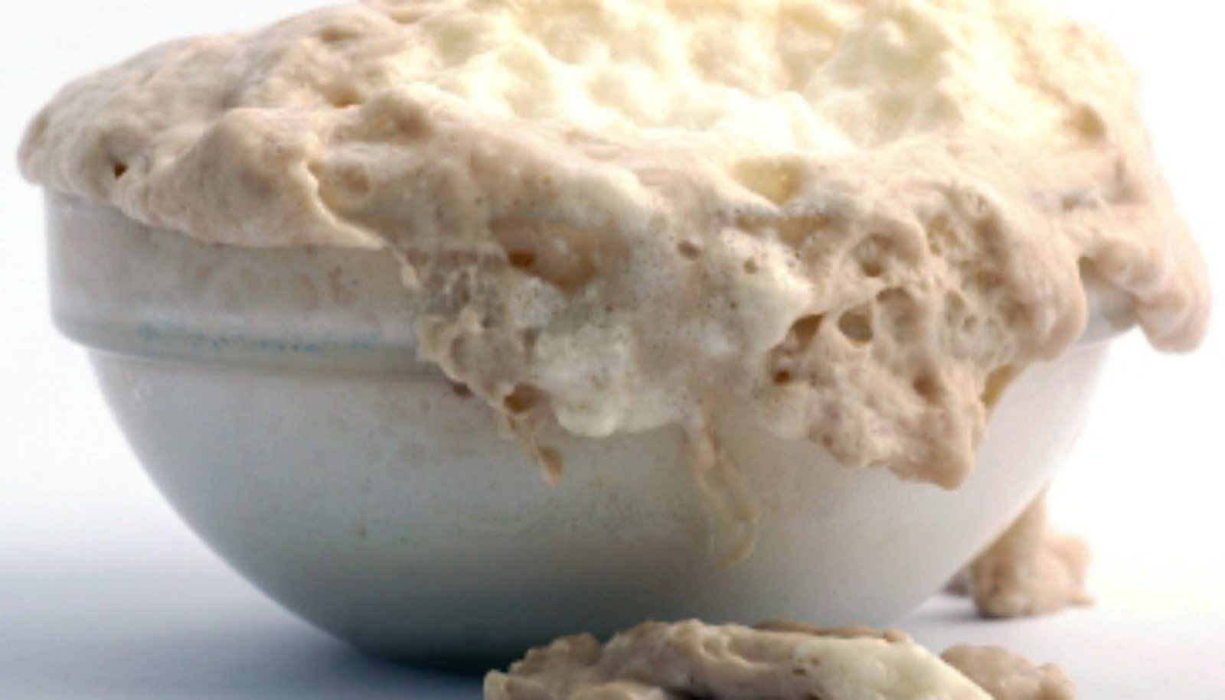
Mark 8:15
¹⁵ Then He charged them, saying, “Take heed, beware of the leaven of the Pharisees and the leaven of Herod.”

Slide 39
What is the leaven of the Pharisees?
In the meantime, when an innumerable multitude of people had gathered together, so that they trampled one another, He began to say to His disciples first of all, “Beware of the leaven of the Pharisees, which is hypocrisy.
Luke 12:1

Slide 40
The leaven of the Pharisees is hypocrisy.
The leaven of the Sadducees is no resurrection.
The leaven of Herod was political ambition, materialism and secularism.

Slide 41

Don’t let the world influence you.
Don’t let legalistic religion influence you.
Don’t let liberal religion influence you.

Slide 42
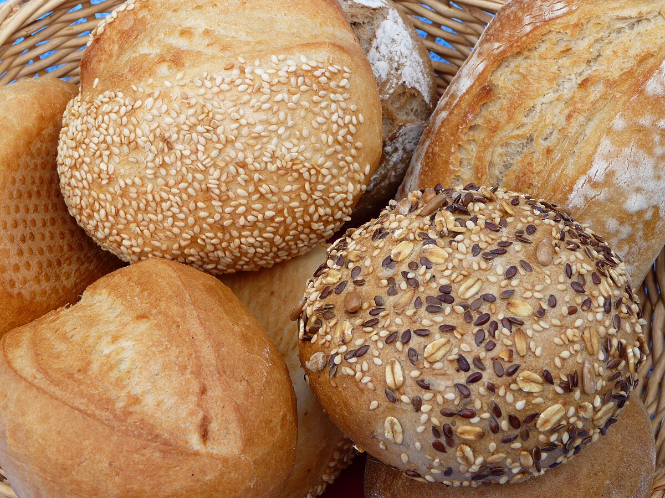
Matthew 16:7
⁷ And they reasoned among themselves, saying, “It is because we have taken no bread.”

Slide 43
Matthew 16:8
⁸ But Jesus, being aware of it, said to them, “O you of little faith, why do you reason among yourselves because you have brought no bread?

Slide 44
Why are you stuck on the physical level?
⁹ Do you not yet understand, or remember the five loaves of the five thousand and how many baskets you took up? ¹⁰ Nor the seven loaves of the four thousand and how many large baskets you took up?
Matthew 16:9-10

Slide 45

Matthew 6:33
³³ But seek first the kingdom of God and His righteousness, and all these things shall be added to you.

Slide 46
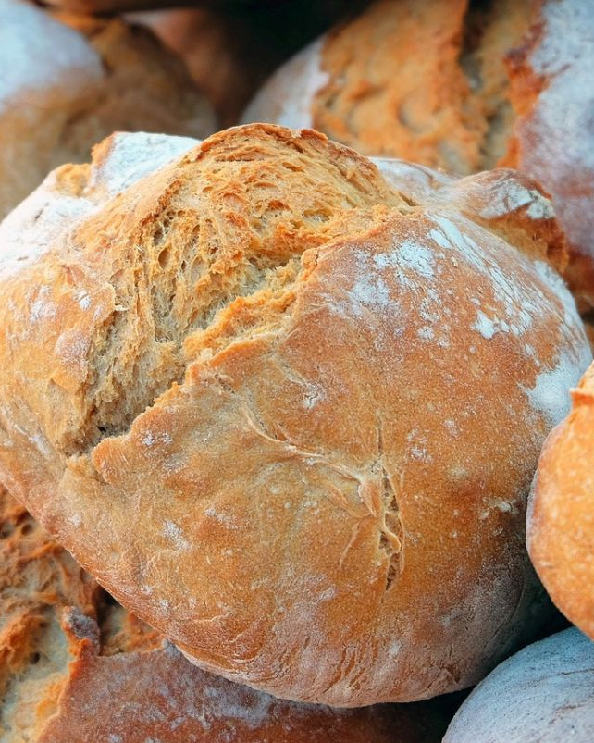
4. Taught by the Lord to see
¹¹ How is it you do not understand that I did not speak to you concerning bread?—but to beware of the leaven of the Pharisees and Sadducees.”
Matthew 16:11

Slide 47
¹⁹ “Do not lay up for yourselves treasures on earth, where moth and rust destroy and where thieves break in and steal; ²⁰ but lay up for yourselves treasures in heaven, where neither moth nor rust destroys and where thieves do not break in and steal.
Matthew 6:19-20

Slide 48

Philippians 3:20
²⁰ For our citizenship is in heaven, from which we also eagerly wait for the Savior, the Lord Jesus Christ,

Slide 49

Colossians 3:2

Slide 50
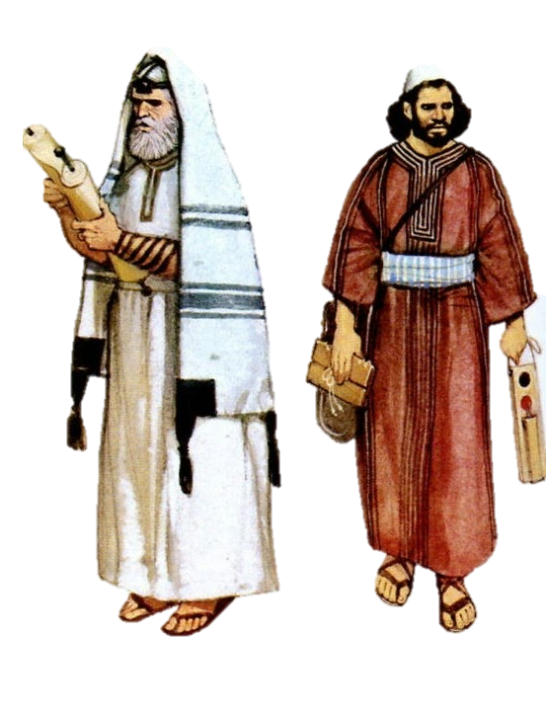
¹² Then they understood that He did not tell them to beware of the leaven of bread, but of the doctrine of the Pharisees and Sadducees.
Matthew 16:12

Slide 51
⁹ But as it is written:
“Eye has not seen, nor ear heard,
Nor have entered into the heart of man
The things which God has prepared for those who love Him.” ¹⁰ But God has revealed them to us through His Spirit. For the Spirit searches all things, yes, the deep things of God.
1 Corinthians 2:9-10

Slide 52
¹² Now we have received, not the spirit of the world, but the Spirit who is from God, that we might know the things that have been freely given to us by God.
1 Corinthians 2:12

Slide 53
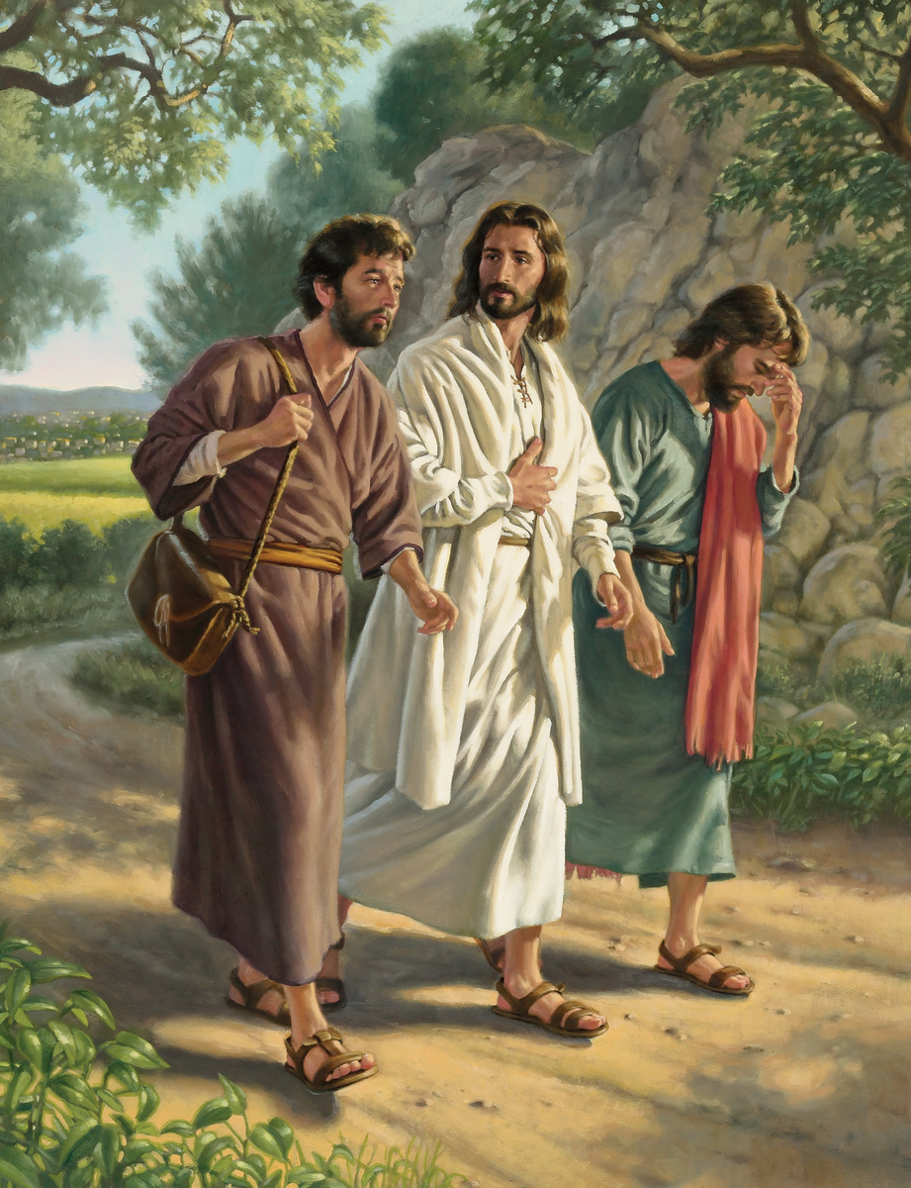
Jesus on Emmaus Road
³² And they said to one another, “Did not our heart burn within us while He talked with us on the road, and while He opened the Scriptures to us?”
Luke 24:32

Slide 54
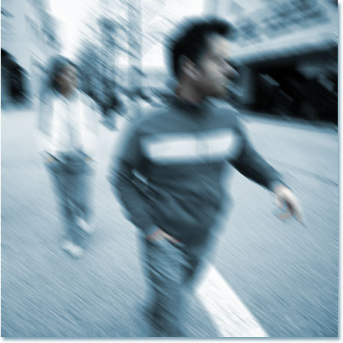
2 Kinds of people
^{The blind who will never see}
The blind who will be made to see

Slide 55

How hungry is your heart?
To be in that Word illuminated by the resident Spirit of God?

Slide 56

What about that one who is blind and will never see?
To plunge into eternal darkness.
Tragic thought.

Slide 57


^{You can choose the light}
^{or}
^{you can choose the darkness.}

