Slide 1

What is the greatest
confession of man?
Matthew 16:13-17

Slide 2
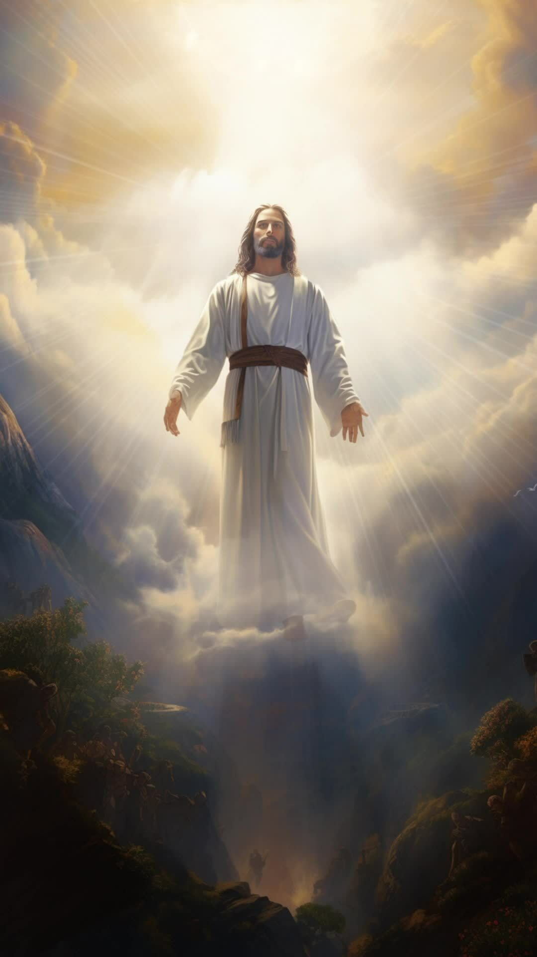
What is the greatest confession of man?
Jesus is the Son of the Living God!
Matthew 16:13-17

Slide 3
13. When Jesus came into the region of Caesarea Philippi, He asked His disciples, saying,
“Who do men say that I, the Son of Man, am?”
¹⁴ So they said, “Some say John the Baptist, some Elijah, and others Jeremiah or one of the prophets.”
¹⁵ He said to them, “But who do you say that I am?”
¹⁶ Simon Peter answered and said, “You are the Christ, the Son of the living God.”
¹⁷ Jesus answered and said to him, “Blessed are you, Simon Bar-Jonah, for flesh and blood has not revealed this to you, but My Father who is in heaven.
Matthew 16:13-17

Slide 4

PASS OR FAIL

Slide 5

Who is Jesus Christ?

Slide 6
Who is Jesus Christ?
He is the Christ, the Son of the living God.

Slide 7
Over 2 and half years our Lord has been moving to this moment,
^{Teaching,}
^{Affirming,}
^{Establishing,}
^{Building, and}
^{Rebuilding their confidence,}
^{Their commitment.}

Slide 8
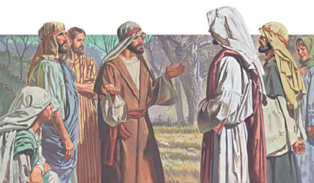
Peter Said,
“You are the Christ, the Son of the living God.”

Slide 9
For some months, Jesus has sought seclusion
Away from the misguided multitudes who wanted to make Him a political ruler,
Away from the hatred and animosity,
Away from the jealous ambition of Herod who wanted to do away with Him,
Away from the Pharisees, the Sadducees, the scribes who saw Him as a threat to their religious security.

Slide 10
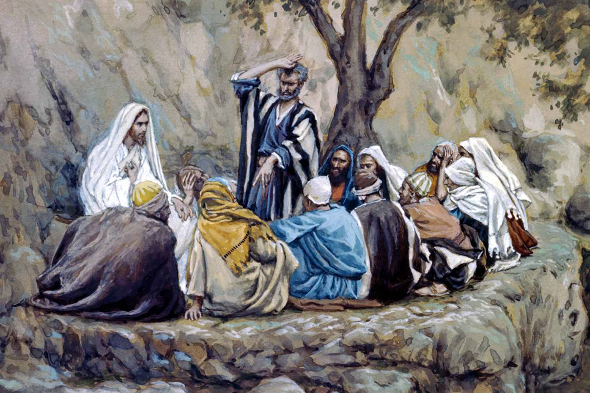
Devoted time given to the twelve.

Slide 11
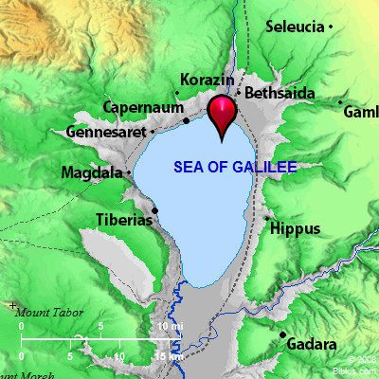

Much Fruitful

Slide 12
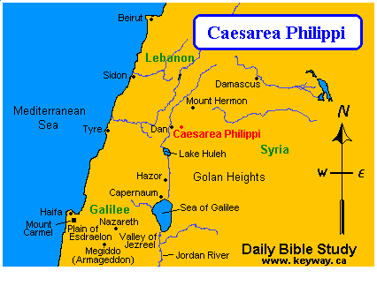
The borders of Caesarea Philippi
Caesarea means of Caesar

Slide 13
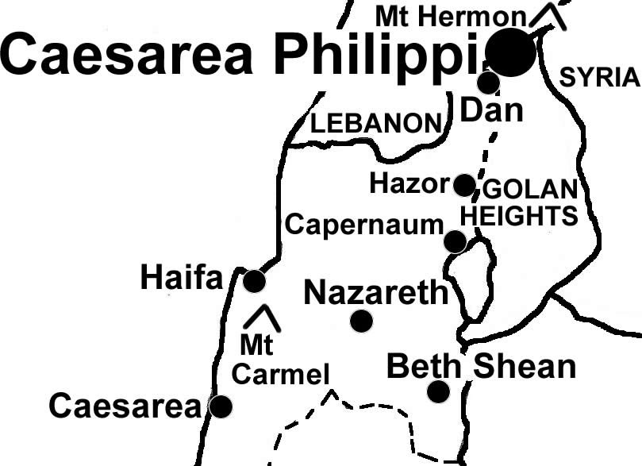
Dan to Beersheba.
The northernmost point in the land of Palestine
was identified by the term Dan.
The southernmost point was identified
by the term Beersheba.
When wanting to encompass the whole land, we say the
land extended from Dan to Beersheba.
The very northeast corner was Dan. Two and a half miles
west of Dan was a town known as Panias.

Slide 14
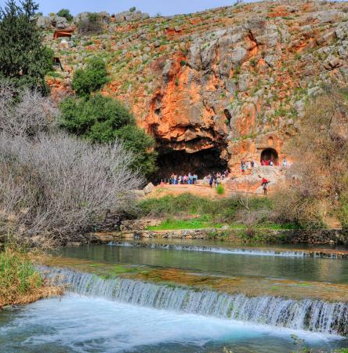
Panias was named for Pan. Pan was a Greek god, supposedly born in a cave in that area. That also was the area where the headwaters of the Jordan started.
Panias

Slide 15
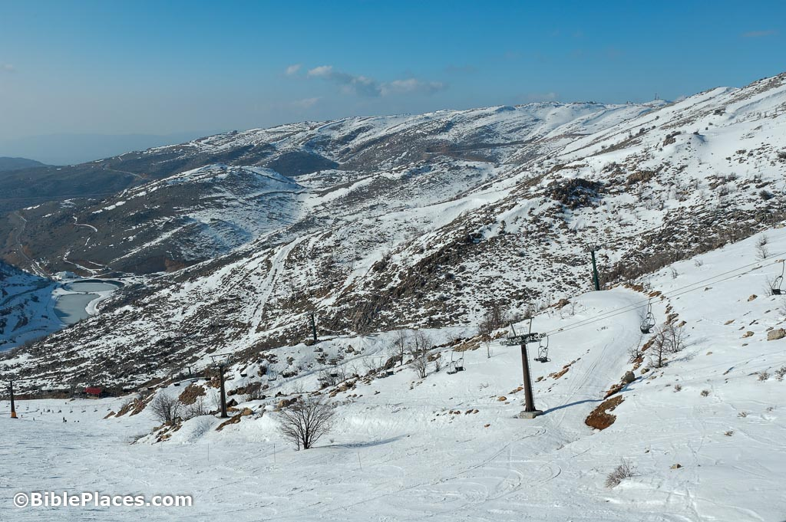
Mount Hermon

Slide 16
Today that part of the world would be as Syria, but at this juncture in history, it’s under the control of Israel.
It was to that place that Jesus retreated.
It would be a welcome retreat from the heat of the Galilean lowlands.
It would be a welcome retreat from the pressure of the very Jewish society there.
It would also be a retreat from the influence of Herod, who was after Jesus Christ, without doubt, into the territory controlled by Philip the Tetrarch.

Slide 17
Mark 8:27
Now Jesus and His disciples went out to the towns of Caesarea Philippi; and on the road He asked His disciples, saying to them, “Who do men say that I am?”

Slide 18
Luke 9:18
And it happened, as He was alone praying, that His disciples joined Him, and He asked them, saying, “Who do the crowds say that I am?”

Slide 19
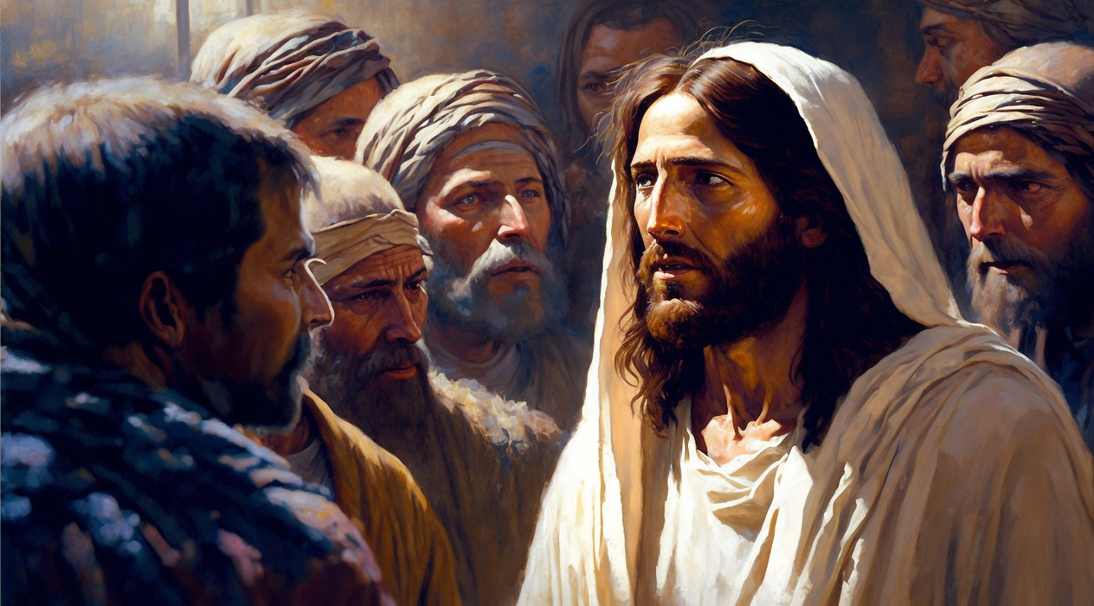
Two important Questions.
1. Who do you say I am?

Slide 20
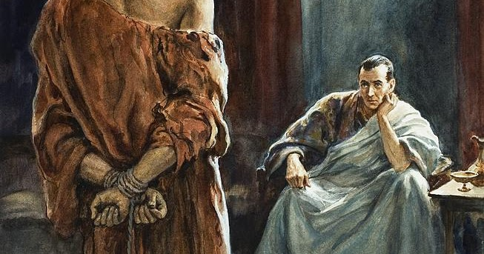
Two important Questions.
2. What then shall I do with Jesus who is called Christ?

Slide 21
Matthew 27:22
Pilate said to them, “What then shall I do with Jesus who is called Christ?” They all said to him, “Let Him be crucified!”

Slide 22
Son of Man
V 13, When Jesus came into the region of Caesarea Philippi, He asked His disciples, saying, “Who do men say that I, the Son of Man, am?”
Jesus uses the term Son of man to refer to Himself.
This term is used 80 plus times in the New Testament, and so it is the Lord’s most common designation of Himself.
Although it is definitely a prophetic title of Messiah taken from
Daniel 7:13 -14.

Slide 23
????
Who do men say that I am?
Who do people say I am?
What a crucial question?
Do they really know who Jesus is?

Slide 24
Answer to the question.
V 14, So they said, “Some say John the Baptist, some Elijah, and others Jeremiah or one of the prophets.”
John the Baptist.
What didn’t they say?
Beelzebub - They had said that back in Matthew 10:25

Slide 25
Matthew 14:1-2
1. At that time Herod the tetrarch heard the report about Jesus ² and said to his servants, “This is John the Baptist; he is risen from the dead, and therefore these powers are at work in him.”

Slide 26
Herod
Herod said, “It’s John the Baptist, back from the dead.”
Why did Herod say that?
Because John the Baptist was a prophet, John the Baptist was declaring the coming of Messiah.

Slide 27
“Some said you are Elijah.”
Elijah was the summit of the prophetic office.
Malachi 4:5, Behold, I will send you Elijah the prophet Before the coming of the great and dreadful day of the Lord.

Slide 28

Jewish Passover

Slide 29
“He is Jeremiah.”

Slide 30
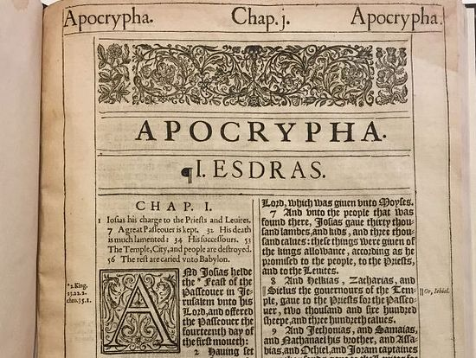
Apocrypha

Slide 31
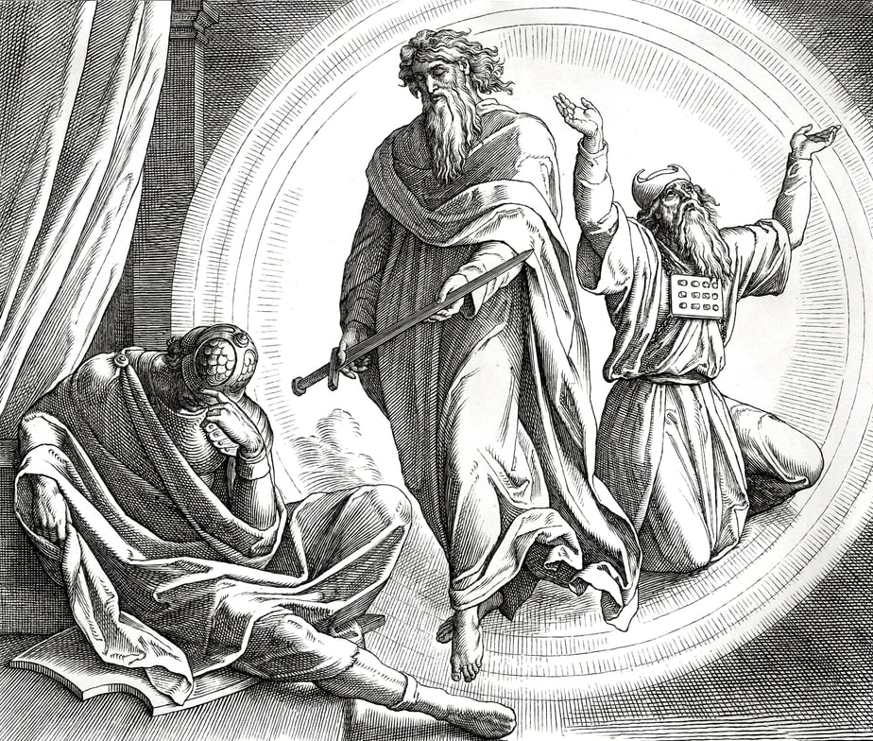
Judas Maccabeus

Slide 32
Many of the Jews were looking for Jeremiah to come back so that he could restore the Ark and the altar to its rightful place.
Again, you have the same two factors.
One is that they were looking for one who was a forerunner of the Messiah.
Two, that he would be one who came back from the grave, or back from heaven, back from life with God, which was the only way they could explain his ability to do miraculous works.
So, some said He’s John the Baptist.
Some said He is Elijah.
Some said He is Jeremiah.

Slide 33
How come they had those variations?
Maybe some saw in Him the character and the quality of John the Baptist.
Maybe some saw in Him the fire and the intensity and the fervency of an Elijah.
Maybe some saw in Him the lamenting, grieving, broken heartedness of Jeremiah.

Slide 34
Same Two Factors
A forerunner of the Messiah and
One come back from the dead.
He was one of the prophets.

Slide 35
Luke 9:19
So they answered and said, “John the Baptist, but some say Elijah; and others say that one of the old prophets has risen again.”

Slide 36
All these Opinions about Jesus are floating around.
But they all have this remarkable thing in common:
They knew He had to be from out of this world,
They believed He was the forerunner of the Messiah.
They did not believe He was the Messiah.
They couldn’t deny that He was a prophet.
They couldn’t deny that He had supernatural power.
But they would not accept that He was the Messiah.
They got as close as they could without getting to the truth.

Slide 37
Matthew 16:15
Jesus asked them the second question.
V15, He said to them, “But who do you say that I am?”
Now I want to hear from you.
Who do you say?

Slide 38
Greatest Discovery

Slide 39
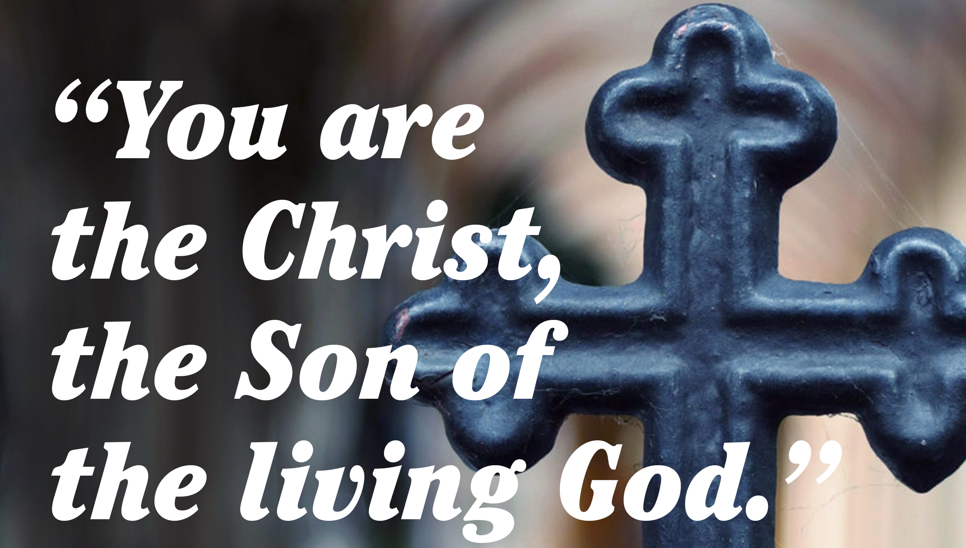
Matthew 16:16

Slide 40
Then Peter answered and said to Him, “Explain this parable to us.”
Matthew 15:15

Slide 41
Then Peter answered and said to Him, “See, we have left all and followed You. Therefore what shall we have?”
Matthew 19:27

Slide 42
Peter answered and said to Him, “Even if all are ]made to stumble because of You, I will never be made to stumble.”
Matthew 26:33

Slide 43
But Simon Peter answered Him, “Lord, to whom shall we go? You have the words of eternal life.
John 6:68

Slide 44
23.Now there was leaning on Jesus’ bosom one of His disciples, whom Jesus loved. 24 Simon Peter therefore motioned to him to ask who it was of whom He spoke.
John 13:23-24

Slide 45
Chris being the Greek equivalent of Messiah.
You are the anointed One of God.
You are the promised Messiah.
You are the One we’ve been looking for, the anointed One, the Prophet that should come, the eternal King, the eternal Saviour, the eternal High Priest.
You are the One who is all the embodiment of all our hopes, dreams, desires, and all the promises.

Slide 46
John 1:40-42
One of the two who heard John speak, and followed Him, was Andrew, Simon Peter’s brother. 41 He first found his own brother Simon, and said to him, “We have found the Messiah” (which is translated, the Christ). 42 And he brought him to Jesus.

Slide 47
John 1:29
The next day John saw Jesus coming toward him, and said, “Behold! The Lamb of God who takes away the sin of the world!

Slide 48
And I have seen and testified that this is the Son of God.”
John 1:34
They were believing the testimony of John the Baptist.
They were also believing what they saw when Jesus.

Slide 49
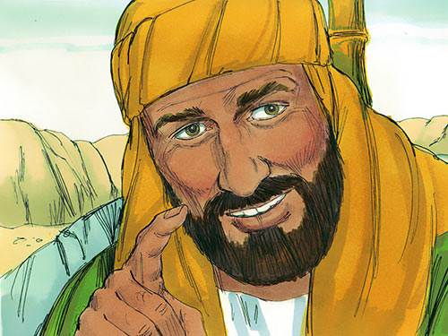
Nathaniel

Slide 50
Matthew :11:2,3
And when John had heard in prison about the works of Christ, he sent two of his disciples ³ and said to Him, “Are You the Coming One, or do we look for another?”

Slide 51
John:6:69
Also we have come to believe and know that You are the Christ, the Son of the living God.”

Slide 52
John:14:8,9
Philip said to Him, “Lord, show us the Father, and it is sufficient for us.” ⁹ Jesus said to him, “Have I been with you so long, and yet you have not known Me, Philip? He who has seen Me has seen the Father; so how can you say, ‘Show us the Father’?

Slide 53
John:5:17,18
But Jesus answered them, “My Father has been working until now, and I have been working.”
¹⁸ Therefore the Jews sought all the more to kill Him, because He not only broke the Sabbath, but also said that God was His Father, making Himself equal with God.

Slide 54
Matthew :16:17
Jesus answered and said to him, “Blessed are you, Simon Bar-Jonah, for flesh and blood has not revealed this to you, but My Father who is in heaven

Slide 55
1 Corin:12:3
Therefore I make known to you that no one speaking by the Spirit of God calls Jesus accursed, and no one can say that Jesus is Lord except by the Holy Spirit.

Slide 56
Matthew:11:27
All things have been delivered to Me by My Father, and no one knows the Son except the Father. Nor does anyone know the Father except the Son, and the one to whom the Son wills to reveal Him.

Slide 57
Romans :10:17
So then faith comes by hearing, and hearing by the word of God.

Slide 58
Matthew:5:17
“Do not think that I came to destroy the Law or the Prophets. I did not come to destroy but to fulfil”.

Slide 59
He taught divine truth.
Matthew 5,
Matthew 6,
Matthew 10,
Matthew 13.

Slide 60
Profound truth. His words were a dynamic revelation of who He was.
His works.
His power over disease.
His power over nature.
His power over demons.
His power over sins.
His power over death.

Slide 61
Matthew:12:8
For the Son of Man is Lord even of the Sabbath.”
They put Jesus out of the possibility of the category of Jeremiah, Elijah, John the Baptist, or one of the prophets. When He said, “I am the Lord of the Sabbath.”

Slide 62
Leviticus:23:1-3
And the Lord spoke to Moses, saying, ² “Speak to the children of Israel, and say to them: ‘The feasts of the Lord, which you shall proclaim to be holy convocations, these are My feasts. ³ ‘Six days shall work be done, but the seventh day is a Sabbath of solemn rest, a holy convocation. You shall do no work on it; it is the Sabbath of the Lord in all your dwellings.

Slide 63
Leviticus:23:6
And on the fifteenth day of the same month is the Feast of Unleavened Bread to the Lord; seven days you must eat unleavened bread.

Slide 64
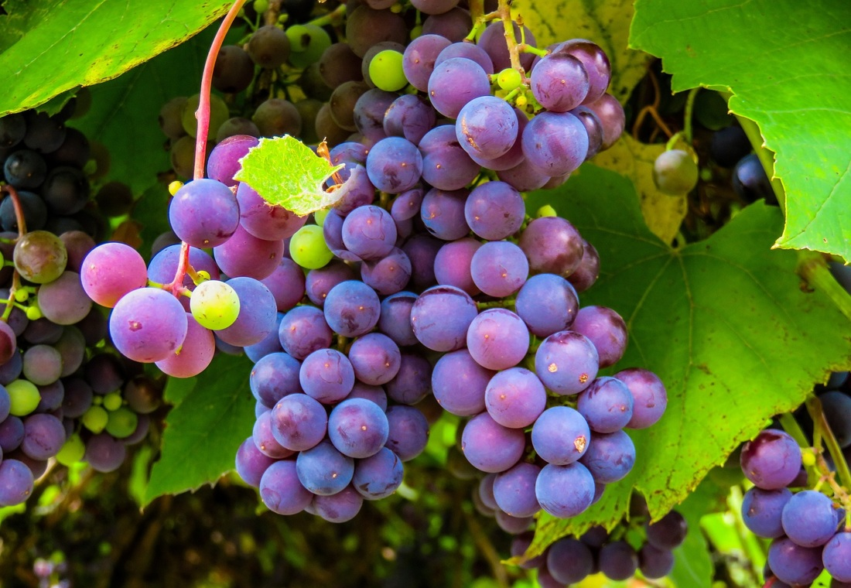
Leviticus:23:9-14
‘Feast of first fruits ’
The feast of first fruits is also a Sabbath. It is a rest. It is a coming before the Lord.

Slide 65
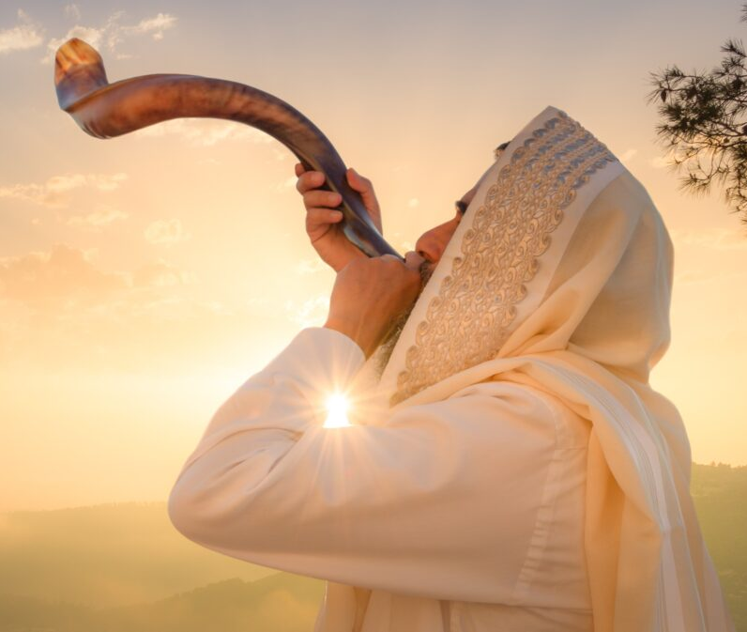
Leviticus:23:23-25
‘Feast of Trumpets'
This Sabbath occurs in the Sabbath month, the seventh month.
You do not work, and you bring an offering before the Lord.

Slide 66
Leviticus:23:26-27
And the Lord spoke to Moses, saying: ²⁷ “Also the tenth day of this seventh month shall be the Day of Atonement. It shall be a holy convocation for you; you shall afflict your souls, and offer an offering made by fire to the Lord.

Slide 67
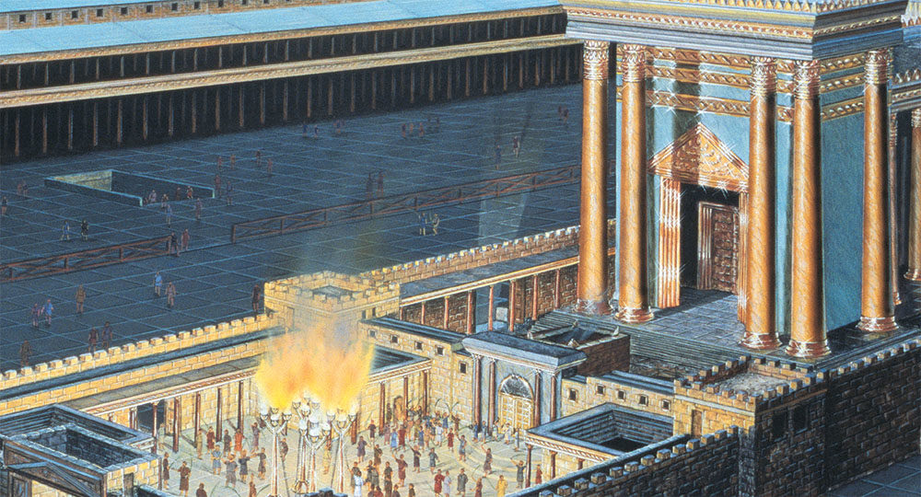
Leviticus 23:33-44
The feast of Tabernacles

Slide 68
Leviticus 25:3-4
The seven-year Sabbath
Six years you shall sow your field, and six years you shall prune your vineyard, and gather its fruit; ⁴ but in the seventh year there shall be a sabbath of solemn rest for the land, a sabbath to the Lord. You shall neither sow your field nor prune your vineyard.

Slide 69
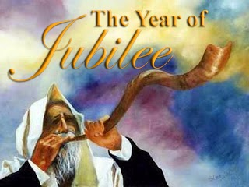
Leviticus 25:8-17
Year of Jubilee
Seven times seven, or after the forty-ninth year, comes the fiftieth, year which is a Sabbath.

Slide 70
Leviticus 25:9-13
Then you shall cause the trumpet of the Jubilee to sound on the tenth day of the seventh month; on the Day of Atonement you shall make the trumpet to sound throughout all your land. ¹⁰ And you shall consecrate the fiftieth year, and proclaim liberty throughout all the land to all its inhabitants. It shall be a Jubilee for you; and each of you shall return to his possession, and each of you shall return to his family. ¹¹ That fiftieth year shall be a Jubilee to you; in it you shall neither sow nor reap what grows of its own accord, nor gather the grapes of your untended vine. ¹² For it is the Jubilee; it shall be holy to you; you shall eat its produce from the field.
¹³ ‘In this Year of Jubilee, each of you shall return to his possession.

Slide 71
Luke 4:16-19
So He came to Nazareth, where He had been brought up. And as His custom was, He went into the synagogue on the Sabbath day, and stood up to read. ¹⁷ And He was handed the book of the prophet Isaiah. And when He had opened the book, He found the place where it was written: ¹⁸ “The Spirit of the Lord is upon Me, Because He has anointed Me To preach the gospel to the poor; He has sent Me to heal the broken hearted, To proclaim liberty to the captives And recovery of sight to the blind, To set at liberty those who are oppressed; ¹⁹ To proclaim the acceptable year of the Lord.”

Slide 72
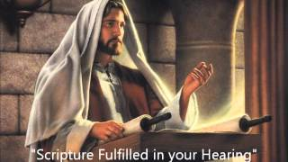
Luke :4:21
And He began to say to them, “Today this Scripture is fulfilled in your hearing.”

Slide 73
Matthew 11:28
Come to Me, all you who labour and are heavy laden, and I will give you rest.

Slide 74
Colossians 2:16-17
So let no one judge you in food or in drink, or regarding a festival or a new moon or sabbaths, ¹⁷ which are a shadow of things to come, but the substance is of Christ.

Slide 75
Hebrews : 4
“There remained a rest for the people of God.”
He says enter into that rest, it is the rest of salvation.

Slide 76
Conclusion

Slide 77
Ephesians 1:3
“And you are blessed with all spiritual blessings in the heavenlies in Christ Jesus.”

Slide 78
All the divine supernatural resources that God can pour out on the children of His love and the brothers of Jesus Christ are yours.

