Slide 1
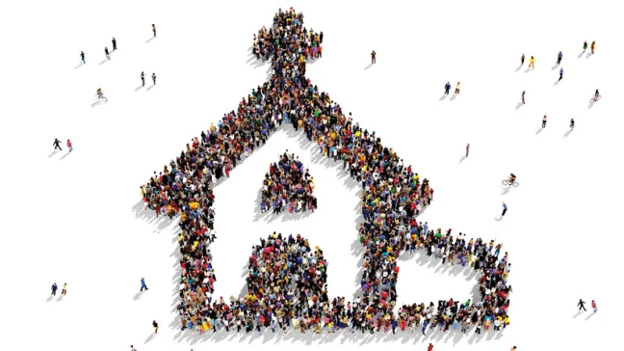
Church Christ Builds!
Matthew 16:13-20

Slide 2
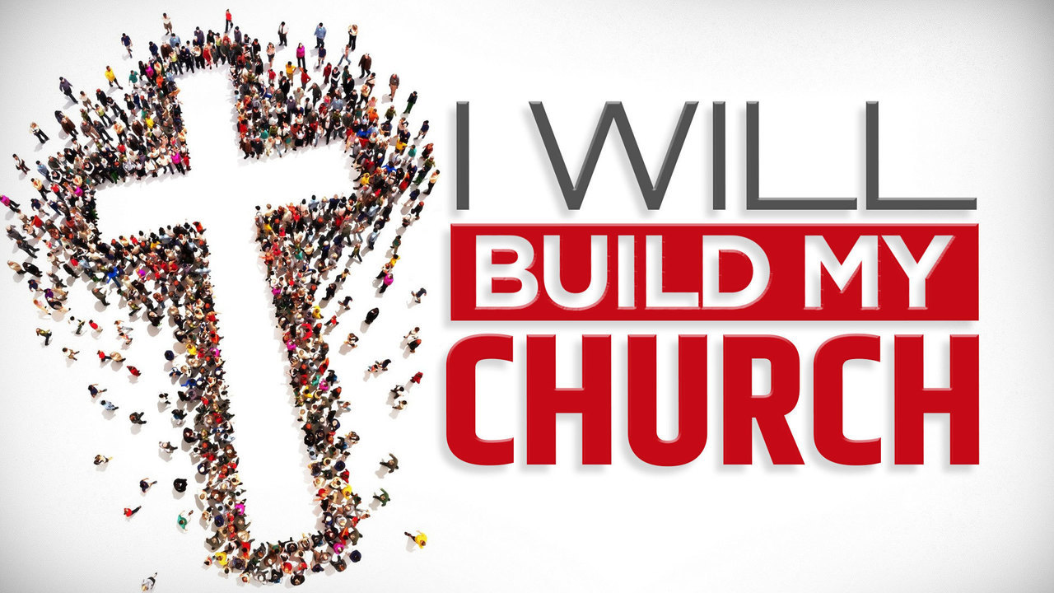
“ekklesia”

Slide 3
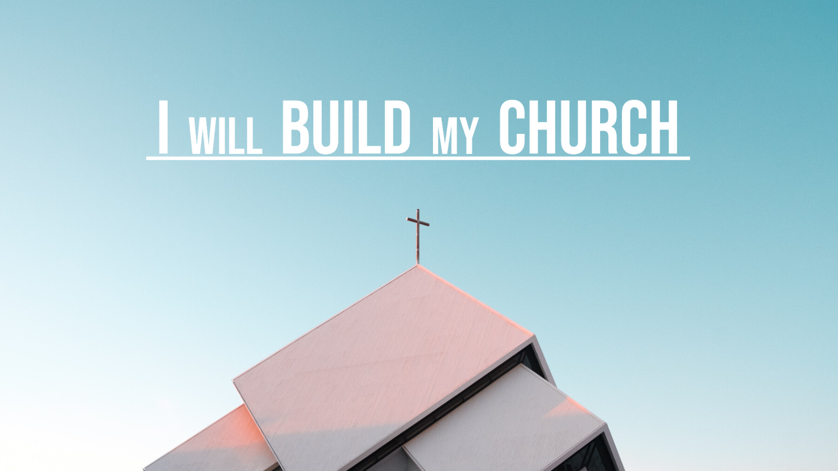
The Lord will build His church

Slide 4
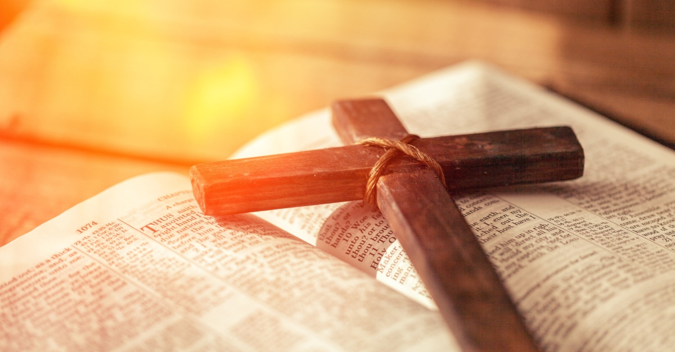
He must go to Jerusalem and suffer many things from the elders and chief priests and scribes, and be killed, and be raised the third day.
Matthew 16:21

Slide 5
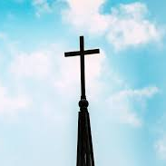
But it never did!
It wouldn’t now!
In Old Testament when Israel was in Egypt
When Israel was in Babylon
When they were worse yet in apostasy and intermarrying with the nations of the world

Slide 6
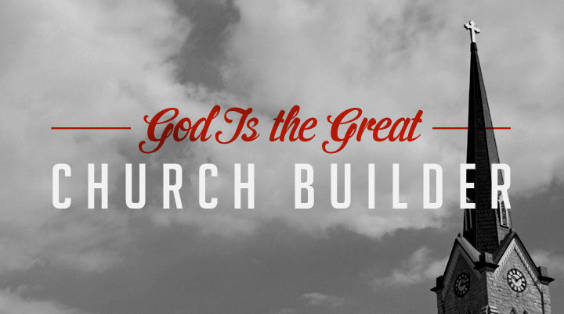
What is the church that Christ builds?
What are its characteristics?
What are its features?

Slide 7
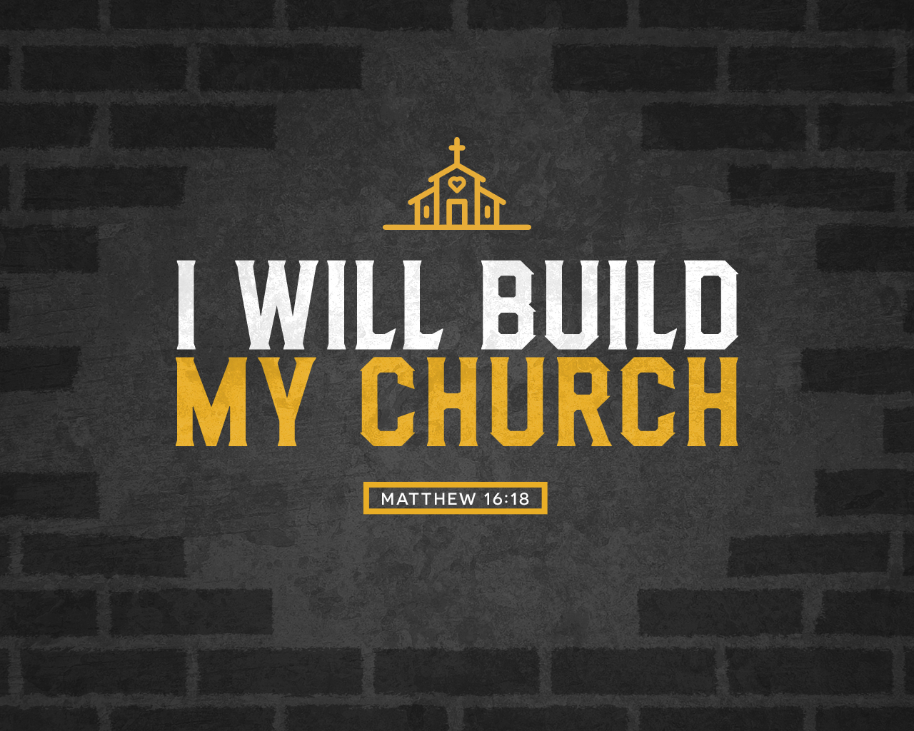

Certain Church

Slide 8
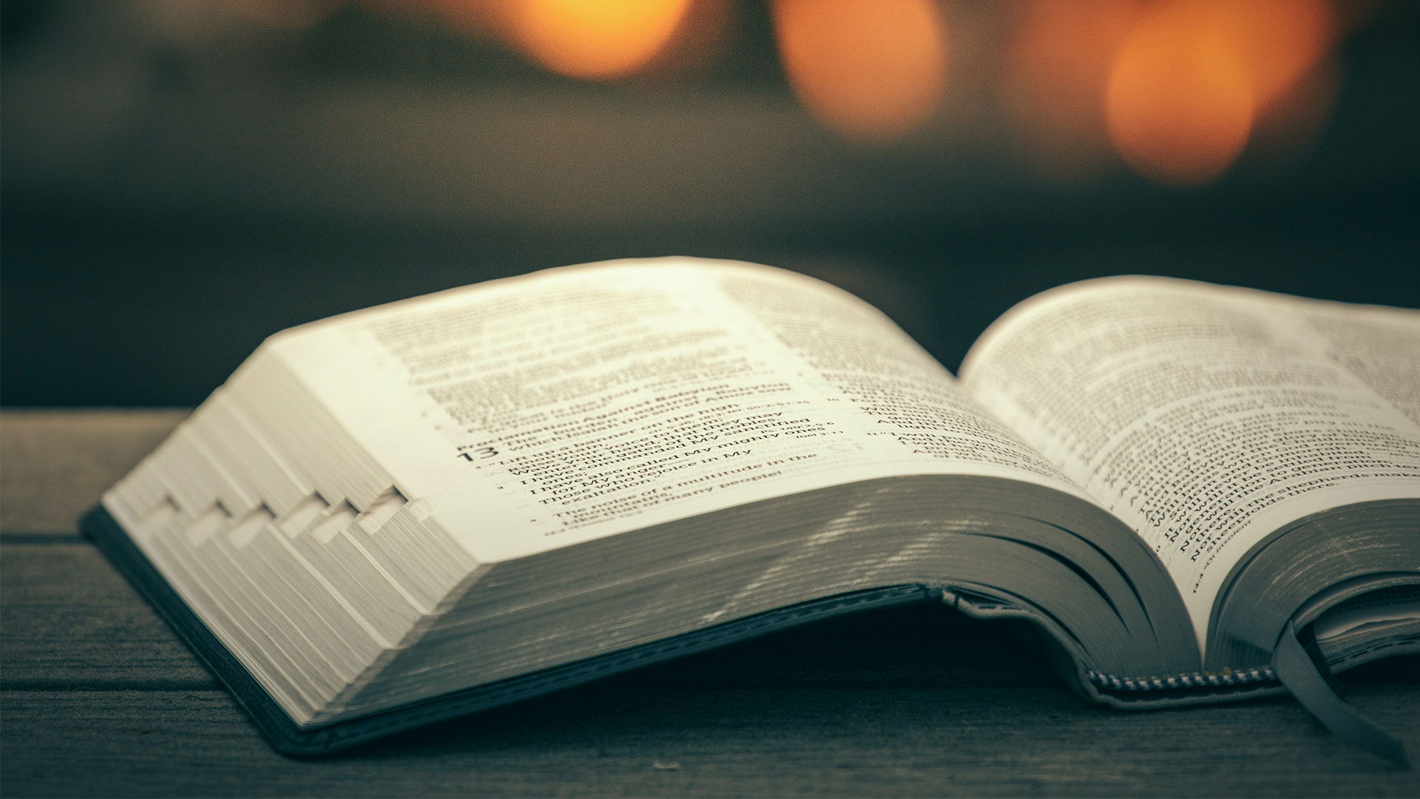
So shall My word be that goes forth from My mouth; It shall not return to Me void, But it shall accomplish what I please
Isaiah 55:11

Slide 9
We are called to walk in the Spirit. to obey the Word of God.
The Scripture tells us how to live, think, speak, act.

Slide 10
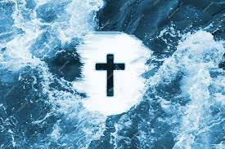
Repent, and let every one of you be baptized in the name of Jesus Christ
Acts 2:38-39

Slide 11
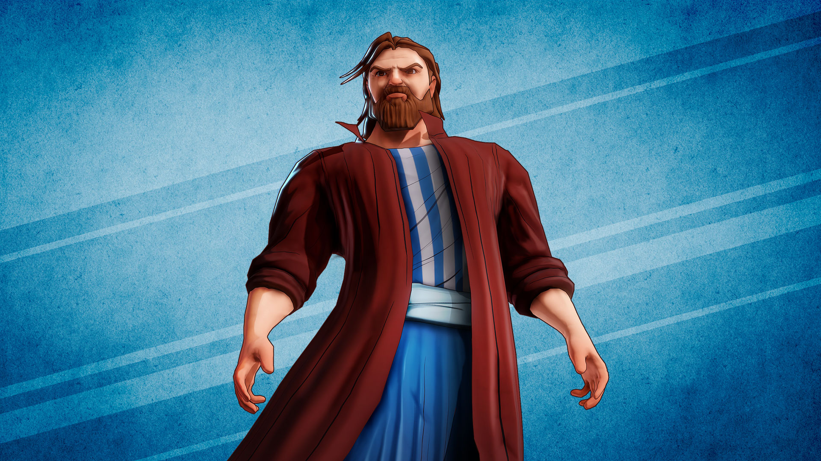
who’s building the church?
Who is calling people?

Slide 12
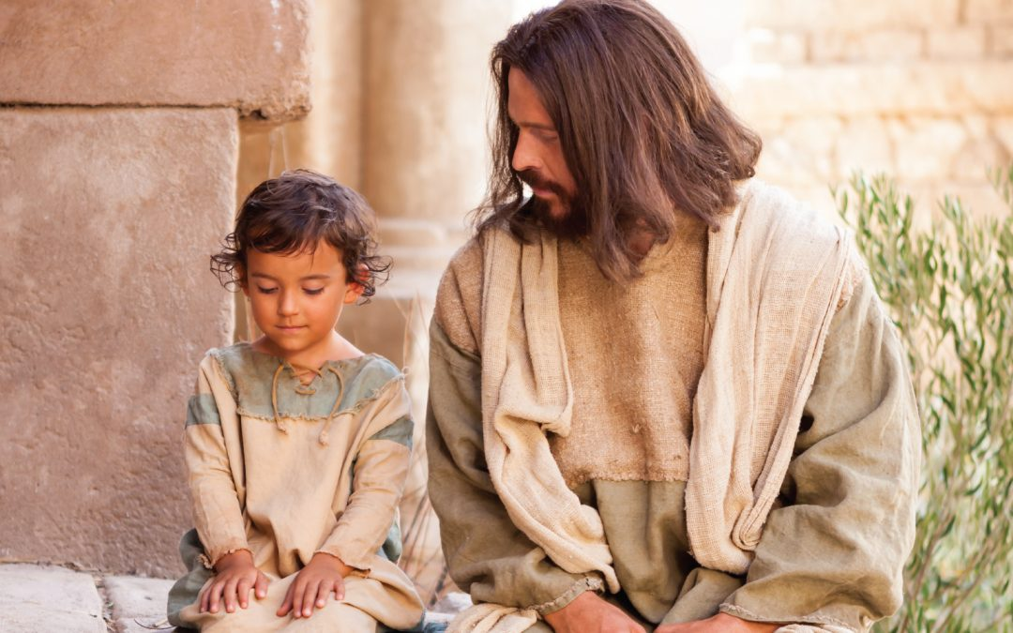
All that the Father gives Me will come to Me
John 6:37

Slide 13
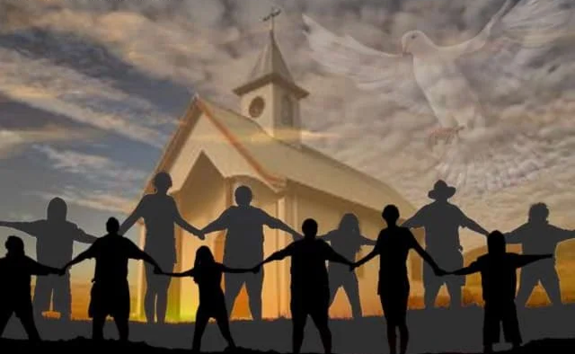
the Lord added to the church daily those who were being saved.
Acts 2:47

Slide 14
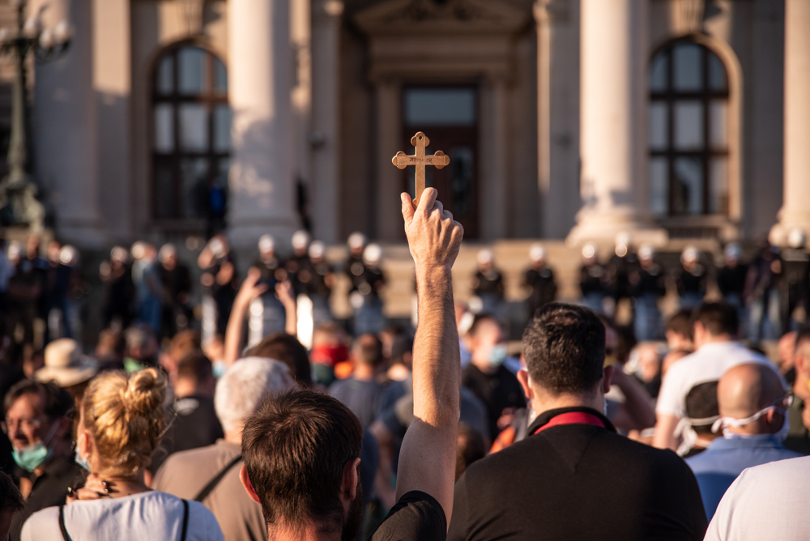
believers were increasingly added to the Lord, multitudes of both men and women
Acts 5:14

Slide 15
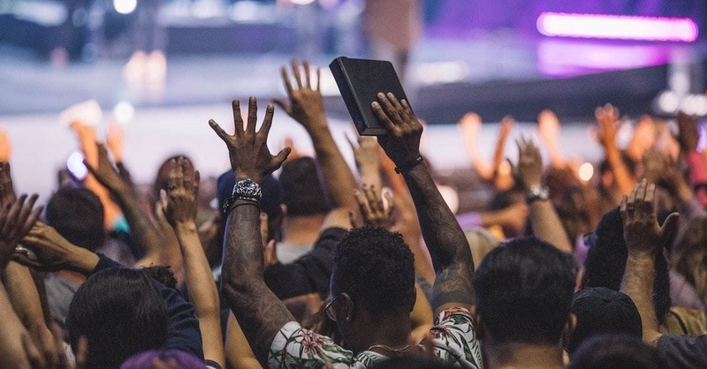
full of the Holy Spirit and of faith. And a great many people were added to the Lord.
Acts 11:24

Slide 16
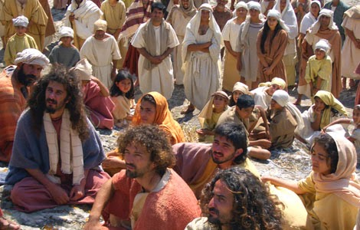
when the Gentiles heard this, they were glad and glorified the word of the Lord. And as many as had been appointed to eternal life believed.
Acts 13:48

Slide 17
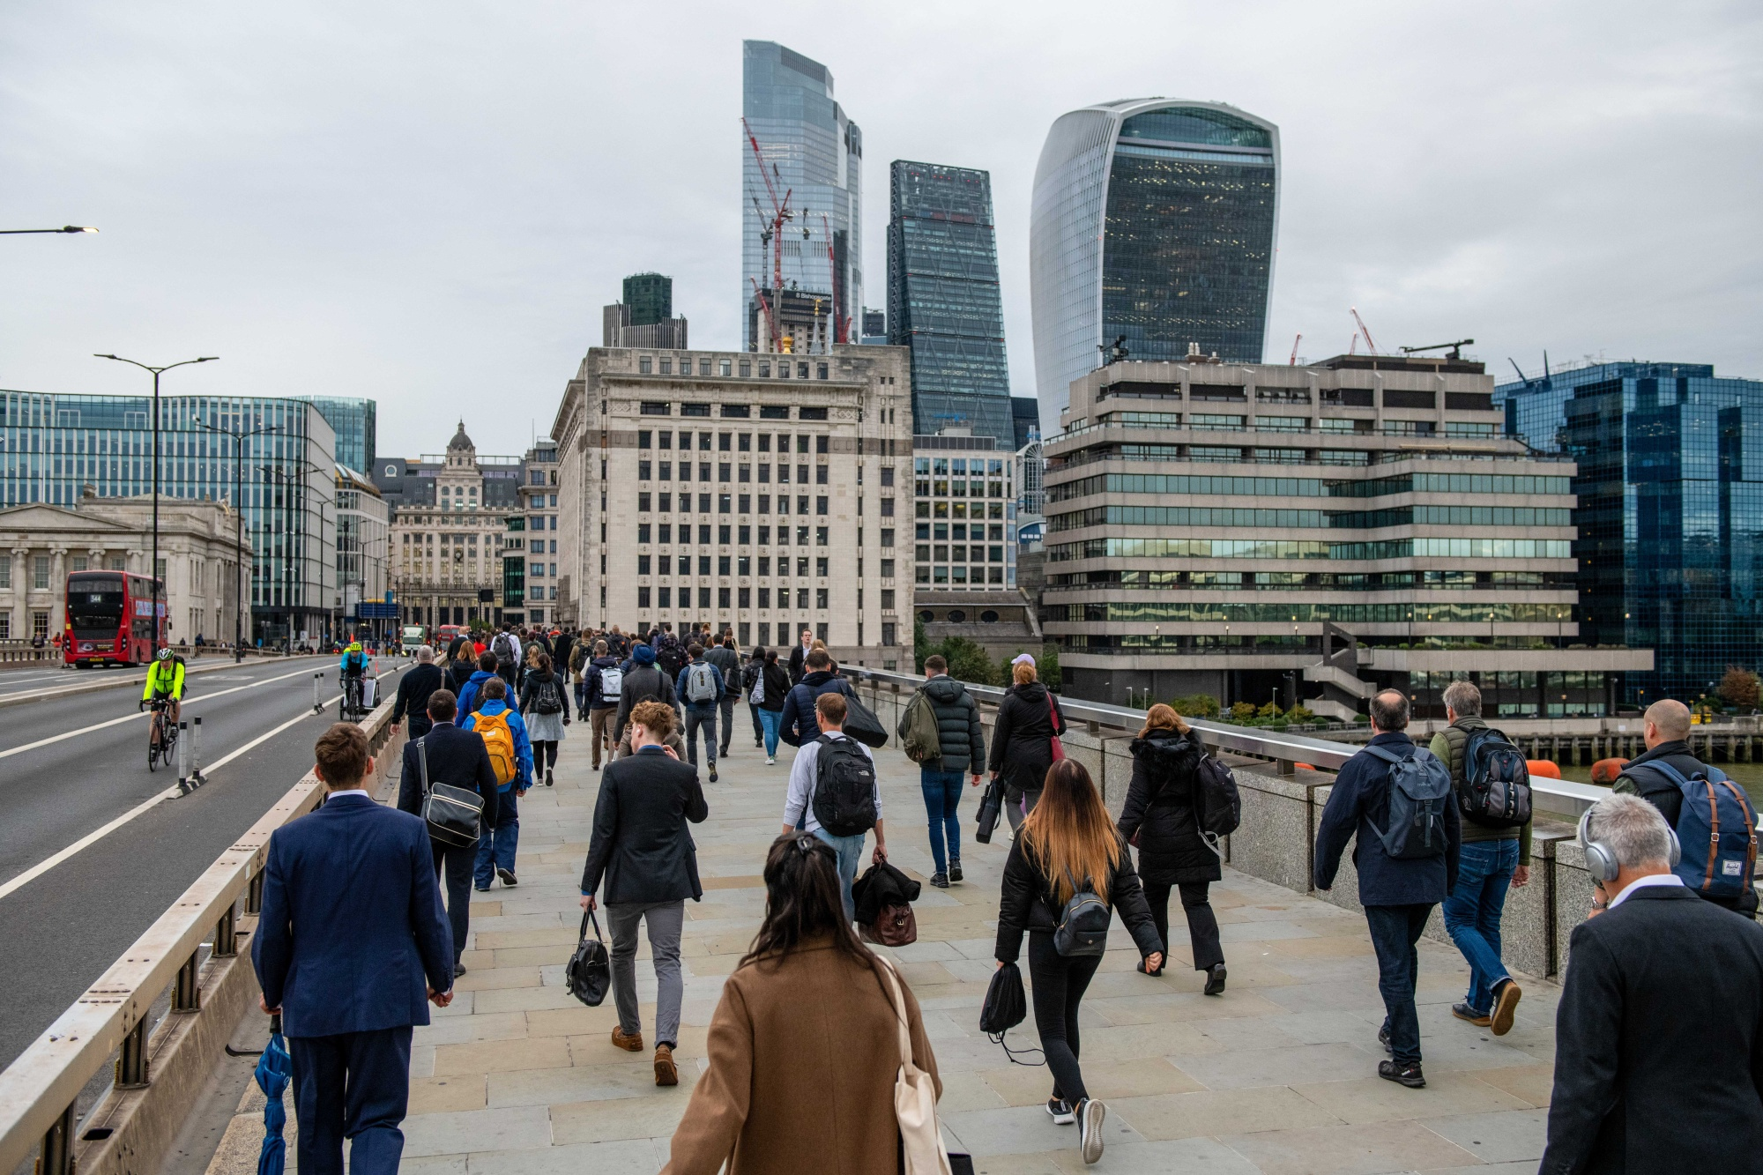
for I am with you, and no one will attack you to hurt you; for I have many people in this city.
Acts 18:10

Slide 18
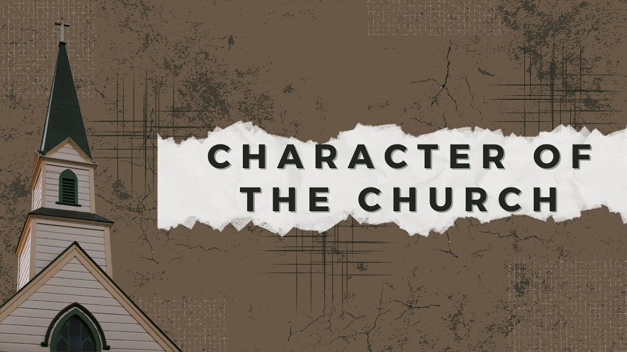
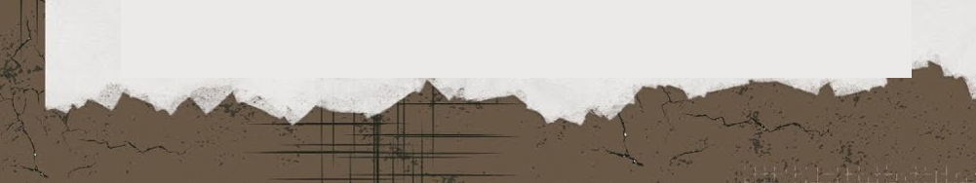
why does Christ build His church?

Slide 19
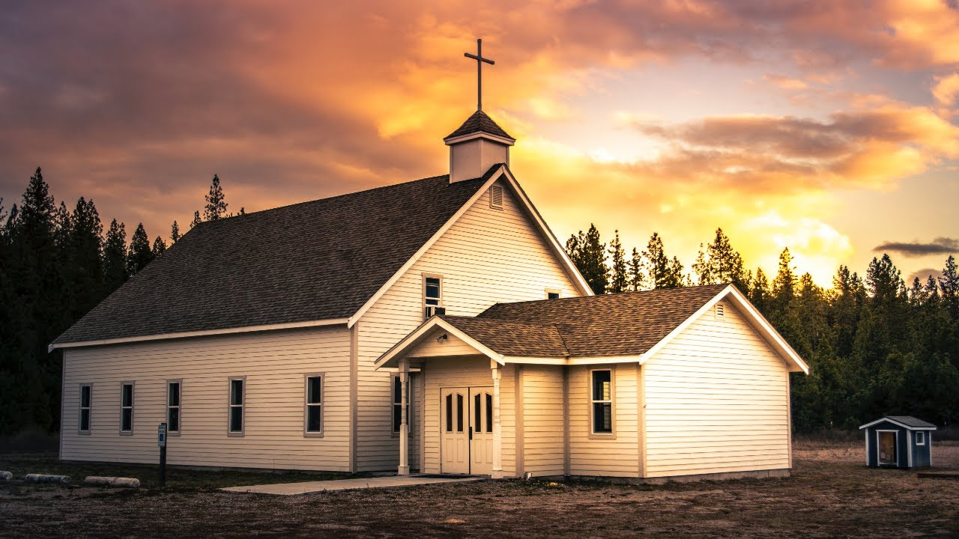
He might present her to Himself a glorious church, not having spot or wrinkle or any such thing
Ephesians 5:25-27

Slide 20
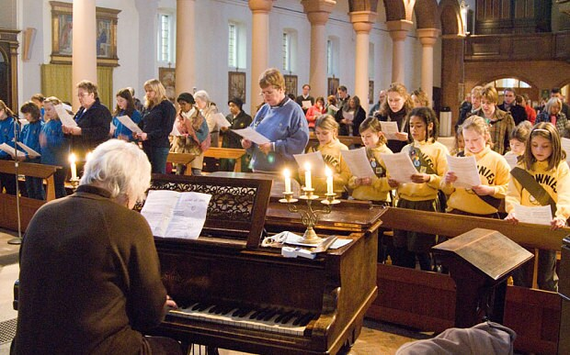
to Him be glory in the church by Christ Jesus to all generations, forever and ever. Amen.
Ephesians 3:21

Slide 21
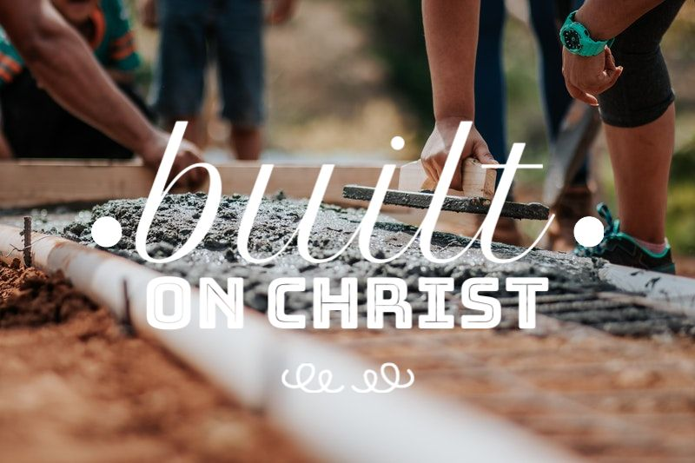
now the manifold wisdom of God might be made known by the church
Ephesians 3:10

Slide 22
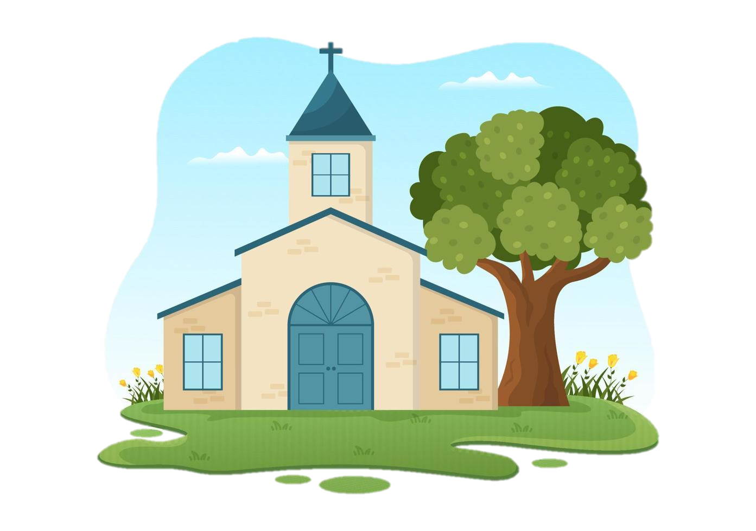
Christ is the owner
The builder
The architect
The owner

Slide 23
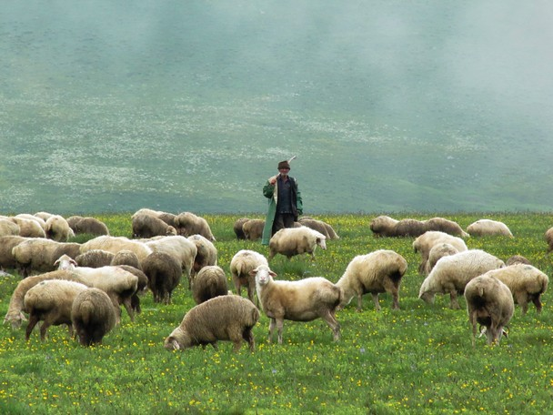
the Holy Spirit has made you overseers, to shepherd the church of God which He purchased with His own blood.
Acts 20:28

Slide 24
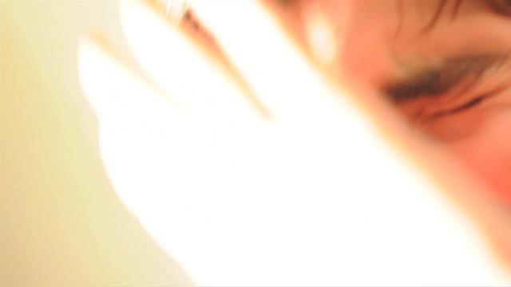
“Saul, Saul, why are you persecuting Me?”
Acts 9:4

Slide 25
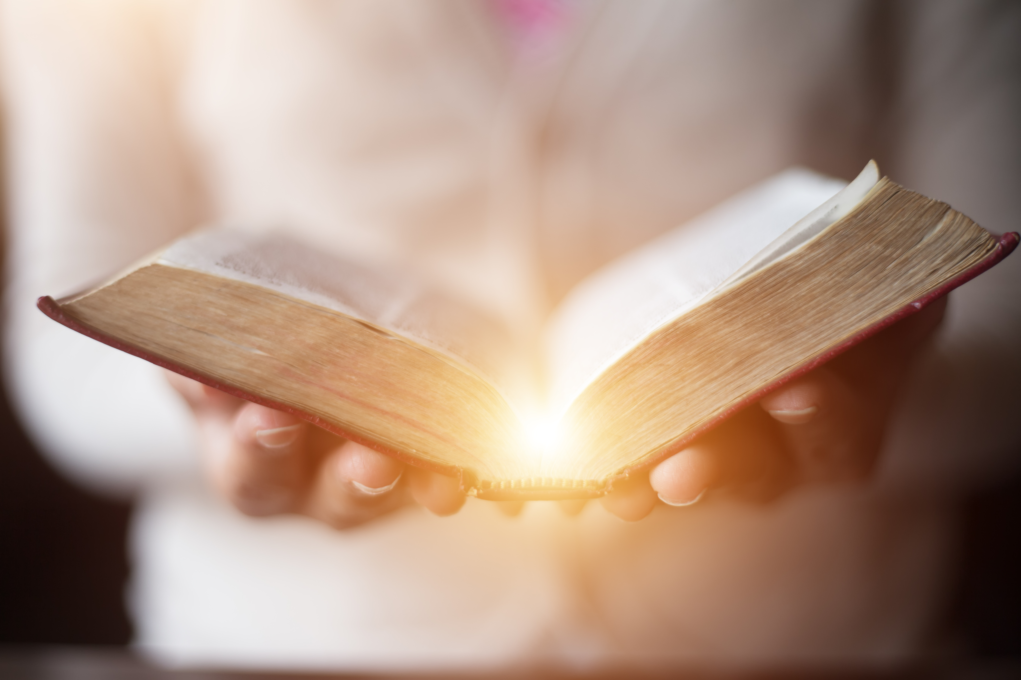
But he who is joined to the Lord is one spirit with Him.
1
Corinthians 6:17

Slide 26

For he who touches you touches the apple of His eye.
Zechariah
2:8

Slide 27
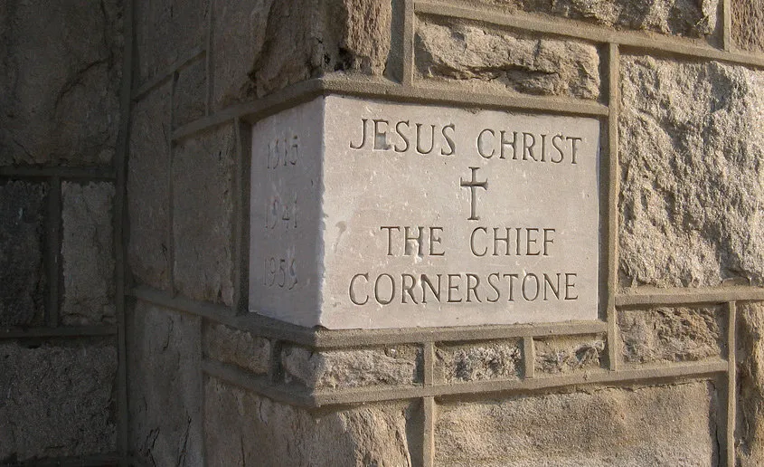
He is the living cornerstone

Slide 28
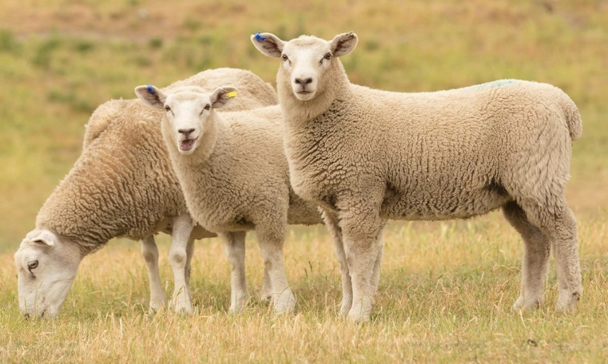
I am the good shepherd; and I know My sheep, and am known by My own.
John
10:14

Slide 29
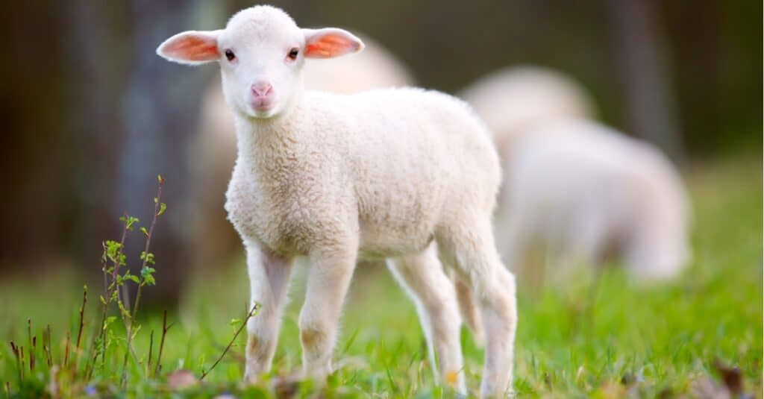
I am the good shepherd. The good shepherd gives His life for the sheep.
John
10:11

Slide 30

And I give them eternal life, and they shall never perish; neither shall anyone snatch them out of My hand
John
10:28-29

Slide 31
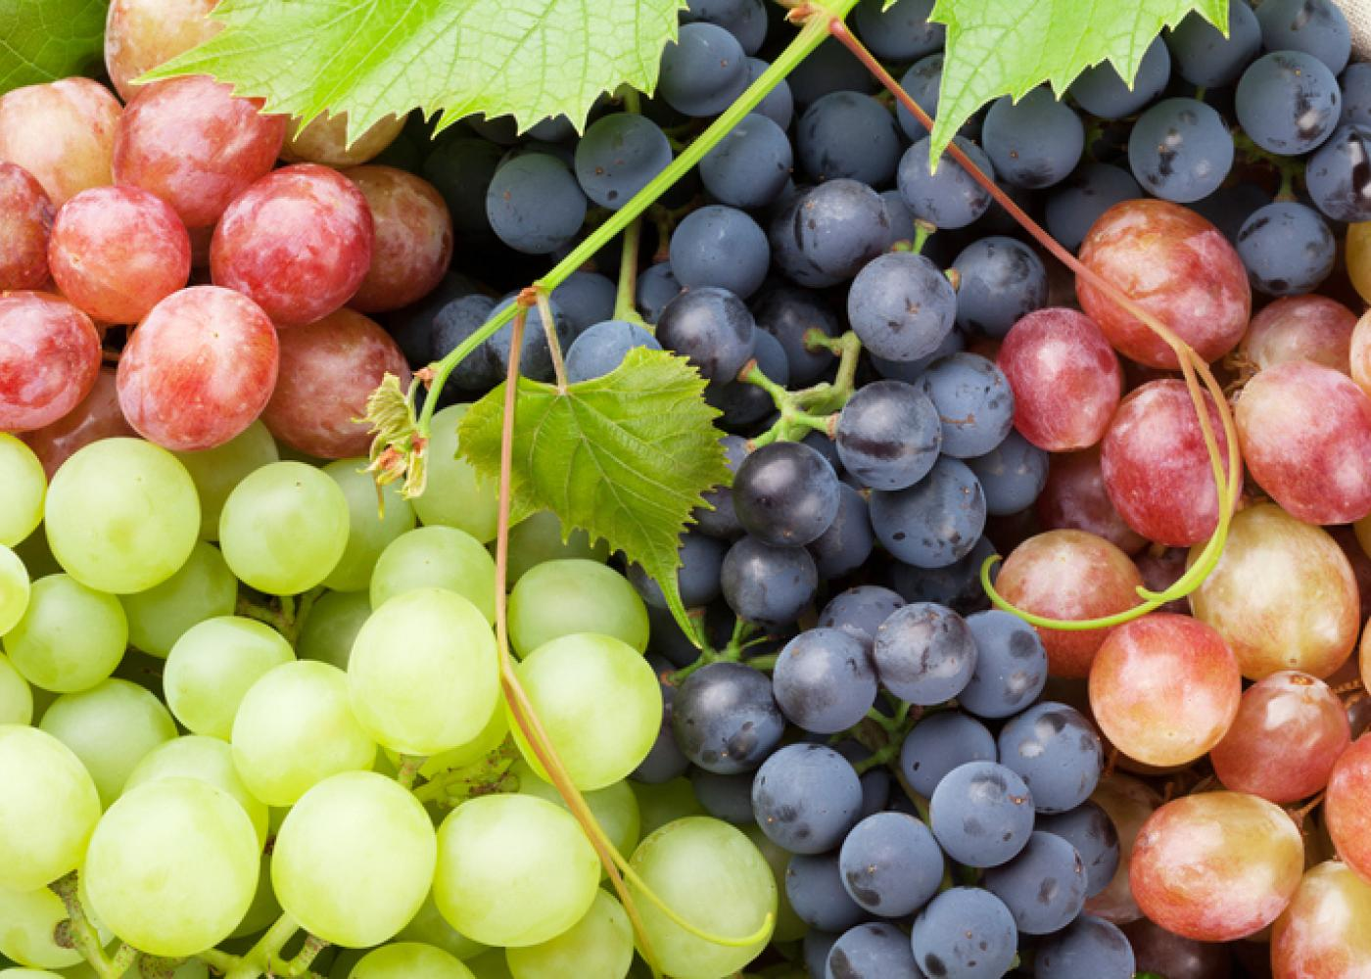
We don’t belong to some organization.
We belong to an intimate union.

Slide 32
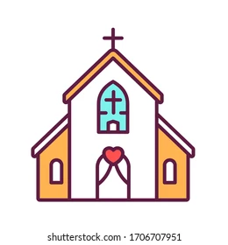
“I will build” - the certainty of it
“my ” - the intimacy of it
“church “ - the identity of it.
3. Identity

Slide 33
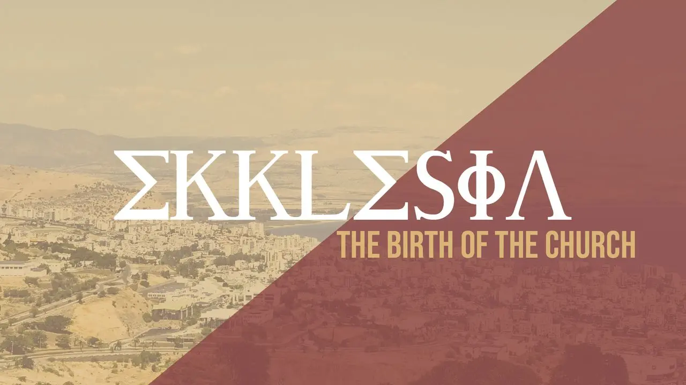
What does Jesus mean by

Slide 34
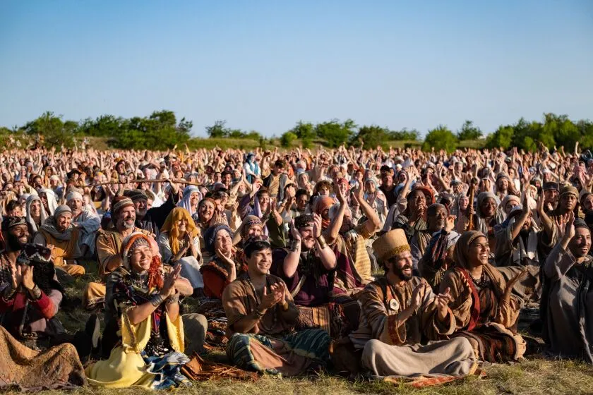
the congregation in the wilderness with the Angel who spoke to him on Mount Sinai
Acts 7:38

Slide 35
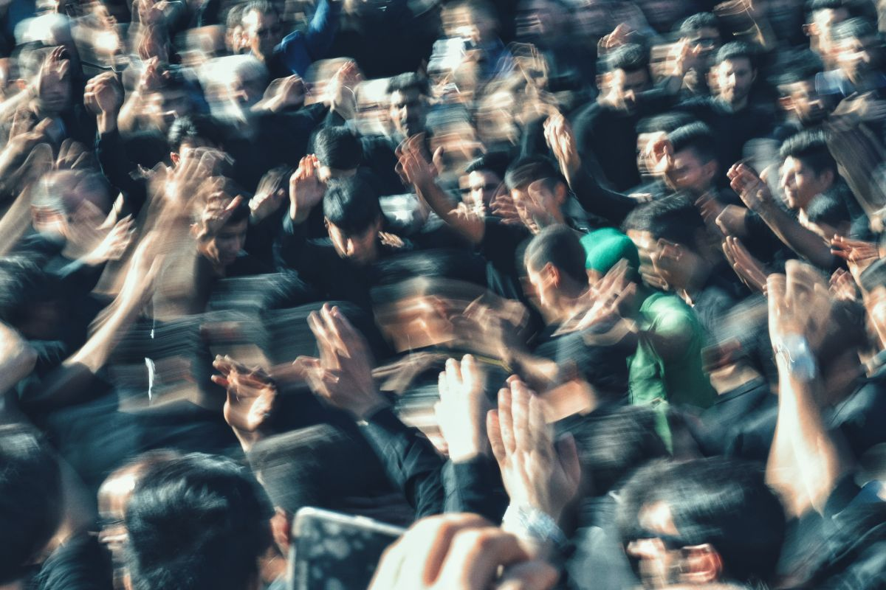
Some therefore cried one thing and some another, for the assembly was confused
Acts 19:32

Slide 36
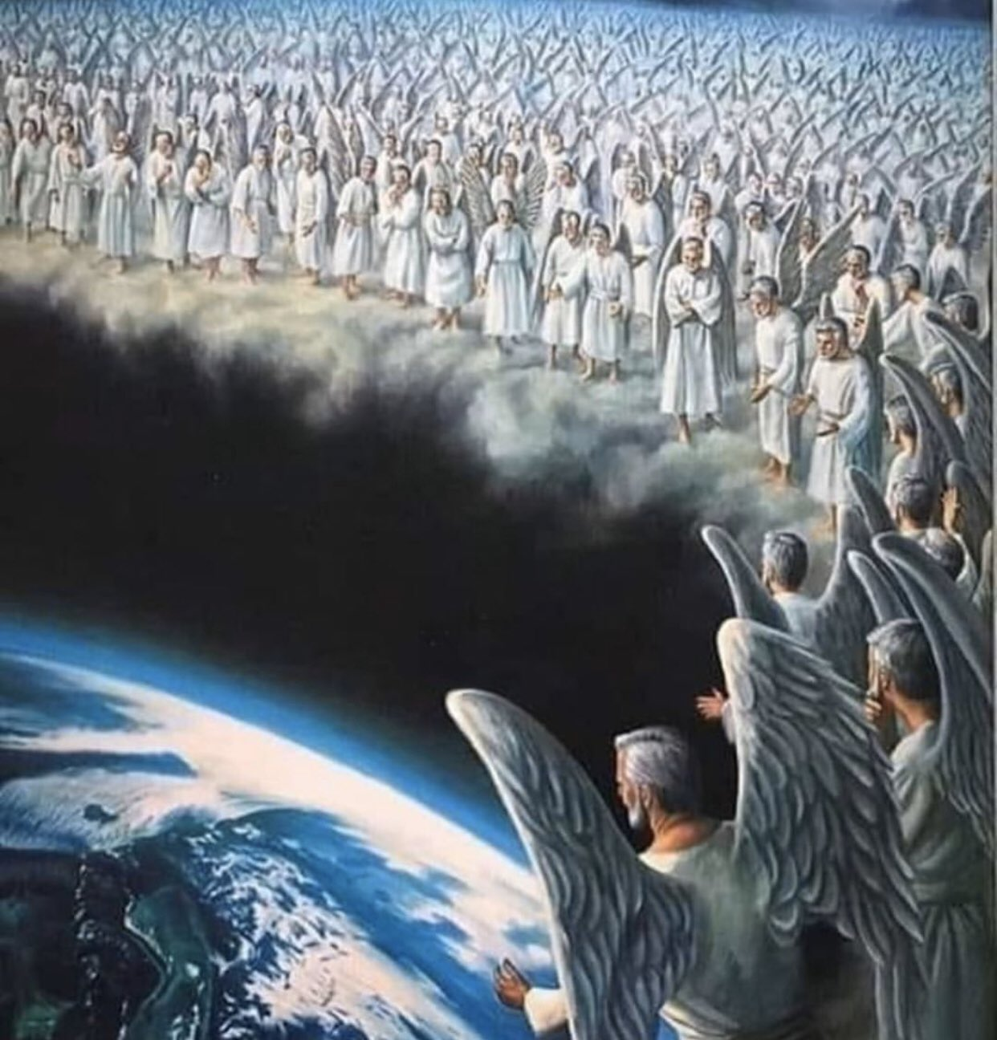
you have come to Mount Zion and to the city of the living God, the heavenly Jerusalem, to an innumerable company of angels
Hebrews 12:22-23

Slide 37
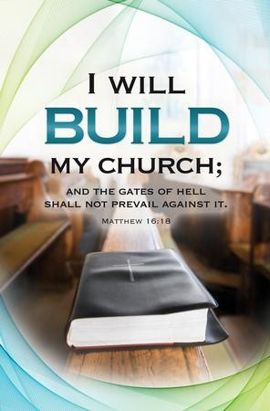
Matthew chapter 16
You interpret the word “church” in 18
You interpret by the word “Kingdom” in 19
“I AM still building my Kingdom.”

Slide 38
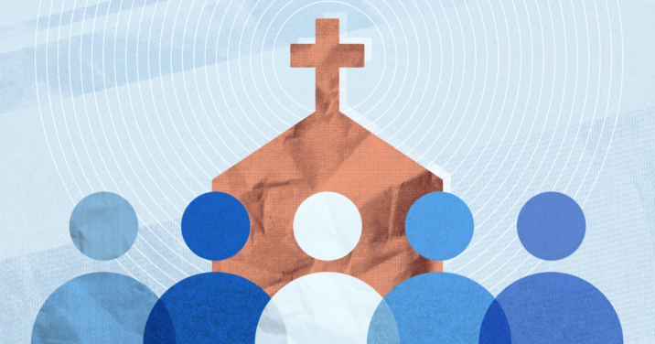
Jesus is building it.
He will build it.
Assembly of redeemed people gathered to God

Slide 39
Jesus said, “I will build my church” certainty, intimacy, and the identity, the continuity of God’s redeemed people.

