Slide 1
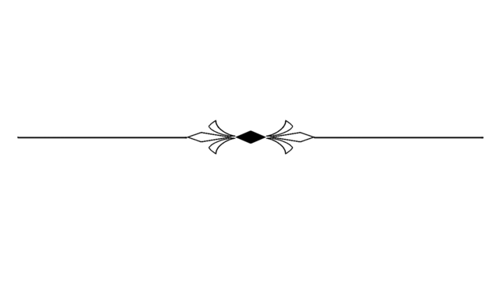
1 3 J a n u a r y – S u n d a y

Slide 2


Christ Builds !
Matthew 16:18-20
Foundation of the Church

Slide 3

Matthew 16:13-20
The ultimate goal of the universe is to Glorify God and all things are
made by Him and for Him

Slide 4
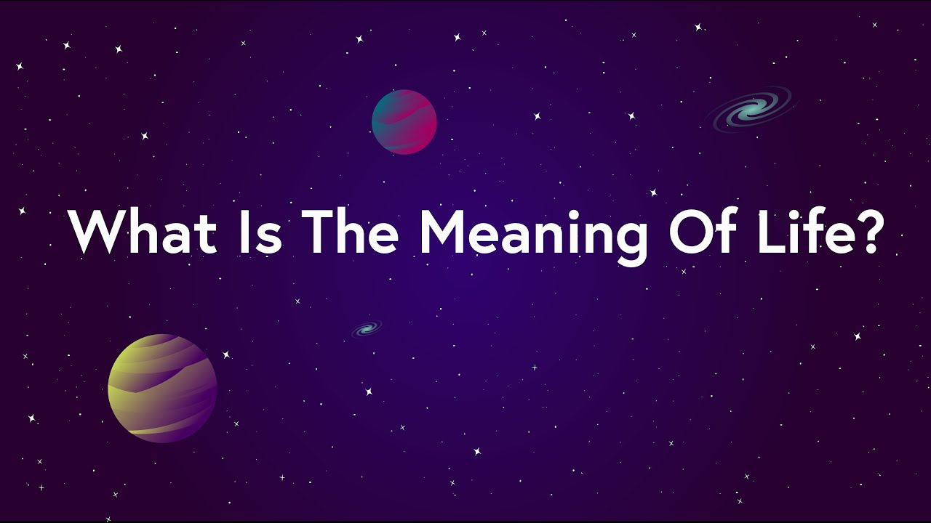

Slide 5
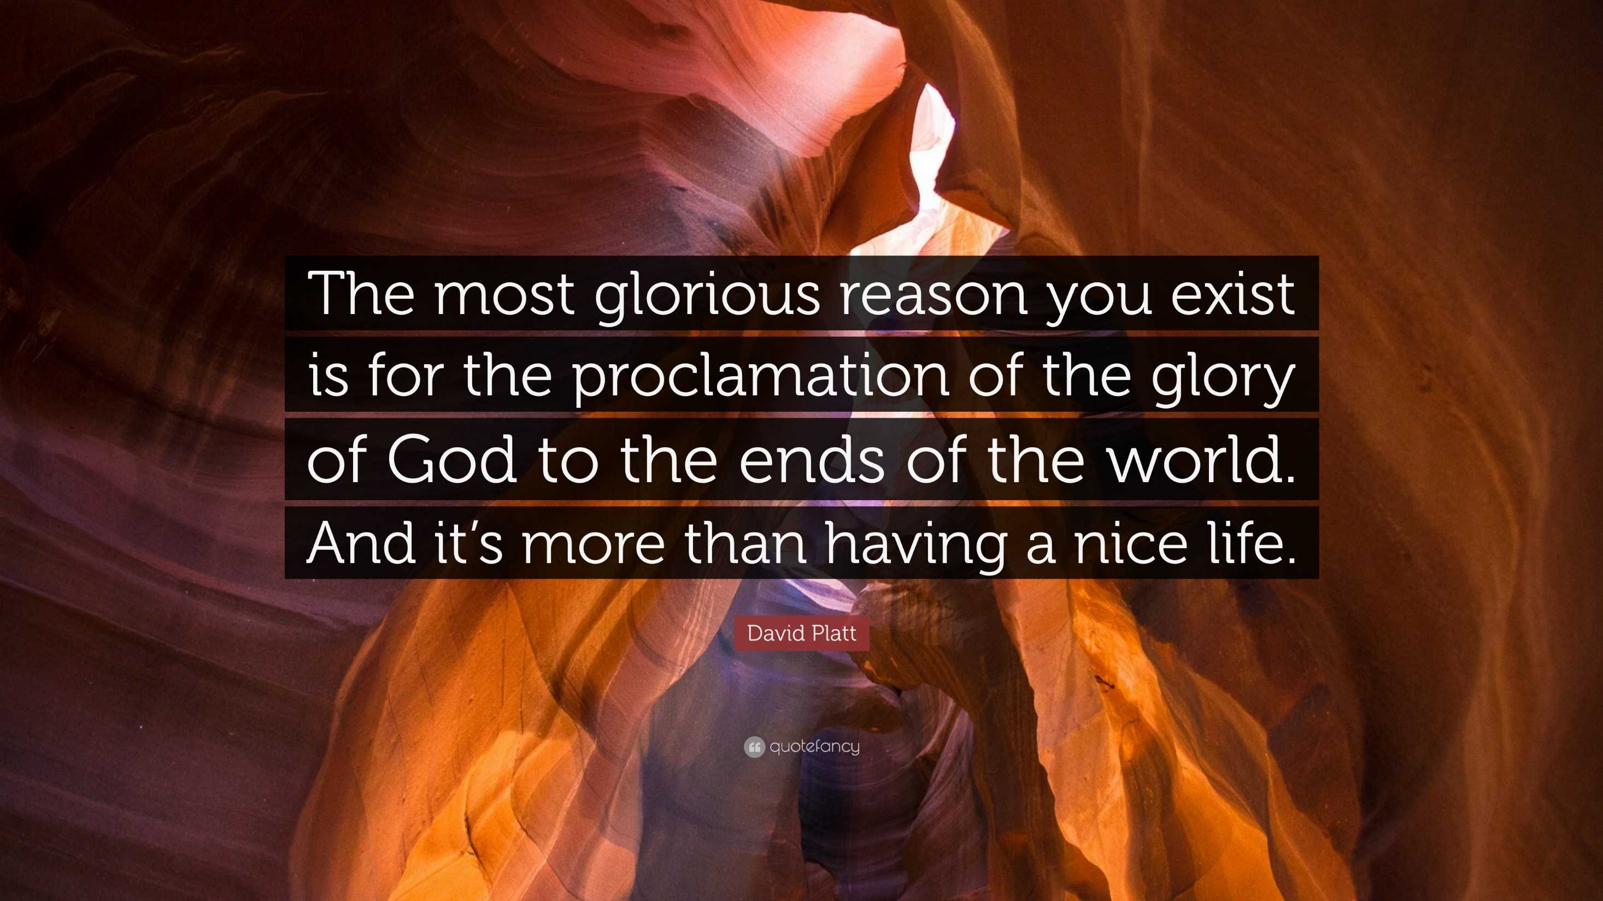

Slide 6
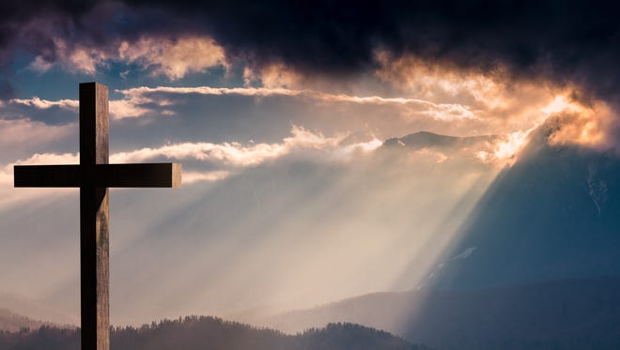
Christ is History
History is His Story

Slide 7

Jesus said,
“I will continue to build my redeemed people.” That’s the reason for history.

Slide 8
Messiah will be the anointed of God.
He will bring righteousness.
He will bring peace.
He will bring prosperity.
He will establish the throne of His father David.
He will reign and rule.

Slide 9
There will be economic prosperity,
There will be religious prosperity,
There will be political prosperity,
There will be military prosperity.

Slide 10
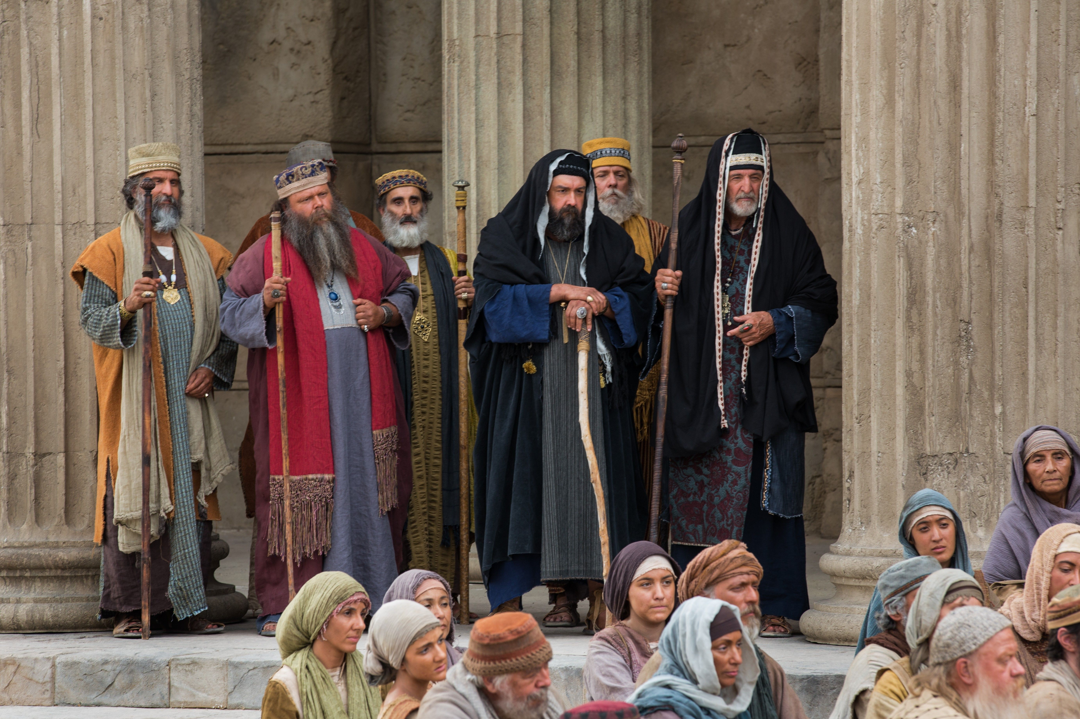
All their expectations were Unfulfilled.

Slide 11
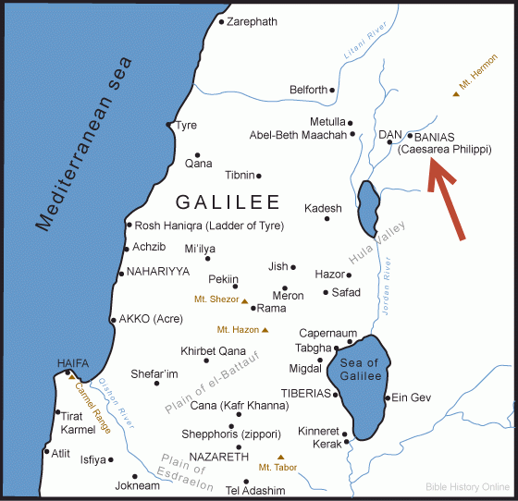
Matthew 16:13

Slide 12
Chapter 16
“Not only I Am going to die,”
V 24 He says, “you are going to take up your cross.”
V 25, “you are going to have to lose your life for my sake.”

Slide 13
Chapter 16:16
“You are Christ, the Son of the living God.”

Slide 14
Chapter 16:18-20,
When Christ builds a church, what’s it like?

Slide 15
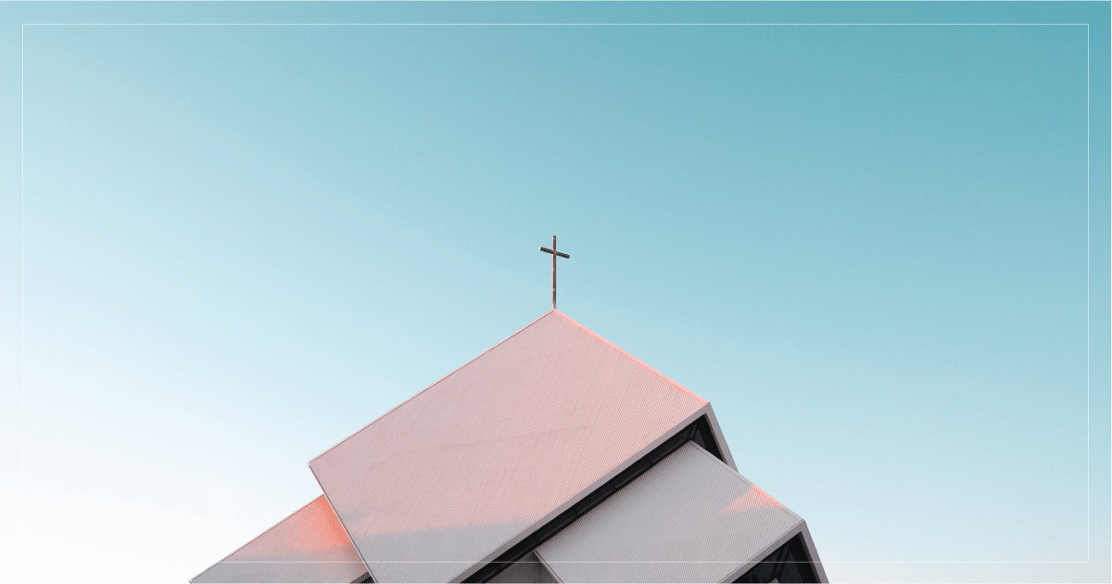
1. The Certain Church.

Slide 16

2. Christ the owner.

Slide 17

John 6, “All that the Father gives to me shall come to me.”
John 10, “My sheep hear my voice and I know them and am known of them.”

Slide 18

3. The identity of the church.

Slide 19
EKKLESIA
Acts 7:38

Slide 20
Acts 19. When the mob at Ephesus rioted, they’re called an ekklesia, a group of people gathered, an assembly broke into a riot.

Slide 21
Hebrews 12:22-24, all the redeemed of all the ages gathered before the throne of God are called the church.

Slide 22
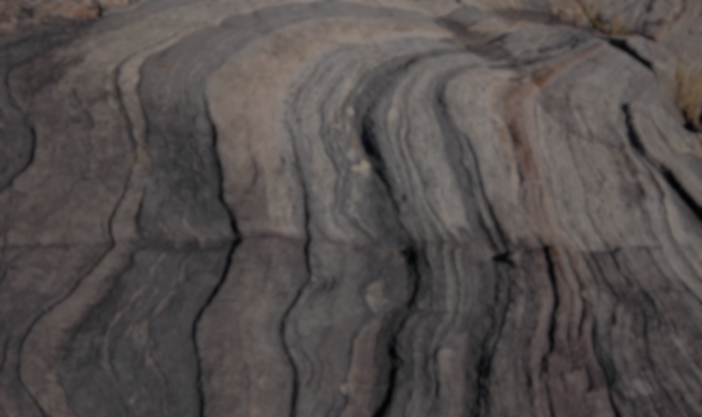
4. The foundation of the church.

Slide 23
Chapter 16:18
And I also say to you that you are Peter, and on this rock I will build My church, and the gates of Hades shall not prevail against it.

Slide 24
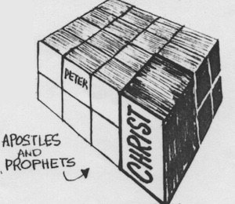
What is that rock?

Slide 25
“You are Peter
I am going to build my church on you’’

Slide 26
Ephesians 2:20,
Having been built on the foundation of the apostles and prophets, Jesus Christ Himself being the chief cornerstone,

Slide 27
Matthew 16
Peter

Slide 28
Petra / Petros difference?
Petros has to be used in the case of Peter because it’s a masculine form and he is a man.

Slide 29
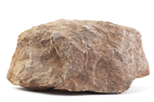
“You are petros,” which means stone.

Slide 30
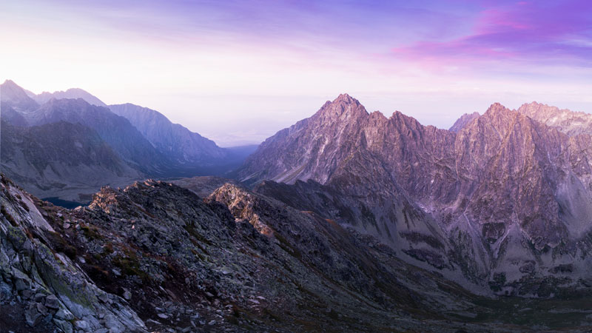
“but upon this petra”
- it means a rock bed or a rocky mountain.

Slide 31
Ephesians 2:20,
That the church is built on the foundation of the apostles, Peter being representative of them.

Slide 32
Acts 2:14,
But Peter, standing up with the eleven, raised his voice and said to them, “Men of Judea and all who dwell in Jerusalem, let this be known to you, and heed my words.

Slide 33
Two thousand more were added later to the church in Acts 4.
Lame man was healed.
Election of Matthias took place to replace Judas.
Heroic message of Peter before the Sanhedrin

Slide 34
Acts 2:42,
And they continued steadfastly in the apostles’ doctrine and fellowship, in the breaking of bread, and in prayers.

Slide 35
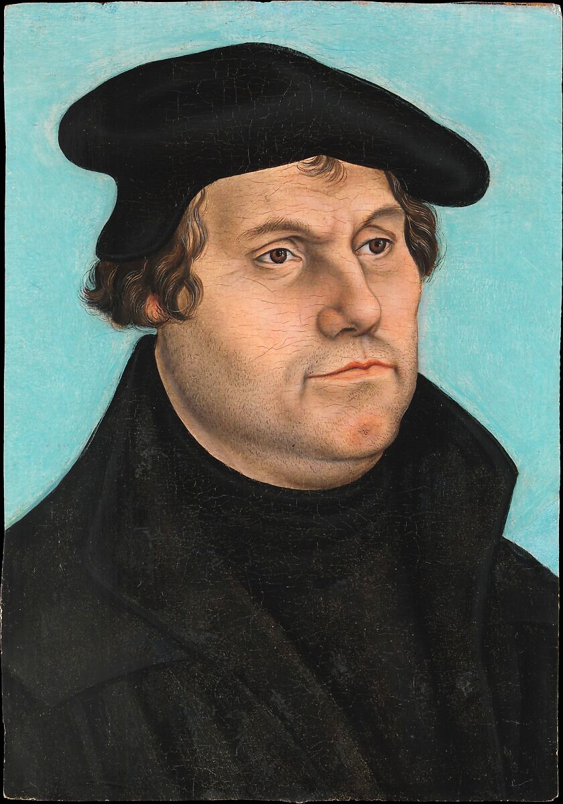
“All who agree with the confession of Peter are Peters themselves, setting a sure foundation.”
Martin Luther.

Slide 36
1 Peter 2:4-5,
4 Coming to Him as to a living stone, rejected indeed by men, but chosen by God and precious,
5 you also, as living stones, are being built up a spiritual house, a holy priesthood, to offer up spiritual sacrifices acceptable to God through Jesus Christ.

Slide 37
1 Corinthians 3:11,
For no other foundation can anyone lay than that which is laid, which is Jesus Christ.

Slide 38
Ephesians 2:20,
You have the apostles’ and prophets’ foundation, here you have Christ the foundation.

Slide 39
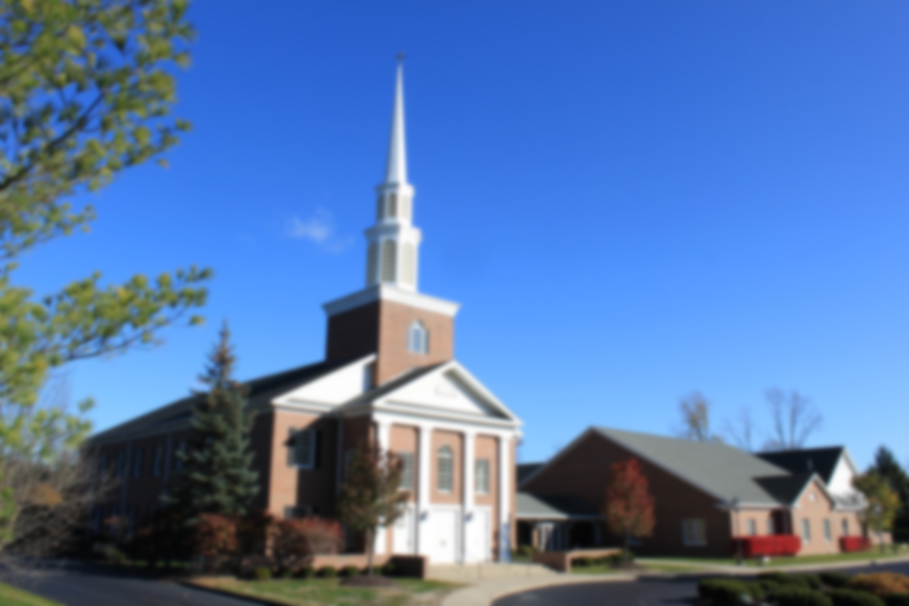
The Lord is still building His church
on people who confess His Word,

Slide 40
Matthew 18:1
At that time the disciples came to Jesus, saying, “Who then is greatest in the kingdom of heaven?”

Slide 41
Matthew 16:19,
And I will give you the keys of the kingdom of heaven, and whatever you bind on earth will be bound in heaven, and whatever you loose on earth will be loosed in heaven.”

Slide 42
Matthew 18:2-3,
2 Then Jesus called a little child to Him, set him in the midst of them,
3 and said, “Assuredly, I say to you, unless you are converted and become as little children, you will by no means enter the kingdom of heaven.

Slide 43
Who is the greatest in the Kingdom of Heaven?
Whoever humbles himself like a little child.

Slide 44
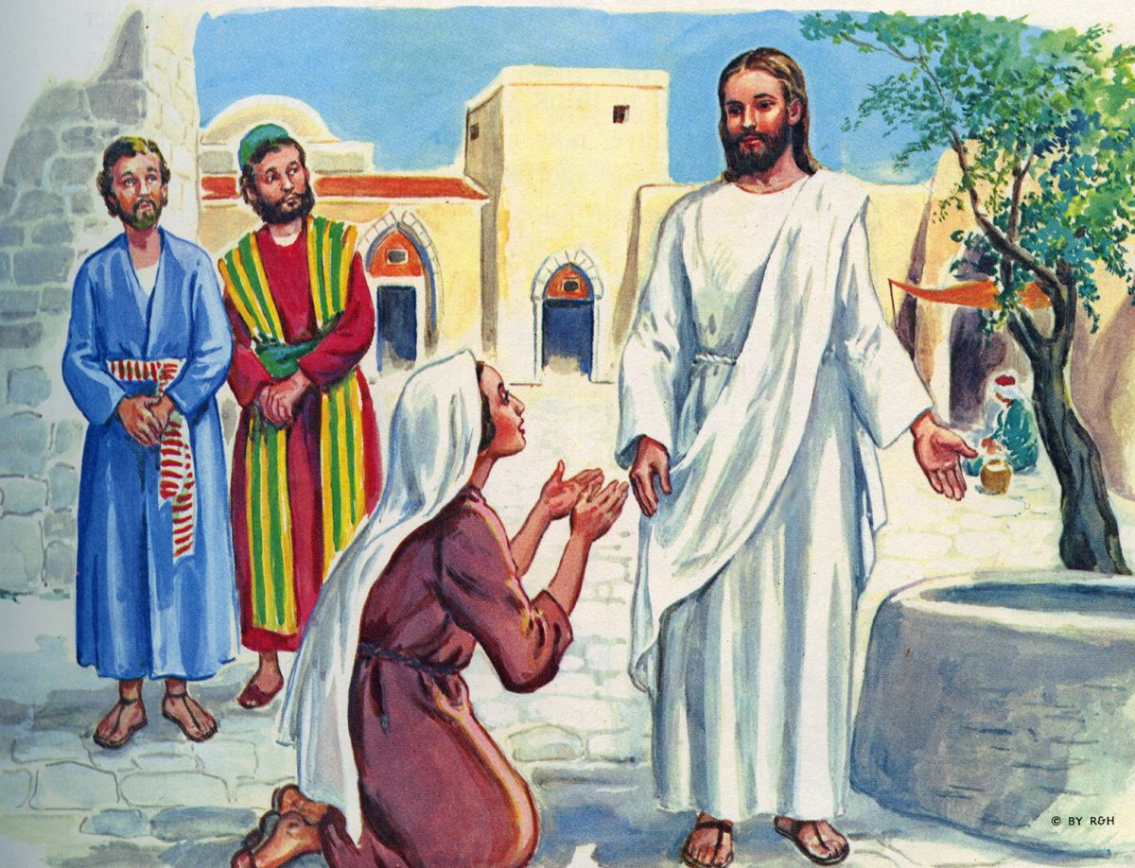
Matthew 20:20-21,
20 Then the mother of Zebedee’s sons came to Him with her sons, kneeling down and asking something from Him.

Slide 45
Matthew 20:20-21
21 And He said to her, “What do you wish?” She said to Him, “Grant that these two sons of mine may sit, one on Your right hand and the other on the left, in Your kingdom.”

Slide 46
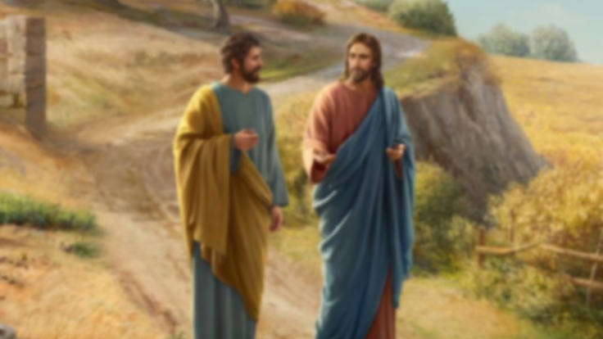
What about Peter?
Did he think he was made pope?

Slide 47
1 Peter 5:1-3,
1 The elders who are among you I exhort, I who am a fellow elder and a witness of the sufferings of Christ, and also a partaker of the glory that will be revealed:

Slide 48
1 Peter 5:1-3,
2 Shepherd the flock of God which is among you, serving as overseers, not by compulsion but willingly, not for dishonest gain but eagerly;
3 nor as being lords over those entrusted to you, but being examples to the flock;

Slide 49
I am just one with all the rest of you guys.
I am just another witness of the sufferings of Christ, a partaker of the glory that shall be revealed.
I am just telling you feed the flock.
I am being an example to the flock.

Slide 50
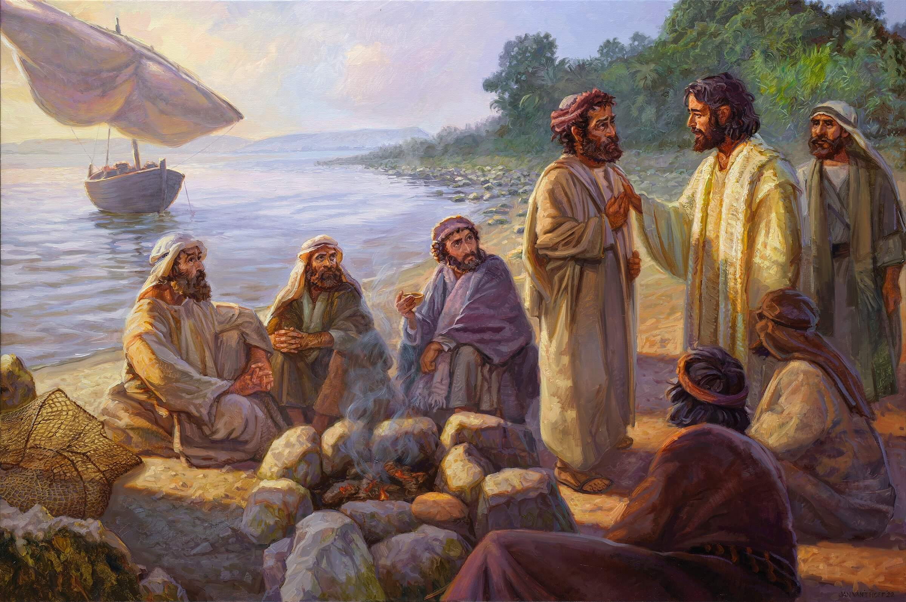
Peter is not pulling rank.
He is saying I am just one like you.

Slide 51
The disciples never perceived Matthew 16 as giving Peter primacy.
James and John never perceived it that way and they were intimate with Jesus.
Peter never perceived it that way or he wouldn’t have said what he said in 1 Peter 5.
The Lord Himself never perceived it that way or He wouldn’t have said the greatest in the Kingdom is anybody who humbles himself like a little child.

Slide 52
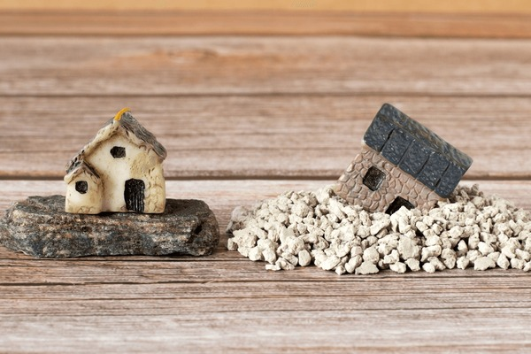
5. The strength of the church.

Slide 53
When Christ builds the church, it is Invincible.

Slide 54
Matthew 16:18
And the gates of Hades shall not prevail against it

Slide 55
H A D E S
the abode of the dead.

Slide 56
H A D E S
the abode of the dead.
S H E O L

Slide 57
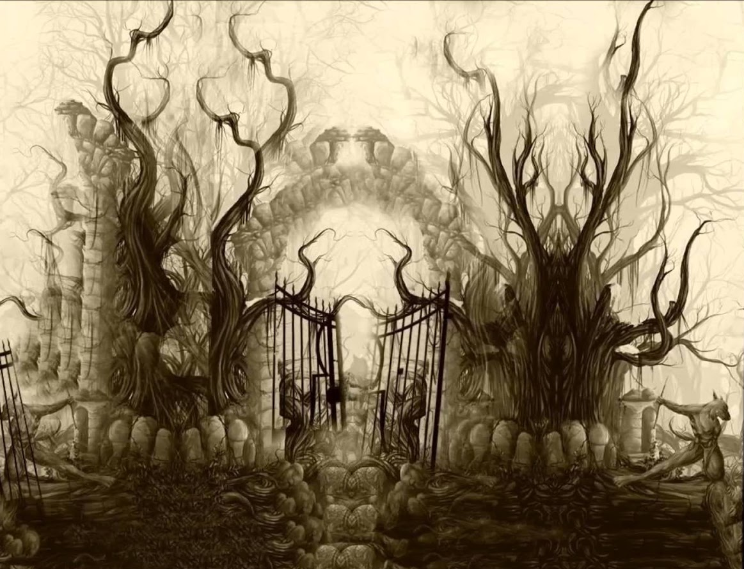
Death can’t hold in God’s redeemed people!
The gates of the grave can’t keep us.

Slide 58
John 14:19
“A little while longer and the world will see Me no more, but you will see Me. Because I live, you will live also.

Slide 59
Hebrews 2:14,
Inasmuch then as the children have partaken of flesh and blood, He Himself likewise shared in the same, that through death He might destroy him who had the power of death, that is, the devil,

Slide 60
Acts 2:24,
Whom God raised up, having loosed the pains of death, because it was not possible that He should be held by it.

Slide 61
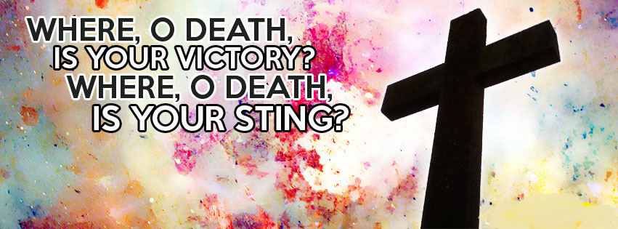
1 Corinthians 15:55,

Slide 62
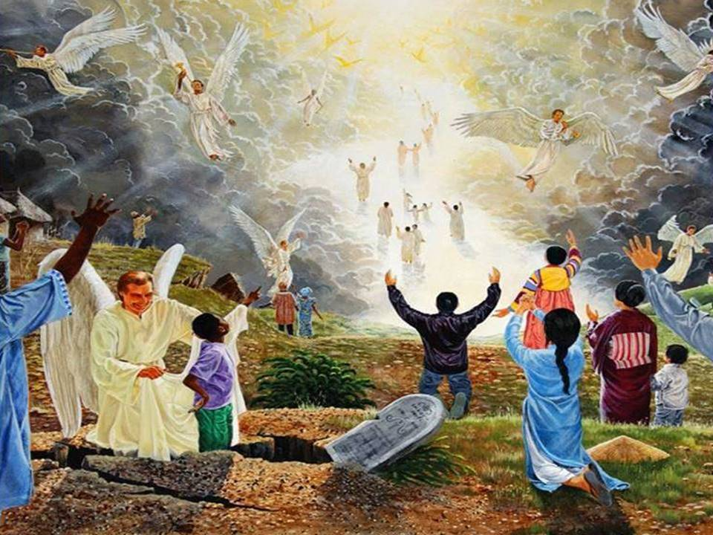
The great hope of the Christian.
This is a promise of Resurrection!

Slide 63
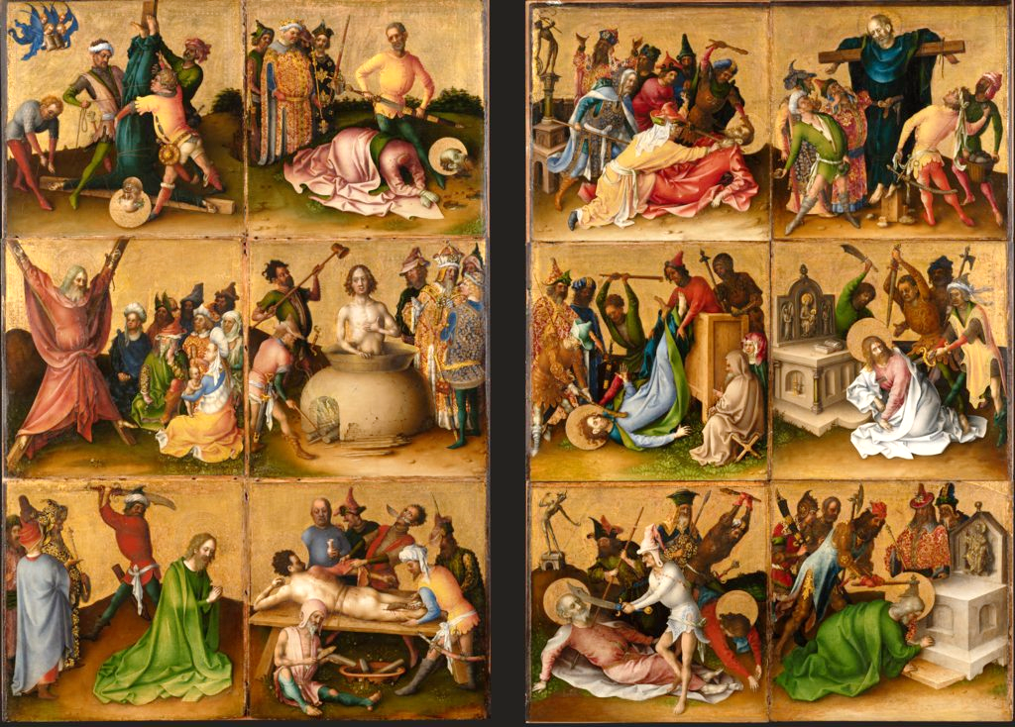

Slide 65
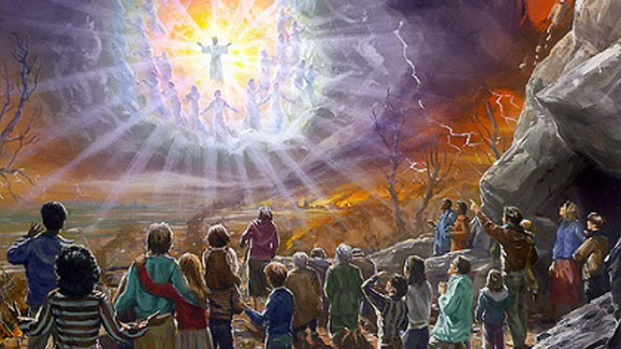

Slide 66
Revelation 1:18,
I am He who lives, and was dead, and behold, I am alive forevermore. Amen. And I have the keys of Hades and of Death.

Slide 67
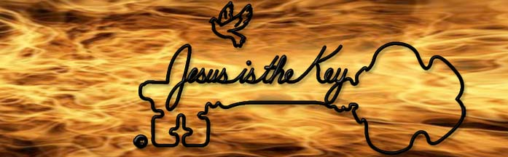

Slide 68
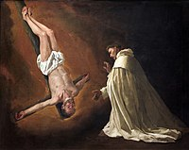
“The gates of Hades shall not prevail against it.”

Slide 69
When Jesus builds a church,
there is certainty,
there is intimacy,
there is identity,
there is foundation,
there is invincibility.

Slide 70
6. The authority of the Church.

Slide 71
Matthew 16:19
And I will give you the keys of the kingdom of heaven, and whatever you bind on earth will be bound in heaven, and whatever you loose on earth will be loosed in heaven.”

Slide 72
John 20:23,
If you forgive the sins of any, they are forgiven them; if you retain the sins of any, they are retained.”

Slide 73
Matthew 18:17
And if he refuses to hear them, tell it to the church. But if he refuses even to hear the church, let him be to you like a heathen and a tax collector.

Slide 74
Matthew 18:18
Assuredly, I say to you, whatever you bind on earth will be bound in heaven, and whatever you loose on earth will be loosed in heaven.

Slide 75
First, Jesus said that to Peter.
Then Jesus said it to all of them.
Then Jesus said it to the whole duly constituted assembly of redeemed people.

Slide 76
Where did we get that authority?
It is in the Word of God.

Slide 77

Never compromise the Word of God
because it’s the only
authority we have

Slide 78
Matthew 18:20
Then He commanded His disciples that they should tell no one that He was Jesus the Christ.

Slide 79
What a church Christ is building
a spiritual church,
a church with authority,
a church with invincibility,
a church with a foundation on the revelation of the living God

