Slide 1
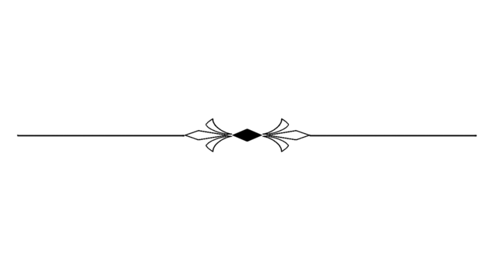
21st J a n u a r y S u n d a y

Slide 2



Matthew 16:21-23
THINGS OF
God and Man

Slide 3
Matthew16:21-23
‘’for you are not mindful of the things of God, but the things of men.’’

Slide 4


Proverbs 14:12
There is a way that seems right to a man, But its end is the way of death.

Slide 5
Psalm 77:19
Your way was in the sea, Your path in the great waters, And Your footsteps were not known.

Slide 6
Psalm 92:5-6
5. O Lord, how great are Your works! Your thoughts are very deep.
6. A senseless man does not know, Nor does a fool understand this.

Slide 7
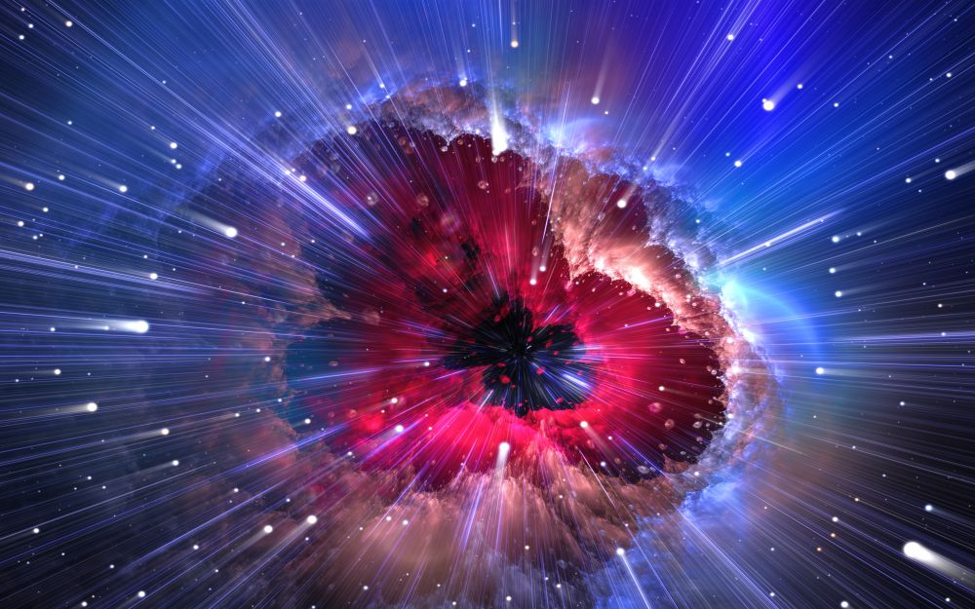
We don’t know
God’s thoughts.
We don’t know God’s ways in.

Slide 8
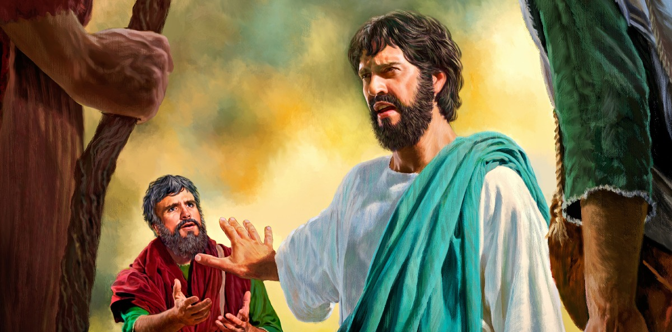
For Peter thought in his own human wisdom that He needed to correct
Jesus Christ.

Slide 9
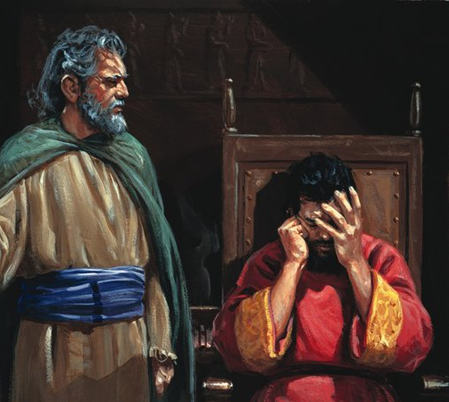
2 Samuel 7
David refused
of building the temple

Slide 10
2 Samuel 7:19
And yet this was a small thing in Your sight, O Lord God; and You have also spoken of Your servant’s house for a great while to come. Is this the manner of man, O Lord God?

Slide 11
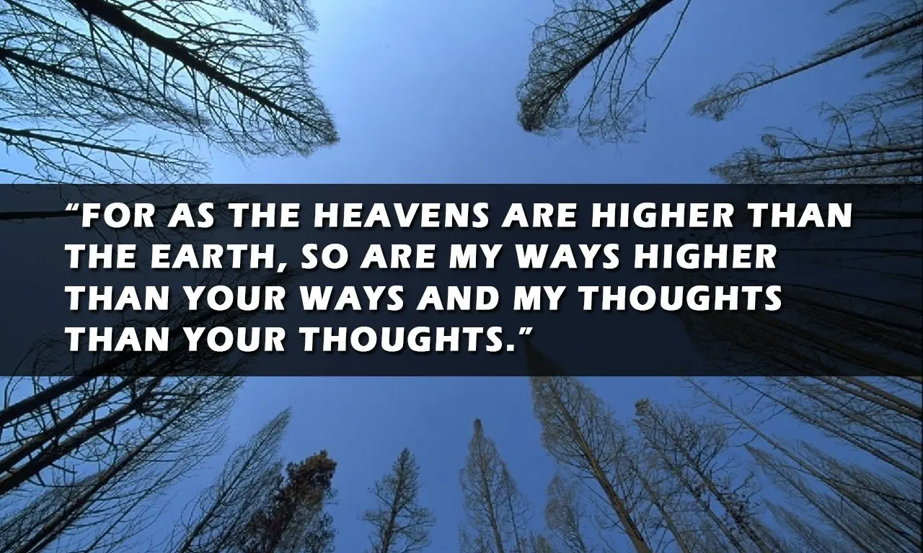

Slide 12

This is the reason when we pray,

Slide 13

Peter here is a believer.. and so this is a lesson for believers..

Slide 14
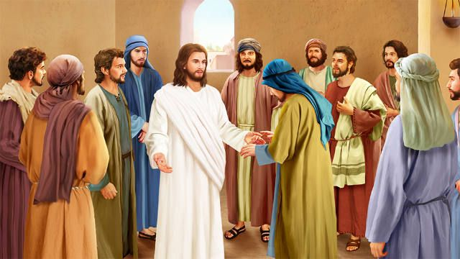
B a c k g r o u n d

Slide 15
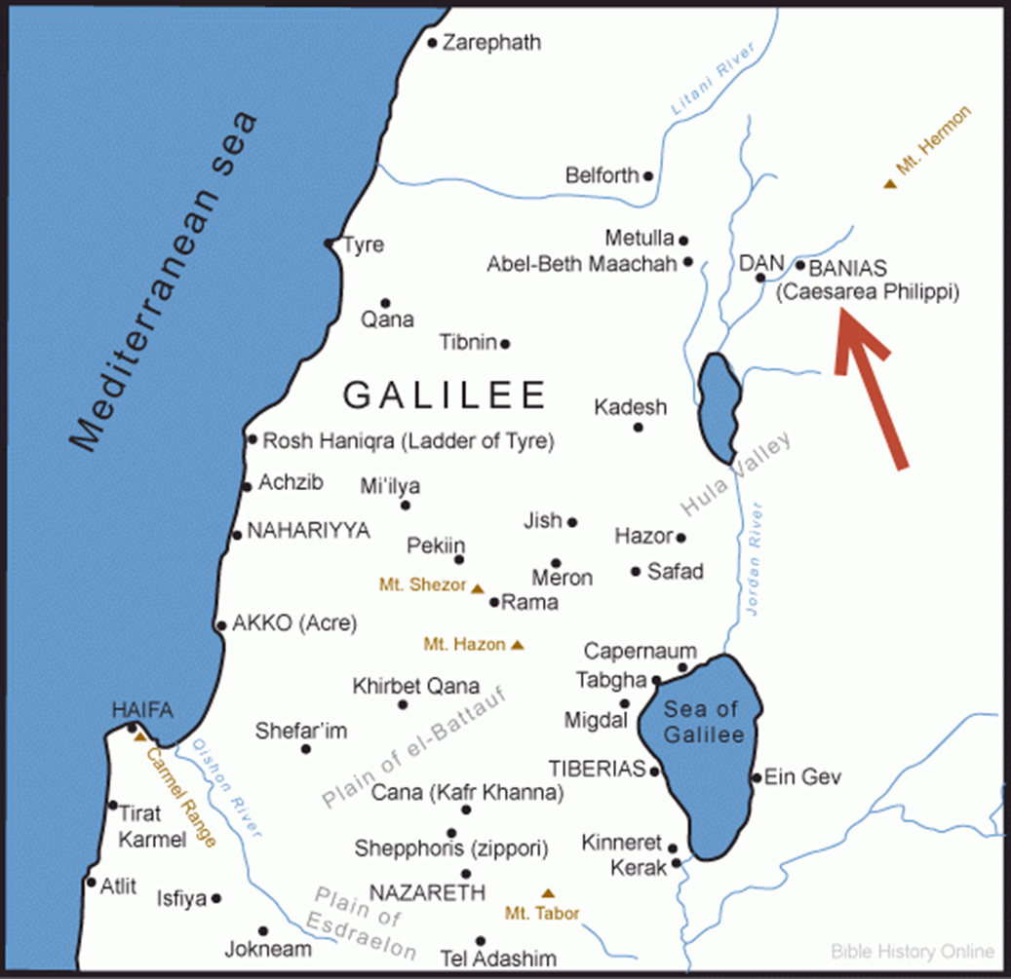
Matthew 16:13

Slide 16
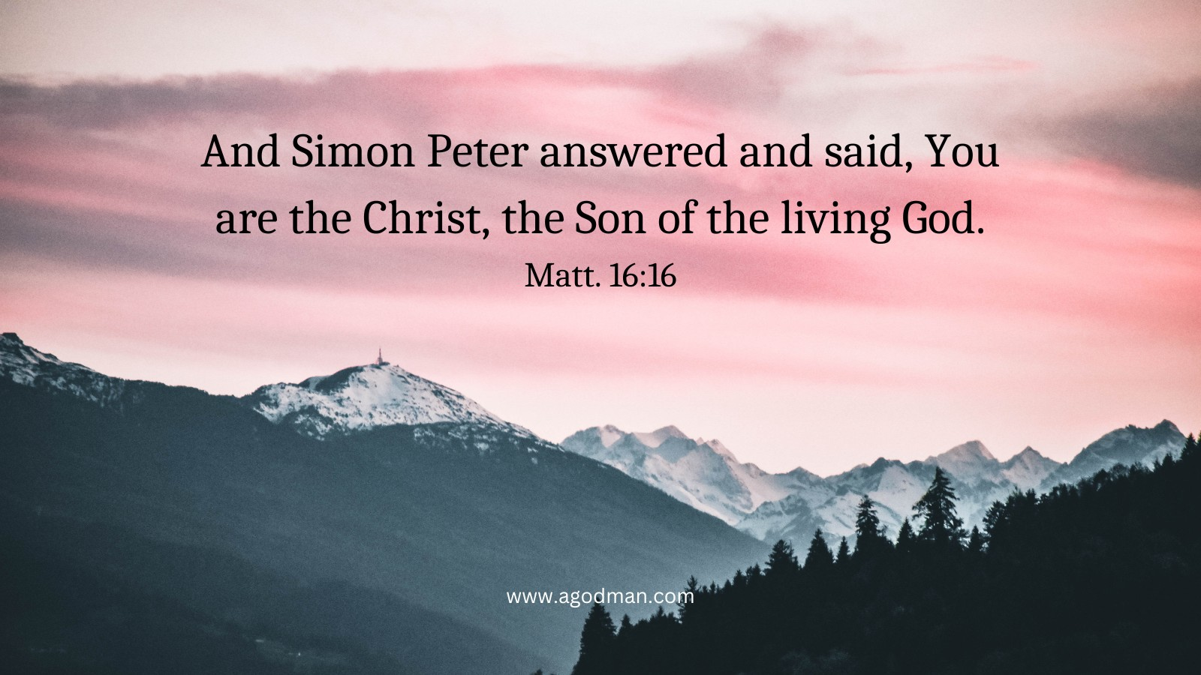
Who am I ?

Slide 17

V 16, “You are the Christ, the Son of the living God.”
The affirmation that He is the Messiah.
They understand that.
There is no other explanation for His words.
There is no other explanation for His works.
There is no other explanation for the fact that He said He was the Lord of the Sabbath.

Slide 18
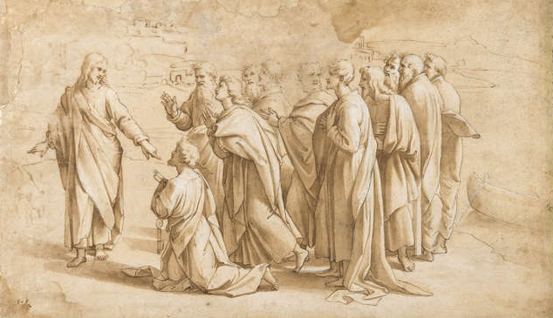
This was
revealed
to you by
God the Father.

Slide 19
“I am the Messiah,
I am building my Kingdom,
and death will not stop it.”

Slide 20
Matthew16:21
“I will be killed, and I will be raised again the third day.”

Slide 21
1 Corinthians 1:18
For the message of the cross is foolishness to those who are perishing, but to us who are being saved it is the power of God.

Slide 22
Chapter 17, Chapter 20, and John 12,
Jesus is continuing to show these things to them about His death and resurrection, which they never are able to grasp.

Slide 23
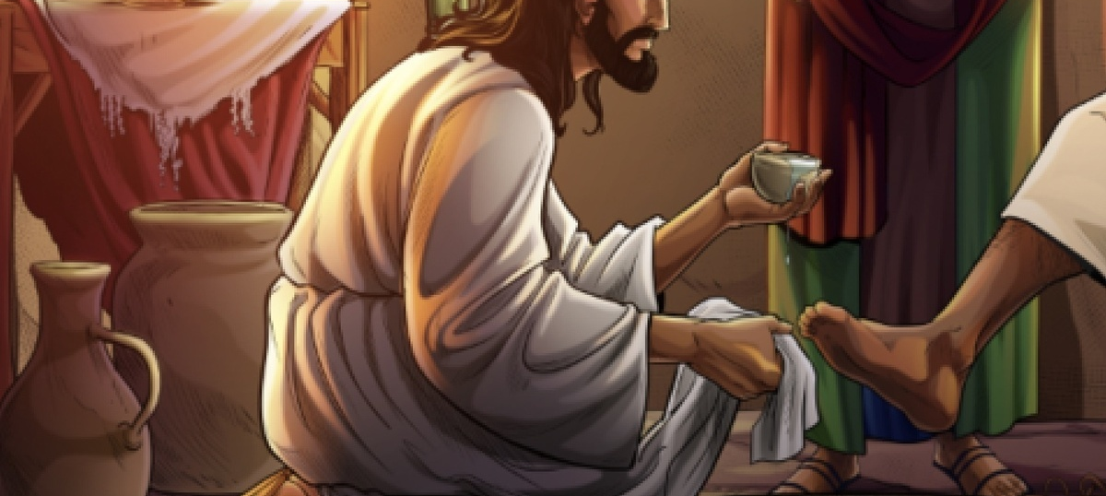
John 13:8
Peter said to Him, “You shall never wash my feet!”

Slide 24

When the Holy Spirit comes……
“He will bring all things to your remembrance.”

Slide 25
How we must be careful not to substitute the things of men for the things of God?

Slide 26

The plan of .
God

Slide 27
Matthew 16:21
From that time Jesus began to show to His disciples that He must go to Jerusalem, and suffer many things from the elders and chief priests and scribes, and be killed, and be raised the third day.

Slide 28
Matthew 4:17
From that time Jesus began to preach and to say, “Repent, for the kingdom of heaven is at hand.”

Slide 29
Matthew 16:21
“began”
Jesus began the process of showing His disciples that He must die and be raised from the dead.

Slide 30
Matthew 16:21
“must”
That is the necessity.
There is no plan B.
This is not whimsical.
This is a must.

Slide 31
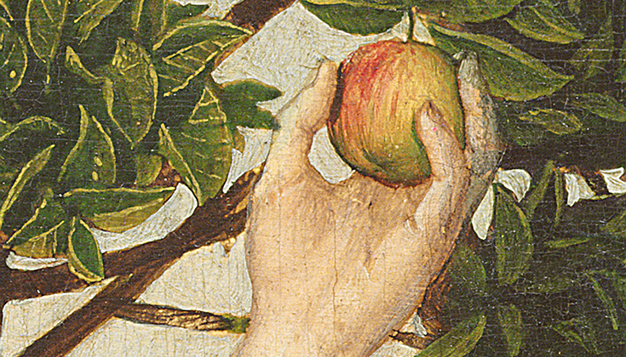
FOUR things made it necessary
a) Human sin.

Slide 32
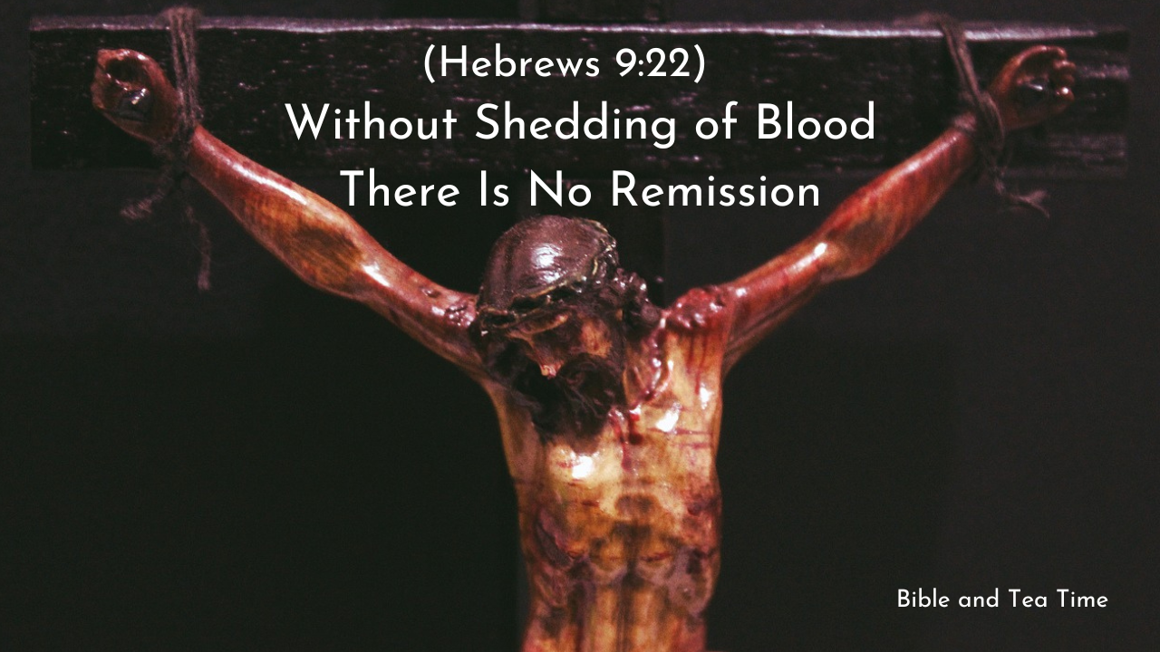
FOUR things made it necessary
b) Divine Requirement.

Slide 33
FOUR things made it necessary
c) Divine decree.
God by His determinate counsel and foreknowledge brought it to pass.

Slide 34
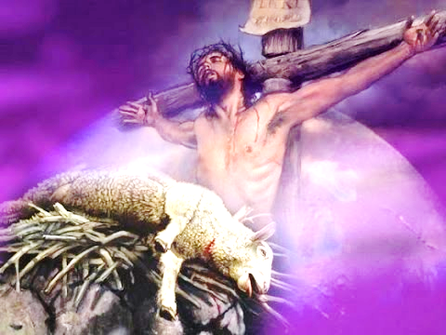
FOUR things made it necessary
Prophetic promise.

Slide 35
Matthew 16:21
From that time Jesus began to show to His disciples that He must go to Jerusalem, and suffer many things from the elders and chief priests and scribes, and be killed, and be raised the third day.

Slide 36
i) He must go to Jerusalem, it is a must.
o Jesus had to go to the city of sacrifices.
o Jesus had to be the Passover Lamb.
o Jesus had to die the death for sin.

Slide 37
John 11:16
Then Thomas, who is called the Twin, said to his fellow disciples, “Let us also go, that we may die with Him.”

Slide 38
Matthew 15:1
Then the scribes and Pharisees who were from Jerusalem came to Jesus, saying,

Slide 39
They never have to hunt Him like a fugitive.
He would go and offer Himself.

Slide 40
John 10:18
“No one takes it from Me, but I lay it down of Myself. I have power to lay it down, and I have power to take it again. This command I have received from My Father.”

Slide 41
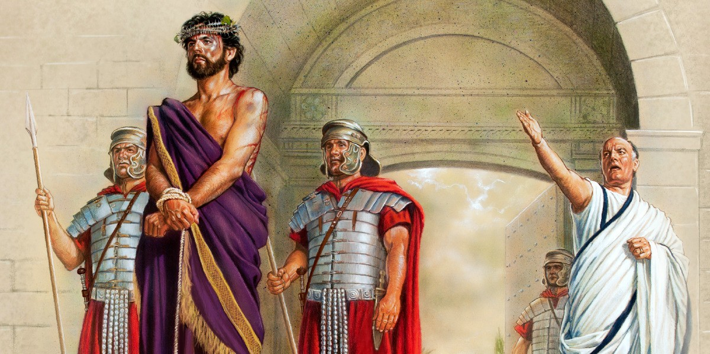
John 19:10-11

Slide 42
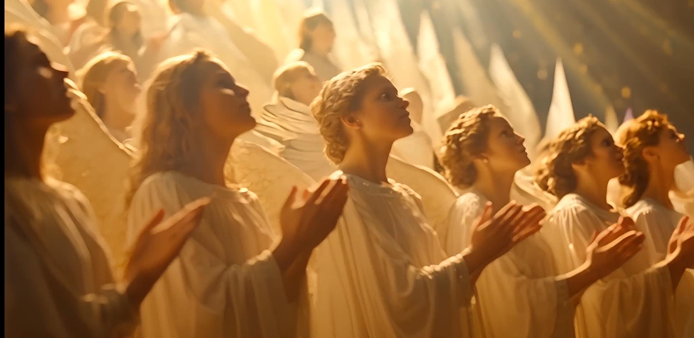
Matthew 26:53

Slide 43
Genesis 14:19
And he blessed him and said: “Blessed be Abram of God Most High, Possessor of heaven and earth;

Slide 44
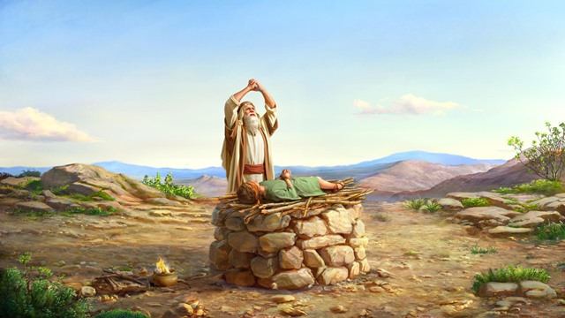
Genesis 22

Slide 45
2 Samuel 5:9,
Then David dwelt in the stronghold, and called it the City of David. And David built all around from the Millo and inward.

Slide 46
Song of Solomon 6:4
O my love, you are as beautiful as Tirzah, Lovely as Jerusalem, Awesome as an army with banners!

Slide 47
Psalm 137:5,
If I forget you, O Jerusalem, Let my right hand forget its skill!

Slide 48
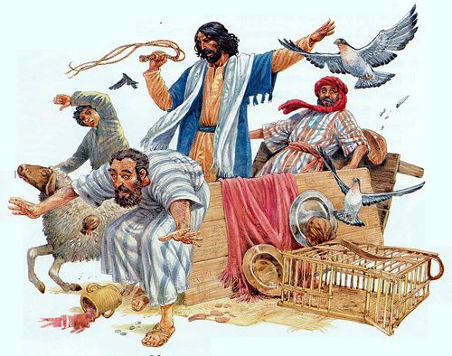
The first Passover
John 2

Slide 49
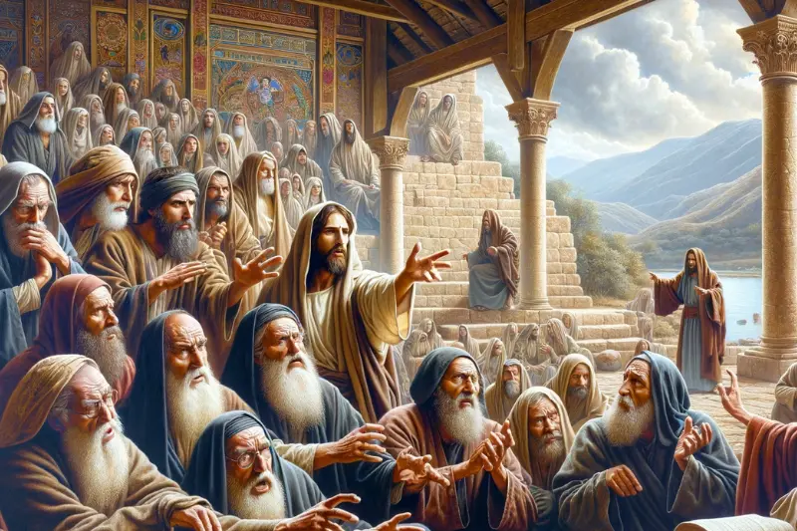
The SECOND
Passover

Slide 50
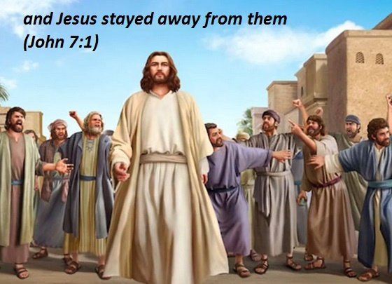
The THIRD
Passover

Slide 51
Revelation 11:8
And their dead bodies will lie in the street of the great city which spiritually is called Sodom and Egypt, where also our Lord was crucified.

Slide 52
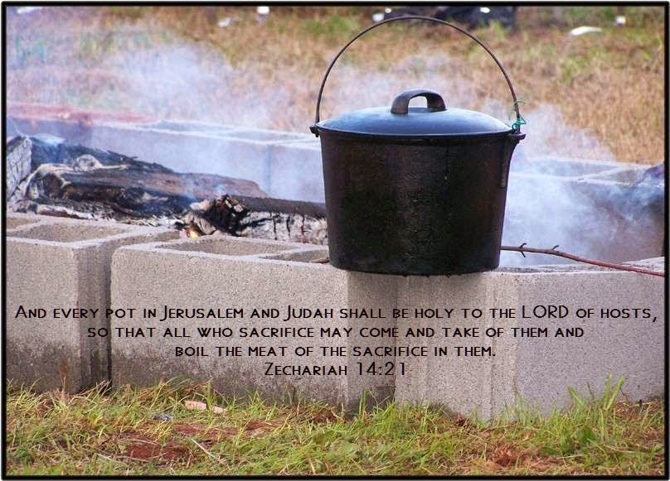
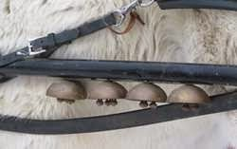
Zechariah 14:20-21

Slide 53
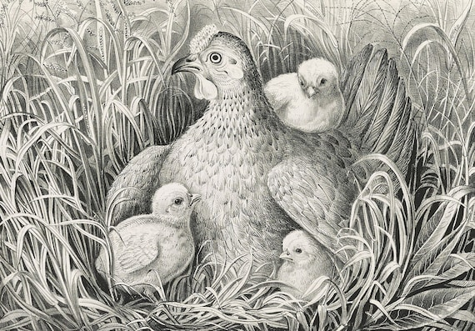
Luke 13:33-34,

Slide 54
ii) Must suffer many things.
Jesus says,
“I Am going to be killed.”
Jesus breaks terrible news.

Slide 55
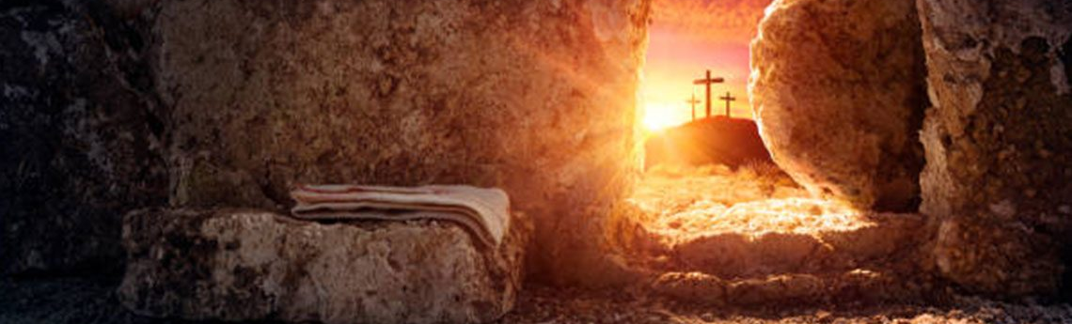
Matthew 16:21
“And be raised again the third day.”

Slide 56
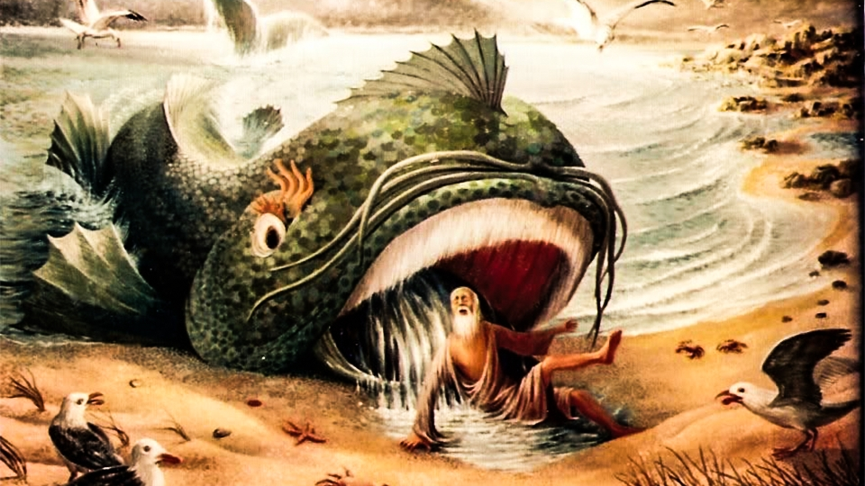
Matthew 12:40,

Slide 57
Matthew 16:22
Then Peter took Him aside and began to rebuke Him, saying, “Far be it from You, Lord; this shall not happen to You!”

Slide 58
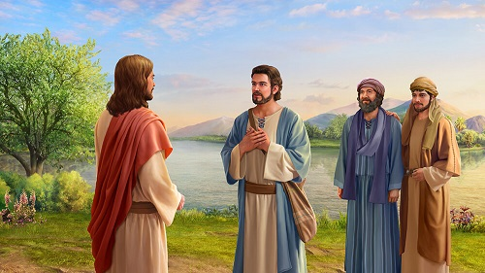
“Then Peter took Him aside.”

Slide 59
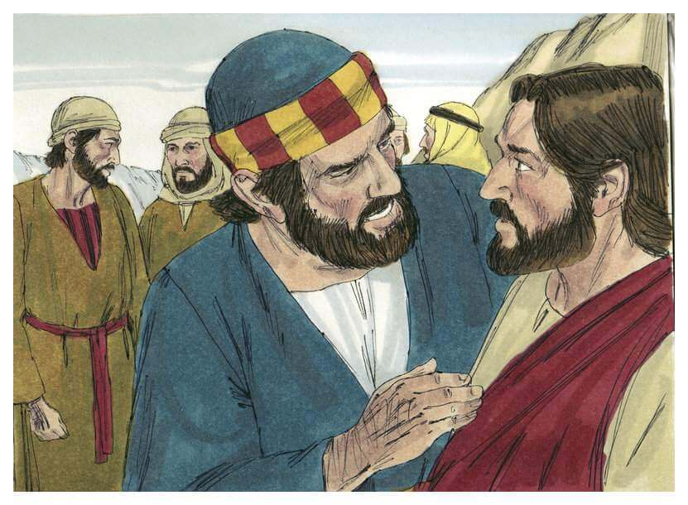

Slide 60
Peter hauls Him off.
“Far be it from You, Lord; this shall not happen to You!”

Slide 61
Peter could not see a suffering, Messiah.
He couldn’t see a humiliated Messiah.
He couldn’t see a crucified Messiah.

Slide 62
3. Protest of Christ.
Peter’s intentions seem honourable on the surface.

Slide 63
He is saying this out of love.
He is saying it out of ignorance.
He doesn’t want the Lord to die.
He doesn’t want the Lord to have the pain.
He doesn’t want personally to have the pain that comes in the loss of the Lord.

Slide 64
Matthew 16:23
But He turned and said to Peter, “Get behind Me, Satan! You are an offense to Me, for you are not mindful of the things of God, but the things of men.”

Slide 65
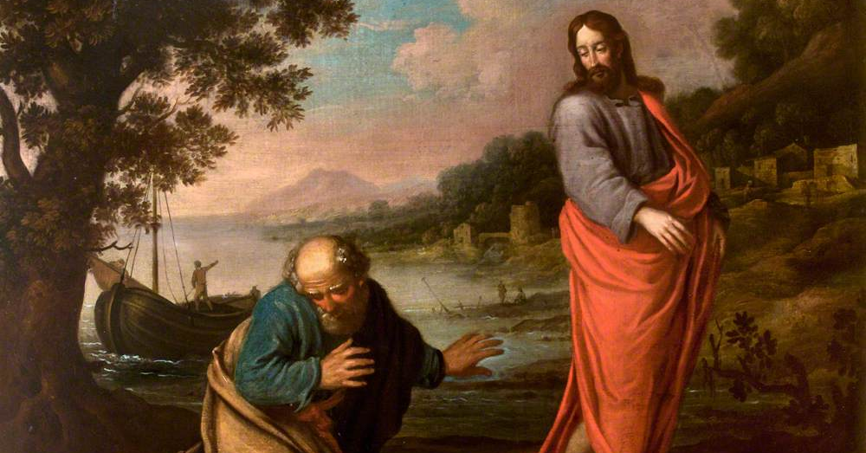
“He turned and said to Peter,”
“Get behind Me, Satan! You are an offense to Me.”

Slide 66
Why does Jesus say that?

Slide 67
Does such a small sin deserve such a destructive blast of fury from the Lord?

Slide 68
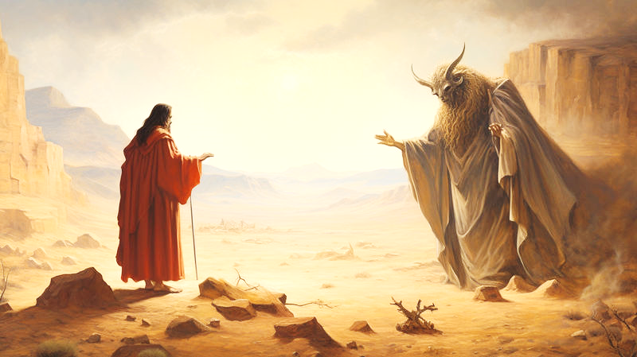
Matthew 4:9-10

Slide 69
Matthew 4:9-10
Begone, Satan.

Slide 70
Luke 4:13
Now when the devil had ended every temptation, he departed from Him until an opportune time.

Slide 71
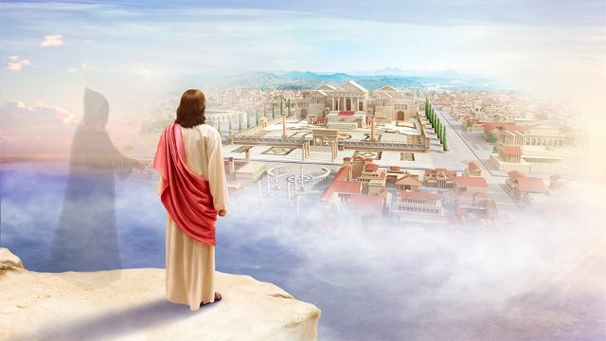
Matthew 4 and Luke 4

Slide 72
Hebrews 4:15,
For we do not have a High Priest who cannot sympathize with our weaknesses, but was in all points tempted as we are, yet without sin.

Slide 73
As soon as that
temptation came to Him,
just that fast did He say,
“Get behind Me, Satan.”

Slide 74
S K A N D A L O N
The word skandalon means to entice somebody to destroy them.

Slide 75


Slide 76
Matthew 16:23
for you are not mindful of the things of God, but the things of men.”
You are not thinking the things of God.

Slide 77
From God’s viewpoint
Jesus had to die.
Jesus had to suffer.
Jesus had to go to Jerusalem to be that, Lamb.
that had to happen, that was a divine must.
From Man’s viewpoint
It was incomprehensible with their Messianic view

Slide 78
Lesson 1
The Saviour, the Messiah, the Son of God may not fit men’s definitions, but He is no less the fulfilment of God’s plan.

Slide 79
Men are still saying that today.
Jesus talked about judgment,
Jesus talked about sin,
Jesus was rejected,
Jesus was murdered.

Slide 80
Lesson 2
If you are going to follow Him then you must take up a cross.
&
you are going to lose your life in the process.

Slide 81

There is no Glory to be had without Pain.
There is no Crown to be won without a Thorn in the process.

Slide 82
We say to God, “Help me get mine in line with yours.”
▪ Our way is the glory way.
▪ Our way is the joy way.
▪ Our way is the blessing way.
▪ Our way is the painless way.

Slide 83
1 Peter 5:10,
But may the God of all grace, who called us to His eternal glory by Christ Jesus, after you have suffered a while, perfect, establish, strengthen, and settle you.

Slide 84

Shall we?

Slide 86


