Slide 1
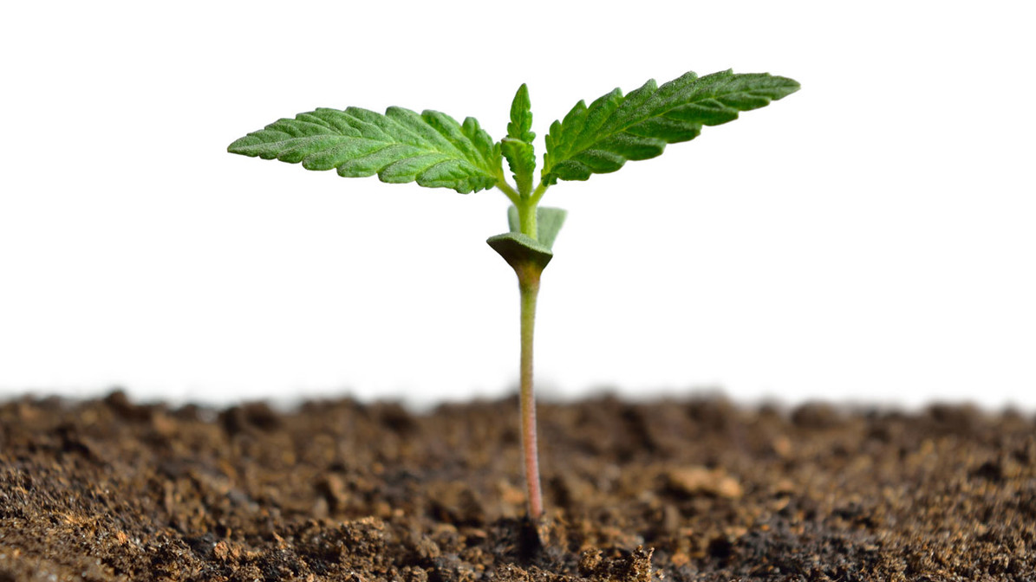
Die to Live
Matthew 16:24-28

Slide 2

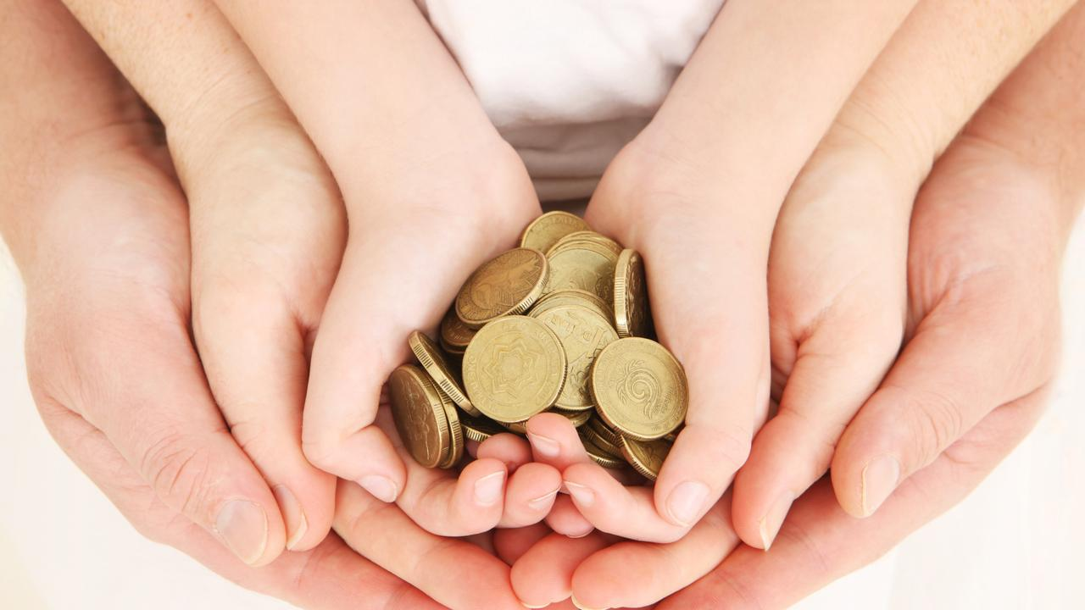
There is pain before the gain.
There is a cross before the crown.
There is suffering before the glory.
There is sacrifice before the reward.

Slide 3
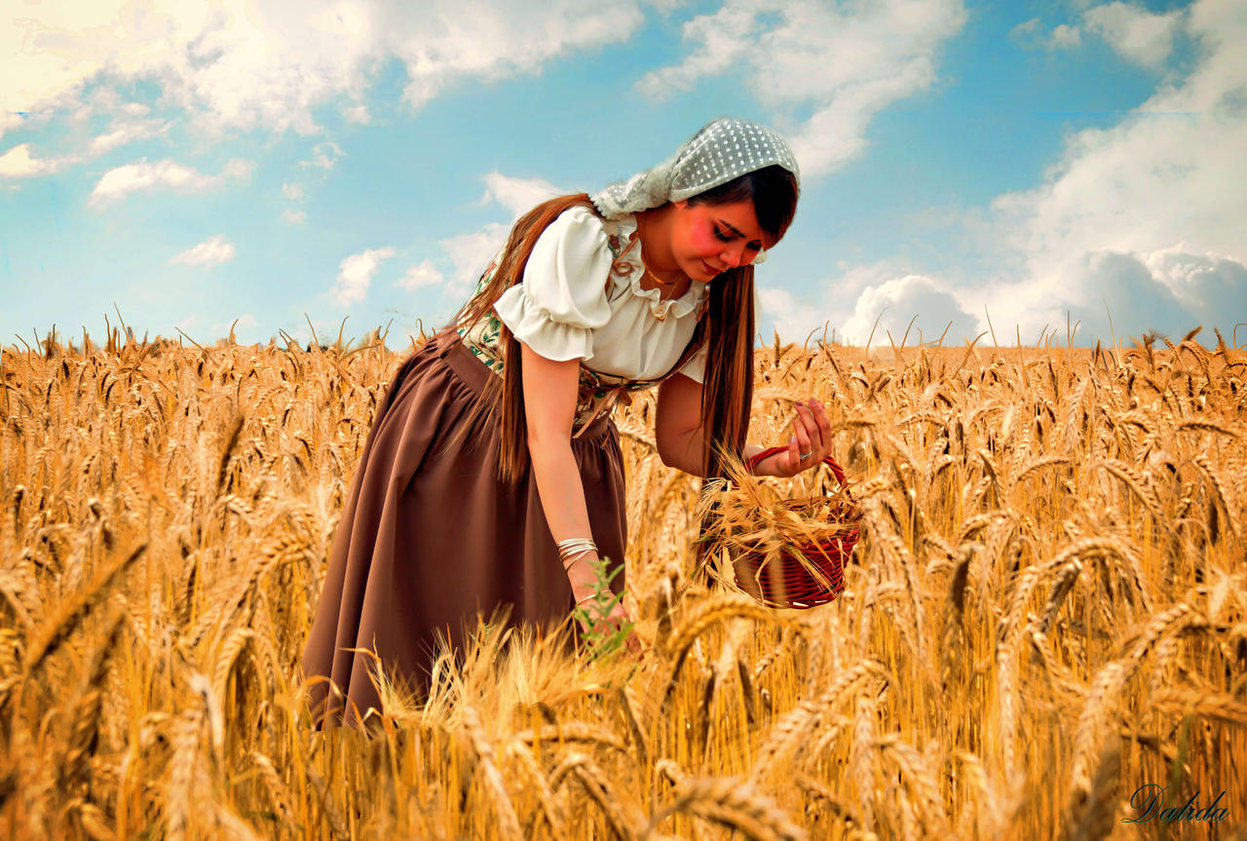
He who loves father or mother more than Me is not worthy of Me. And he who loves son or daughter more than Me is not worthy of Me. ³⁸ And he who does not take his cross and follow after Me is not worthy of Me. ³⁹ He who finds his life will lose it, and he who loses his life for My sake will find it.
Matthew
10:37-39

Slide 4

Then Jesus, looking at him, loved him, and said to him, “One thing you lack: Go your way, sell whatever you have and give to the poor, and you will have treasure in heaven; and come, take up the cross, and follow Me.”
Mark 10:21

Slide 5
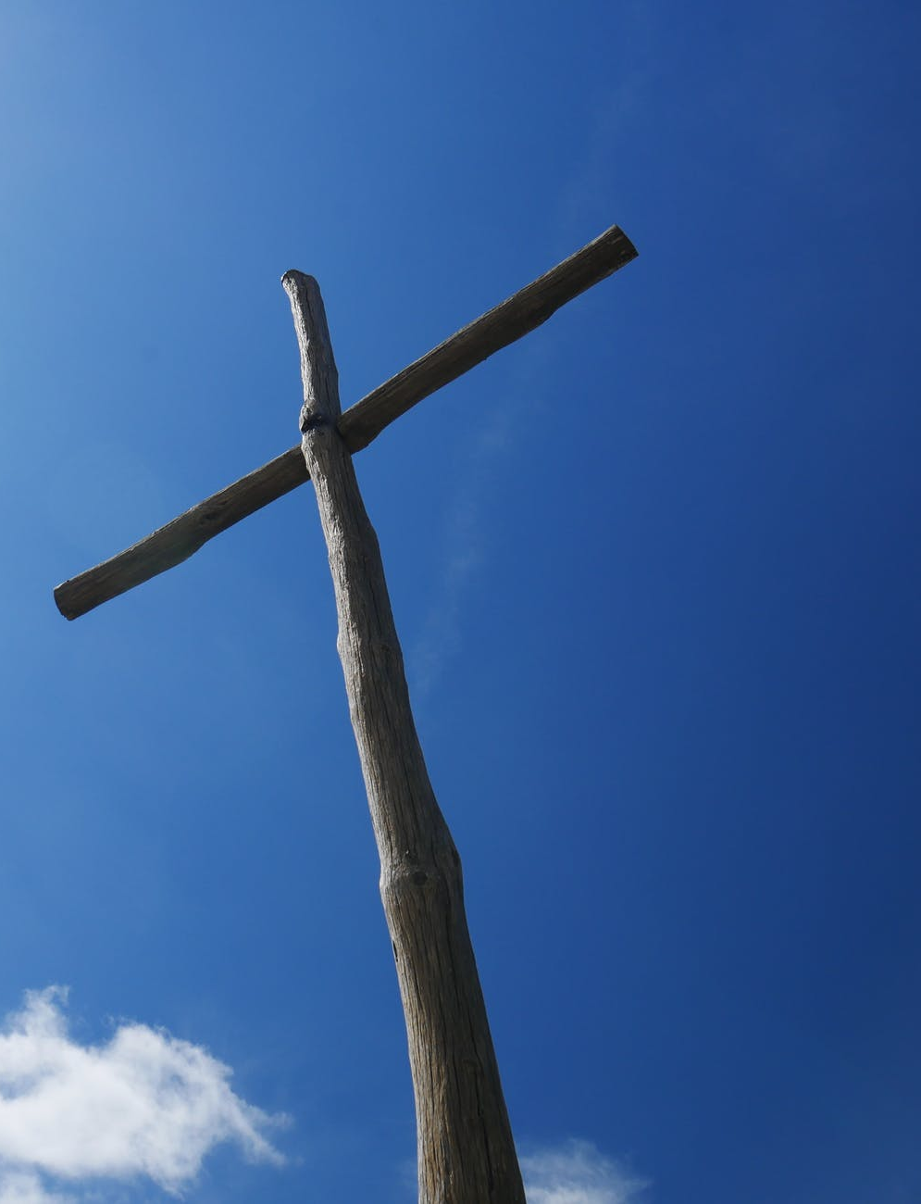
Now great multitudes went with Him. And He turned and said to them, ²⁶ “If anyone comes to Me and does not hate his father and mother, wife and children, brothers and sisters, yes, and his own life also, he cannot be My disciple. ²⁷ And whoever does not bear his cross and come after Me cannot be My disciple.
Luke 14:25-27

Slide 6

Most assuredly, I say to you, unless a grain of wheat falls into the ground and dies, it remains alone; but if it dies, it produces much grain. 25 He who loves his life will lose it, and he who hates his life in this world will keep it for eternal life.
John 12:24-25

Slide 7
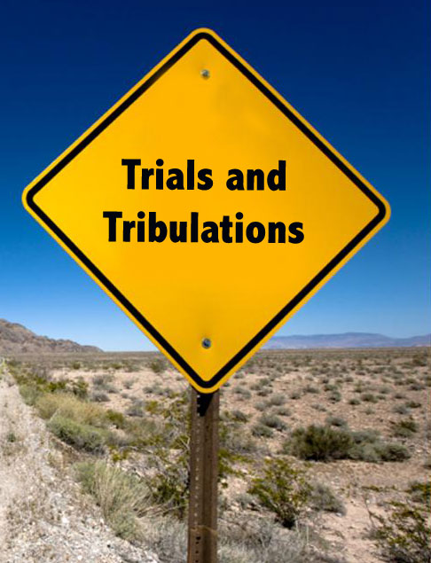
strengthening the souls of the disciples, exhorting them to continue in the faith, and saying, “We must through many tribulations enter the kingdom of God.”
Acts 14:22

Slide 8

“ I will build My church, and the gates of Hades shall not Prevail against it.”
Matthew 16:18

Slide 9

And I will give you the keys of the kingdom of heaven, and whatever you bind on earth will be bound in heaven, and whatever you loose on earth will be loosed in heaven.”
Matthew 16:19

Slide 10
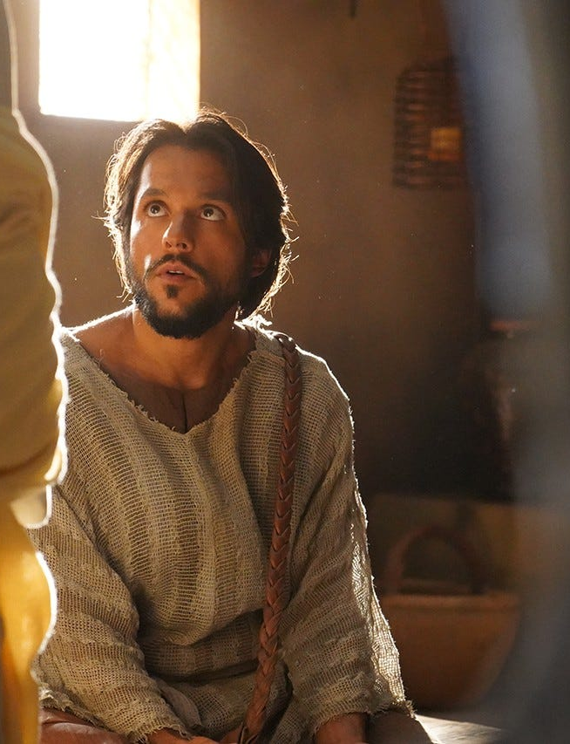
From that time Jesus began to show to His disciples that He must go to Jerusalem, and suffer many things from the elders and chief priests and scribes, and be killed, and be raised the third day. ²² Then Peter took Him aside and began to rebuke Him, saying, “Far be it from You, Lord; this shall not happen to You!” ²³ But He turned and said to Peter, “Get behind Me, Satan! You are ^{[j]}an offense to Me, for you are not mindful of the things of God, but the things of men.”
Matthew
16:21-23

Slide 11
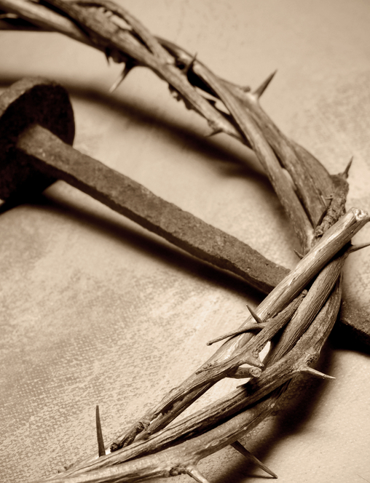
Yes, and all who desire to live godly in Christ Jesus will suffer persecution.
2 Timothy
3:12

Slide 12
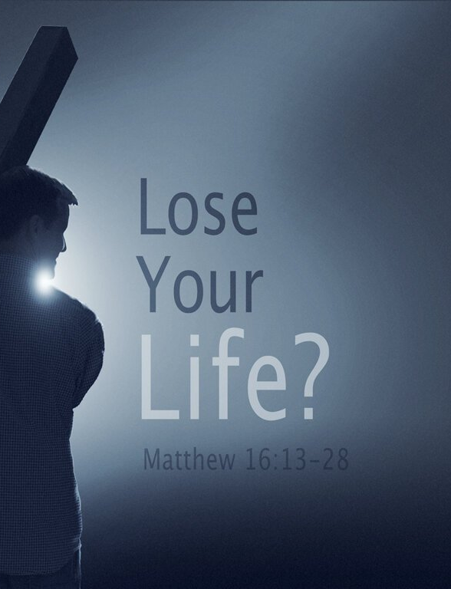
Then Jesus said to His disciples, “If anyone desires to come after Me, let him deny himself, and take up his cross, and follow Me.
Matthew
16:24

Slide 13
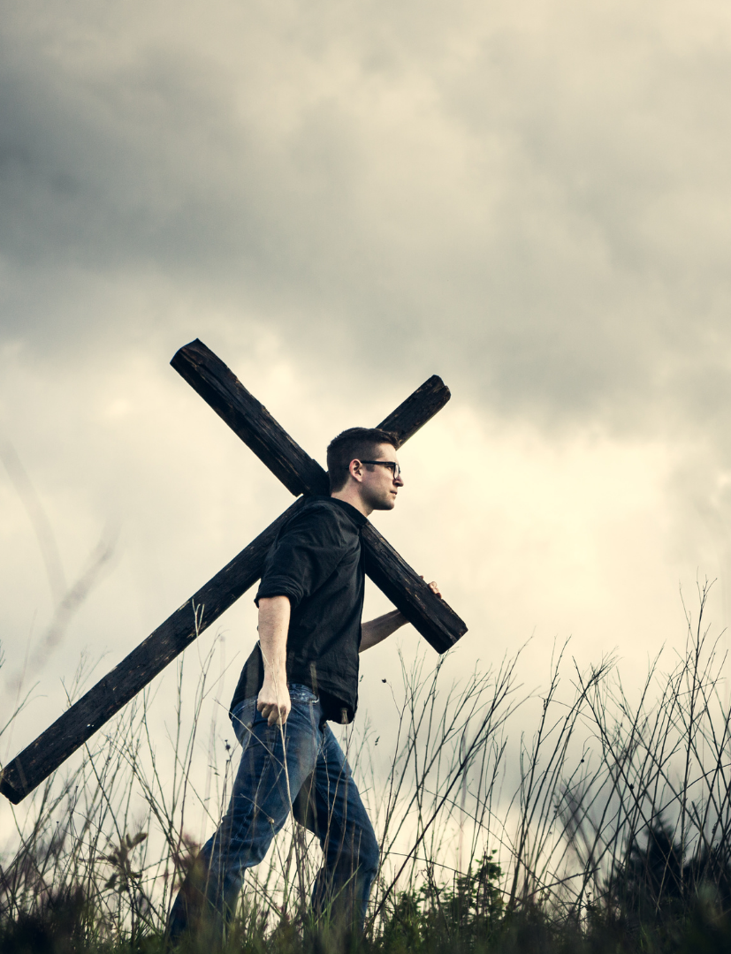
let him deny himself, and take up his cross, and follow Me.
Matthew 16:24
              1. Self-Denial

Slide 14
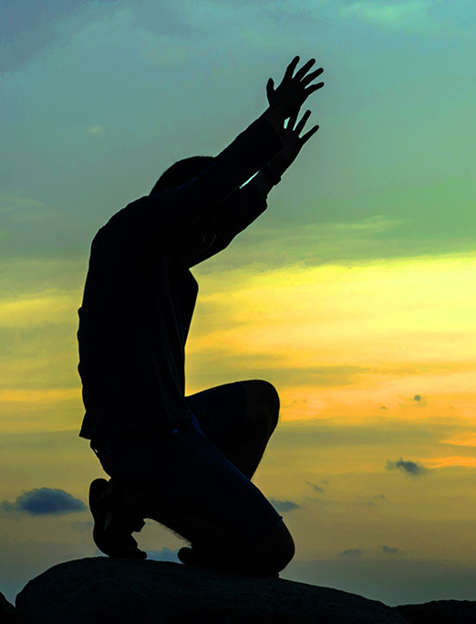
For I know that in me (that is, in my flesh) nothing good dwells; for to will is present with me, but how to perform what is good I do not find.
Romans 7:18

Slide 15
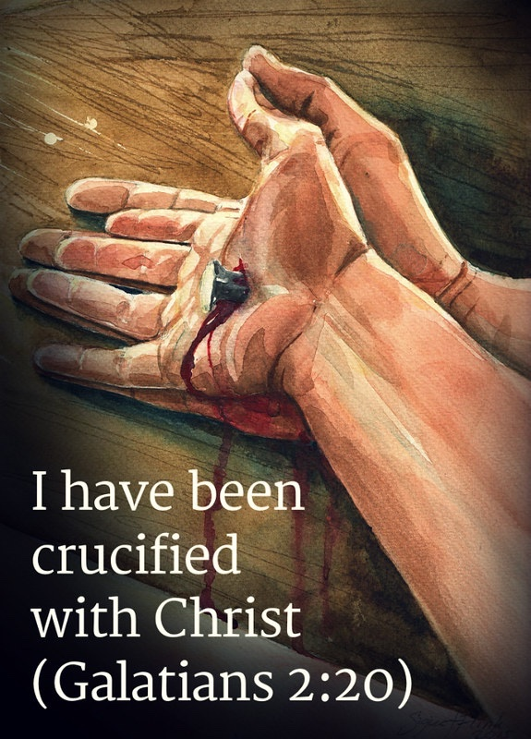
I have been crucified with Christ; it is no longer I who live, but Christ lives in me; and the life which I now live in the flesh I live by faith in the Son of God, who loved me and gave Himself for me.
Galatians 2:20

Slide 16

For we are the circumcision, who worship God in the Spirit, rejoice in Christ Jesus, and have no confidence in the flesh,
Philippians 3:3

Slide 17

Blessed are the poor in spirit, For theirs is the kingdom of heaven.
Matthew 5:3

Slide 18
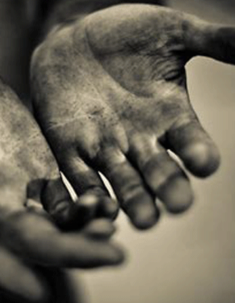
How poor?
Ptōchos
in the Greek.
So poor you must beg

Slide 19
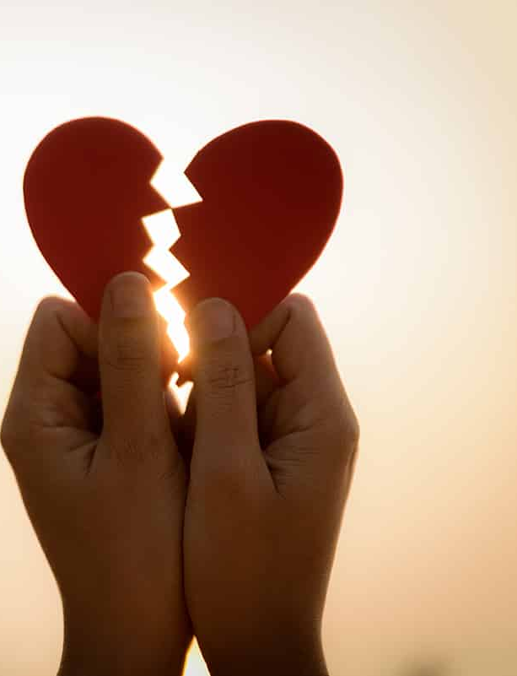
The Lord is near to those who have a broken heart, And saves such as have a contrite spirit.
Psalms 34:18

Slide 20
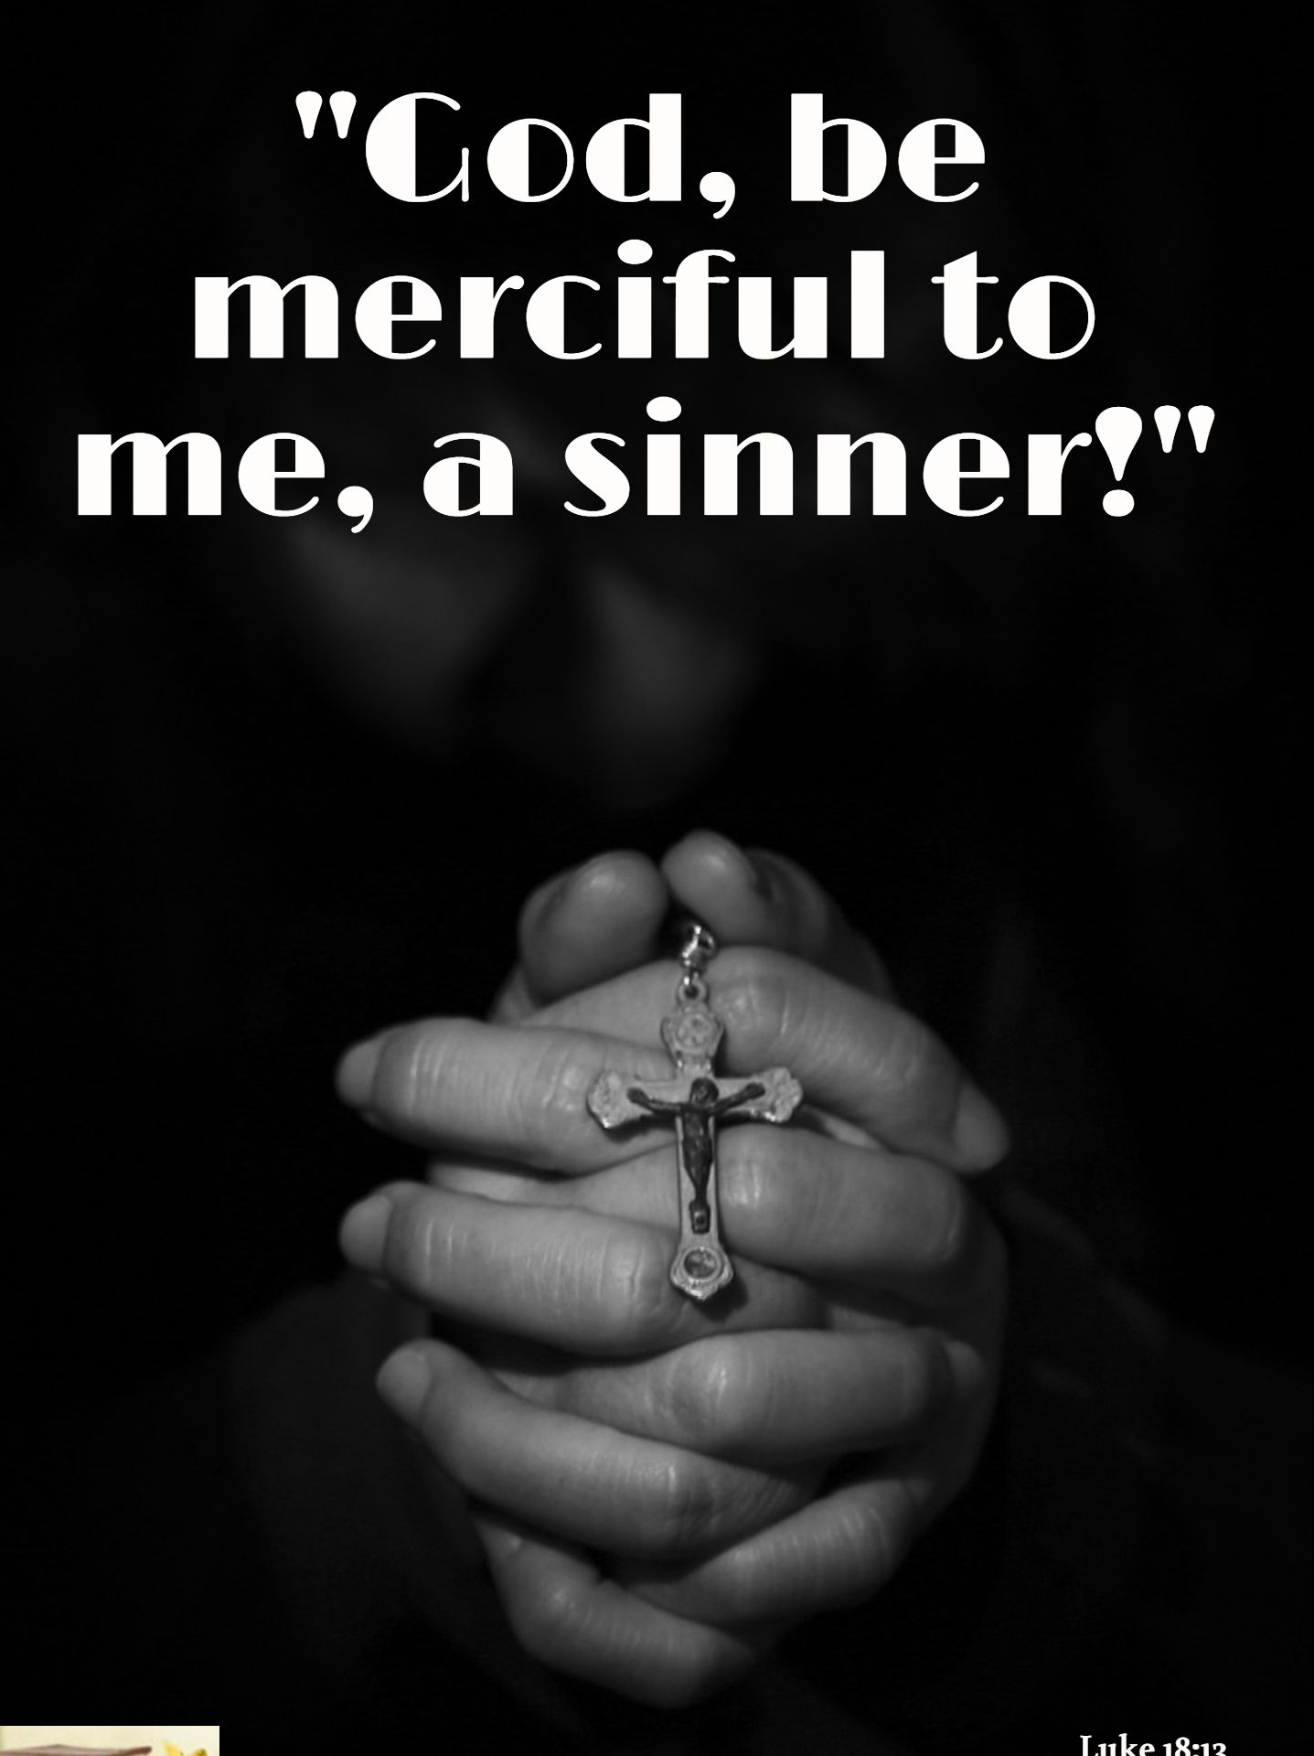
‘God, I thank You that I am not like other men—extortioners, unjust, adulterers, or even as this tax collector. ¹² I fast twice a week; I give tithes of all that I possess.’
Luke 18:11-14

Slide 21

Blessed are those who mourn, For they shall be comforted.
Matthew 5:4

Slide 22
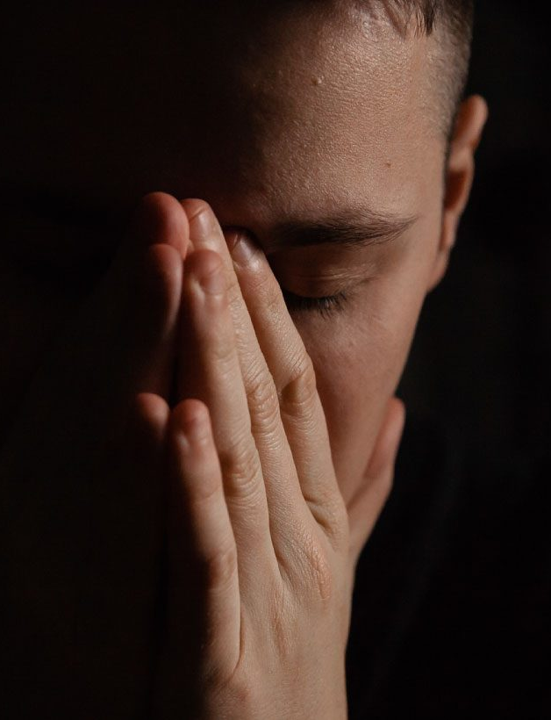
Blessed are the meek, For they shall inherit the earth.
Matthew 5:5

Slide 23
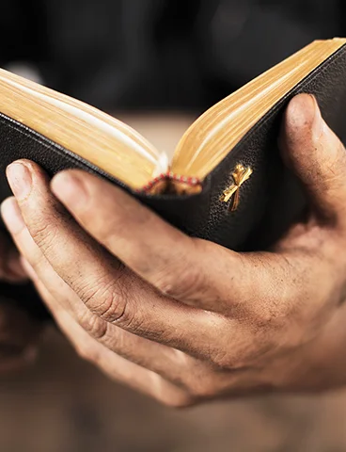
Blessed are those who hunger and thirst for righteousness, For they shall be filled.
Matthew 5:6

Slide 24

to put off your old self, which is being corrupted by its deceitful desires
Ephesians 4:22

Slide 25
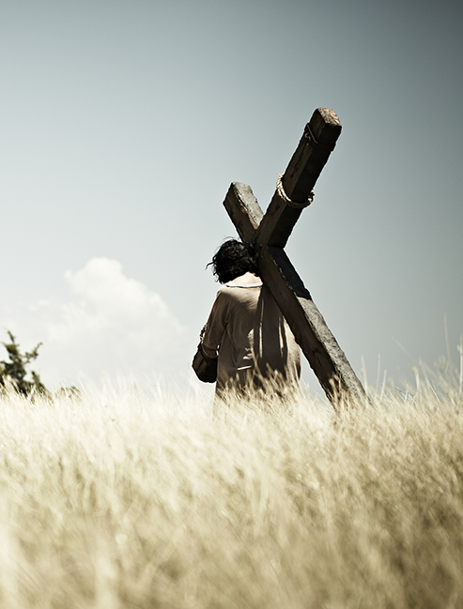
Dying to self is one thing, taking up the cross is another.
2. Cross bearing/ take up his cross

Slide 26
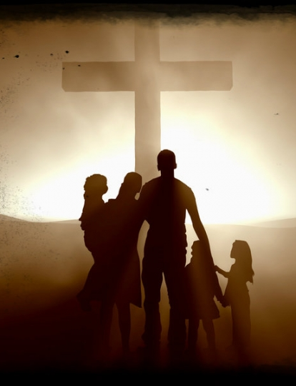
The willingness to endure persecution, rejection, reproach, shame, suffering, even martyrdom, for His sake. That’s all.
What is the cross?

Slide 27

that the Spirit of grace and glory would rest on you, and you would have such an overwhelming sense of the dispensation of the grace of God by His Blessed Spirit that you would find in the midst of your death great joy.
1 Peter 4:14

Slide 28
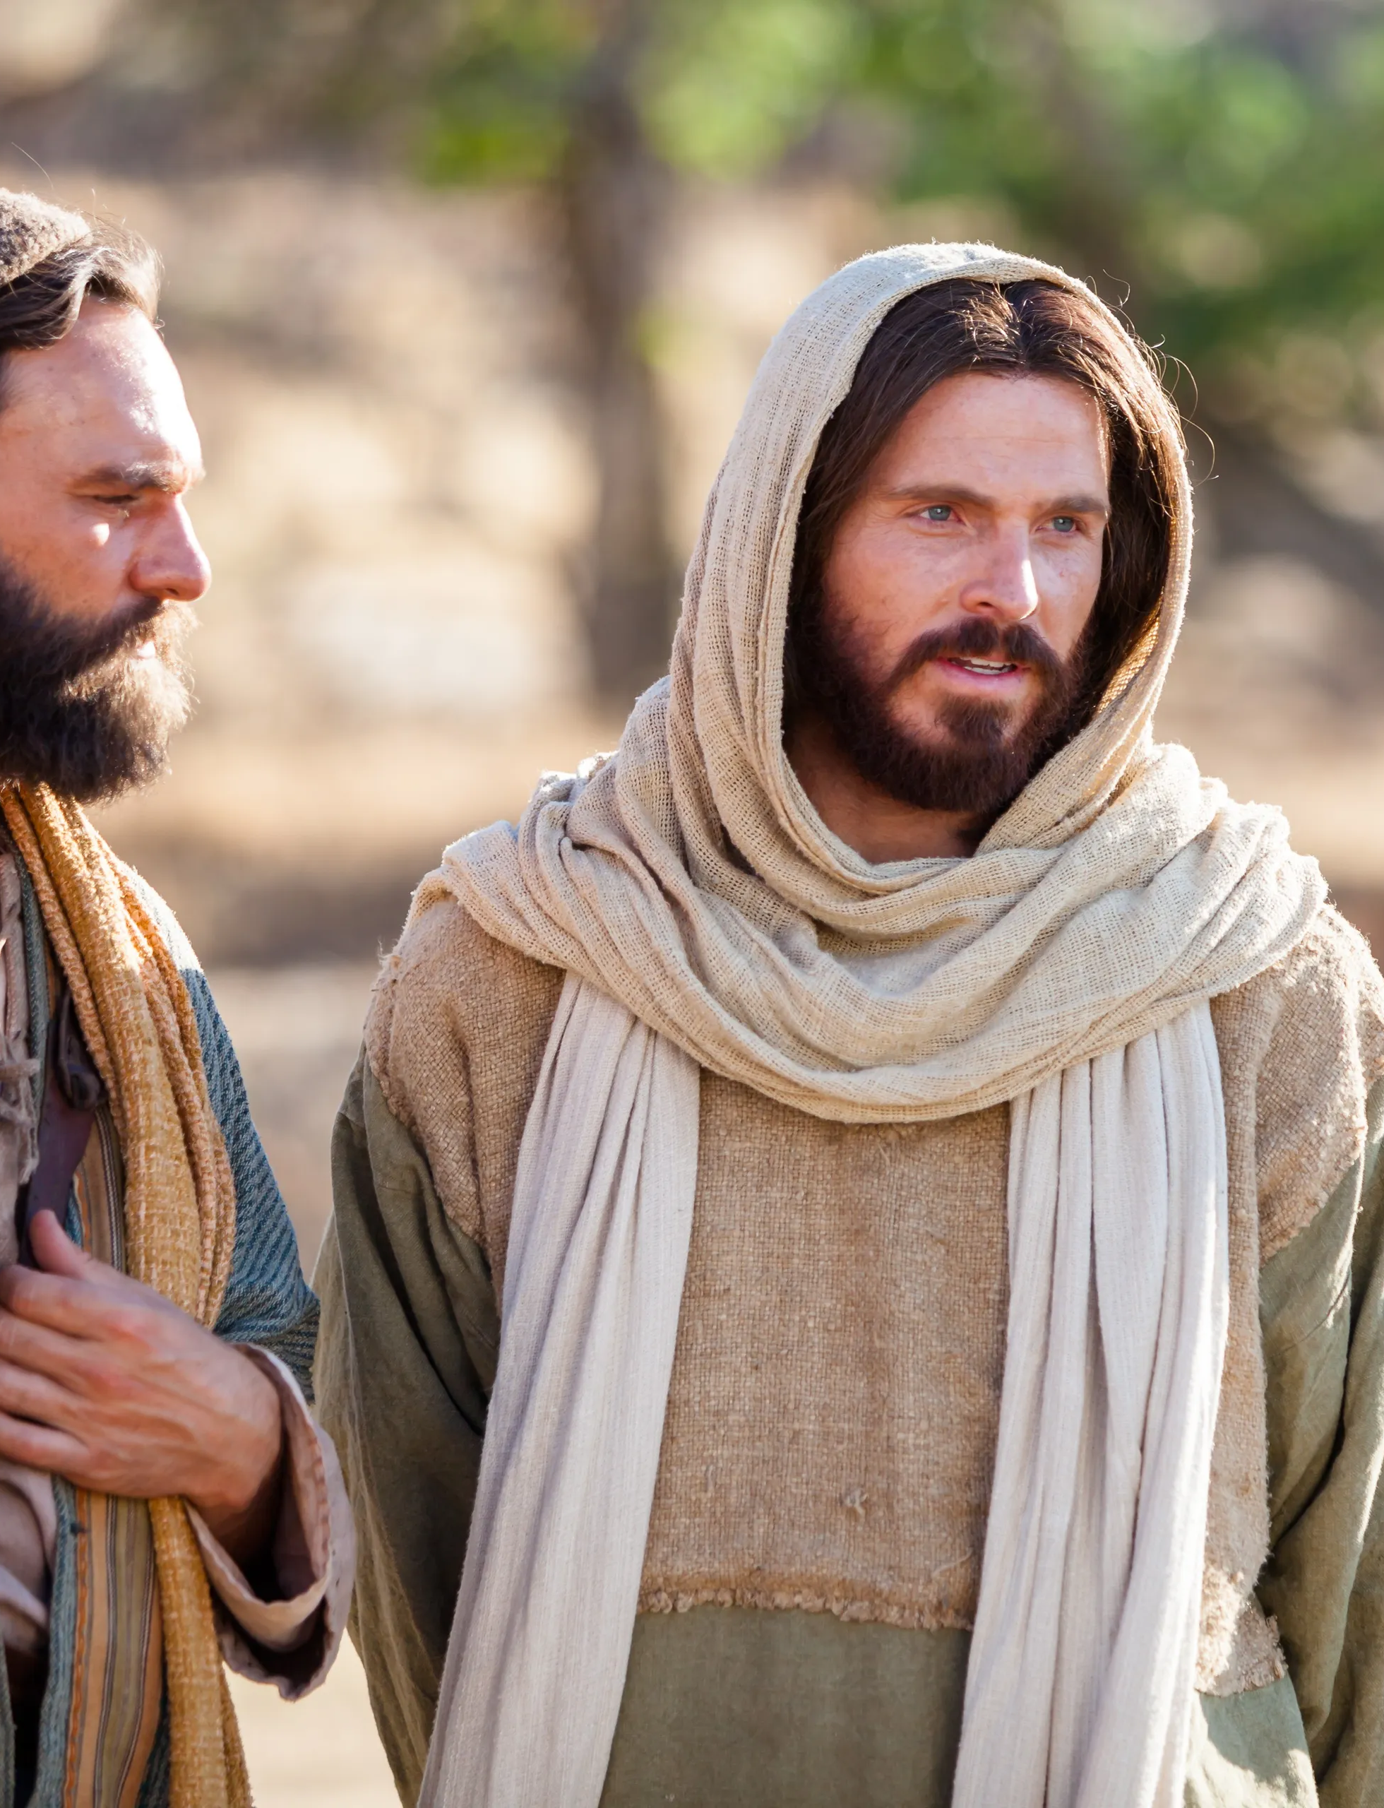
A disciple is not above his teacher, nor a servant above his master. ²⁵ It is enough for a disciple that he be like his teacher, and a servant like his master.
Matthew 10:24-25

Slide 29
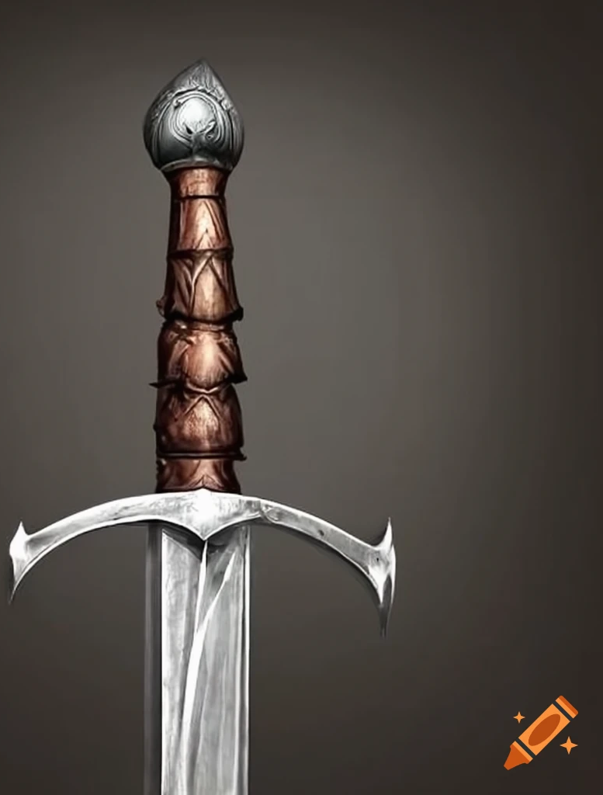
Do not think that I came to bring peace on earth. I did not come to bring peace but a sword.
Matthew 10:34-36

Slide 30
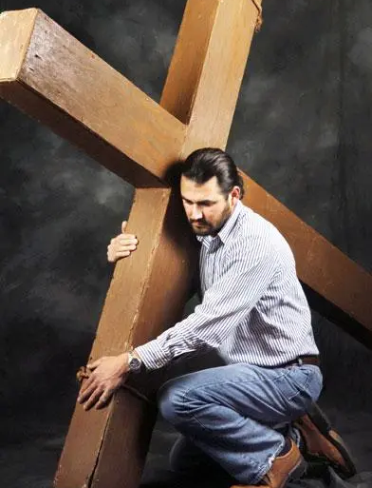
Then He said to them all, “If anyone desires to come after Me, let him deny himself, and take up his cross daily, and follow Me.
Luke 9:23

Slide 31
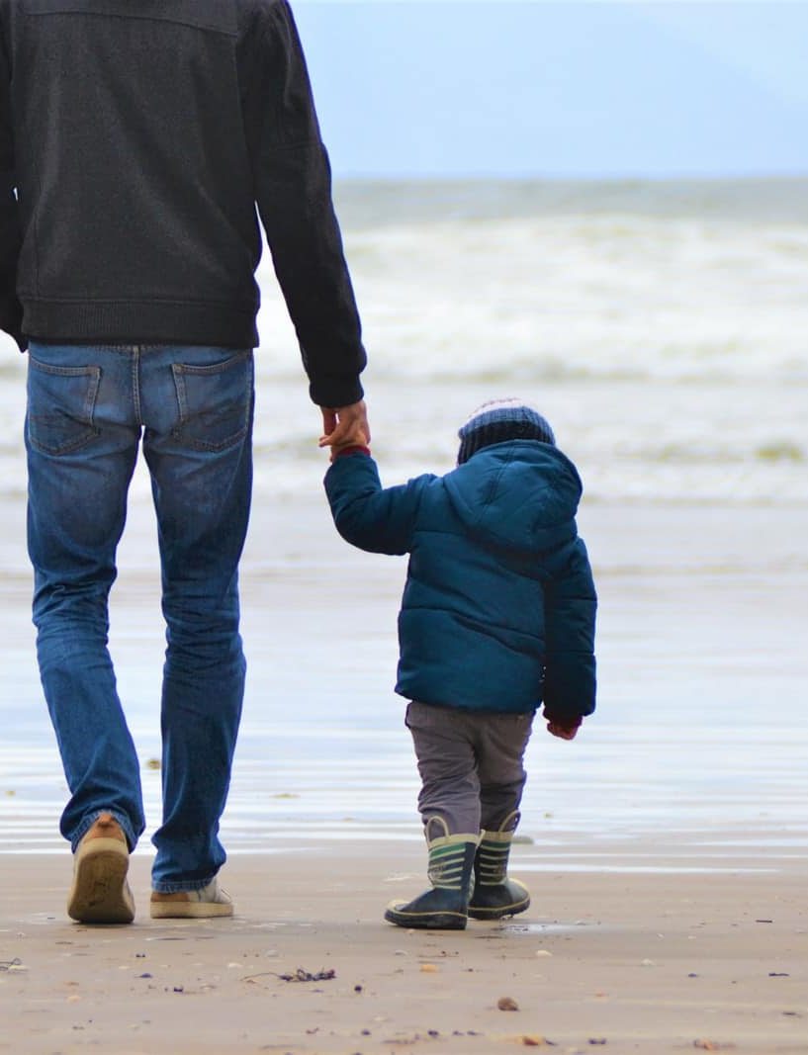
let him deny himself, and take up his cross, and follow Me.
Matthew 16:24
              3.Loyal obedience

Slide 32
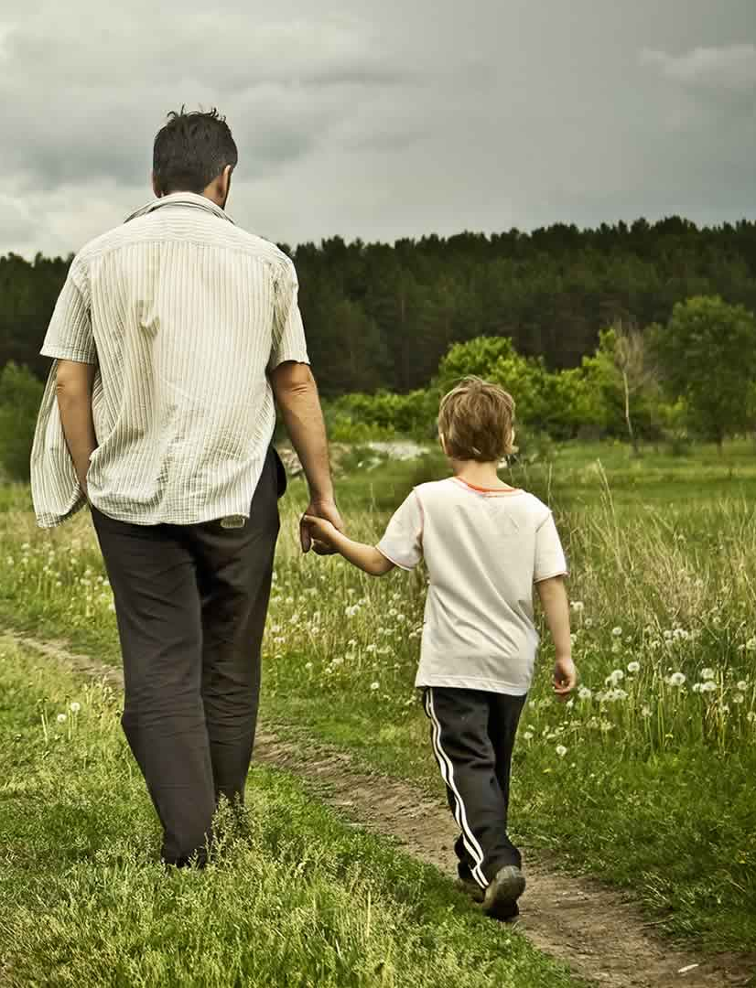
He who says he abides in Him ought himself also to walk just as He walked.
1 John 2:6

Slide 33
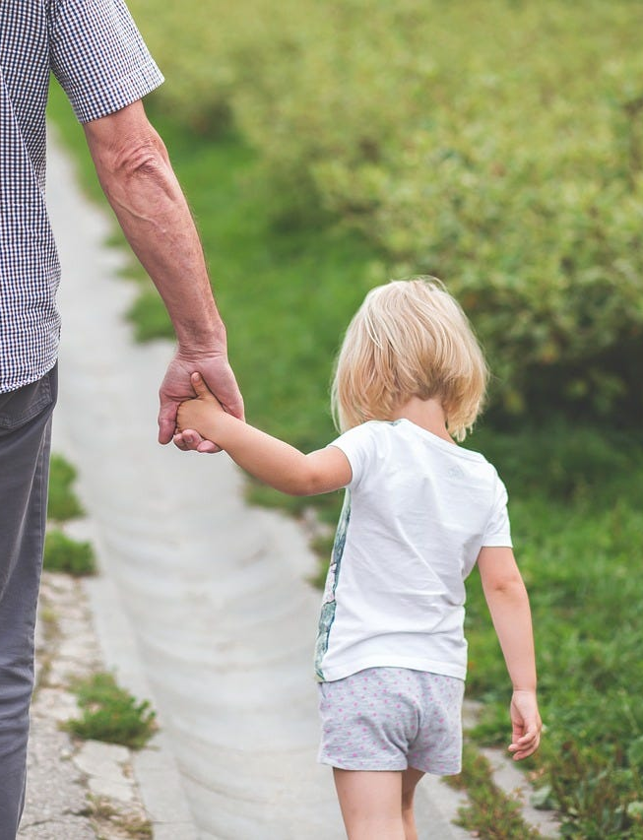
“Not everyone who says to Me, ‘Lord, Lord,’ shall enter the kingdom of heaven, but he who does the will of My Father in heaven.
Matthew 7:21

Slide 34
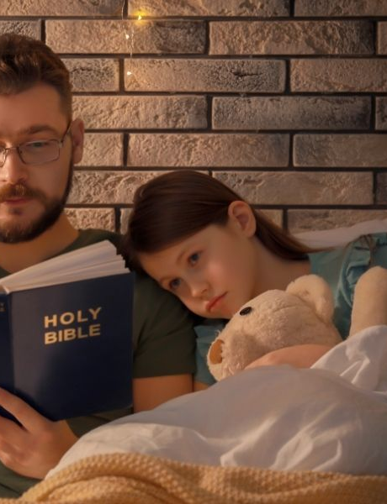
Then Jesus said to those Jews who believed Him, “If you abide in My word, you are My disciples indeed
John 8:31

Slide 35
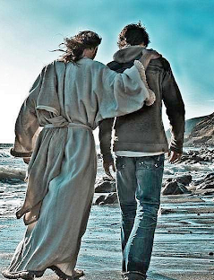
For whoever desires to save his life will lose it, but whoever loses his life for My sake will find it.
Matthew 16:25

Slide 36
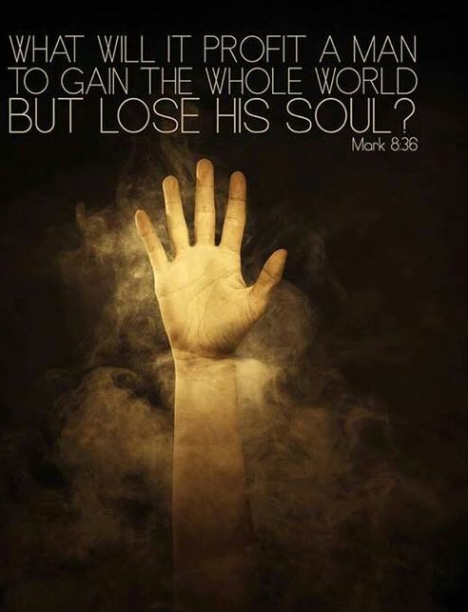
For what profit is it to a man if he gains the whole world, and loses his own soul? Or what will a man give in exchange for his soul?
Matthew 16:26

