Slide 1

18TH FEB
S u n d a y

Slide 2
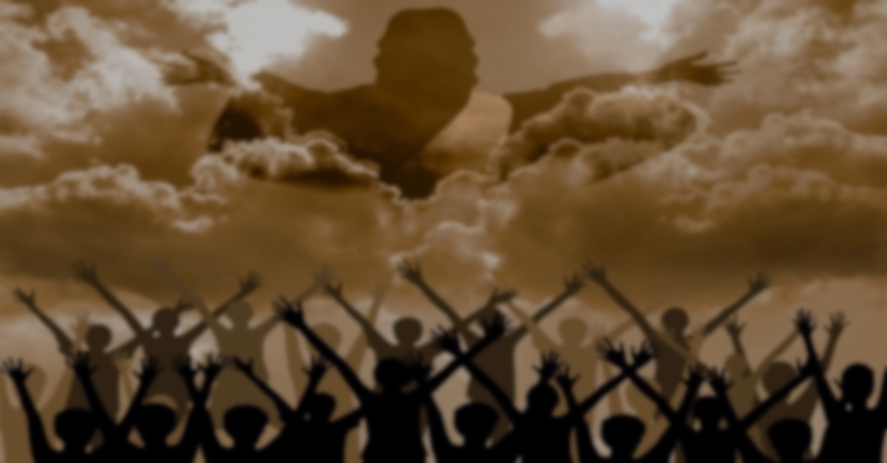


THE SECOND COMING OF JESUS
P R E V I E W

Slide 3
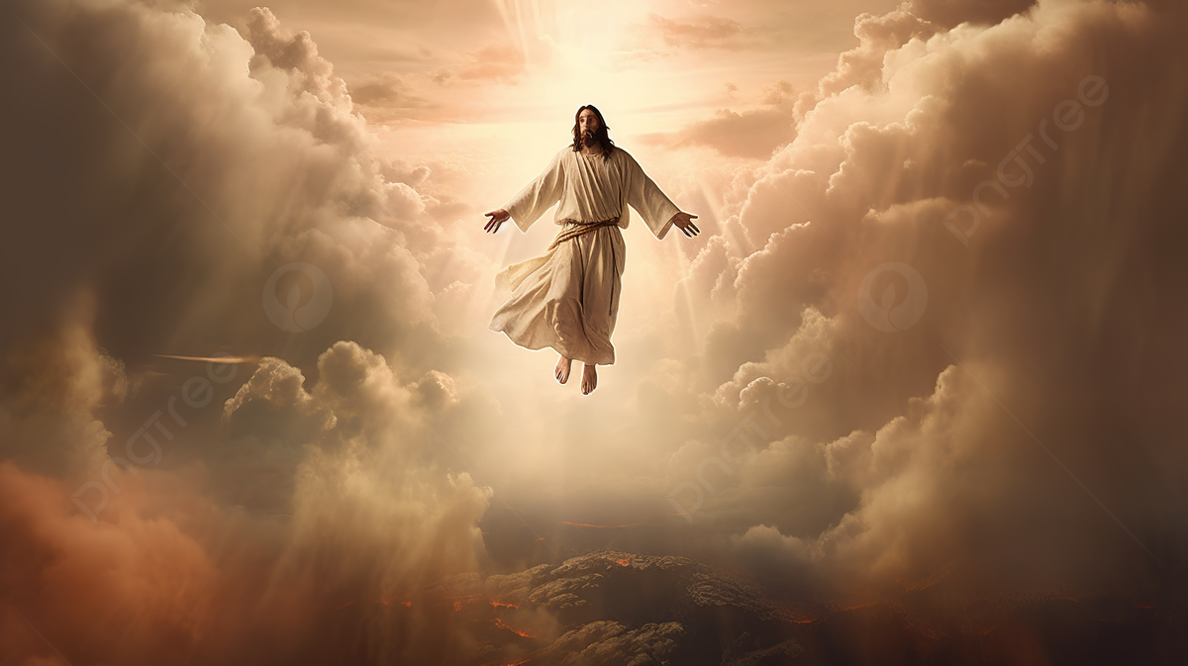
Matthew 16:27-28

Slide 4
Matthew 16
✓ Jesus has them affirm that He is the Messiah.
✓ You are the Son of the living God.
✓ I will build My Church.
✓ The plan is on schedule.
✓ The gates of Hades will not prevail against it.
✓ Jesus speaks of the power of His kingdom.
✓ Jesus will die and rise again the third day.
✓ He has revealed to them His death and His resurrection.

Slide 5
Clear Revelation Of His Second Coming
✓ He is Messiah.
✓ He is God in human flesh.
✓ He will build His kingdom.
✓ Nothing can stop it.
✓ He will die.
✓ He will rise again to prove even death can’t stop it.
✓ He will return in full blazing glory.
.

Slide 6
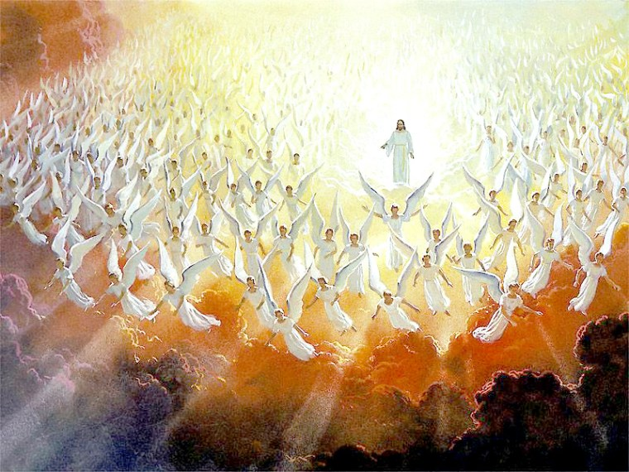
The last view the world has of Jesus Christ will not be as a crucified criminal.
He will come again in full Glory

Slide 7
FIRST COMING
rejection, hostility, and death
SECOND COMING
in glory, majesty, dominion, power and might, and is worshipped as King of Kings and Lord of Lords.

Slide 8
Matthew 16 : 27
A promise character.
a promise to those who believe.
A warning character.
a warning to those who don’t believe.
.

Slide 9
Revelation 22:20
He who testifies to these things says, “Surely I am coming quickly.” Amen. Even so, come, Lord Jesus!

Slide 10
Revelation 6:10
And they cried with a loud voice, saying, “How long, O Lord, holy and true, until You judge and avenge our blood on those who dwell on the earth?”

Slide 11
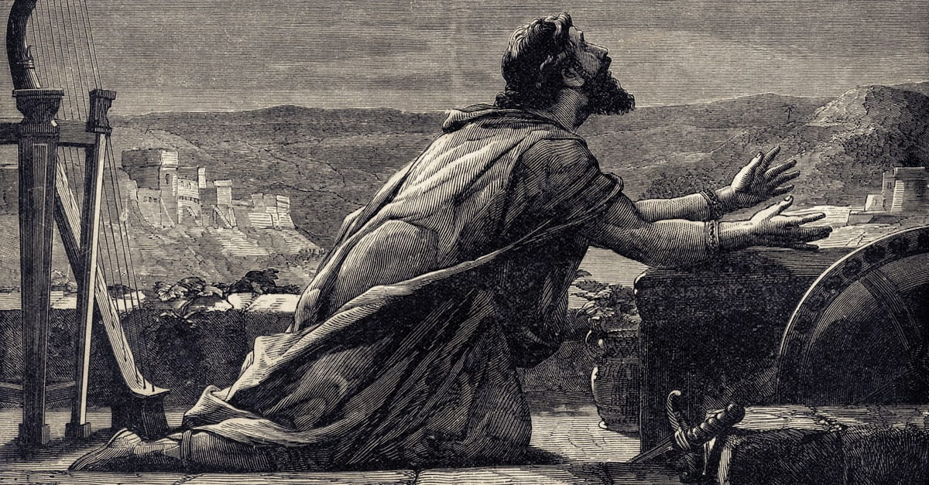
Psalms 94:3
Lord, how long will the wicked, How long will the wicked triumph?

Slide 12
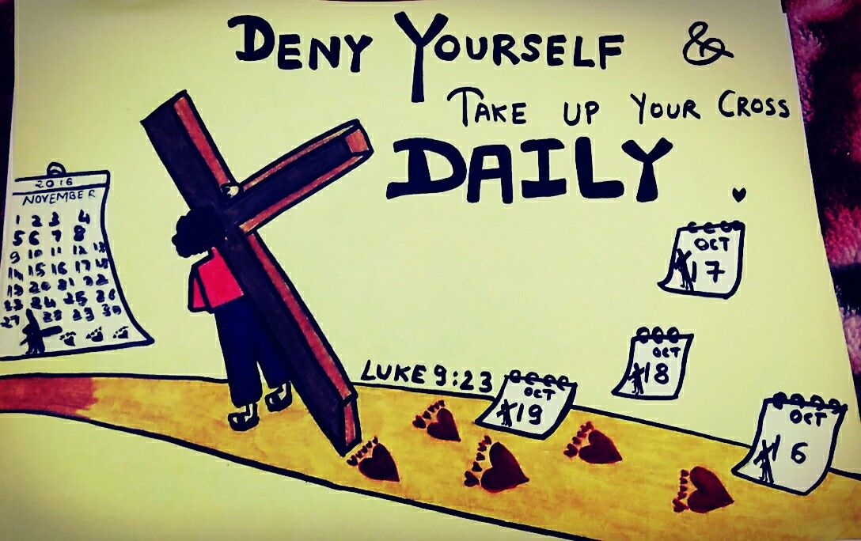
V 24, Jesus said these are the conditions of discipleship.

Slide 13
You say no to ease and comfort, and you say yes to a cross
The cross of rejection,
The cross of persecution,
The cross of alienation from the people of the world, and maybe
The cross of martyrdom.

Slide 14
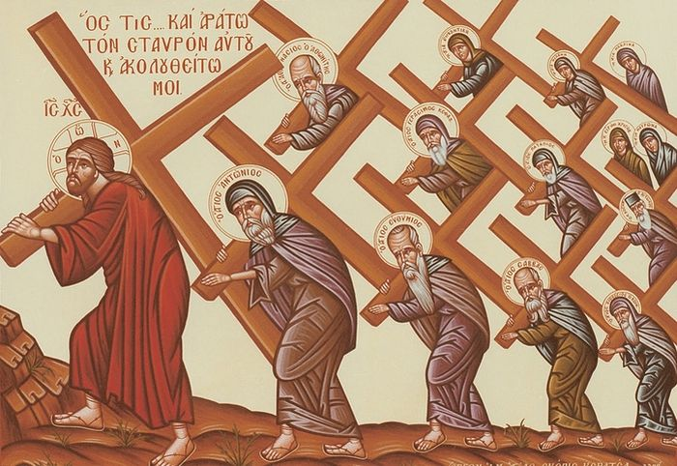
Loyal obedience at any price.
Those are the conditions.

Slide 15
Jesus says to them,
“Not only do I have to be killed, but I want you all to take a cross. I want you all to deny yourself.
I want you all to follow me no matter what the price. Instead of gaining the whole world, I want you to say no to all of that and follow Me.”

Slide 16

Little heavy.
They see a lot of the pain,
They see a lot of the suffering,
They see a lot of cross.

Slide 17
Romans 8:18
For I consider that the sufferings of this present time are not worthy to be compared with the glory which shall be revealed in us.

Slide 18
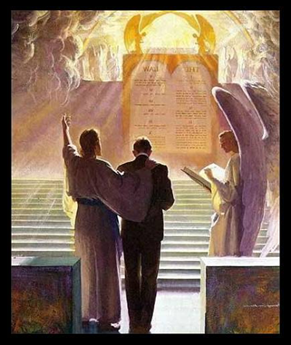
A warning character

Slide 19
Matthew 16 : 25-26
25 For whoever desires to save his life will lose it, but whoever loses his life for My sake will find it.
26 For what profit is it to a man if he gains the whole world, and loses his own soul? Or what will a man give in exchange for his soul?

Slide 20
“He will render to every man according to His works.”

Slide 21
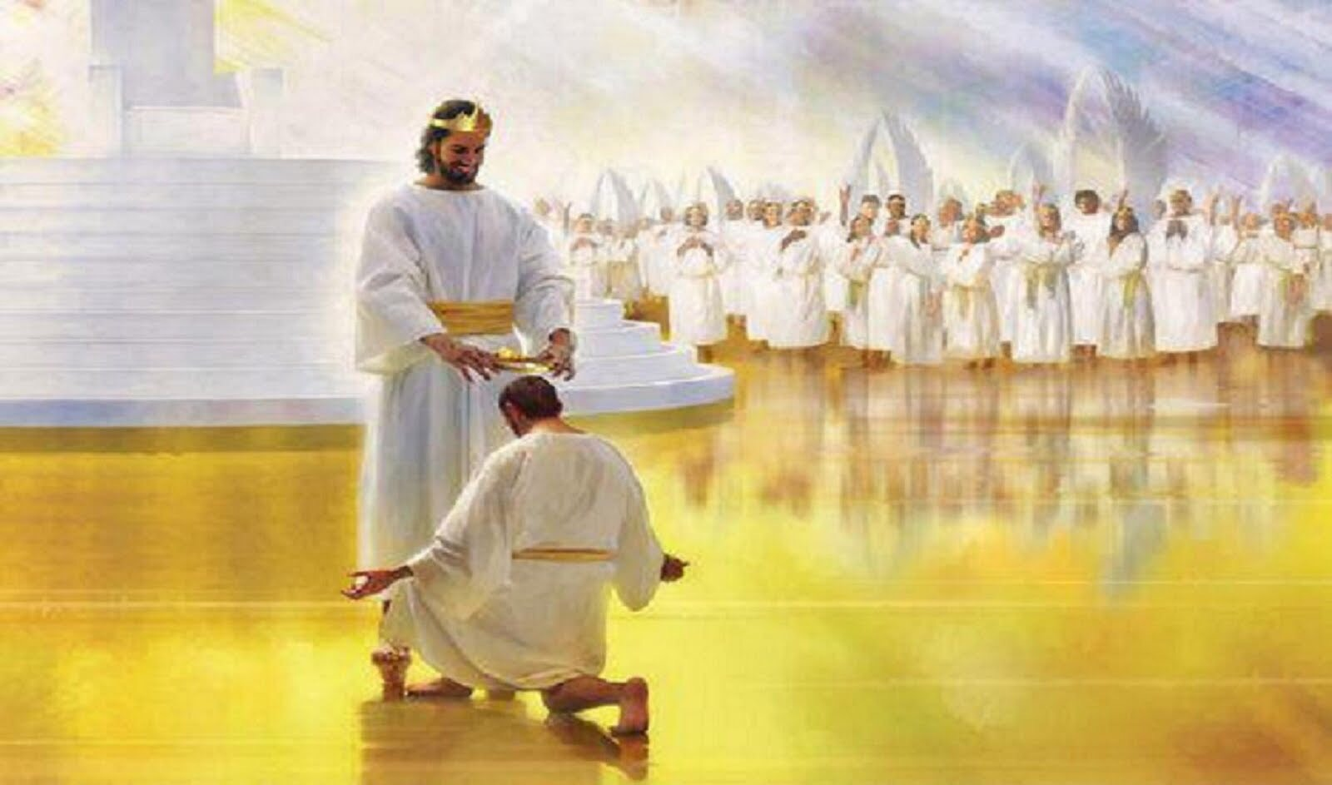
2 Timothy 4:8
Crown of Righteousness

Slide 22
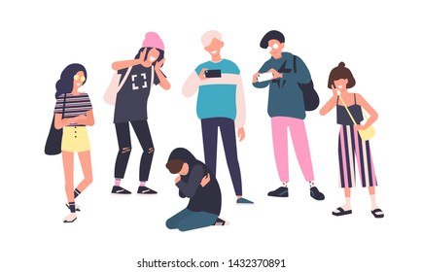
2 Peter 3:3-4
“Where is the promise of His coming

Slide 23
Revelation 10:10
Then I took the little book out of the angel’s hand and ate it, and it was as sweet as honey in my mouth. But when I had eaten it, my stomach became bitter.

Slide 24
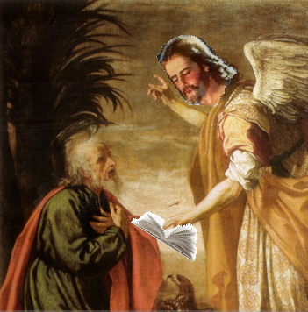
The sweetness is the promised character for the believers.
The bitterness is the warning character for the unbelievers.

Slide 25
2 Corinthians 5:11
Knowing, therefore, the terror of the Lord, we persuade men; but we are well known to God, and I also trust are well known in your consciences.

Slide 26
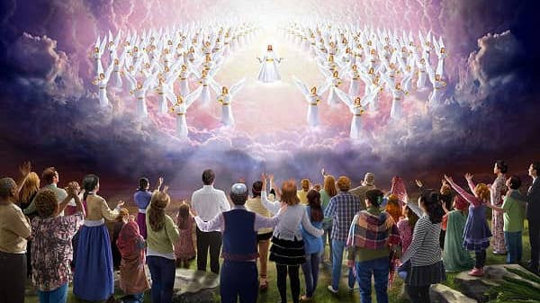
But He will come….

Slide 27

1. Identity Reveals Judgment.
V 27,
“For the Son of Man shall come.”

Slide 28
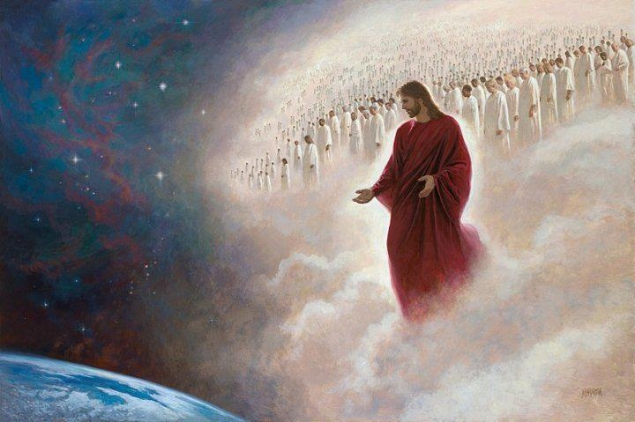
“For the Son of Man shall come.”

Slide 29
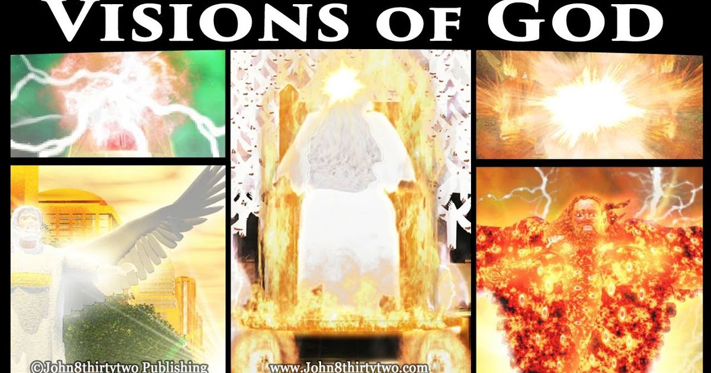
Daniel 7:9

Slide 30
His garment white as snow speaks of His purity,
His utter and absolute holiness,
His hair like pure wool of His wisdom.
His throne like fiery flame.

Slide 31
His majesty and His authority are like wheels and burning fire.
It is a throne on fire is what it is, with whirling flames at the foot of that throne in consuming judgment, purging judgment.

Slide 32
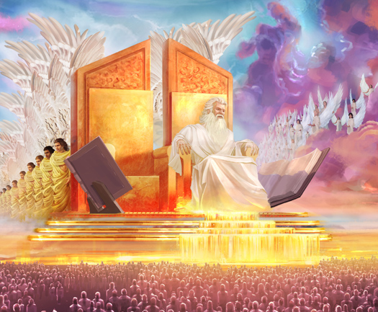
Daniel 7:10

Slide 33
Daniel 7:11-12
the destruction of the satanic world leader, the beast, the Antichrist, and the end time is destroyed and devastated.

Slide 34
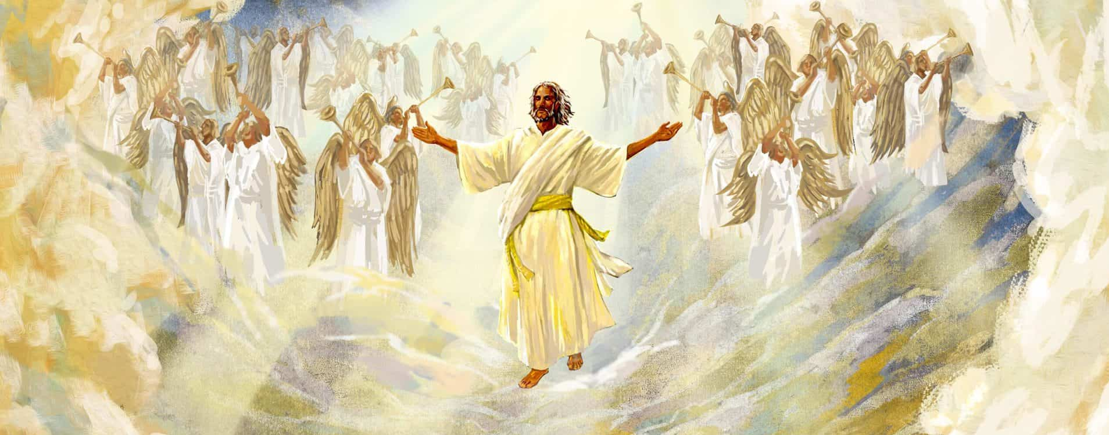
Daniel 7:13-14

Slide 35
Matthew 16:27
So, this is Jesus in judgment,
Jesus in glory, Jesus coming to take His kingdom.

Slide 36
Exodus 33:18-19
Moses says, “Let me see Your glory.”
God says, “I will show you My attributes.”

Slide 37
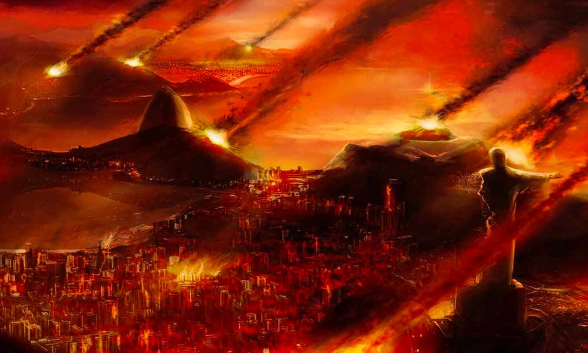
Matthew 24:29

Slide 38
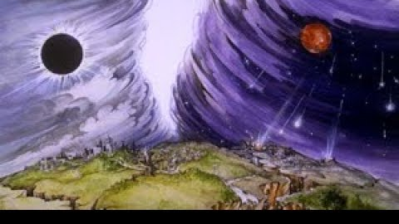

Slide 39
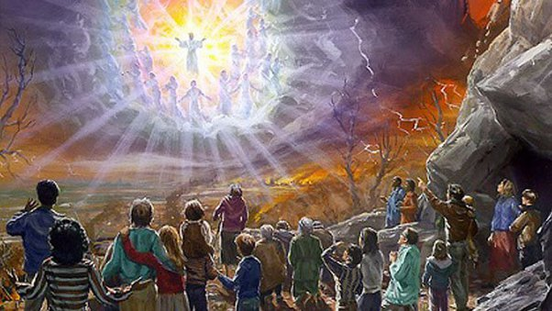
Matthew 24:30-31

Slide 40
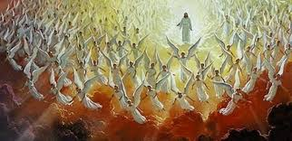

Slide 41
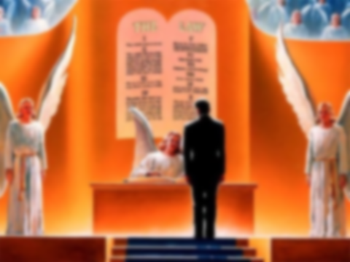
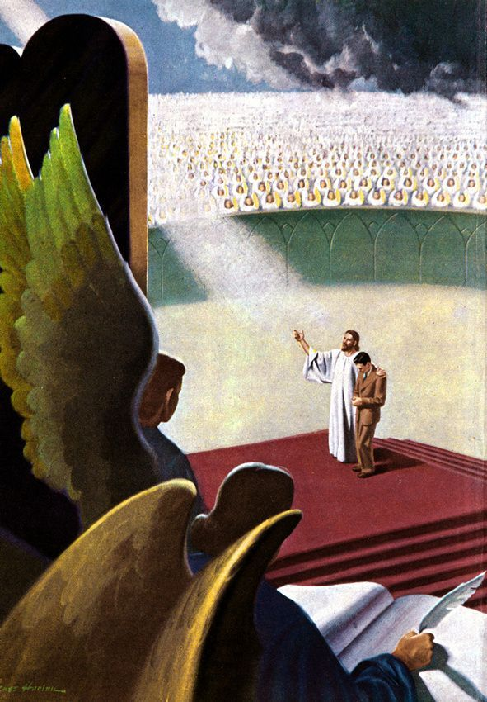
2. Reward to your works.

Slide 42
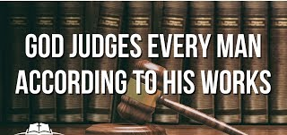

Slide 43
Ephesians 2:8-9
For by grace you have been saved through faith, and that not of yourselves; it is the gift of God, 9 not of works, lest anyone should boast.

Slide 44
1 Corinthians 3
says He is going to judge them on their works.
2 Corinthians 5
is going to judge men on their works.
It talks about it in Galatians 6, Revelation 2, Revelation 20, Revelation 22.

Slide 45
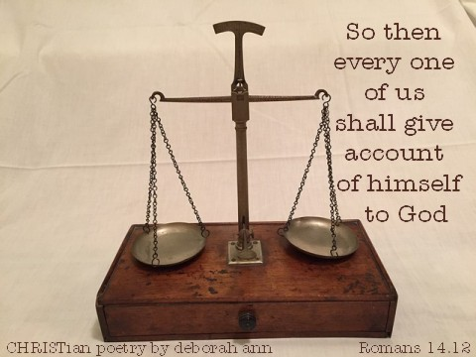
Romans 14:12

Slide 46
Romans 2:5-6
5 But in accordance with your hardness and your impenitent heart you are treasuring up for yourself wrath in the day of wrath and revelation of the righteous judgment of God,
6 who “will render to each one according to his deeds”:

Slide 47
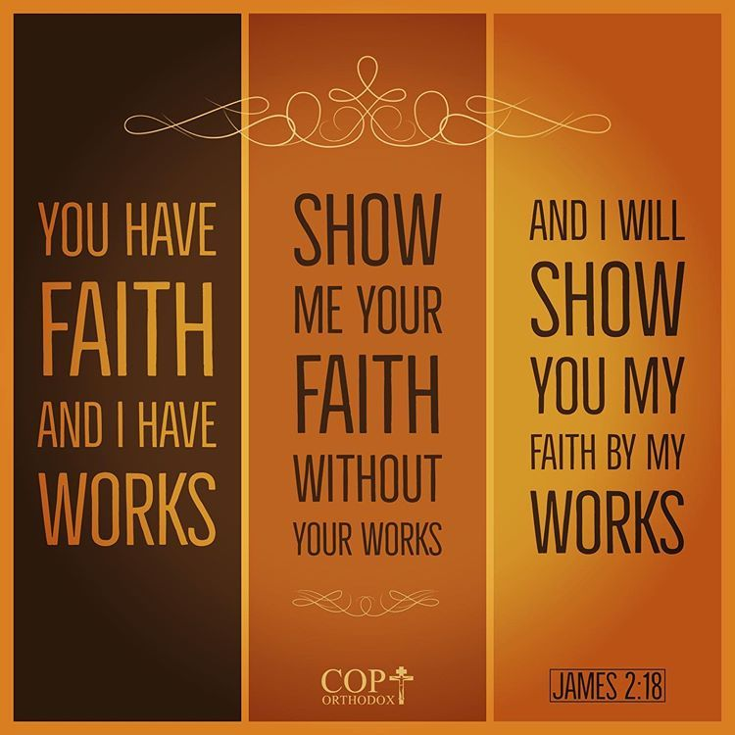
James 2:17-18

Slide 48
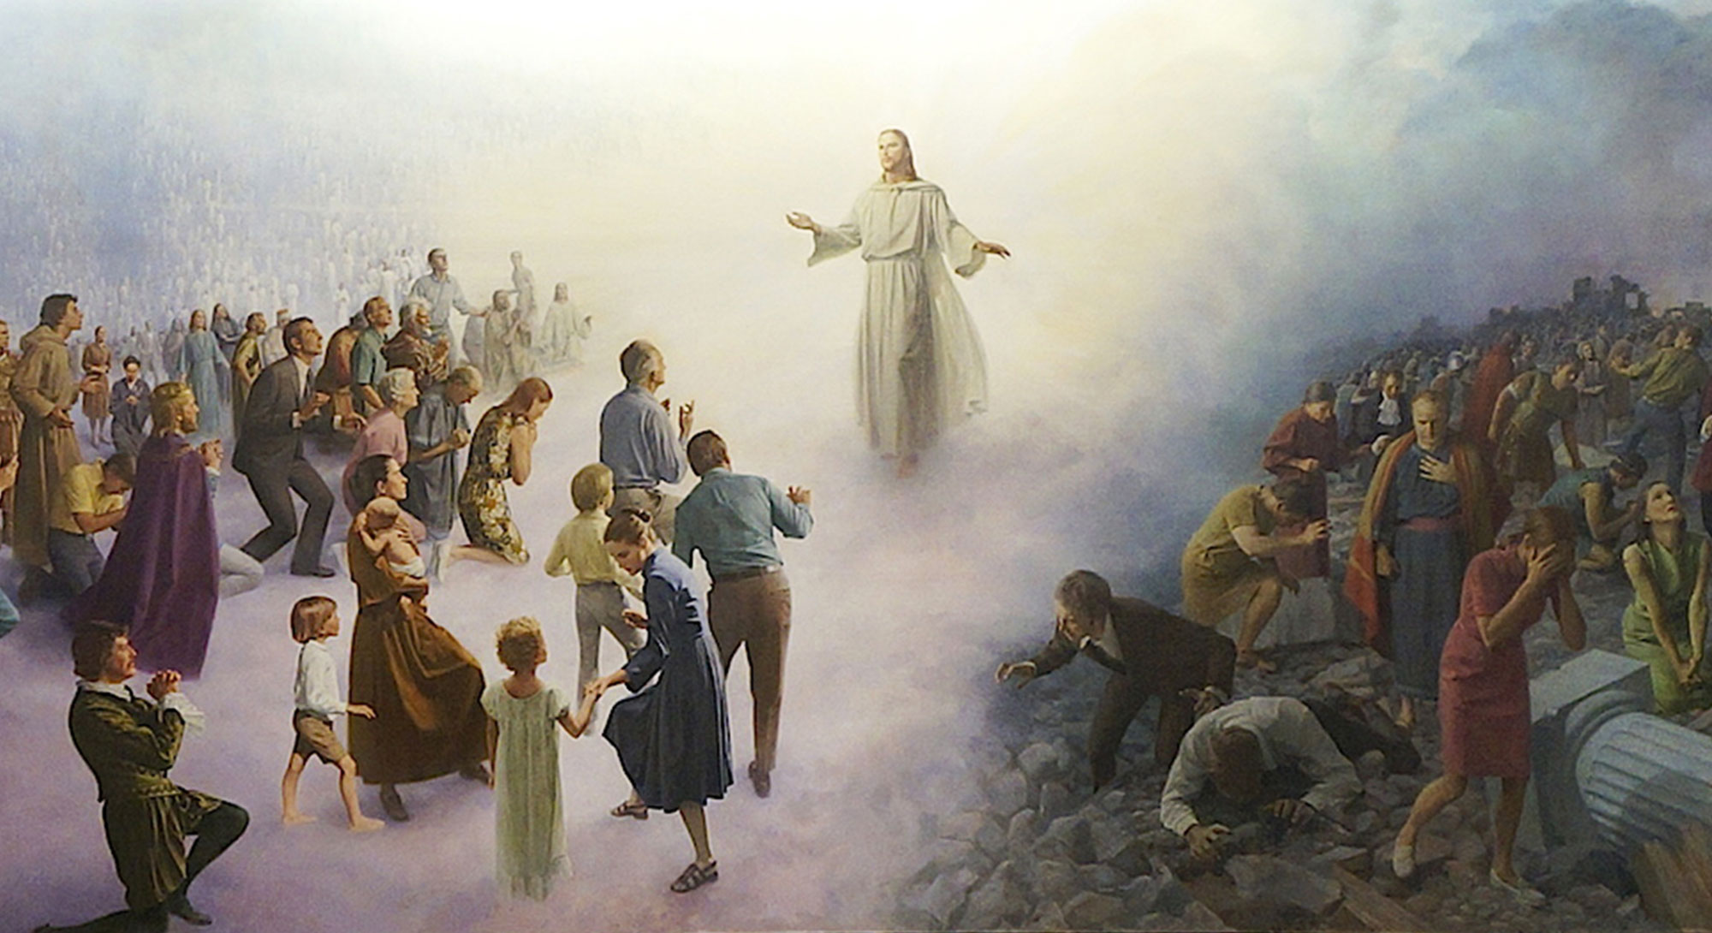
Matthew 7:21

Slide 49
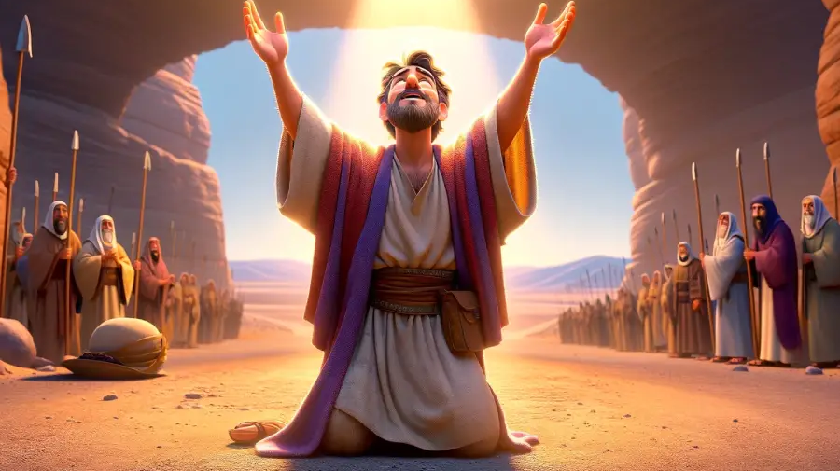
Romans 2:7

Slide 50
Romans 3:10-11
As it is written: “There is none righteous, no, not one; 11 There is none who understands; There is none who seeks after God.

Slide 51

Romans 2:8-11

Slide 52
Matthew 16
A promise for those who love Christ.

Slide 53
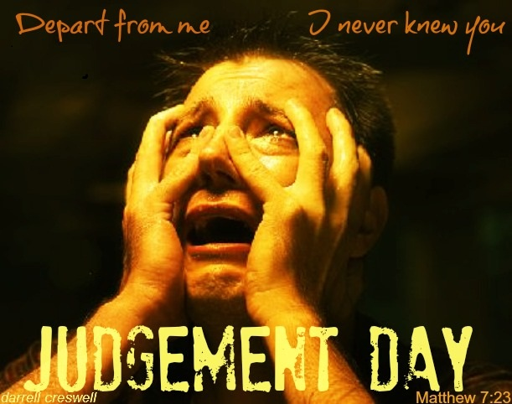
For the unbeliever:
It will be a day of such fear it’s hard to describe.

Slide 54
2 Thessalonians 1:5-10
Rest you saints,
your glory is coming.
Beware you unbelievers, vengeance is coming.

Slide 55
They are in a very real situation where they don’t have any resources:
The kingdom doesn’t seem to be coming.
The people don’t accept Him as Messiah.
The Jews hate Him and want Him dead.
Now He is talking about dying and them dying.

Slide 56
3. Preview of His Glory.
V 28,
Assuredly, I say to you, there are some standing here who shall not taste death till they see the Son of Man coming in His kingdom.”

Slide 57
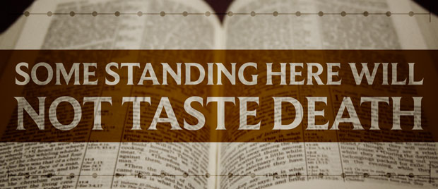

Slide 58
B A S I L E I A
to render it not only as the kingdom itself, but the kingliness of the King in regal splendour, royal majesty.

Slide 59
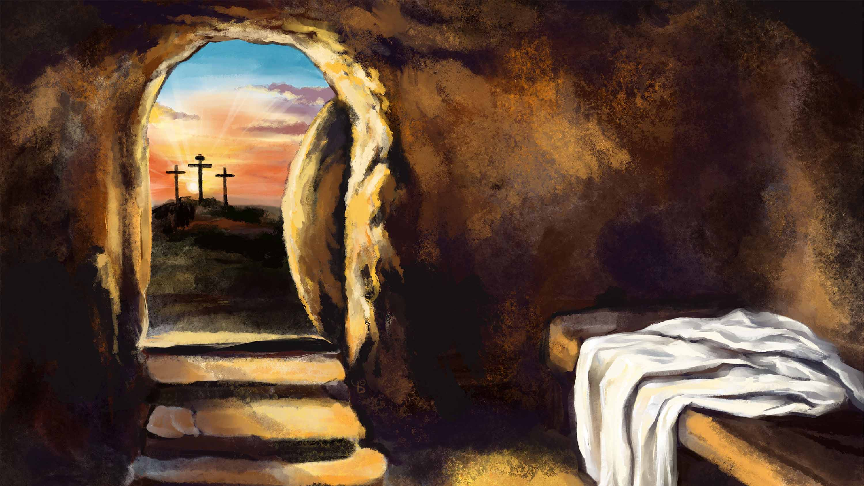
Suggested it means the resurrection, that He came out of the grave in
Royal Splendour.

Slide 60
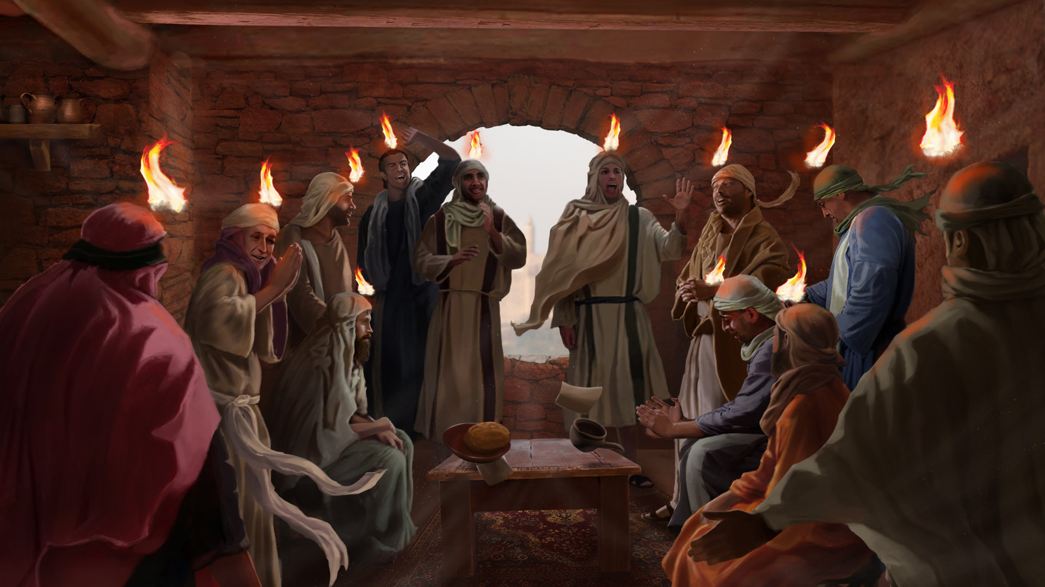
The coming of the Holy Spirit on the day of Pentecost,

Slide 61
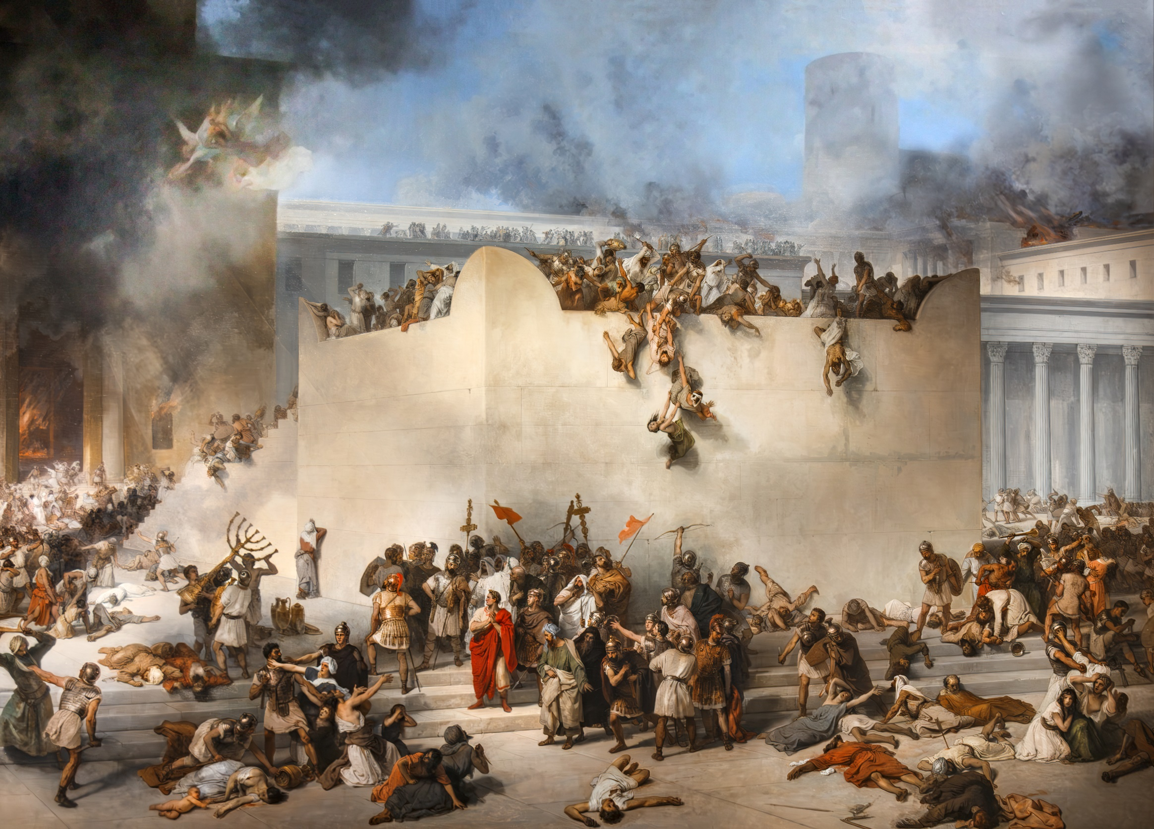
Destruction of Jerusalem in 70 A.D

Slide 62
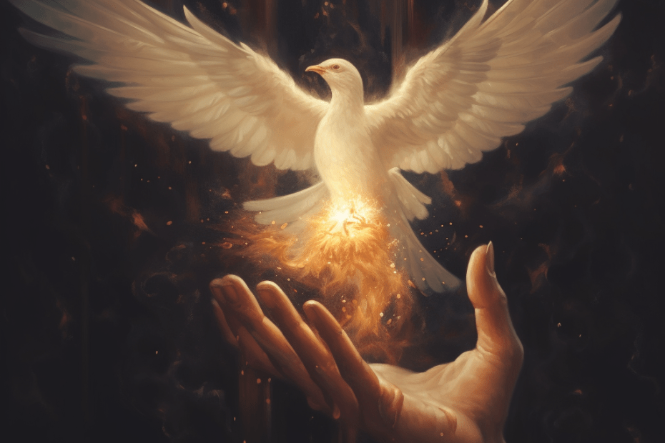
The Holy Spirit

Slide 63
“Some of you standing will not see death,”
appears in Matthew, Mark, and Luke.

Slide 64
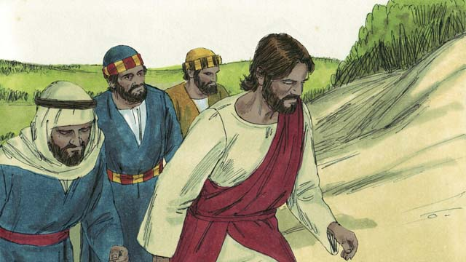
Matthew 17:1

Slide 65
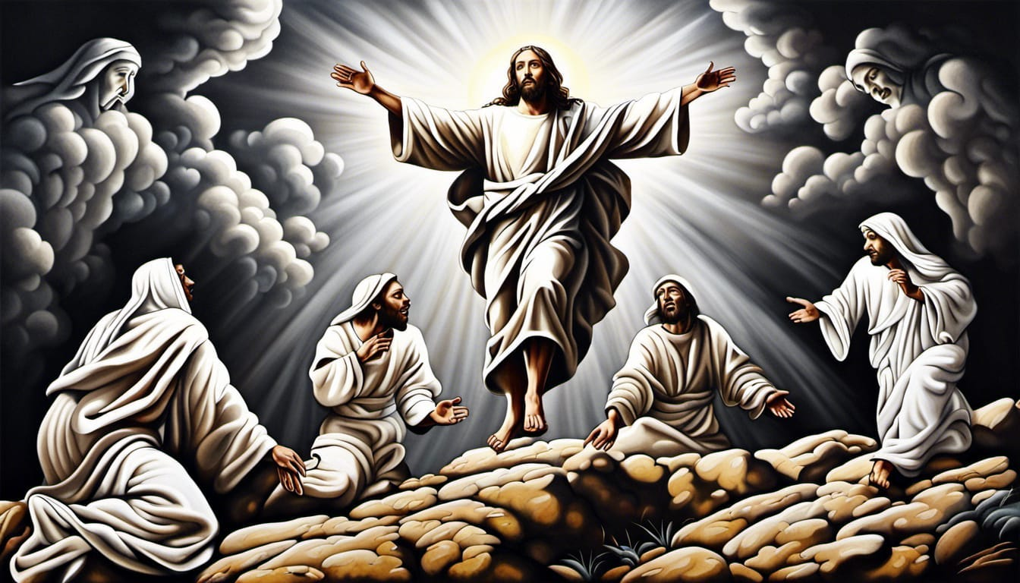
Matthew 17:2

Slide 66
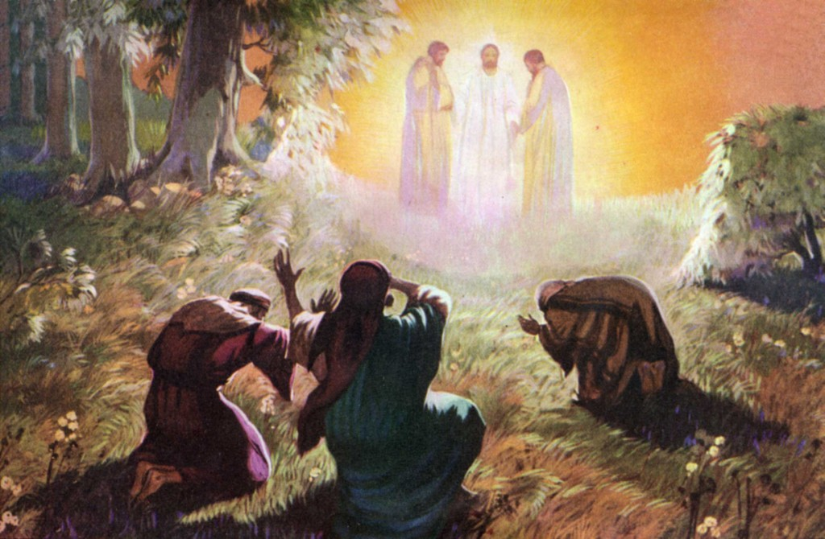
Matthew 17:3-6

Slide 67
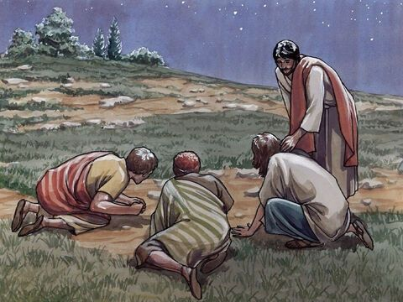
Matthew 17:7-8

Slide 68
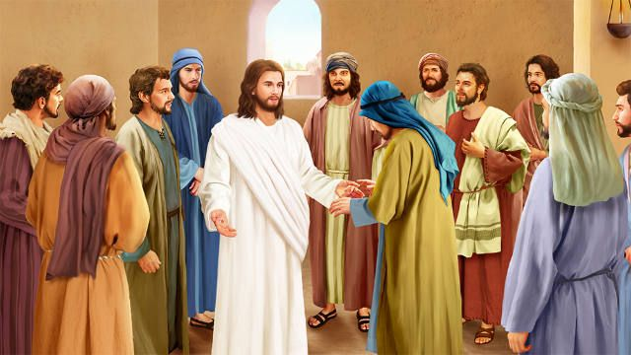
C o n c l u s i o n

Slide 69
1 Peter or 2 Peter,
“Don’t worry about your pain and suffering. He is coming.”

Slide 70
2 Peter 1:16,
For we did not follow cunningly devised fables when we made known to you the power and coming of our Lord Jesus Christ, but were eyewitnesses of His majesty.

Slide 71
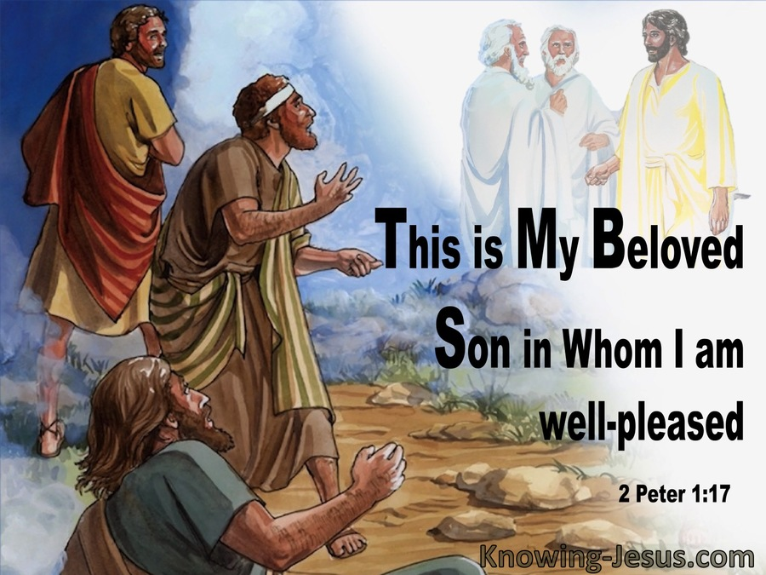
2 Peter 1:17-18,

Slide 72
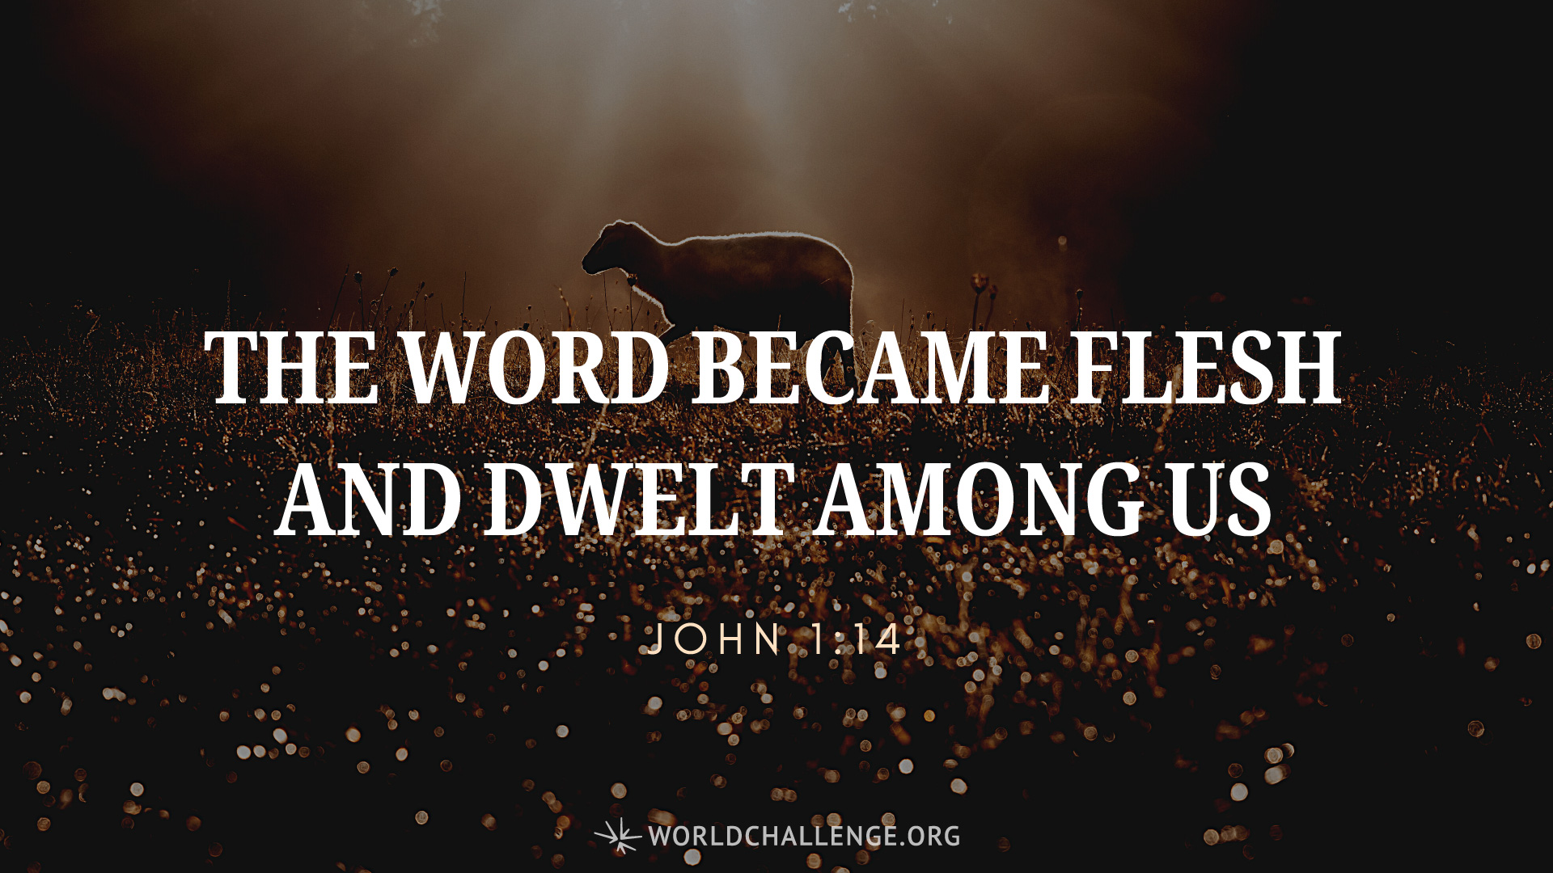

Slide 73
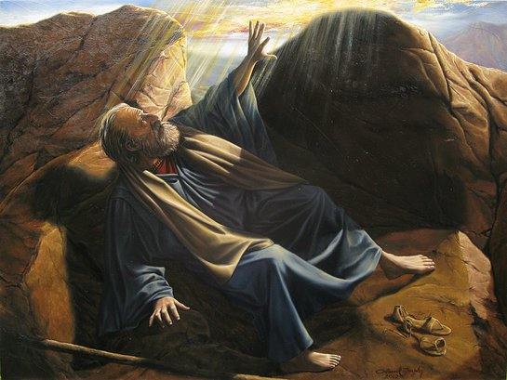
Exodus 33

Slide 74
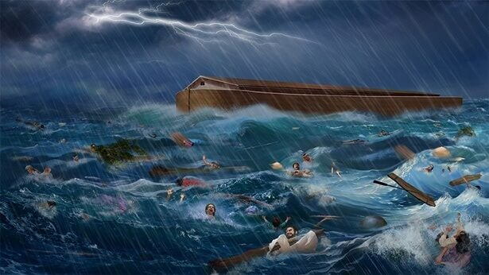
2 Peter 3:3-7
Peter says,
Have you forgotten the flood?

Slide 75
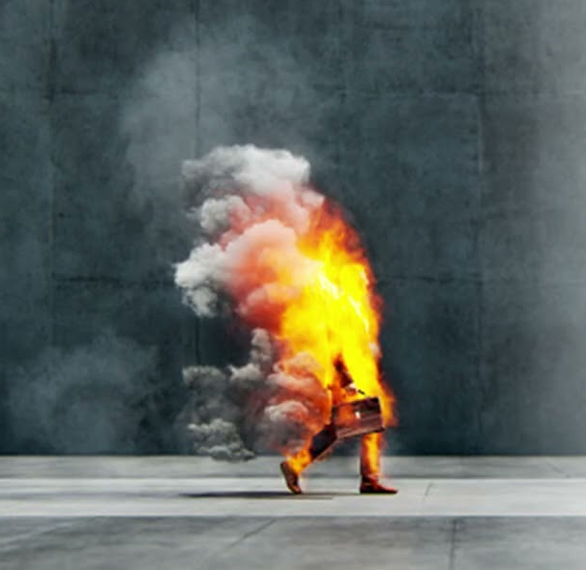
2 Peter 3:11,
Therefore, since all these things will be dissolved, what manner of persons ought you to be in holy conduct and godliness,

Slide 76
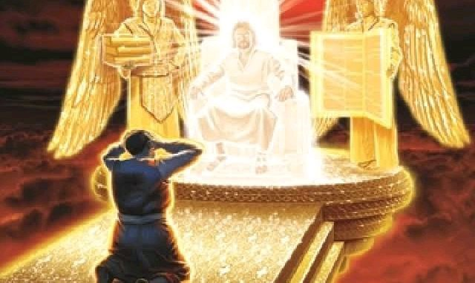
You cannot hide !!!

Slide 79


