Slide 1

25th February 2024
S U N D A Y

Slide 2
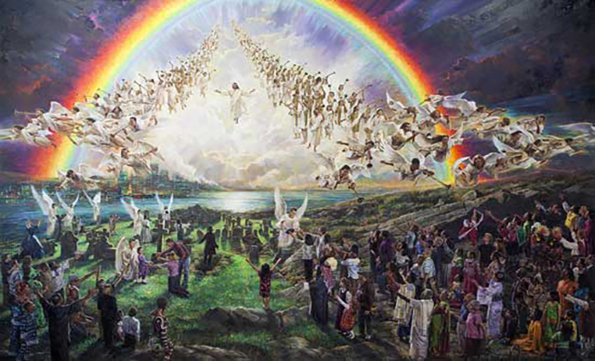
Matthew 16:27-17:5

Slide 3
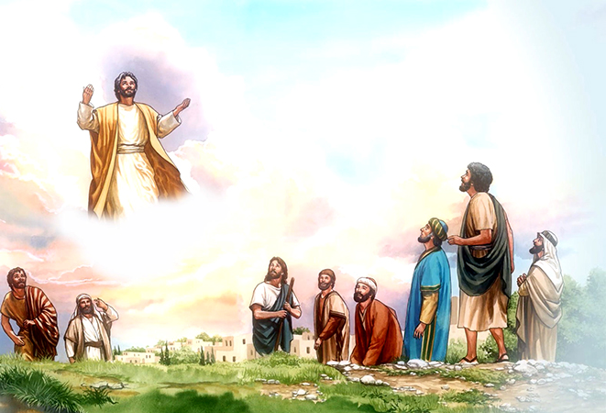

Slide 4
Matthew 24-26.
FIRST COMING
rejection, hostility, and death
SECOND COMING
in glory, majesty, dominion, power and might, and is worshipped as King of Kings and Lord of Lords.

Slide 5
Old Testament
1,525 prophecies of the second coming.
New Testament
1 out of every 25 verses, or 320 verses talk about the second coming of Jesus Christ in glory
The Bible is very clear about Jesus’ 2nd coming.

Slide 6
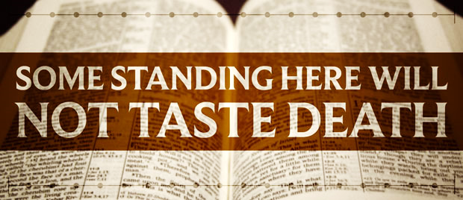
Matthew 16:28

Slide 7
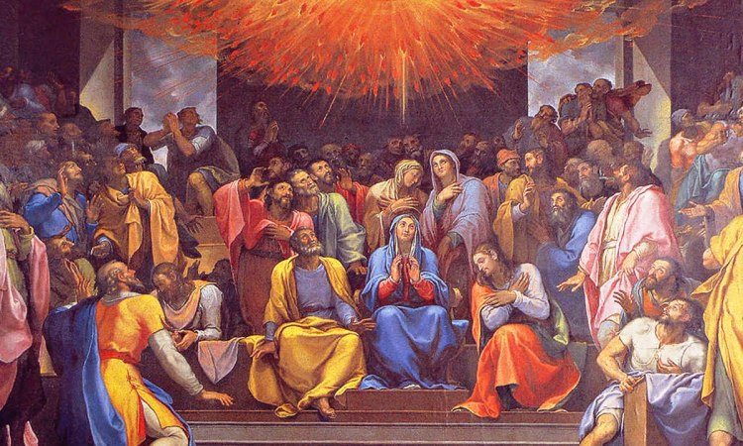
Acts 2

Slide 8
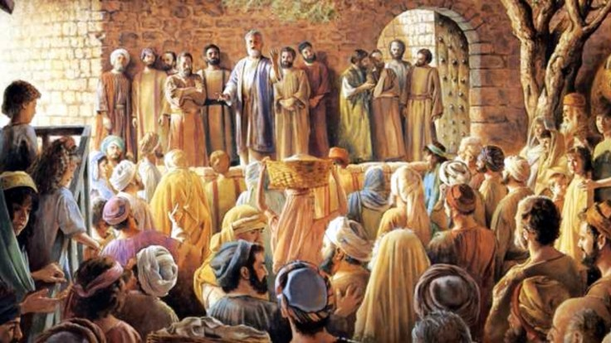
Acts 2:12-13

Slide 9
Acts 2:16-21
And it shall come to pass That whoever calls on the name of the Lord Shall be Saved.

Slide 10
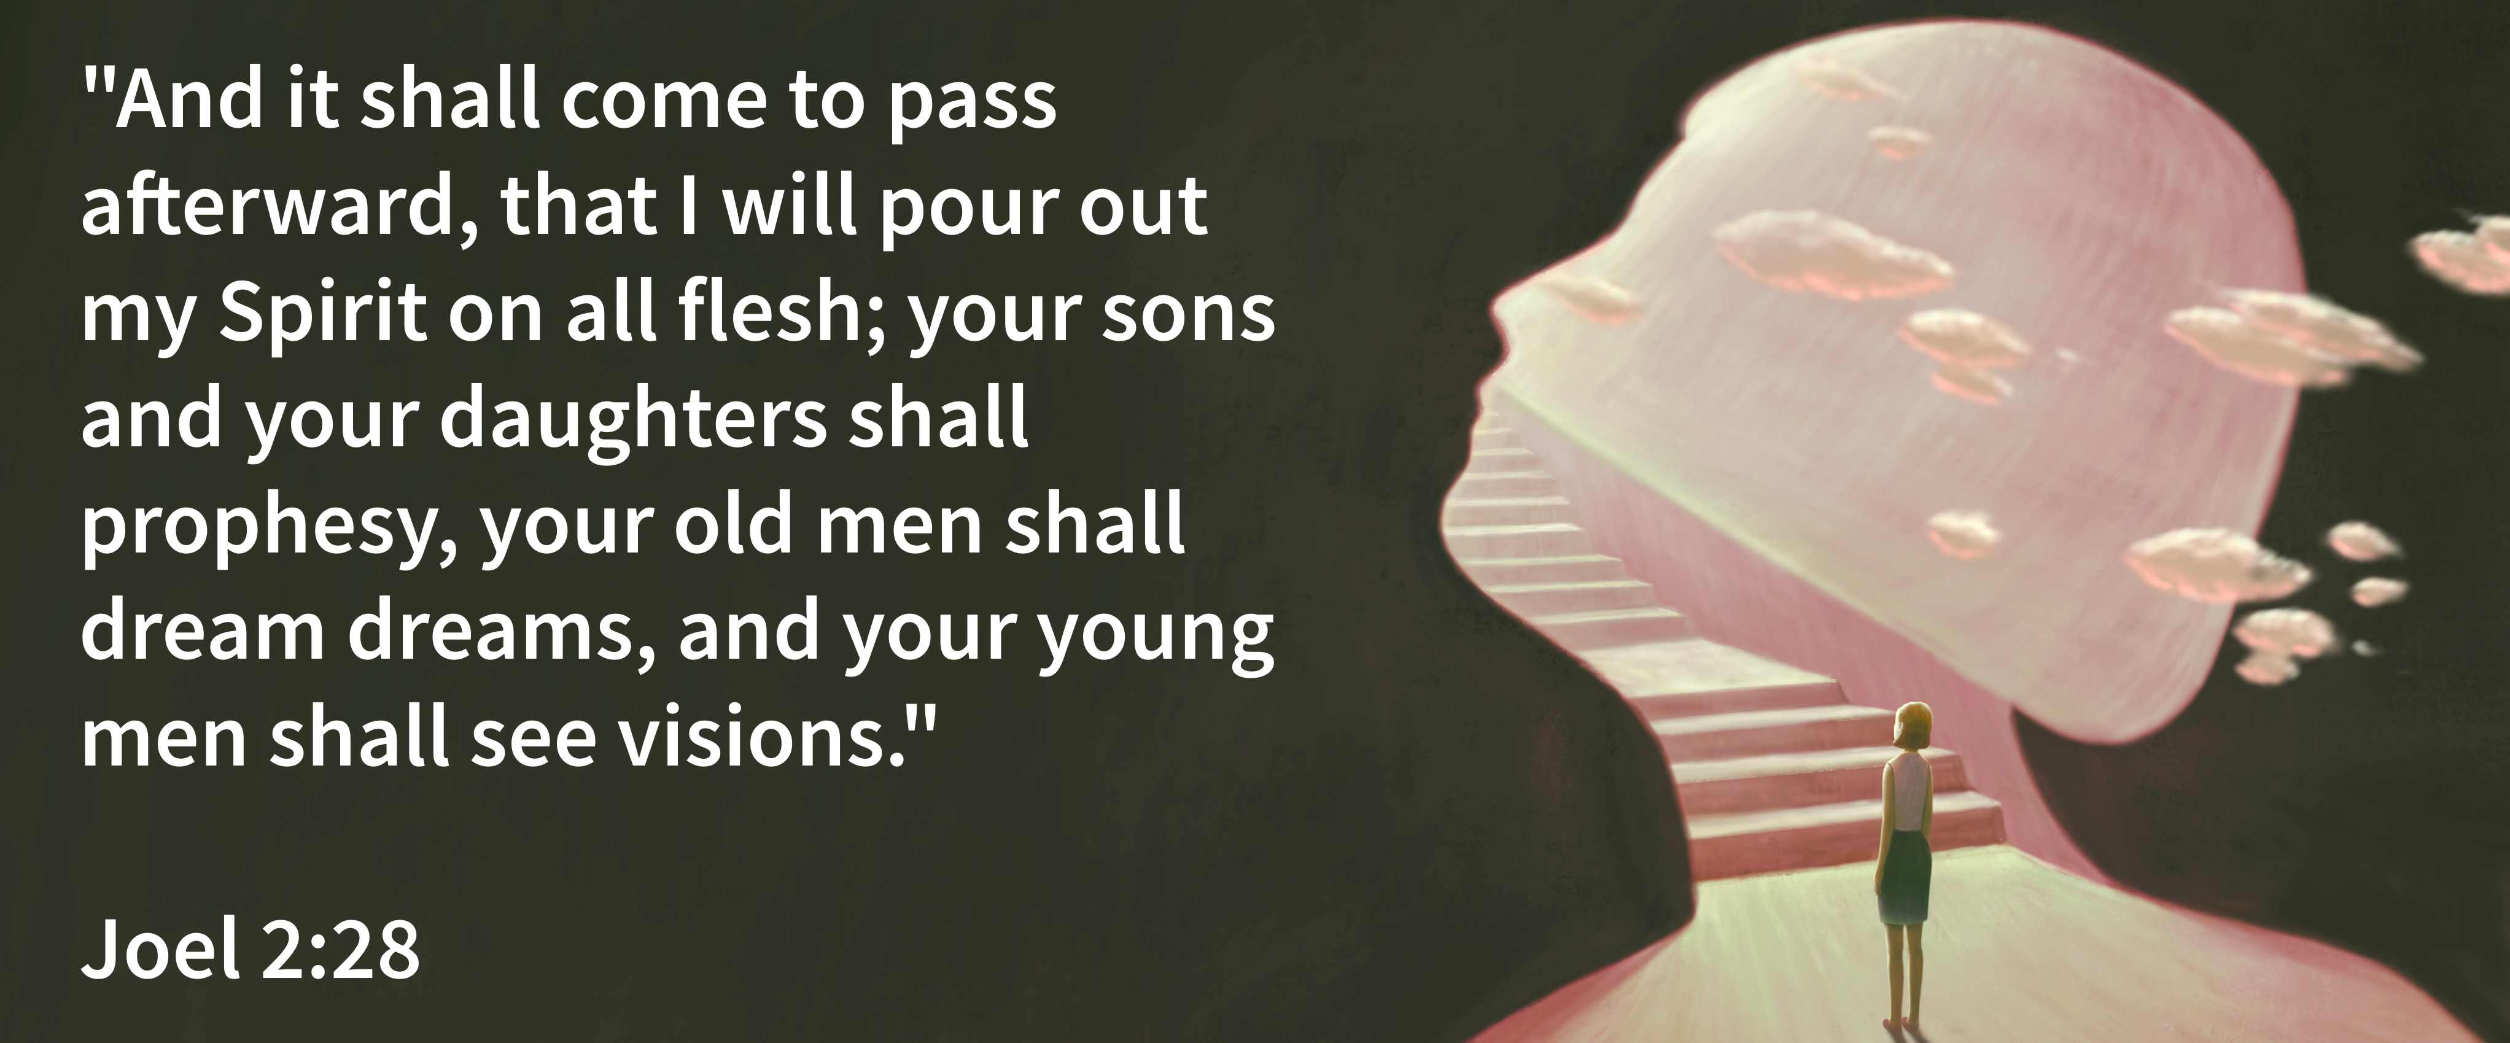
Joel 2:28-32
And it shall come to pass That whoever calls on the name of the Lord Shall be Saved.

Slide 11
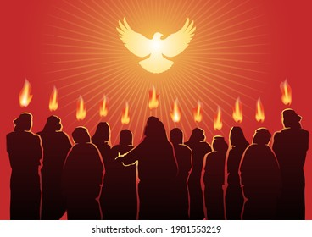

Slide 12
Hebrews 6:5
and have tasted the good word of God and the powers of the age to come,

Slide 13
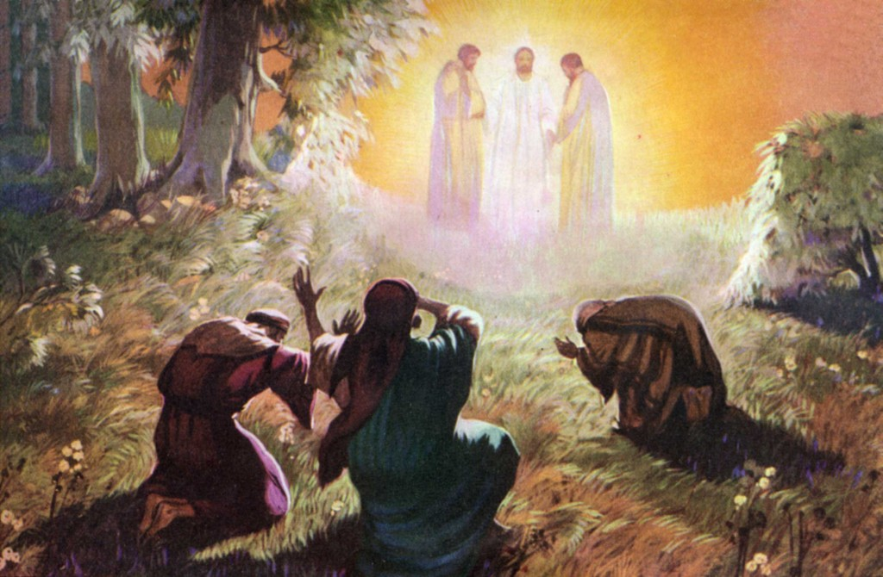
Luke 9:28

Slide 14
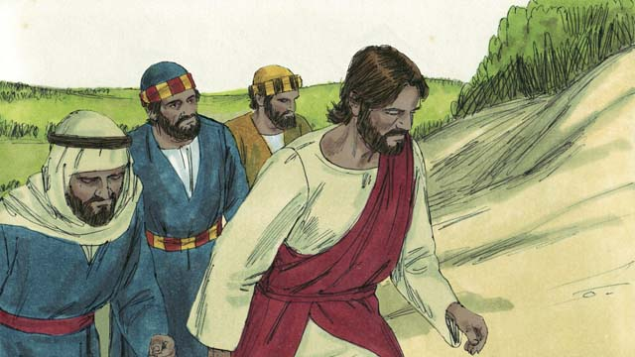
Why does He take Peter, James, and John?”
To be witnesses

Slide 15
Deuteronomy 19:15
by the mouth of two or three witnesses the matter shall be established.

Slide 16
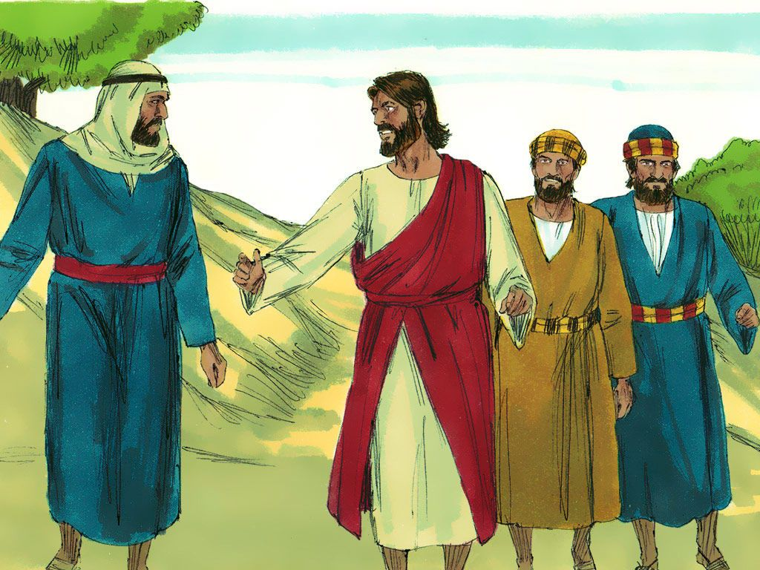
They were the closest to Him.
They were around Him the most.

Slide 17
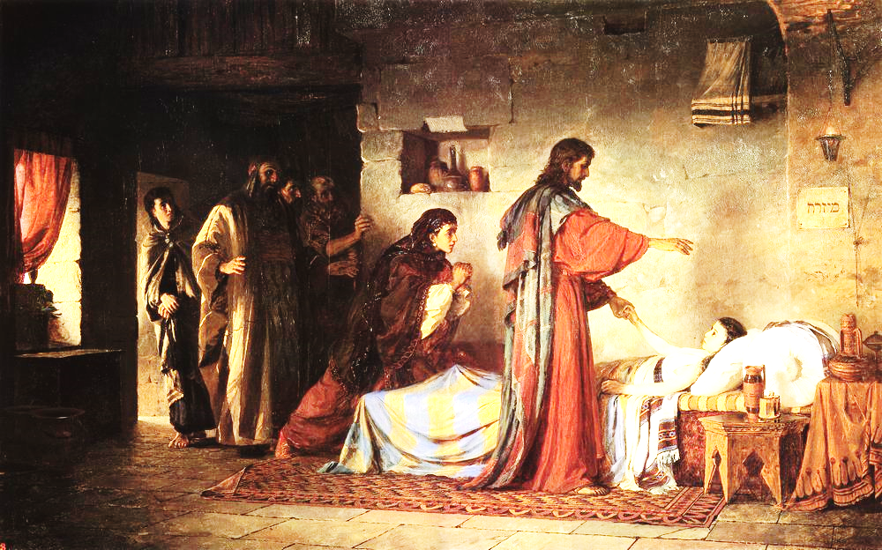
They were there at the raising of the young girl

Slide 18
Mark 5:37,
And He permitted no one to follow Him except Peter, James, and John the brother of James.

Slide 19
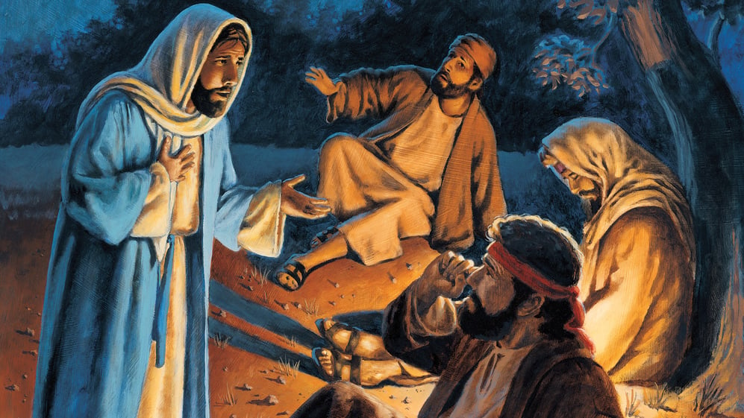
Mark 14:32-33

Slide 20
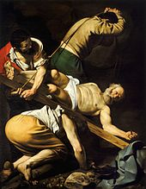
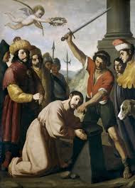
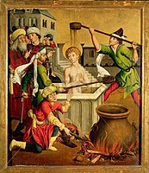
PETER JAMES JOHN

Slide 21
Jesus took them was because they were acknowledged, trustworthy leaders.

Slide 22
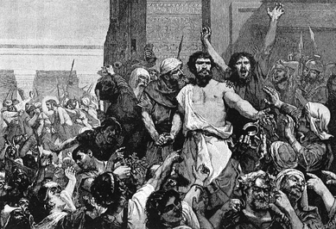
Negative reason why he only took three.

Slide 23
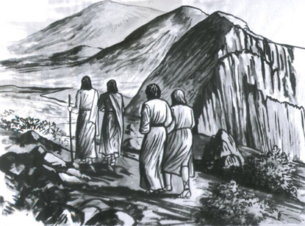
V 1, He took them into a high mountain.

Slide 24
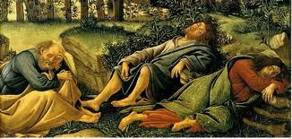
They did what usually did.
Sleep…

Slide 25
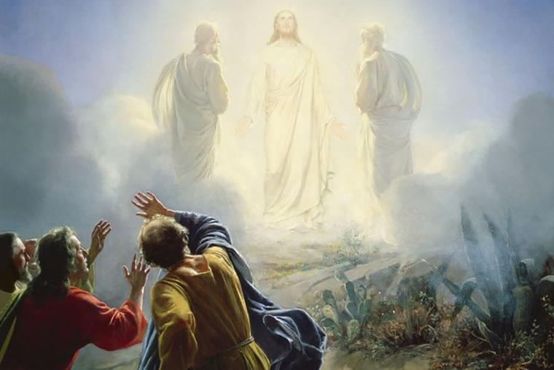
Luke 9:32,

Slide 26
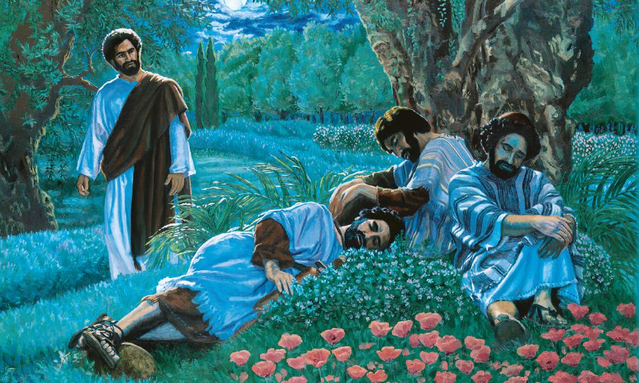
Garden of Gethsemane..

Slide 27
Luke 22:45-46
“Why do you sleep? Rise and pray, lest you enter into temptation.”

Slide 28

Depressed people want to sleep for good.

Slide 29
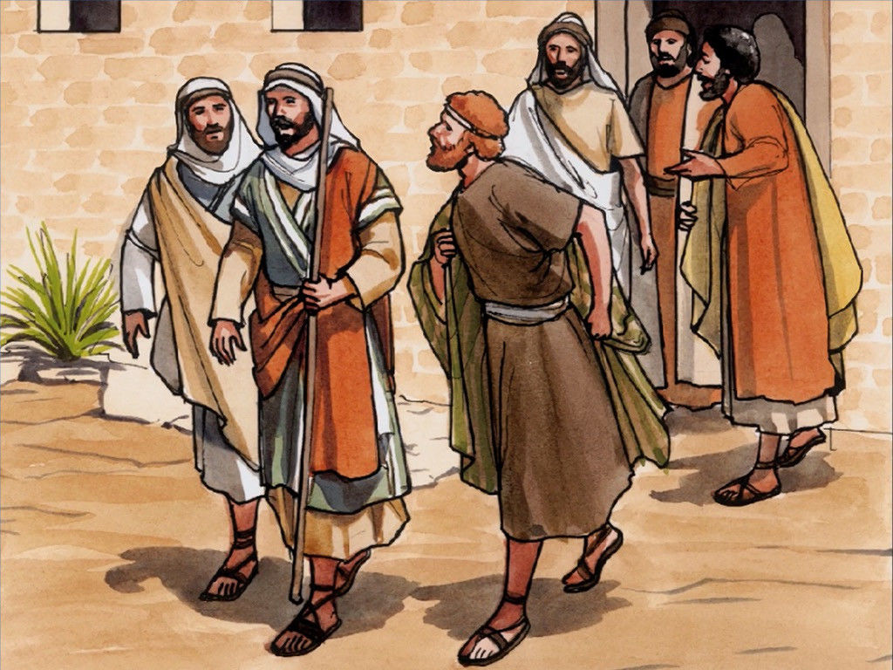
John 11:16
“Let us also go, that we may
die with Him.”

Slide 30
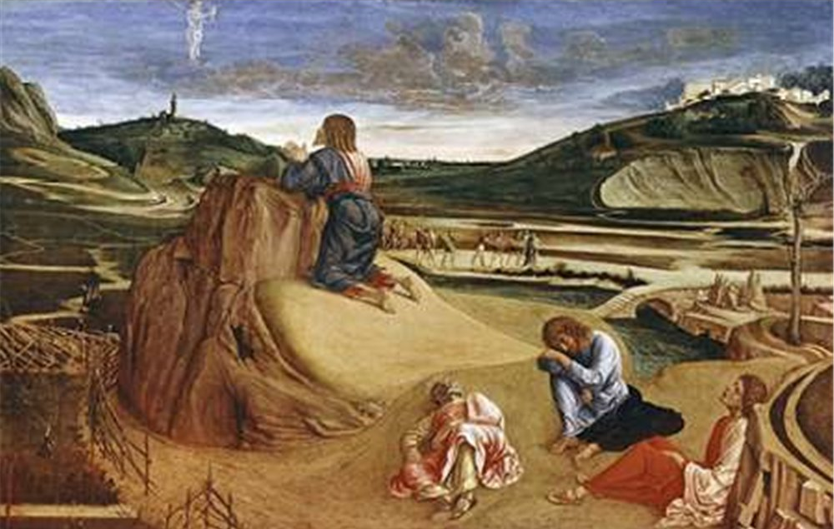
Jesus was praying
They were sleeping.
One way to deal with their depression.

Slide 31

1. The transformation of the Son

Slide 32
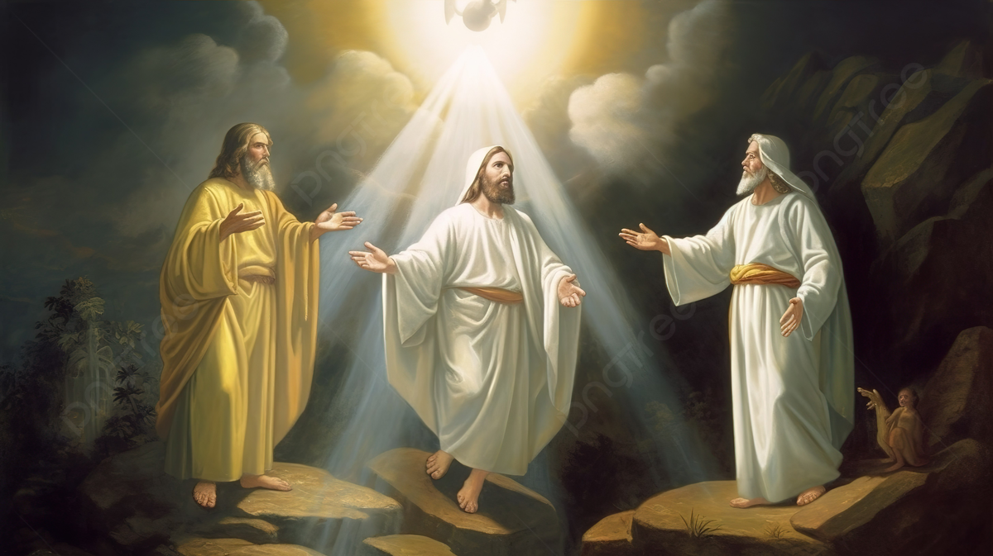
His face shone like the sun, and His clothes became as white as the light.

Slide 33
Metamorphosis
The term morphoō has to do with the body and form

Slide 34
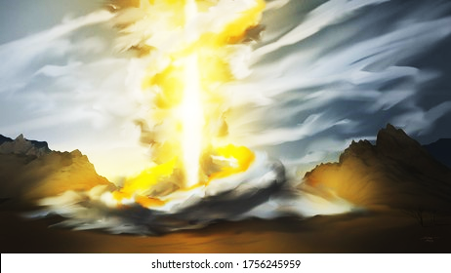

Shekinah- Glory of God

Slide 35
2 Peter 1
“We do not speak to you about the second coming of the Lord Jesus Christ in power as some fable, but we were eyewitnesses of His majesty;
we saw it.”

Slide 36
John 1:14
“We beheld His glory as of the only begotten of the Father, full of grace and truth.

Slide 37
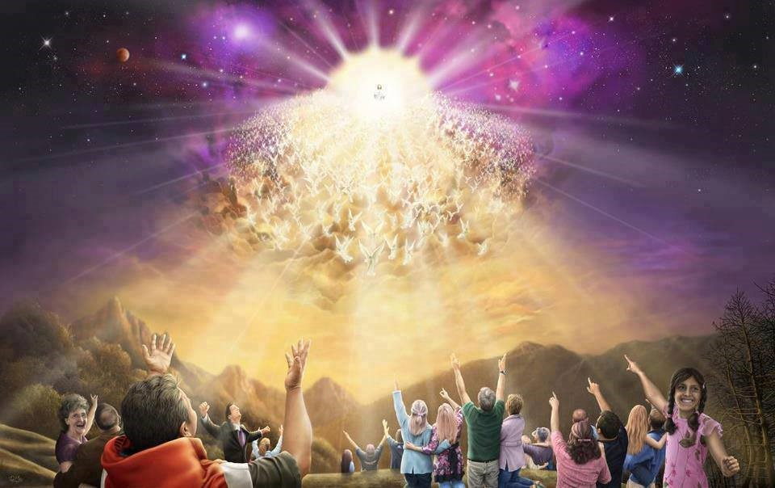
Matthew 24:31
“We beheld His glory as of the only begotten of the Father, full of grace and truth.

Slide 38
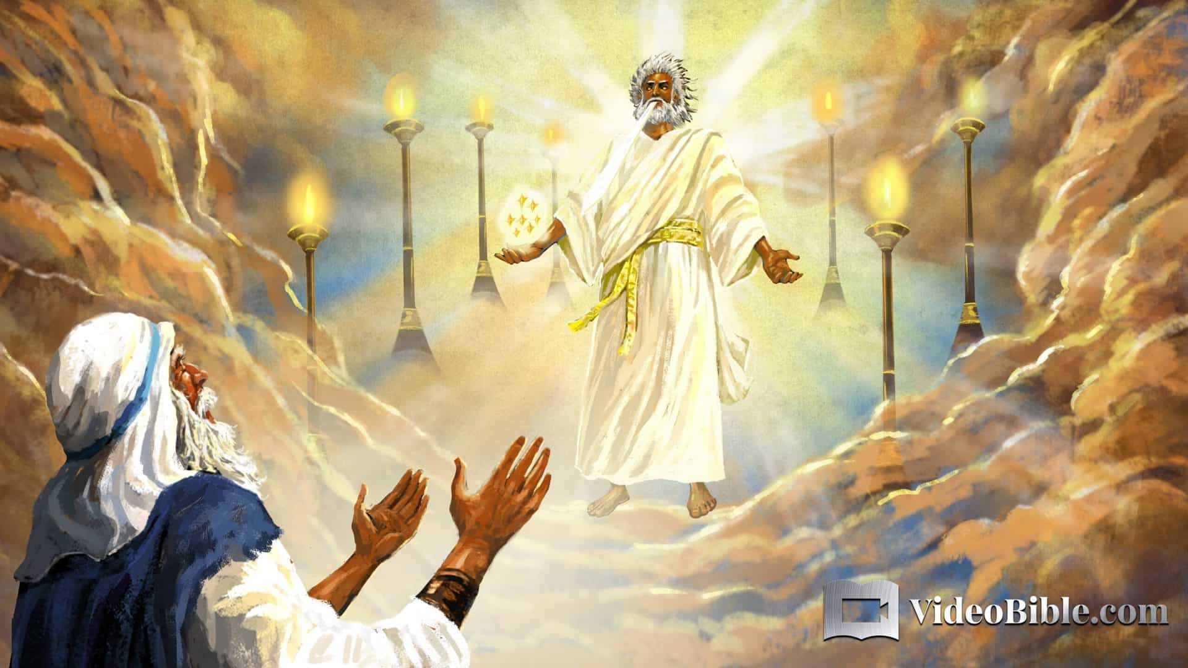
Revelation 1:12-16,

Slide 39
2. By the testimony of the saints.

Slide 40
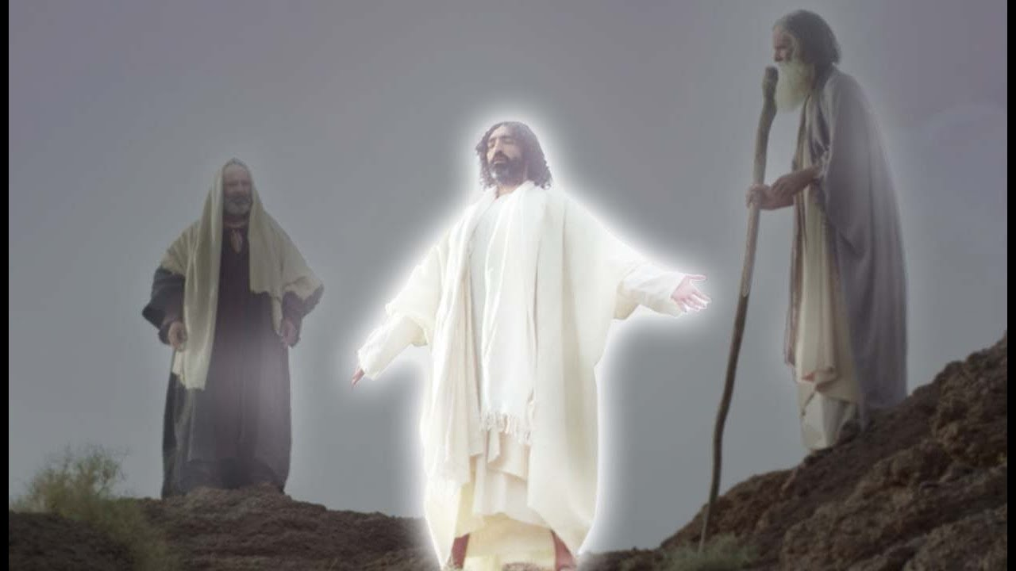
V 3, And behold, Moses and Elijah appeared to them, talking with Him.

Slide 41
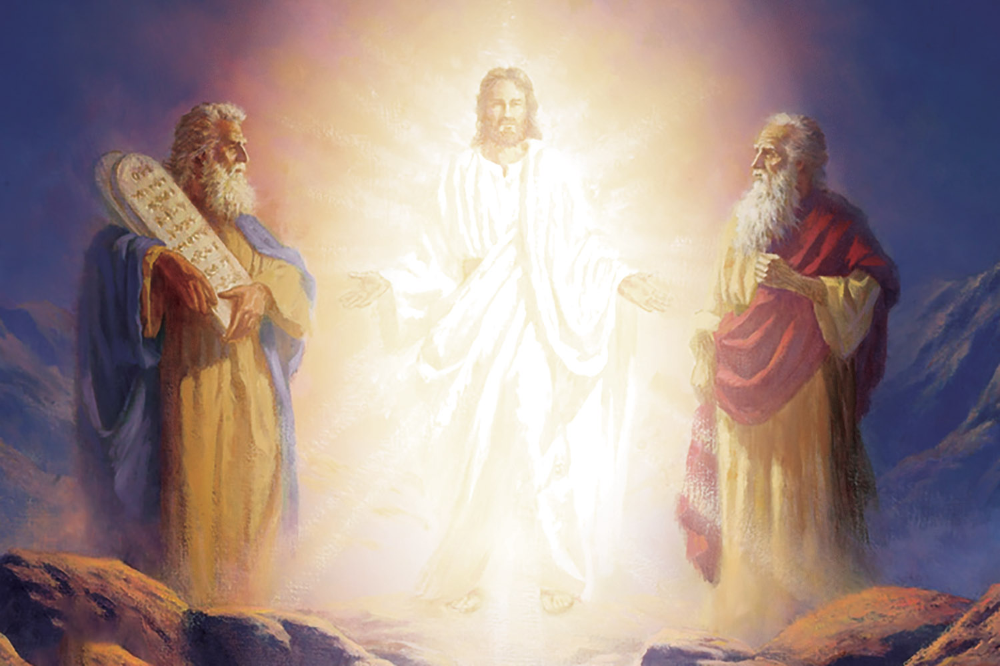
Moses and Elijah

Slide 42
Moses and Elijah
Moses gave the law,
Elijah guarded the law,

Slide 43
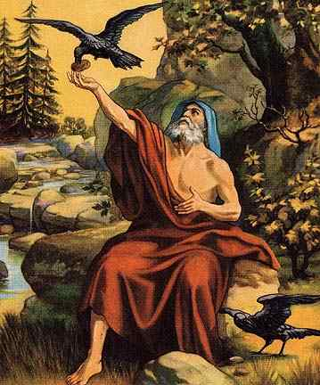
1 Kings,
Elijah stands for all the prophets. He is considered the most zealous and preeminent of them all.

Slide 44
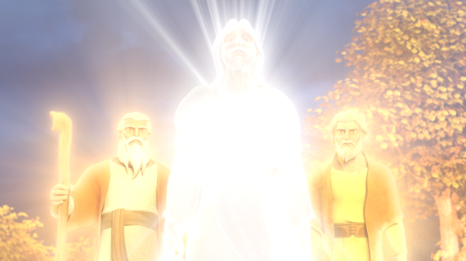
Old Testament verification.
“I have come to fulfil the law and the prophets.”

Slide 45
Matthew says they were talking with Jesus.
Luke tells us what they were talking about.

Slide 46
Luke 9:30-31,
And behold, two men talked with Him, who were
Moses and Elijah,

Slide 47
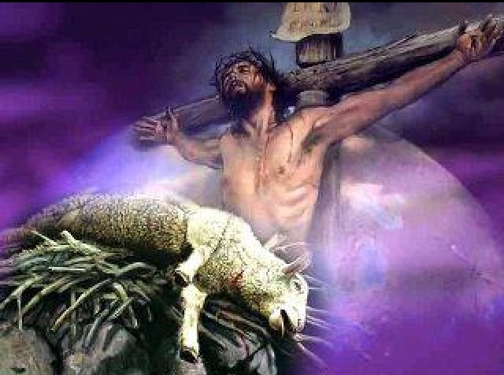
Talking about
Christ’s death.

Slide 48
Acts 2:23
Him, being delivered by the determined purpose and foreknowledge of God, you have taken by lawless hands, have crucified, and put to death;

Slide 49
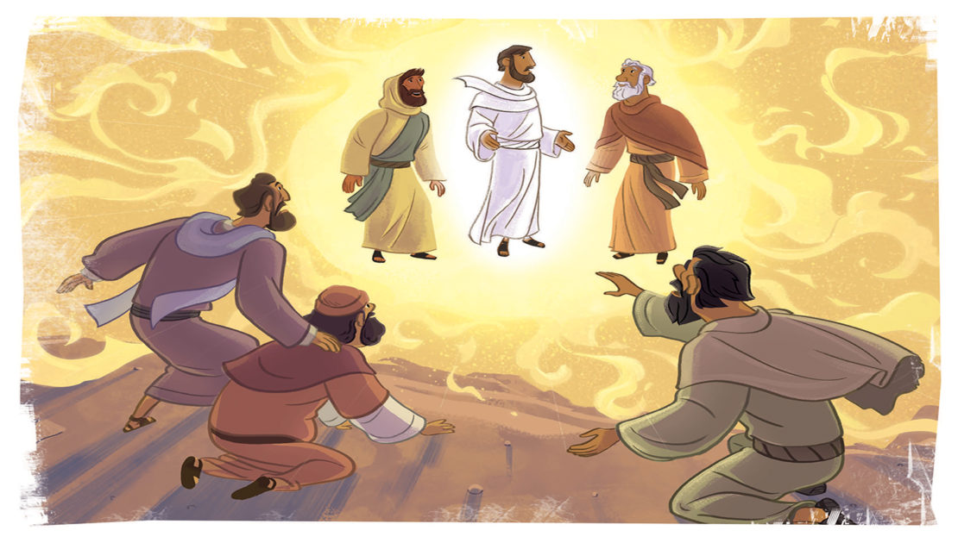
if You wish, let us make here three tabernacles: one for You, one for Moses, and one for Elijah.”

Slide 50
Luke 9:33,
“Master, it is good for us to be here; and let us make three tabernacles: one for You, one for Moses, and one for Elijah”—not knowing what he said.

Slide 51
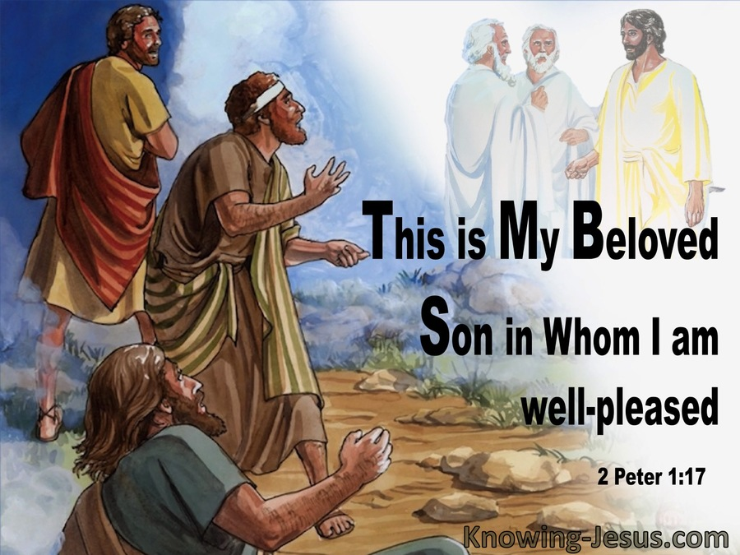

Slide 52
3. The terror of the Father.

Slide 53
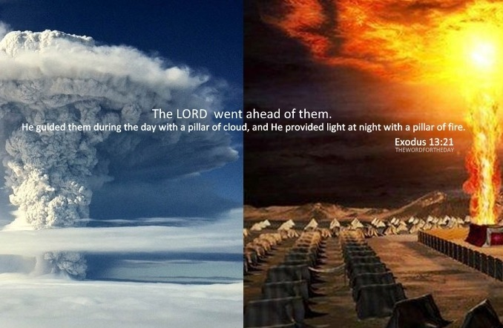
Exodus 13:21,

Slide 54
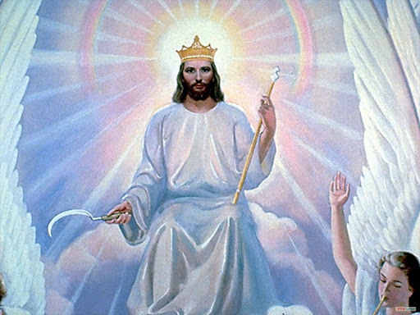
Revelation 14:14-16

Slide 55
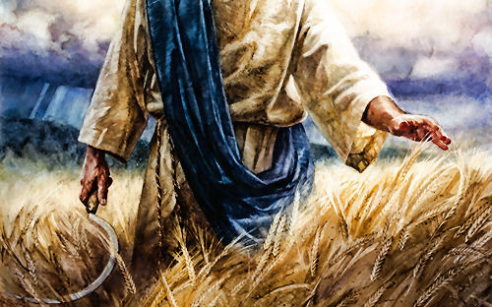
Revelation 14:14-16

Slide 56
