Slide 1

Matthew 18:23-27
Forgiving like the children in the Kingdom
God Forgives Unpayable debts!

Slide 2

Matthew 16
Jesus said

Slide 3
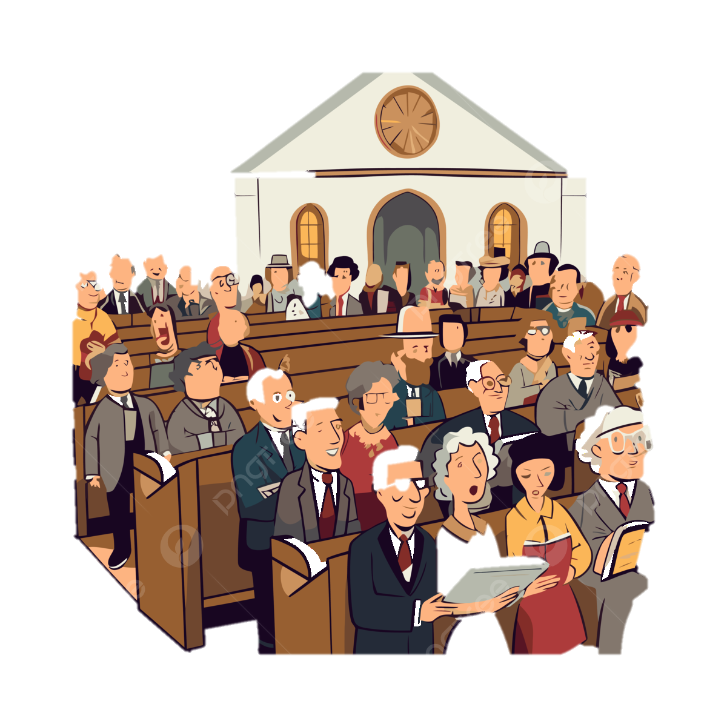
Matthew 18
Jesus shows
how to live in that Church
as a Kingdom.

Slide 4
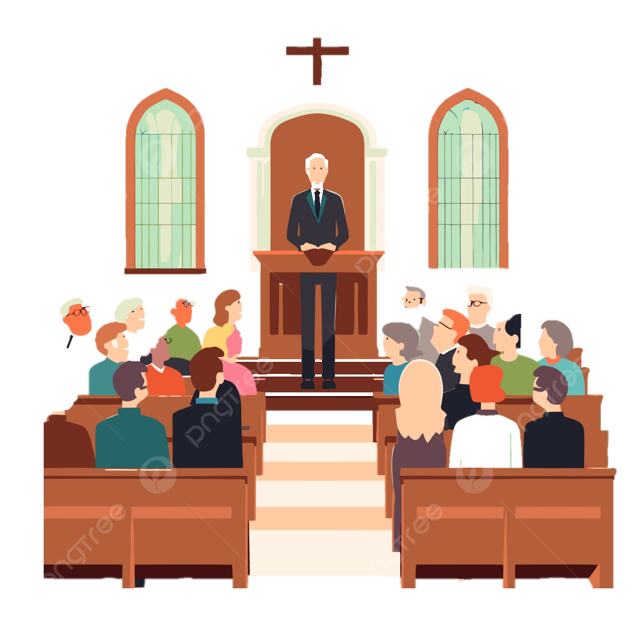
Matthew 28
Jesus tells the What the Church should do

Slide 5

Matthew 18
becomes the cornerstone for the Church

Slide 6
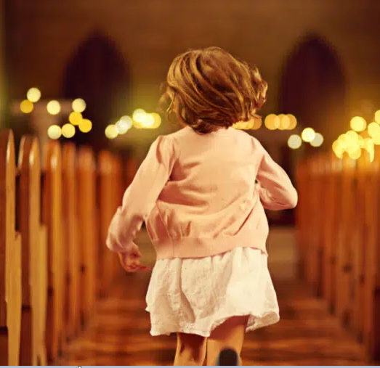




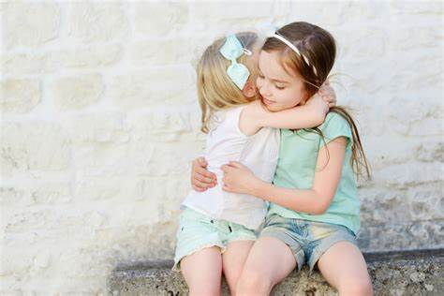
Matthew 18
Entering the church ( 1-4 )
Caring in the church ( 5-9 )
Protecting in the church ( 10 -14)
Disciplining the church ( 15- 20)
Forgiving in the church ( 21- 35)

Slide 7
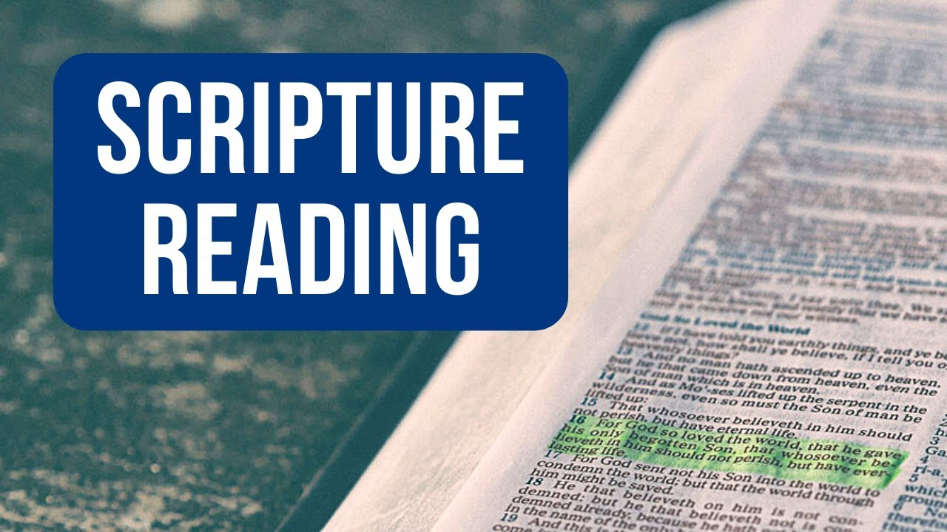
Matthew 18:21-35

Slide 8
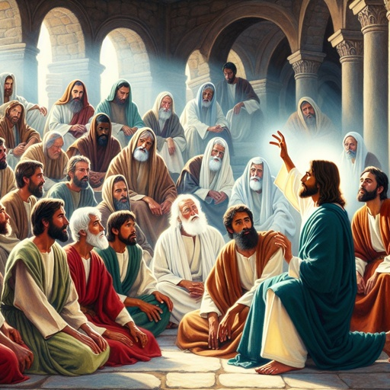
Therefore the kingdom of heaven is like a certain king who wanted to settle accounts with his servants.
Matthew 18: 23

Slide 9
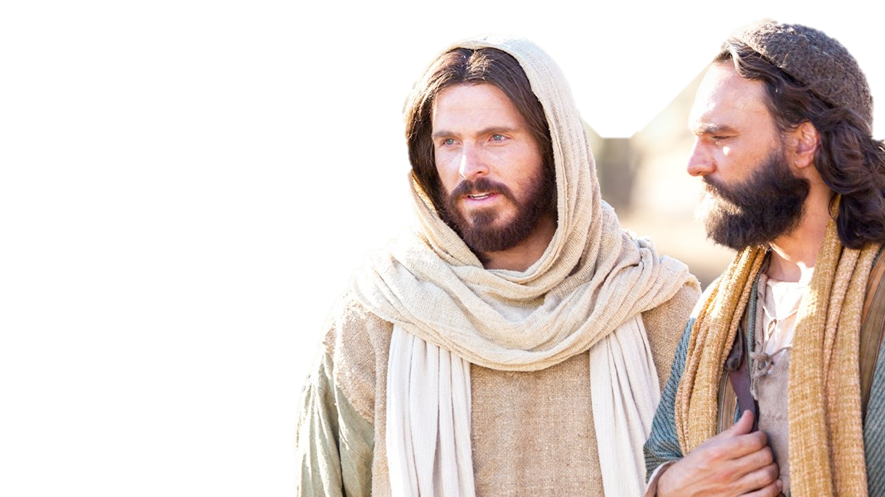
Then Peter came to Him and said, “Lord, how often shall my brother sin against me, and I forgive him? Up to seven times?”
Matthew 18: 21

Slide 10

The kingdom of heaven is the sphere of God’s rule on earth through grace and salvation.

Slide 11
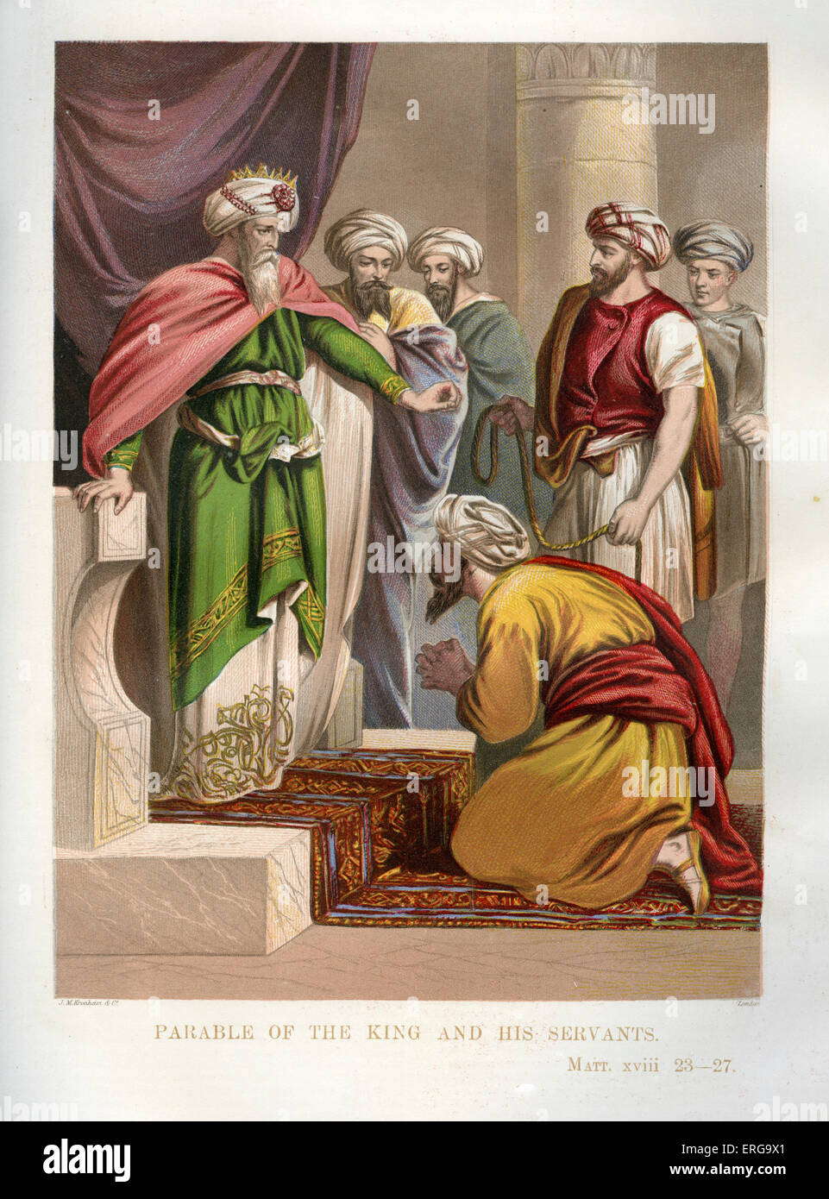
Therefore the kingdom of heaven is like a certain king who wanted to settle accounts with his servants.
Matthew 18: 23

Slide 12
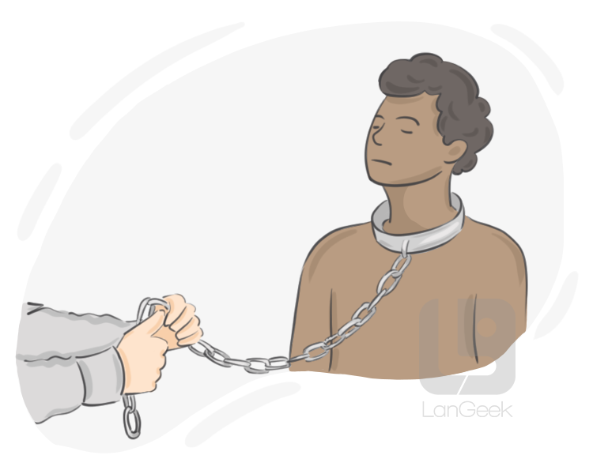
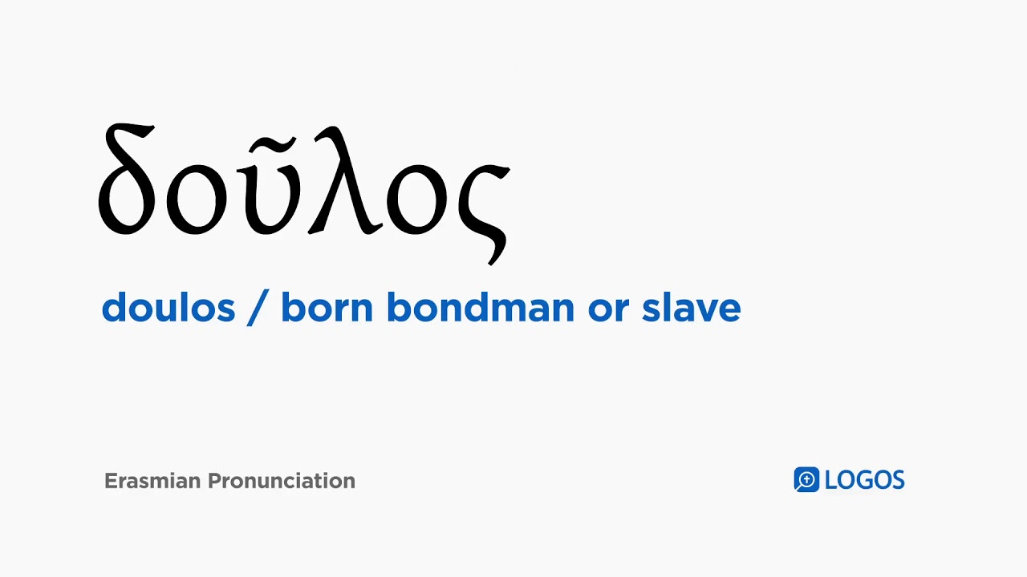

Slide 13
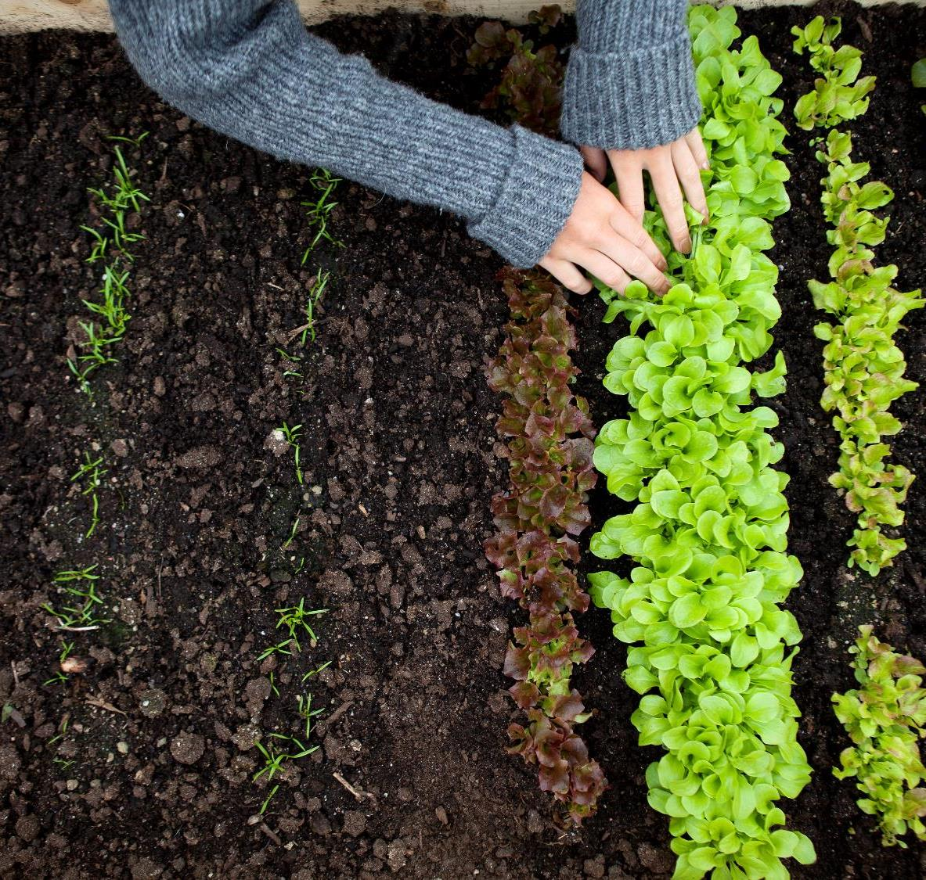
Then God blessed them, and God said to them, “Be fruitful and multiply; fill the earth and subdue it; have dominion over the fish of the sea, over the birds of the air, and over every living thing that moves on the earth.”
Genesis 1:28

Slide 14

The heaven, even the heavens, are the Lord’s; But the earth He has given to the children of men.
Psalms 115:16

Slide 15
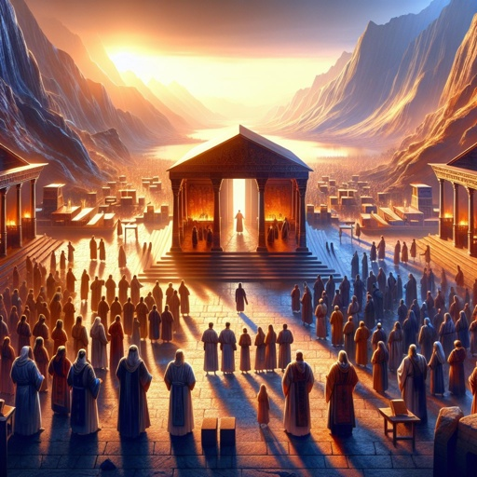
Then they fell on their faces, and said, “O God, the God of the spirits of all flesh, shall one man sin, and You be angry with all the congregation?”
Numbers 16:22

Slide 16
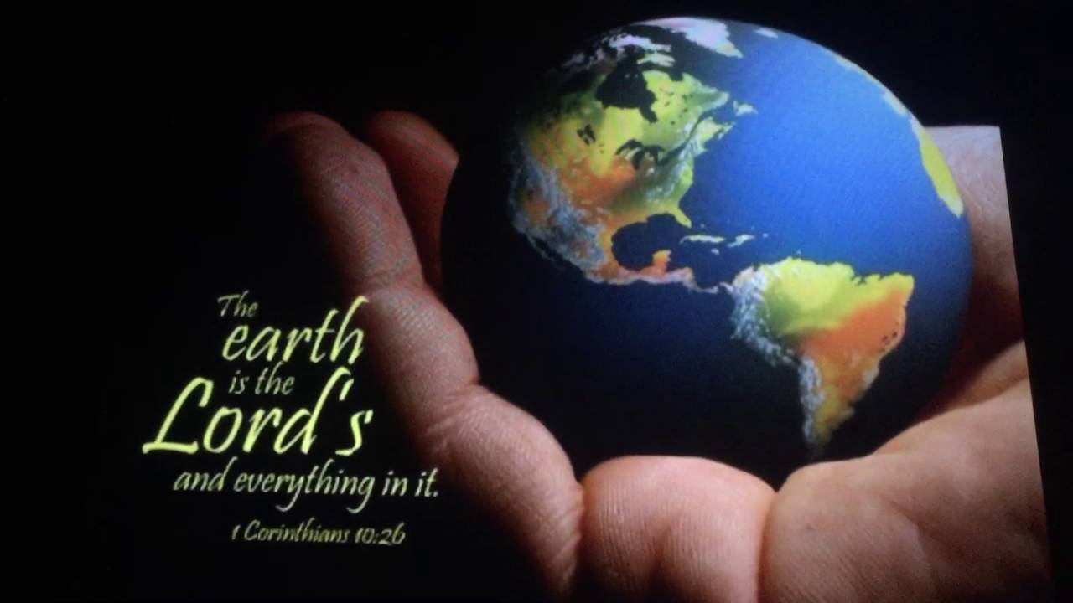
Behold, all souls are Mine; The soul of the father As well as the soul of the son is Mine; The soul who sins shall die.
Ezekiel 18:4

Slide 17

For who makes you differ from another? And what do you have that you did not receive? Now if you did indeed receive it, why do you boast as if you had not received it?
1 Corinthians 4:7

Slide 18

“And you shall remember the Lord your God, for it is He who gives you power to get wealth, that He may establish His covenant which He swore to your fathers, as it is this day.
Deuteronomy 8:18

Slide 19
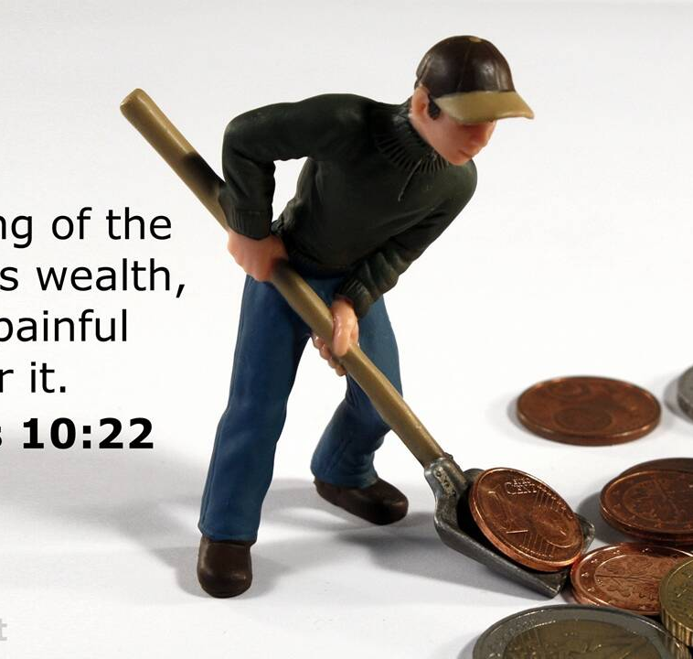
The blessing of the LORD makes one rich, And He adds no sorrow with it.
Proverbs 10:22

Slide 20
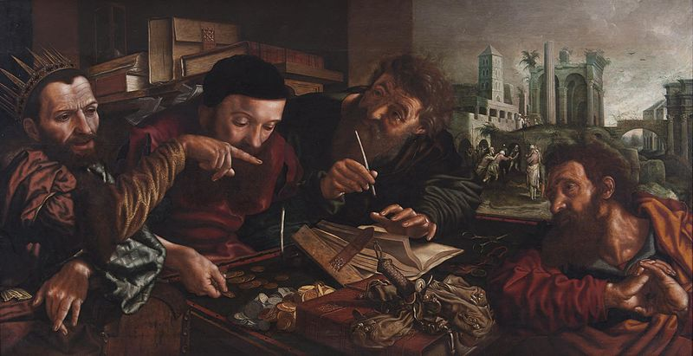
Therefore the kingdom of heaven is like a certain king who wanted to settle accounts with his servants.
Matthew 18: 23

Slide 21
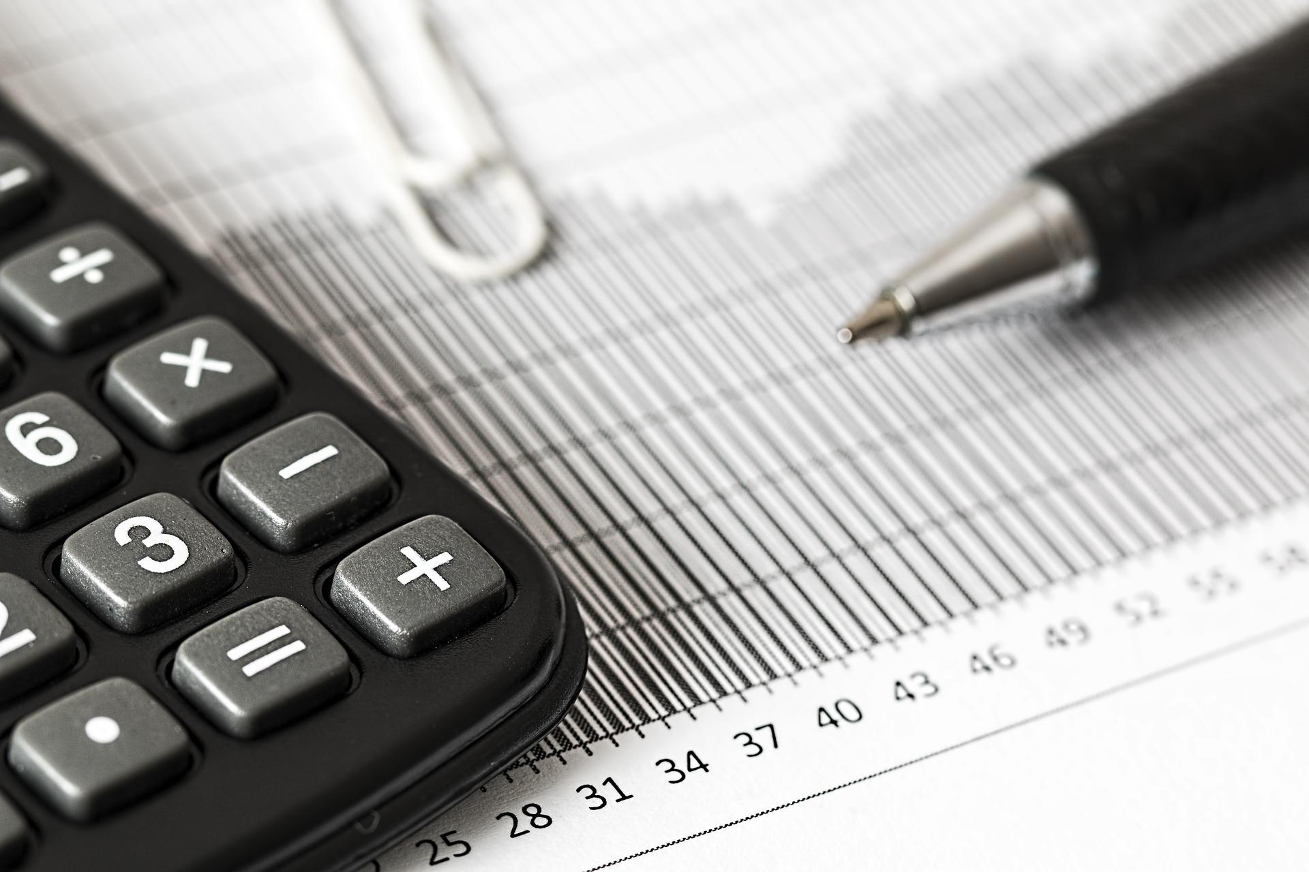
God calls men to an accounting for their lives

Slide 22
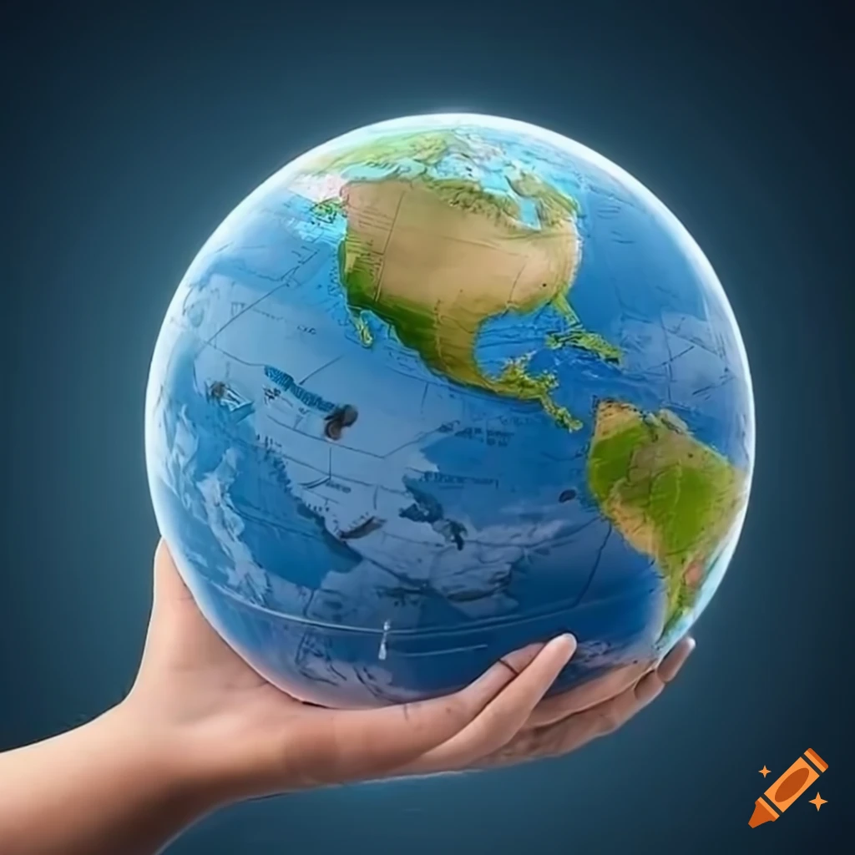
For since the creation of the world His invisible attributes are clearly seen, being understood by the things that are made, even His eternal power and Godhead, so that they are without excuse,
Romans 1:20

Slide 23


God has given to man
The environment around him enough information that he may follow that path to the knowledge of God.
The intellectual capability to understand, reason, and see the truth.
The revealed Word, the Holy Spirit.
To follow that perception to the full understanding of who He is and what He wants.
Periodically calls men to such accounting.

Slide 24

And when He has come, He will convict the world of sin, and of righteousness, and of judgment:
John 16:8,

Slide 25

Has then what is good become death to me? Certainly not! But sin, that it might appear sin, was producing death in me through what is good, so that sin through the commandment might become exceedingly sinful.
Romans 7:13

Slide 26
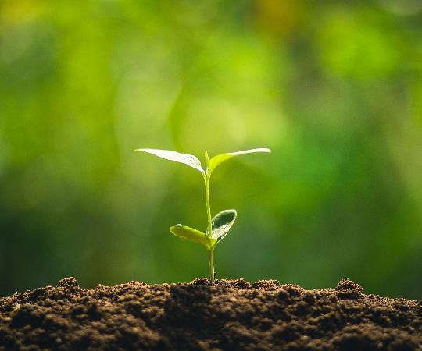
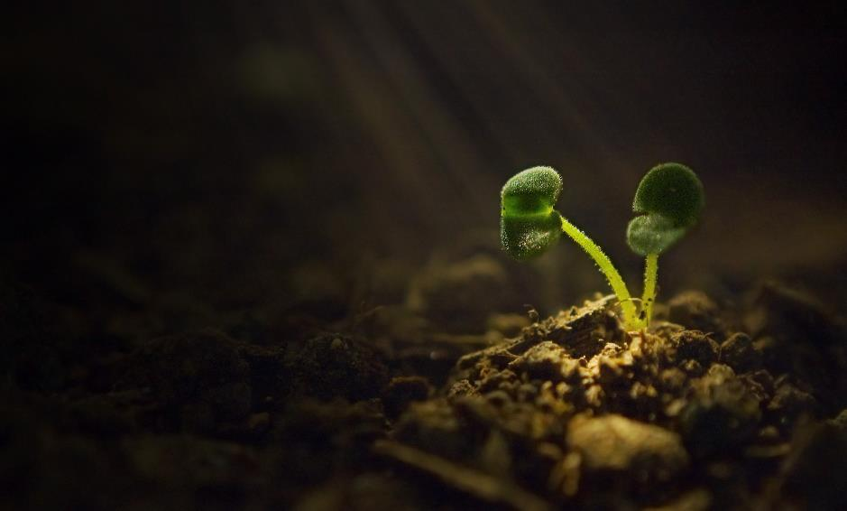
The Rich Young Ruler
was confronted by Jesus
Christ. He, too, thought
that sin was only an
external issue of
what you do or
don’t do.

Slide 27
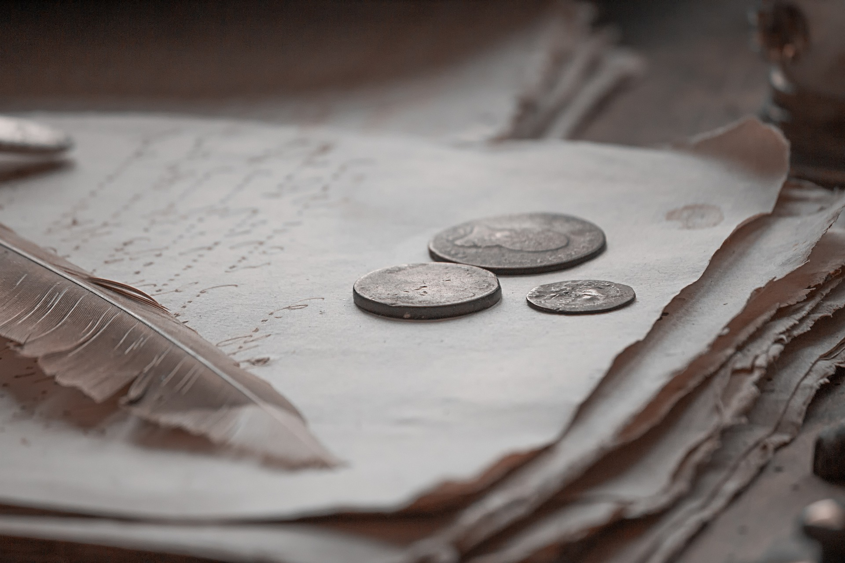
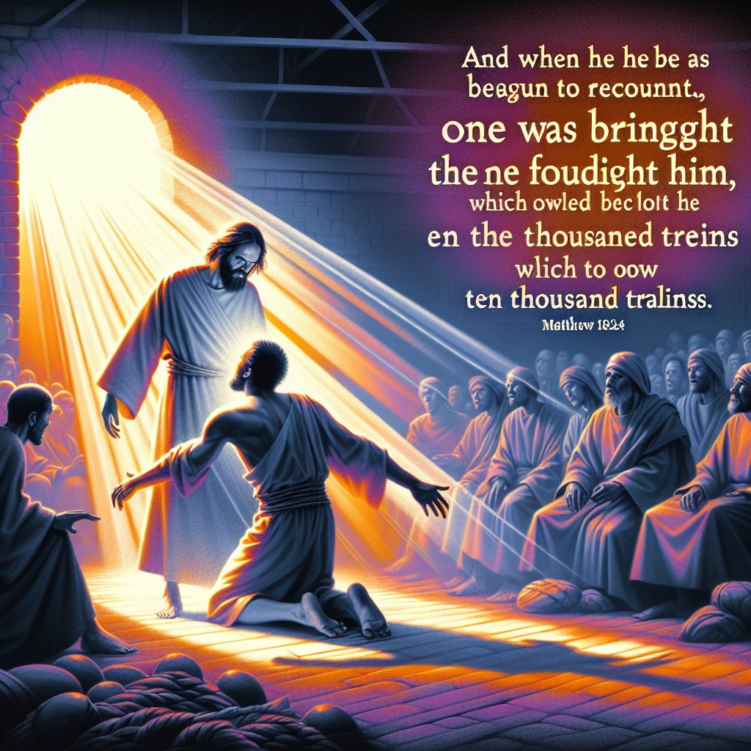
And when he had begun to settle accounts, one was brought to him who owed him ten thousand talents.
Matthew 18: 24

Slide 28
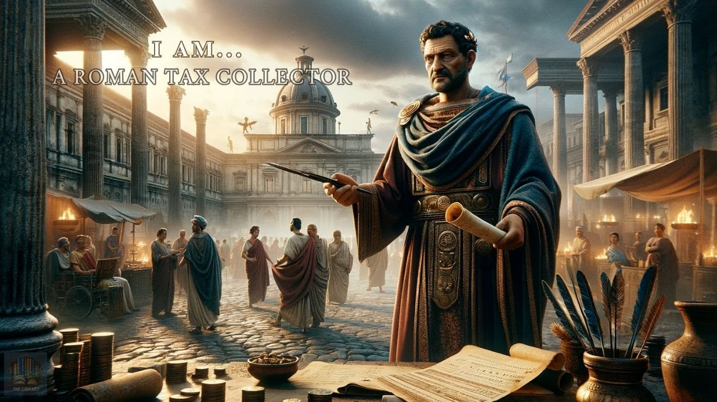
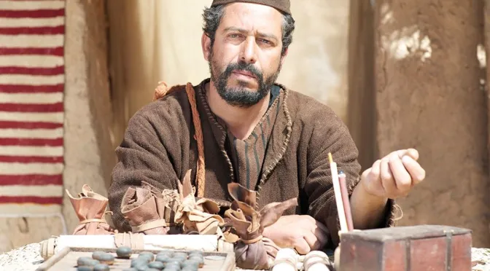
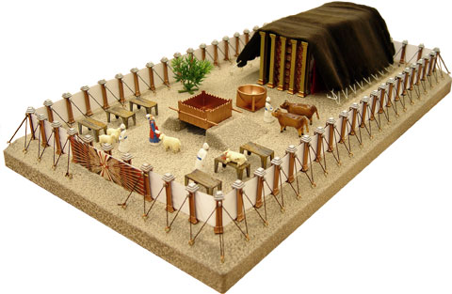
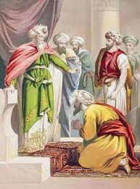
Comparison at the time around the life of Jesus.
Talents
600
300
29
10,000
Revenue collected by the Roman government from Idumea, Judea and Samaria
revenue collected from Galilee
All precious gold that overlaid all those factors in the tabernacle
is an astronomical figure.

Slide 29
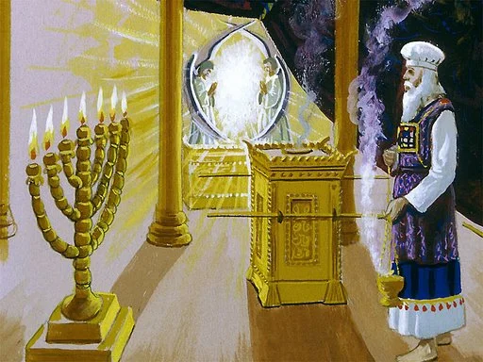
All the gold that was used in all the work of the holy place, that is, the gold of the offering, was twenty-nine talents and seven hundred and thirty shekels, according to the shekel of the sanctuary.
Exodus 38:24
29 talents.

Slide 30
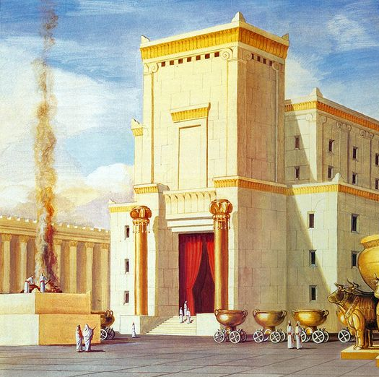
three thousand talents of gold, of the gold of Ophir, and seven thousand talents of refined silver, to overlay the walls of the houses;
1 Chronicles 29:4
3,000 talents.

Slide 31
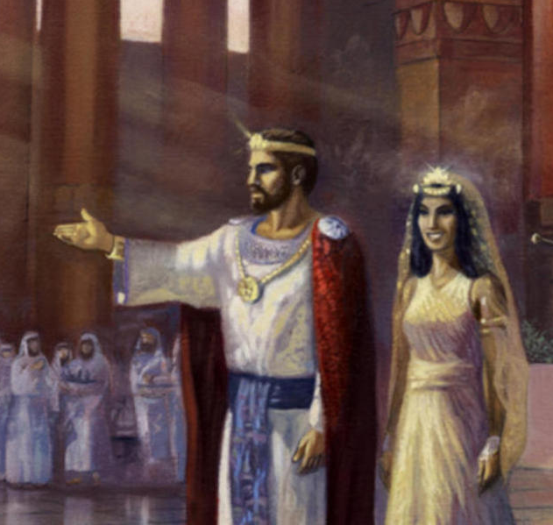
Then she gave the king one hundred and twenty talents of gold, spices in great quantity, and precious stones. There never again came such abundance of spices as the queen of Sheba gave to King Solomon.
1 Kings 10:10
120 talents.

Slide 32
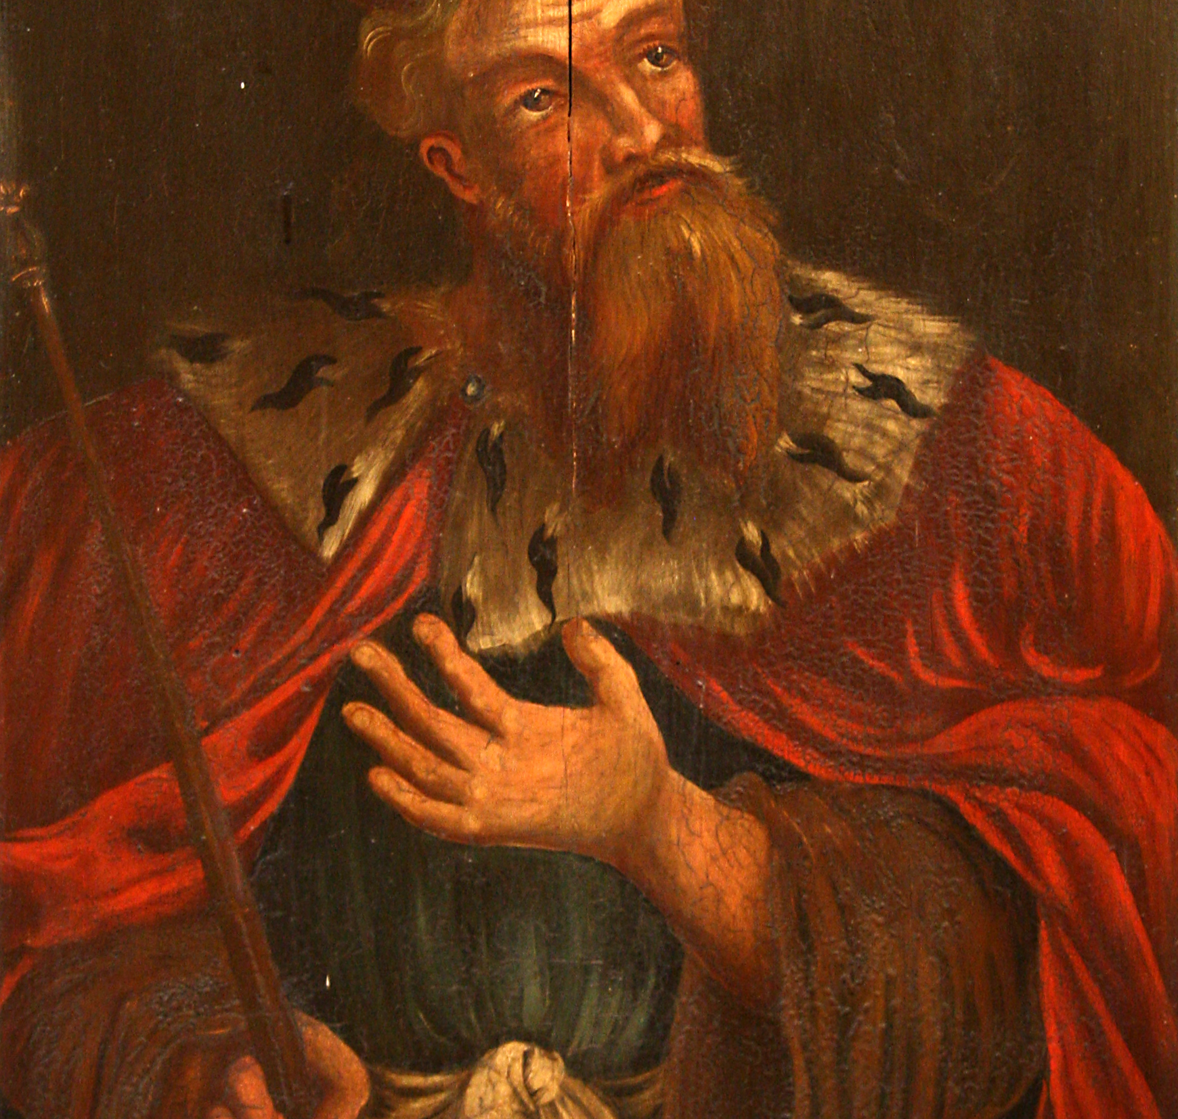
Then Hezekiah king of Judah sent to the king of Assyria at Lachish, saying, “I have done wrong; turn away from me; whatever you impose on me I will pay.” And the king of Assyria assessed Hezekiah king of Judah three hundred talents of silver and thirty talents of gold.
2 Kings 18:14
30 talents.

Slide 33
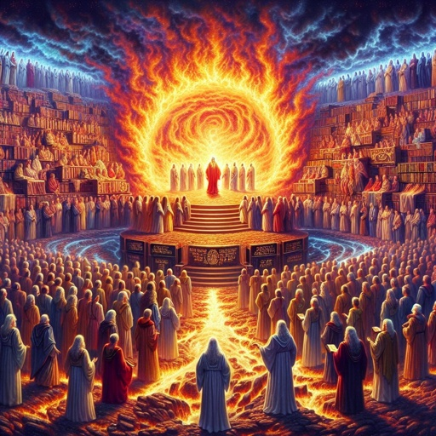
A fiery stream issued And came forth from before Him. A thousand thousands ministered to Him; Ten thousand times ten thousand stood before Him. The court was seated, And the books were opened.
Daniel 7:10

Slide 34
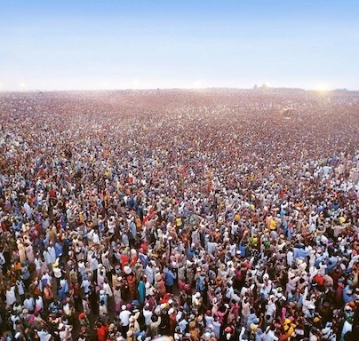
Then I looked, and I heard the voice of many angels around the throne, the living creatures, and the elders; and the number of them was ten thousand times ten thousand, and thousands of thousands,
Revelation 5:11

Slide 35
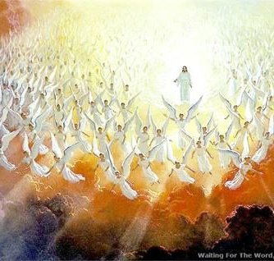
Muriōn
“ten thousand times ten thousand,”

Slide 36

I saw the utter sinfulness of sin. Or the exceeding sinfulness of sin.
Romans 7:13

Slide 37
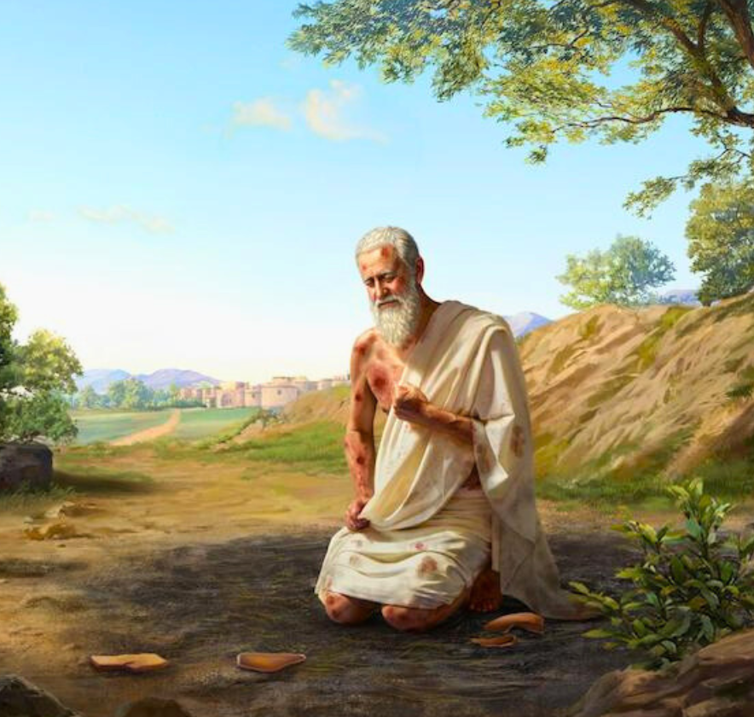
Therefore I abhor myself, And repent in dust and ashes.”
Job 42:6

Slide 38
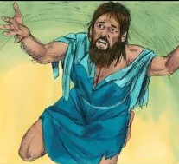
And I said: “O my God, I am too ashamed and humiliated to lift up my face to You, my God; for our iniquities have risen higher than our heads, and our guilt has grown up to the heavens.
Ezra 9:6

Slide 39
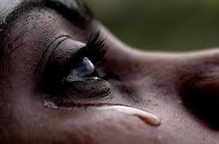
For Your name’s sake, O LORD, Pardon my iniquity, for it is great.
Psalms 25:11

Slide 40
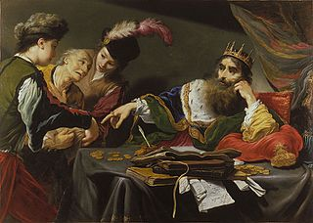
And since he could not pay, his master ordered him to be sold, with his wife and children and all that he had, and payment to be made.
Matthew 18: 25

Slide 41
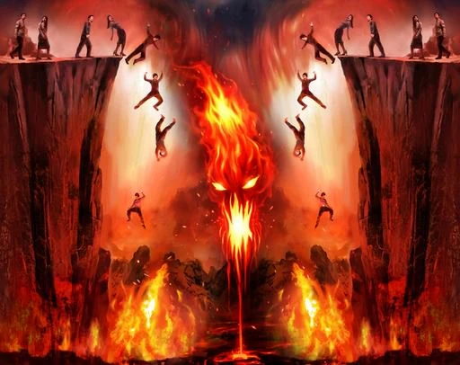
Where do people go as punishment for the debt they owe to God?
HELL

Slide 42
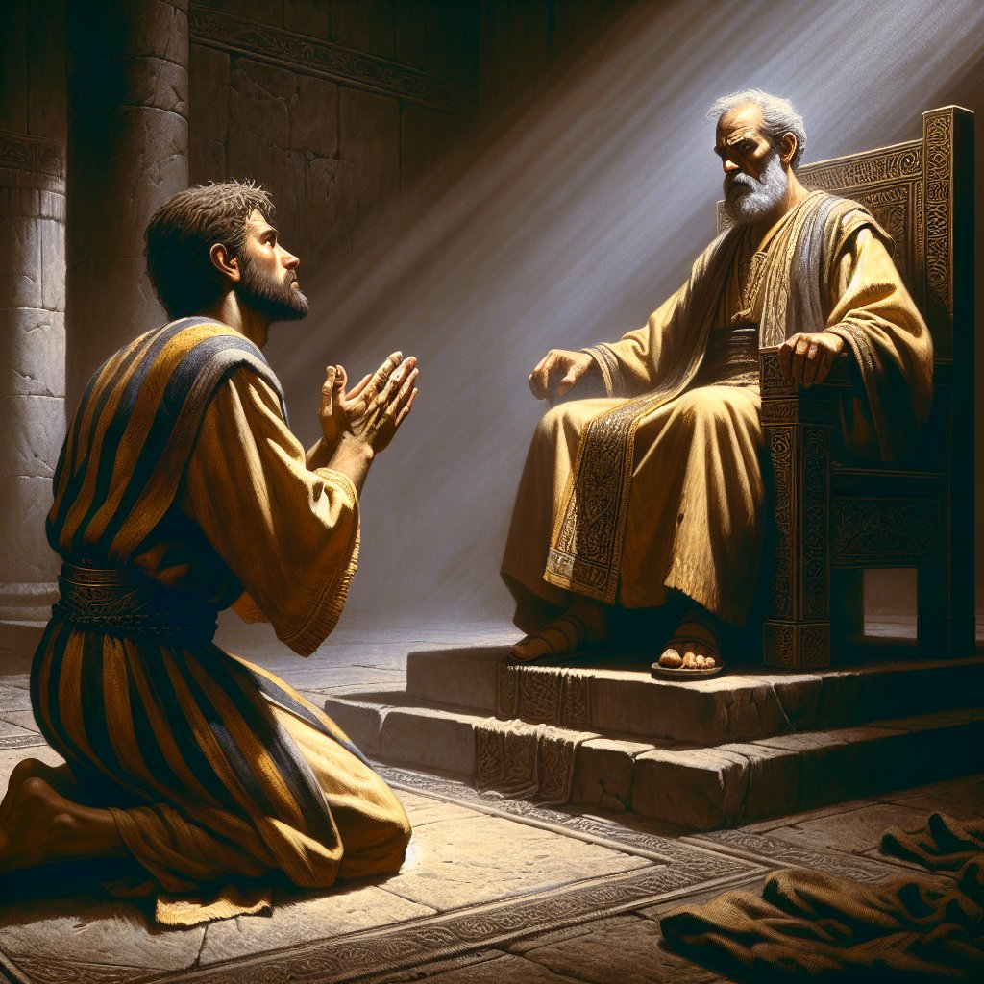
The servant therefore fell down before him, saying, ‘Master, have patience with me, and I will pay you all.’
Matthew 18: 26

Slide 43
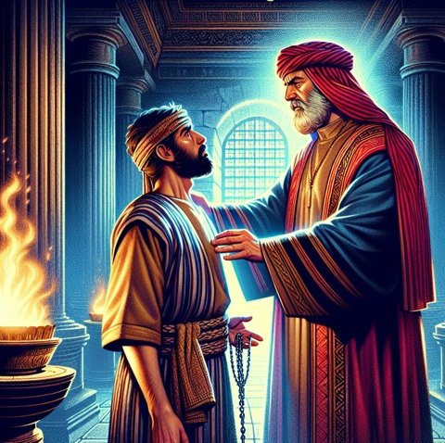
Then the master of that servant was moved with compassion, released him, and forgave him the debt.
Matthew 18: 27
Grace!

Slide 44

The moment………..
- he confesses that sin,
- he repents that sin,
- worships the God who alone can forgive that sin
God rushes in with the forgiveness

Slide 45
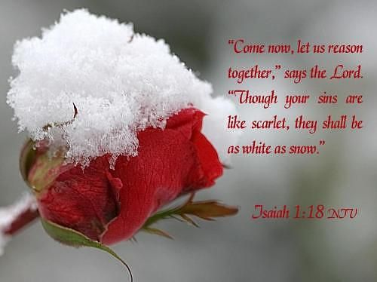
“Come now, and let us reason together,” Says the Lord, “Though your sins are like scarlet, They shall be as white as snow; Though they are red like crimson, They shall be as wool.
Isaiah 1:18

Slide 46
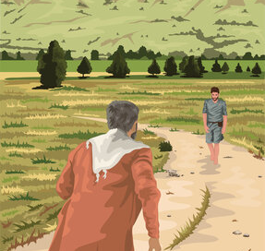
“But when he came to himself, he said, ‘How many of my father’s hired servants have bread enough and to spare, and I perish with hunger! 18 I will arise and go to my father, and will say to him, “Father, I have sinned against heaven and before you, 19 and I am no longer worthy to be called your son. Make me like one of your hired servants.” ’ 20 “And he arose and came to his father. But when he was still a great way off, his father saw him and had compassion, and ran and fell on his neck and kissed him. 21 And the son said to him, ‘Father, I have sinned against heaven and in your sight, and am no longer worthy to be called your son.’
Luke 15:17-24

Slide 47
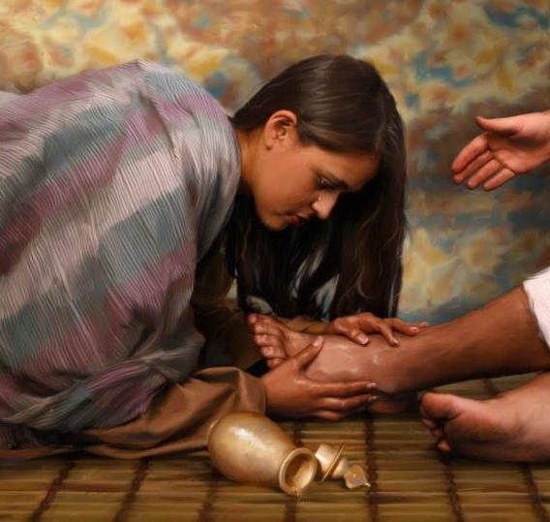
Then He turned to the woman and said to Simon, “Do you see this woman? I entered your house; you gave Me no water for My feet, but she has washed My feet with her tears and wiped them with the hair of her head. 45 You gave Me no kiss, but this woman has not ceased to kiss My feet since the time I came in. 46 You did not anoint My head with oil, but this woman has anointed My feet with fragrant oil. 47 Therefore I say to you, her sins, which are many, are forgiven, for she loved much. But to whom little is forgiven, the same loves little.” 48 Then He said to her, “Your sins are forgiven.”
Luke 7:44-48

Slide 48

Could you receive the gift of forgiveness in Jesus Christ

