Slide 1

MAY 26TH
S u n d a y

Slide 2



Matthew 18:28-35
Forgiving like the Children in the Kingdom
Forgive all!

Slide 3
Matthew 16 -Jesus said I will build My Church.
Matthew 18 -Jesus shows how to live in that Church as a Kingdom.
Matthew 28 -Jesus tells the What the Church should do.
Matthew 18 -becomes the cornerstone for the church.

Slide 4
Matthew 18:1-5, Entering the Church.
Matthew 18:6-9, Caring in the Church.
Matthew 18:10-14, Protecting in the Church.
Matthew 18:15-20, Discipling in the Church.
Matthew 18:21-35, Forgiving in the Church.

Slide 5
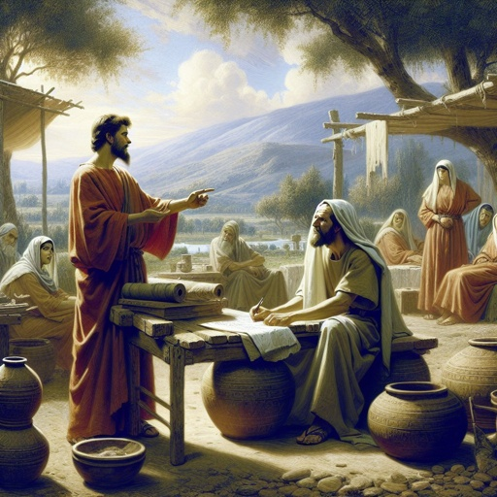
Matthew18:21-32

Slide 6
Ephesians 4:32,
‘’And be kind to one another, tender hearted, forgiving one another, even as God in Christ forgave you.’’

Slide 7



Slide 8
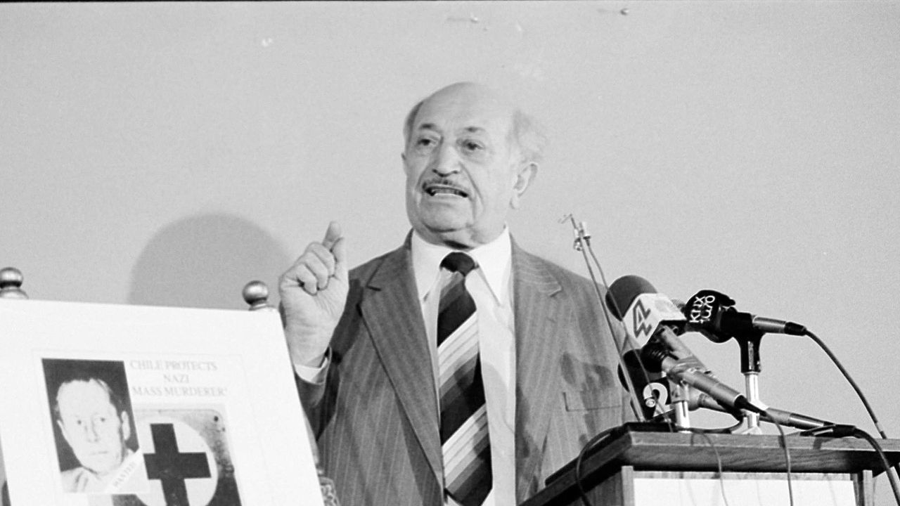

Slide 9
No word was spoken.
No forgiveness was given.

Slide 10
Matthew 18:21
Peter says, “How often shall my brother sin against me and I forgive him?”

Slide 11


Slide 12
Matthew 18:22
The Lord says 490 times, unlimited, endless, and continuous.

Slide 13
Matthew 6:12-15
‘’Where the Lord says that if you don’t forgive each other, He won’t forgive you.’’

Slide 14
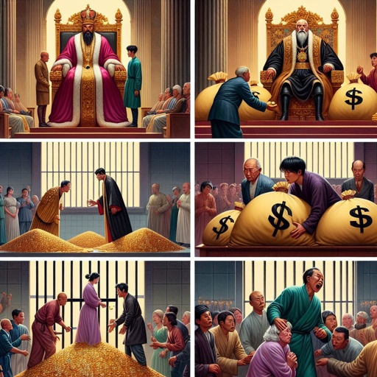
Matthew 18:23

Slide 15
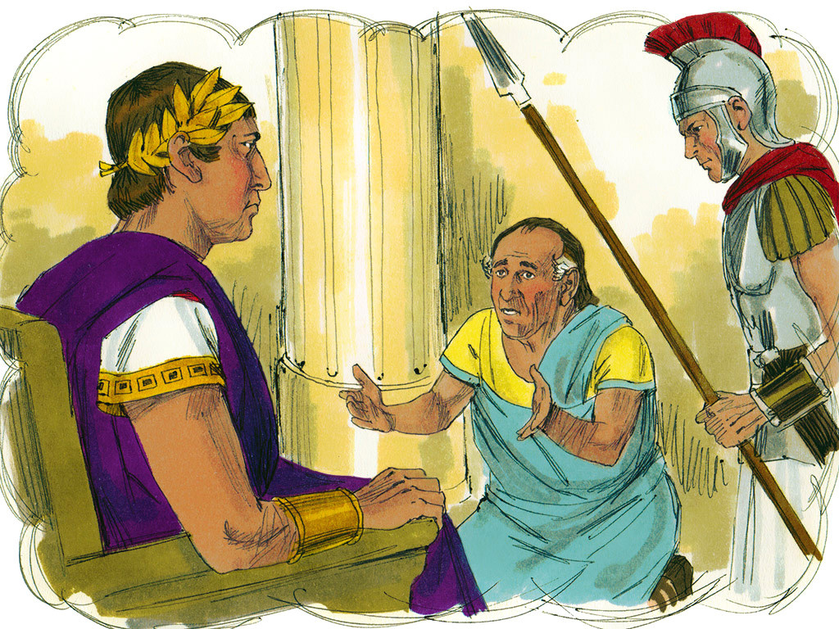
Matthew 18:24

Slide 16
Matthew 18:25

Slide 17
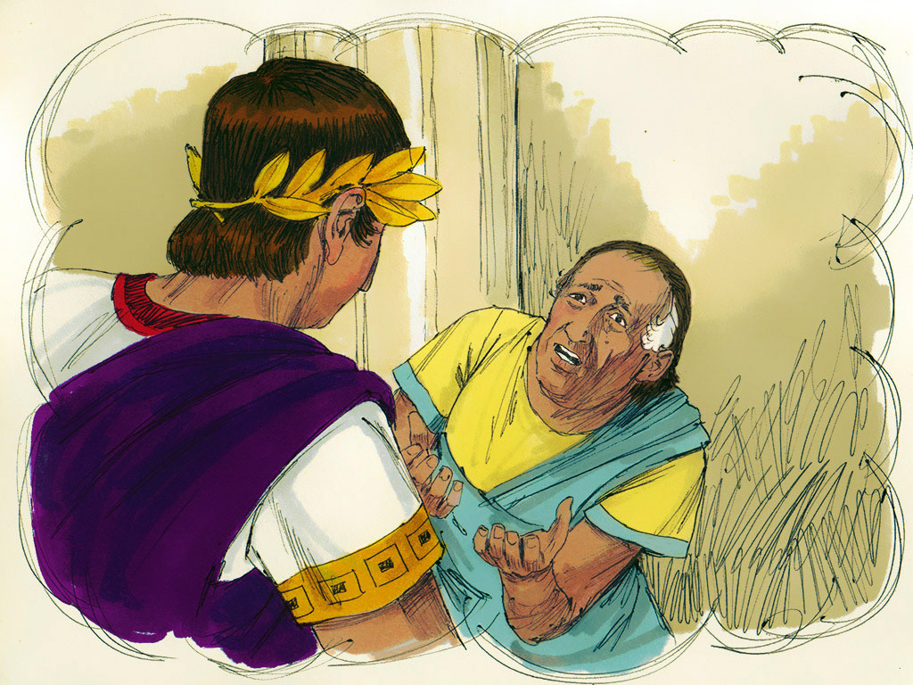
Matthew 18:26

Slide 18
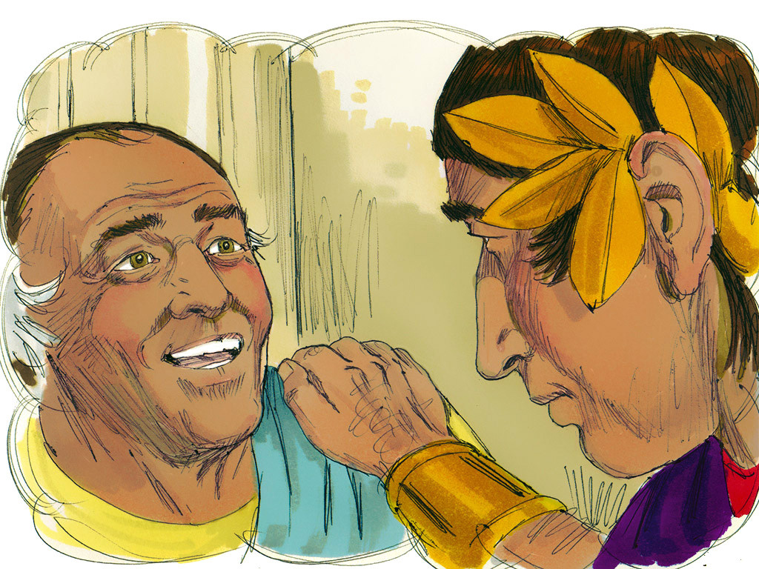
Matthew 18:27

Slide 19
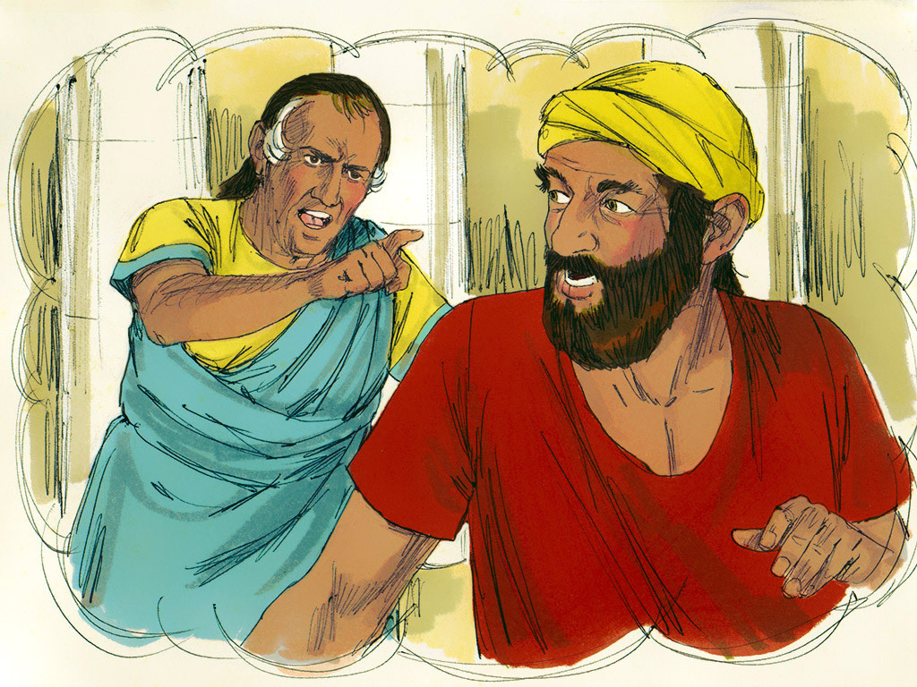
Matthew 18:28

Slide 20
How soon did he forget what he had been forgiven?
How soon did he forget his Lord’s compassion?

Slide 21
SUNDOULON
“Fellow Servant.”

Slide 22
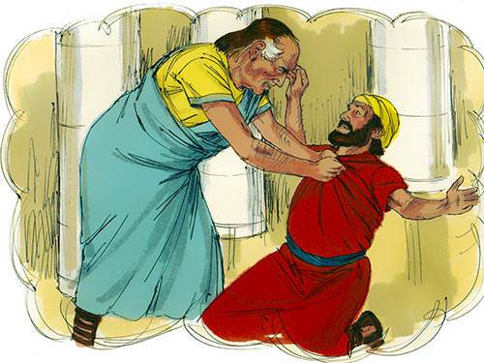
‘’ he went about choking him and saying pay me what you owe me.”

Slide 23
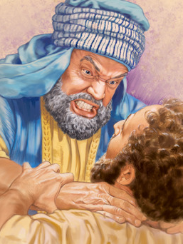
*Do you have anybody that owes you money?
*Do you think of them?
*Can you think of them?
*How many times have you choked on them in your mind?

Slide 24
1 Corinthians 6,
Where the Christians were suing each other.

Slide 25
Matthew 18:29

Slide 26
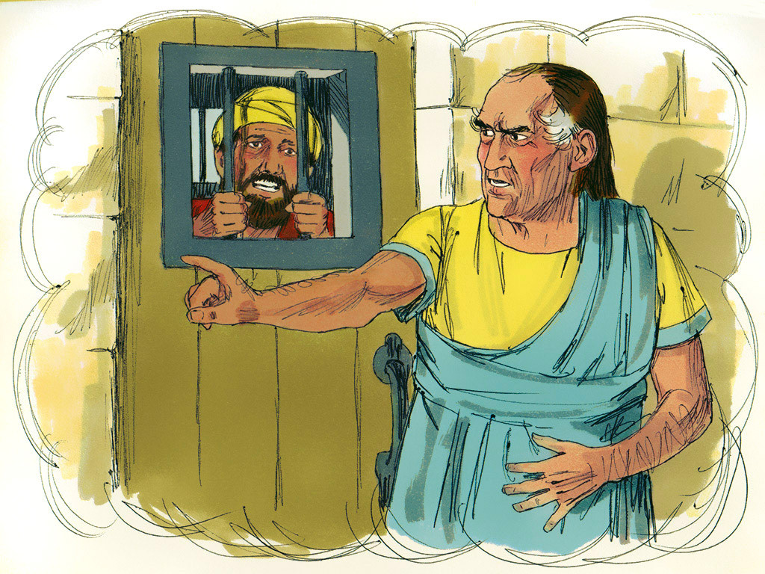
Matthew 18:30

Slide 27
Himself pitied.
He should have pitied.
Himself forgiven.
He should have forgiven.

Slide 28
Titus 3:2-6,
But when the kindness and the love of God our Savior toward man appeared,

Slide 29
Matthew 5:7
“Blessed are the merciful for they shall obtain mercy.”

Slide 30
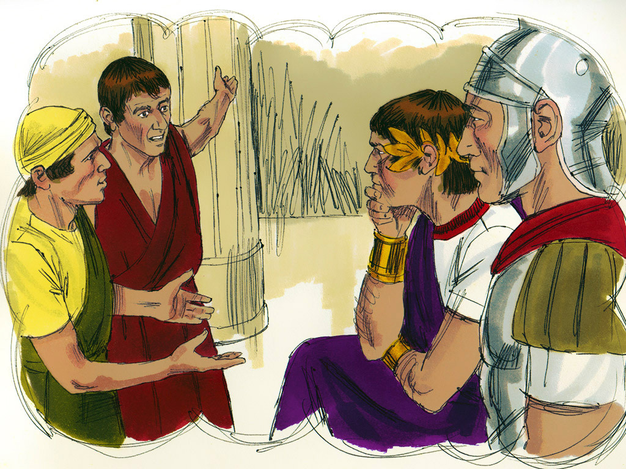
Matthew 18:31

Slide 31
“sorry.”
SPHODRA
“excessively grieved, violently grieved.”

Slide 32
“Came and told their Lord.”

Slide 33
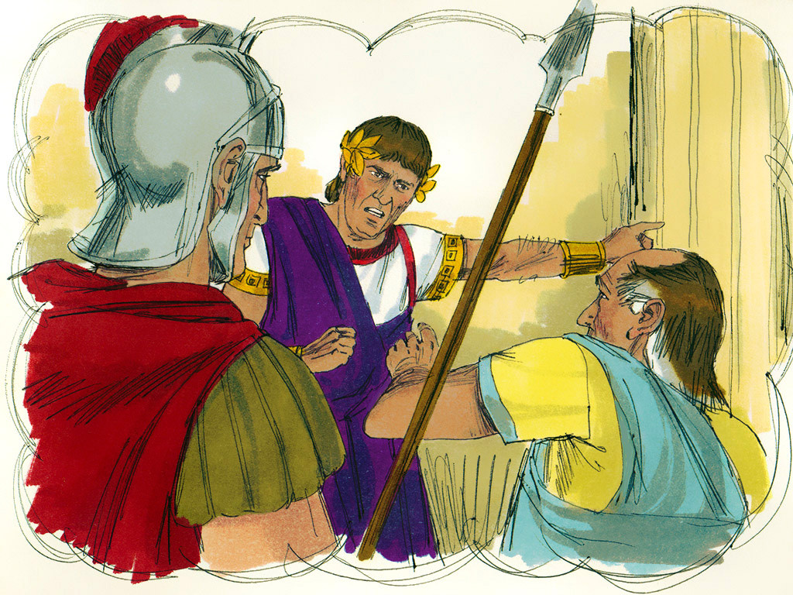
Matthew 18:32

Slide 34
What is God’s attitude?
You wicked servant.
Can this be a Christian?
God would never say that to a Christian. Is it?
What is wickedness?
Sin.
Do Christians sin?
One sin is constituted wickedness.

Slide 35
“You wicked servant I forgave you all that debt.”

Slide 36
“Because you begged me.”

Slide 37
Matthew 18:33
Should you not also have had compassion on your fellow servant, just as I had pity on you?’

Slide 38
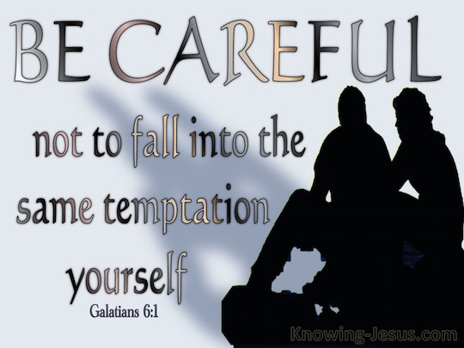
Galatians 6:1,

Slide 39
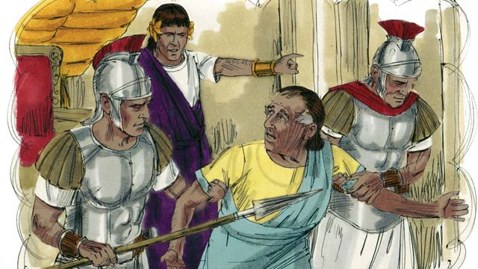
Matthew 18:34

Slide 40
What makes God angry?
Sin makes God angry.

Slide 41
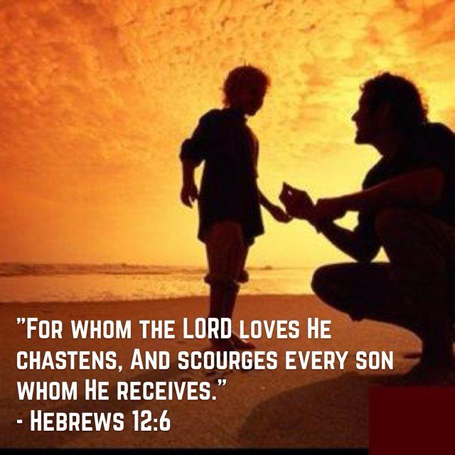
Hebrews 12:5-6,

Slide 42
Hebrews 12:7,8
But if you are without chastening, of which all have become partakers, then you are illegitimate and not sons.

Slide 43
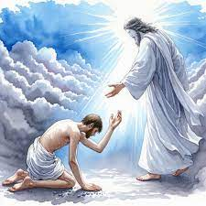
Matthew 18:35

Slide 44
Two things stand out in this parable.
Positive:
We ought to forgive because we have been forgiven so much.
Negative:
We ought to forgive, because if we don’t, we are going to be chastened.

Slide 45
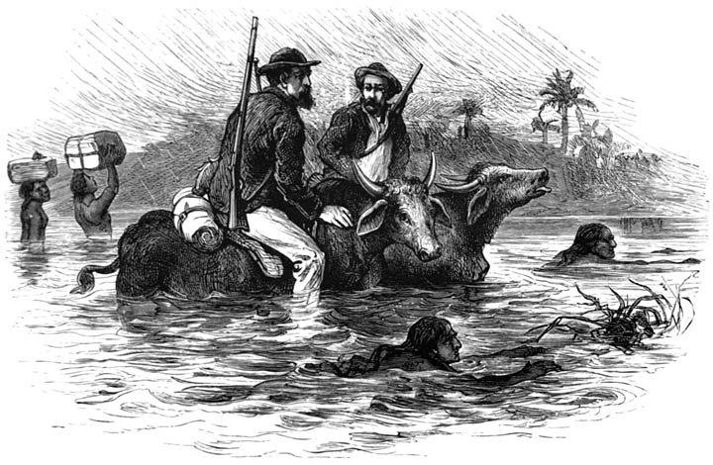

Slide 46
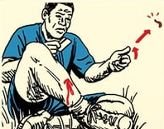

Slide 47
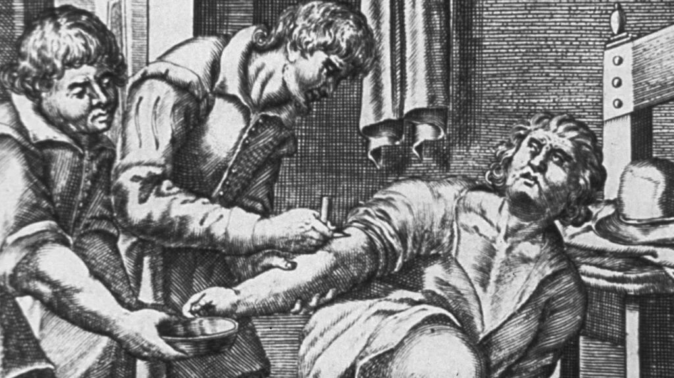

Slide 48
Each unforgiven injury rankling in the heart is like a leech sucking life’s blood.
William Arnot.

Slide 49
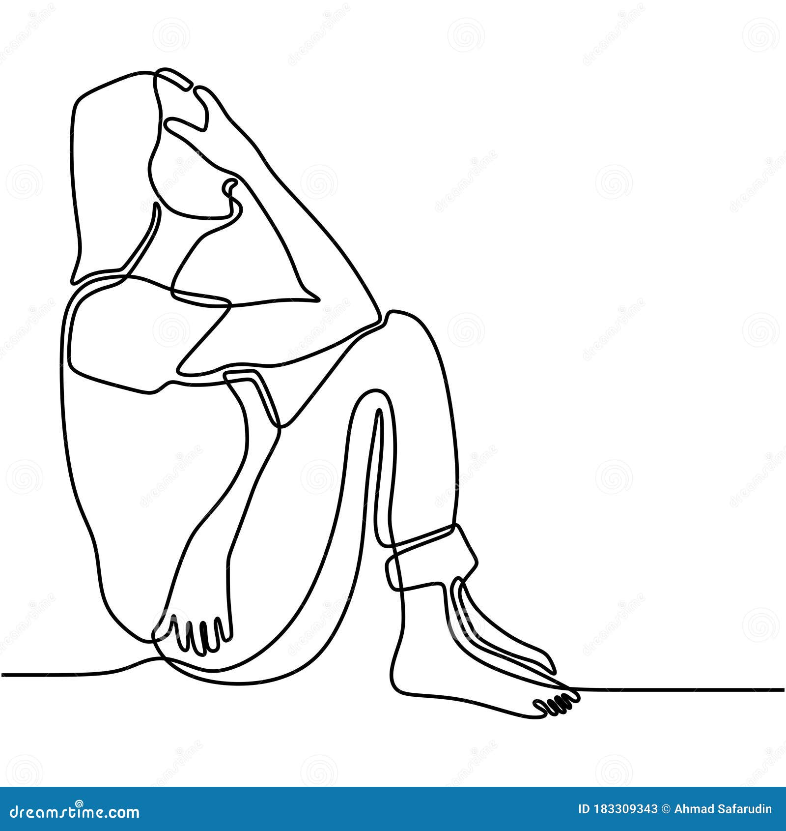
Three stages in forgiveness.
Suffering.

Slide 50
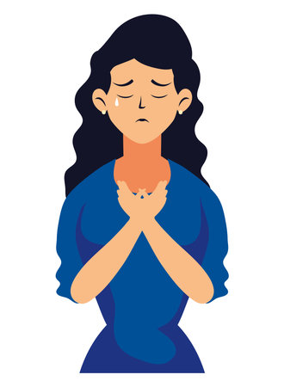
Three stages in forgiveness.
Surgery

Slide 51
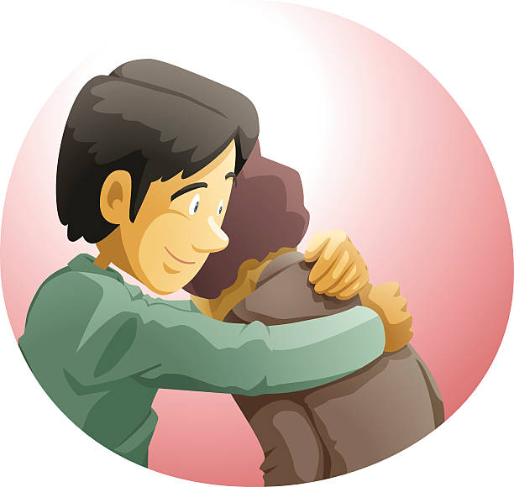
Three stages in forgiveness.
Starting over

Slide 52
That’s what our Lord is after.
o We are children in the family, beloved.
o We need to forgive each other, because we are just human.
o If we are a society of forgiving people, we will be so unlike the world.

Slide 53
CONCLUSION
Two incidents.
Two different responses.

Slide 54
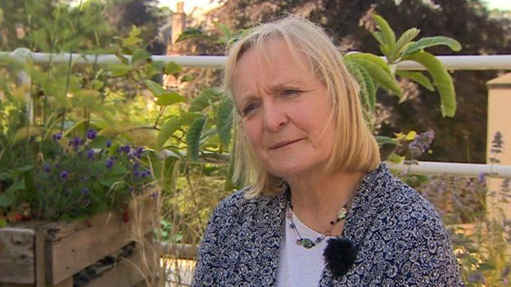
Rev Julie Nicholson. 7th July 2005.

Slide 55
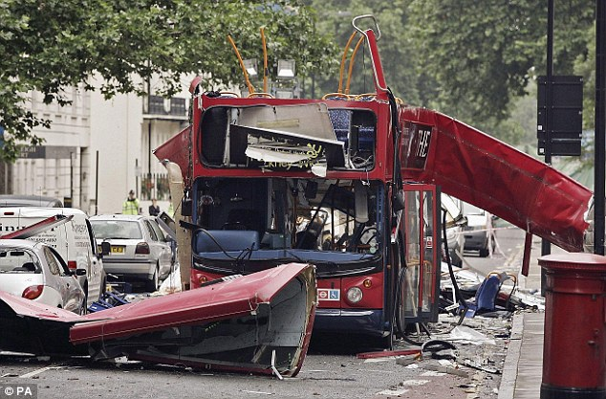

Slide 56
"It's very difficult for me to stand behind an altar and celebrate the Eucharist, the Communion, and lead people in words of peace and reconciliation and forgiveness when I feel very far from that myself."

Slide 57
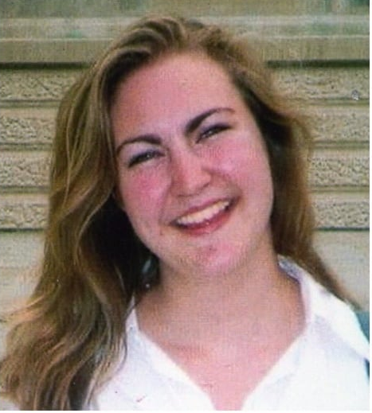
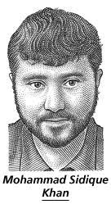
Jenny Nicholson

Slide 58
Mrs. Bristol and Michael Keys

Slide 59


Slide 60
Ask God if there’s unforgiveness in your heart.
If you want, ask forgiveness to anyone just go to the person and ask and reconcile now.

