Slide 1
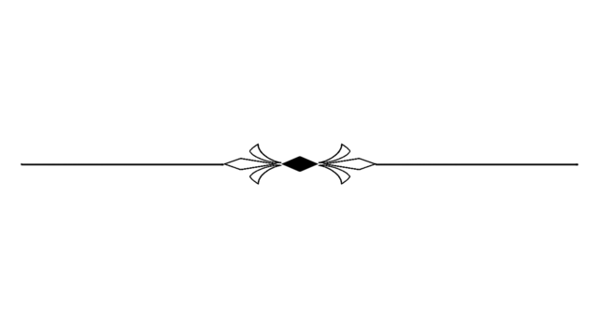
JUNE 30TH
S u n d a y

Slide 2



Matthew 19:13-15
Jesus and Infant Baptism!

Slide 3
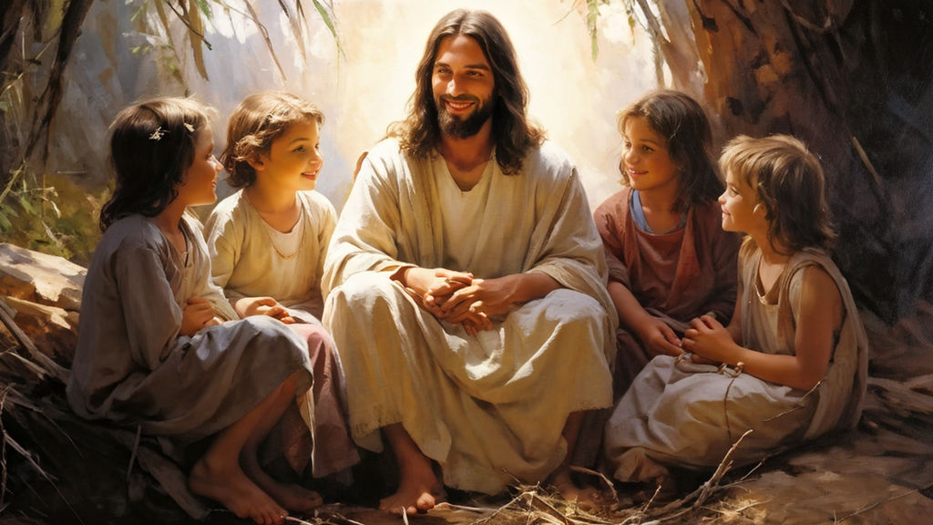
Matthew19:13-15

Slide 4
Ephesians 6:4
And you, fathers, do not provoke your children to wrath, but bring them up in the training and admonition of the Lord.

Slide 5
Confidence that you have brought your child to Jesus.
➢ If they die, you know where they are!
➢ If they live, you know to whom they belong!

Slide 6
Matthew19:13
Then little children were brought to Him that He might put His hands on them and pray, but the disciples rebuked them.

Slide 7
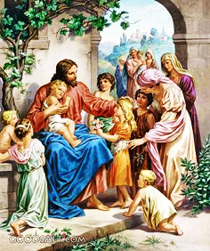
Mark 10:10,
In the house His disciples also asked Him again about the same matter.

Slide 8
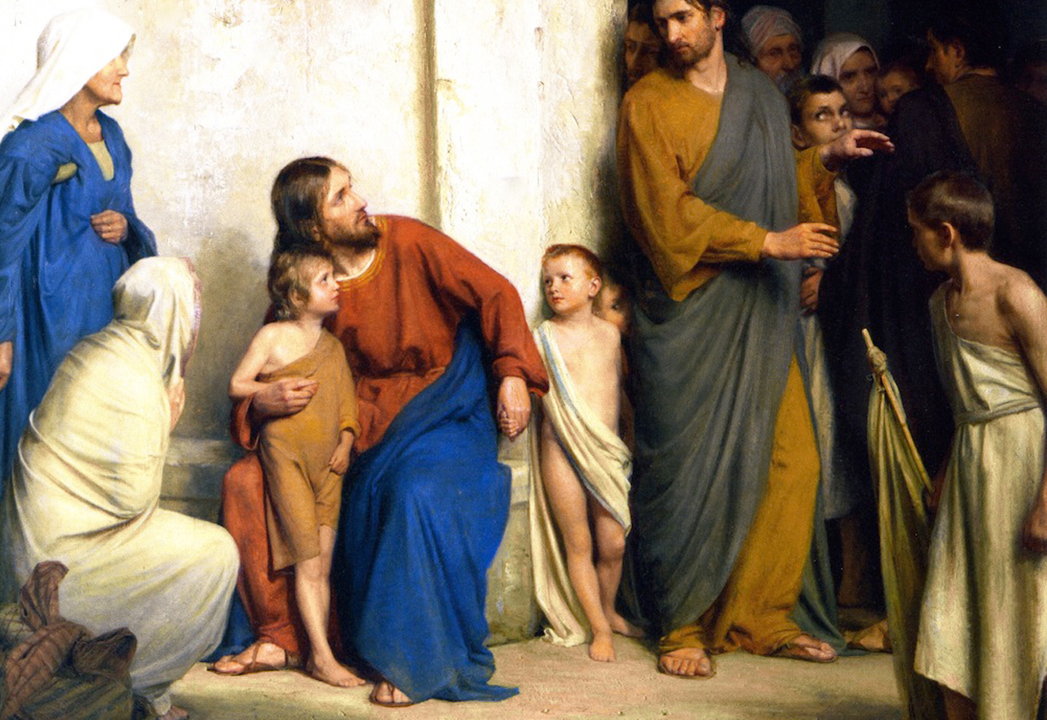
Matthew19:13
but the disciples rebuked them.

Slide 9
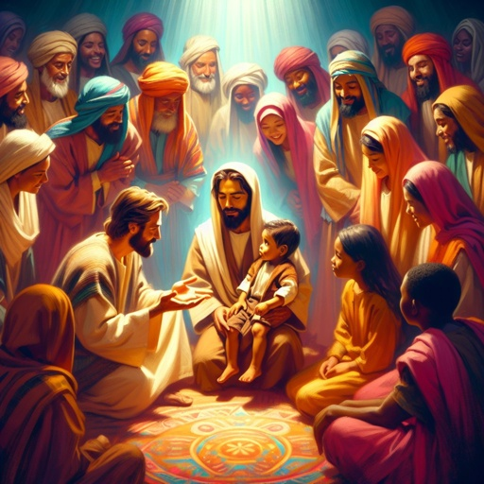
Matthew 18:2

Slide 10
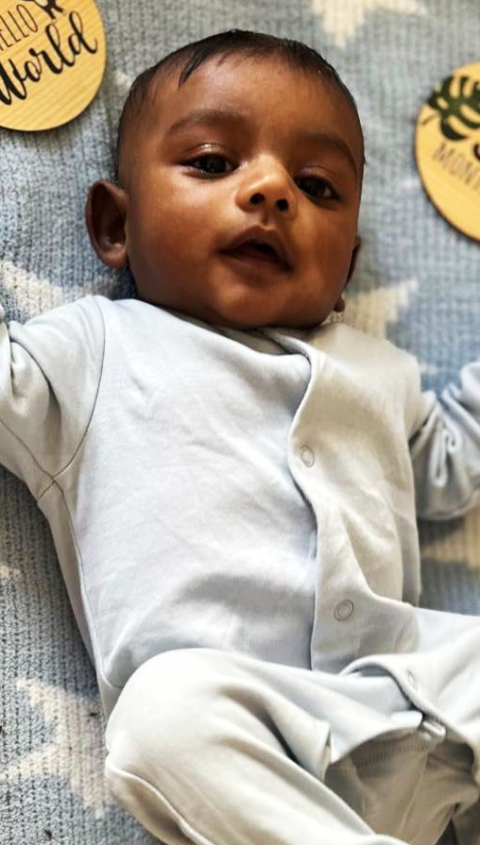
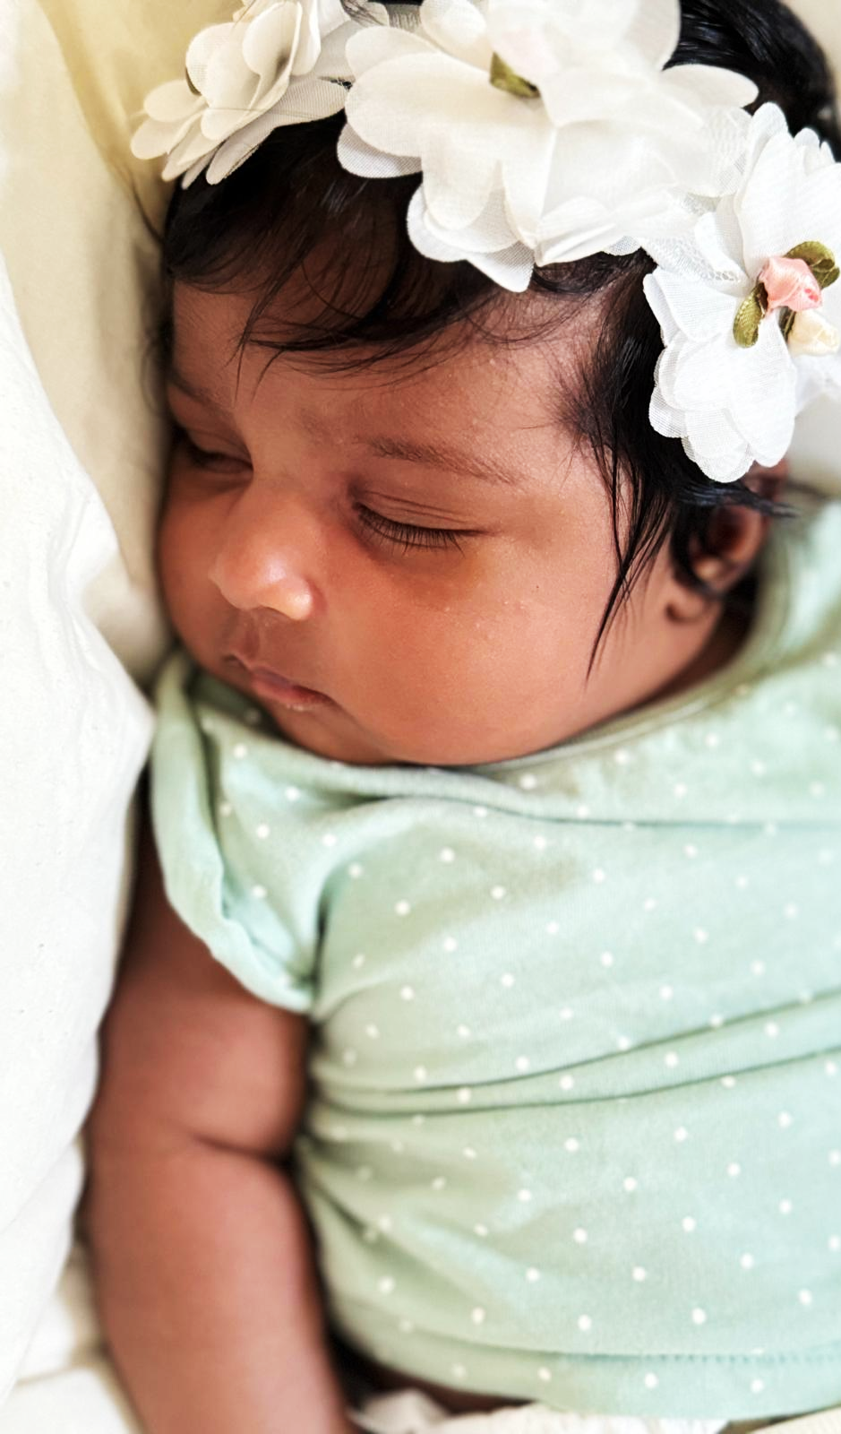
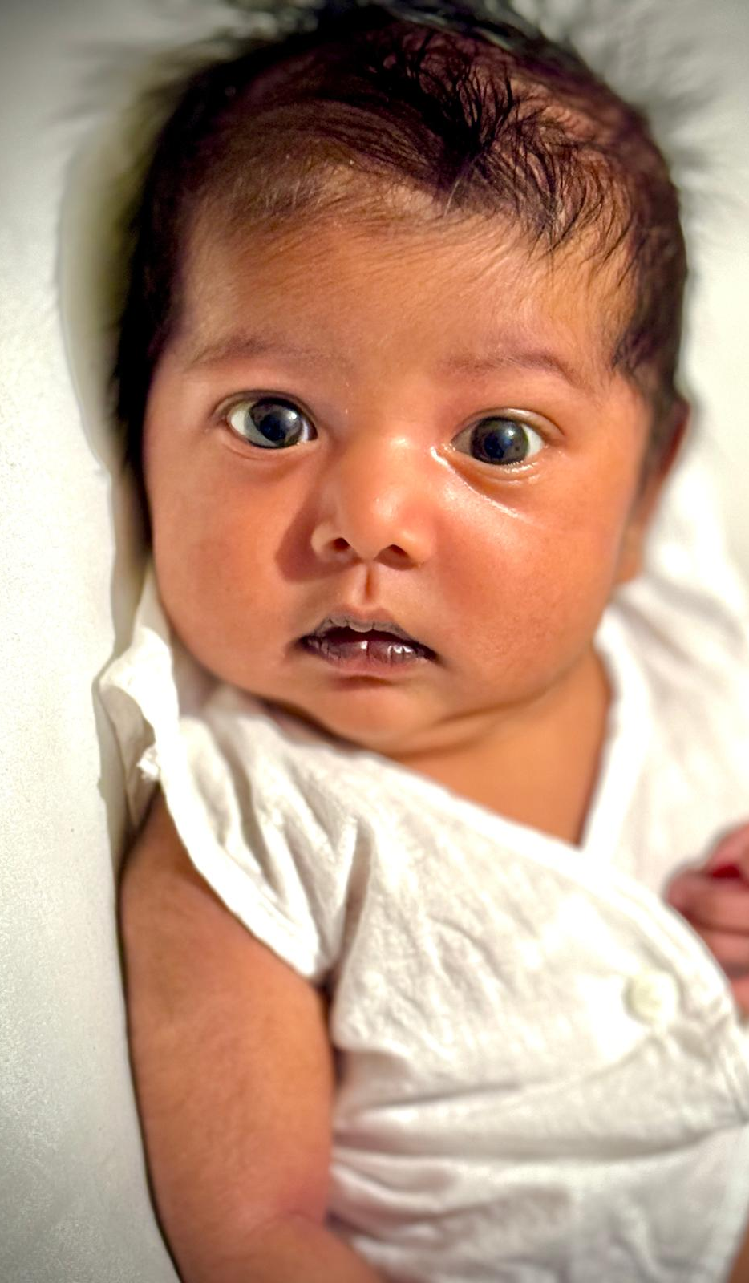
David Lewis Elliott
Zionna Susan
Priscilla Estel

Slide 11
Brephos
Infant', or 'baby', and is used of babies whether in the womb (unborn) or out of the womb (born).

Slide 12
Mark 10:16
And He took them up in His arms, laid His hands on them, and blessed them.

Slide 13
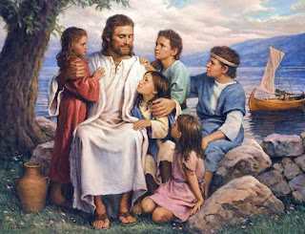

Slide 14
Sometimes Jesus was fearful.
Sometimes He was very threatening.
But sometimes He was very tender, and even children found comfort in His arms.

Slide 15
John 3:6
That which is born of the flesh is flesh, and that which is born of the Spirit is spirit.

Slide 16
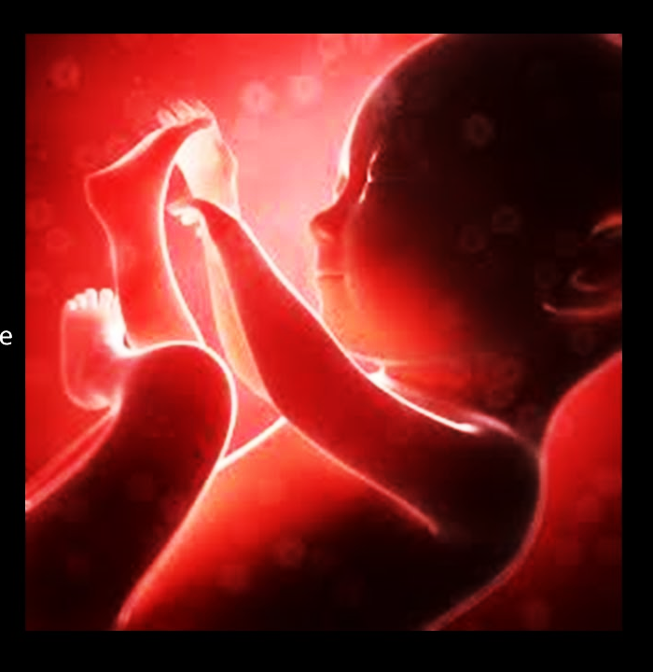
Psalm 51:5,
Behold, I was brought forth in iniquity, And in sin my mother conceived me.

Slide 17
There was no shallow sentimentalism about children.
There was no idea that children are righteous, or holy, or pure, or innocent, or undefiled.

Slide 18
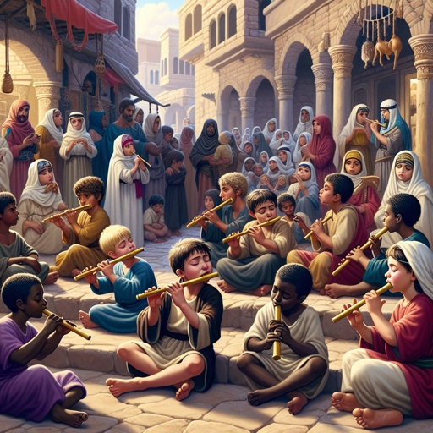
Matthew 11:16-17,

Slide 19
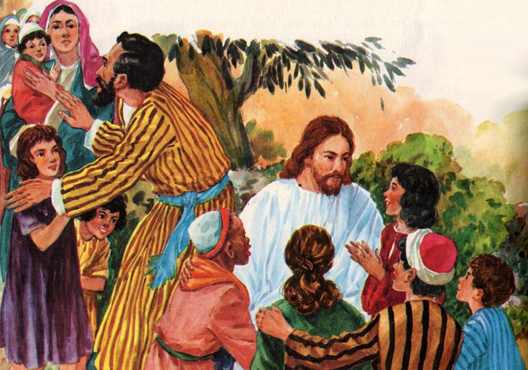
Matthew19:13
but the disciples rebuked them.

Slide 20
Matthew19:14
“Let the little children come to Me, and do not forbid them; for of such is the kingdom of heaven.”

Slide 21
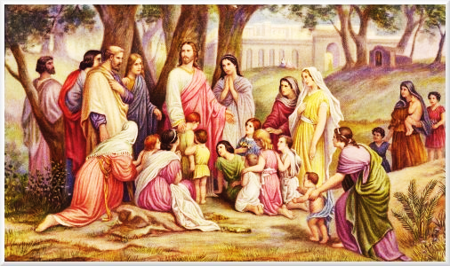
Mark 10:14,

Slide 22
Jesus uses the word indignant (KJV)
Feeling or showing anger or annoyance at what is perceived as unfair treatment.

Slide 23
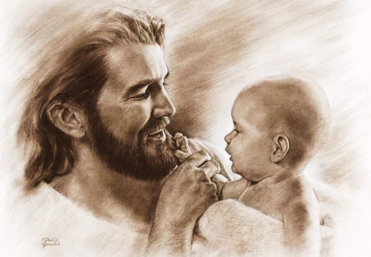
i) Jesus loved babies.

Slide 24
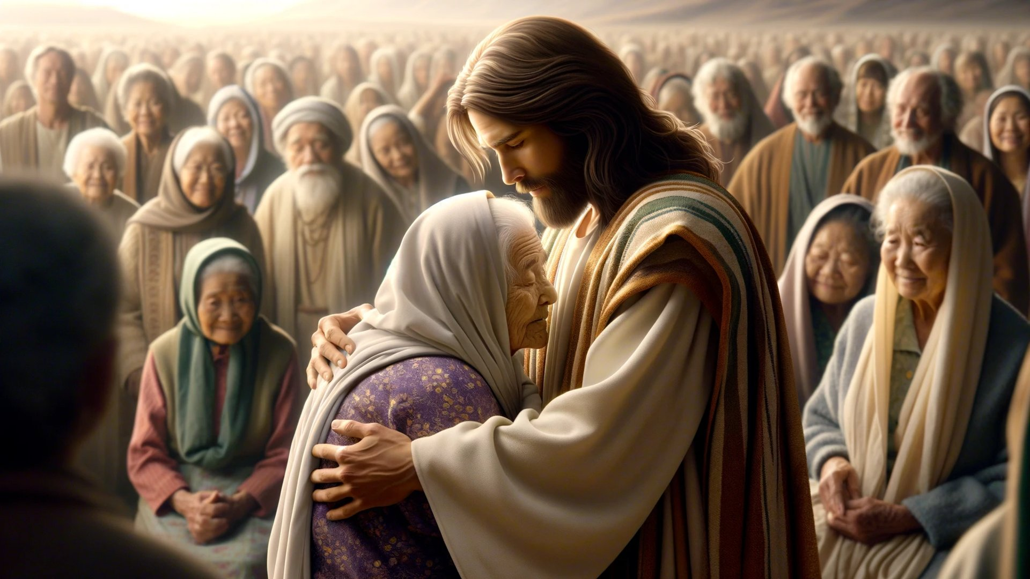
ii) Jesus also loved adults.

Slide 25
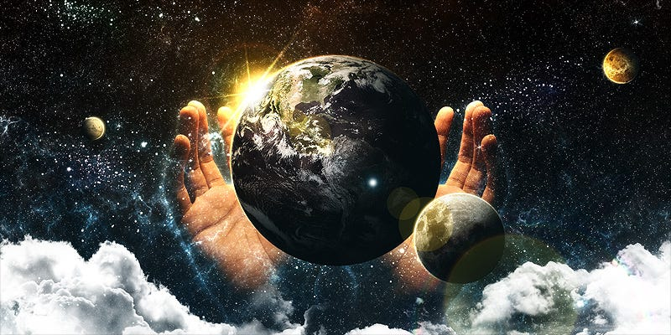
iii) No one is outside the care.

Slide 26
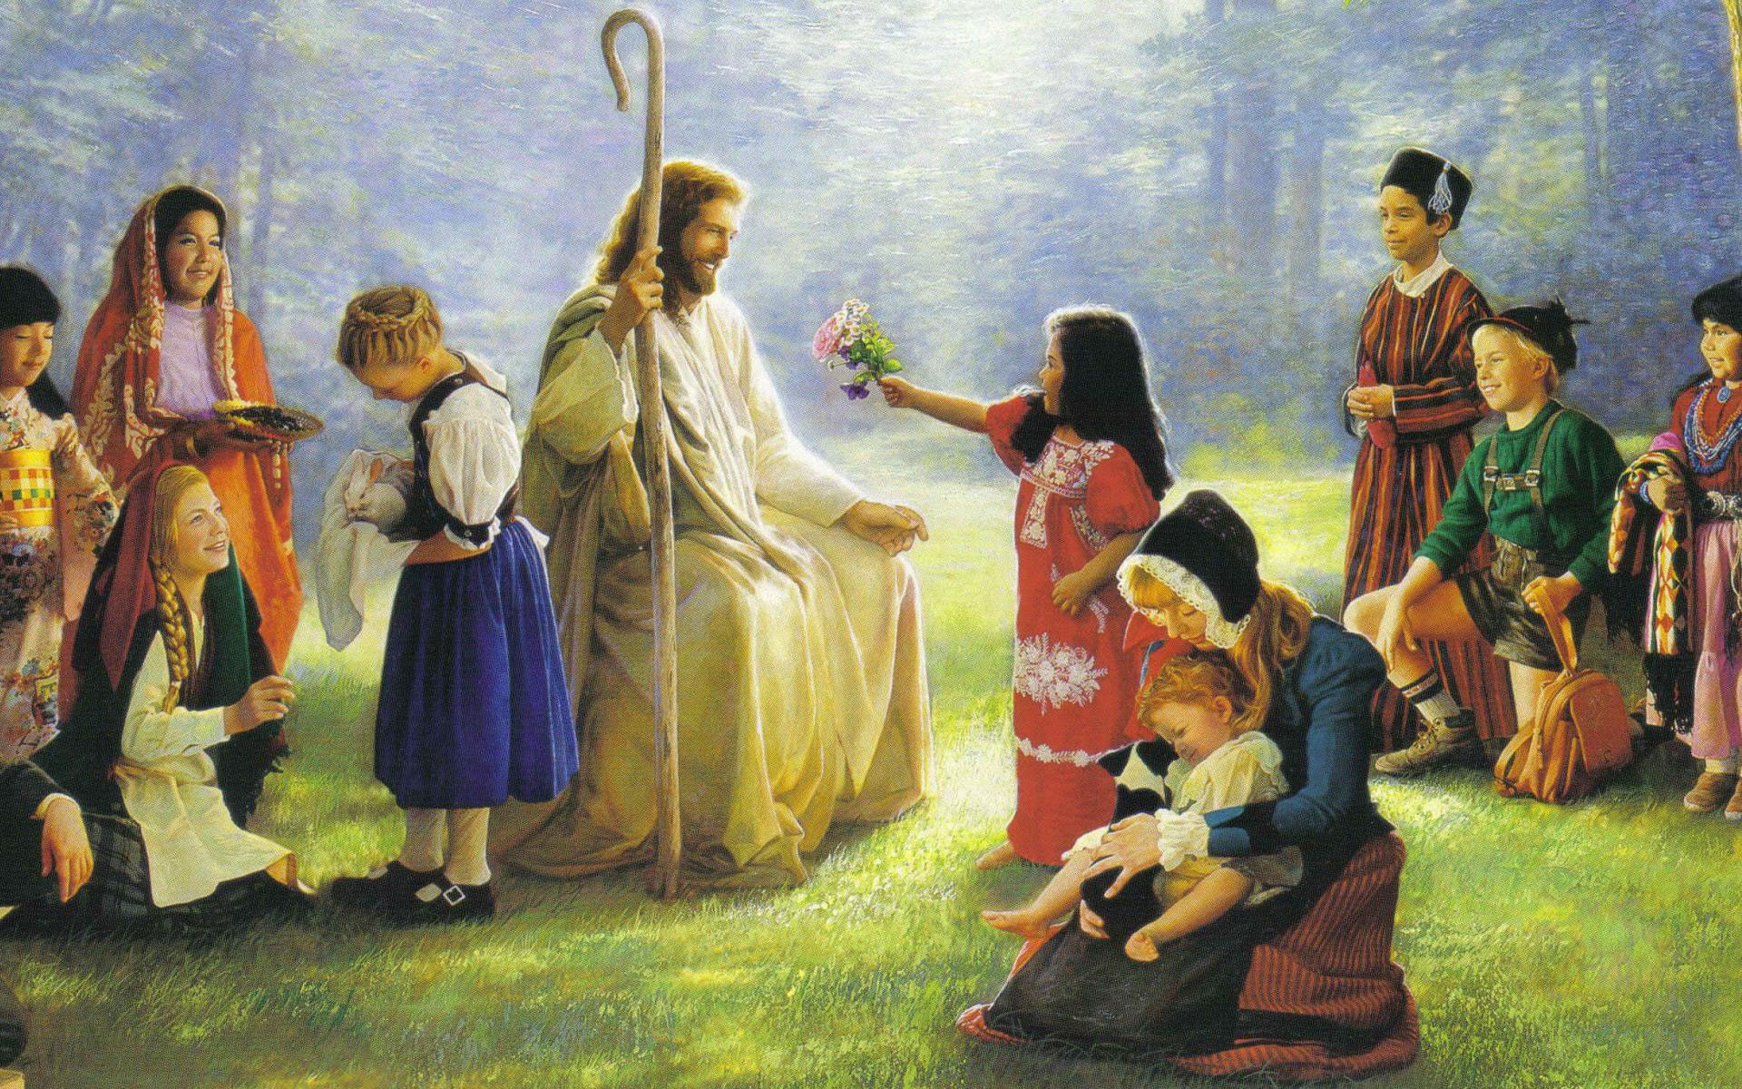
iv) They were used for illustration.

Slide 27
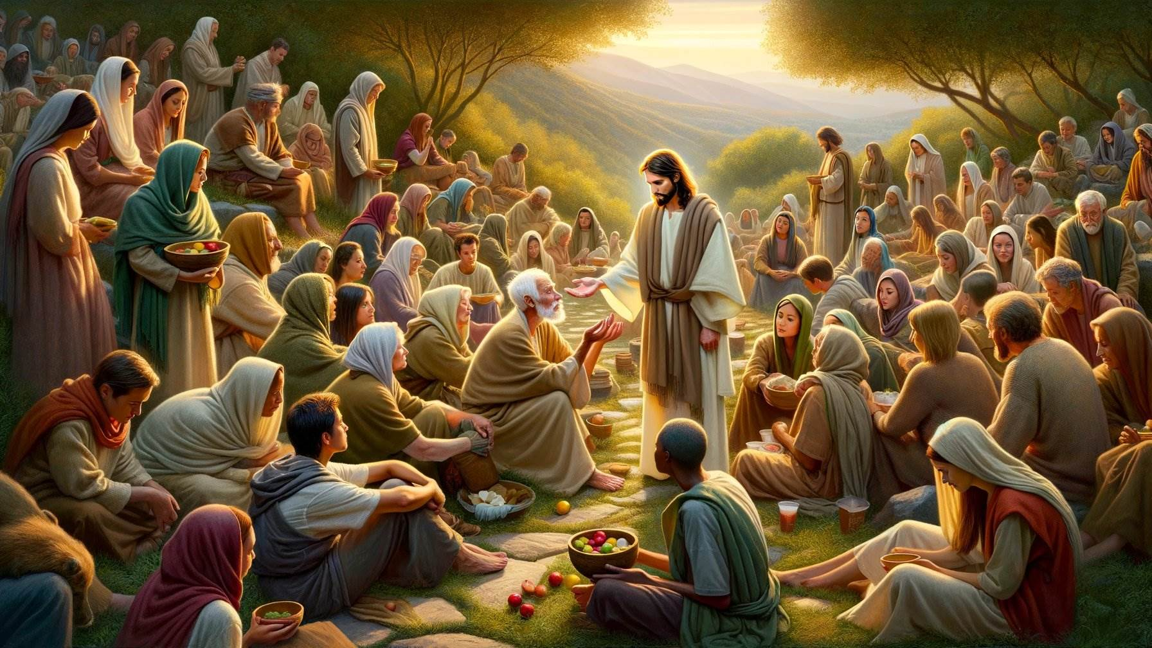
v) Don’t decide who can and who can’t enter.

Slide 28
Matthew19:14
“Let the little children come to Me, and do not forbid them; for of such is the kingdom of heaven.”

Slide 29
• They weren’t coming for some magical rite.
• They weren’t coming for some magical ceremony.
• They weren’t coming to get baptized.
• They came because their hearts were right.

Slide 30
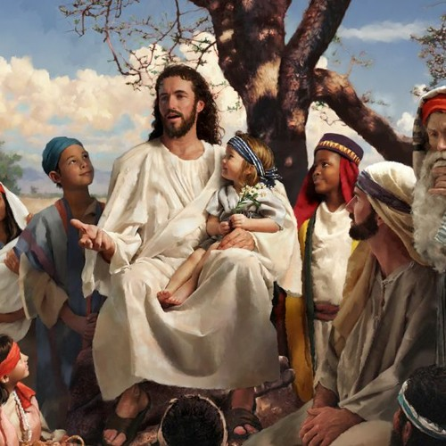
Jesus says, “For now, you permit them to come, and for future, don’t ever forbid them to come.”

Slide 31
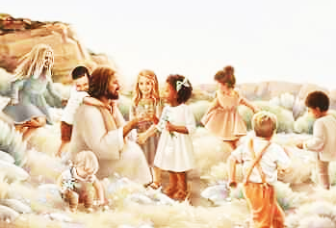
Jesus says, “For now, you permit them to come, and for future, don’t ever forbid them to come.”

Slide 32
There is no baptism here of babies.
There is no indication of the faith of the parents.
There is no parental covenant here.
“Babies such as these”

Slide 33
1 Corinthians 13:11,
When I was a child, I spoke as a child, I understood as a child, I thought as a child; but when I became a man, I put away childish things.

Slide 34
2 Samuel 12:22-23
But now he is dead; why should I fast? Can I bring him back again? I shall go to him, but he shall not return to me.”

Slide 35
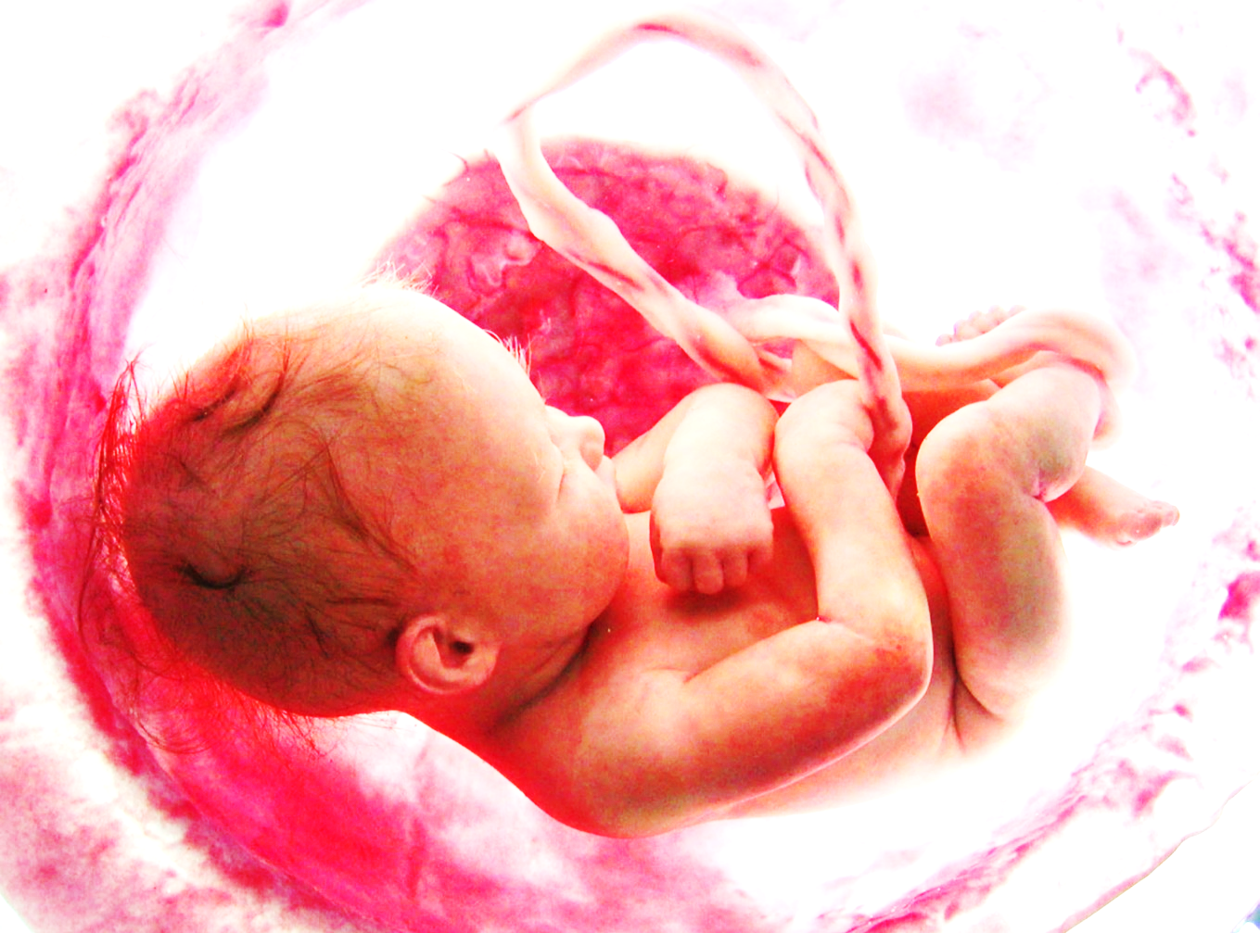
Babies are sinners, no question about it. Because they are produced by sinners yet, God has a special place for them.

Slide 36
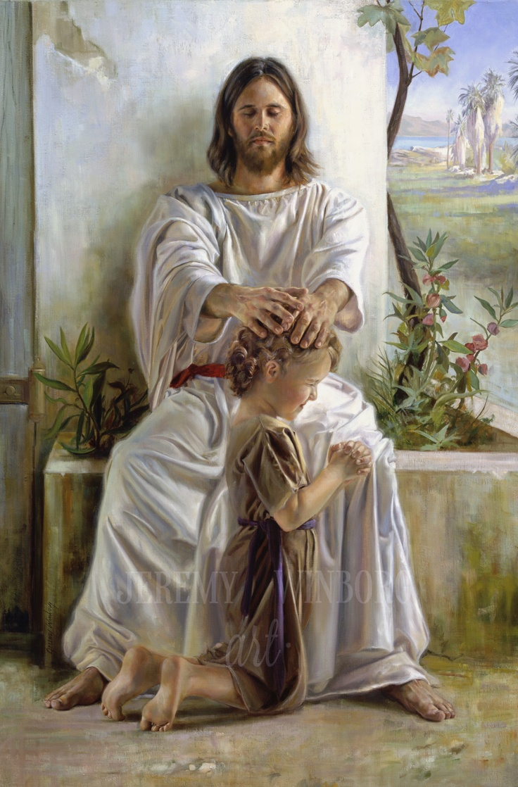
Matthew19:15
And He laid His hands on them and departed from there.

Slide 37
Luke 18:17,
Assuredly, I say to you, whoever does not receive the kingdom of God as a little child will by no means enter it.”

Slide 38
Matthew 18:3,
And said, “Assuredly, I say to you, unless you are converted and become as little children, you will by no means enter the kingdom of heaven.

Slide 39
Conclusion
What about your children?

Slide 40
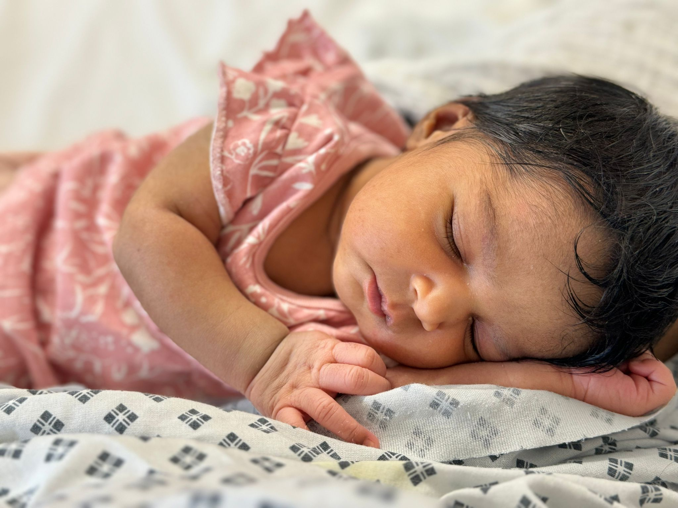
1 Remember
Remember to be bringing your children to Jesus.

Slide 41
a) God created your child.

Slide 42
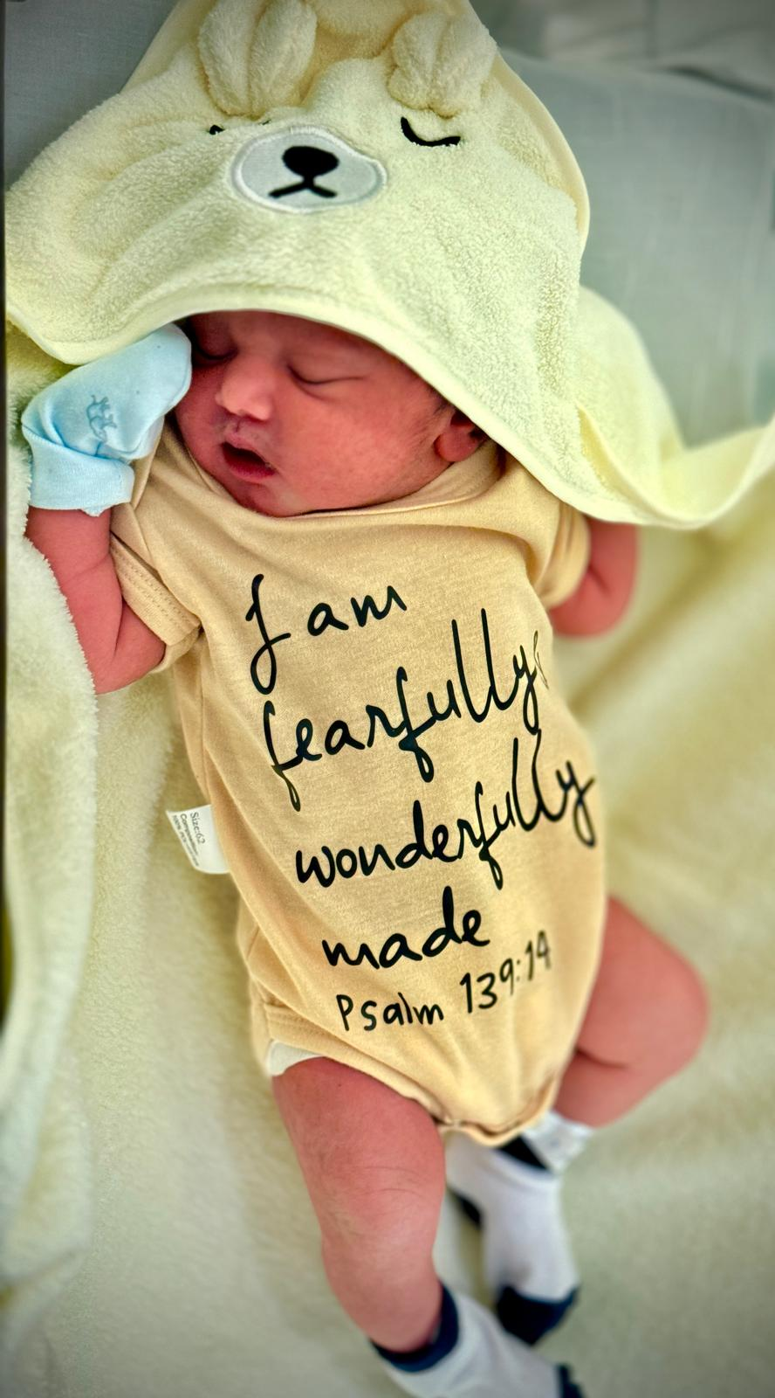
Psalm 139:13-14,

Slide 43
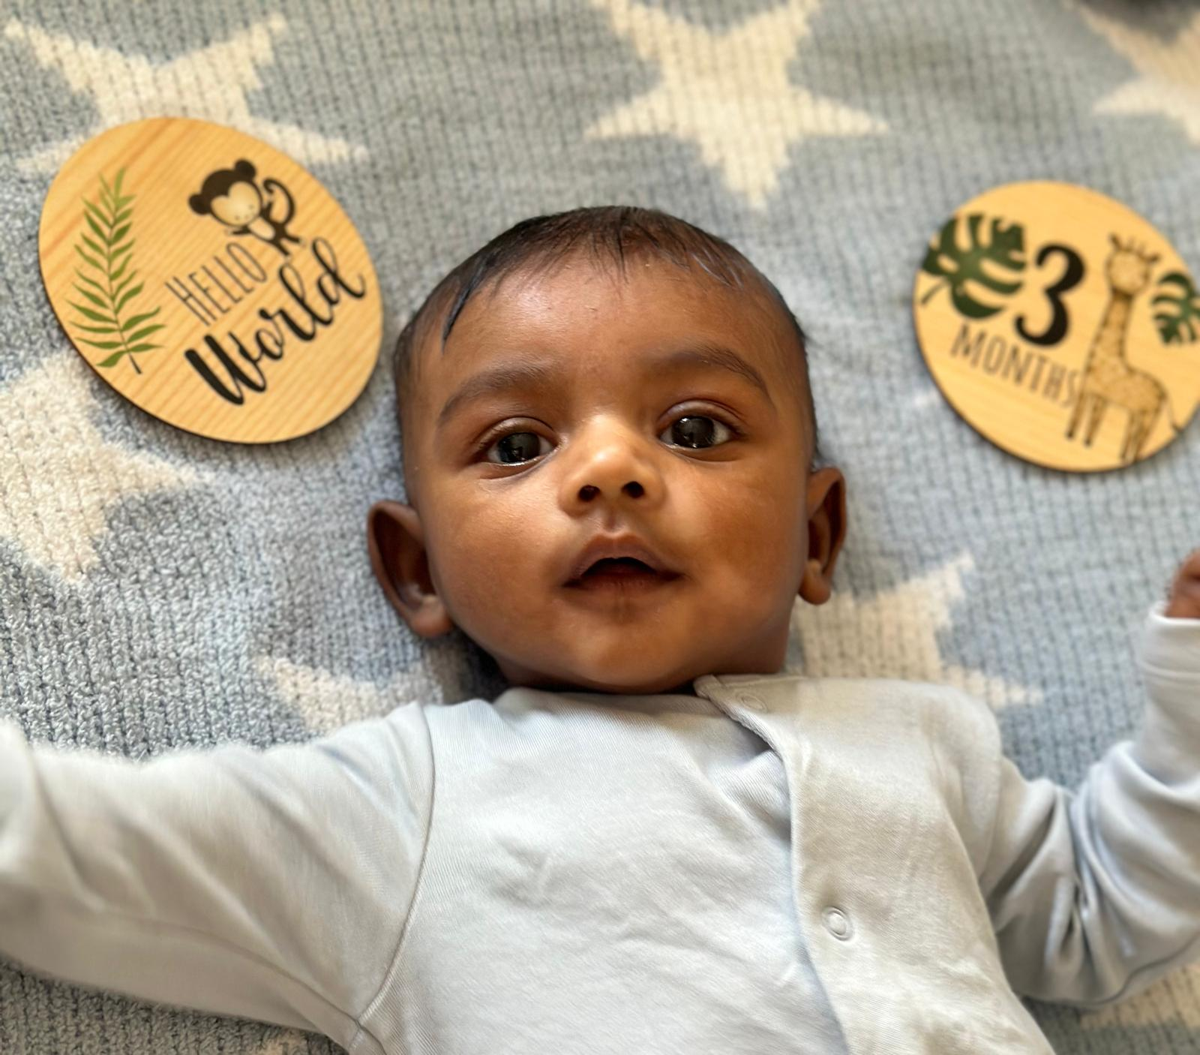
b) God gave that child to you as a gift.

Slide 44
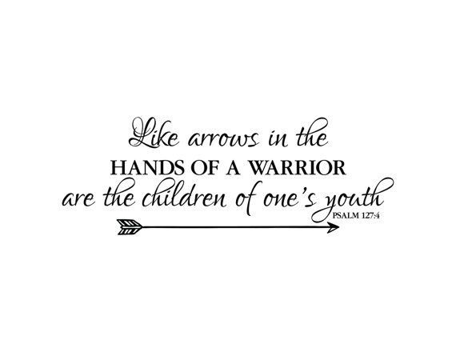
Psalm 127:4-5

Slide 45
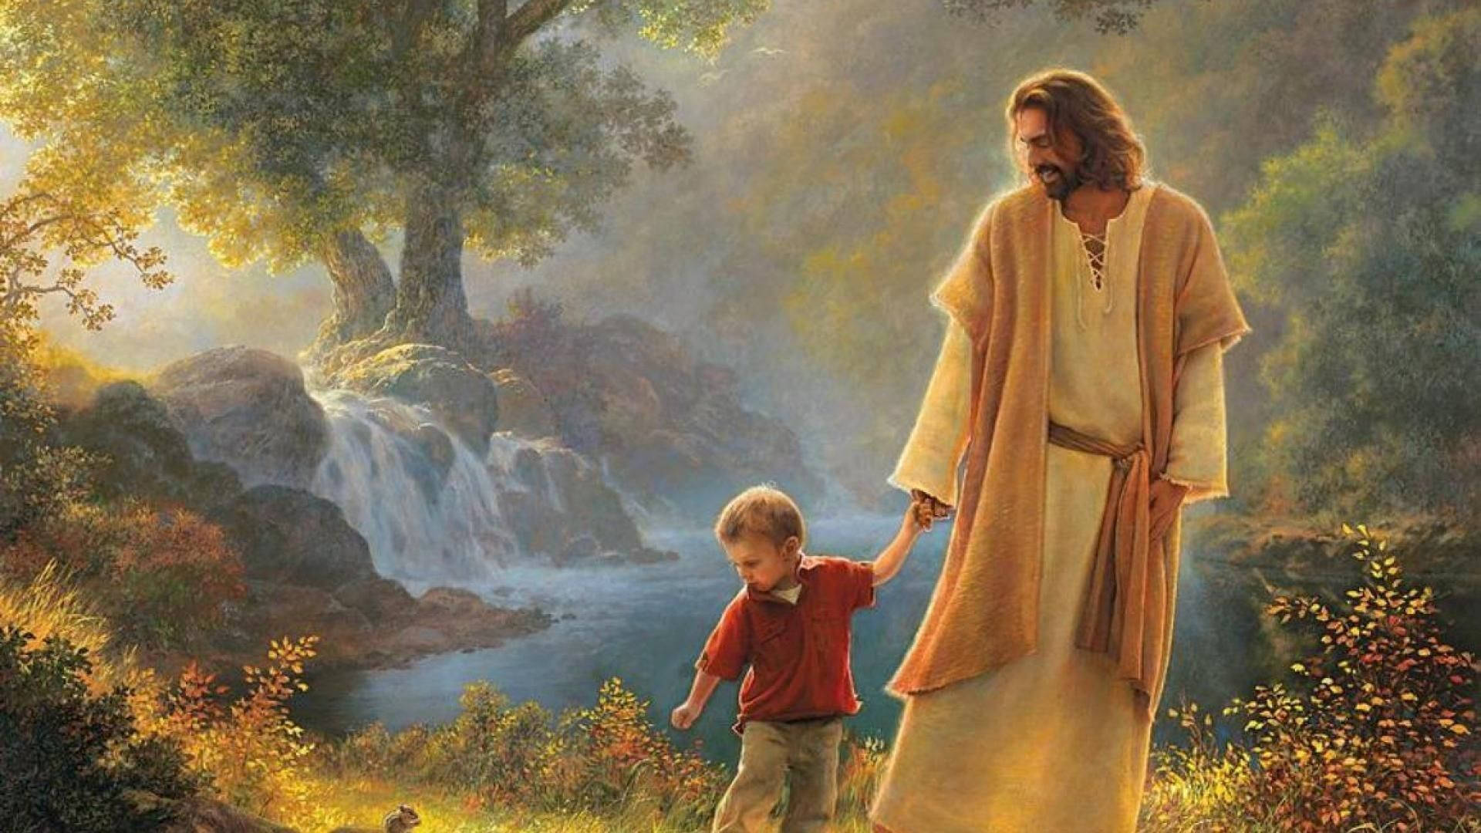
c) God wants them returned to Him for His use.

Slide 46
Ephesians 6:4,
And you, fathers, do not provoke your children to wrath, but bring them up in the training and admonition of the Lord.

Slide 47
2. Teach
We are called by God to teach.

Slide 48
2 Timothy 3:15,
And that from childhood you have known the Holy Scriptures, which are able to make you wise for salvation through faith which is in Christ Jesus.

Slide 49
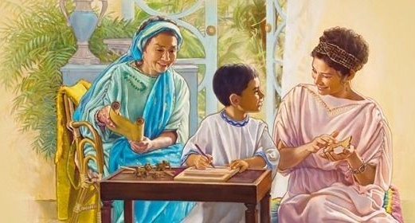
Lois and Eunice

Slide 50
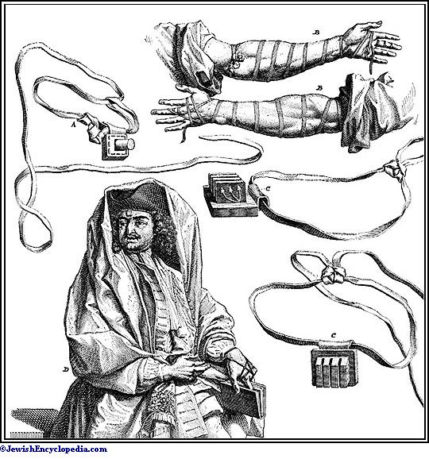
Deuteronomy 6:6-9,

Slide 51
Another thing you need to do.
Do you have Bible verses hanging around your house?
Do you have little plaques that remind them of great scriptural truths hanging in their rooms?
Do you have Bibles all around?
Do you read them stories?

Slide 52
Deuteronomy 6:10-13,
houses full of all good things, which you did not fill, hewn-out wells which you did not dig, vineyards and olive trees which you did not plant—when you have eaten and are full

Slide 53
3. Model.
We must set the pattern.
You must set an example.

Slide 54
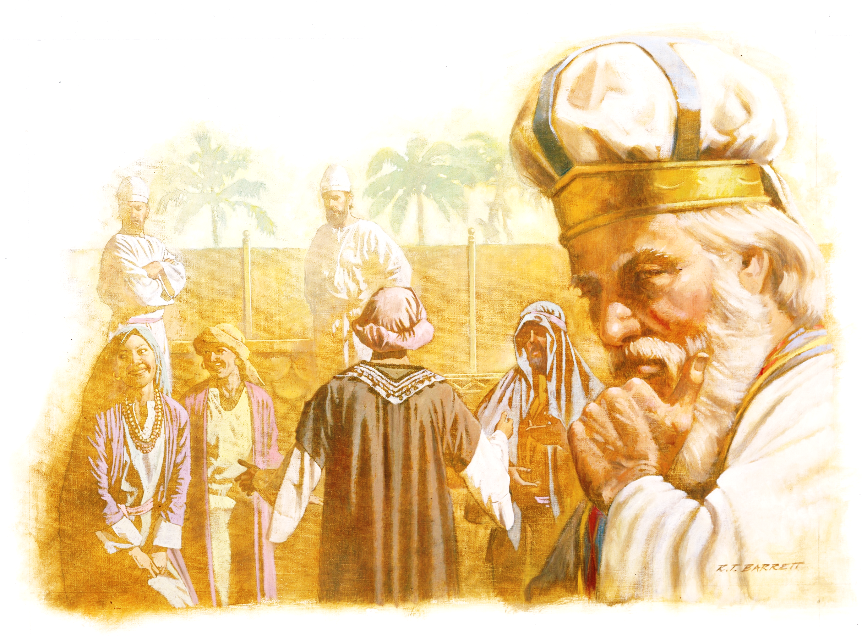

Slide 55
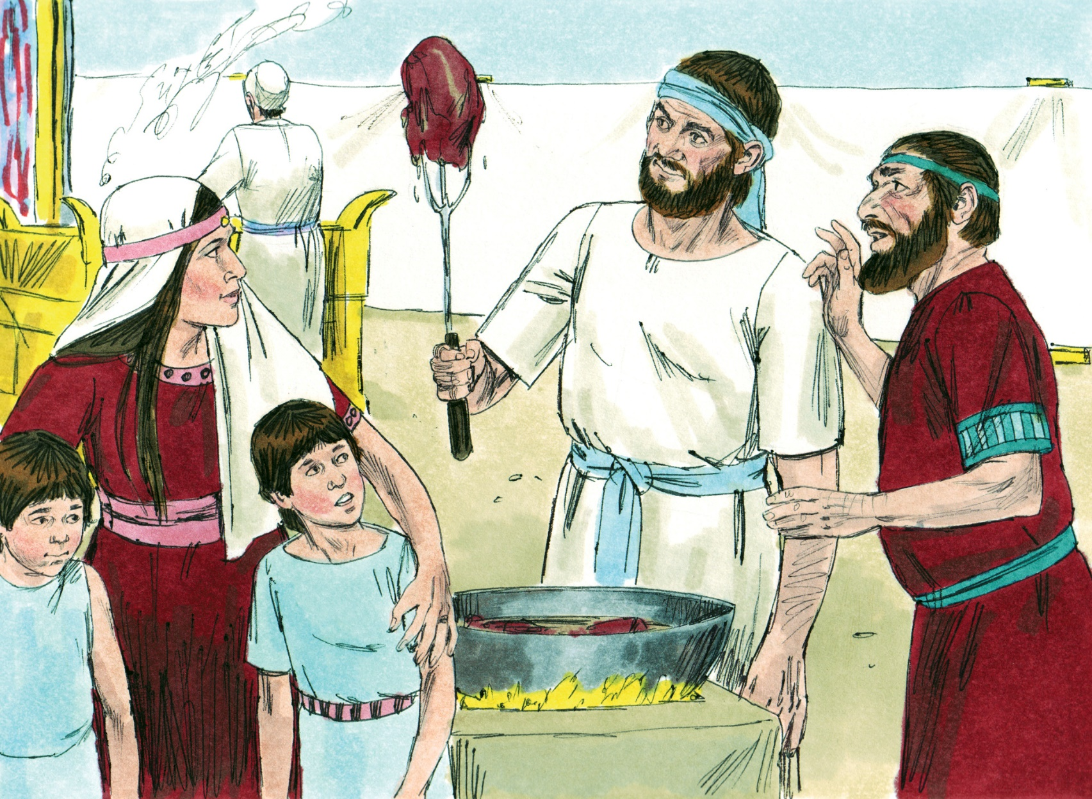
1 Samuel 2:15-16,

Slide 56
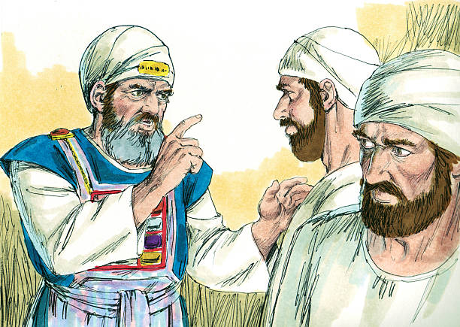
1 Samuel 2:23-25,

Slide 57
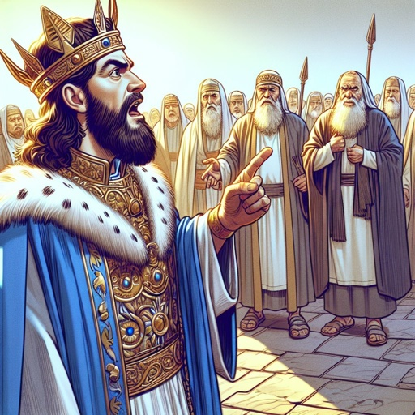
1 Kings 12:13-14,
“My father made your yoke heavy, but I will add to your yoke; my father chastised you with whips, but I will chastise you with scourges!”

Slide 58
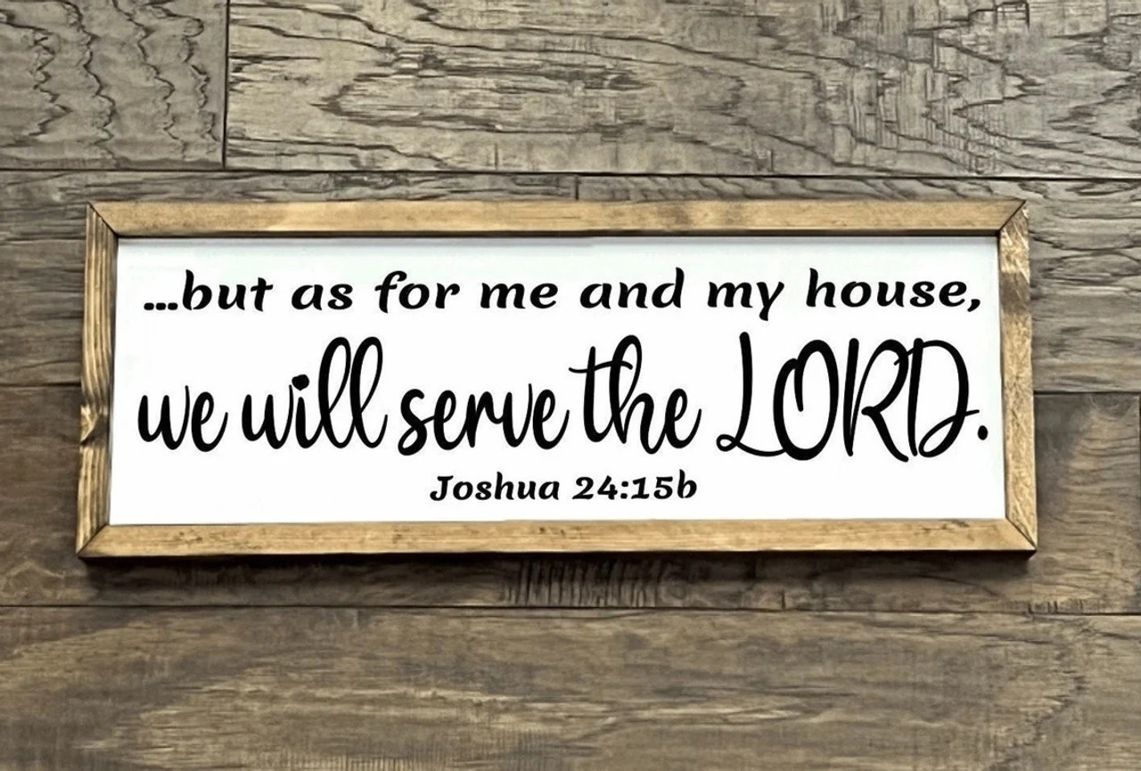
Joshua 24:15,

Slide 59
4. Trust.
When you have done all that, trust God.

Slide 60
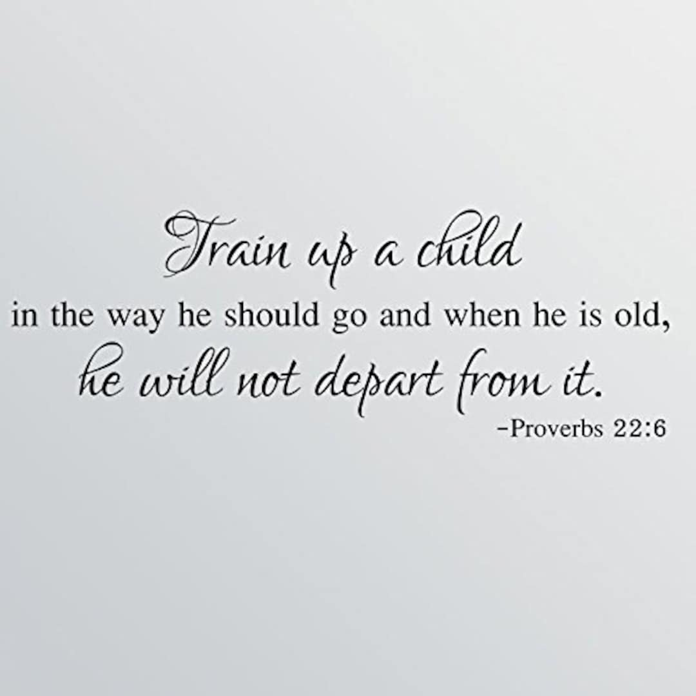
Proverbs 22:6,

Slide 61


Slide 62


Slide 63
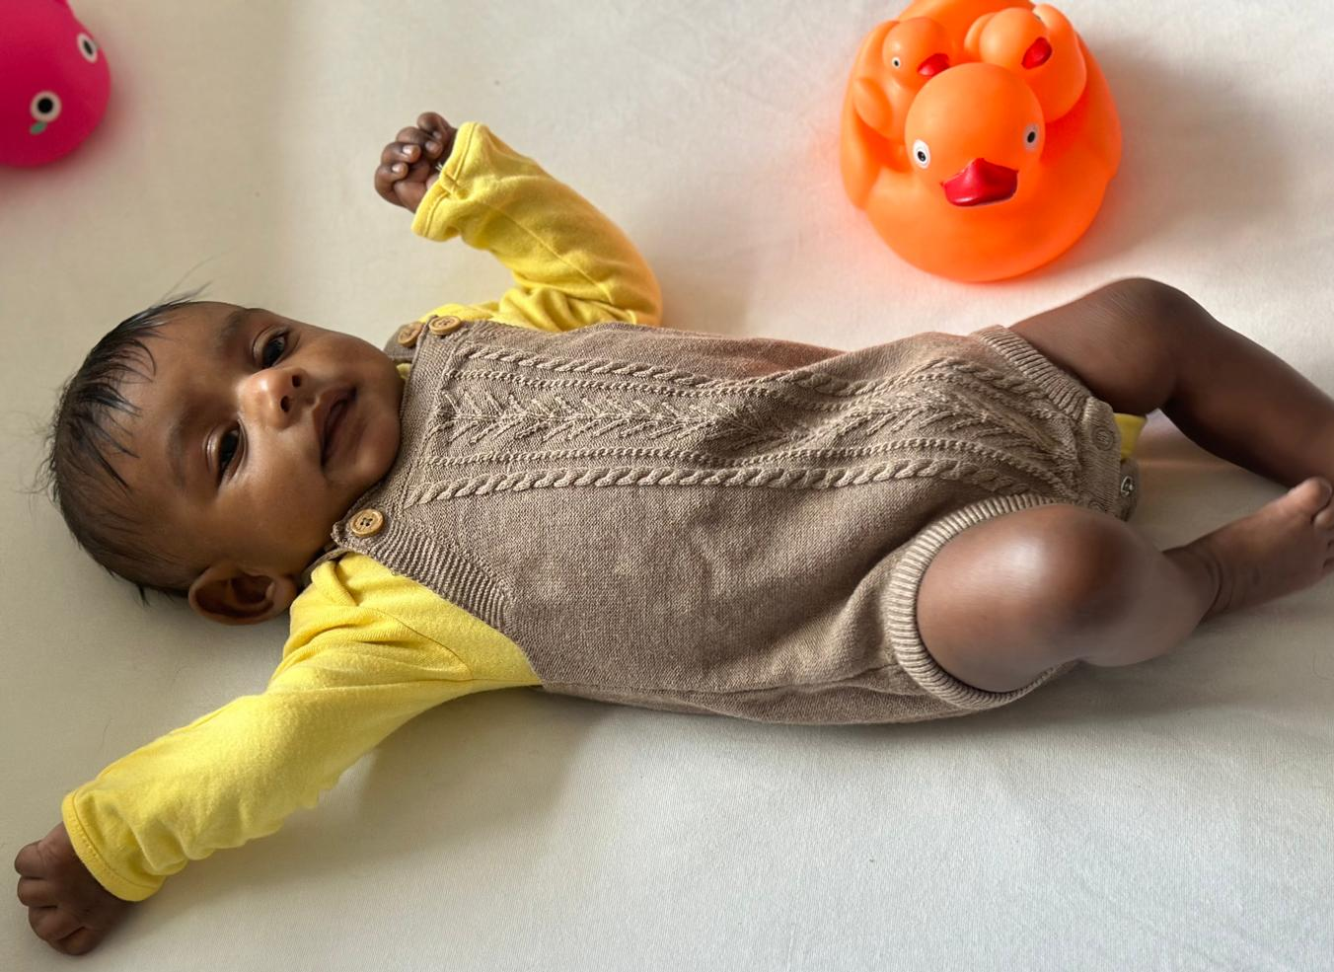
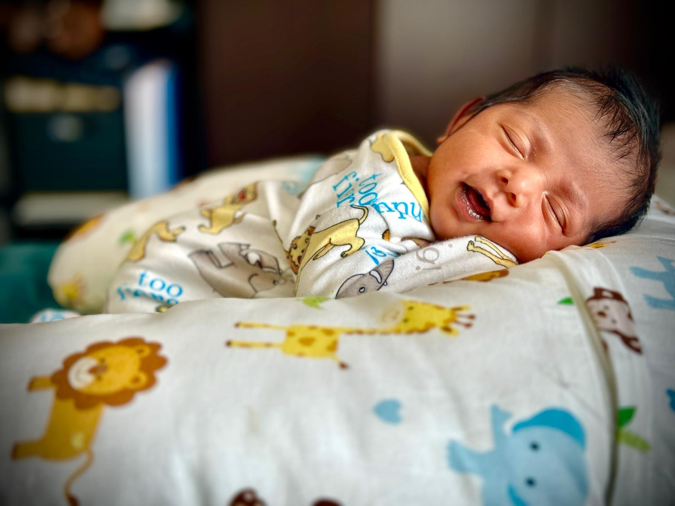
Zionna Susan
David Lewis Elliott
Priscilla Estel

