Slide 1

JULY 7
S u n d a y

Slide 2



Matthew 19:16-22
Jesus and Eternal life!

Slide 3
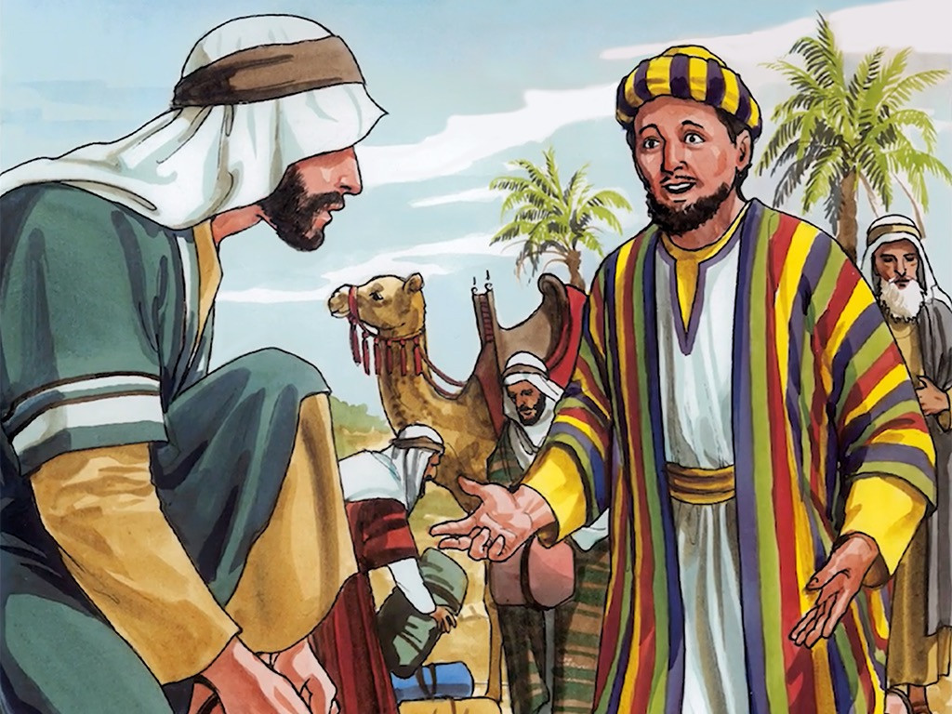
Matthew19:16-22

Slide 4
Luke 14:33
So likewise, whoever of you does not forsake all that he has cannot be My disciple.

Slide 5


There was a test.
On the one hand, he had his possessions.
On the other hand, there was Jesus Christ.

Slide 6

How to obtain eternal life?
“Eternal life” is used about 50 times

Slide 7
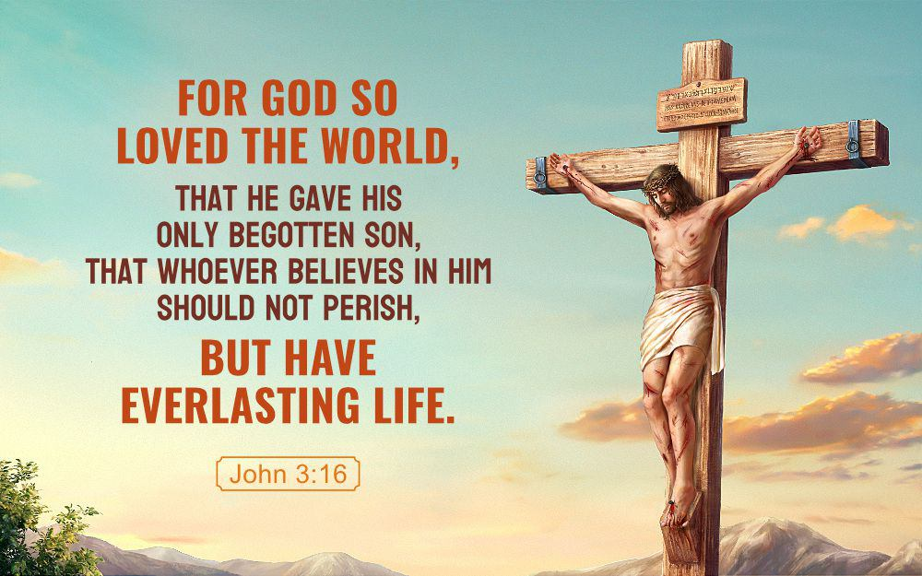
John 3:16

Slide 8
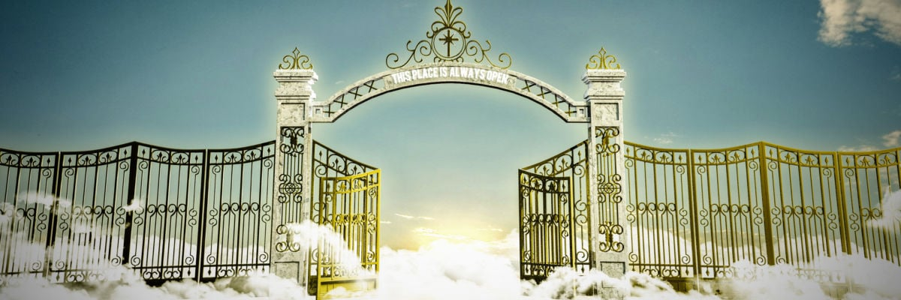
John 6
“How do you get eternal life?”

Slide 9
What kind of evangelism is this?
Jesus would have failed the evangelism class.
He doesn’t know how to get closure.
He doesn’t know how to draw the net.
He doesn’t know how to sign the guy up.

Slide 10
Matthew19:16
Now behold, one came and said to Him, “Good Teacher, what good thing shall I do that I may have eternal life?”

Slide 11

He wanted eternal life.
He knew he didn’t have it.
He had a lot of things, but he didn’t have eternal life.

Slide 12
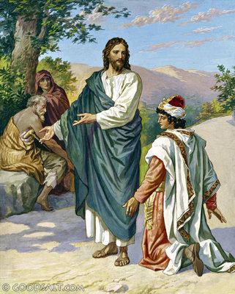
1. He knew what he wanted.
He was young.
He was rich.
Had great possessions.

Slide 13
He didn’t have eternal life
He had not found the reality to put his soul at rest.
He had not found a confident permanent peace, joy, and settled hope.
He was coming on the grounds of a felt need.
There was restlessness in his heart.
There was an anxiety in his heart.
There was a sense of being unfulfilled.

Slide 14
Life means the ability to respond to your environment.
Eternal life means the ability to permanently respond to your environment.

Slide 15

Apostle John uses the word zōē 34 times,

Slide 16
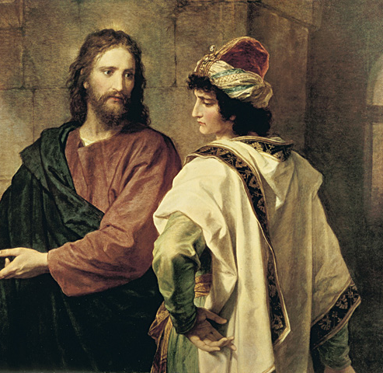
2. Urgency in seeking.

Slide 17
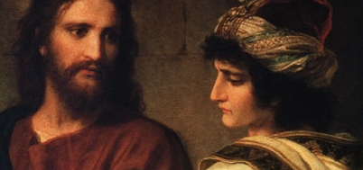
V 20,
“All these things I have kept from my youth. What do I still lack?”

Slide 18
“I want this thing.”
• He has lived an exemplary life outwardly.
• He has avoided outward sins.
• He tells all those laws that he supposedly thinks he had kept.

Slide 19
“I want this thing.”
• He is moral.
• He is religious.
• He is strong in heart to conform to the standards of his religion.
• He is a leader in terms of the eyes of the people.

Slide 20
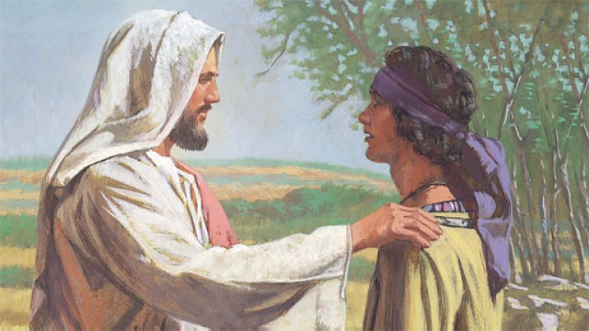
3. To seek diligently.

Slide 21
Jeremiah 29:13-14,
And you will seek Me and find Me, when you search for Me with all your heart.
I will be found by you, says the Lord,

Slide 22
Mark 10:17,
“Good Teacher, what shall I do that I may inherit eternal life?”

Slide 23
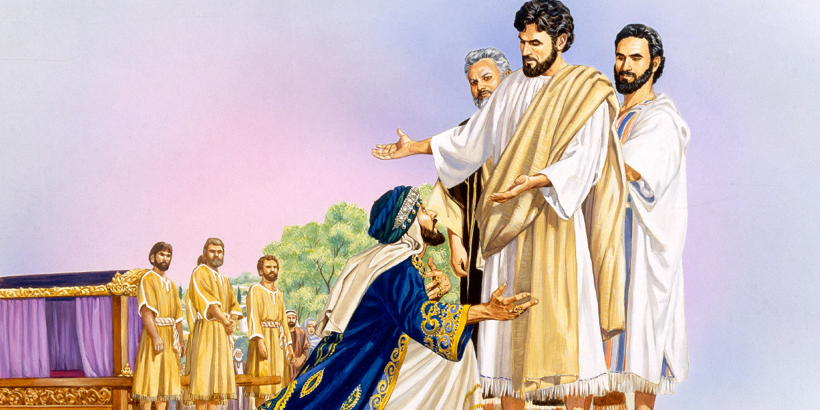
4. He came to the right source.

Slide 24
1 John 5:11,
And this is the testimony: that God has given us eternal life, and this life is in His Son.

Slide 25
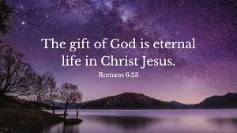
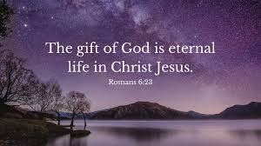
1 John 5:20,

Slide 26
“Good, “Greek word ’Agathos.’
Kalos means good on the outside.
Agathos means good on the inside,

Slide 27
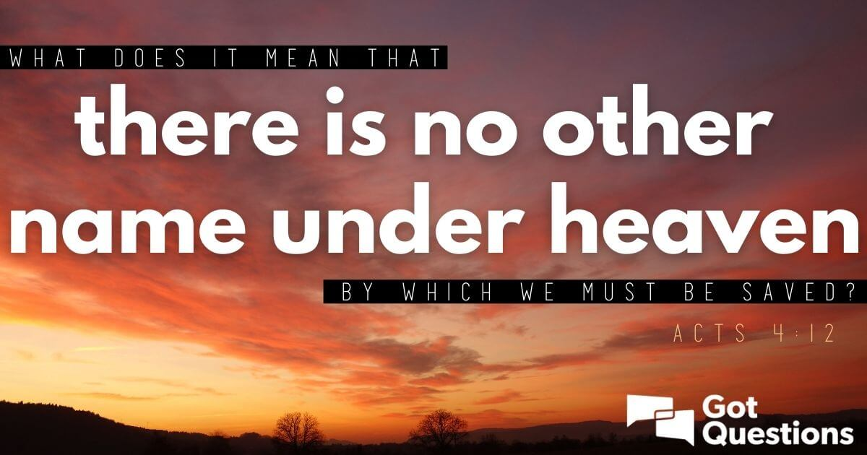
Acts 4:12,

Slide 28
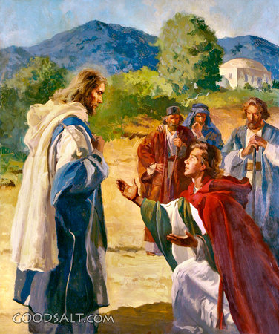
5. He asks the right question.

Slide 29
He didn’t ask,
How can I be more religious?
How can I be more moral?
How can I get more self-respect?

Slide 30
John 6:28,
Then they said to Him, “What shall we do, that we may work the works of God?”

Slide 31
John 6:29,
Jesus answered and said to them, “This is the work of God, that you believe in Him whom He sent.”

Slide 32
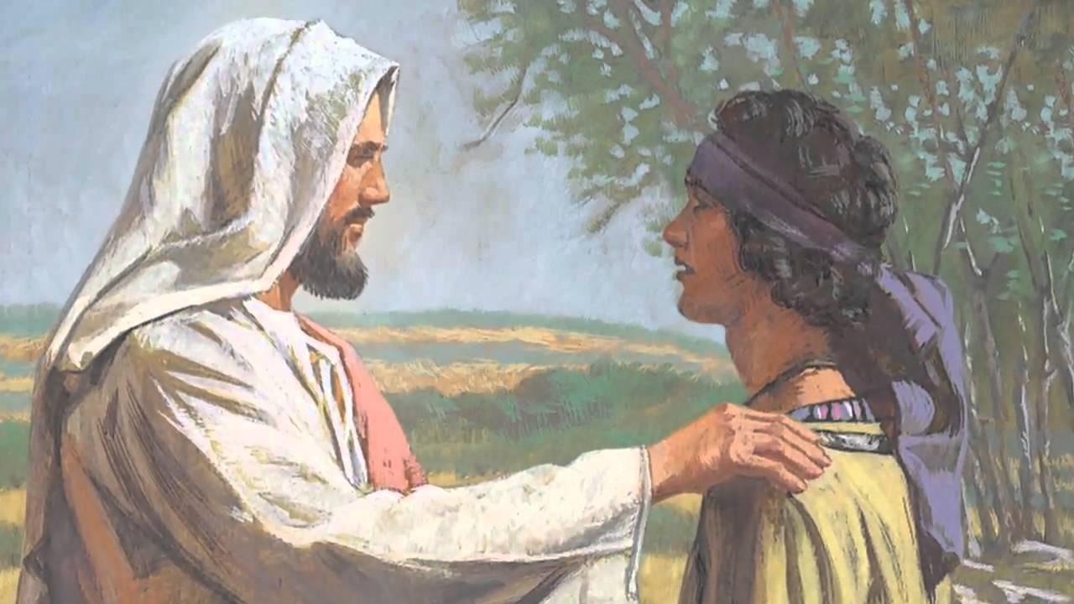
What do I need to do to have eternal life?

Slide 33
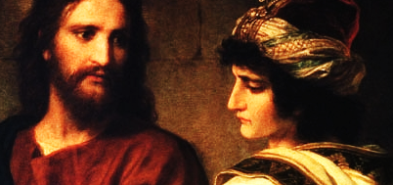
V 17
“Why do you call Me good? No one is good but One, that is, God.

Slide 34
The rich young ruler had no sense of his offending God, he had no remorse.
➢ There must be remorse.
➢ The Beatitude attitude.
➢ One must be begging God for forgiveness.

Slide 35
➢ There needs to be meekness.
➢ There needs to be mourning, overwhelmed by sin.

Slide 36
Psalms 7:11,
God is a just judge, And God is angry with the wicked every day.

Slide 37
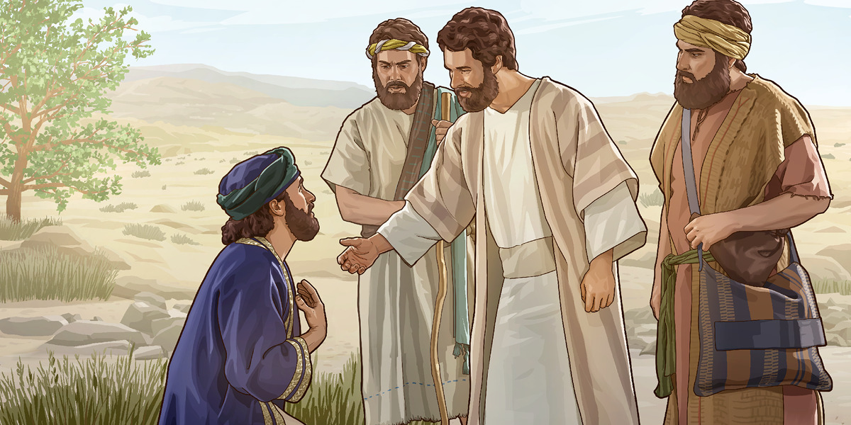
V 18-19,

Slide 38
The Ten Commandments are divided into two parts.
➢ The first half deal with God.
➢ The second half deal with man.

Slide 39
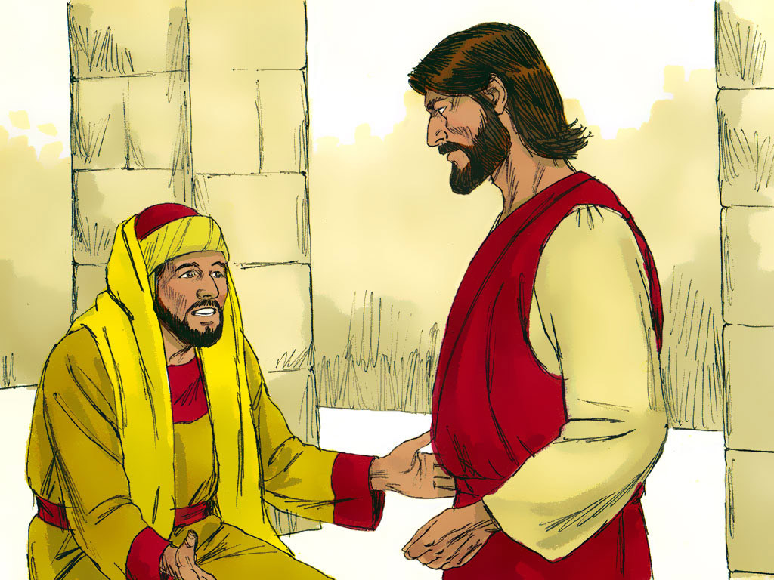
V 20,
“All these things I have kept from my youth. What do I still lack?”

Slide 40
This shows us how he perceived those laws. o Maybe he never murdered anybody. o Maybe he never committed adultery. o Maybe he never stole anything. o Maybe he never lied to anybody. o Maybe he honoured his father and mother.

Slide 41

Matthew 5

Slide 42
The YOUNG RICH man didn’t understand the internal character of God’s law, he understood only the externals.

Slide 43
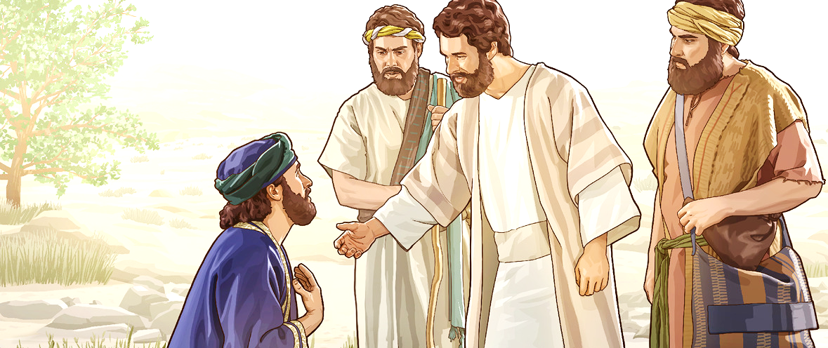
He wouldn’t confess his sin.
➢ Confession of sin,
➢ Repentance,
➢ Turning from sin

Slide 44
V 20,
“All these things I have kept from my youth. What do I still lack?”

Slide 45
Young man believed this. .
He believed he was righteous.
He believed he had kept the law.
He couldn’t figure out what else he ought to do.

Slide 46
Mark 10:21
Go your way, sell whatever you have and give to the poor, and you will have treasure in heaven; and come, take up the cross, and follow Me.”

Slide 47

6. Obtaining eternal life is confession & repentance.

Slide 48
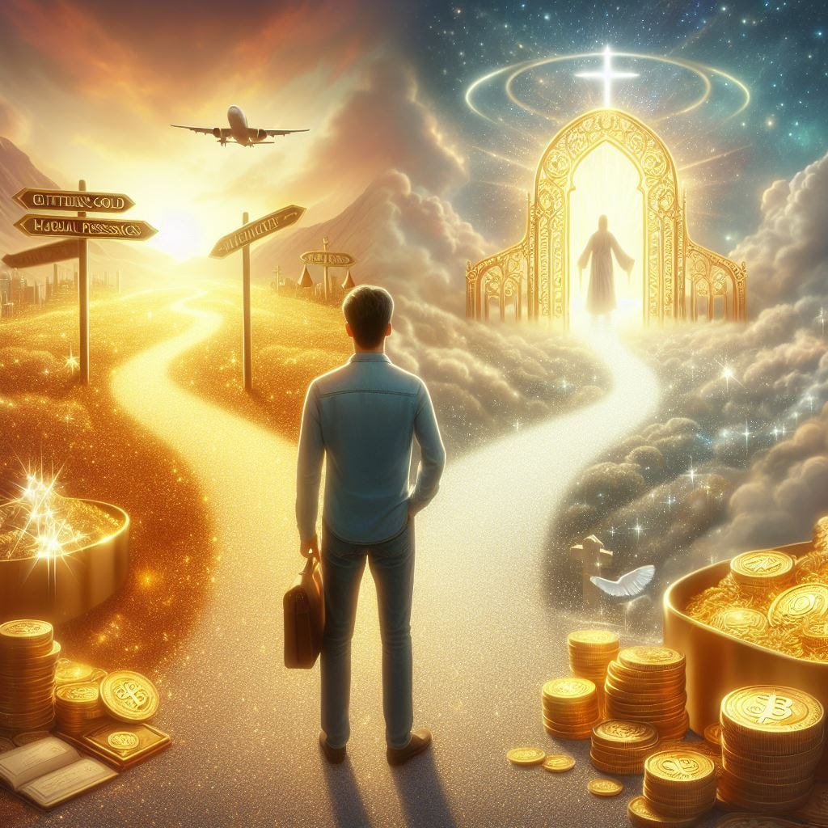
V 21,

Slide 49

7. Surrender to obey the Lord.

Slide 50
True salvation includes confession of sin, repentance.
True salvation includes a submission to obey the Lord.

Slide 51
The sin of this young ruler was a sin of covetousness.
• Sin of indulgence,
• Sin of materialism,
• Sin of wealth.

Slide 52
Luke 14:33
So likewise, whoever of you does not forsake all that he has cannot be My disciple.

Slide 53
because He knew this was most important to the young ruler. o For some people it might be a car. o For some people it might be a girl. o For some people it might be a job, or a career, or a certain sin they want to indulge in, or whatever.

Slide 54
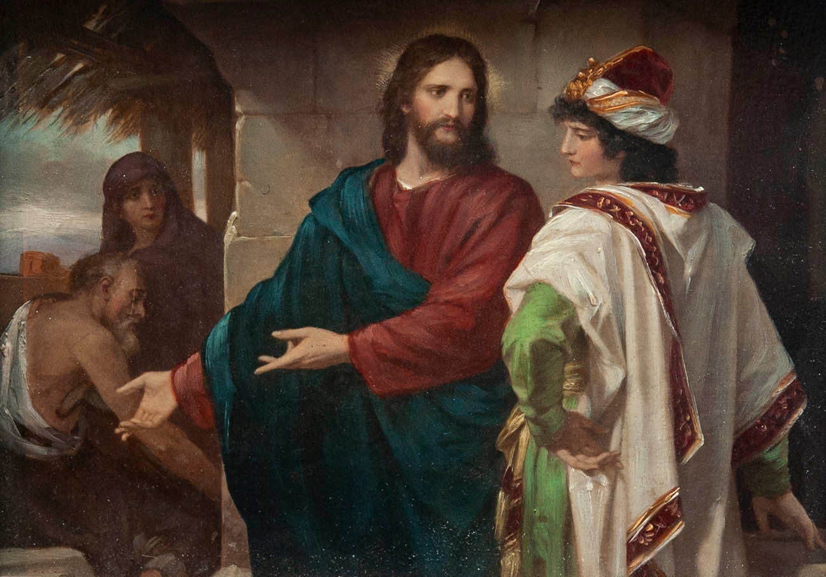
For this rich young ruler, it was his money and his possessions.

Slide 55
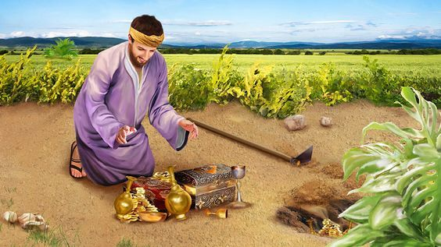
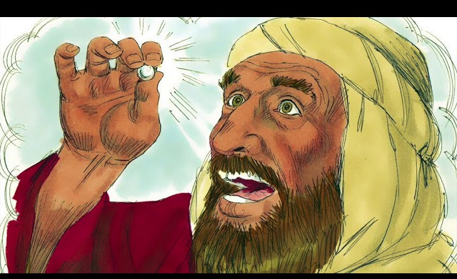
Matthew 13

Slide 56
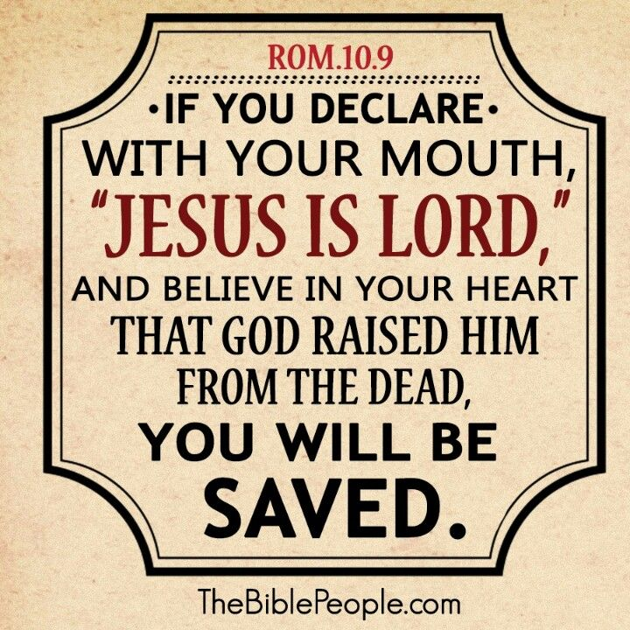
Romans 10:9-10,

Slide 57
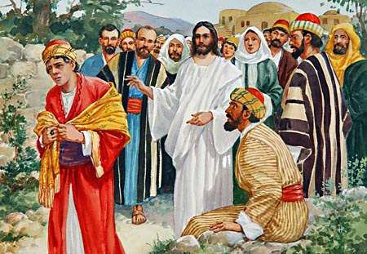
V 22,

Slide 58
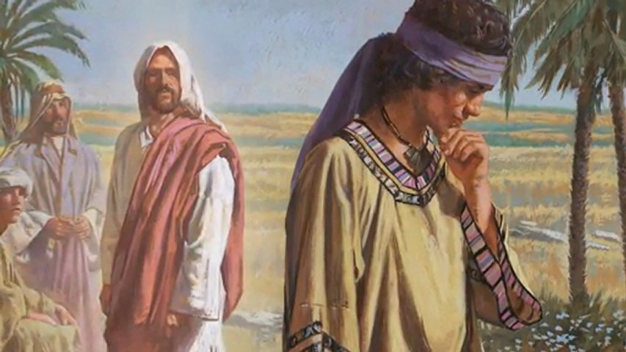
He really did want eternal life; he wasn’t willing to pay the price.

Slide 59
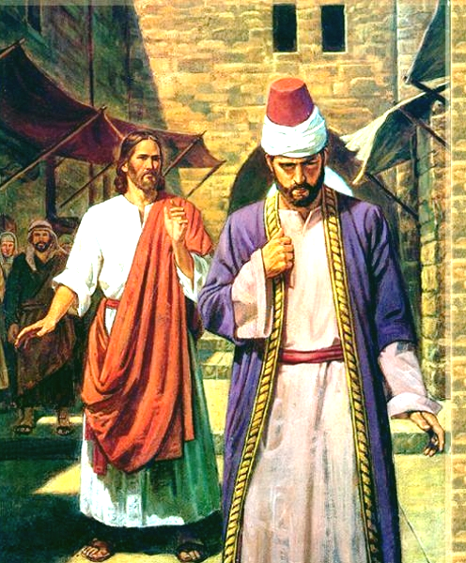
Conclusion

Slide 60
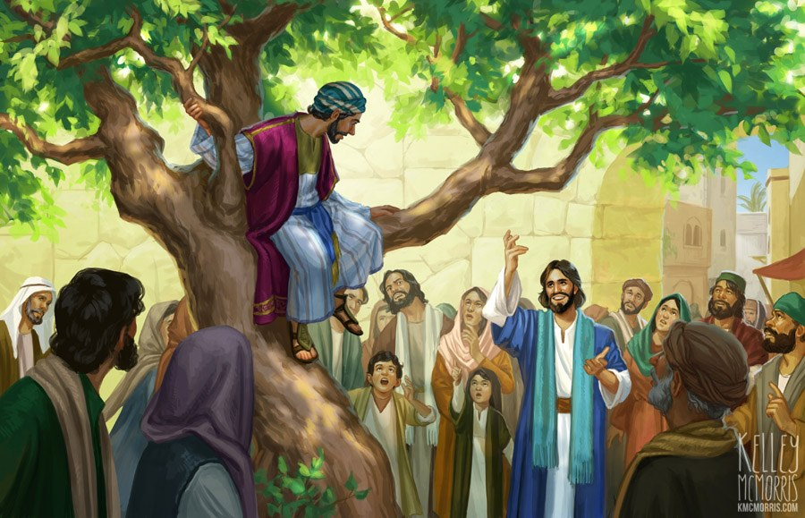
Luke 19:8-10,

Slide 61
Zacheus knew he had been doing wrong all the time.
I have got to get my life right.
I have got to give everything back.
I have got to give all this stuff to the poor.
I have got to return to everybody four hundred percent.

Slide 62
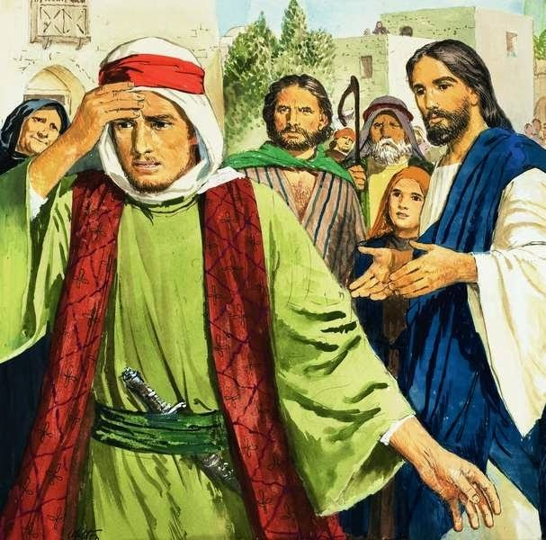
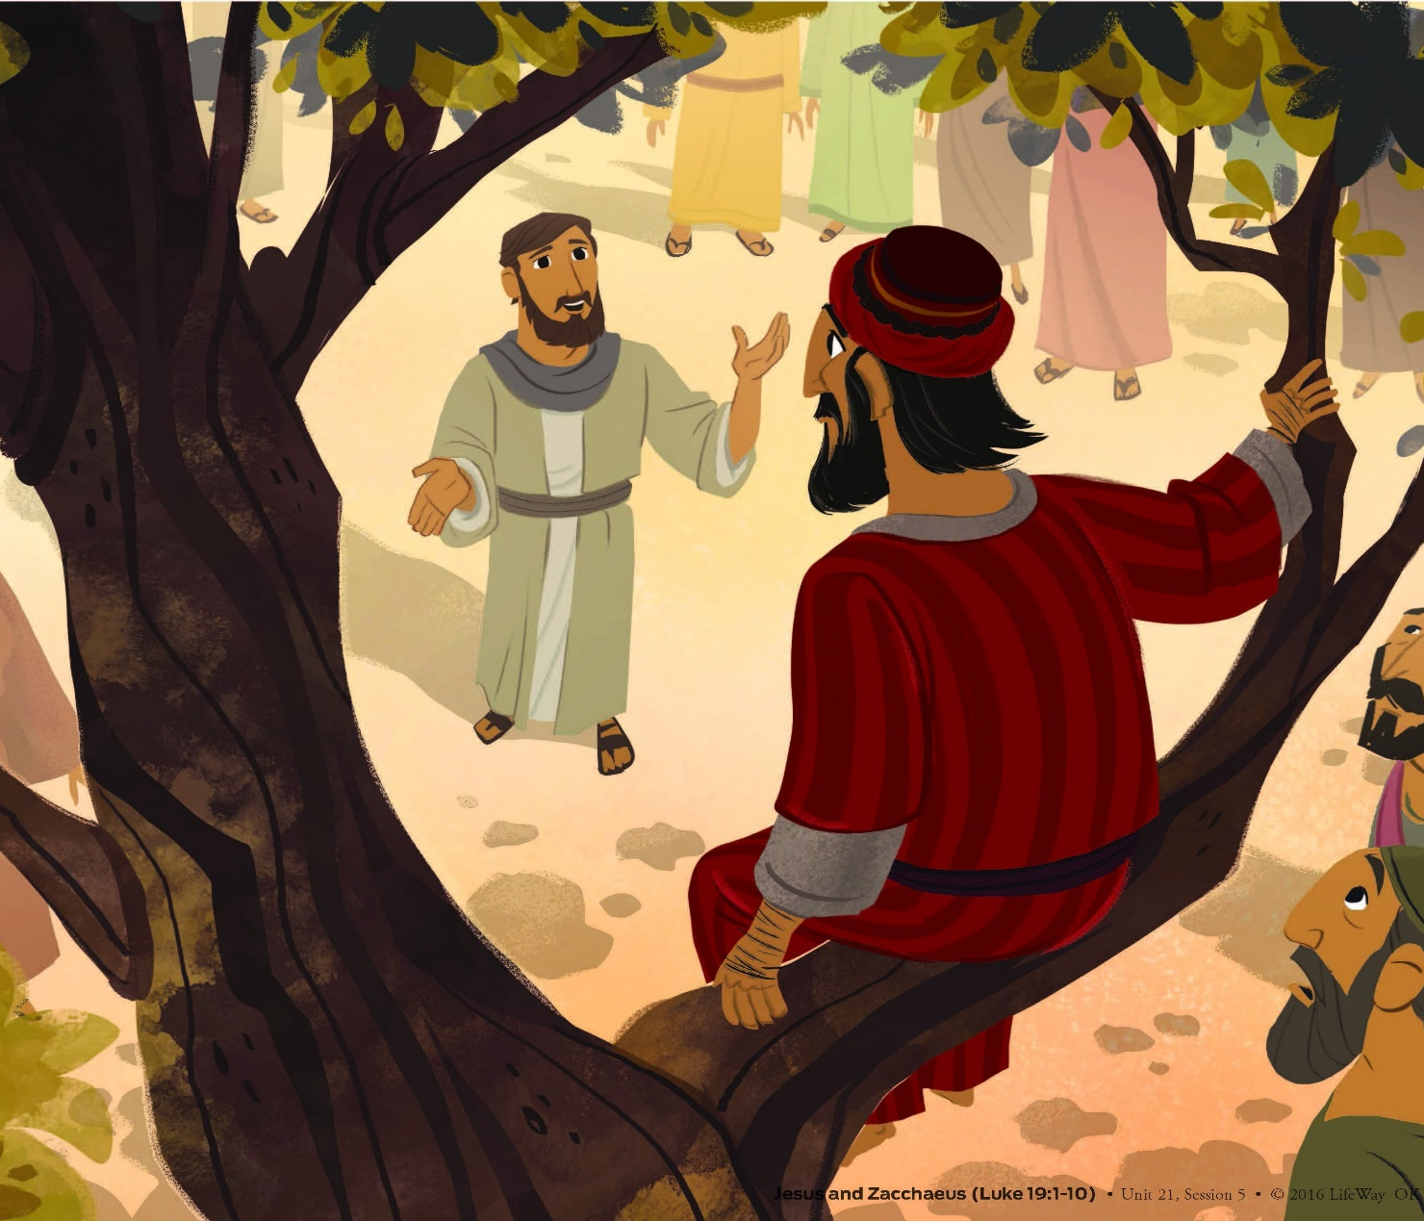
Matthew 19 and Luke 19

