Slide 1

JULY 21
S u n d a y

Slide 2



Matthew 19:23-29
Can a rich person be saved?

Slide 3
Matthew19:16-22
follows the incident with the rich young ruler…..

Slide 4
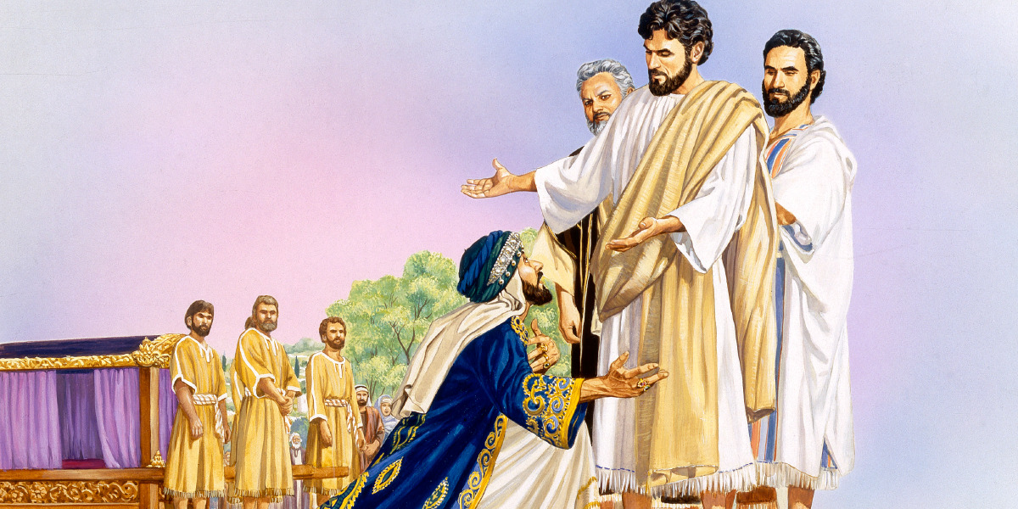
Right Attitude.
Came Kneeling.
Right Person.
Right Question.

Slide 5
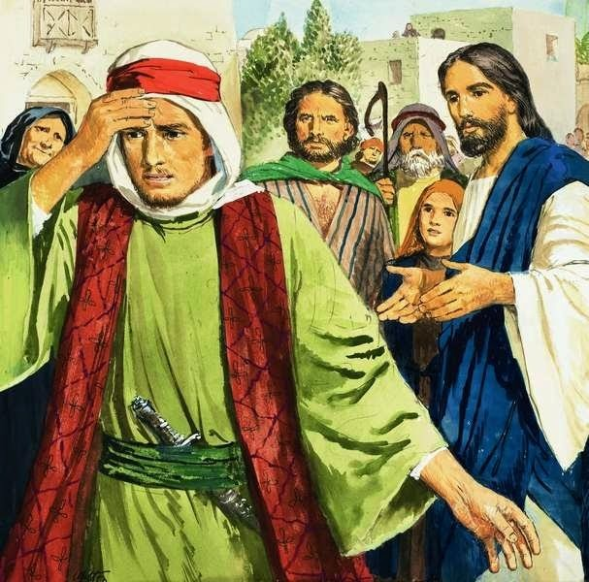
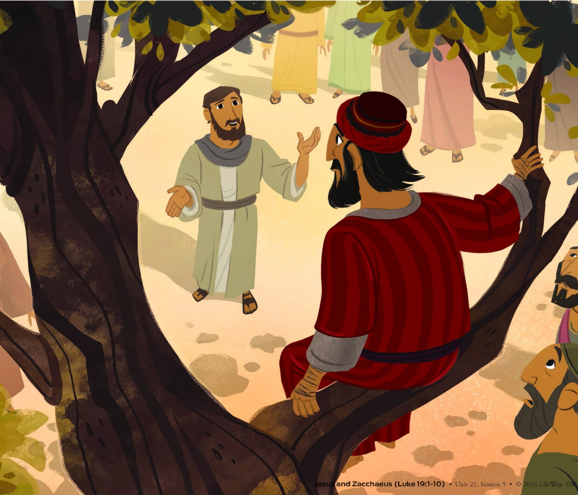
Matthew 19 and Luke 19

Slide 6
Proverbs 13:7,
There is one who makes himself rich yet has nothing; And one who makes himself poor yet has great riches.

Slide 7
PARADOXICAL
Bible has a lot to say about riches, and poverty.
The young man was a tragedy.

Slide 8
Luke 14:33,
So likewise, whoever of you does not forsake all that he has cannot be My disciple.

Slide 9
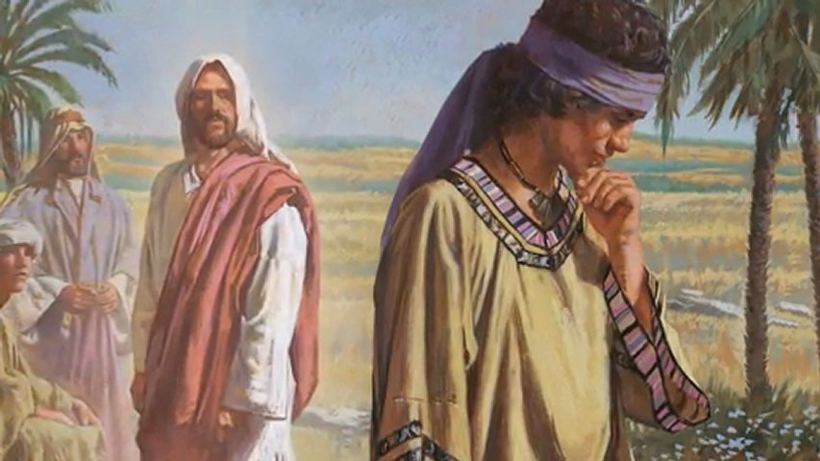
He really did want eternal life; he wasn’t willing to pay the price.

Slide 10
Matthew19:16
Now behold, one came and said to Him, “Good Teacher, what good thing shall I do that I may have eternal life?”

Slide 11
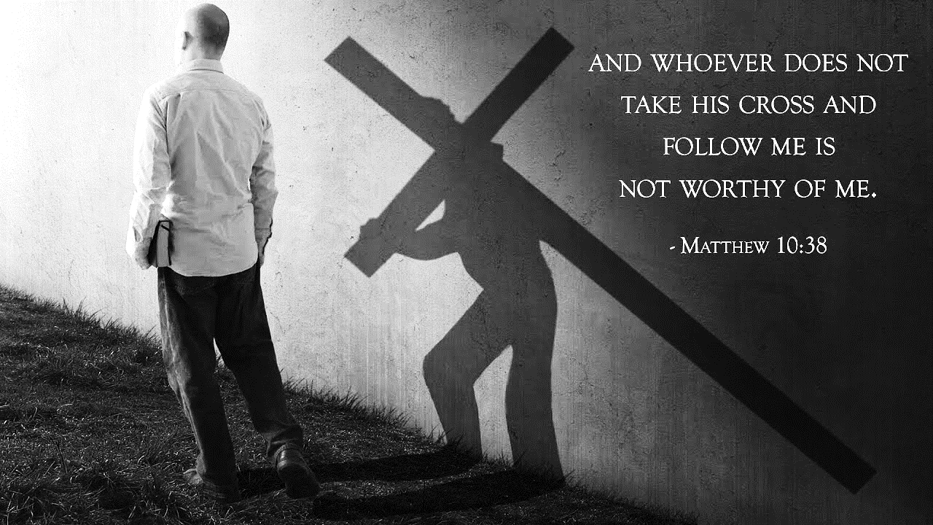
Matthew 10:38,

Slide 12
Matthew 19:23
“Assuredly, I say to you that it is hard for a rich man to enter the kingdom of heaven

Slide 13
‘Duskolōs’
Greek word “Truly”
used three times in the New Testament.
In Matthew, Mark and Luke.

Slide 14
Matthew 19:24
‘’ It is easier for a camel to go through the eye of a needle than for a rich man to enter the kingdom of God.”

Slide 15
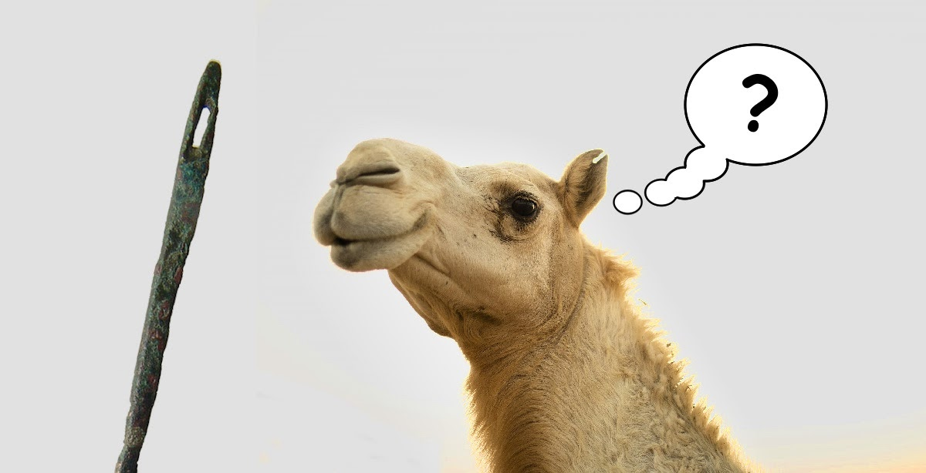
It is impossible.

Slide 16
Talmud has a saying that was used in Persia,
“It is it is easier to put an elephant through the eye of a needle.”

Slide 17
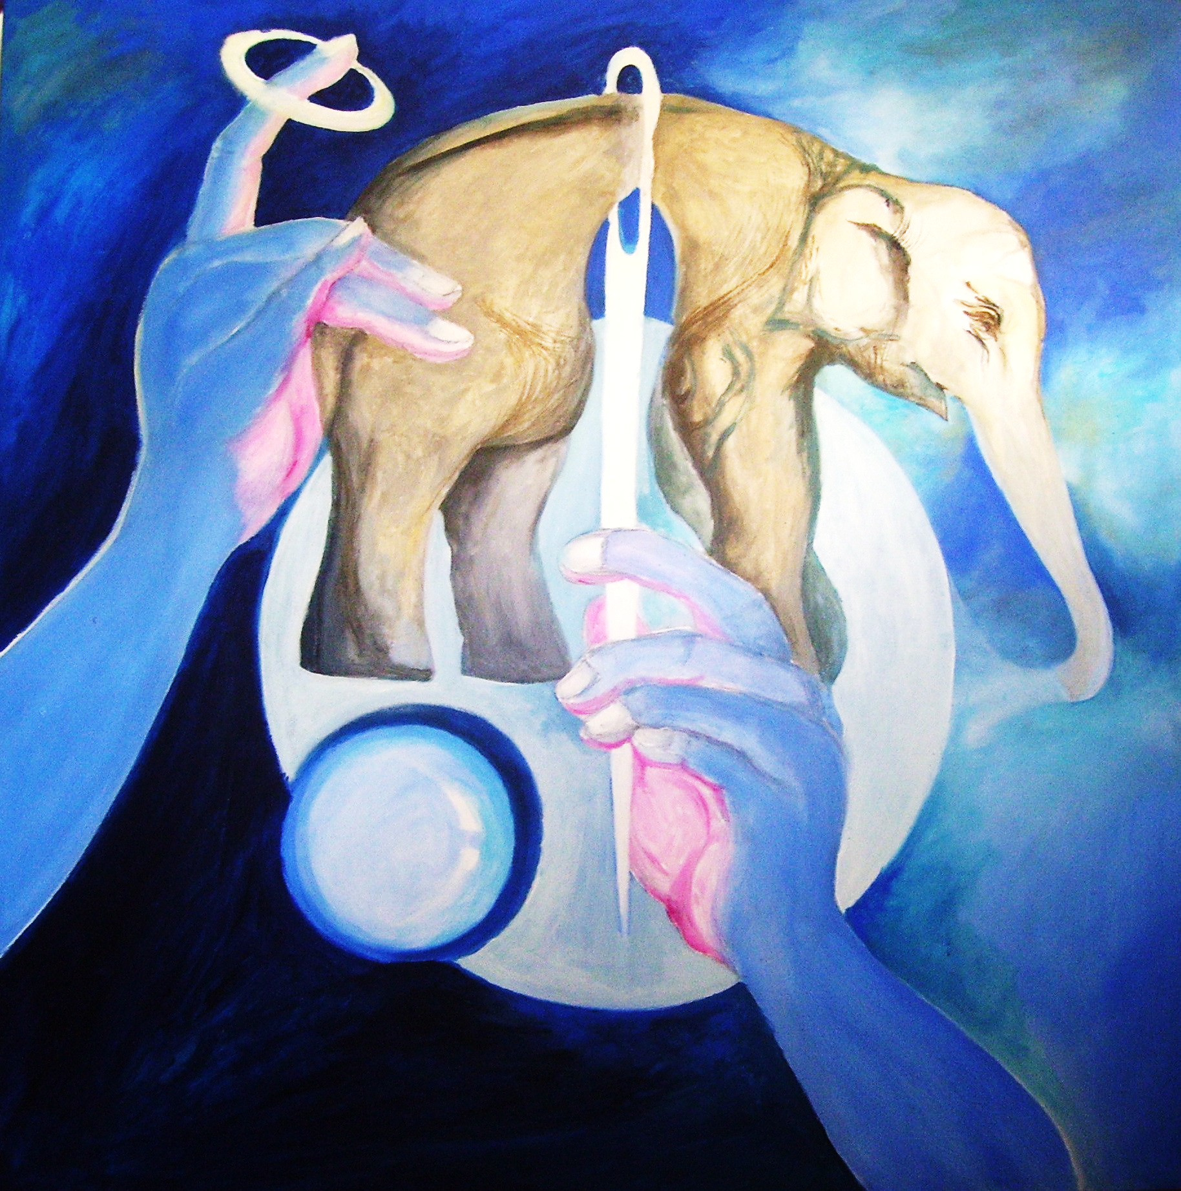
It is impossible.

Slide 18

How difficult is it for rich people to get saved?
Impossible.

Slide 19
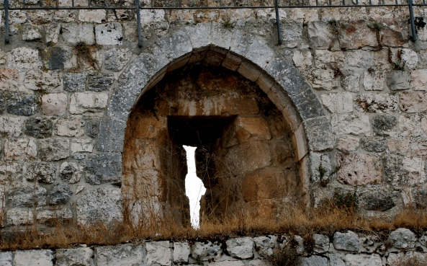
Jerusalem-Needle Gate

Slide 20
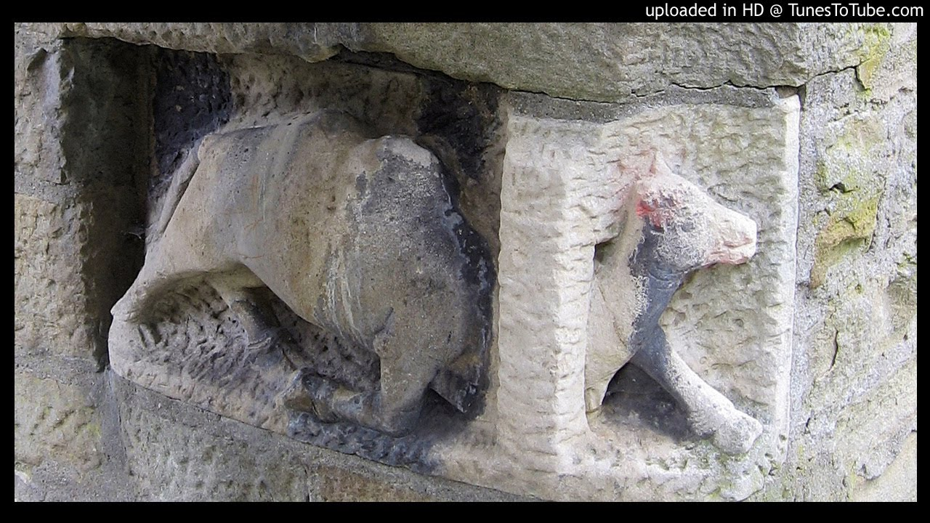

Slide 21
Matthew 7:14,
Because narrow is the gate and difficult is the way which leads to life, and there are few who find it.

Slide 22
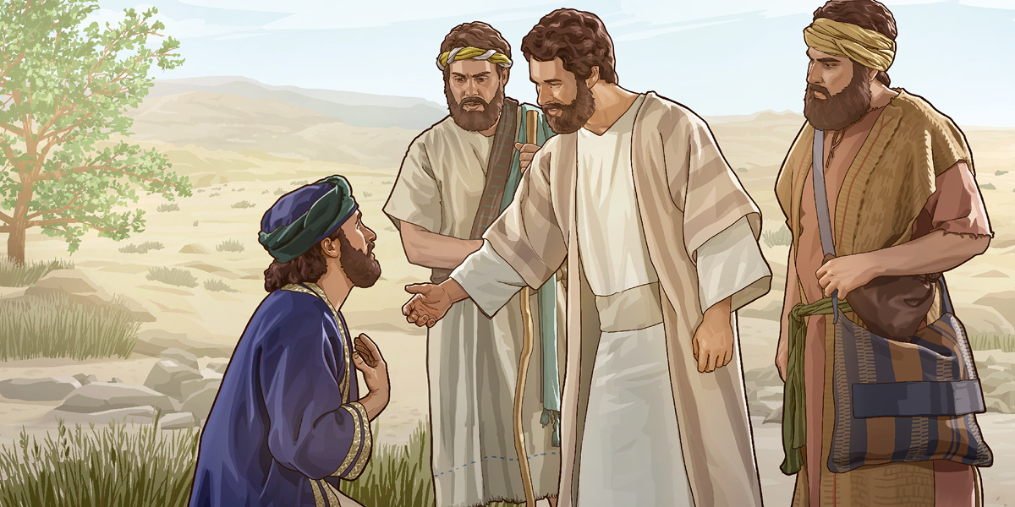
Impossible

Slide 23
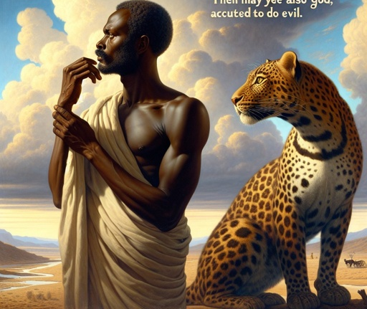
Jeremiah 13:23,

Slide 24
Man can’t be saved by himself.
No amount of works, no amount of religion, no amount of activity,
no amount of desire,
no amount of wilfulness.
It’s impossible!

Slide 25

1. Rich people have false security.

Slide 26
Rich people don’t need God because they have got all their resources.
They can buy anything they need. No sense in depending on God.

Slide 27
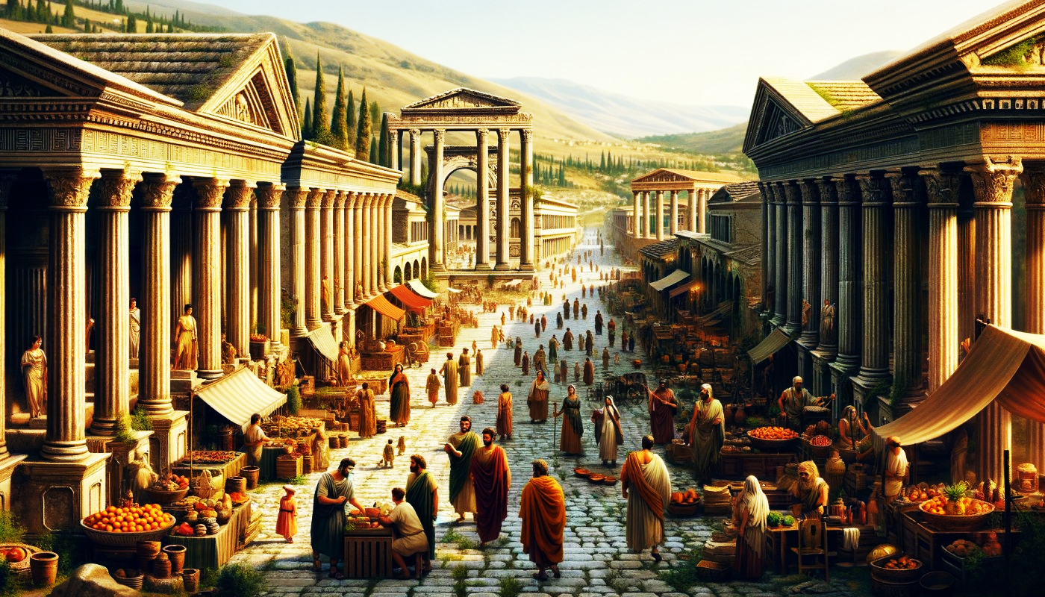

Slide 28
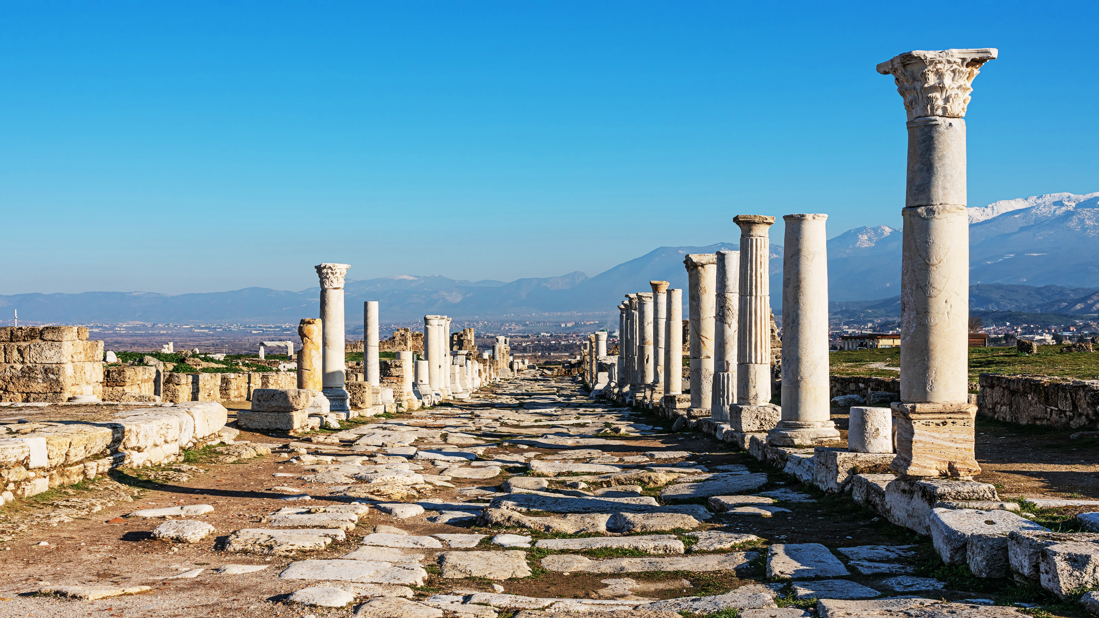

Slide 29
Revelation 3:17,
Because you say, ‘I am rich, have become wealthy, and have need of nothing’—and do not know that you are wretched, miserable, poor, blind, and naked—

Slide 30
1 Timothy 6:17,
Command those who are rich in this present age not to be haughty, nor to trust in uncertain riches but in the living God, who gives us richly all things to enjoy.

Slide 31
1 Timothy 6:18-19,
18,Let them do good, that they be rich in good works, ready to give, willing to share,

Slide 32
1 Timothy 6:18-19,
19 storing up for themselves a good foundation for the time to come, that they may lay hold on eternal life.

Slide 33
Luke 12:15,
“Take heed and beware of covetousness, for one’s life does not consist in the abundance of the things he possesses.”

Slide 34
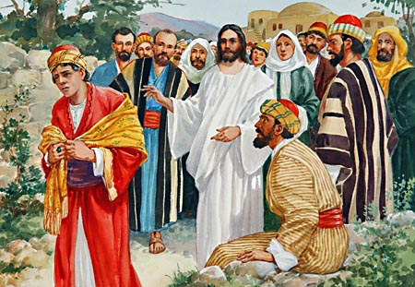
It is so difficult for rich people to be saved because they trust in their riches.

Slide 35

2. Rich people are bound to this world.

Slide 36
1 Timothy 6:6-7,
We brought nothing into this world, and it is certain we can carry nothing out.

Slide 37

1 Timothy 6:8-10,

Slide 38

Matthew 6:21,

Slide 39
Mark 4:19,
And the cares of this world, the deceitfulness of riches, and the desires for other things entering in choke the word, and it becomes unfruitful.

Slide 40
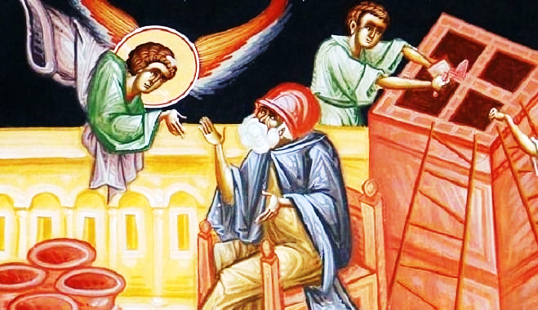
Luke 12:16-21,

Slide 41
What do rich people want?
Easy life.
Eat, drink, and be merry.

Slide 42
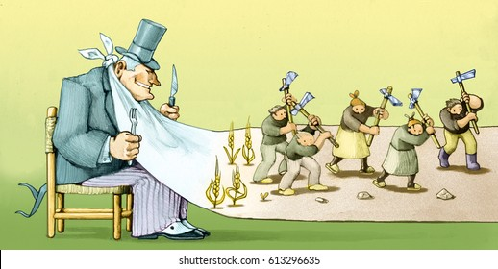
3. Rich are selfish.

Slide 43
Luke 12:19,
And I will say to my soul, “Soul, you have many goods laid up for many years; take your ease; eat, drink, and be merry.”

Slide 44
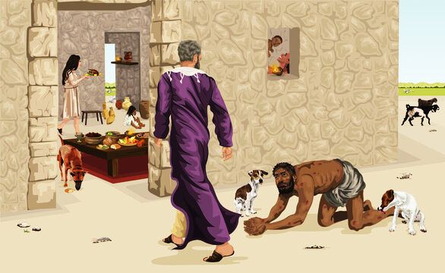
Parable of Rich man and Lazarus in Luke 16?

Slide 45
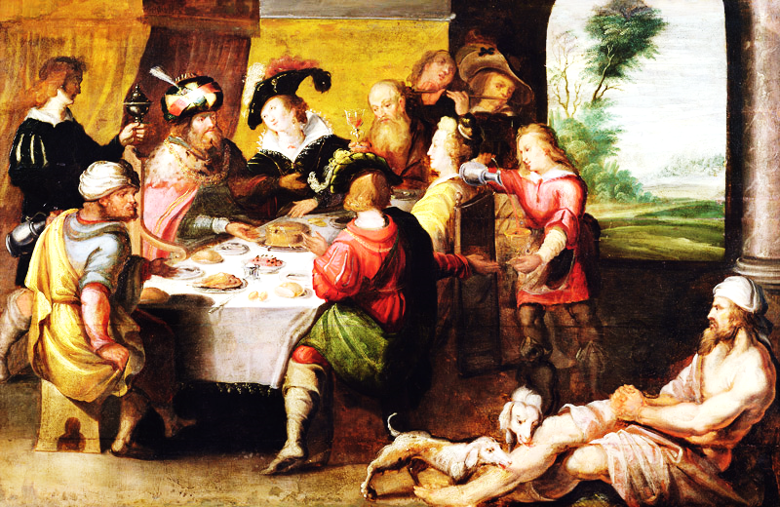

Slide 46
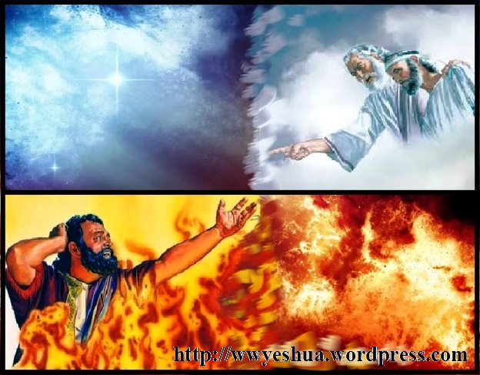

Slide 47
“Alms giving is more excellent than all offerings, and is equal to the whole law, and will deliver from the condemnation of hell and make one perfectly righteous.” Talmud.

Slide 48
V 25,
When His disciples heard it, they were greatly astonished, saying, “Who then can be saved?”

Slide 49
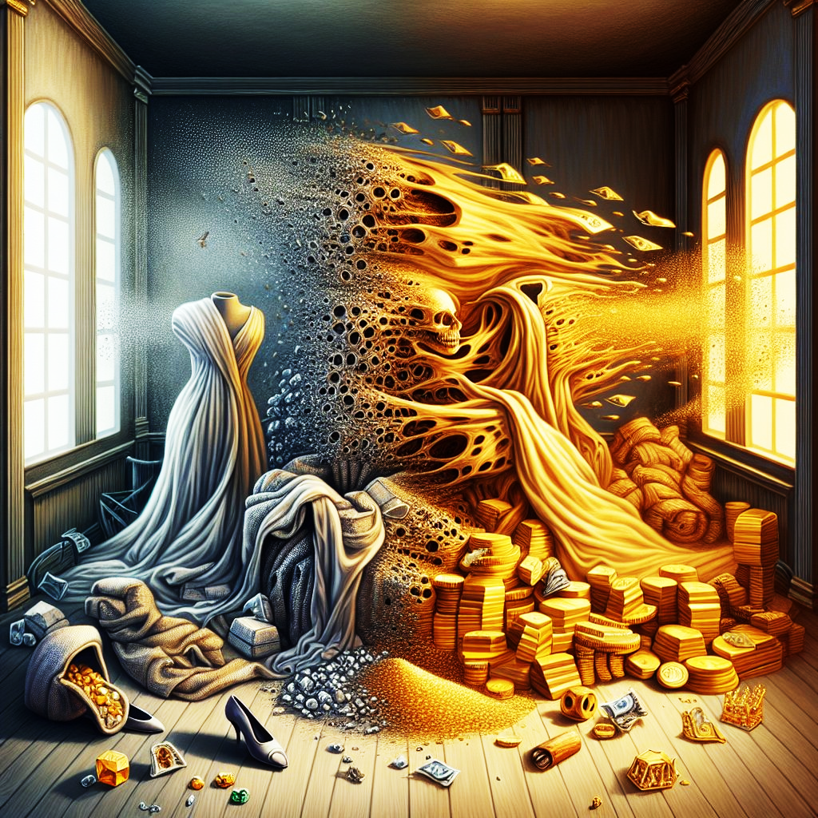
James 5:1-3,

Slide 50
V 26
“With men this is impossible, but with God all things are possible.”

Slide 51
John 1:12,
But as many as received Him, to them He gave the right to become children of God, to those who believe in His name:

Slide 52
John 1:13,
who were born, not of blood, nor of the will of the flesh, nor of the will of man, but of God.

Slide 53
2 Timothy 2:24-25
In humility correcting those who are in opposition, if God perhaps will grant them repentance, so that they may know the truth,

Slide 54
John 6:44,
No one can come to Me unless the Father who sent Me draws him; and I will raise him up at the last day.

Slide 55
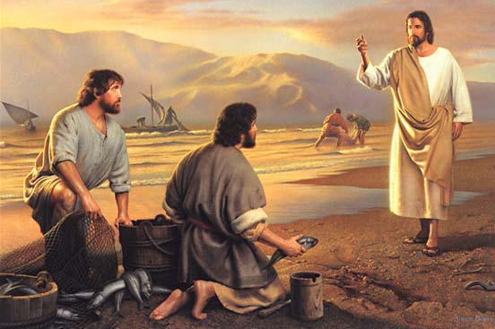
V 27,

Slide 56
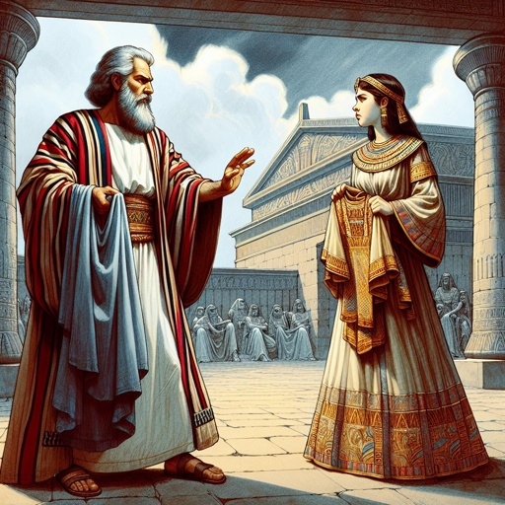
Hebrews 11:24-26,

Slide 57
V 27
Therefore, what shall we have?”

Slide 58
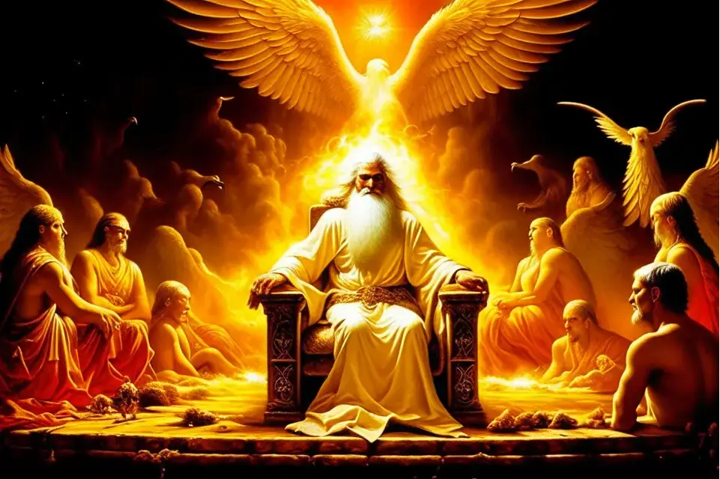
V 28

Slide 59
What is regeneration?
Referring to the millennial kingdom, the rebirth.

Slide 60
Titus 3:5
Not by works of righteousness which we have done, but according to His mercy He saved us,

Slide 61
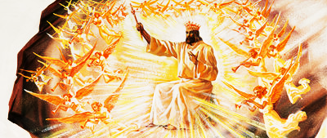
Psalm 2

Slide 62

Revelation 19,

Slide 63
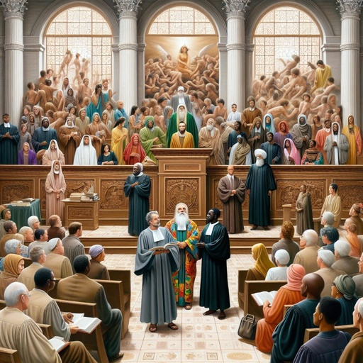
1 Corinthians 6:2

Slide 64
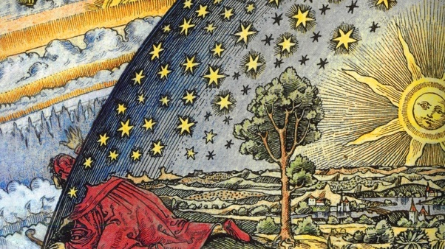
Matthew 24:29-30,

Slide 65
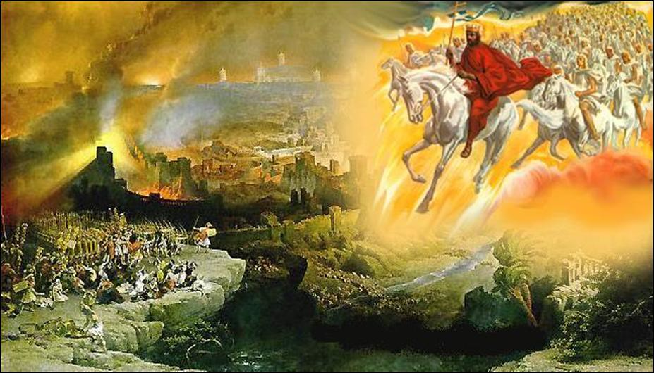
Matthew 24:29-30,

Slide 66
Acts chapter 3
The times of refreshing, or the times of rest when the earth rests from the curse.

Slide 67
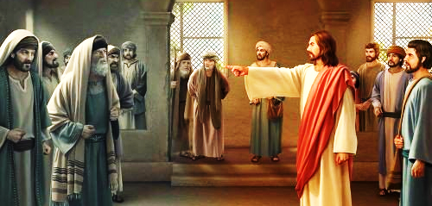
Matthew 12:32,

Slide 68
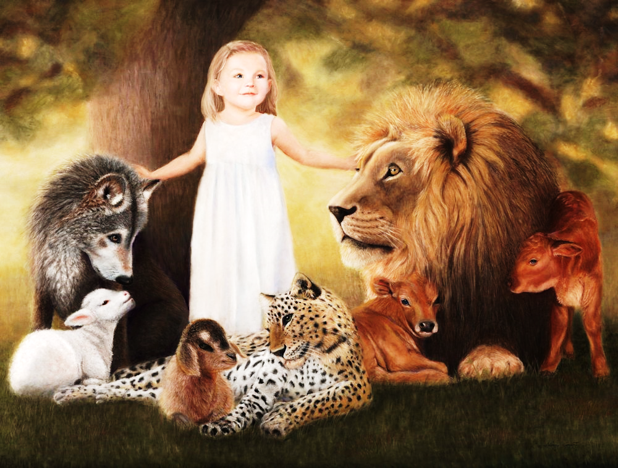
The Great Millennial Kingdom

Slide 69
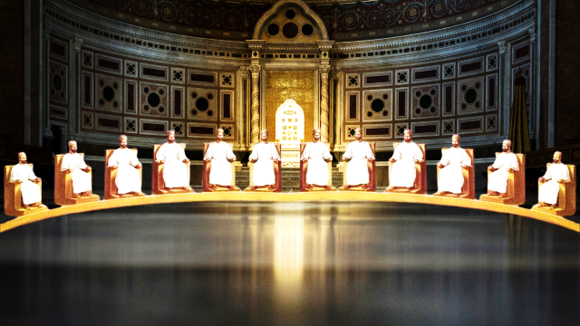
a) You will rule over Israel.

Slide 70
1 Peter 2:9,
But you are a chosen generation, a royal priesthood, a holy nation, His own special people,

Slide 71
1 Peter 2:9,
that you may proclaim the praises of Him who called you out of darkness into His marvellous light;

Slide 72
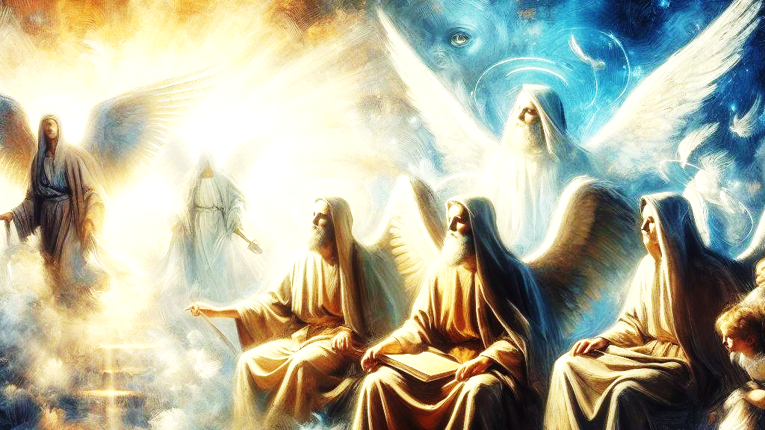
Judge Angels or even Rule them

Slide 73
b) They receive more than they gave up.

Slide 74
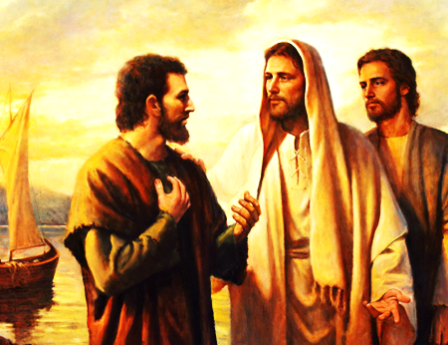
V 29,

Slide 75
Mark 10:30,
But many who are first will be last, and the last first.”

Slide 76
c) Will inherit everlasting life.

Slide 77
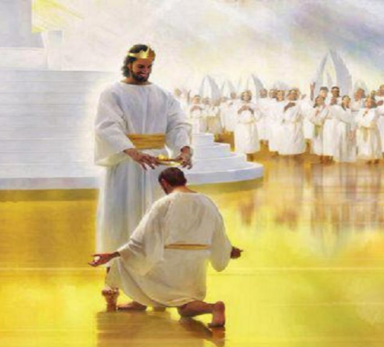
You will be rewarded for Eternity

Slide 78
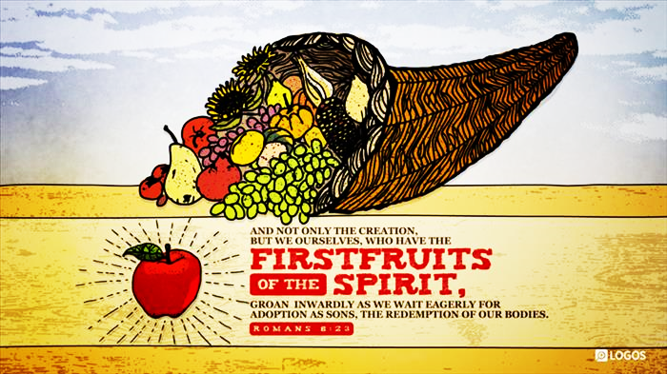
Romans 8:23,

Slide 79
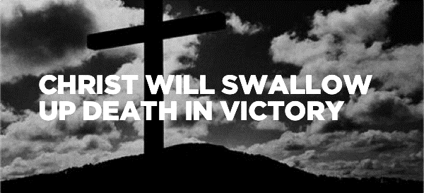
1 Corinthians 15:53-54,

Slide 80
Take your choice:
Rich now, poor forever!
Poor now, rich forever!!

