Slide 1

JULY 28
S u n d a y

Slide 2


Matthew 19:30-20:1-16
COMMON Reward for All

Slide 3

This is not fair.

Slide 4

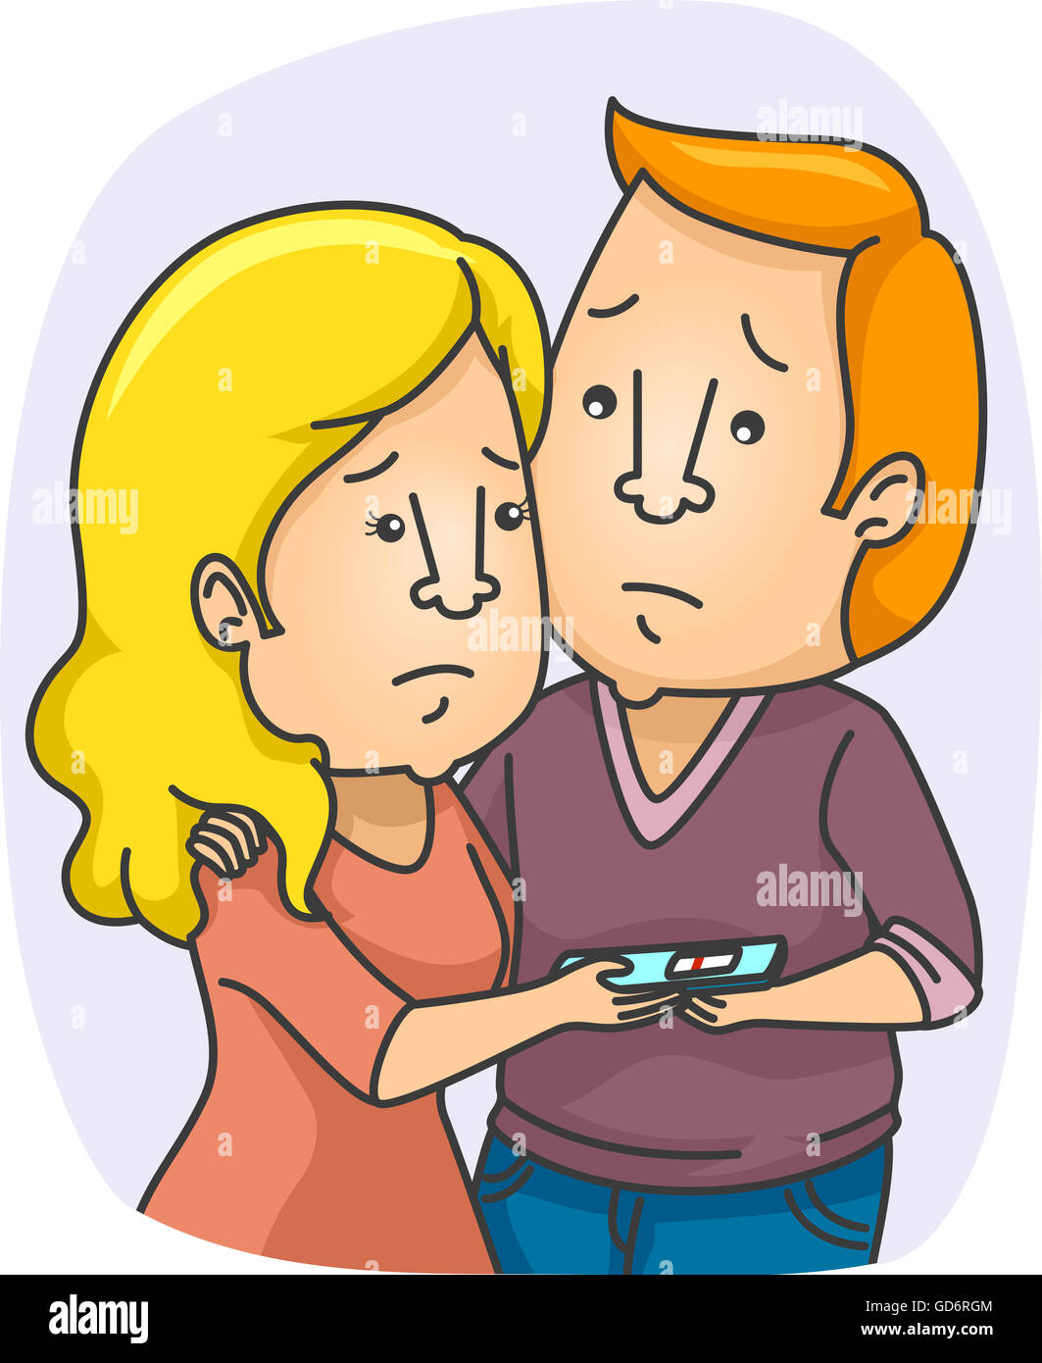
This is not fair.

Slide 5
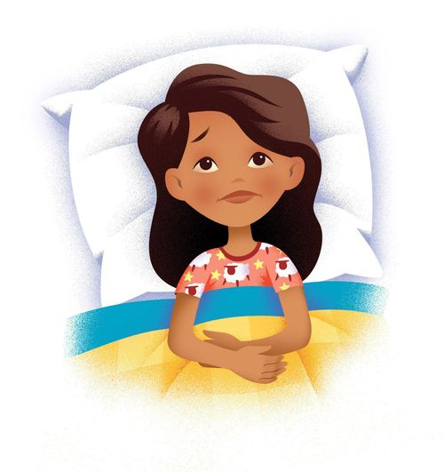
This is not fair.

Slide 6
This is not fair.

Slide 7
There were three different times the people were deported from Israel
605, 597 and 586 B.C.

Slide 8
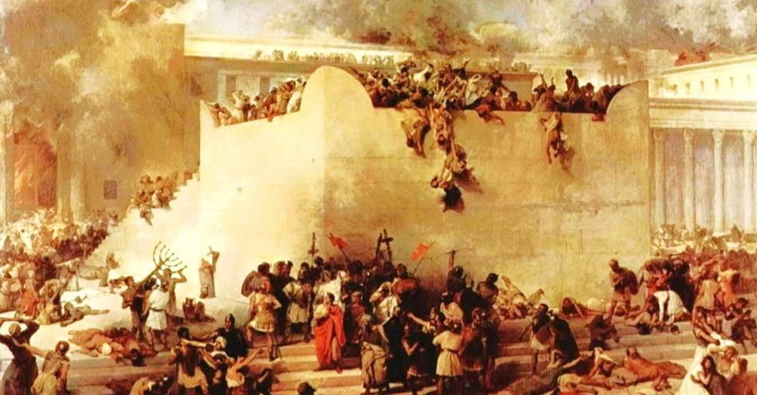

Slide 9
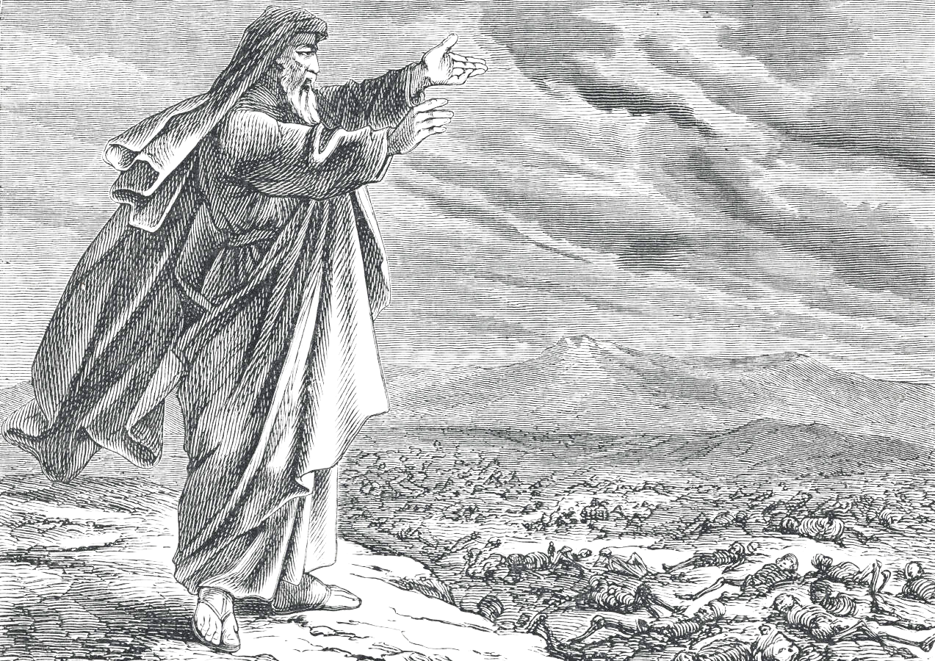
They accused God of being unjust.
They accused God of being unfair.

Slide 10
Ezekiel 18:25
O house of Israel, is it not My way which is fair, and your ways which are not fair?

Slide 11
Commonality…
…of truth in the gospel.
…of repentance,
…of faith.
…of the application of justification and sanctification of the believer in salvation.
…in the way God treats us.

Slide 12

Matthew 19:30
But many who are first will be last, and the last first.

Slide 13
Matthew 19:30
But many who are first will be last, and the last first.

Slide 14
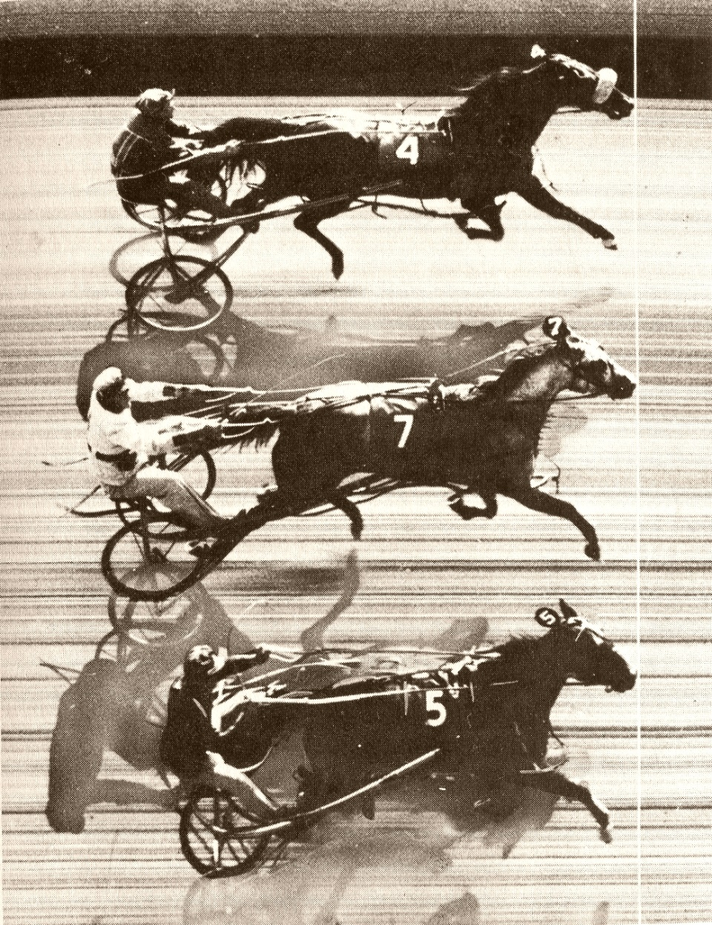

DEAD HEAT

Slide 15
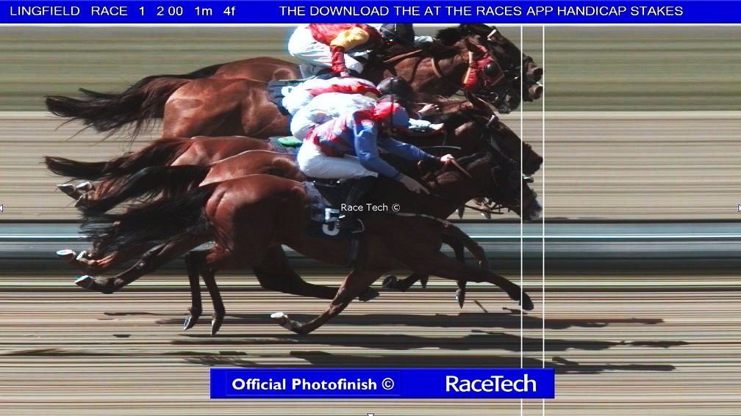

Slide 16
The first are last, and the last are first because everybody finishes the same.
“Everyone are the same.”
There is no inequality.

Slide 17


Slide 18
Matthew 20:1
“For the kingdom of heaven is like a landowner who went out early in the morning to hire labourers for his vineyard.

Slide 19

The kingdom of heaven is the
Sphere of Salvation.

Slide 20
Greek word
oikodespotēs,
‘Somebody who rules over a house.

Slide 21
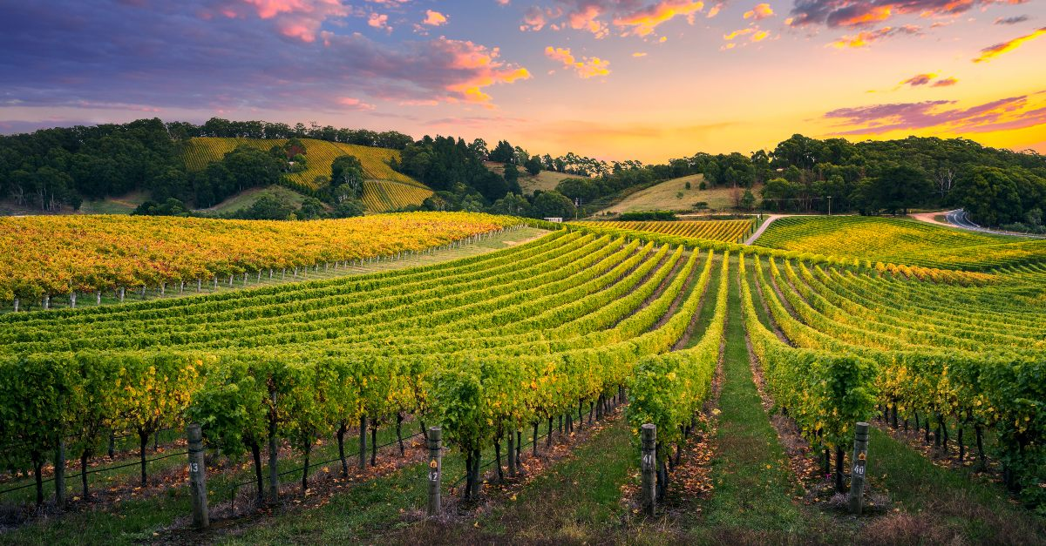
(according to V 15)

Slide 22
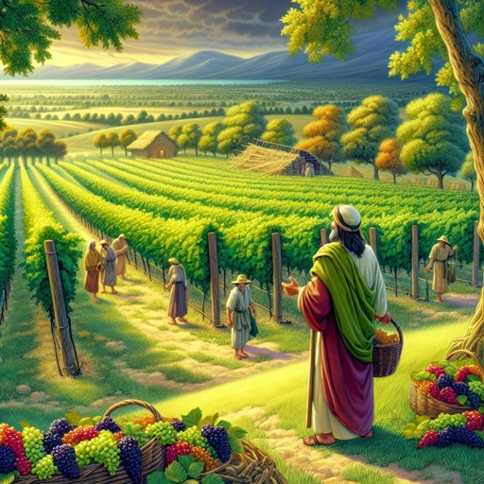

Slide 23
‘There was a sequence that they followed.
➢ In spring, they prepared the soil to be productive.
➢ In summer they pruned and tied for maximum effect.
➢ In September the harvest came.

Slide 24
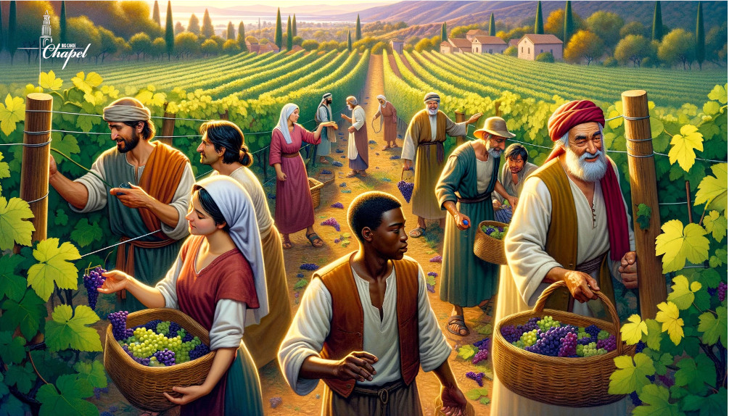

Slide 25
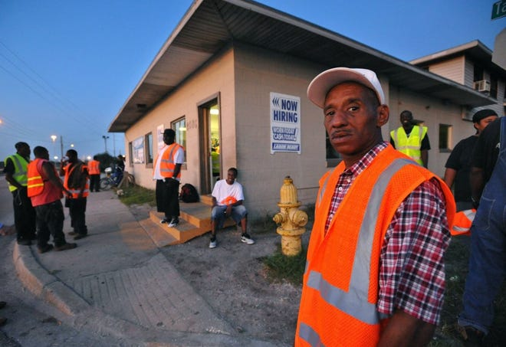

Slide 26
Prime time for work.
From 6:00 AM to 6:00 PM.
It was 12-hour workday, and it was a 6-day workweek

Slide 27
He went into the marketplace where the day labourers would be waiting to be hired.
Approx 5:00 am in the Morning

Slide 28
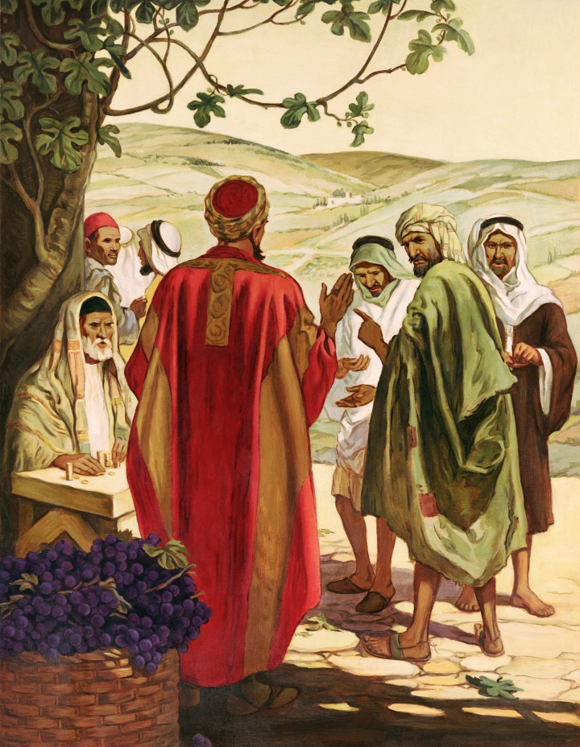
Now when he had agreed with the labourers for a denarius a day, he sent them into his vineyard.

Slide 29
Leviticus 19:13,
‘You shall not cheat your neighbour, nor rob him. The wages of him who is hired shall not remain with you all night until morning.

Slide 30
Deuteronomy 24:15,
Each day you shall give him his wages, and not let the sun go down on it, for he is poor and has set his heart on it; lest he cry out against you to the Lord, and it be sin to you.

Slide 31
Matthew 20:3
And he went out about the third hour and saw others standing idle in the marketplace,

Slide 32
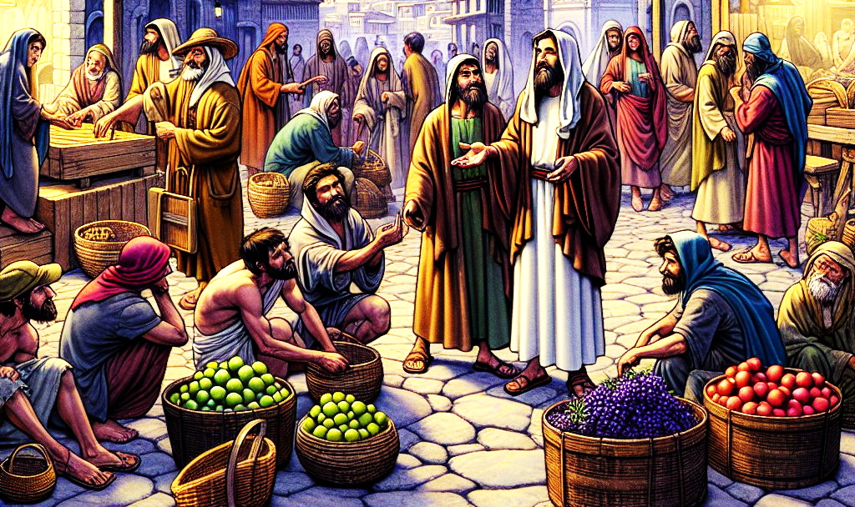
He went back at 9:00 AM in the morning

Slide 33
Matthew 20:4
and said to them, ‘You also go into the vineyard, and whatever is right I will give you.’ So they went.

Slide 34
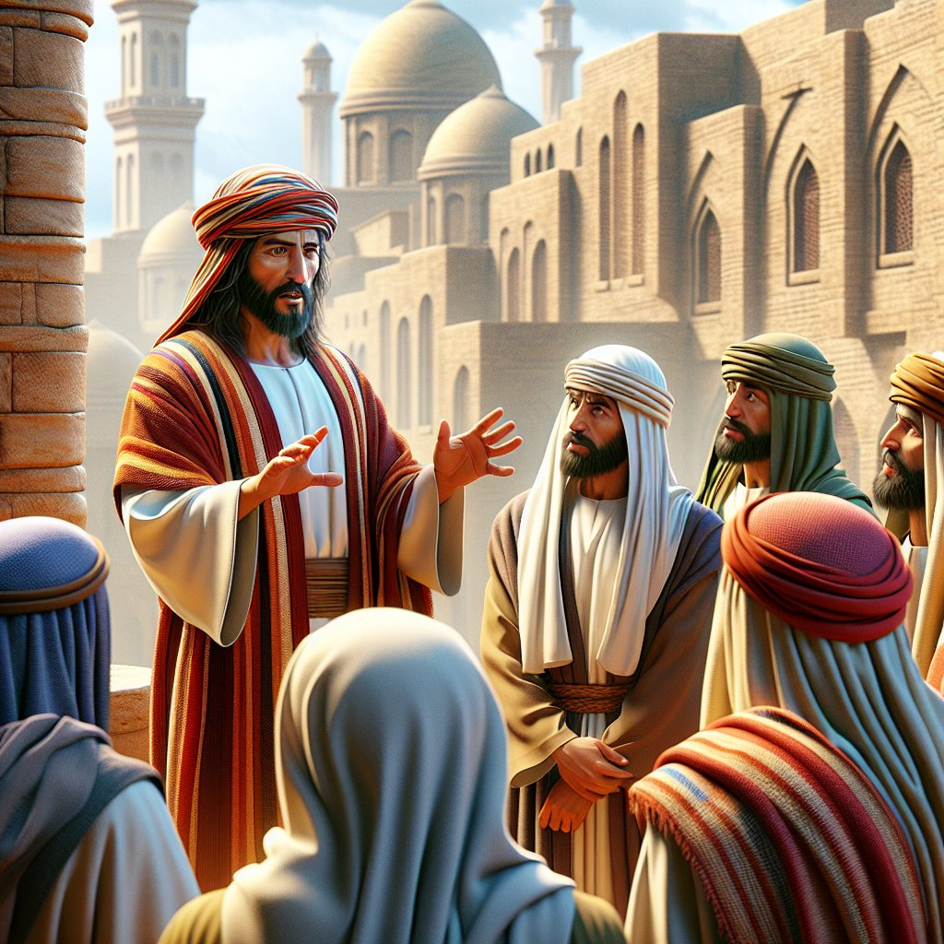
They didn’t debate.
They didn’t have a negotiating position.

Slide 35
Matthew 20:5
Again he went out about the sixth and the ninth hour and did likewise.

Slide 36
At the sixth hour 12.00 in the afternoon.
At the ninth hour 03.00 pm in the afternoon.

Slide 37
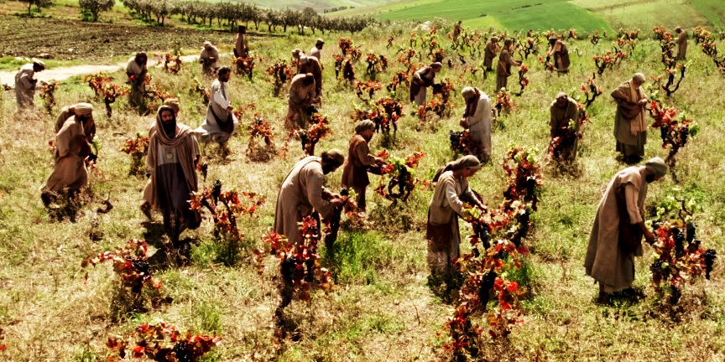

Slide 38
Matthew 20:6
And about the eleventh hour he went out and found others standing idle, and said to them, ‘Why have you been standing here idle all day?’

Slide 39
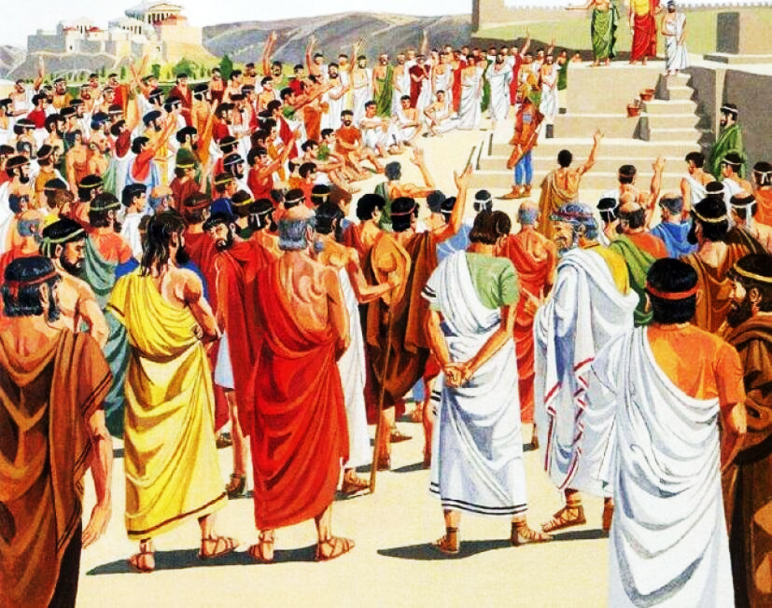
At eleventh hour 5.00 pm in the evening

Slide 40
Matthew 20:7
They said to him, ‘Because no one hired us.’ He said to them, ‘You also go into the vineyard, and whatever is right you will receive.’

Slide 41
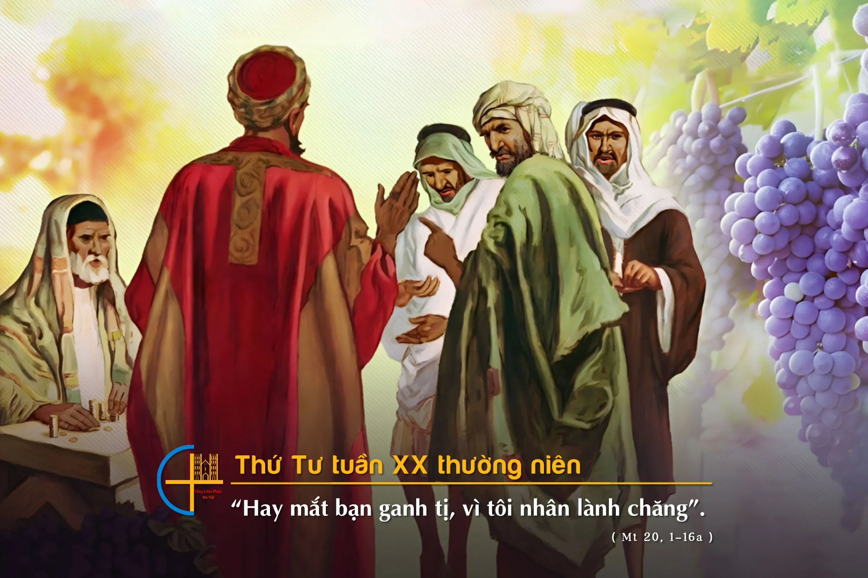

Slide 42
Matthew 20:8
“So when evening had come, the owner of the vineyard said to his steward, ‘Call the labourers and give them their wages, beginning with the last to the first.

Slide 43
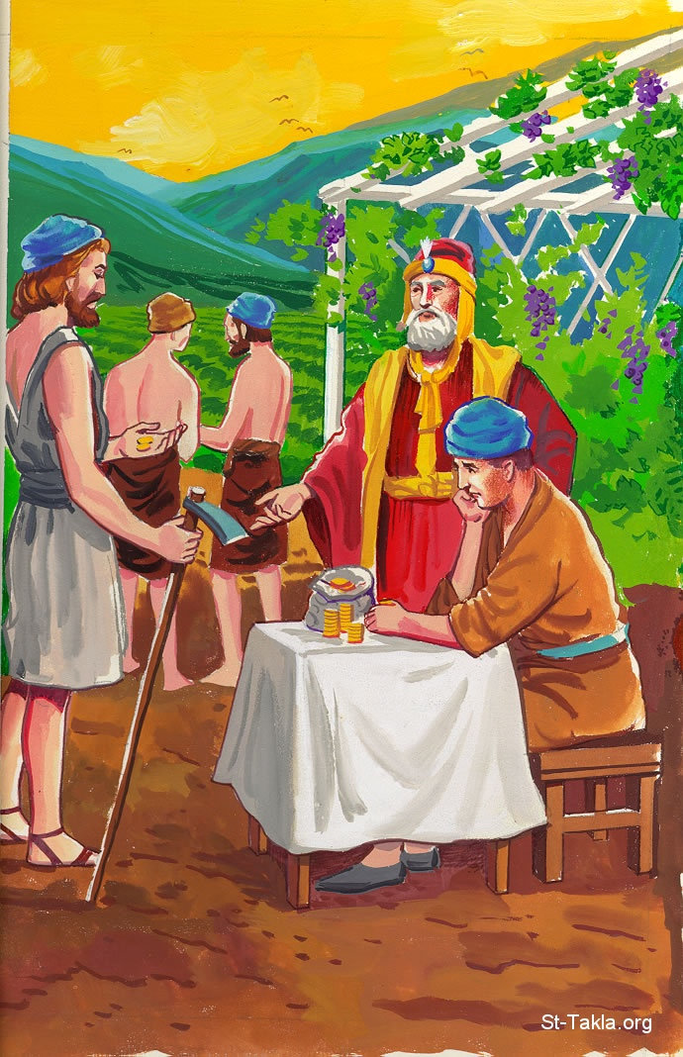

Slide 44
Matthew 20:9
And when those came who were hired about the eleventh hour, they each received a denarius.

Slide 45
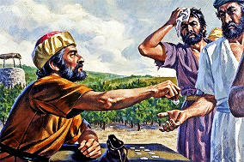

Slide 46
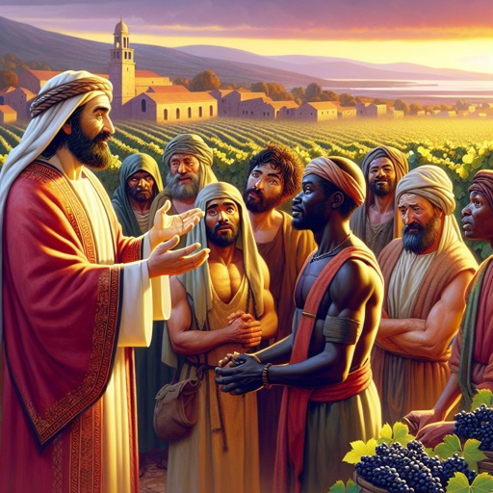
What mercy?
What graciousness?
What kindness?
What generosity?
To receive a denarius.

Slide 47
Matthew 20:10
But when the first came, they supposed that they would receive more; and they likewise received each a denarius.

Slide 48
Matthew 20:11
And when they had received it, they complained against the landowner,

Slide 49
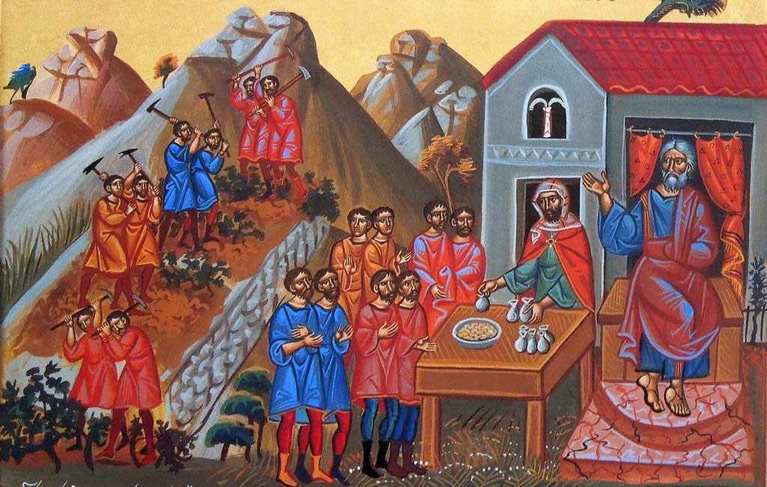

Slide 50
Matthew 20:12
Saying, ‘These last men have worked only one hour, and you made them equal to us who have borne the burden and the heat of the day.’

Slide 51
We have been here with our parched lips and our sun beaten bodies.
We have been going for 12 hours. The evenings cool down in Israel.

Slide 52
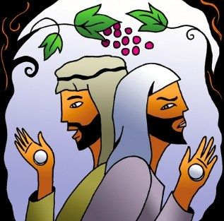
1 hour
Cool twilight
12 hour
scorchingblazing

Slide 53
Matthew 20:13
But he answered one of them and said, ‘Friend, I am doing you no wrong. Did you not agree with me for a denarius?

Slide 54
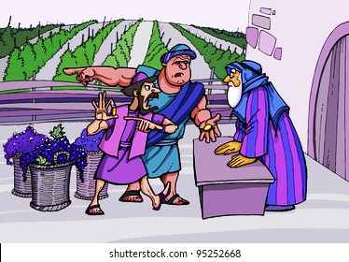
Hetairos- Friend

Slide 55
Matthew 20:14
Take what is yours and go your way. I wish to give to this last man the same as to you.

Slide 56
Matthew 20:15
Is it not lawful for me to do what I wish with my own things? Or is your eye evil because I am good?’

Slide 57
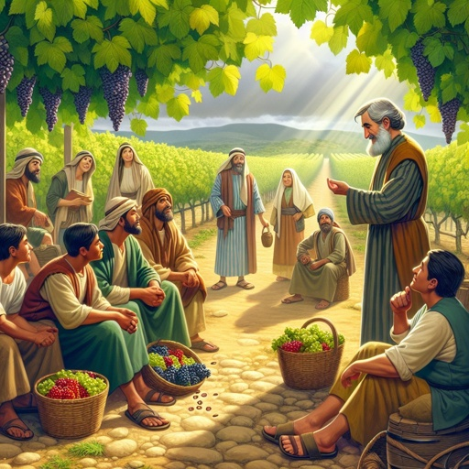
Was this illegal?
Was it unjust?
Was it unfair?
Was it without mercy?
No

Slide 58
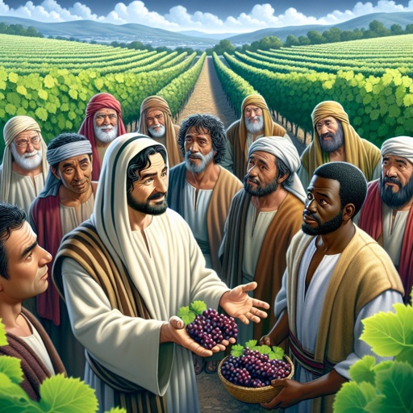
Whether they worked a brief time or a long time or anything in between they all had the same need and he met it with generosity.

Slide 59


Slide 60
People coming into a vineyard, working different hours, putting out different effort, in the end,
all receive the same result.

Slide 61
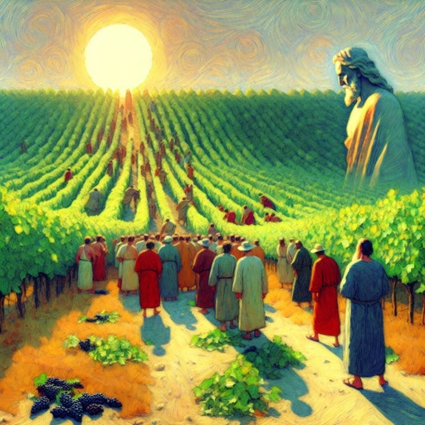
The householder is
God

Slide 62
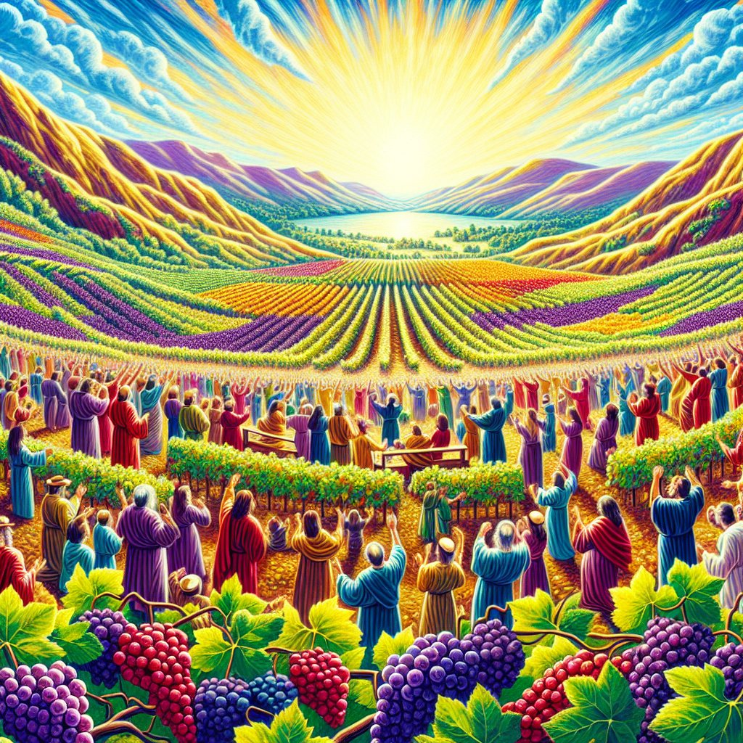

The vineyard
is His kingdom

Slide 63
Matthew 20:1

Slide 64
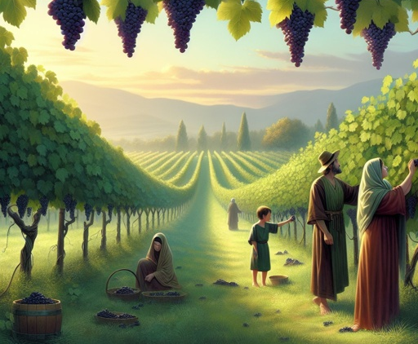
The day of work is
TIME

Slide 65
Jesus Christ who gives out those REWARDS

Slide 66
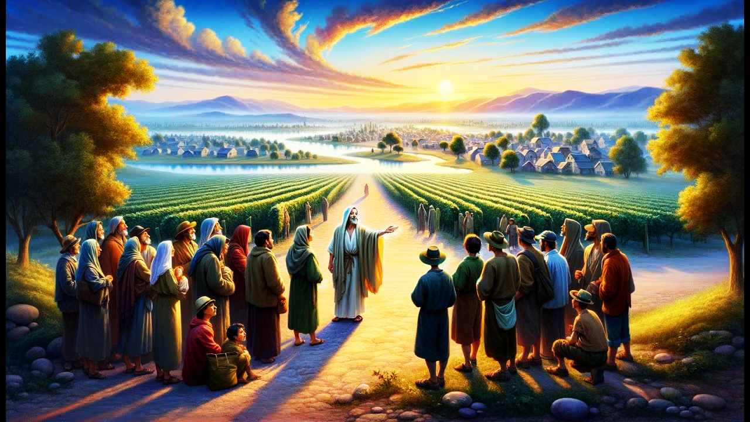
Eternal life

Slide 67
James 1:12
Blessed is the man who endures temptation; for when he has been approved, he will receive the crown of life which the Lord has promised to those who love Him.

Slide 68
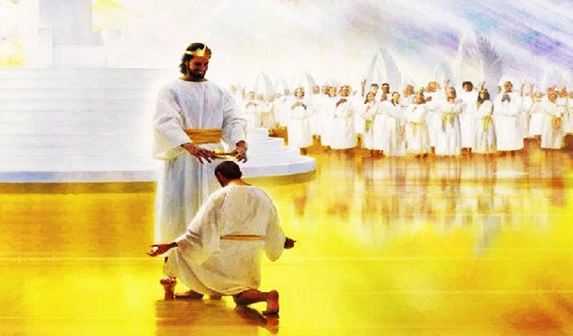
2 Timothy 4:8,

Slide 69
we receive the common eternal life.
Some people are going to spend decades of their life,
some people will spend a half century of their life in the service of the King.

Slide 70
we receive the common eternal life.
Some people have spent their lives in very difficult, challenging, sacrificial kinds of service to Christ.

Slide 71
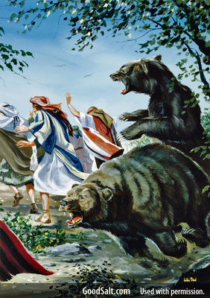
we receive the common eternal life.
Some people have trekked through jungles, swamps, and fought against beasts in the history of the church.

Slide 72
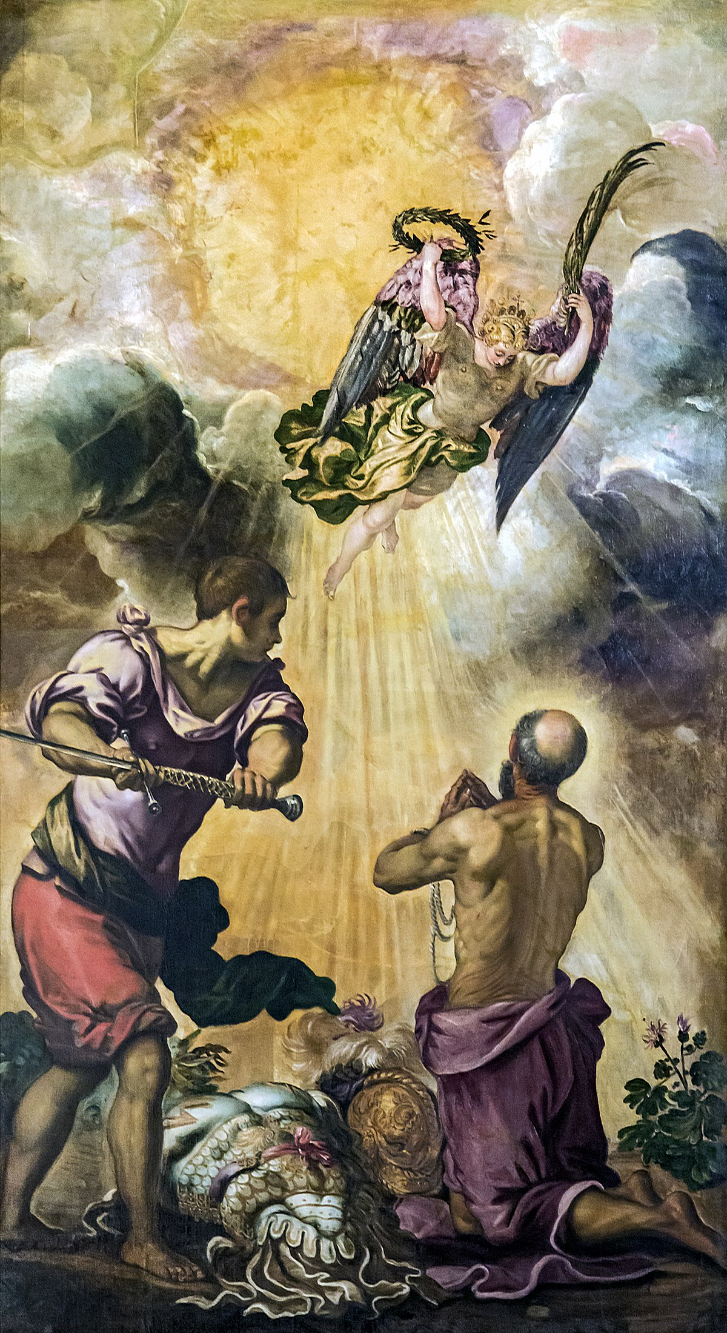
we receive the common eternal life.
Some have been martyred. Some today are being martyred for their faith in Christ.

Slide 73
we receive the common eternal life.
Some work diligently to the point of sweat and exhaustion in the service of the King.

Slide 74
we receive the common eternal life.
Some work diligently to the point of sweat and exhaustion in the service of the King.

Slide 75
Do they all receive the same eternal life?
Yes, yes.

Slide 76
No matter how long the service,
No matter how short the service,
No matter how hard the effort was,
No matter how easy the effort might have been,

Slide 77
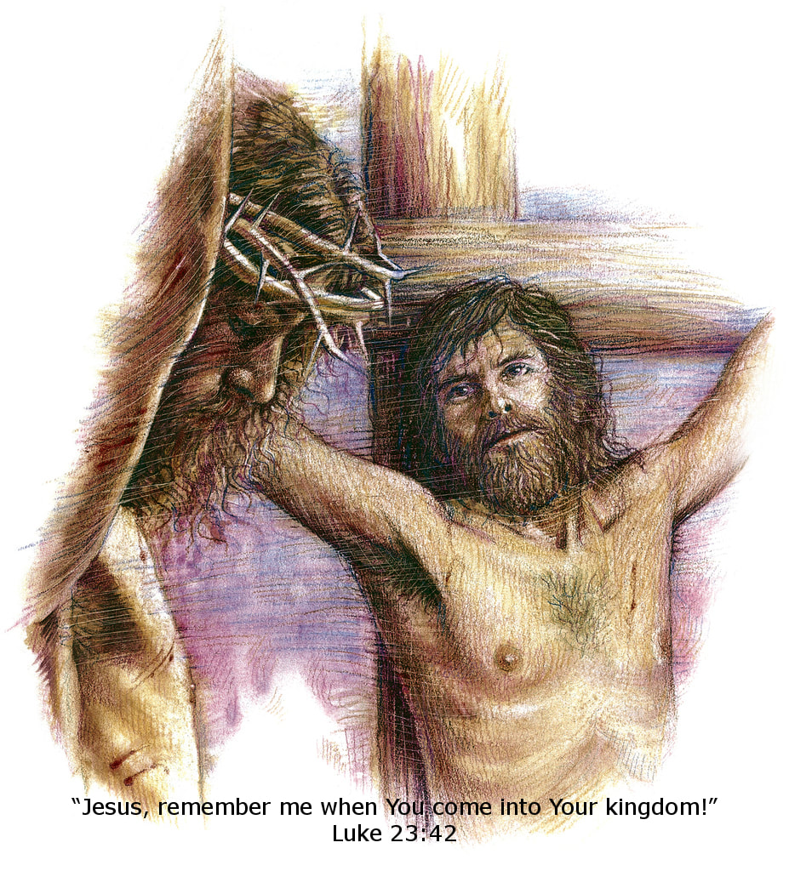
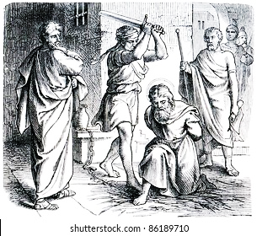
The same glorious eternal life will belong to us all

Slide 78
Matthew19:16
Now behold, one came and said to Him, “Good Teacher, what good thing shall I do that I may have eternal life?”

Slide 79
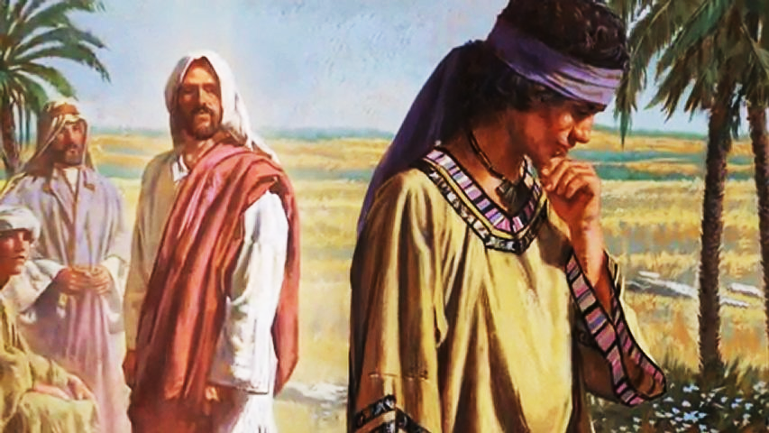
He really did want eternal life; he wasn’t willing to pay the price.

Slide 80
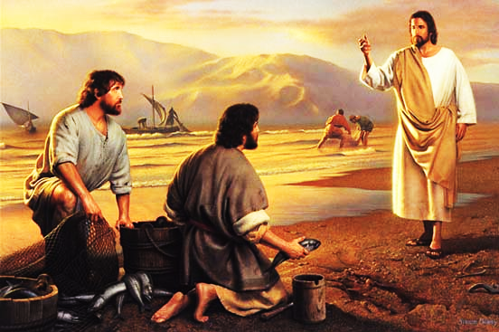
Matthew19:27

Slide 81
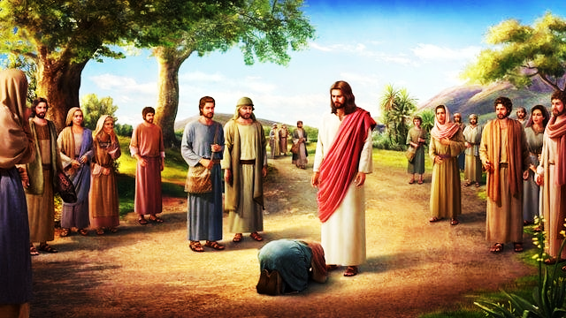

Slide 82
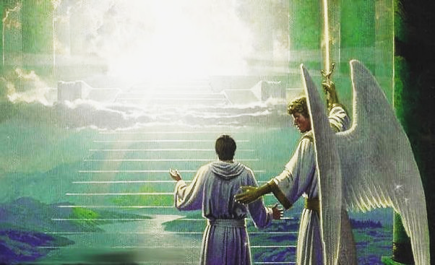
Matthew19:28,29

Slide 83
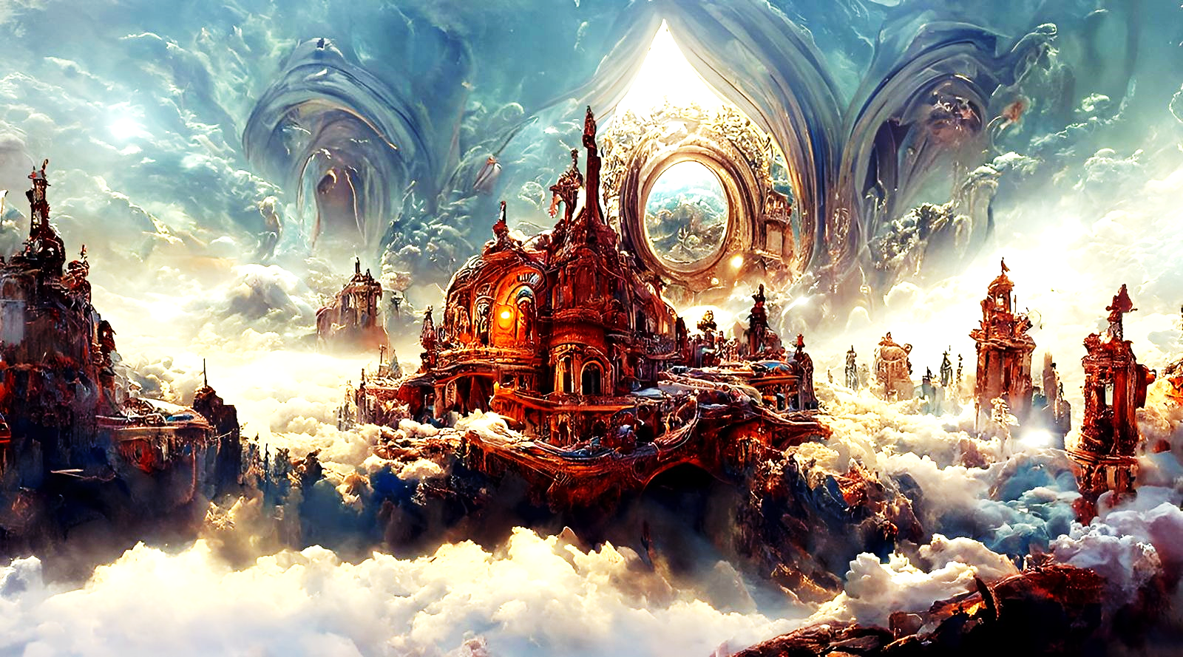
John 14:2

Slide 84


Slide 85
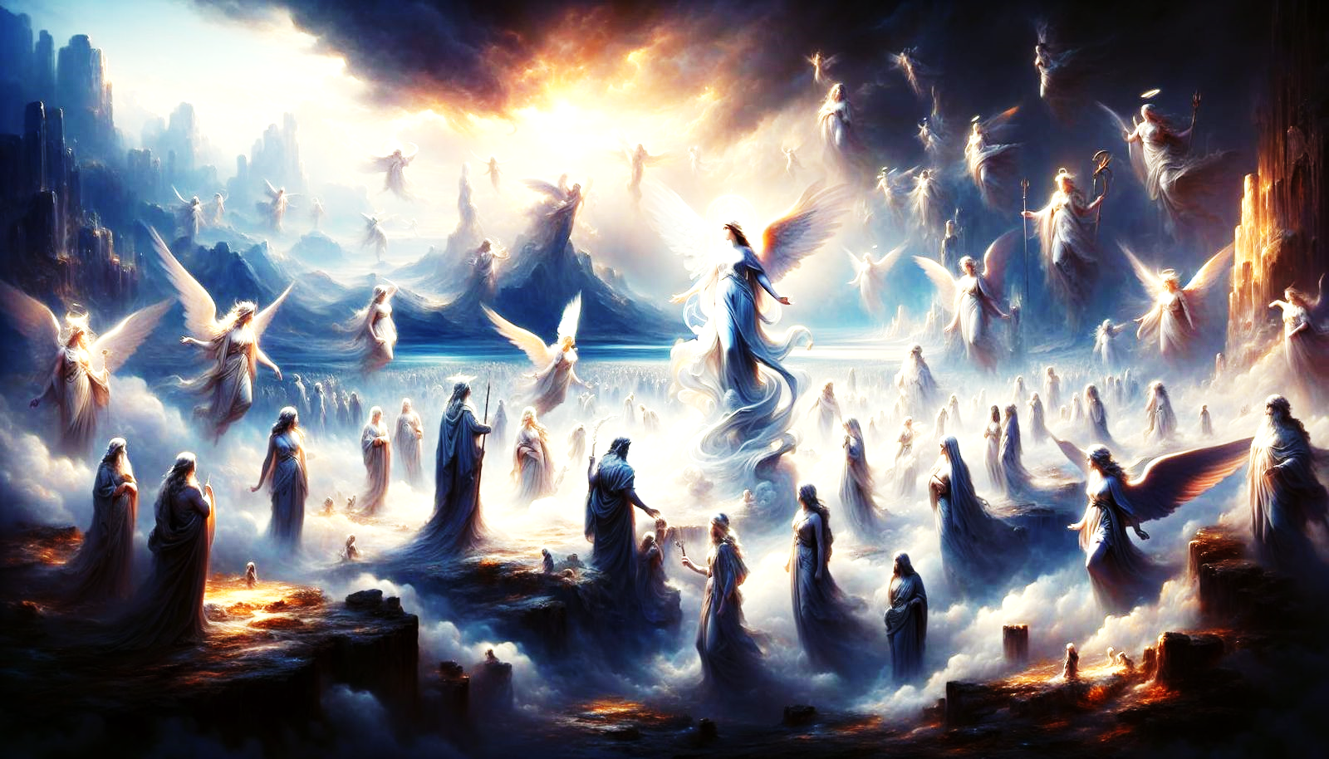

Slide 86
Isn’t there inequality?
No, because we all have the same need and God’s generosity will give us the same great blessing.

Slide 87
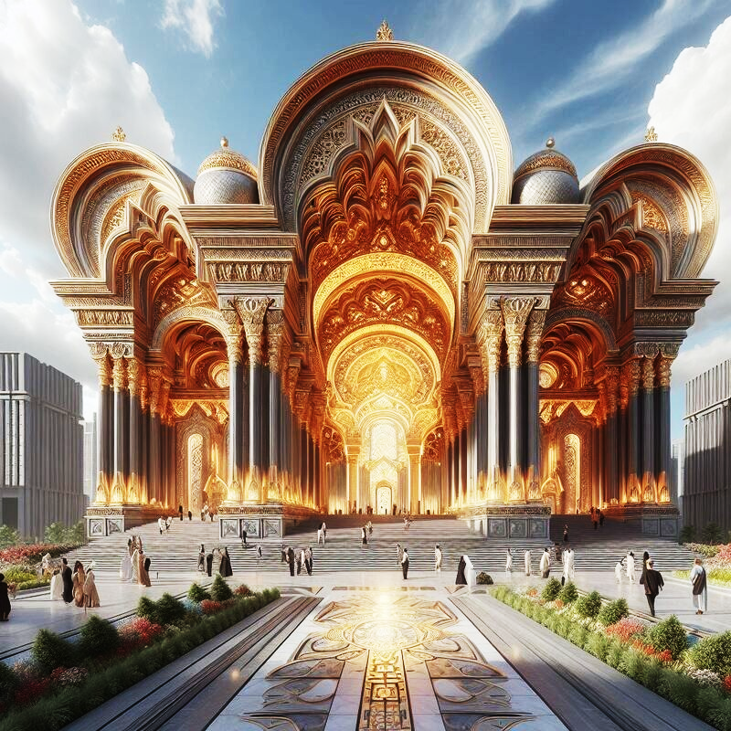
All eternal reward is by Grace.

Slide 88
The length and difficulty of service is not a factor. Sovereign Grace.
God’s incredible mercy
God graciously gives to all undeserving sinners, the same eternal life.

Slide 89


Slide 90
i) God initiates salvation sovereignly.

Slide 91
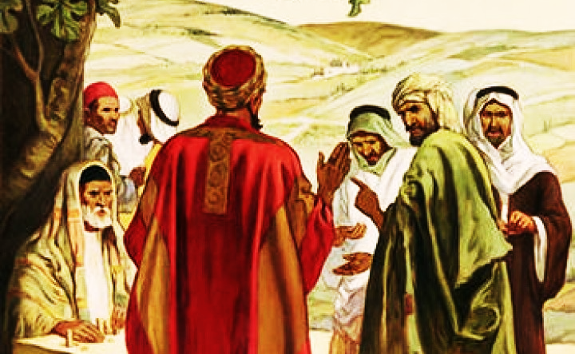
i) God initiates salvation sovereignly.

Slide 92
John 15:16,
You did not choose Me, but I chose you and appointed you that you should go and bear fruit,

Slide 93
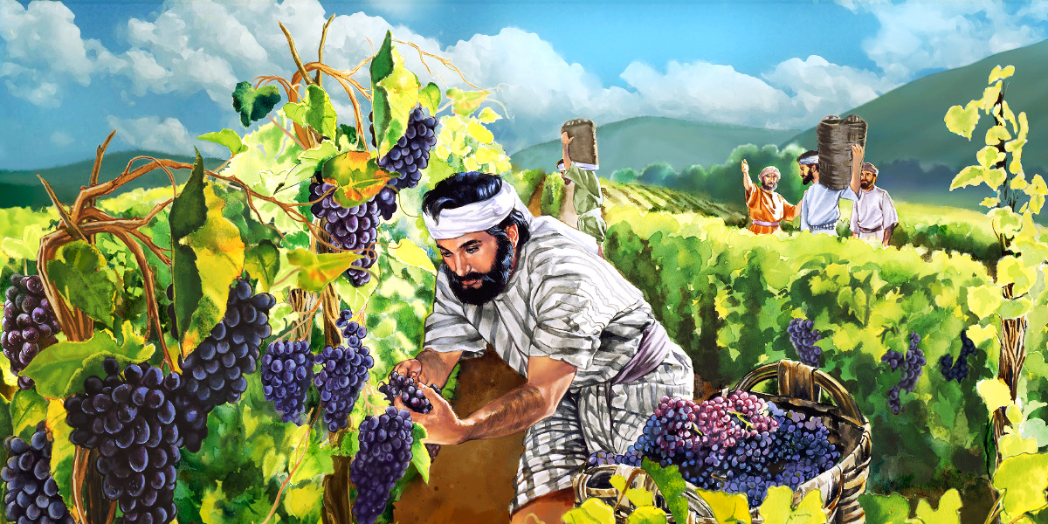
ii) God establishes the terms.

Slide 94
The terms of the gospel have been established.
Jesus set them.
God set them.

Slide 95
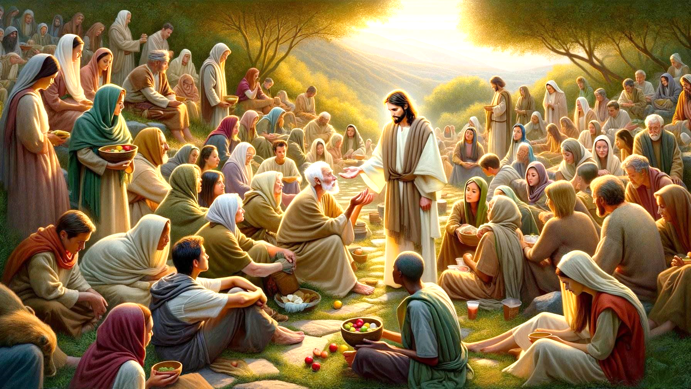
iii) God is continually calling people into his kingdom.

Slide 96
John 5:17,
But Jesus answered them, “My Father has been working until now, and I have been working.”

Slide 97
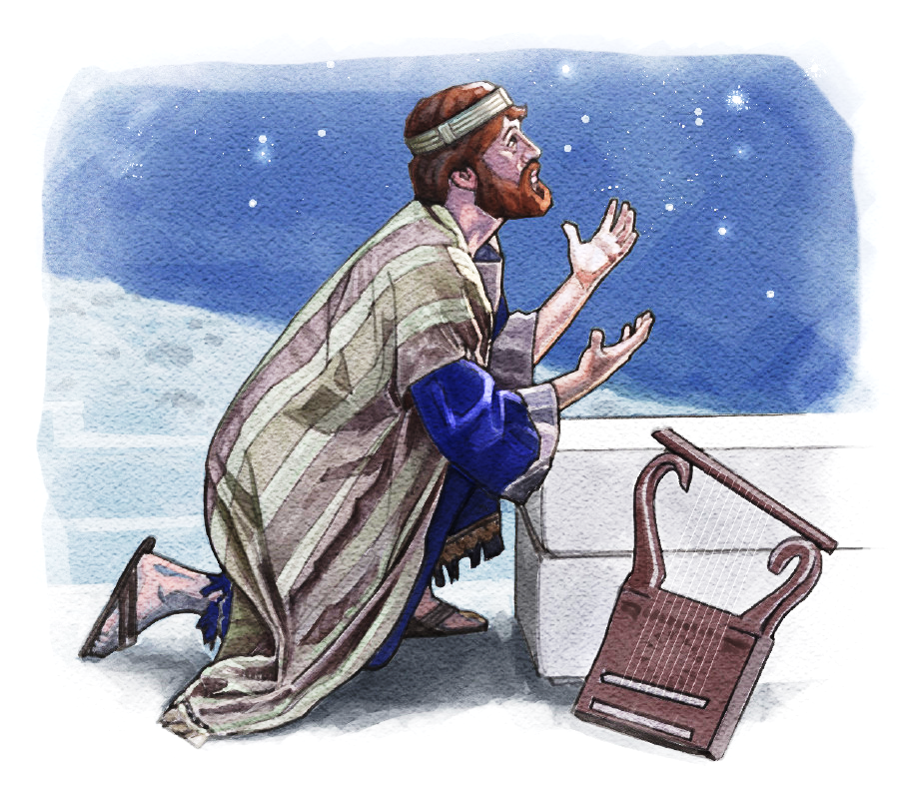
iv) God redeems those who are willing.

Slide 98
They were available.
They were willing.
They knew they were dependent.
They knew they had nothing apart from this.
They were not rich.

Slide 99
They were not self-sufficient.
They were not satisfied.
They were the poor.
They were meek.
They were without resources.

Slide 100
v) God is compassionate.

Slide 101
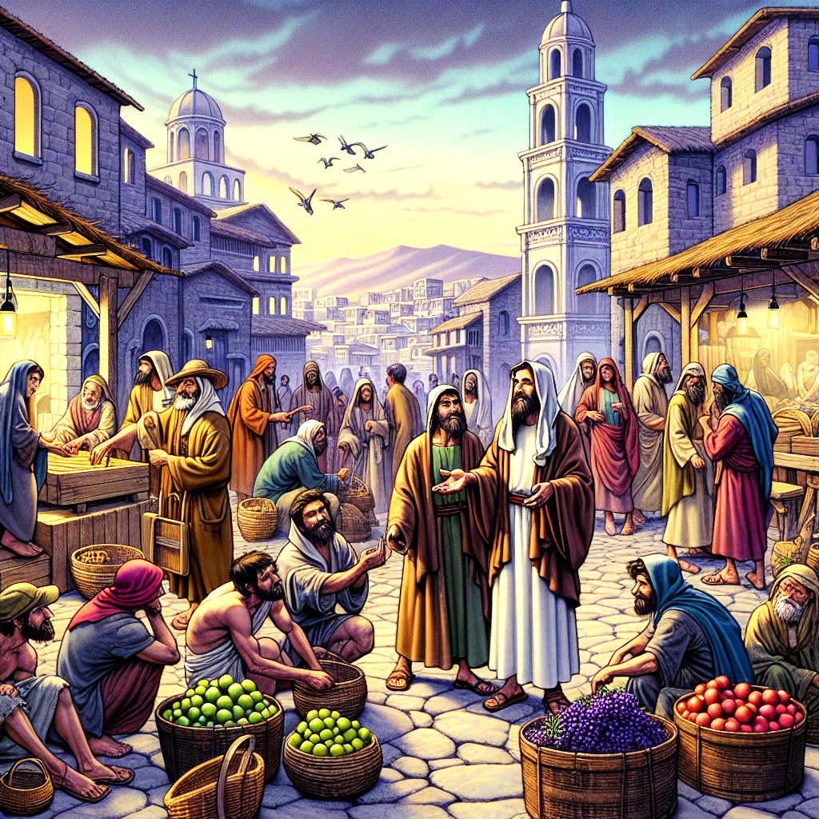
v) God is compassionate.

Slide 102
Why does he keep coming back?
The only answer to that is that he represents God.

Slide 103
vi) All are workers.

Slide 104
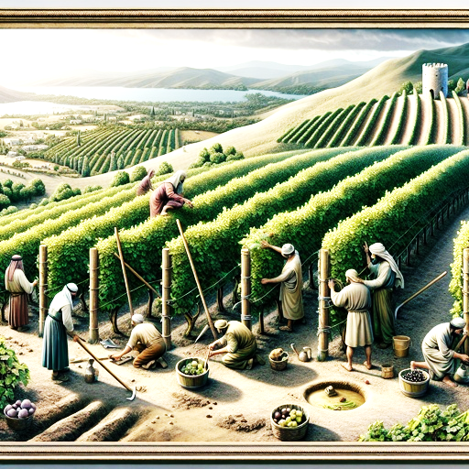
vi) All are workers.

Slide 105
What is the work?
Evangelism. Harvest.

Slide 106
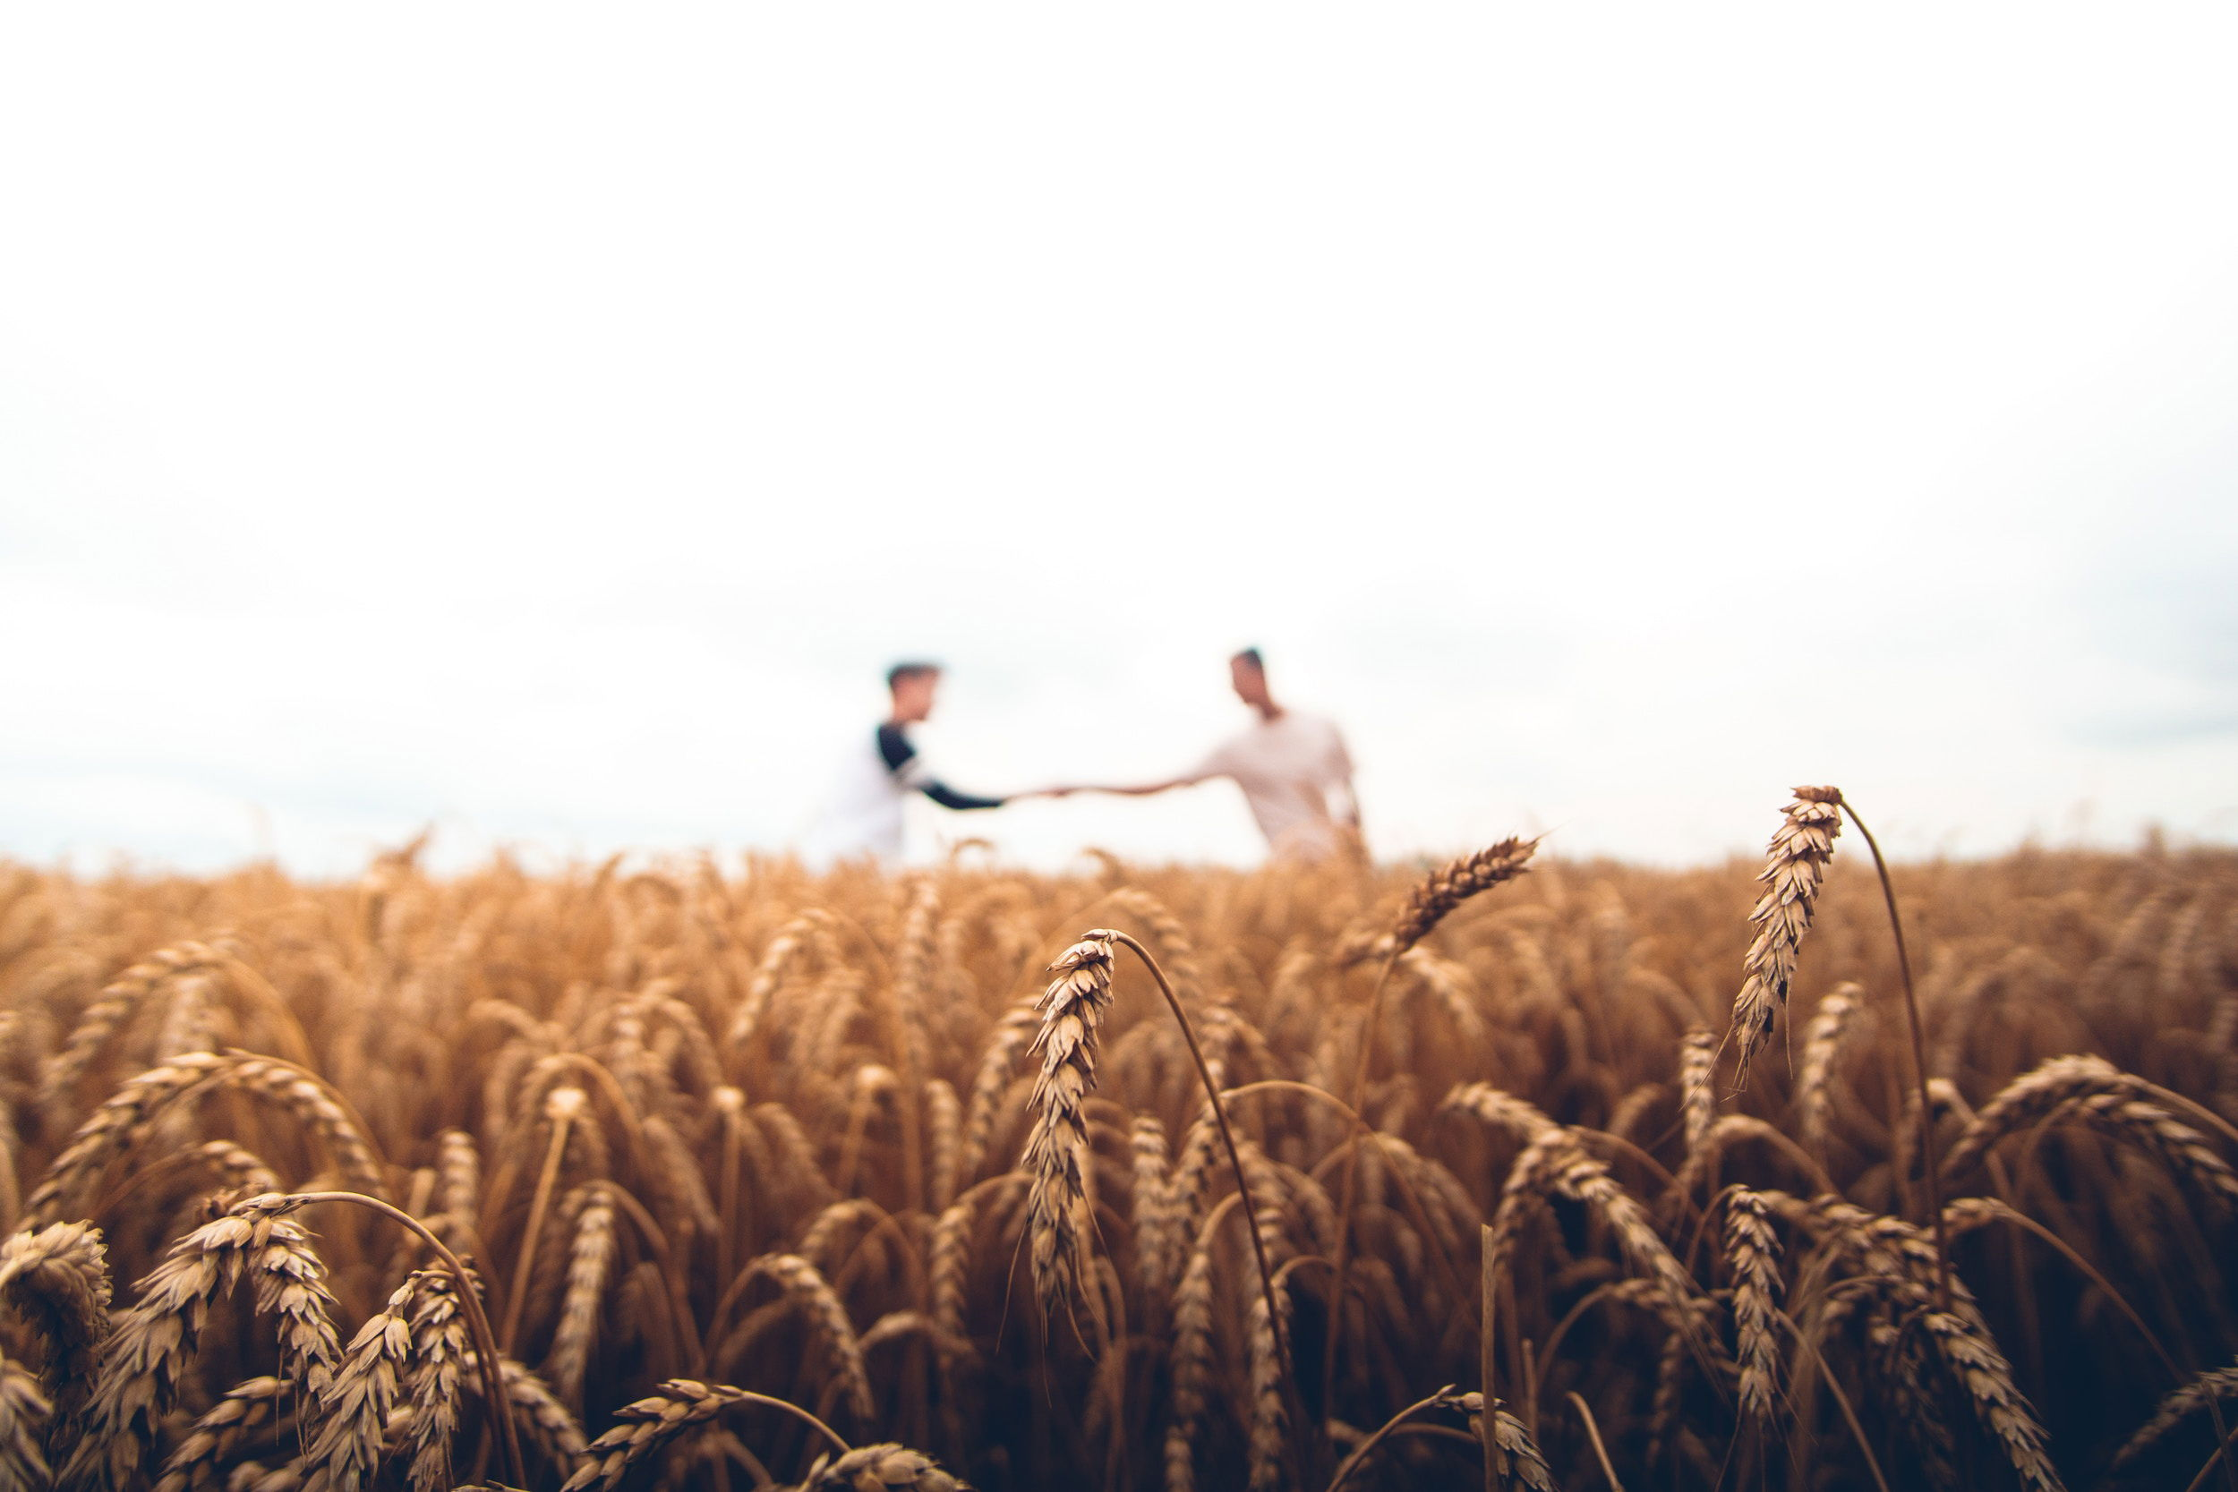
The only work we do here is HARVEST.

Slide 107
➢ We could praise in heaven,
➢ We could worship in heaven,
➢ We could live those holy lives in heaven,
➢ We could fellowship.
➢ We all will be perfect.
➢ We won’t have to confront anything.
➢ We will just enjoy everything.

Slide 108
vii) God gives all of us more than we deserve.

Slide 109
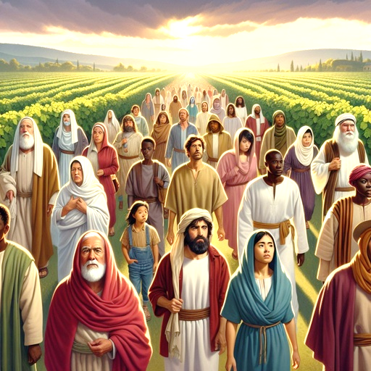
vii) God gives all of us more than we deserve.

Slide 110
viii) Right attitude.
Humility and unworthiness are the only right attitude.
There is no place for envy.
There is no place for jealousy.

Slide 111
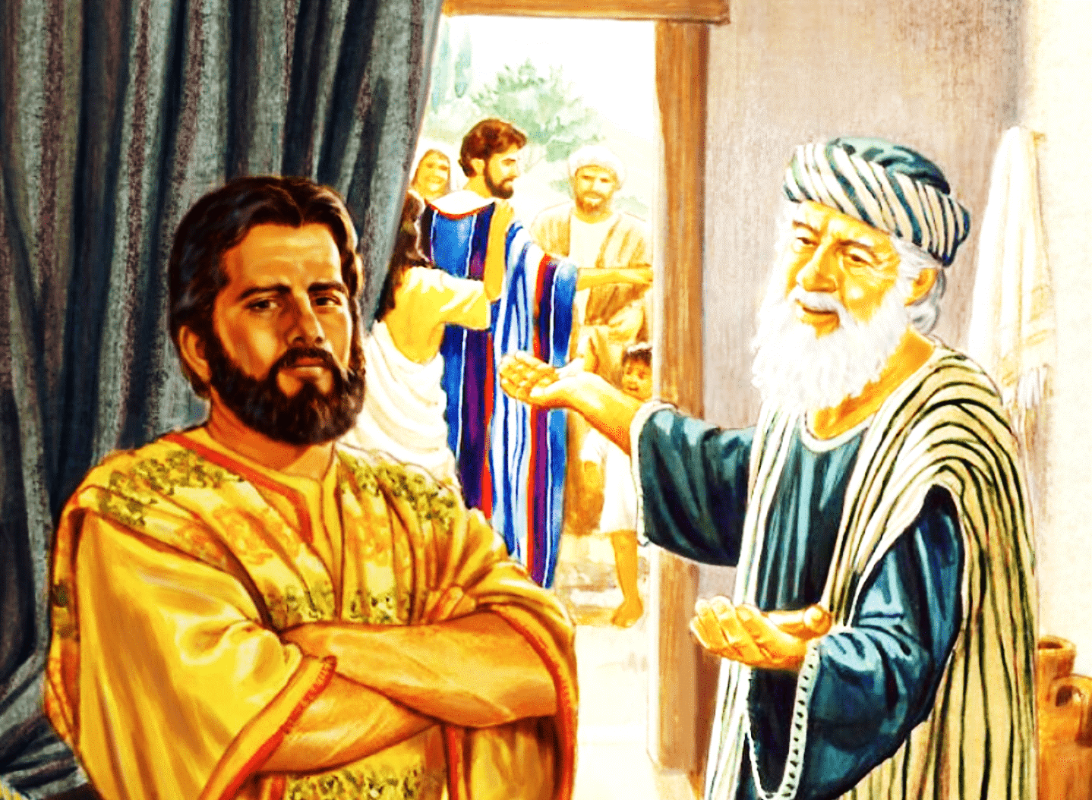

Slide 112
ix) Eternal reward is by grace.

Slide 113
ix) Eternal reward is by grace.
Length of service, difficulty of service has no factor.
Works are irrelevant in the matter of eternal life.

Slide 114

God’s ways are equal.

