Slide 1

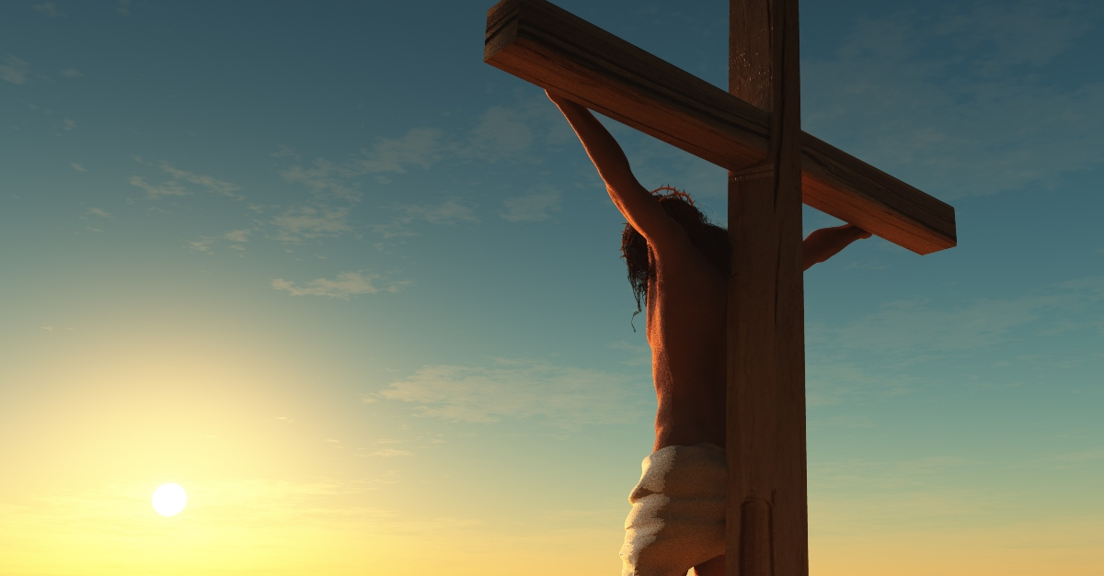
Jesus predicts about HIS death!
Matthew 20:17-19

Slide 2
Matthew 20:17-19
Mark 10:32-34
Luke 18:31-34

Slide 3

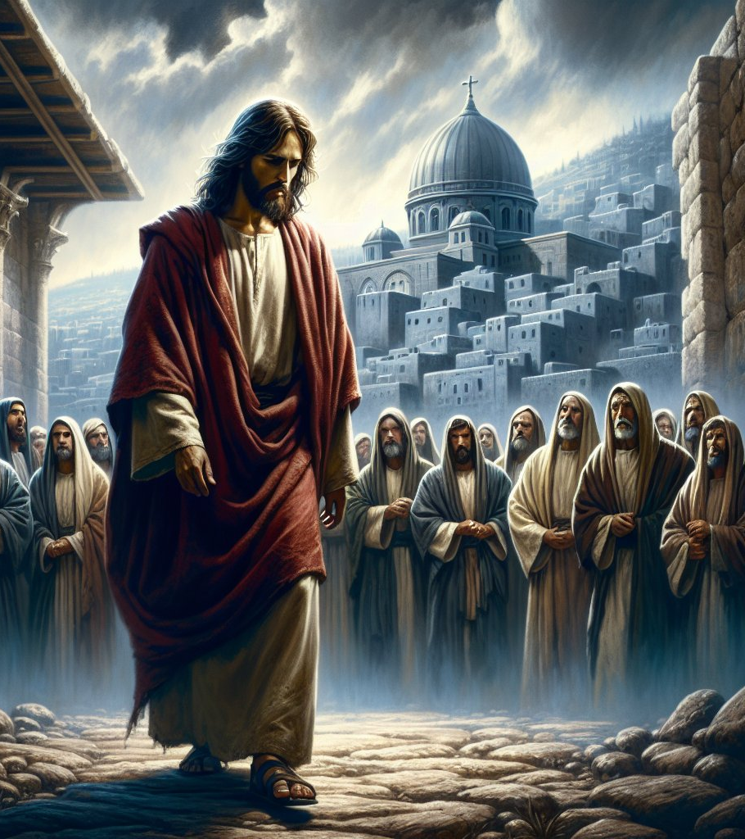

Matthew
16:21
From that time Jesus began to show to His disciples that He must go to Jerusalem and suffer many things from the elders and chief priests and scribes, and be killed, and be raised the third day.

Slide 4
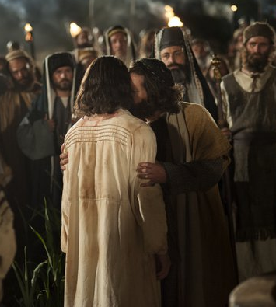
Matthew 17:22-23
Now while they were staying in Galilee, Jesus said to them, “The Son of Man is about to be betrayed into the hands of men, and they will kill Him, and the third day He will be raised up.” And they were exceedingly sorrowful.

Slide 5
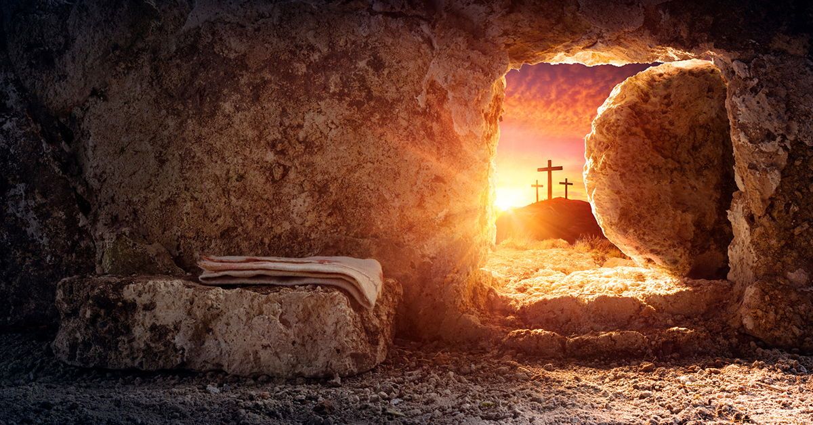
The center of the biblical revelation is the death and resurrection of Jesus Christ.

Slide 6
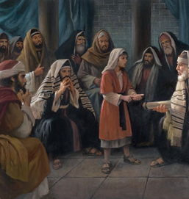
Luke 2:49
And He said to them, “Why did you seek Me? Did you not know that I must be about My Father’s business?”

Slide 7
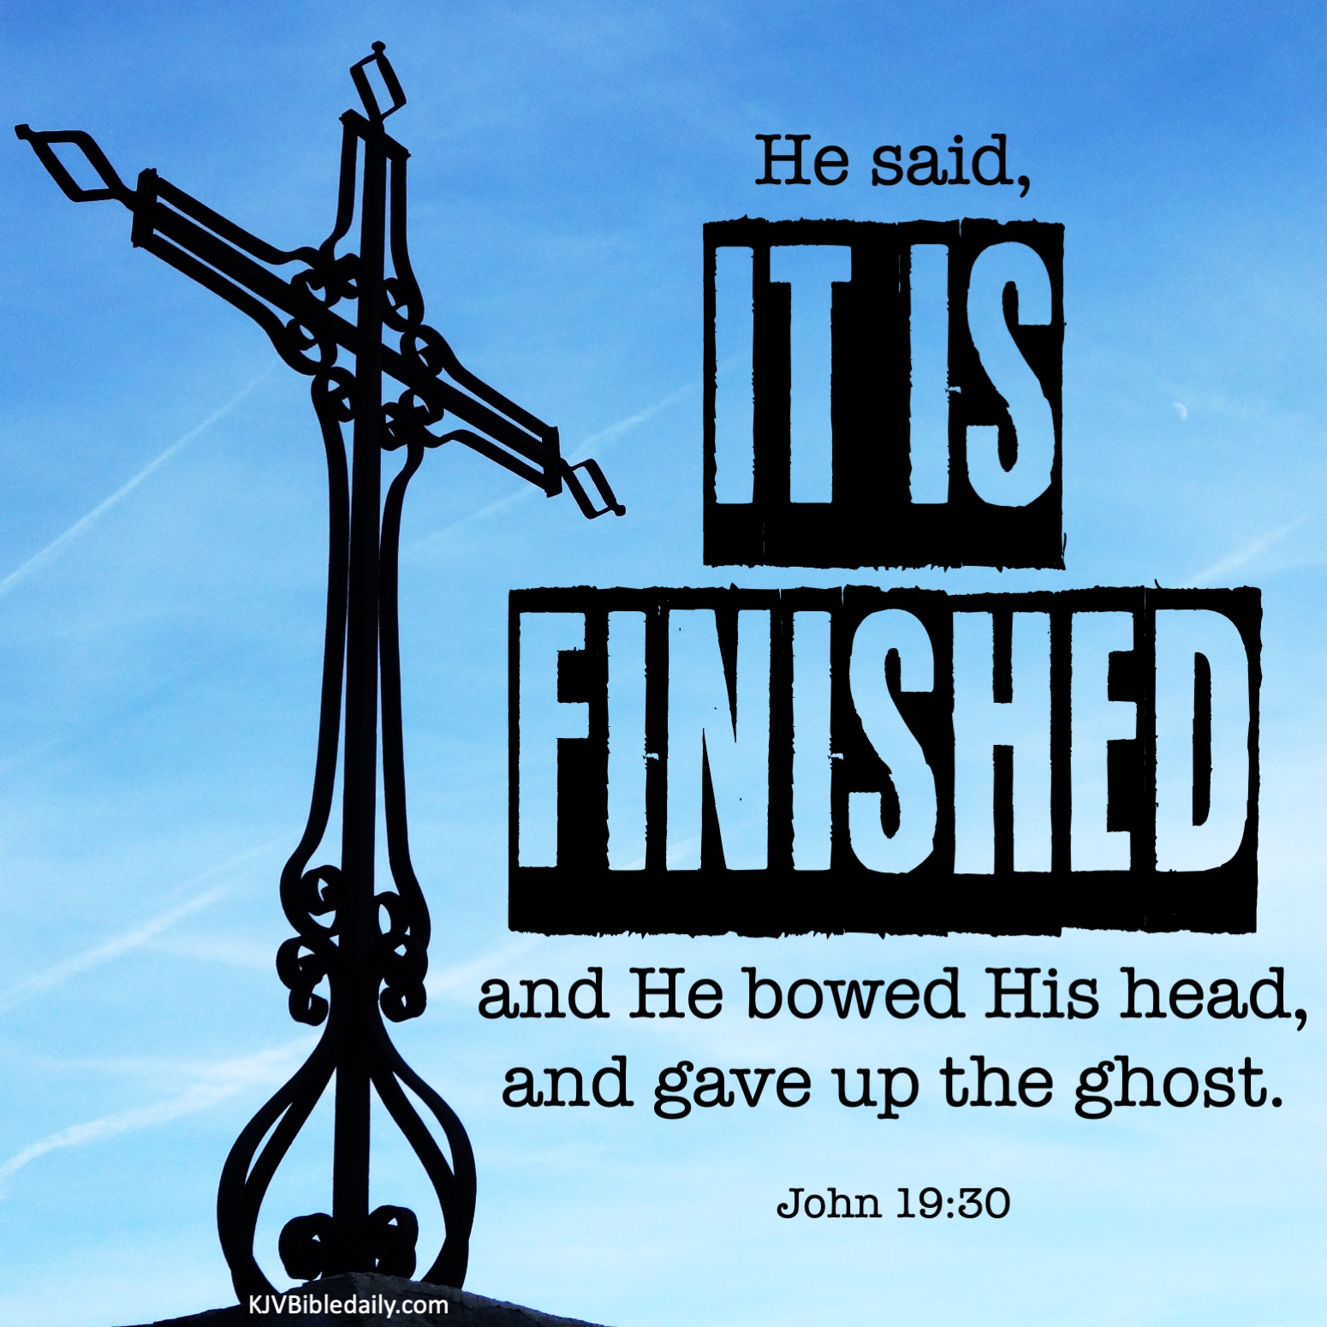
John 19:30
So when Jesus had received the sour wine, He said, “It is finished!” And bowing His head, He gave up His spirit.

Slide 8
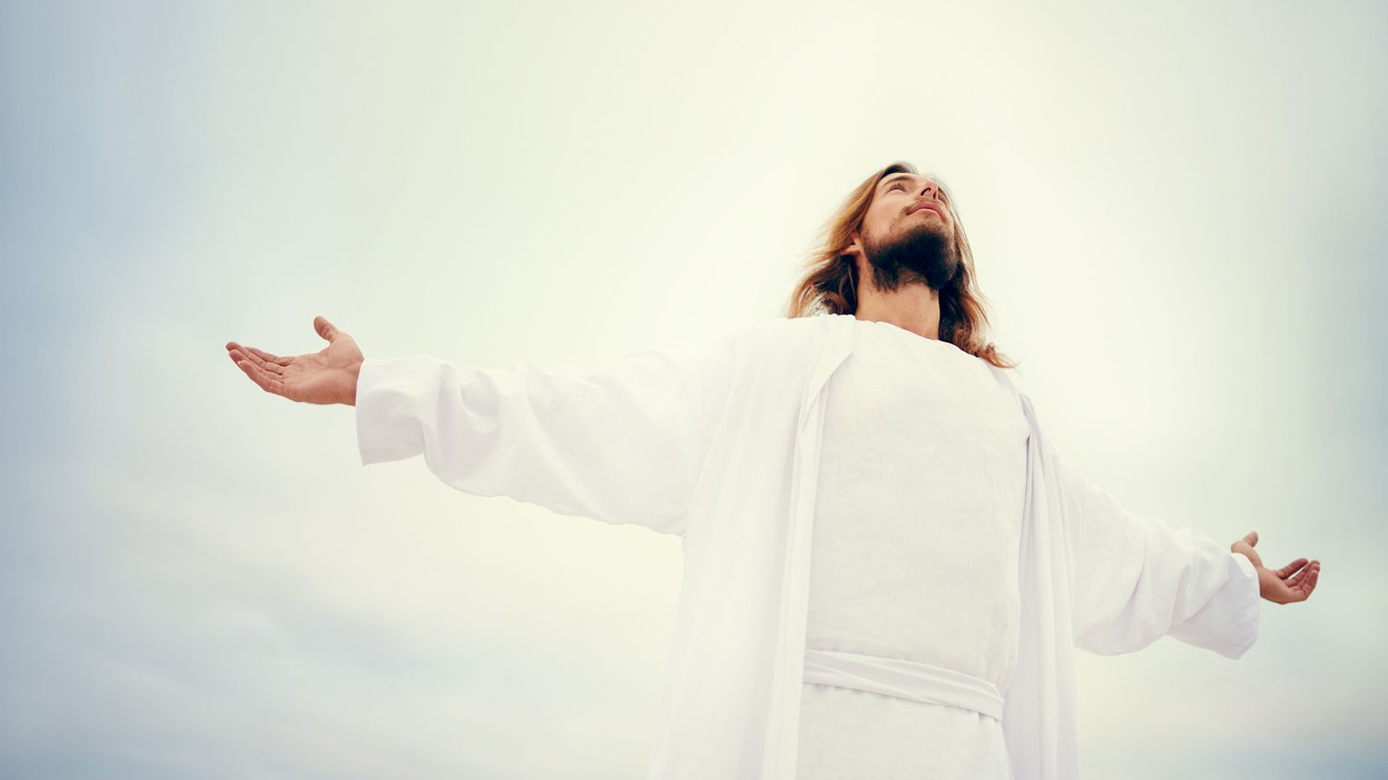

Jesus knew why He was on the earth and every detail of it

Slide 9

Matthew 20:17-18
Now Jesus, going up to Jerusalem, took the twelve disciples aside on the road and said to them, 18 “Behold, we are going up to Jerusalem, and the Son of Man will be betrayed to the chief priests and to the scribes; and they will condemn Him to death,
The Plan

Slide 10
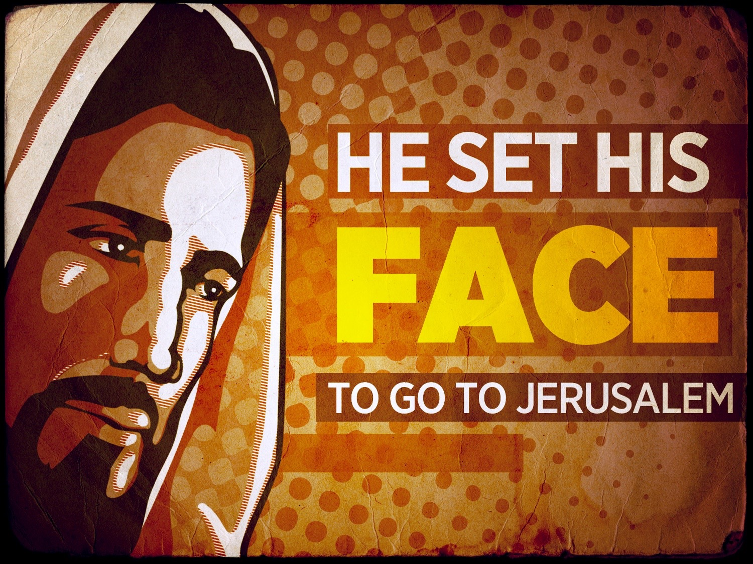
Luke 9:51
Now it came to pass, when the time had come for Him to be received up, that He steadfastly set His face to go to Jerusalem,

Slide 11
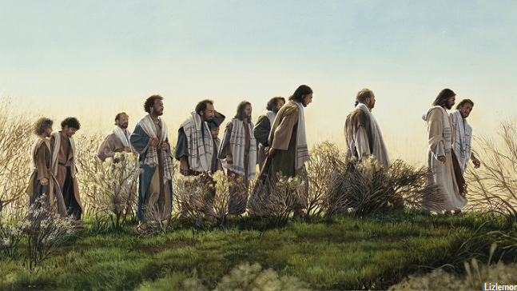
Matthew 20:29
Now as they went out of Jericho, a great multitude followed Him.

Slide 12
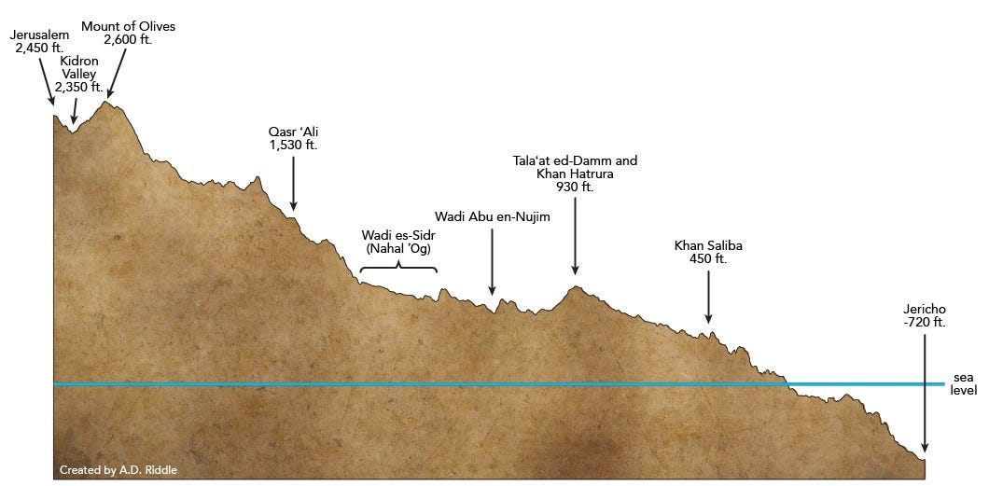

Jericho is about 1000 feet below sea level,
Jerusalem is over 5,000 above sea level.
5000ft
1000ft
15 miles

Slide 13
Matthew 20:29
says there was a great multitude that followed Him.

Slide 14
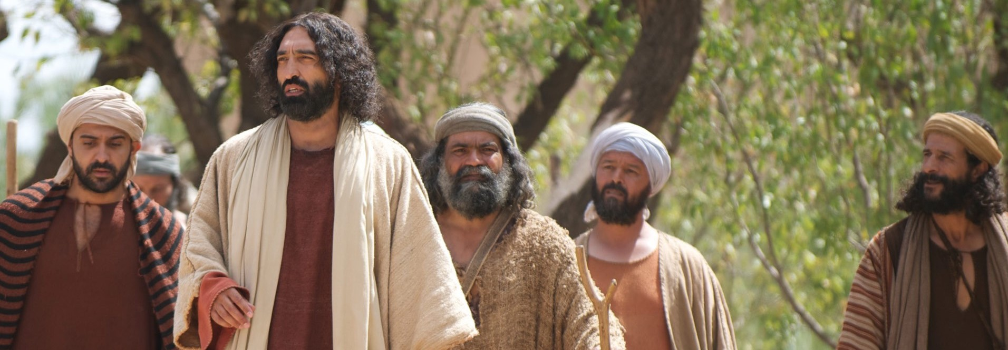
Mark 10:32
“Amazed and Afraid.”
Now they were on the road, going up to Jerusalem, and Jesus was going before them; and they were amazed. And as they followed they were afraid. Then He took the twelve aside again and began to tell them the things that would happen to Him:

Slide 15
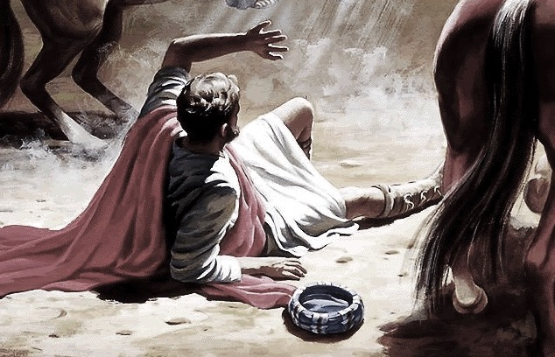
amazed, in Greek is thambeō

Slide 16
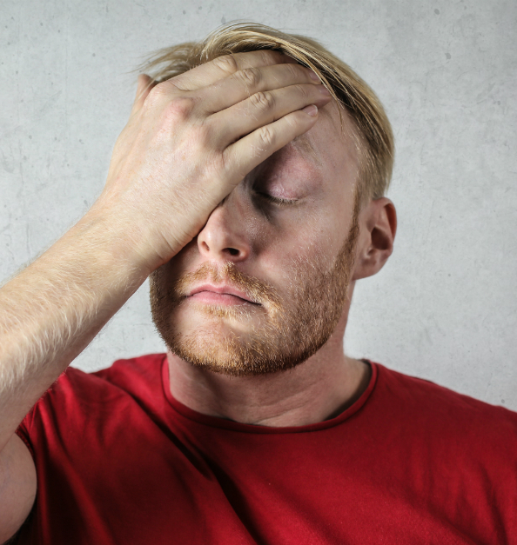
Afraid phobos because of their confusion

Slide 17
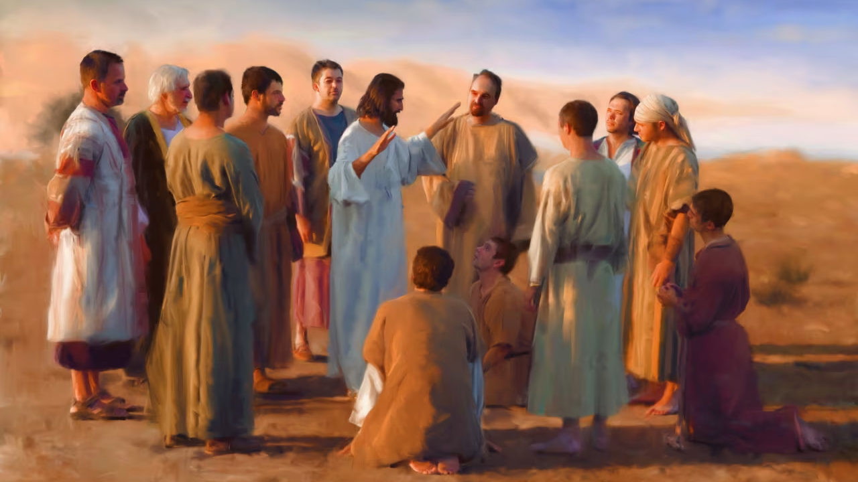
Luke 18:31
Then He took the twelve aside and said to them, “Behold, we are going up to Jerusalem, and all things that are written by the prophets concerning the Son of Man will be accomplished.

Slide 18
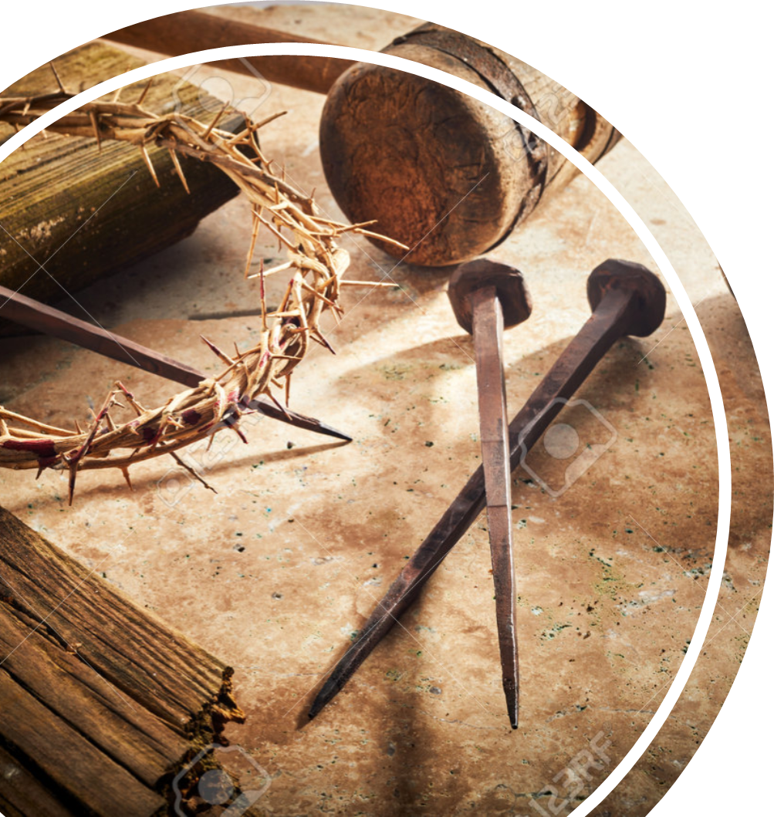
We will find numerous passages predicting all the factors of Jesus Christ’s life.
Zechariah 9:9 says that He would enter into Jerusalem.
Psalm 2, that He would know the fury and rage of His enemies.
Zechariah 13:7, that He would be deserted by His friends.
Zechariah 11:12, that His betrayal would be for 30 pieces of silver.
Psalm 22:16, that He would be pierced on the cross.
Exodus 12:46 and Psalm 34:20. none of His bones would be broken.
Psalm 22:18 says that His garments will be parted by casting of lots.
Psalm 69:21 says He will be given vinegar to drink.
Psalm 22:1, He will cry out in the pain of distress.
Zechariah 12:10 says they will pierce Him with a sphere.
Psalm 16:10, that He will rise from the dead.
Psalm 110:1 says He will ascend into heaven.

Slide 19
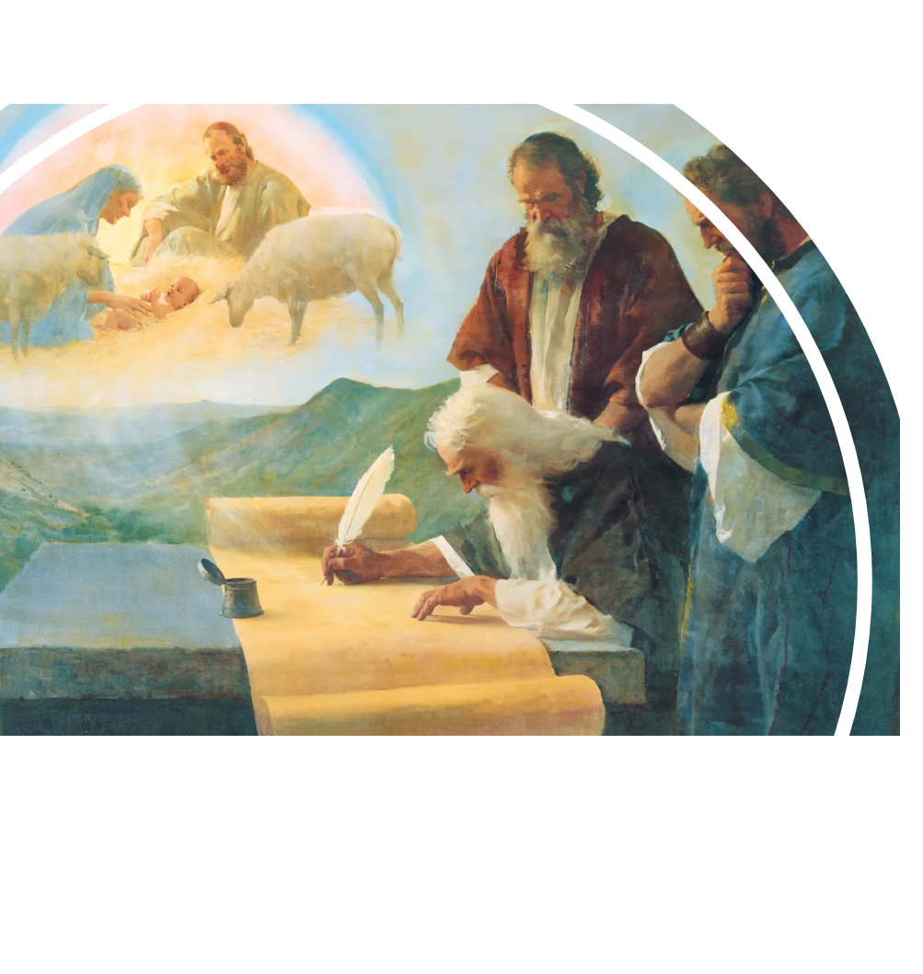
All those things are part of the Old Testament prophets.
we can read from Psalm 22, Isaiah 53, and Zechariah’s prophecy.

Slide 20

Genesis 3
Guilt, shame, and separation covered by sacrifice.

Slide 21
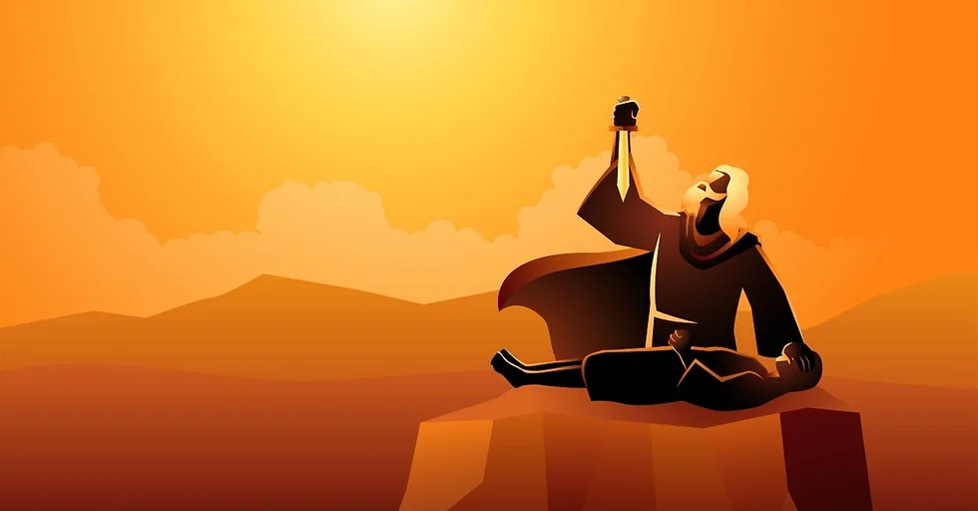
Genesis 22
God will provide a substitute.

Slide 22
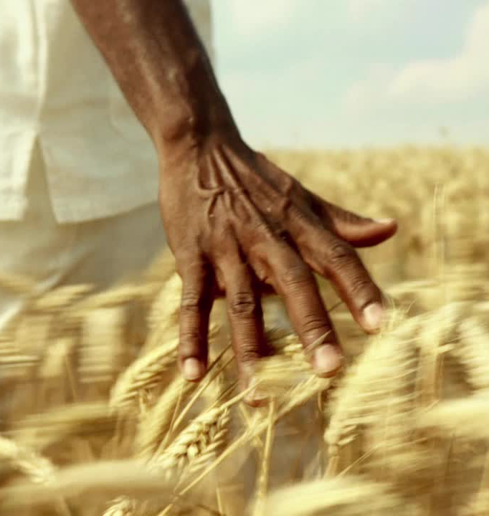
Hebrews 11:19
God will provide a substitute
concluding that God was able to raise him up, even from the dead, from which he also received him in a figurative sense.

Slide 23
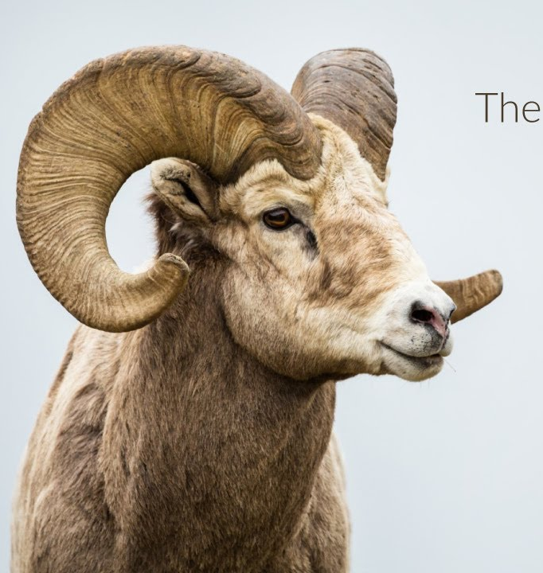
Genesis 22:14
And Abraham called the name of the place, The-Lord-Will-Provide; as it is said to this day, “In the Mount of the Lord it shall be provided.”

Slide 24
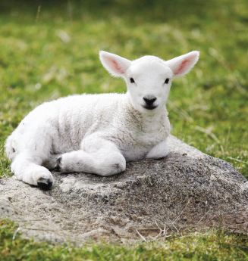
Exodus 20
sacrifice must be unblemished/pure.

Slide 25
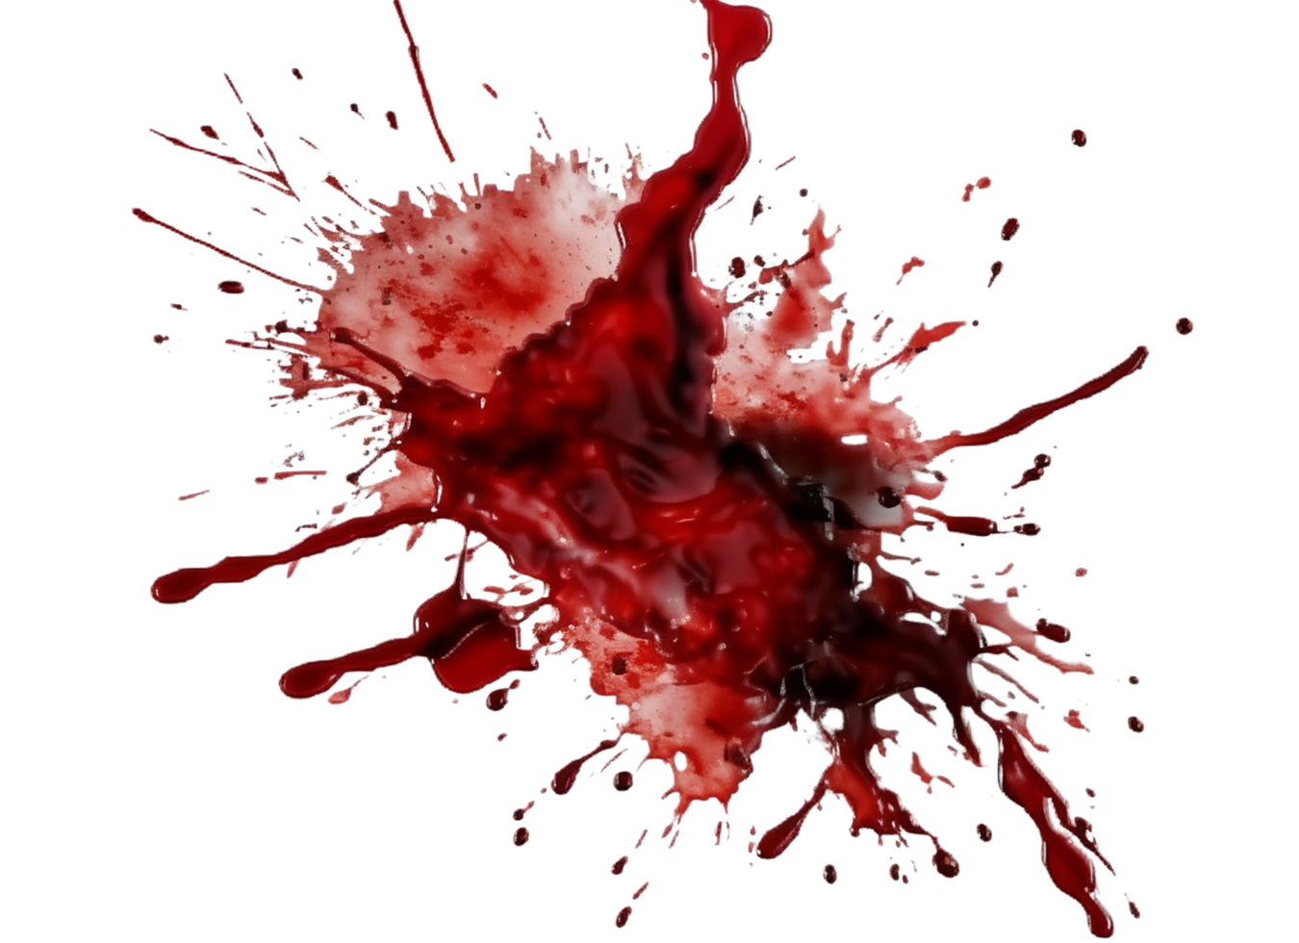
A blood sacrifice will deliver you from judgement.
Genesis 3, that sin must be dealt with by sacrifice.
Genesis 22, that a sacrifice can be substituted for the guilty person.
Exodus 20, the sacrifice must be unblemished, must be pure.

Slide 26

Bring all these pictures together.
Genesis 3, that sin must be dealt with by sacrifice.
Genesis 22, that a sacrifice can be substituted for the guilty person.
Exodus 20, the sacrifice must be unblemished, must be pure.
The centrality of sacrifice in the law, we learn the importance of sacrifice in a worshiping life.
There will be no worship of God without sacrifice

Slide 27
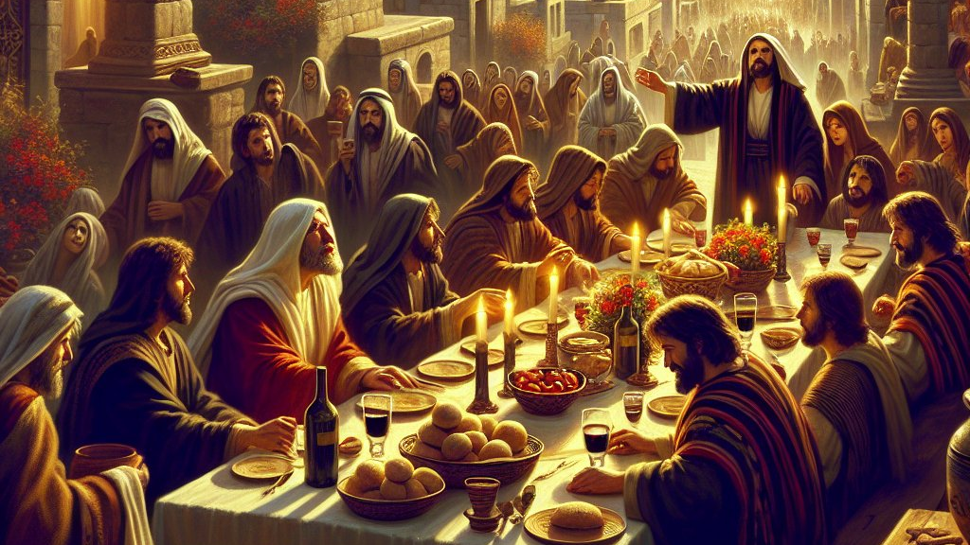
The disciples think we are going there for Passover.
What they did not know was that they were going there with the Passover Lamb.

Slide 28
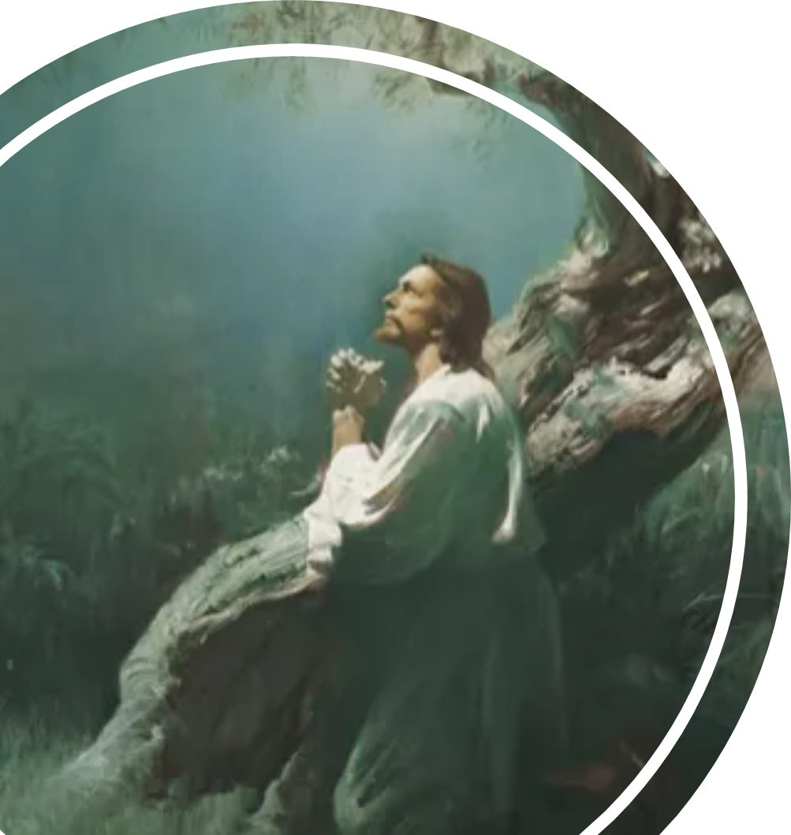
Luke 24:26-27
Ought not the Christ to have suffered these things and to enter into His glory?” 27 And beginning at Moses and all the Prophets, He expounded to them in all the Scriptures the things concerning Himself.

Slide 29
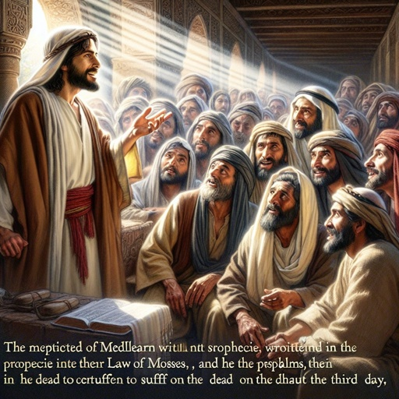
Luke 24:46
Then He said to them, “Thus it is written, and thus it was necessary for the Christ to suffer and to rise from the dead the third day

Slide 30
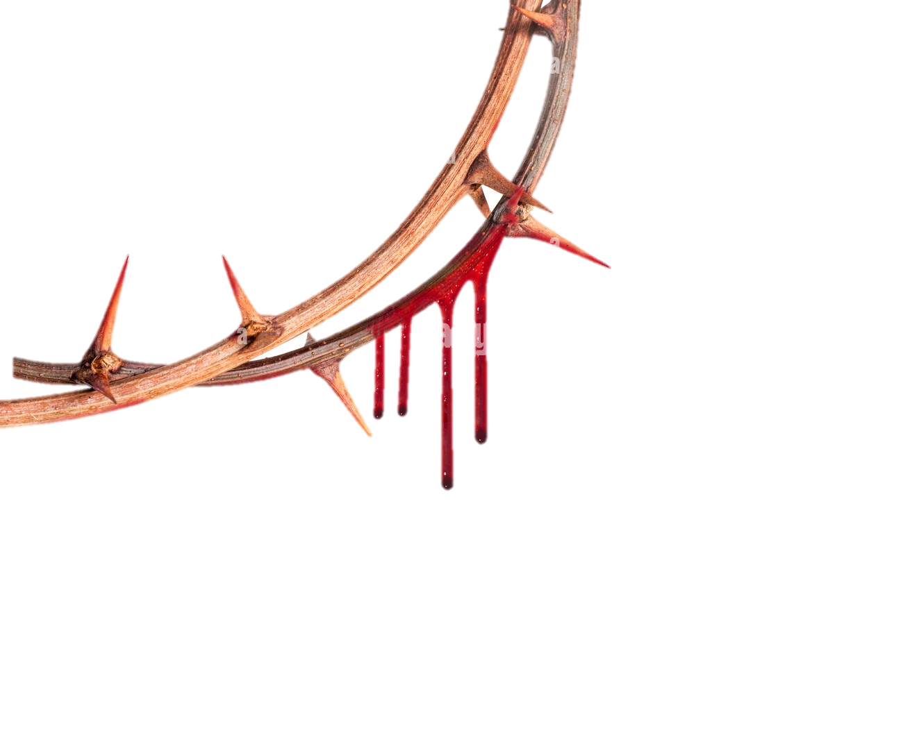
1 Corinthians 15:3-4
For I delivered to you first of all that which I also received: that Christ died for our sins according to the Scriptures, 4 and that He was buried, and that He rose again the third day according to the Scriptures,

Slide 31

1 Peter 1:11
searching what, or what manner of time, the Spirit of Christ who was in them was indicating when He testified beforehand the sufferings of Christ and the glories that would follow.

Slide 32
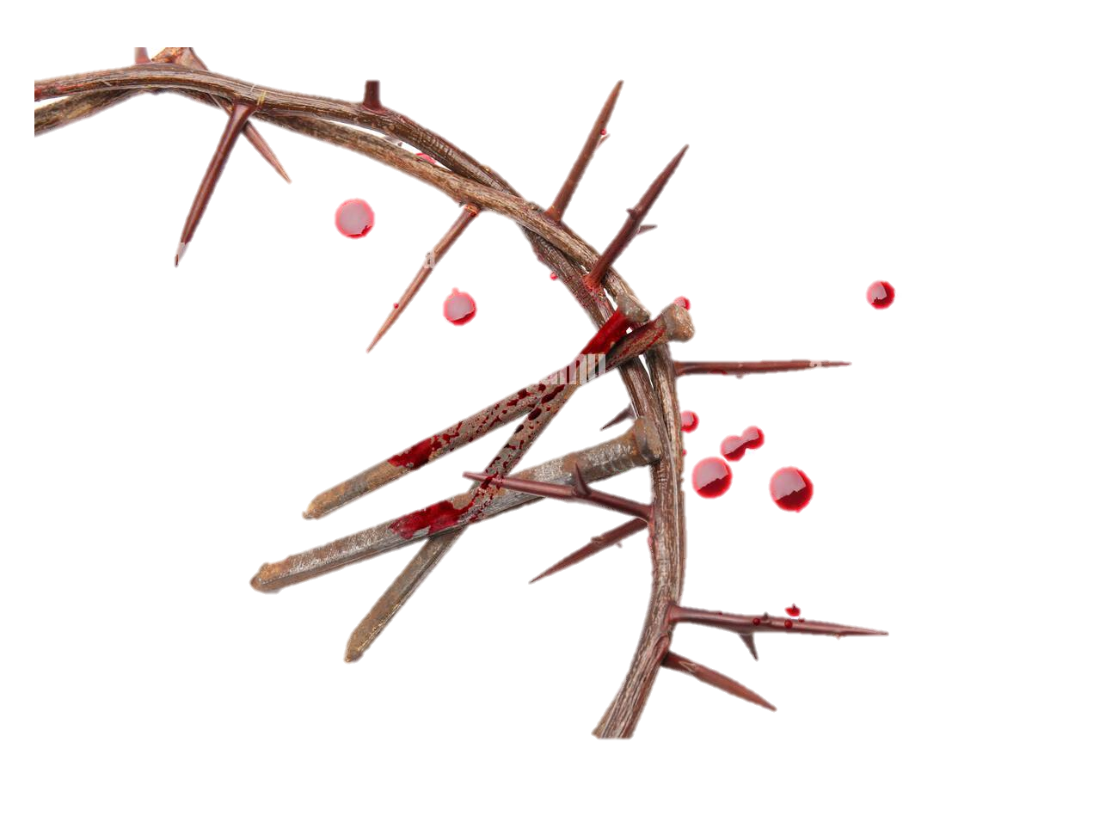
Because if you don’t see the suffering, you can’t understand Christ.
They do not know what to do with Psalm 22,
They have not got a clue what to do with Isaiah 53, and
They have lost in Zechariah also.

Slide 33
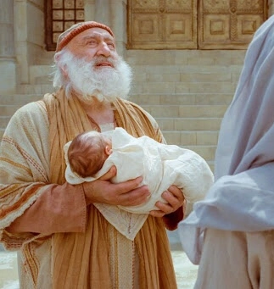
Luke 2:34-35
Then Simeon blessed them, and said to Mary His mother, “Behold, this Child is destined for the fall and rising of many in Israel, and for a sign which will be spoken against 35 (yes, a sword will pierce through your own soul also), that the thoughts of many hearts may be revealed.”

Slide 34
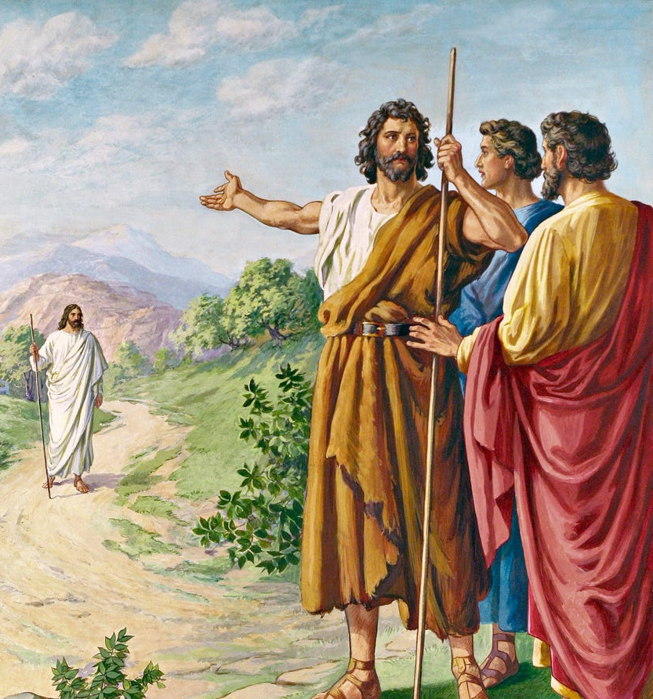
John 1:29
The next day John saw Jesus coming toward him, and said, “Behold! The Lamb of God who takes away the sin of the world!

Slide 35
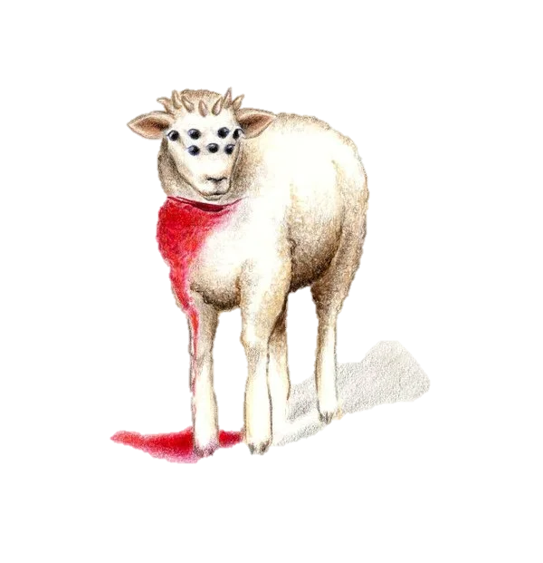
Revelation 5:6
And I looked, and behold, in the midst of the throne and of the four living creatures, and in the midst of the elders, stood a Lamb as though it had been slain, having seven horns and seven eyes, which are the seven Spirits of God sent out into all the earth.

Slide 36
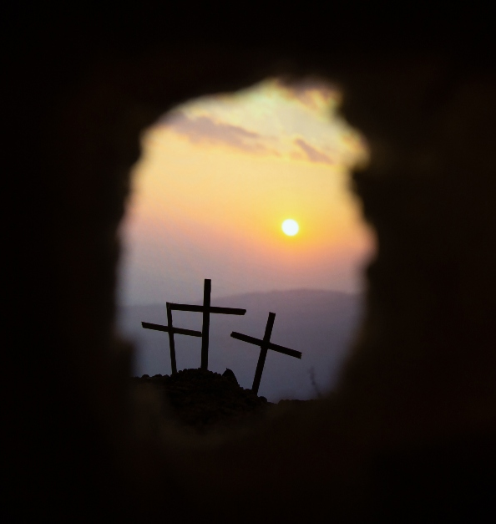
Matthew 20:17-19
Now Jesus, going up to Jerusalem, took the twelve disciples aside on the road and said to them, 18 “Behold, we are going up to Jerusalem, and the Son of Man will be betrayed to the chief priests and to the scribes; and they will condemn Him to death, 19 and deliver Him to the Gentiles to mock and to scourge and to crucify. And the third day He will rise again.”

Slide 37
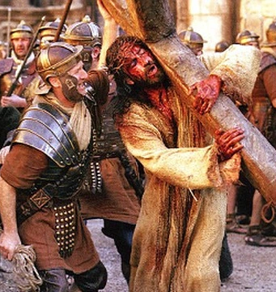
Incredible details:
Betrayal,
Handing over to chief priests, scribes,
Condemned to death,
Handed over to the Pagans where He will be mocked.
Matthew and Luke add, “He will be spit on.”
Scourged,
Crucified, and
He rise again.”

Slide 38
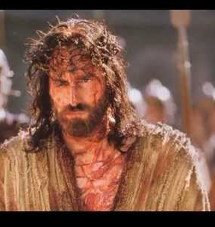
Proportion/Extent of suffering.
In 2 Corinthians 1:5 it mentions the sufferings of Christ.
In Philippians 3:10, the fellowship of His sufferings.
In 1 Peter 1:11, the sufferings.
In 1 Peter 4:13, the sufferings.
Luke 24:26, “suffered many things.”
Hebrews 2:10, His salvation was made perfect through sufferings.

Slide 39
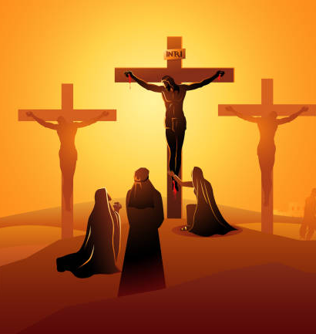
They were left there until such a time as they should have been dead and taken down. Two of them lived, one died.” Which is to say that crucifixion in and of itself did not necessarily kill everybody.

Slide 40
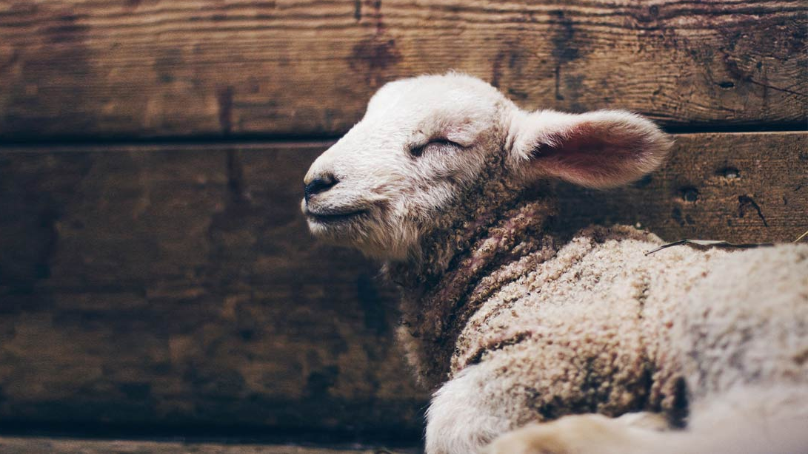
Isaiah 53
clearly revealed many facets of His suffering.

Slide 41
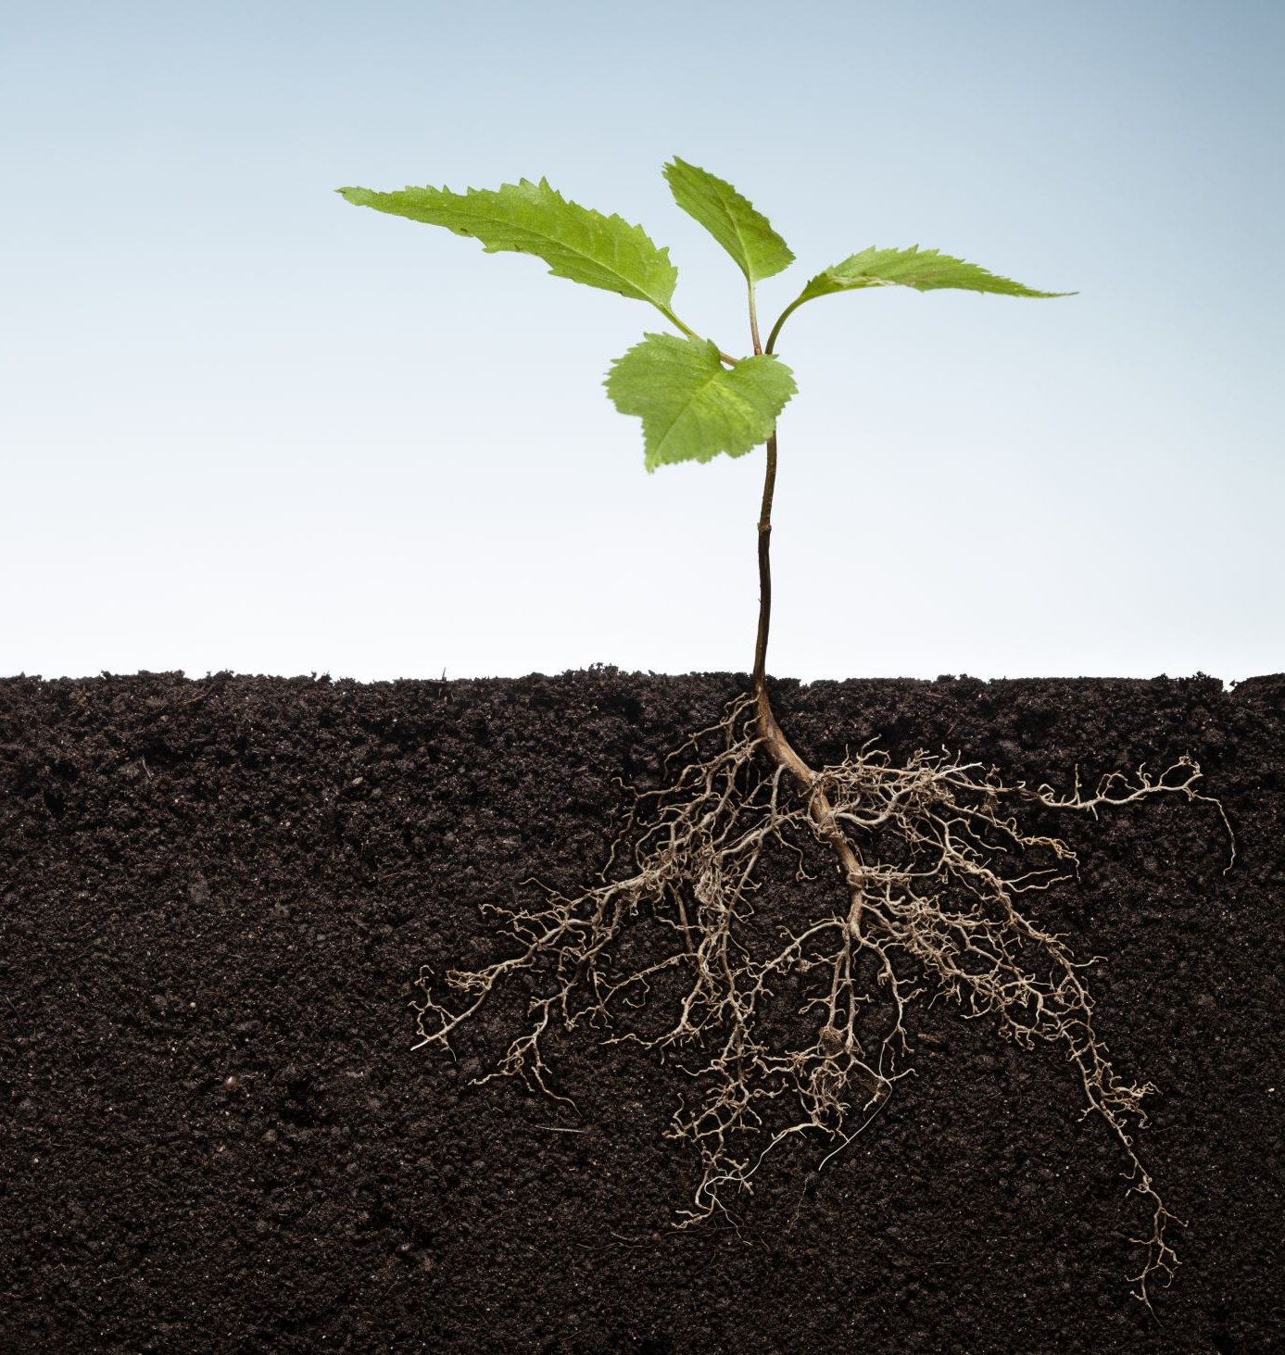
Isaiah 53:2
For He shall grow up before Him as a tender plant, And as a root out of dry ground. He has no form or comeliness;

Slide 42
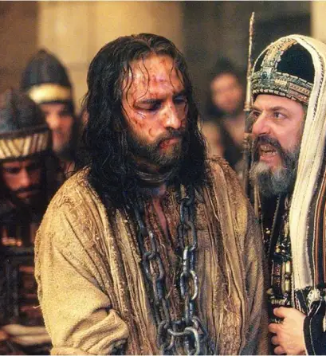
Isaiah 53:3
He is despised and rejected by men, A Man of sorrows and acquainted with grief. And we hid, as it were, our faces from Him; He was despised, and we did not esteem Him.

Slide 43
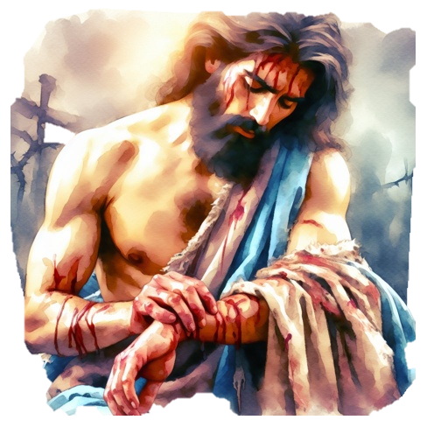
Isaiah 53:4
Surely He has borne our griefs And carried our sorrows; Yet we esteemed Him stricken, Smitten by God, and afflicted.

Slide 44
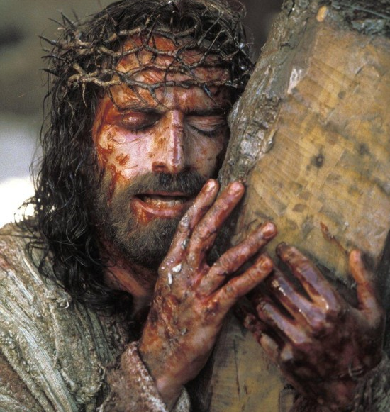
Isaiah 53:5
But He was wounded for our transgressions, He was bruised for our iniquities; The chastisement for our peace was upon Him, And by His stripes we are healed.

Slide 45
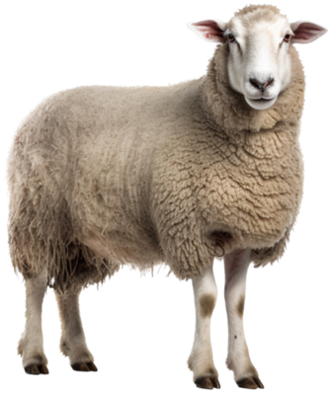
Isaiah 53:6
All we like sheep have gone astray; We have turned, every one, to his own way; And the Lord has laid on Him the iniquity of us all.

Slide 46
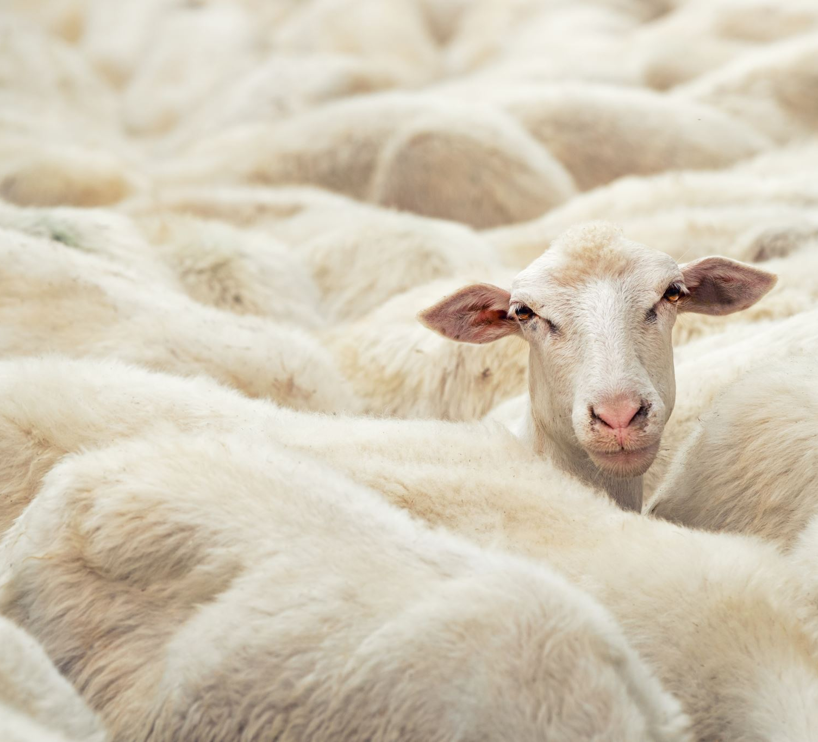
Isaiah 53:7
He was oppressed and He was afflicted, Yet He opened not His mouth; He was led as a lamb to the slaughter, And as a sheep before its shearers is silent, So He opened not His mouth.

Slide 47
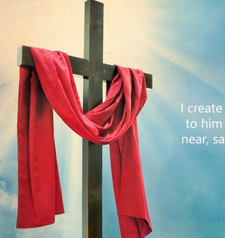
Isaiah 53:8
He was taken from prison and from judgment, And who will declare His generation? For He was cut off from the land of the living; For the transgressions of My people He was stricken.

Slide 48

Isaiah 53:11-12
He shall see the labour of His soul, and be satisfied. By His knowledge My righteous Servant shall justify many, For He shall bear their iniquities. 12 Therefore I will divide Him a portion with the great, And He shall divide the spoil with the strong, Because He poured out His soul unto death, And He was numbered with the transgressors, And He bore the sin of many, And made intercession for the transgressors.

Slide 49
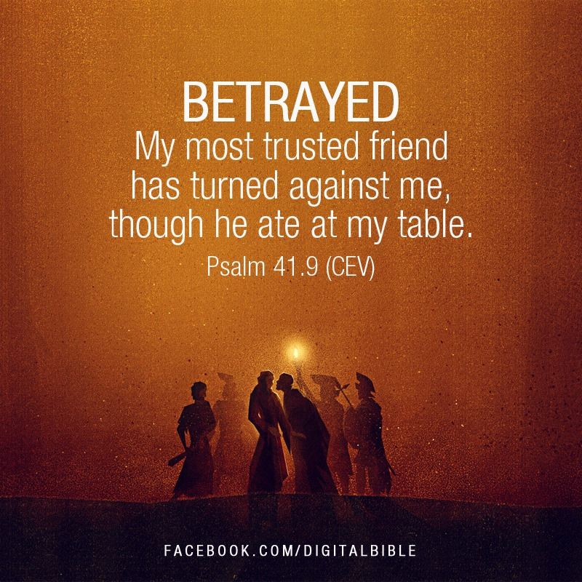
Psalm 41:9
The suffering of disloyalty.

Slide 50

John 1:11
He came to His own, and His own did not receive Him.
2. The suffering of rejection.

Slide 51
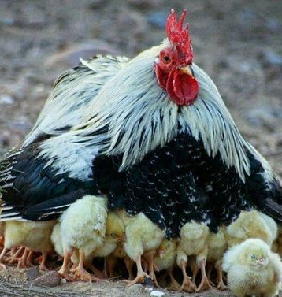
Matthew 23:37
“O Jerusalem, Jerusalem, the one who kills the prophets and stones those who are sent to her! How often I wanted to gather your children together, as a hen gathers her chicks under her wings, but you were not willing!

Slide 52
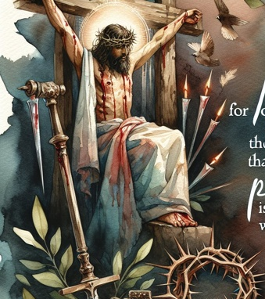
Isaiah 53:3
He is despised and rejected by men,

Slide 53
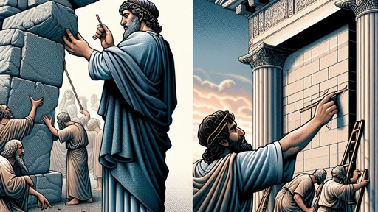
Psalms 118:22
The stone which the builders rejected Has become the chief cornerstone.

Slide 54

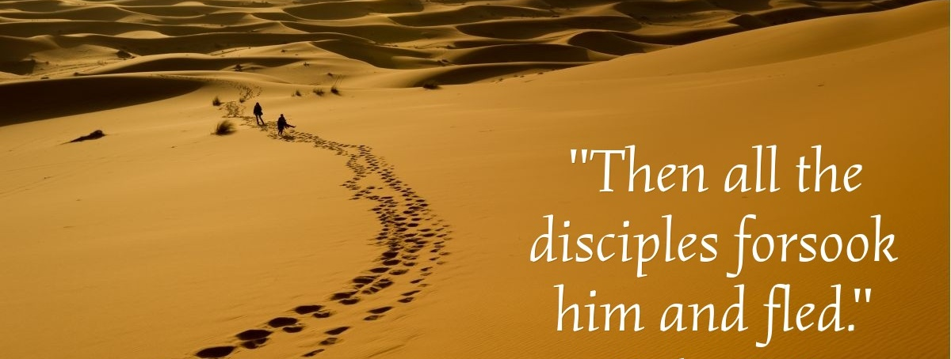
Matthew 26:56

Slide 55
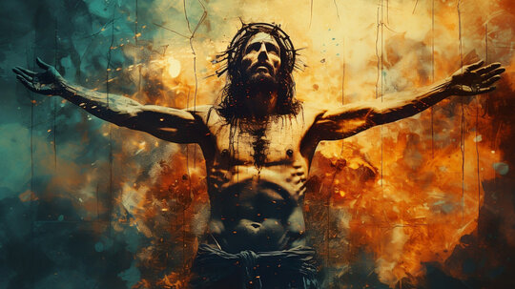
3. The suffering of humiliation.

Slide 56
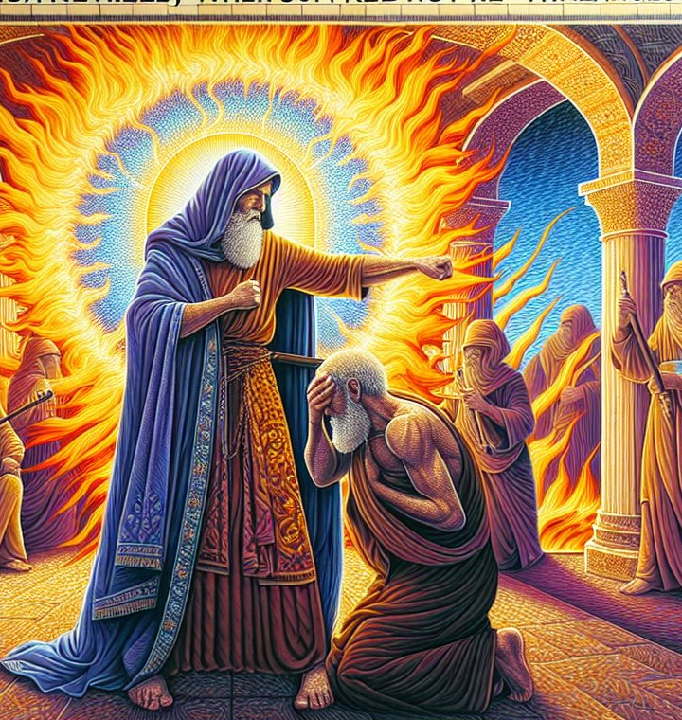
1 Peter 2:23
who, when He was reviled, did not revile in return; when He suffered, He did not threaten, but committed Himself to Him who judges righteously.

Slide 57
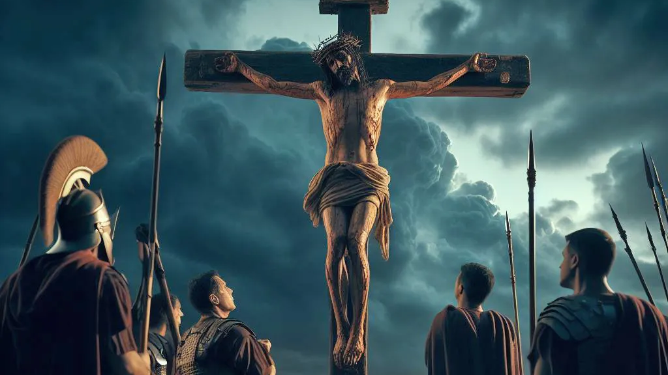
4.The pain of unjust guilt.

Slide 58
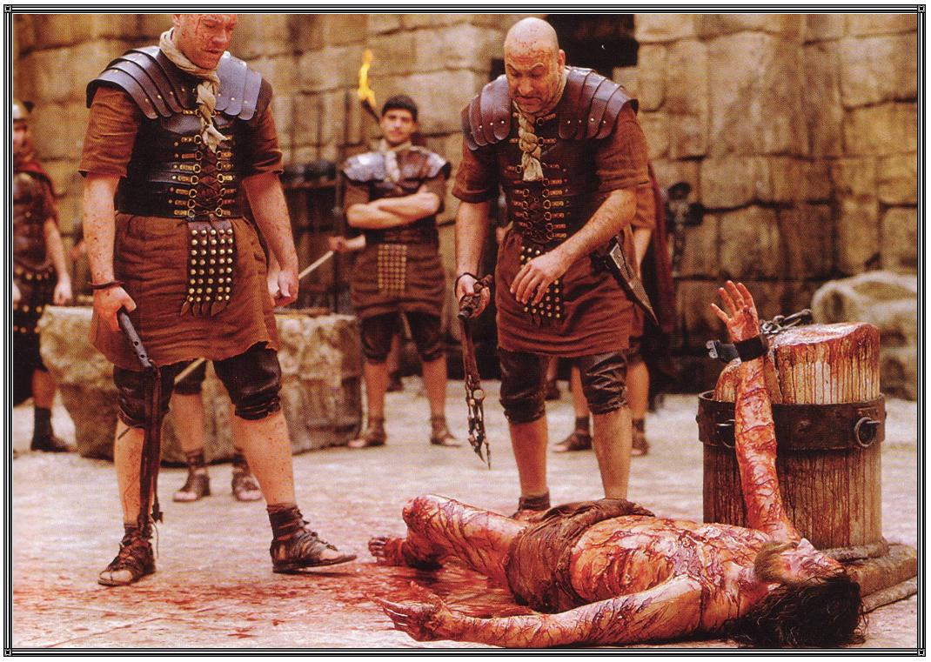
5. The pain of injury.

Slide 59

Psalm 16:10
For You will not leave my soul in Sheol, Nor will You allow Your Holy One to see corruption.

Slide 60

Matthew 20:20-21
Then the mother of Zebedee’s sons came to Him with her sons, kneeling down and asking something from Him. 21 And He said to her, “What do you wish?” She said to Him, “Grant that these two sons of mine may sit, one on Your right hand and the other on the left, in Your kingdom.”

Slide 61

1 Peter 3:18
For Christ also suffered once for sins, the just for the unjust, that He might bring us to God, being put to death in the flesh but made alive by the Spirit

Slide 62

What reconciled them?
Sacrifice.
When Adam and Eve sinned, they were separated.

