Slide 1

11TH AUGUST
S u n d a y

Slide 2

Matthew 20: 20-28 Mark 10:35-45
GREATNESS
in the
WORLD & KINGDOM!

Slide 3
Self-promotion, self-esteem pride movement has found its way into Christianity.
Leaders, Pastors are now twisting the Bible to promote pride, self-esteem, self-glory, self-promotion, self-image building.

Slide 4


There are even Christian books on how to make your body more beautiful and your face more beautiful.

Slide 5
We know very little about sacrifice.
We know very little of the pain of suffering.
All we want to do is eliminate every problem and pain so that we can get on to self-fulfillment.

Slide 6
We are consumed with the creature of comforts, pleasure, vacations, travel, etc., In the process, we have begun to exalt pride.

Slide 7
Now the church wants to be..
proud, fulfilled, and indulgent...
The Church has fallen prey to flip-flopping the sin of pride and the virtue of humility.

Slide 8
Bible is very clear about these things !!!.

Slide 9
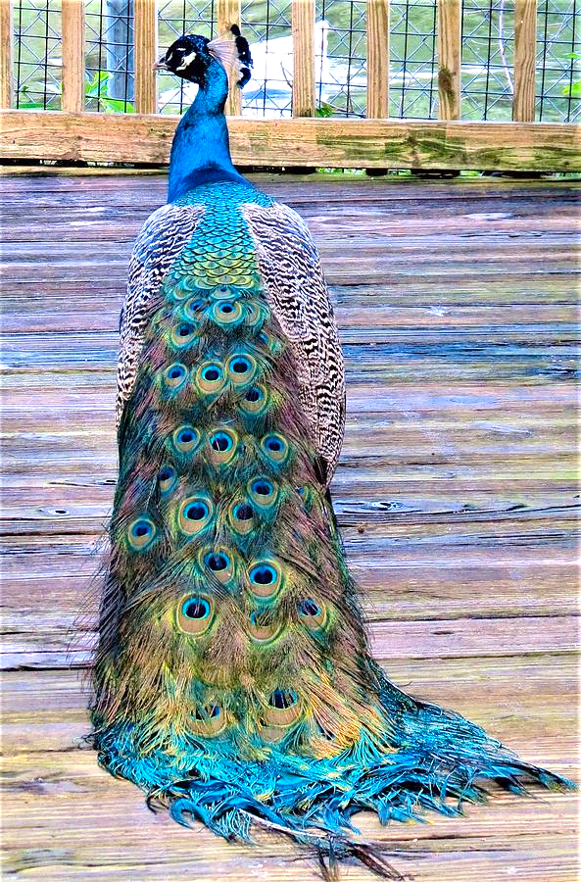
Proverbs 21:4,
A haughty look, a proud heart, And the ploughing of the wicked are sin.

Slide 10
Romans 1:30
Pride is the mark of man’s fallenness into a reprobate mind.

Slide 11
1 Timothy 3:6, “Pride comes from the devil.”
1 John 2:16, Pride is part of the world.
1 Timothy 6:3-4 pride belongs to false teachers.

Slide 12
Pride is SIN
It is an abomination

Slide 13
Isaiah 23:9 it says He brings the proud into contempt.
Psalm 31:23 it says the proud will be judged.
Exodus 18:11, the proud will be subdued.

Slide 14
Psalm 18:27, pride will be brought low.
Daniel 4:37, proud will be humiliated.
Luke 1:51, proud will be scattered,
Malachi 4:1 proud will be punished,

Slide 15
Bible calls humility is a
Virtue and is Exalted.

Slide 16
Micah 6:8,
He has shown you, O man, what is good; And what does the Lord require of you But to do justly, To love mercy, And to walk humbly with your God?

Slide 17
There are many verses in the Bible talks about the great benefit from God when you are humble.

Slide 18
We are not alone in this lesson the disciples join with us to learn it.
The disciples too sought
self-glory.

Slide 19
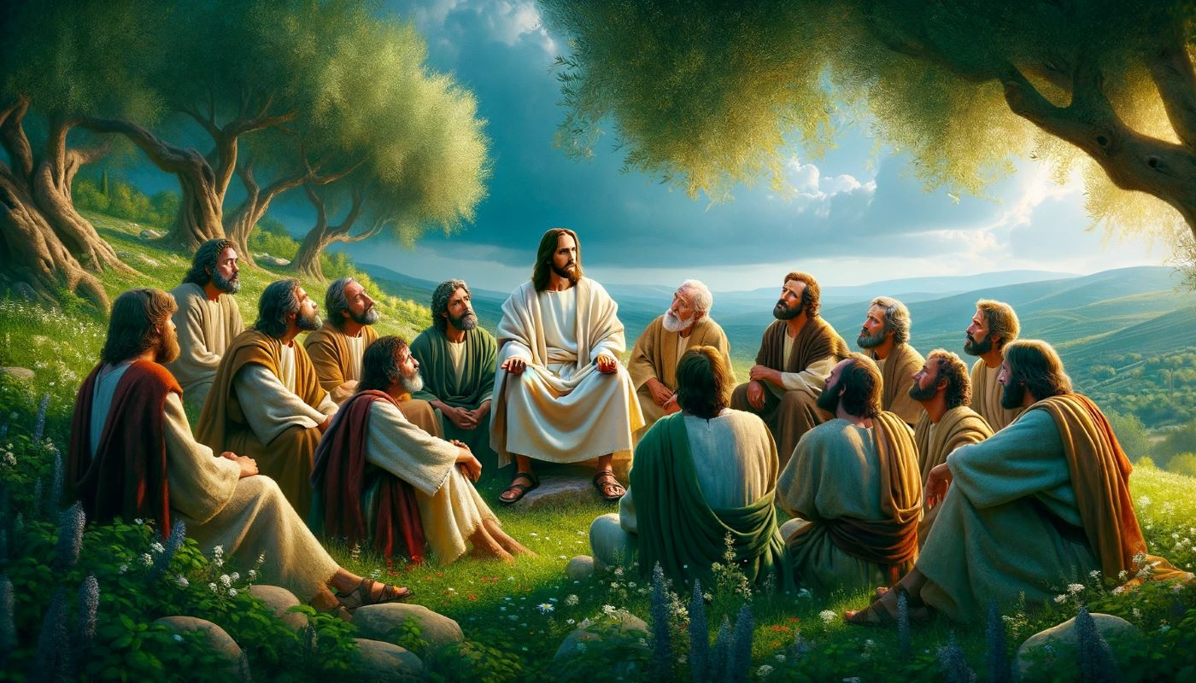
BACKGROUND

Slide 20
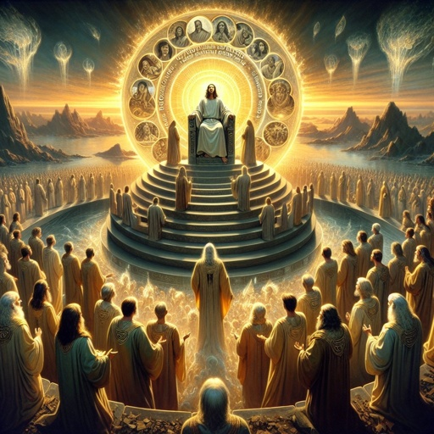
Matthew 19:28-29,

Slide 21
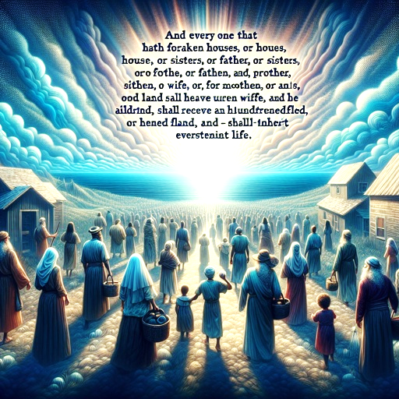
Matthew 19:28-29,

Slide 22
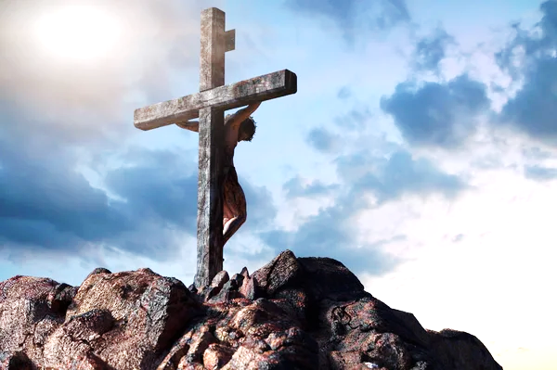
Matthew 20:17-19

Slide 23
Jesus already told them in Matthew 16 and 17,
Now for the third time that He is going to Jerusalem to suffer and die.

Slide 24
There is a kingdom, but the way to the kingdom is through suffering.
* Death then glory.
* Humility is before honour

Slide 25
Matthew 8,
He told them that they may not find a place to sleep.

Slide 26
Matthew 10,
You may have to use a sword against your own family..

Slide 27
Matthew 16,
Take up your own cross and follow Me.

Slide 28
They got a lot of lessons about suffering, but it never seemed to go inside their understanding because they were so prepared themselves for their glory and greatness in the kingdom.

Slide 29
Matthew 18,
You must come as a child into the kingdom.
You must forsake everything to come to the kingdom.

Slide 30
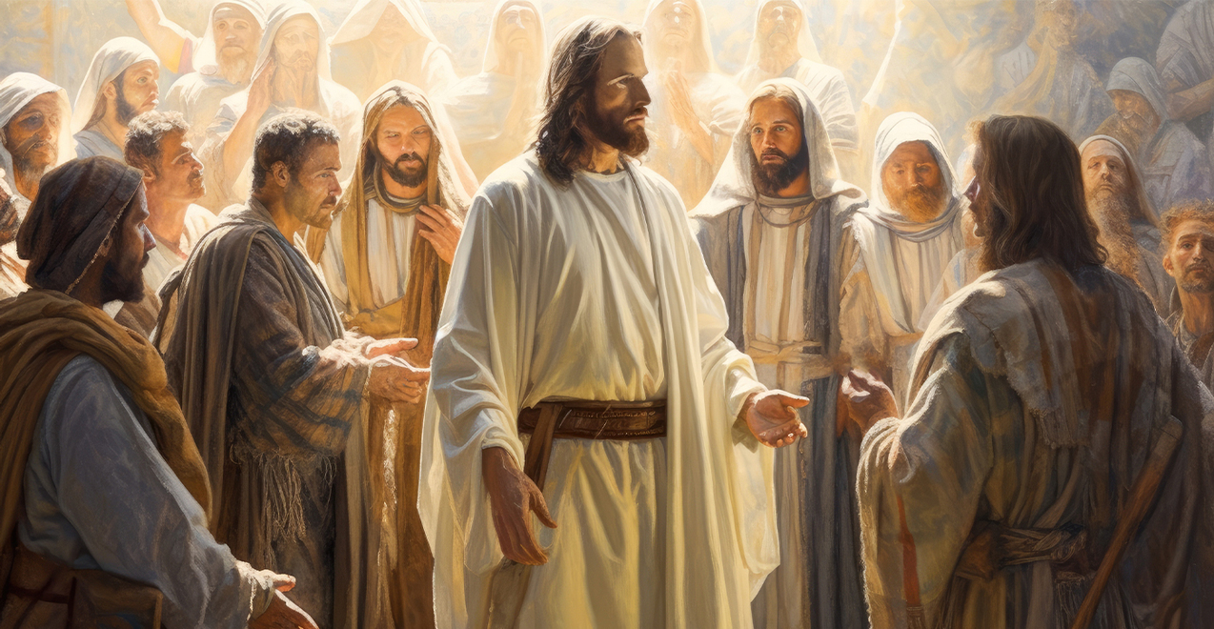
But they kept asking what shall I get?

Slide 31
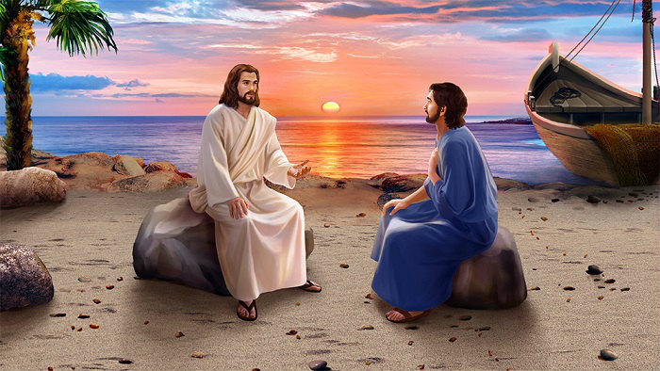
Matthew 19:27,

Slide 32
Selfishness is incurable in this life.
It only can be brought under control.
It can’t be eliminated.

Slide 33
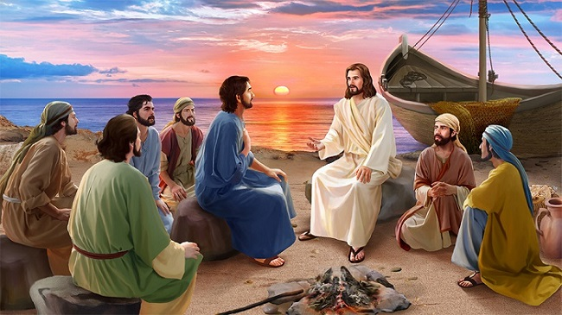
Matthew 20:17-19,

Slide 34
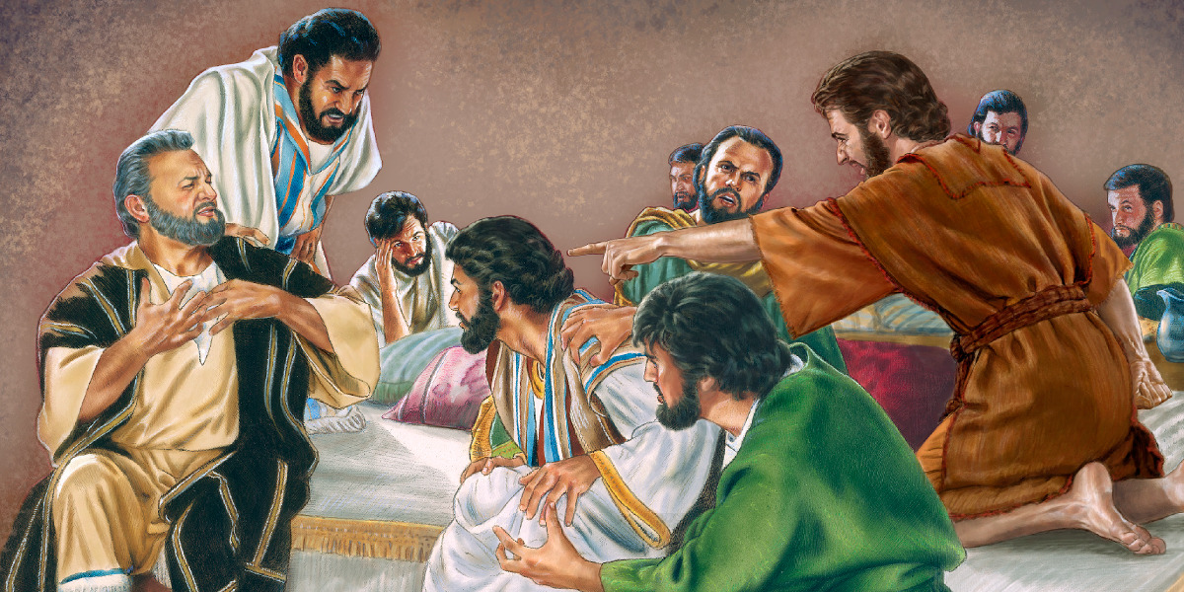
Arguing about who was going to be the greatest in the kingdom

Slide 35
I trust that none of us is approaching the Christian life like that.
None of us is looking at the Christian life as to what we can get out of it.

Slide 36
“A chorus of many voices is chanting in unison today that I must at all costs love myself.”
-John Stott

Slide 37
A. How not to be great?

Slide 38
How not to be great?
Four wrong, worldly ways to seek greatness are given in this passage.

Slide 39
Power play.
If you want to go up the ladder, you have got to get next to the people who have got the influence.

Slide 40
Power play.
If you want to go up the ladder, you have got to get next to the people who have got the influence.

Slide 41
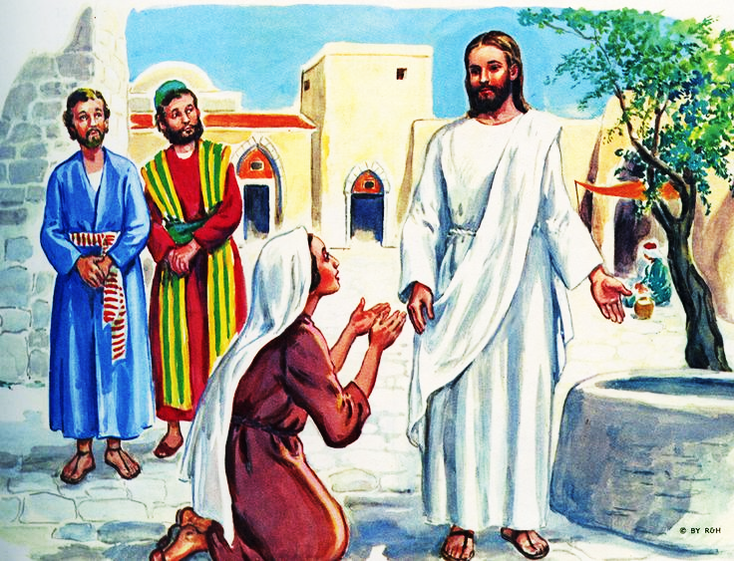

Slide 42
Mark 10: the mother is not even mentioned.
She was not on her own. They were tagging along.
V 22, They said to Him, “We are able.”

Slide 43
They came as a trio.
Matthew seems to focus on her.
Mark focuses on James and John.

Slide 44
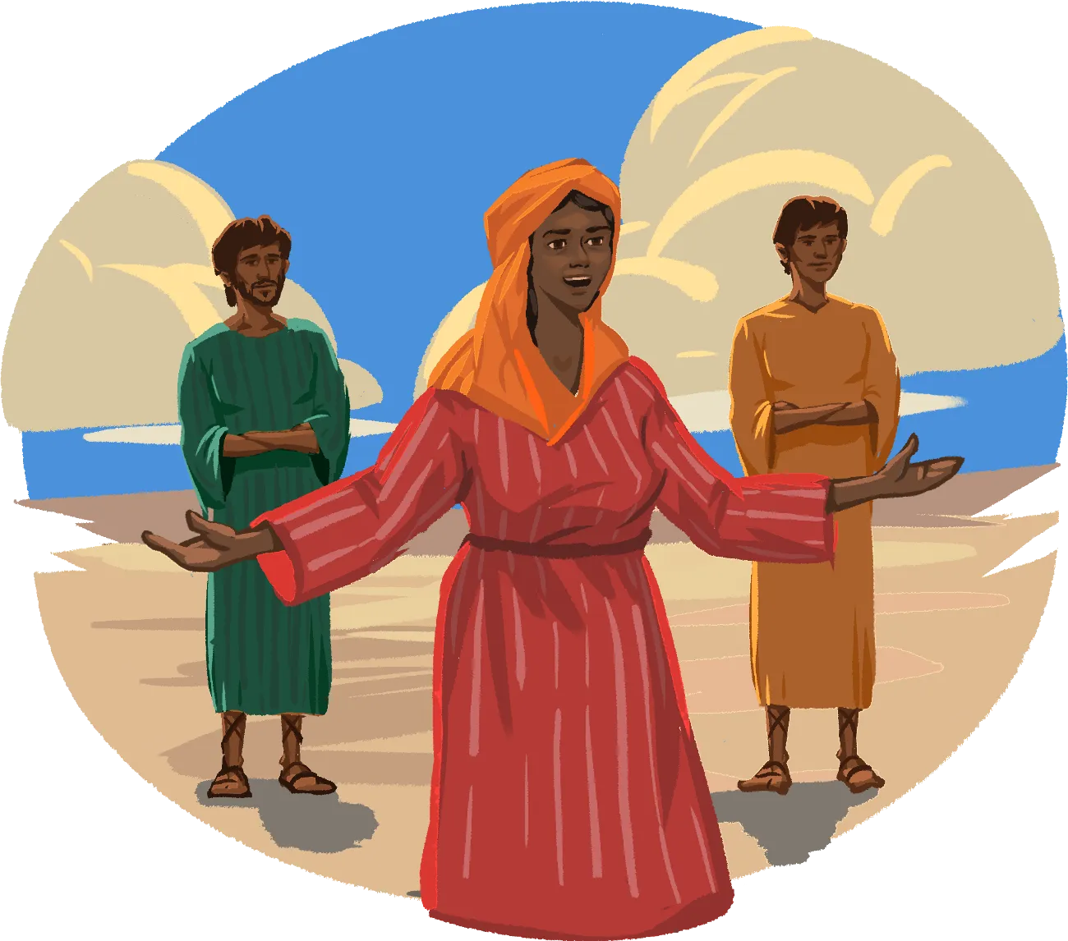
V 21,

Slide 45
This is a proud act.
o They want the chief place in the kingdom.
o They are seeking self-glory.
o They are seeking promotion, honour, esteem.
o They want to ride the throne.

Slide 46
o They want to be next to Christ so people can say that look at those two.
o Look how close they are to Christ. They must be the second and third most holy people there are.
o They were bold.

Slide 47
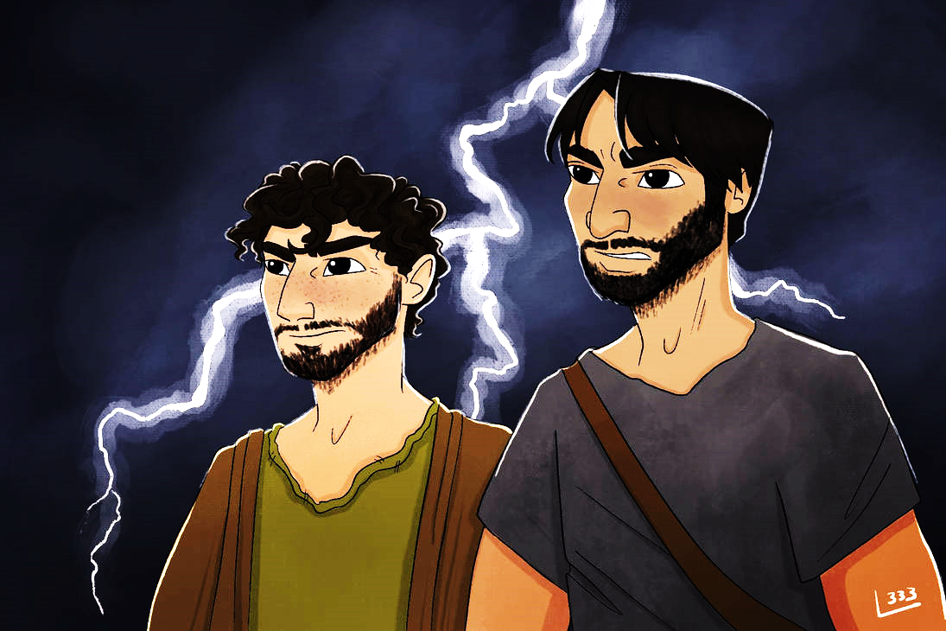
“Sons of thunder.”

Slide 48
They came to Jesus in what is a political power play.
They are playing on something which is very interesting.

Slide 49
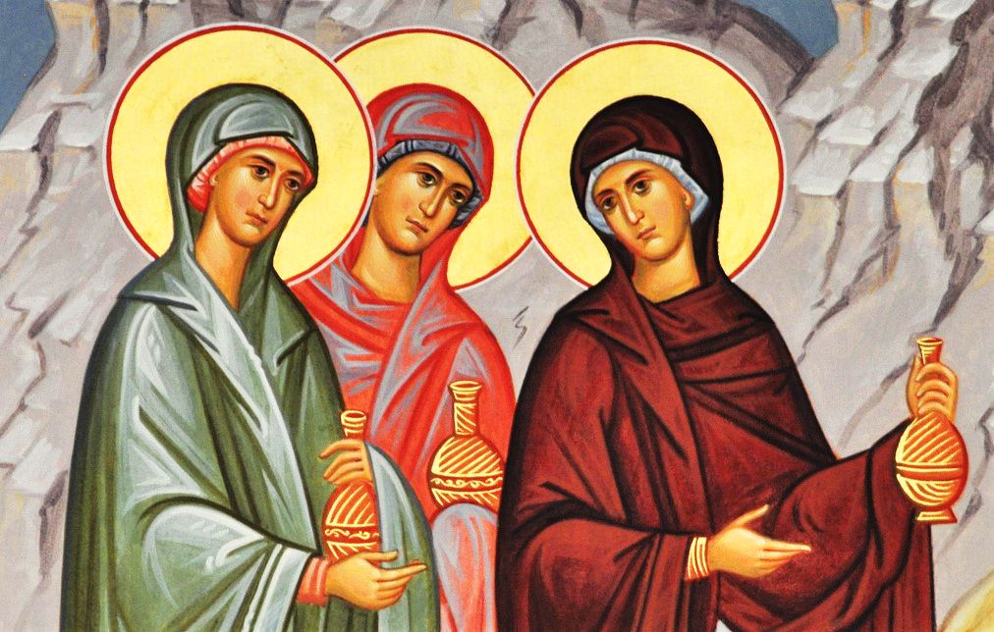
Matthew 27:56,

Slide 50
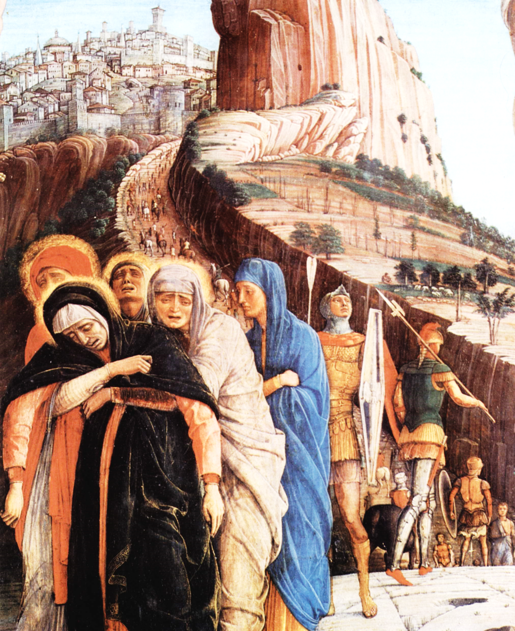
Mark 15:40

Slide 51
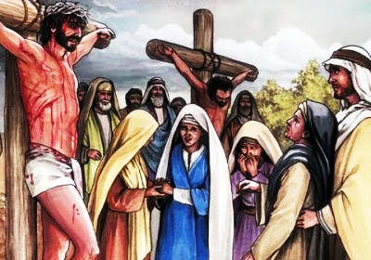
John 19:25,

Slide 52
She worships Proskuneō, bowed down, knelt, treated Him like a king.

Slide 53
Mark 10 says she wouldn’t tell Him. She wanted Him to promise to give it to before she told Him what it was.

Slide 54
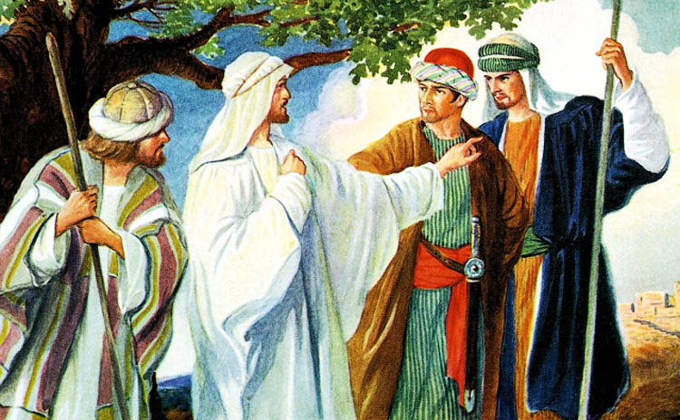
Mark 10:35-36,

Slide 55
Childish.
Have you ever had your child do that to you?

Slide 56
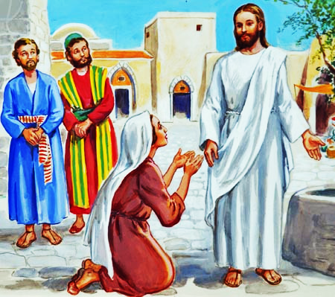
She comes like a little child.

Slide 57
V 21,
“Grant that these two sons of mine may sit, one on Your right hand and the other on the left, in Your kingdom.”

Slide 58
3 John 1:9,
I wrote to the church, but Diotrephes, who loves to have the pre-eminence among them, does not receive us.

Slide 59
There is always that self-seeking.
It is true in Christianity.

Slide 60
People in the church who want to be known, esteemed, and lifted up.

Slide 61
But our Lord rejects political power play.

Slide 62
2. Selfish Ambition

Slide 63
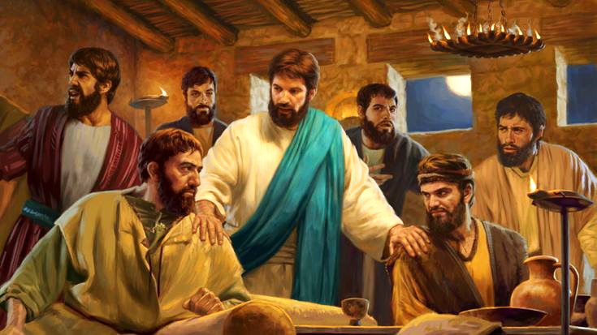
V 22-24,

Slide 64
Who will be those who receive the greatest reward in heaven?
Those who suffered the most in life for the cause of Jesus Christ.

Slide 65
2 Corinthians 4:17,
For our light affliction, which is but for a moment, is working for us a far more exceeding and eternal weight of glory,

Slide 66
What is it that leads to glory?
It is an affliction.

Slide 67
“Are you able to drink the cup?”

Slide 68
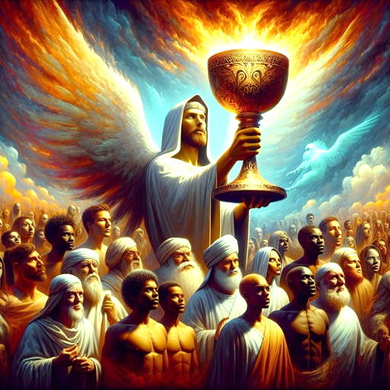
Isaiah which talks about the cup of God’s fury.
Christ drank all of that.

Slide 69
Are you able to take it all in to experience all of it?
Matthew 26,
the bitter cup,
the cup of suffering.

Slide 70
V 22,
They said to Him,
“We are able.”

Slide 71
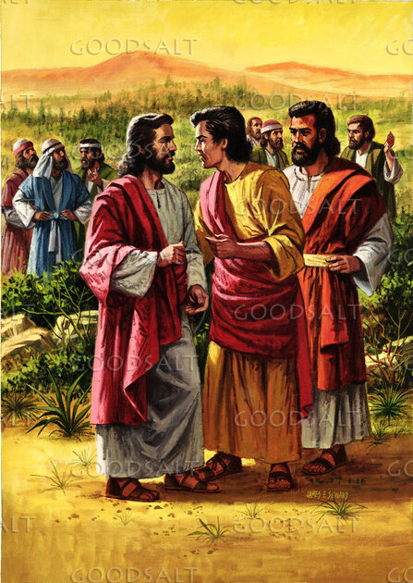
How dumb?
They weren’t able. Excessive confidence.

Slide 72
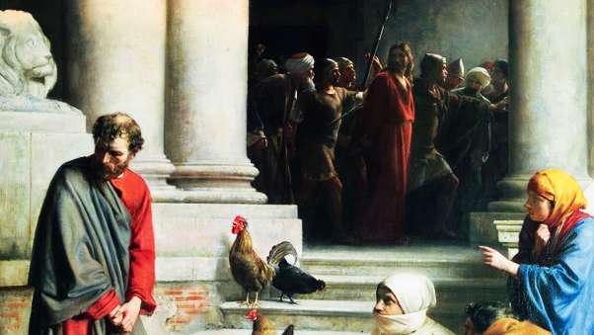
“Everybody may forsake you. I will never forsake you.”

Slide 73
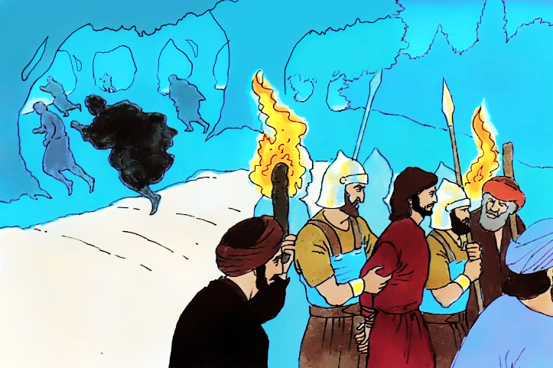
Matthew 26:31-56,

Slide 74
V 23,
“You will indeed drink My cup, and be baptized with the baptism that I am baptized with;

Slide 75
Jesus told them the truth.
The time came when they were faithful.

Slide 76
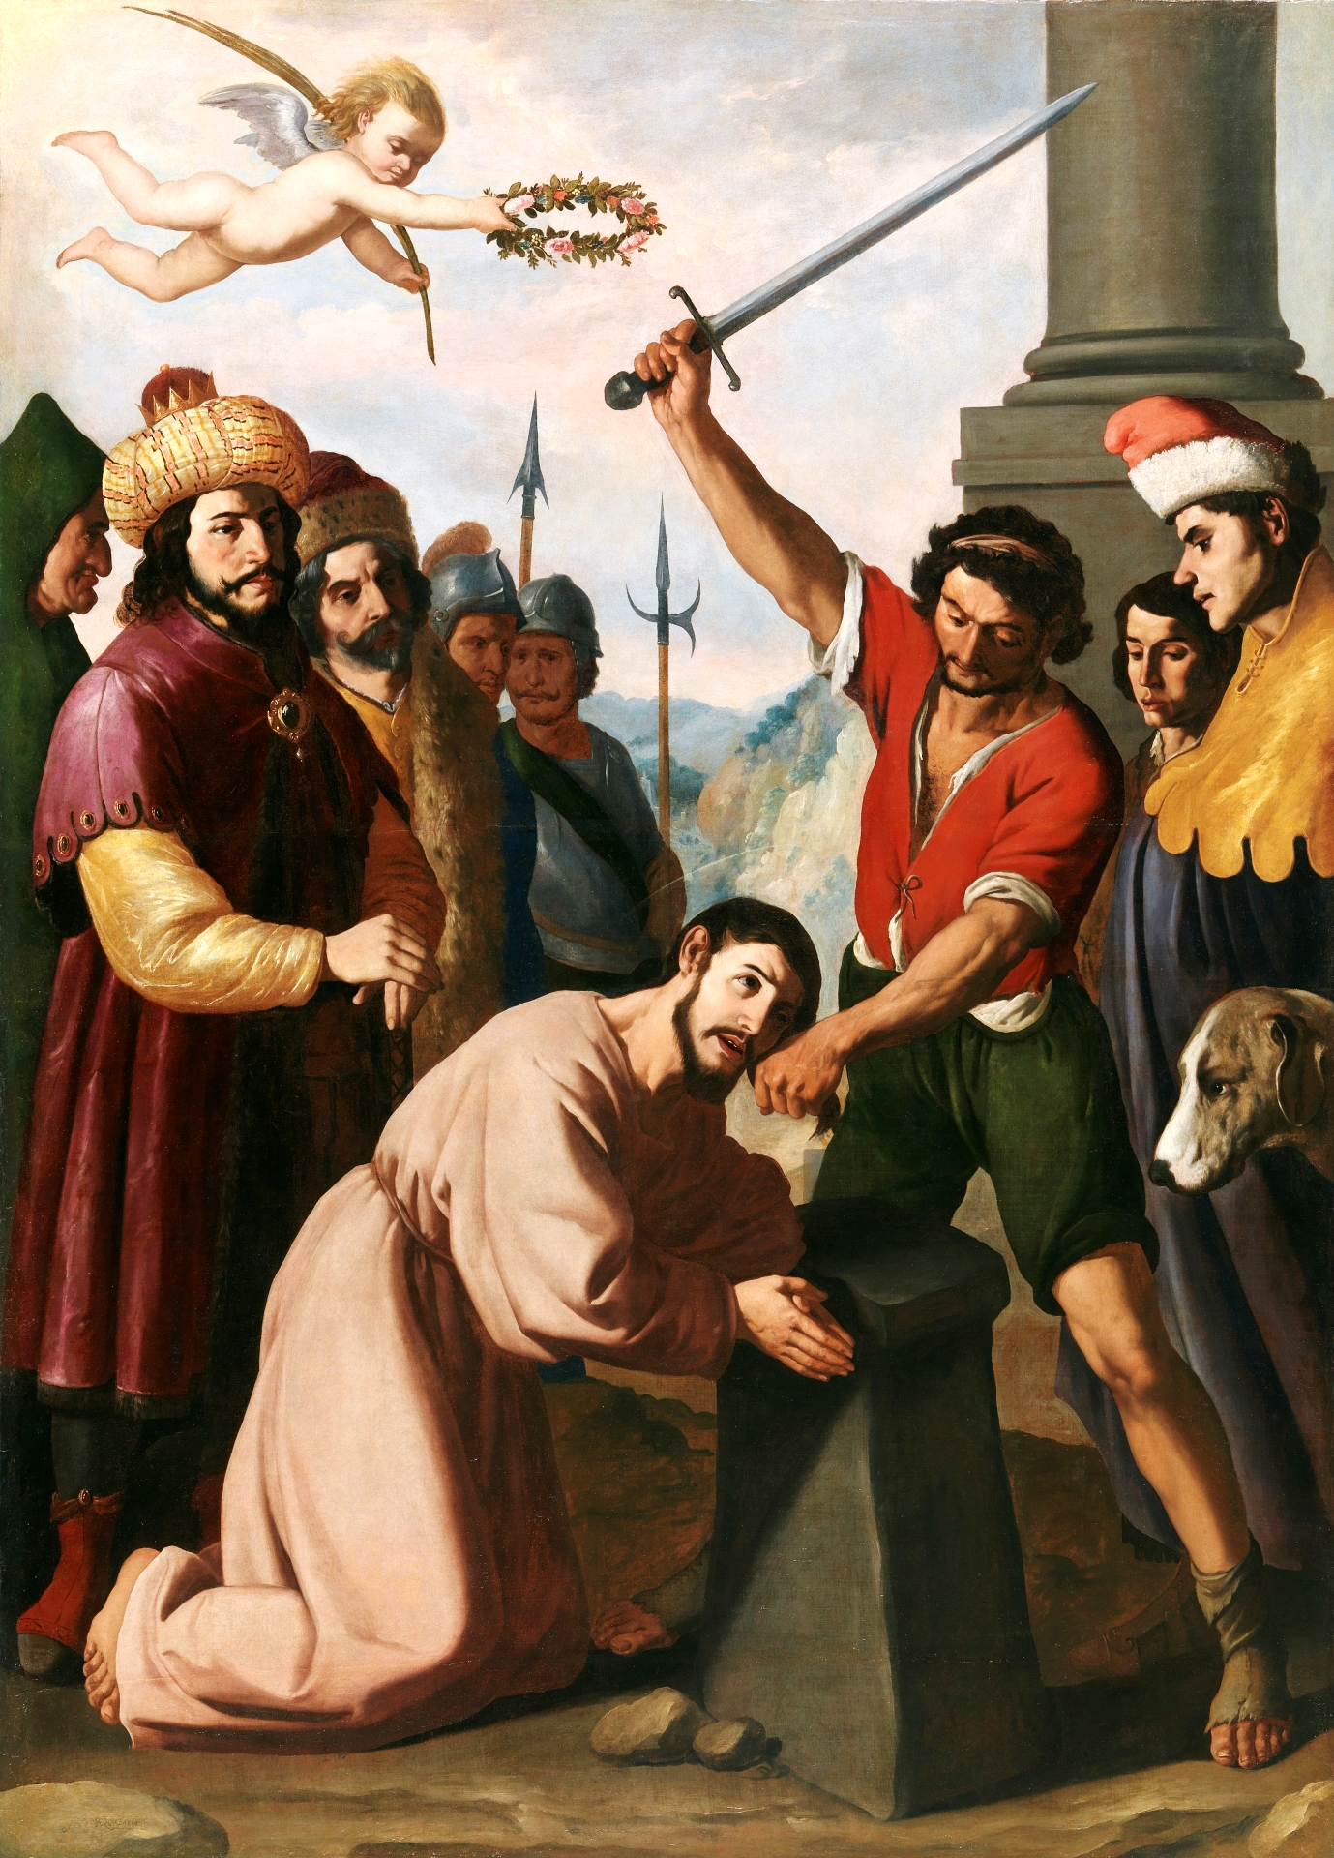
Acts 12
James was the first Dying Martyr

Slide 77
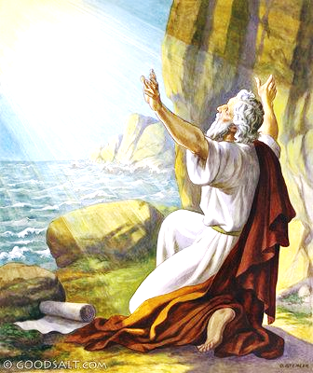
Acts 12
JOHN was the first living martyr, exiled to the Isle of Patmos to spend his life.

Slide 78
They couldn’t have drunk it all as Jesus did, but they tasted that same cup.

Slide 79
V 23,
But to sit on My right hand and on My left is not Mine to give, but it is for those for whom it is prepared by My Father.”

Slide 80
I am in submission now.
I am going to suffer.
I am emphasizing My submissiveness to the Father.
He is the one passing out the rewards.

Slide 81
Who would be the most glorified?
The only answer is the one who suffered the most, the one who is the most abandoned to self-denial.

Slide 82
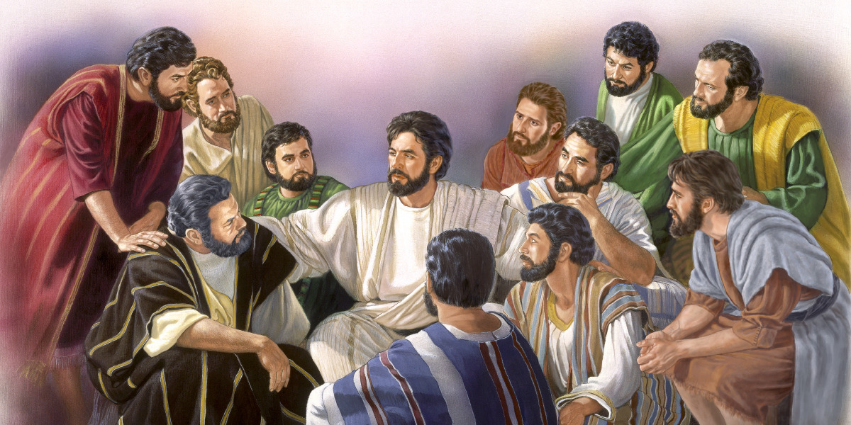
V 24,

Slide 83
All of them weren’t spiritual.
They were mad, because they got in there before they did.

Slide 84
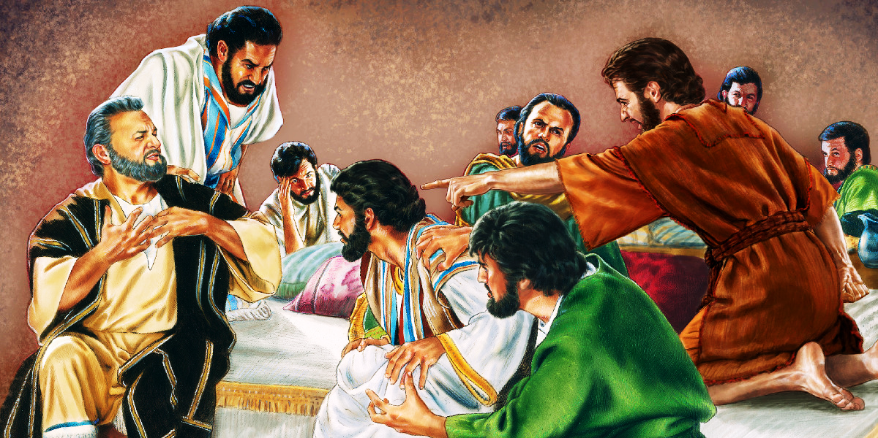
Luke 22:24-27,

Slide 85
3. Dictatorship.

Slide 86
V 25,
“You know that the rulers of the Gentiles lord it over them,

Slide 87
They lord it over them. This is a dominant dictatorship.
This is the world’s way.

Slide 88
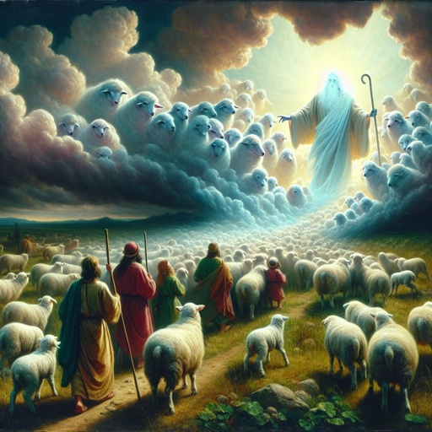
1 Peter 5:2,

Slide 89
4. Charming control.

Slide 90
V 25,
and those who are great exercise authority over them.

Slide 91
This happens in the church too!
People with charm and the cleverness.

Slide 92
If you would be great don’t seek it by political power play.
o Don’t try to climb some ladder based on who you know.
o Don’t seek it by audacious ambition.
o Don’t overstate confidently your abilities.
o Don’t seek it by dominant dictatorship.

Slide 93
o Don’t just try to pull rank on people and shove them around.
o Don’t use your natural capabilities and personality characteristics to manipulate and move people around.

Slide 94
B. How to be great?

Slide 95
The encouragement comes in verses 26 and 27.
The example is given in verse 28.

Slide 96
Encouragement.
V 26, “But it shall not be so among you”

Slide 97
Encouragement.
V 26, “But it shall not be so among you”

Slide 98
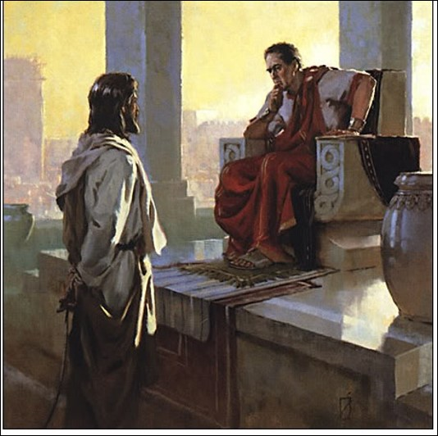
John 18:36,
My kingdom is not of this world.

Slide 99
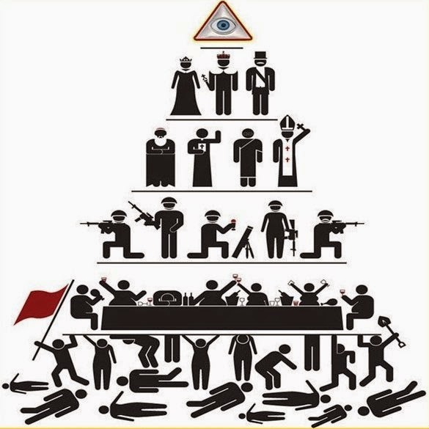

Slide 100
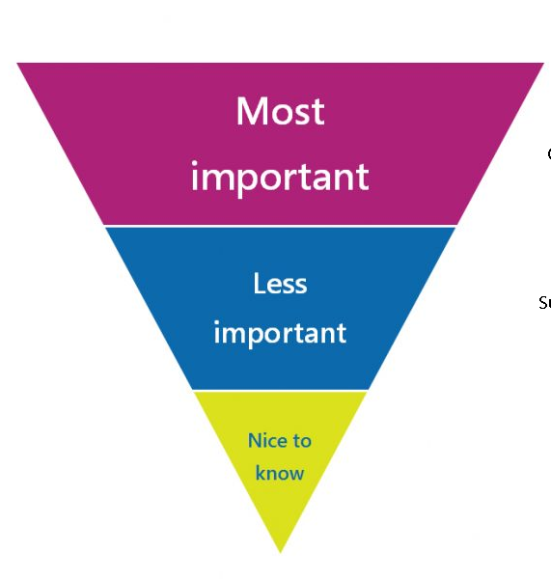
YOU

Slide 101
There are many who pursue the limelight of Christianity.
o They want to want to seek a prominent place, the place of prestige and honour.
o The place of respect,

Slide 102
o The place of power and control.
o They can generate those kinds of creature comforts that minister most to their physical bodies and their psychological needs.

Slide 103
V 26,
Yet it shall not be so among you; but whoever desires to become great among you, let him be your servant.

Slide 104
Jesus never promotes a sinful ambition.
Jesus dealt with the sinful ambition of James and John.

Slide 105
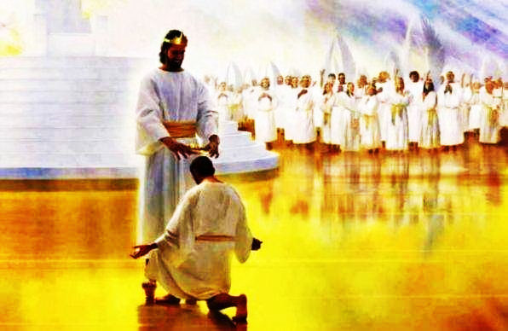
Revelation 22:12,

Slide 106
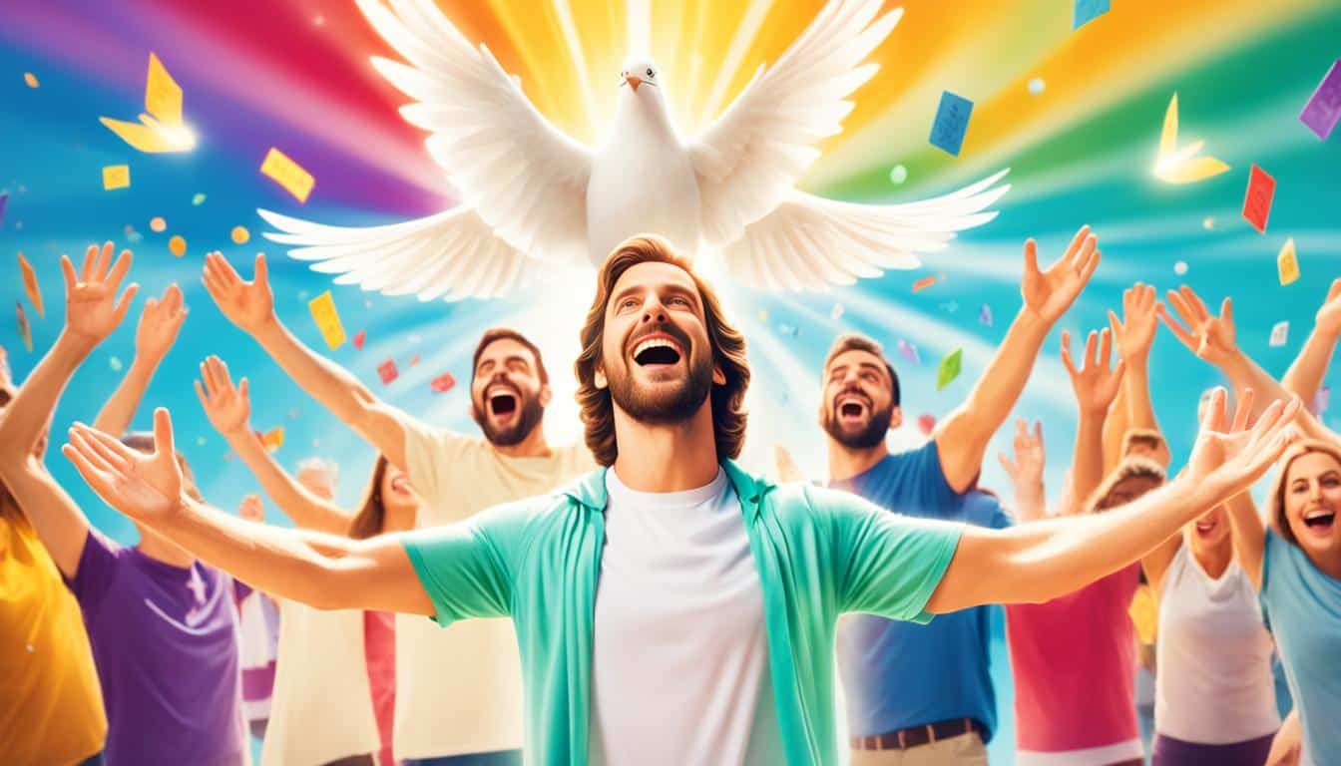
It is not wrong to seek glory in eternity.

Slide 107
The track of suffering.
➢ The path to glory is the path of suffering.
➢ The path of sacrifice.
➢ The path of slavery.
➢ The path of selfless service.

Slide 108
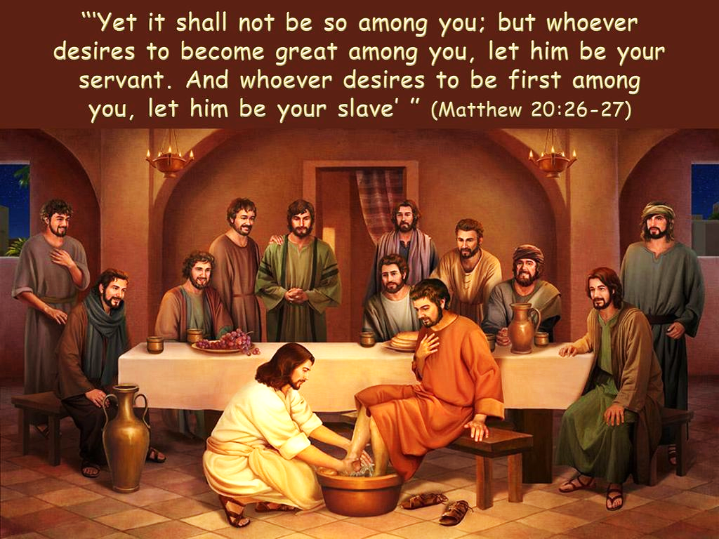
V 27,

Slide 109
• They knew what it was to see slaves whipped and beaten.
• They knew what it was to serve in the terrible kind of conditions that many of them served in.

Slide 110
Romans 14:8,
For if we live, we live to the Lord; and if we die, we die to the Lord. Therefore, whether we live or die, we are the Lord’s.

Slide 111
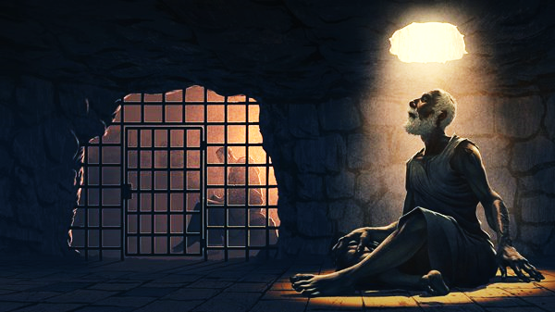
Paul was a slave bound to
Christ.

Slide 112
All of us need to ask that question is my motive is pure?

Slide 113
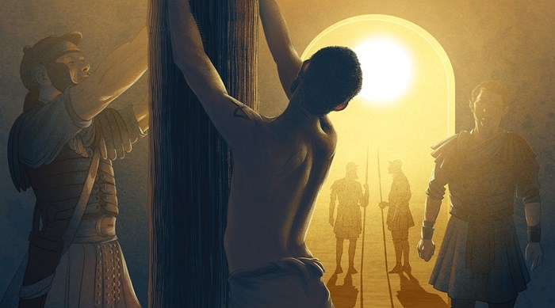
Paul becomes a wonderful illustration for us, who sought glory, but he was also willing to bear the pain.

Slide 114
People who are seeking to do ministry are you seeking without any hardship?

Slide 115
Willing to go through the uncomfortable things and places for the sake of Gospel?

Slide 116
The cost of greatness may be persecution.

Slide 117
There is a certain loneliness.
There is a certain being apart from the social scene.
There is a price of quietness to pay.

Slide 118
Loneliness is the price of saintliness.
- A. W. Tozer.

Slide 119
2. Example. V 26, “But it shall not be so among you”

Slide 120
V 28,
Just as the Son of Man did not come to be served, but to serve, and to give His life a ransom for many.”

Slide 121
1 John 2:6,
He who says he abides in Him ought himself also to walk just as He walked.

Slide 122
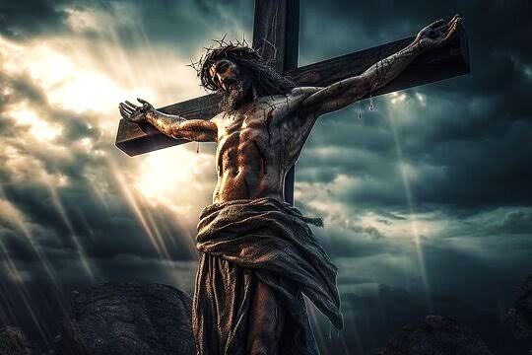
Philippians 2:6-9,

Slide 123
Son of Man.
The messianic term drawn from Daniel 7:13 used more than 80 times in the Gospels by Christ to refer to Himself.

Slide 124
The Messiah, God in human flesh.
did not come to be served, but to serve,

Slide 125
John 18:37,
“My kingdom is not of this world. If My kingdom were of this world, My servants would fight,

Slide 126
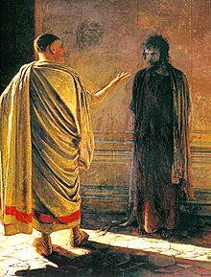
Pilate got confused.
You don’t look like a king, and you don’t act like one.

Slide 127
You don’t do anything.
You don’t retaliate.

Slide 128
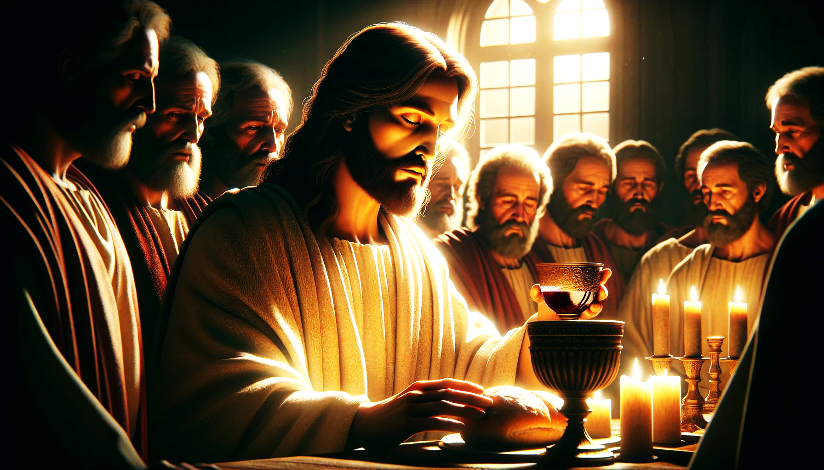
Luke 22:27,

Slide 129
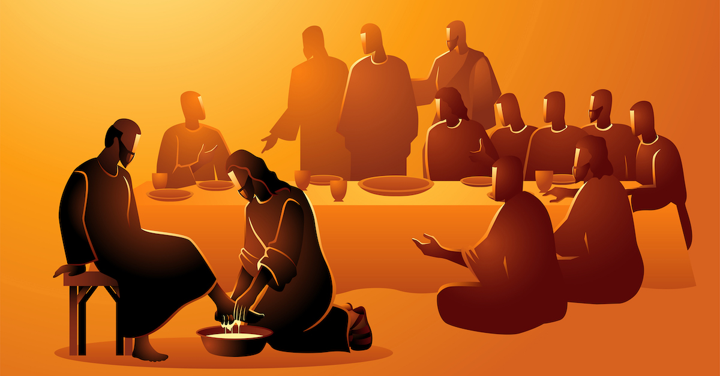

Slide 130
V 28,
to give His life a ransom for many.”

Slide 131
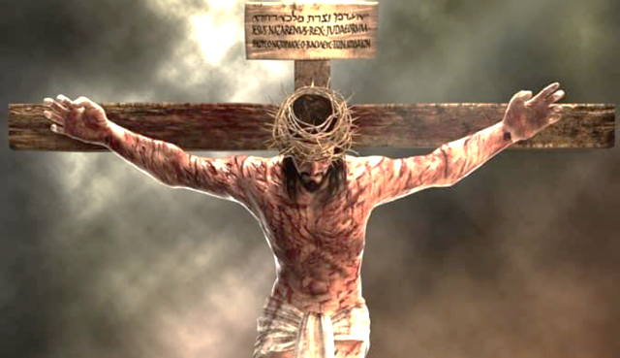
John 15:13-14,

Slide 132
1 Peter 2:21,
For to this you were called, because Christ also suffered for us, leaving us an example, that you should follow His steps

Slide 133
1 Peter 2:24,
Who Himself bore our sins in His own body on the tree, that we, having died to sins, might live for righteousness—by whose stripes you were healed.

Slide 134
The word “ransom” Only used twice in the New Testament.

Slide 135
Here and in Mark 10:45.
The Greek word Lutron is the price of the release of a slave.
Lutron was whatever the price was too free him.

Slide 136
We were slaves of sin, death, Satan, the flesh, the world, and hell.
Christ paid the Lutron to release us.

Slide 137
1 Corinthian 6:20,
For you were bought at a price; therefore glorify God in your body and in your spirit, which are God’s.

Slide 138
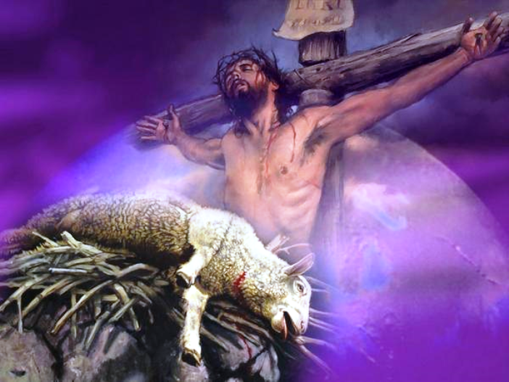
1 Peter 1:18-19,

Slide 139
V 28
the word “for,” because it is a very important theological term.

Slide 140
It is the Greek word anti.
It means as over against something or in exchange for something, or in the place of something.

Slide 141
The word “many.”
What does that mean by many?
Did Jesus die for a few/ many?
Is this teaching a limited atonement?

Slide 142
“Many” is simply an expression referring to all, but it is used in a contrasting way, as over against one who gave the sacrifice, many are ransomed.

Slide 143
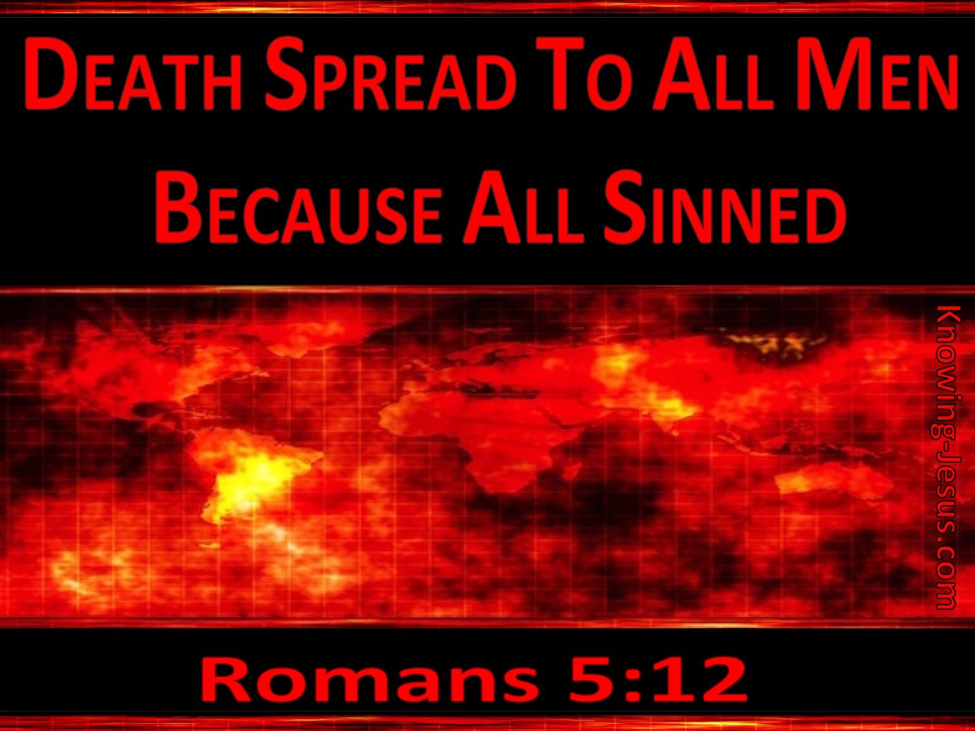
Romans 5:12,

Slide 144

Romans 5:15,

Slide 145
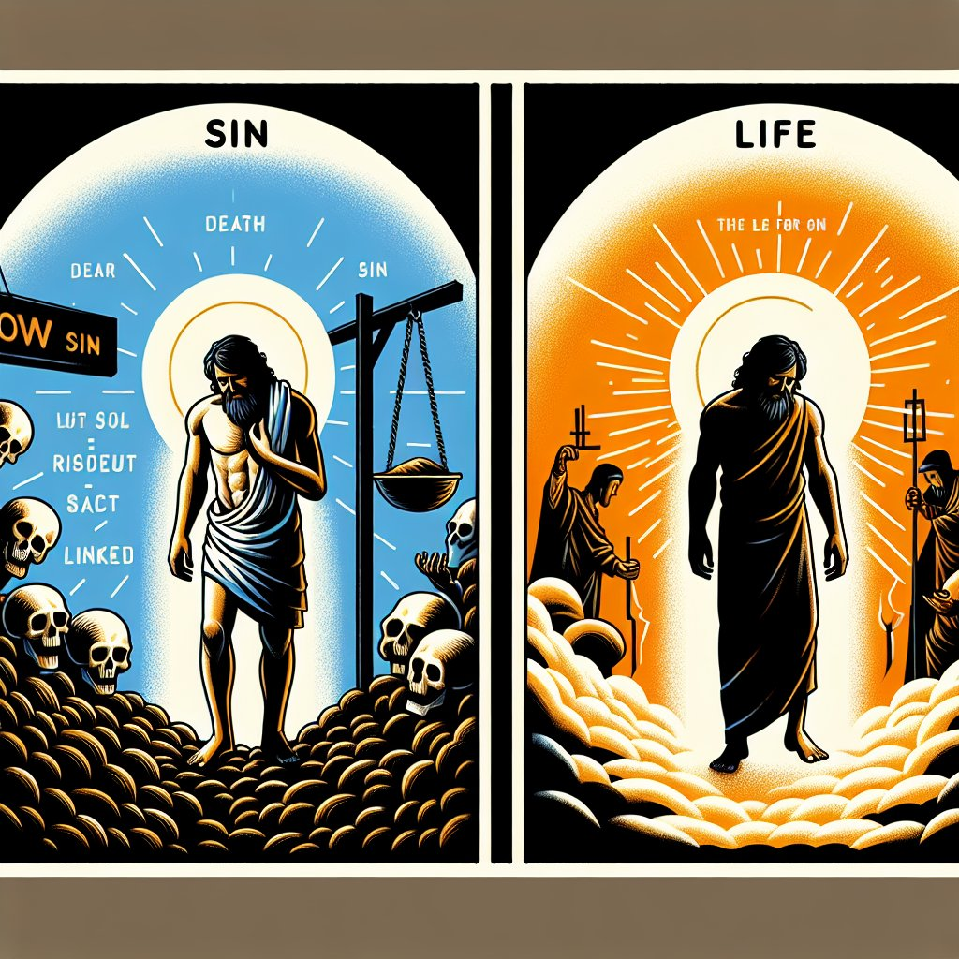
Romans 5:19

Slide 146
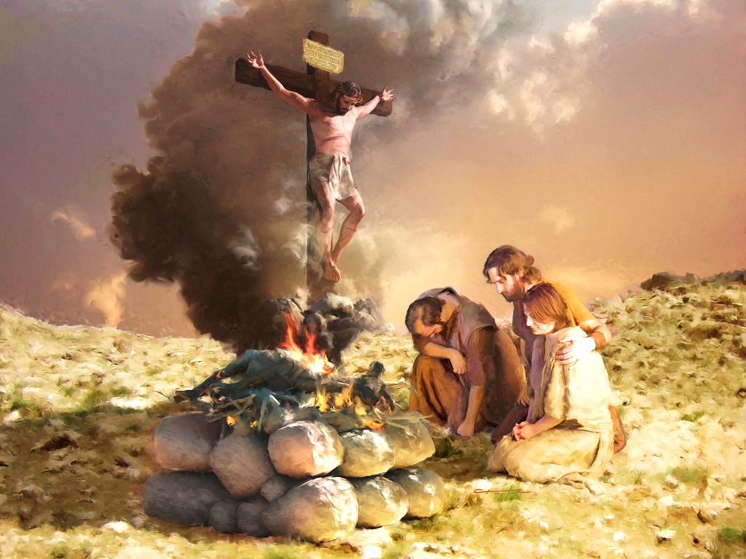
Jesus has been Ransomed

