Slide 1
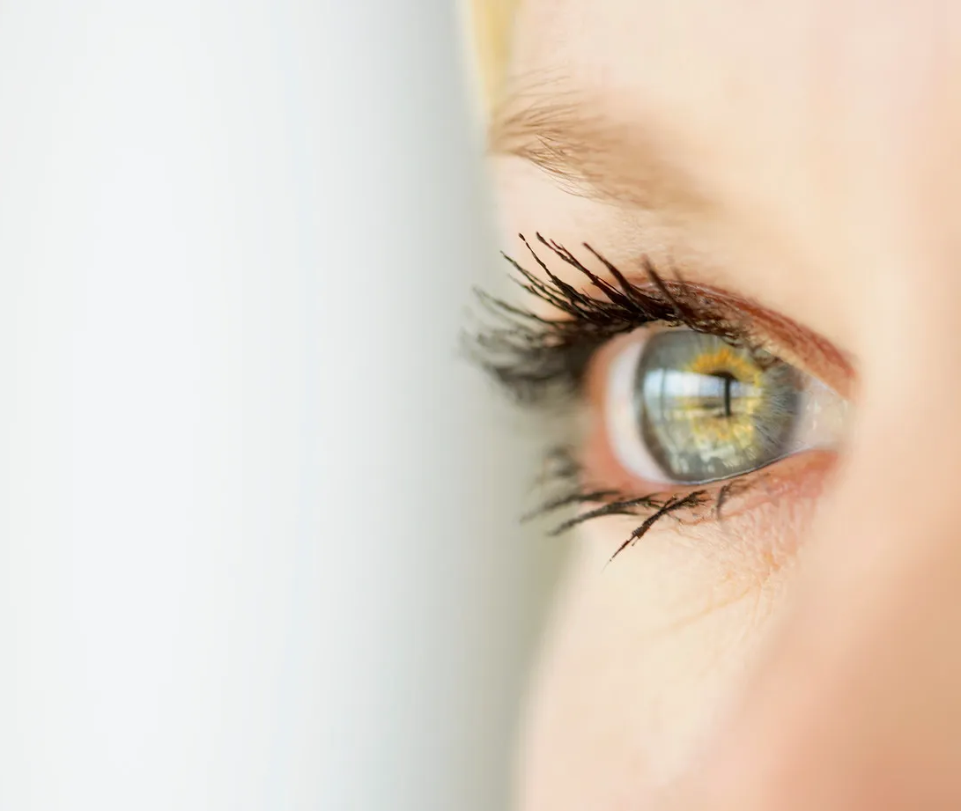
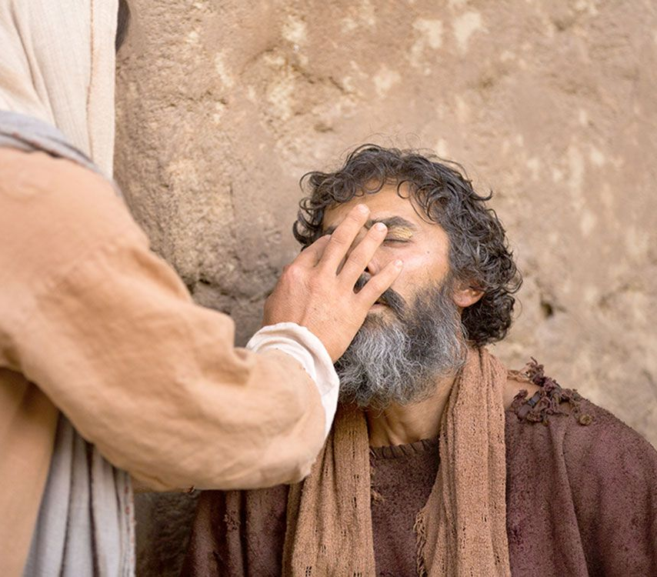
Jesus opens the eyes of the blind!
Matthew
20:29-34
Mark
10:46-52
Luke 18:35-43

Slide 2
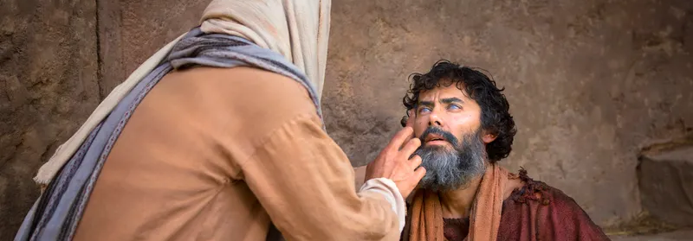
Matthew 20:29-34

Slide 3
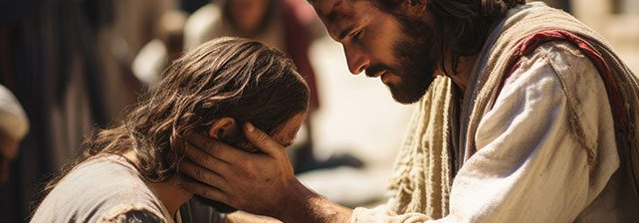
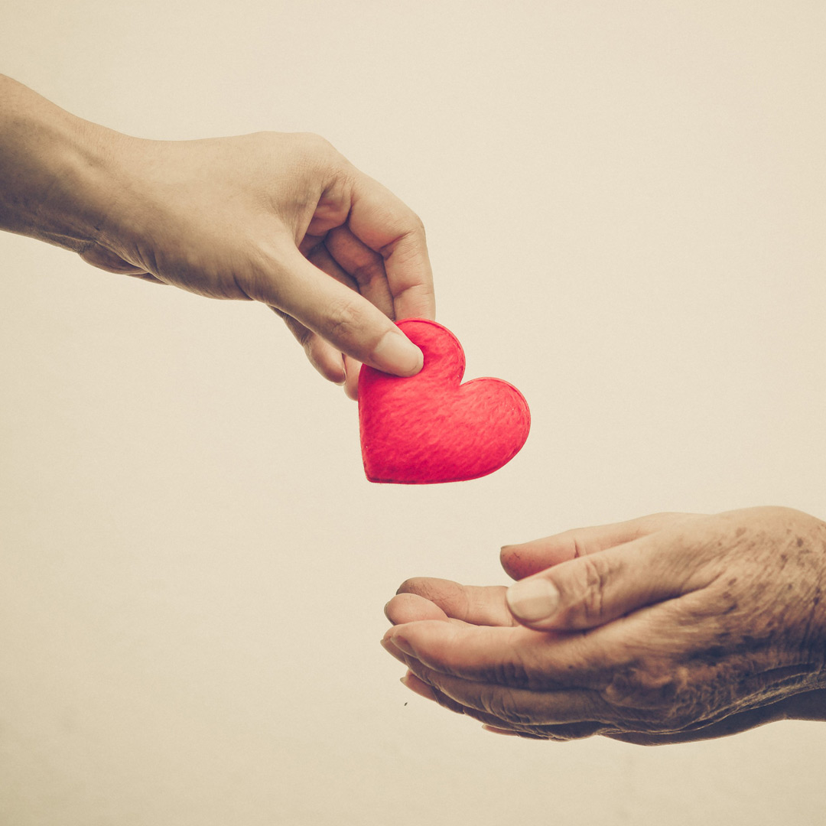
Matthew 20:34
“compassion”

Slide 4

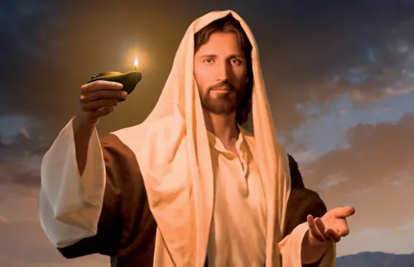
John 1:10-12
That was the true Light which gives light to every man coming into the world. ¹⁰ He was in the world, and the world was made through Him, and the world did not know Him. ¹¹ He came to His own, and His own did not receive Him.

Slide 5
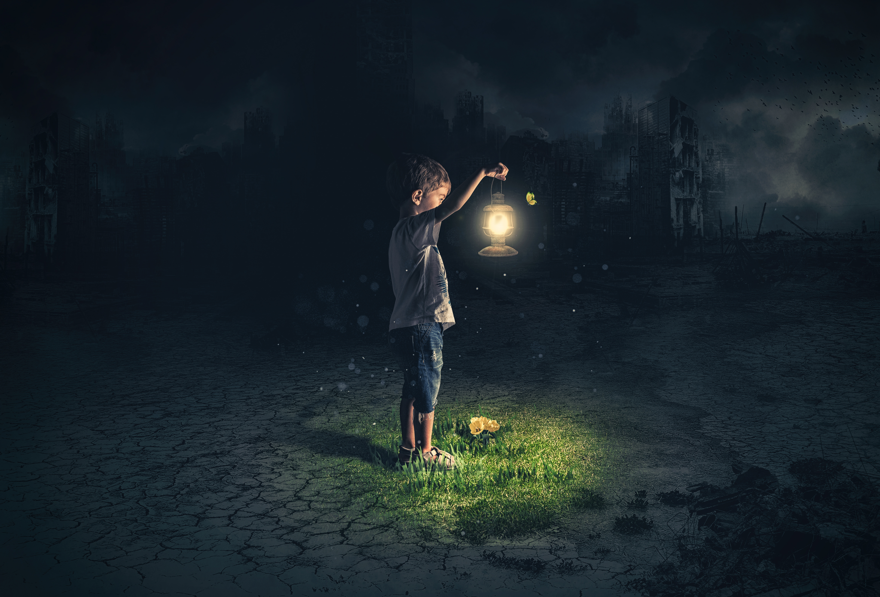
John 3:19
And this is the condemnation, that the light has come into the world, and men loved darkness rather than light, because their deeds were evil.

Slide 6
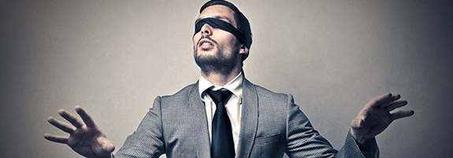
Romans
11:25
For I do not desire, brethren, that you should be ignorant of this mystery, lest you should be wise in your own opinion, that blindness in part has happened to Israel until the fullness of the Gentiles has come in.

Slide 7
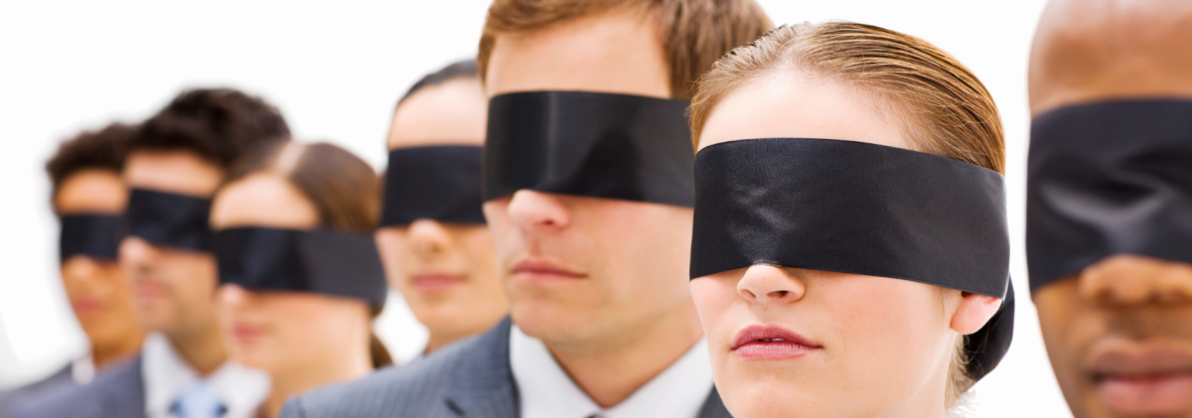
2 Corinthians 3:14
But their minds were blinded. For until this day the same veil remains unlifted in the reading of the Old Testament, because the veil is taken away in Christ.

Slide 8
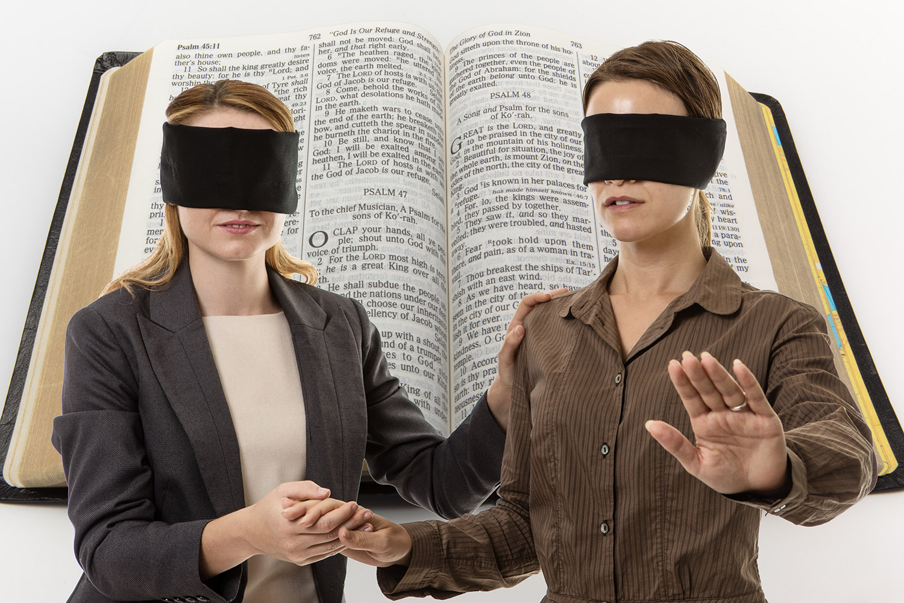
Matthew 15:14
Let them alone. They are blind leaders of the blind. And if the blind leads the blind, both will fall into a ditch.”

Slide 9
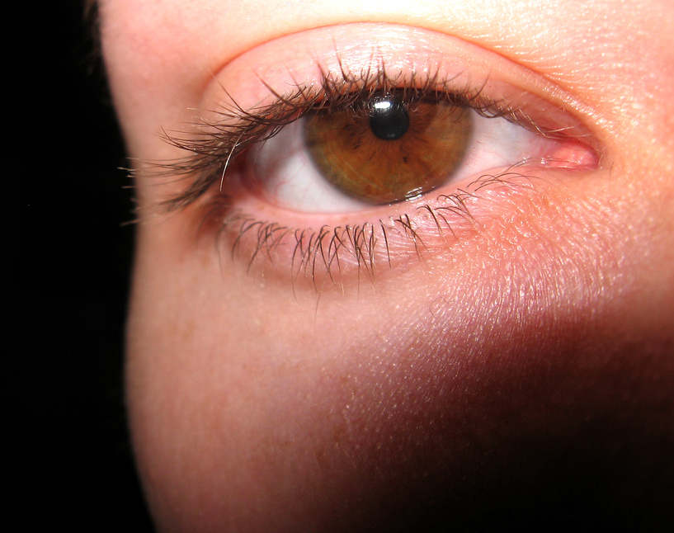
Matthew 6:23
But if your eye is bad, your whole body will be full of darkness. If therefore the light that is in you is darkness, how great is that darkness!

Slide 10
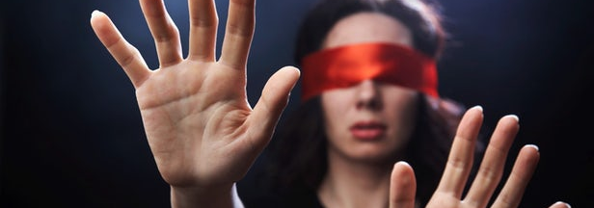
2 Corinthians 4:4
whose minds the god of this age has blinded, who do not believe, lest the light of the gospel of the glory of Christ, who is the image of God, should shine on them.

Slide 11
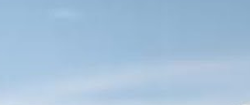
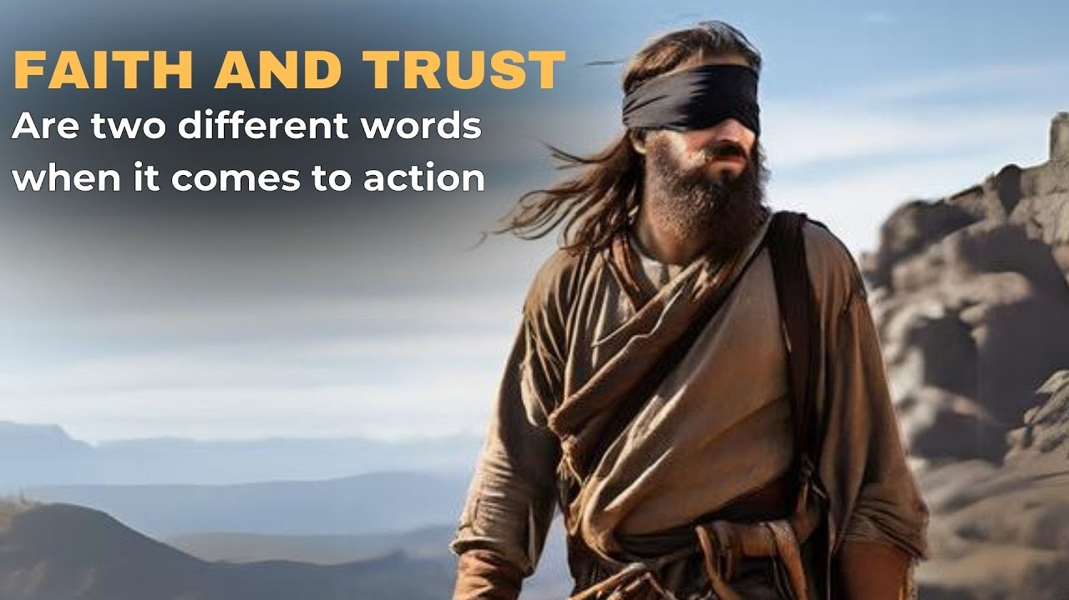
Men are blind by sin.
Doubly blinded by Satan.
Triply blinded by God.

Slide 12
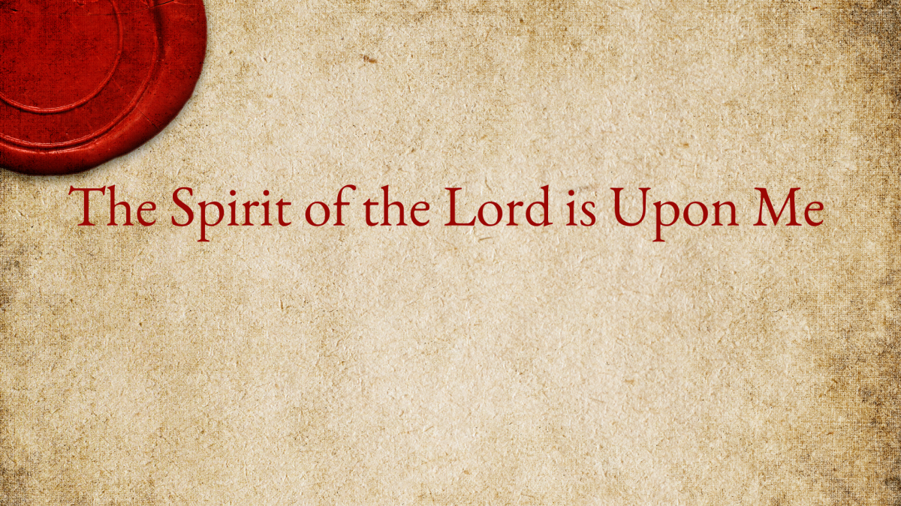
Luke 4:18
to heal the brokenhearted, To proclaim liberty to the captives And recovery of sight to the blind, To set at liberty those who are oppressed;

Slide 13

John 8:12
Then Jesus spoke to them again, saying, “I am the light of the world. He who follows Me shall not walk in darkness, but have the light of life.”

Slide 14


Jesus came to give spiritual light to

Slide 15
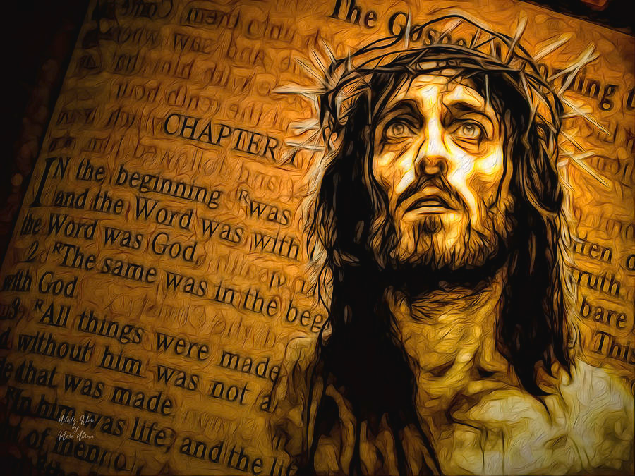
Jesus did that for three reasons
It was part of messianic proof.

Slide 16
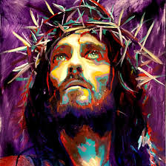
Jesus did that for three reasons
It was part of millennial preview.

Slide 17
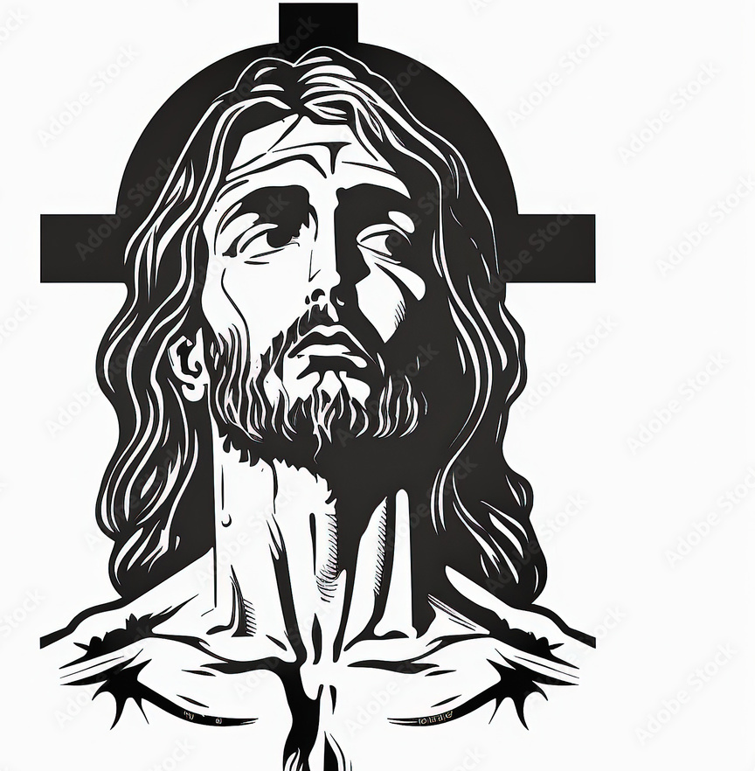
Jesus did that for three reasons
It was a matter of symbol or picture.

Slide 18
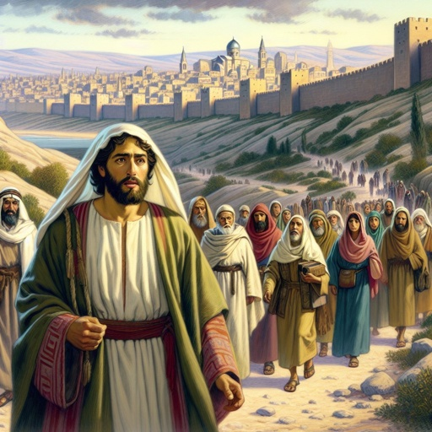
Matthew 20:29
Now as they went out of Jericho, a great multitude followed Him.

Slide 19
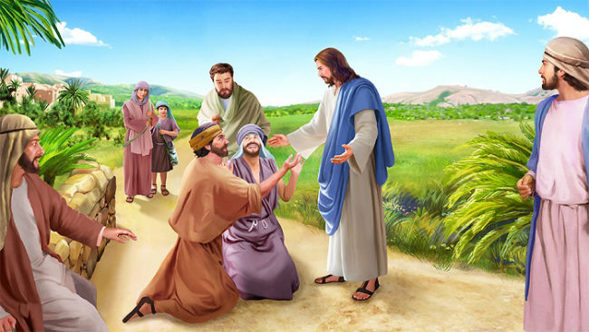
1.Plight
Matthew 20:30
and behold, two blind men sitting by the road, when they heard that Jesus was passing by, cried out, saying, “Have mercy on us, O Lord, Son of David!”

Slide 20
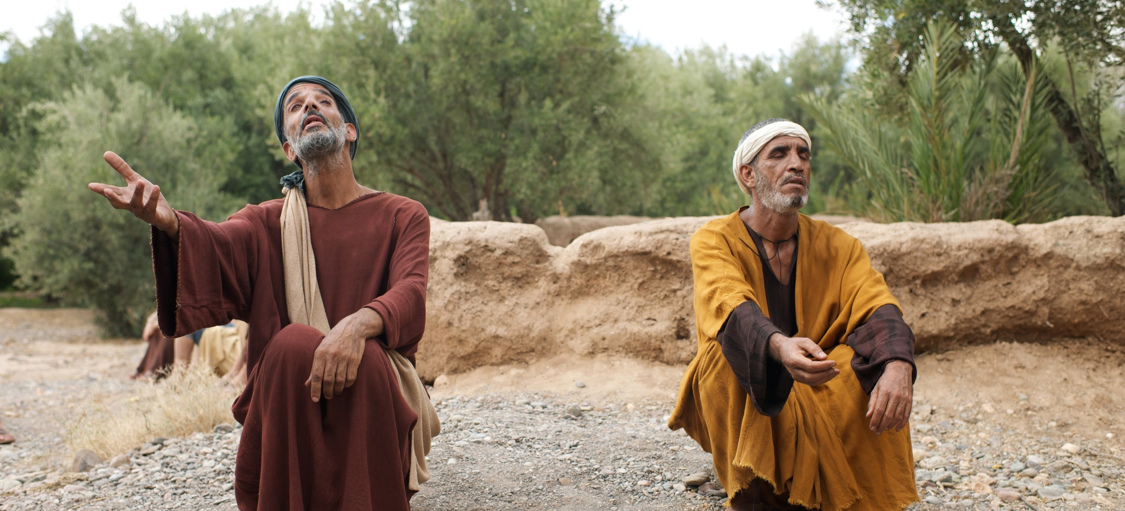
2. Persistence
Matthew 20:30
and behold, two blind men sitting by the road, when they heard that Jesus was passing by, cried out, saying, “Have mercy on us, O Lord, Son of David!”

Slide 21
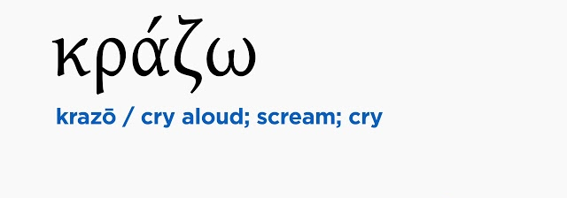
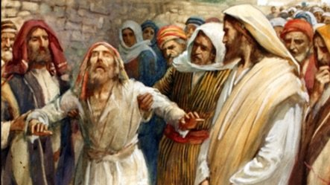
“Have mercy on us.”

Slide 22
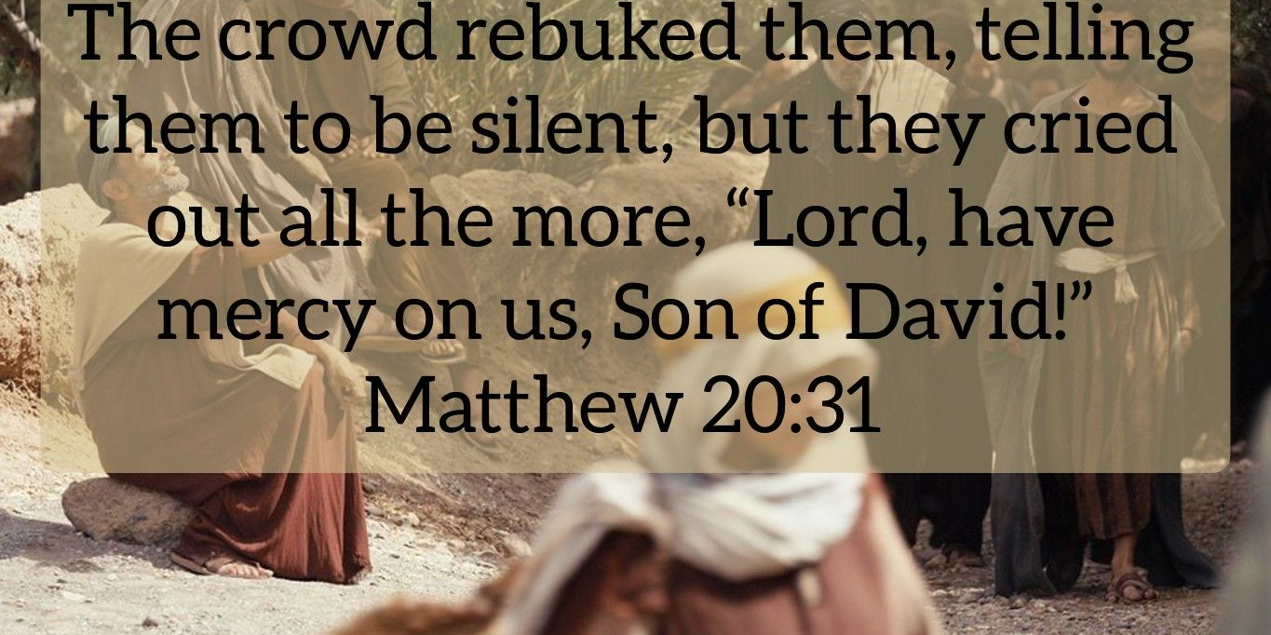
Matthew 20:31

Slide 23
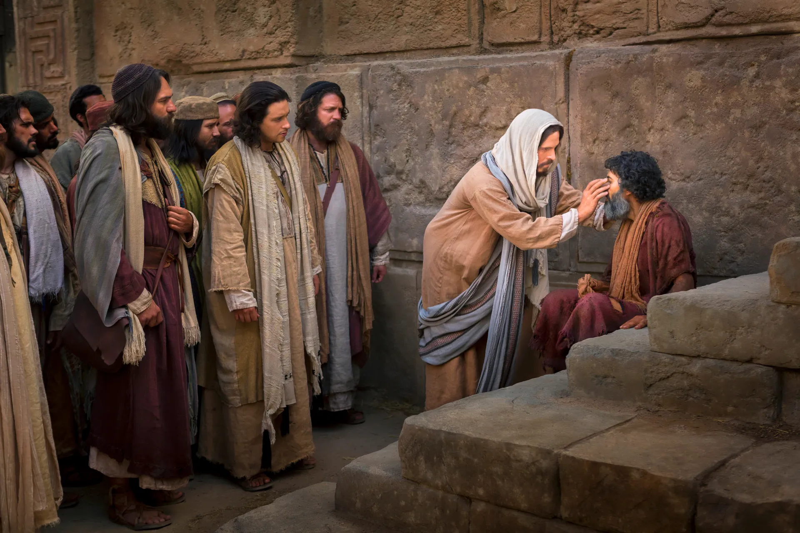
3. Perception
Matthew 20:31
“Have mercy on us, O Lord, Son of David!”

Slide 24
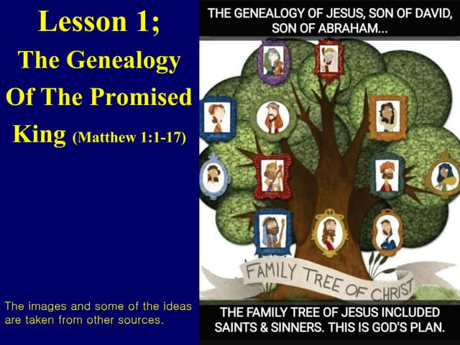
Matthew 1:1
The book of the genealogy of Jesus Christ, the Son of David, the Son of Abraham

Slide 25
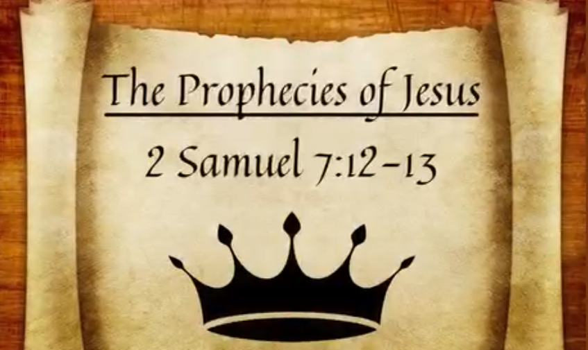
2 Samuel 7:12-13
“When your days are fulfilled and you rest with your fathers, I will set up your seed after you, who will come from your body, and I will establish his kingdom. 13 He shall build a house for My name, and I will establish the throne of his kingdom forever.

Slide 26
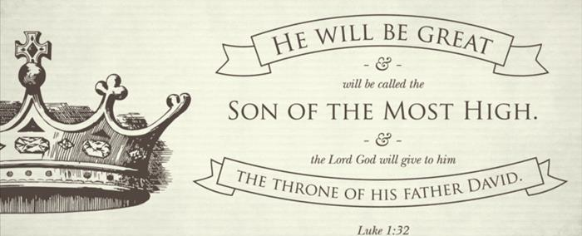
He will be great, and will be called the Son of the Highest; and the Lord God will give Him the throne of His father David. 33 And He will reign over the house of Jacob forever, and of His kingdom there will be no end.”
Luke
1:32-33

Slide 27
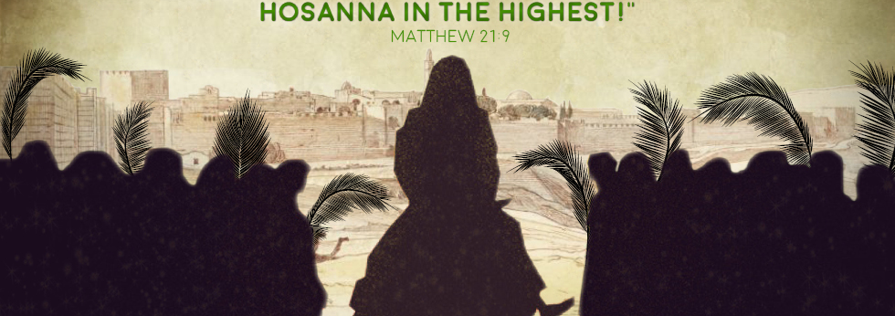
Matthew 21:9
Then the multitudes who went before and those who followed cried out, saying: “Hosanna to the Son of David! ‘Blessed is He who comes in the name of the Lord!’ Hosanna in the highest!”

Slide 28
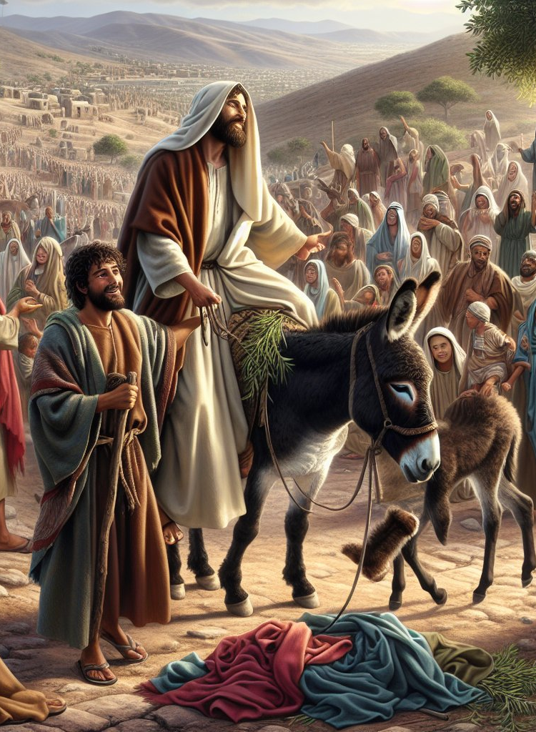
Matthew 21:11
So the multitudes said, “This is Jesus, the prophet from Nazareth of Galilee.”

Slide 29
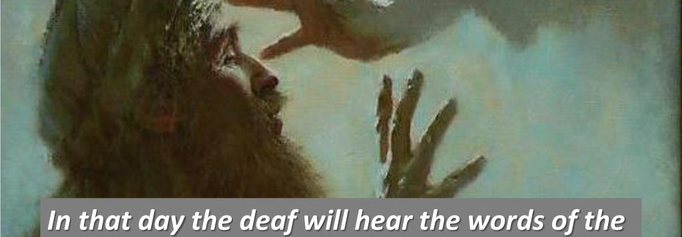
Isaiah
29:18
In that day the deaf shall hear the words of the book, And the eyes of the blind shall see out of obscurity and out of darkness.

Slide 30
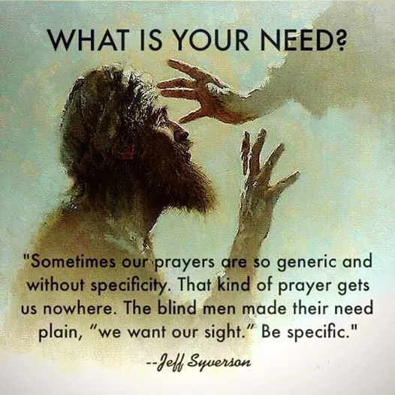
Matthew 20:32
4. Plea.
So Jesus stood still and called them, and said, “What do you want Me to do for you?”

Slide 31
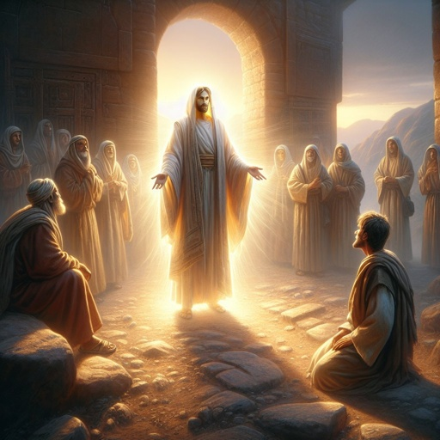
Mark 10:49-50
So Jesus stood still and commanded him to be called. Then they called the blind man, saying to him, “Be of good cheer. Rise, He is calling you.” 50 And throwing aside his garment, he rose and came to Jesus.

Slide 32
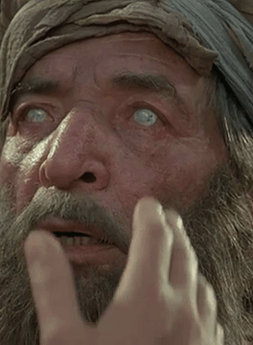
Matthew 20:33
They said to Him, “Lord, that our eyes may be opened.”

Slide 33
5. Supernatural privilege.
Matthew 20:30
So Jesus had compassion and touched their eyes. And immediately their eyes received sight, and they followed Him.

Slide 34
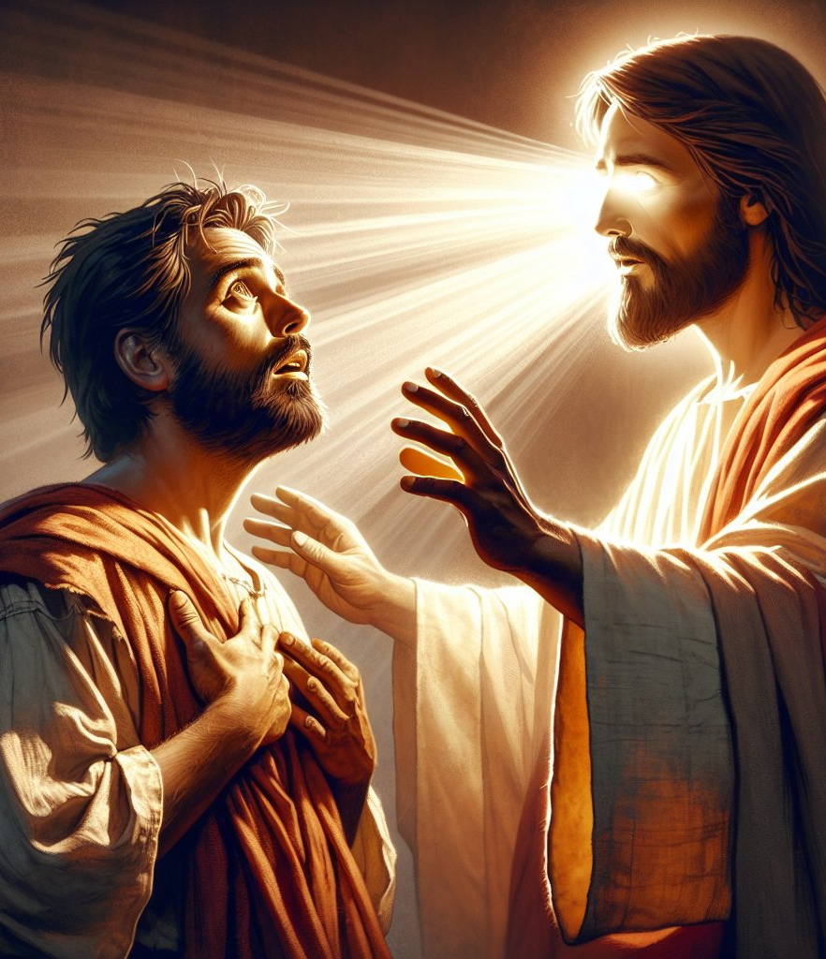
Mark 10:52
Then Jesus said to him, “Go your way; your faith has made you well.” And immediately he received his sight and followed Jesus on the road.

Slide 35

“Your faith has made you whole,” is not iaomai healed you but it’s

Slide 36
Mark 10:52
to these blind men was this, “You are redeemed.”

Slide 37
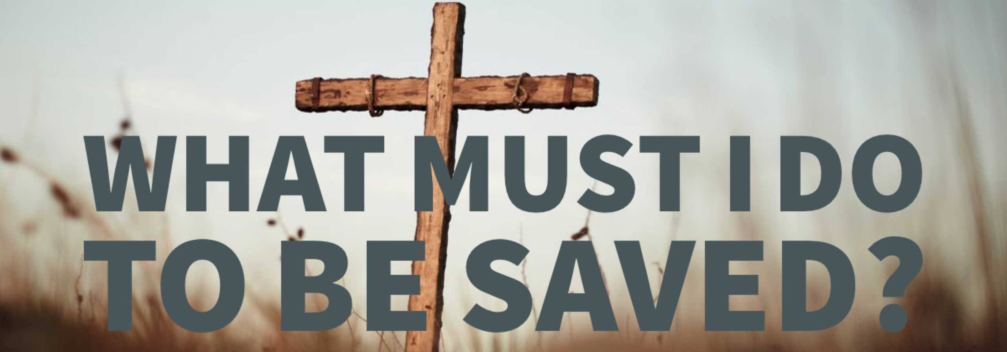
Faith is not necessary for healing,
Faith is necessary for salvation.

Slide 38

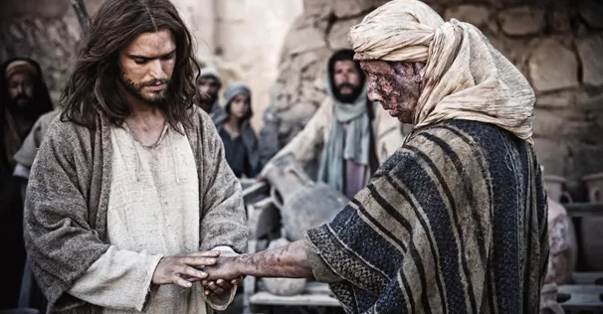

Slide 39
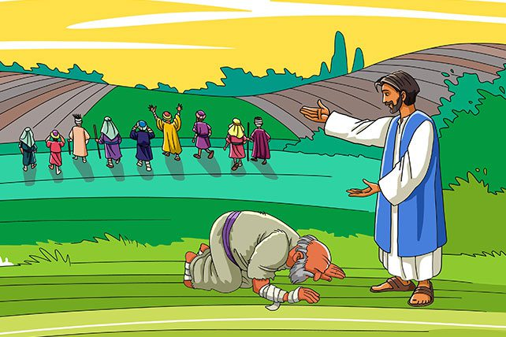
To the one Jesus said, “Your faith has saved you.”

Slide 40
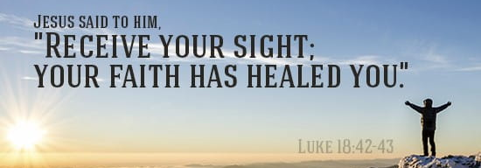
Luke 18:43
And immediately he received his sight, and followed Him, glorifying God. And all the people, when they saw it, gave praise to God.

