Slide 1
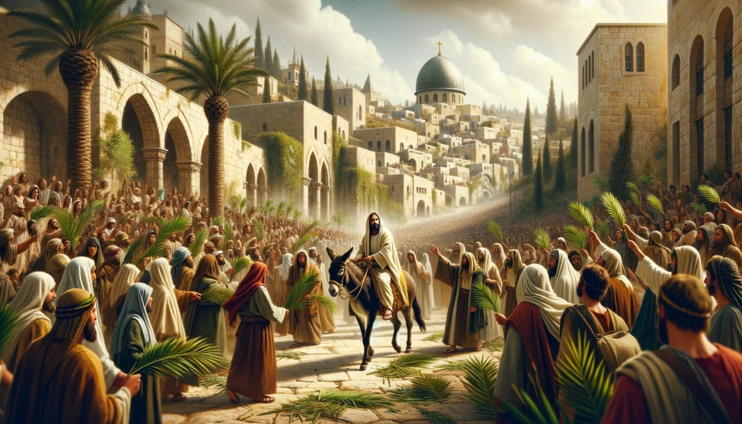
Triumphal entry to Jerusalem
Matthew 21:1-11, Mark 11:1-11, Luke 19:28-40, John 20:12-19

Slide 2
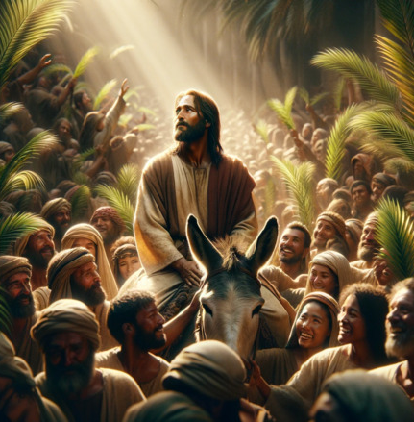
Matthew 21:1-11

Slide 3
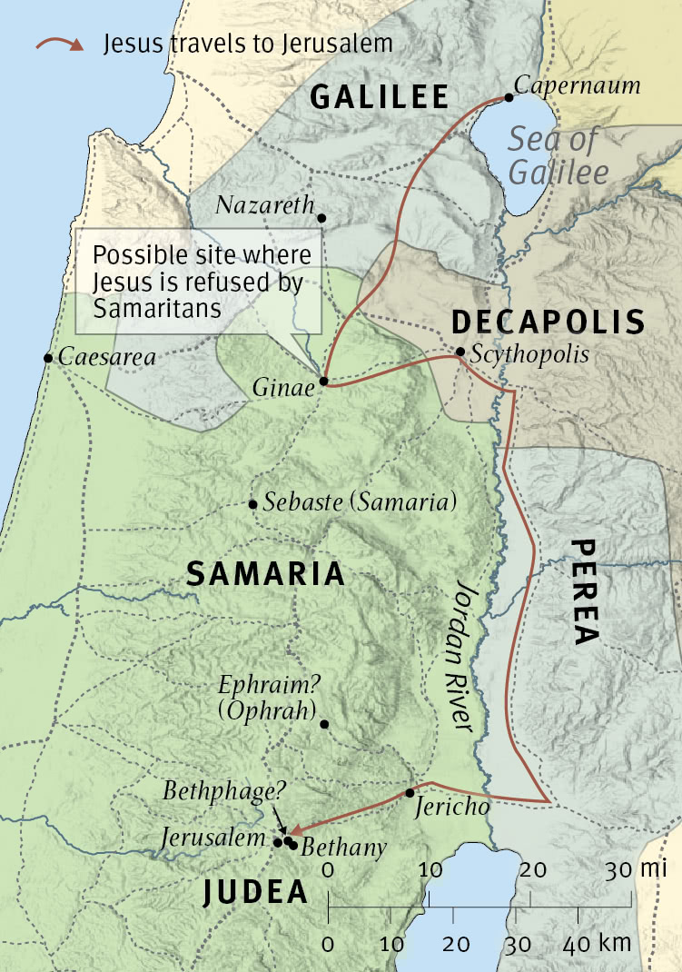





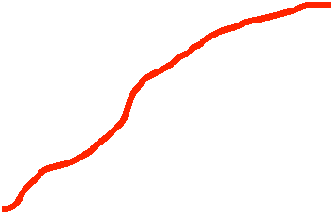

Slide 4
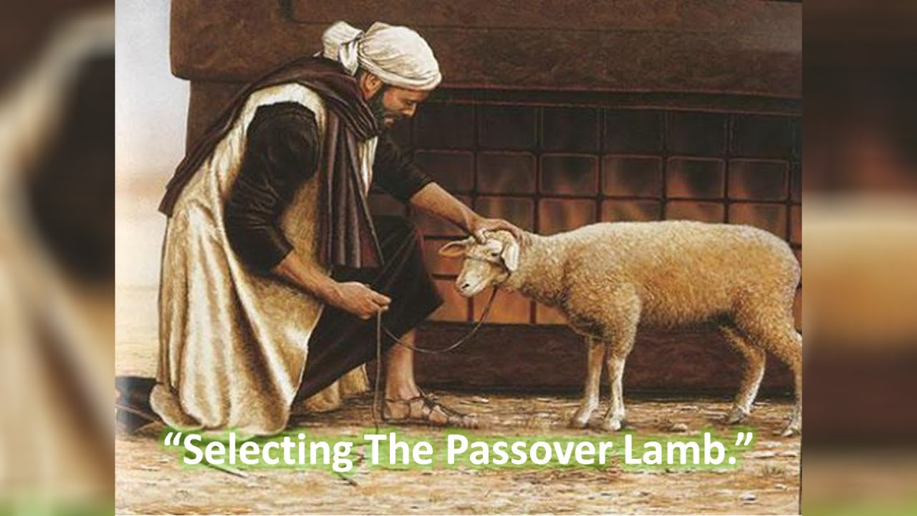
About 260,000 Passover lambs that were slaughtered during that week

Slide 5
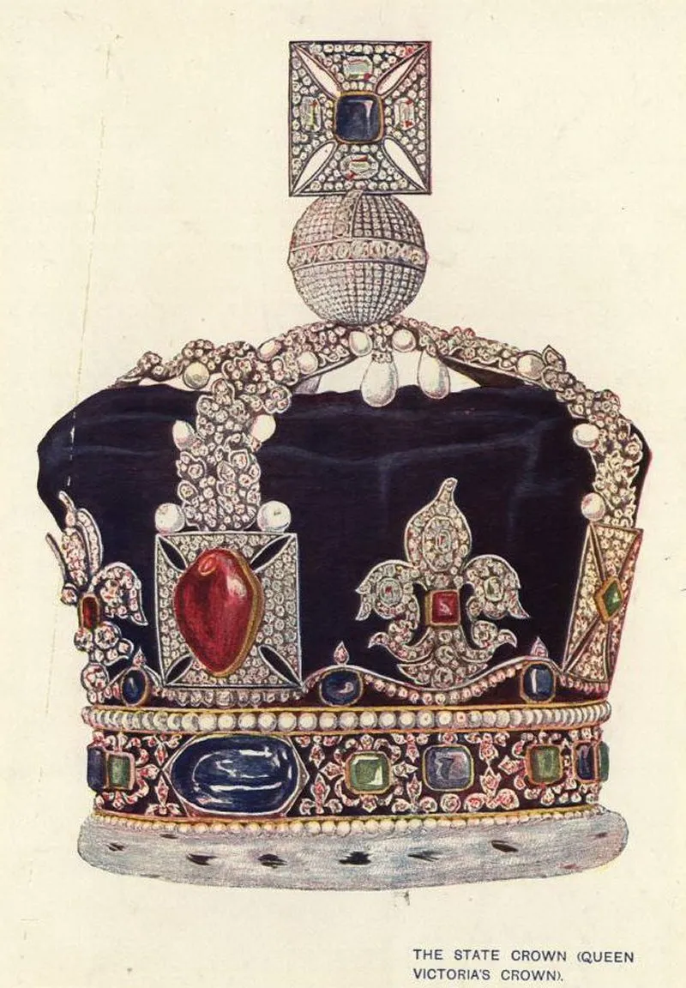
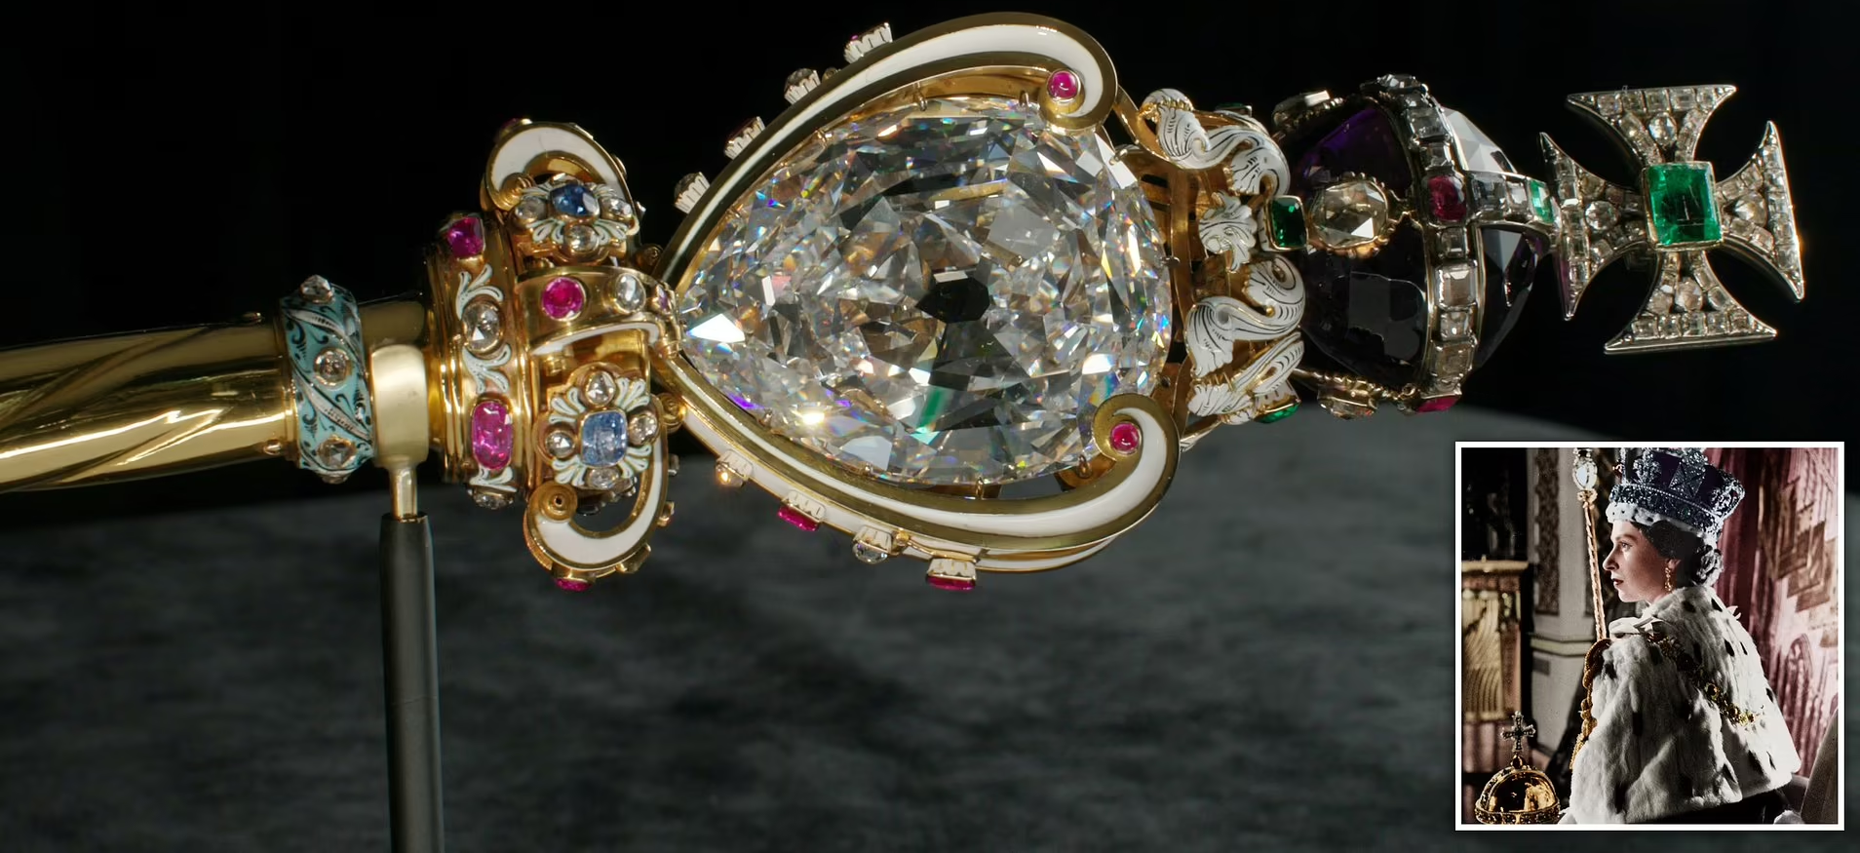
The crown was made all out of rubies and sapphires of monstrous proportions. In the middle of it was a 309 carat diamond.
The scepter which she took in her hand had a diamond on top of it of 517 carats cut from the Star of Africa.

Slide 6
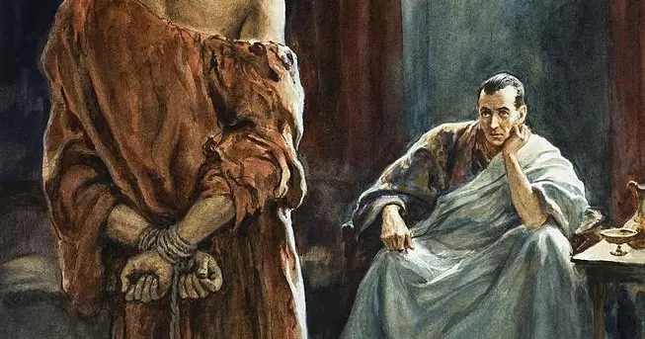
“I am not a king like you think kings are. My kingdom is not of this world.”

Slide 7
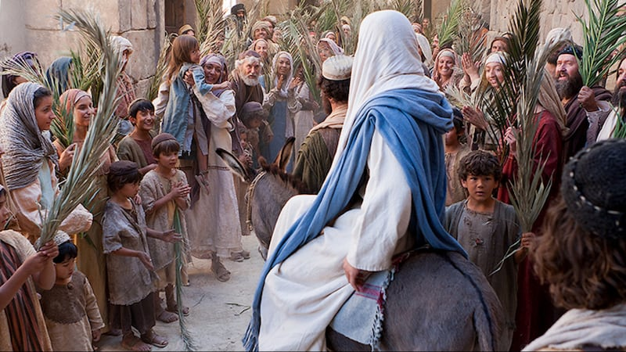
1. Pilgrimage

Slide 8
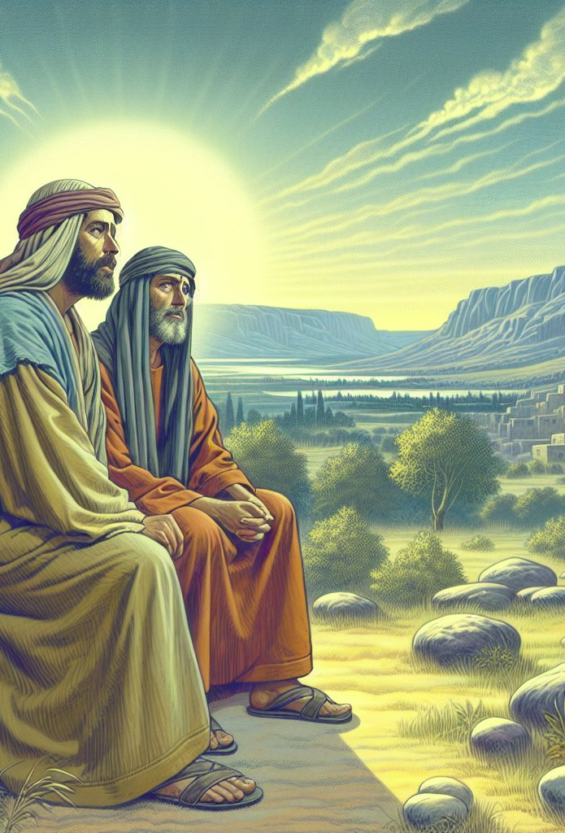
Matthew 21:1
Now when they drew near Jerusalem, and came to Bethphage, at the Mount of Olives, then Jesus sent two disciples

Slide 9
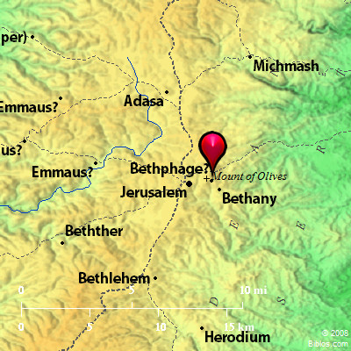
Bethpage means “house of figs.”

Slide 10
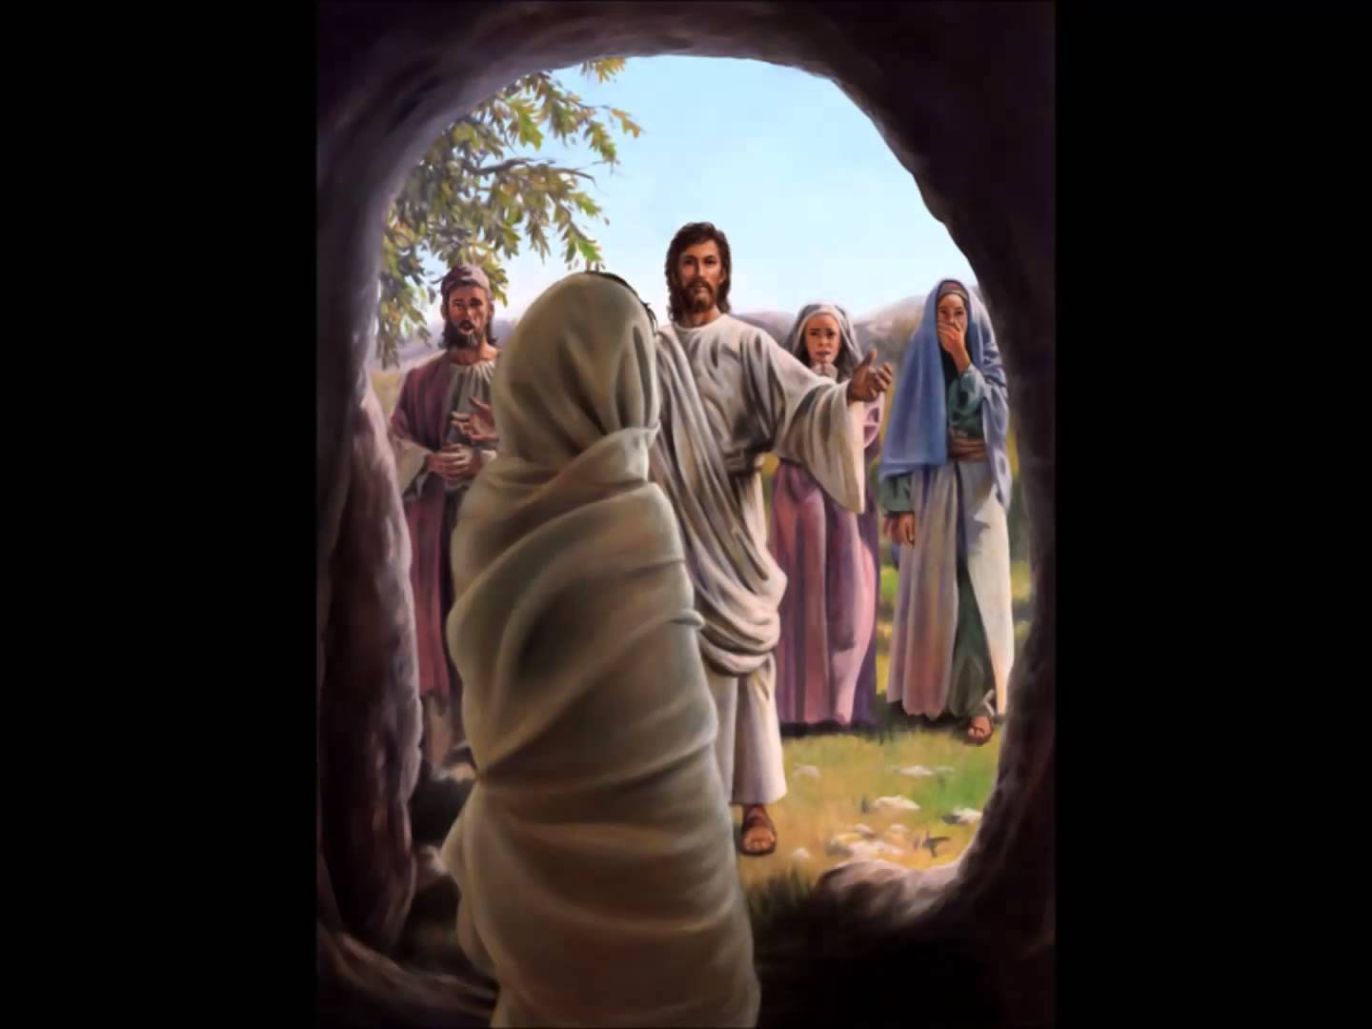
John 12:1
Then, six days before the Passover, Jesus came to Bethany, where Lazarus was who had been dead, whom He had raised from the dead.

Slide 11
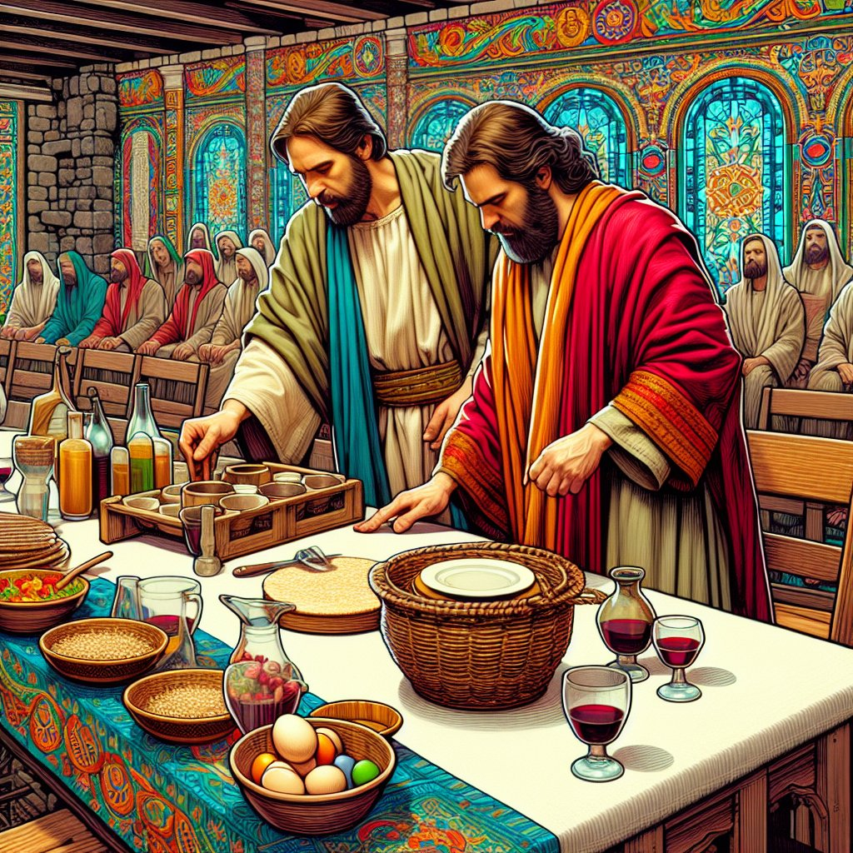
Luke 22:8
And He sent Peter and John, saying, “Go and prepare the Passover for us, that we may eat.”

Slide 12
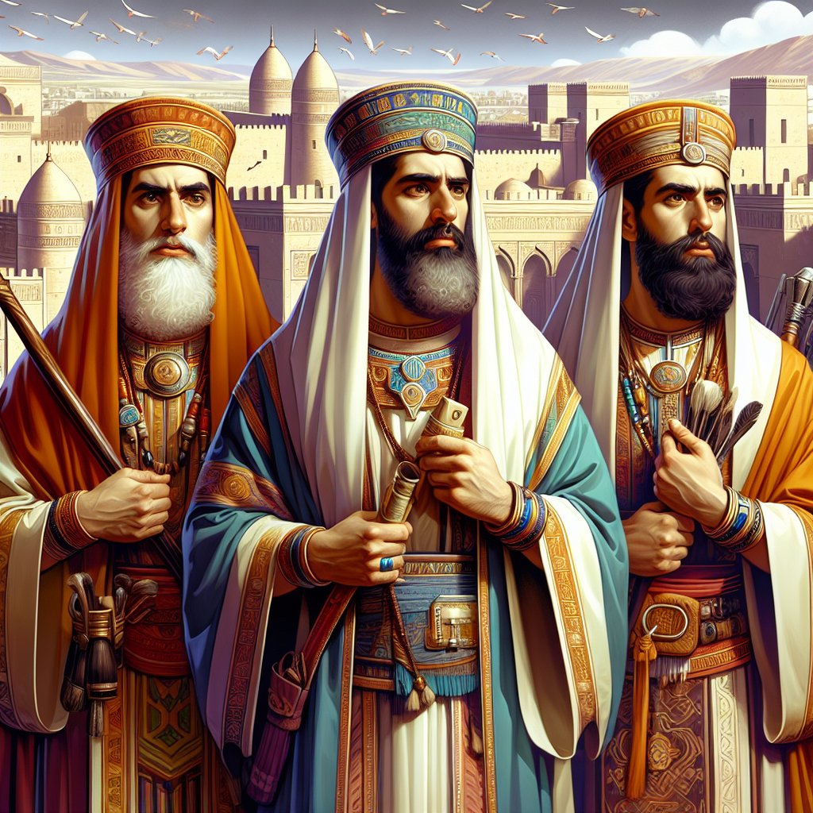
John 11:47-57
it tells us that the leaders of Israel wanted to kill Jesus because of the resurrection of Lazarus.

Slide 13
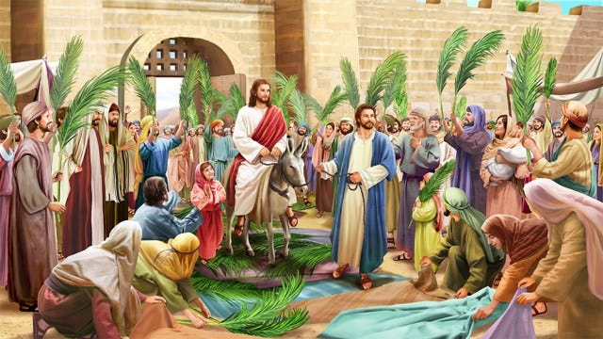
2. Prophecy

Slide 14
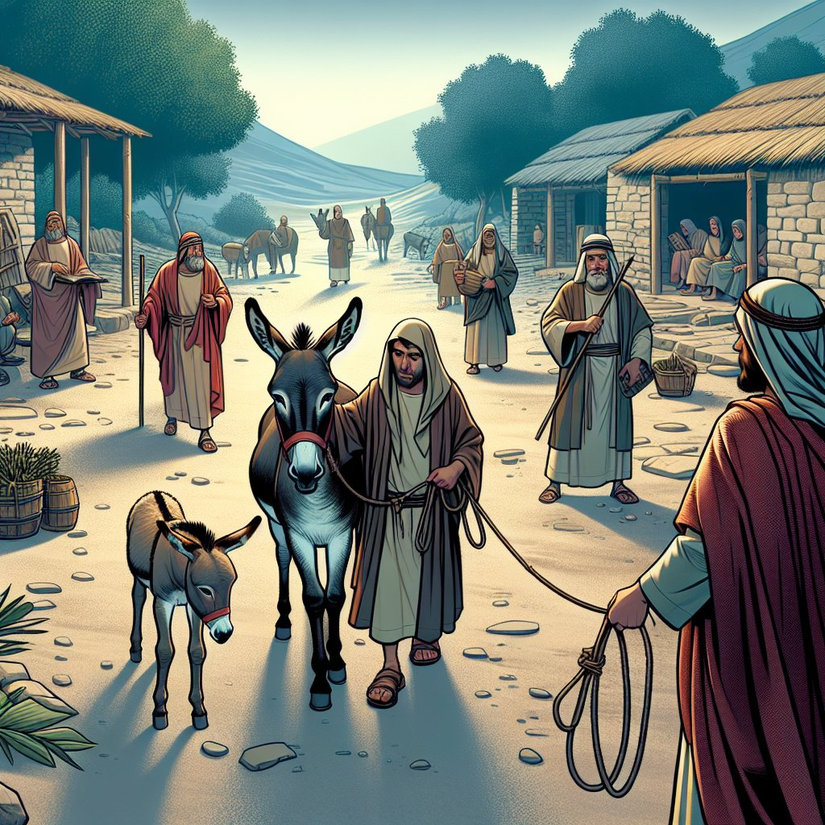
Matthew 21:2
saying to them, “Go into the village opposite you, and immediately you will find a donkey tied, and a colt with her. Loose them and bring them to Me.

Slide 15
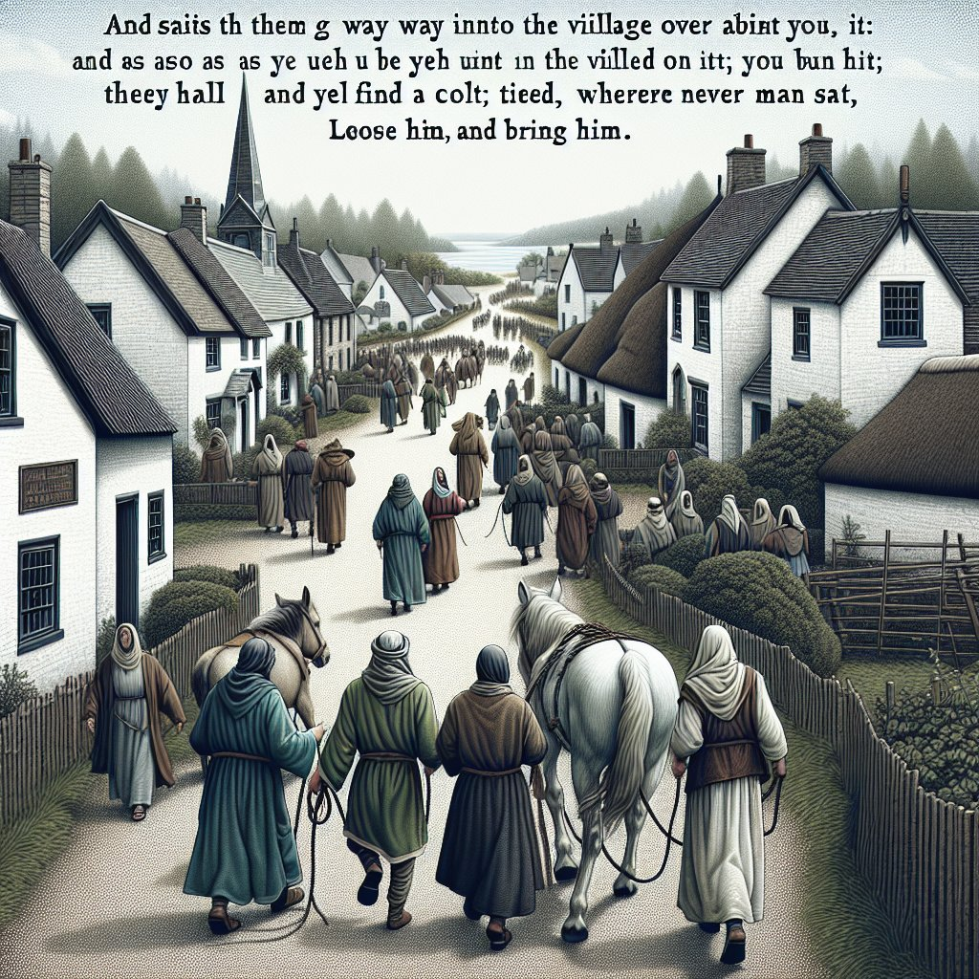
Mark 11:2
and He said to them, “Go into the village opposite you; and as soon as you have entered it you will find a colt tied, on which no one has sat. Loose it and bring it.

Slide 16
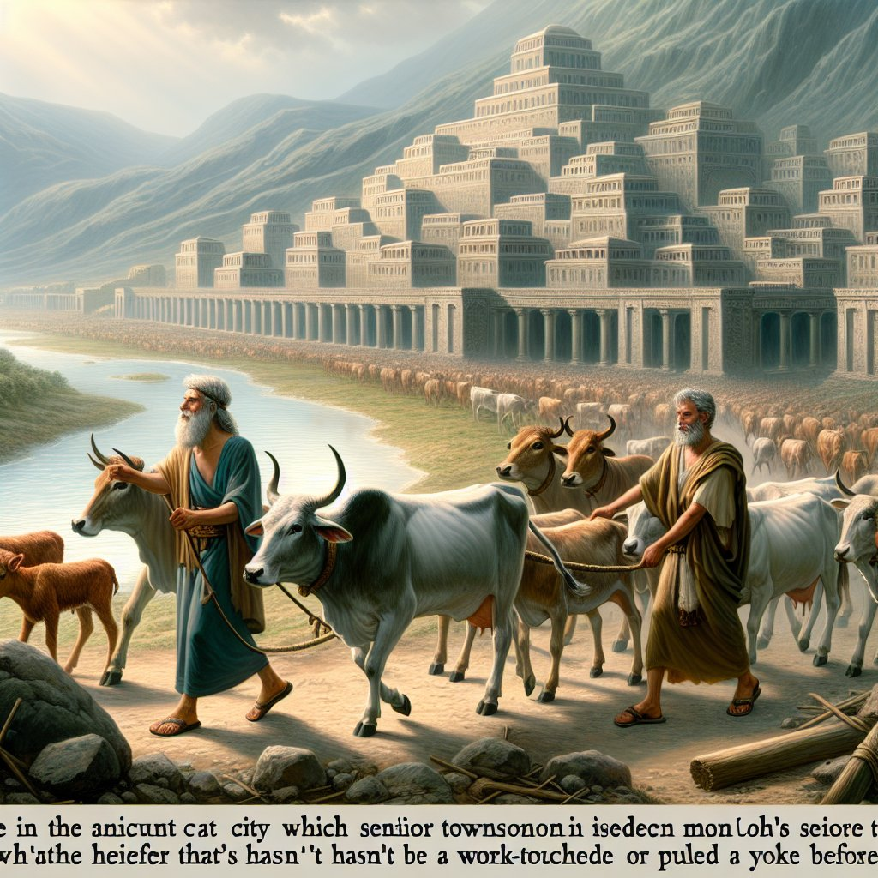
Deuteronomy 21:3
And it shall be that the elders of the city nearest to the slain man will take a heifer which has not been worked and which has not pulled with a yoke.

Slide 17
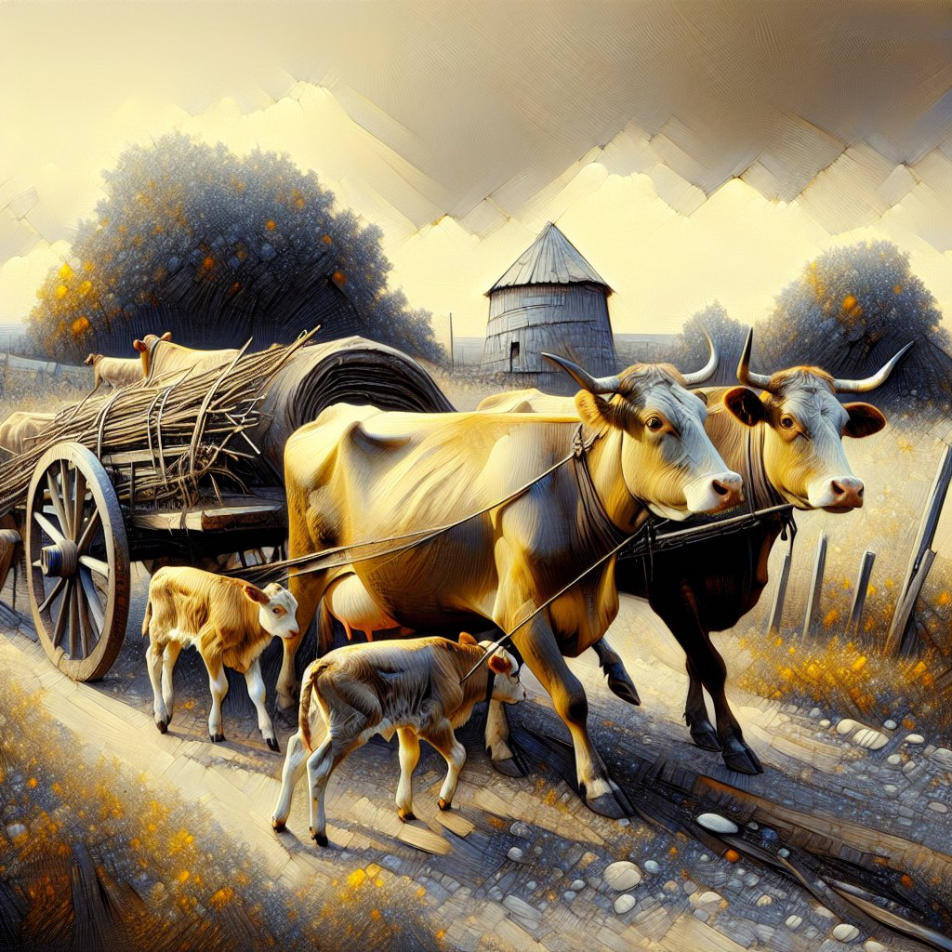
1 Samuel 6:7
Now therefore, make a new cart, take two milk cows which have never been yoked, and hitch the cows to the cart; and take their calves home, away from them.

Slide 18
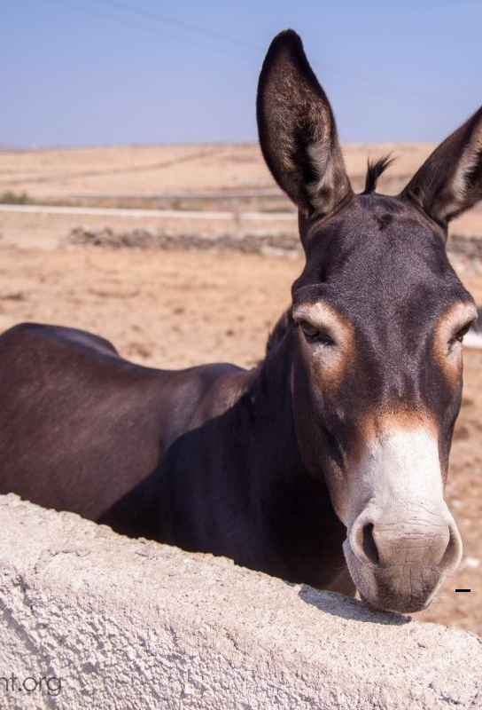
Matthew 21:3
And if anyone says anything to you, you shall say, ‘The Lord has need of them,’ and immediately he will send them.”

Slide 19

Matthew 21:4
All this was done that it might be fulfilled which was spoken by the prophet, saying

Slide 20
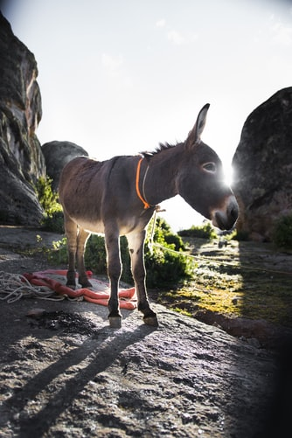
Matthew 21:5
“Tell the daughter of Zion, ‘Behold, your King is coming to you, Lowly, and sitting on a donkey, A colt, the foal of a donkey.’”

Slide 21
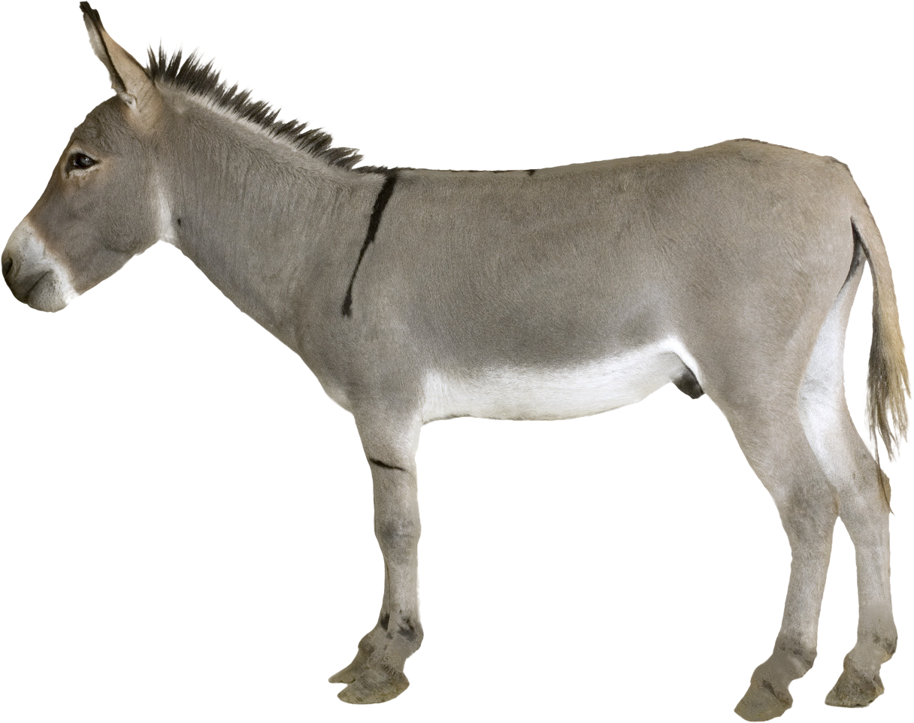
Zechariah 9:9 |Isaiah 62:11
“Say to the daughter of Zion, ‘Surely your salvation is coming; Behold, His reward is with Him, And His work before Him.’”

Slide 22
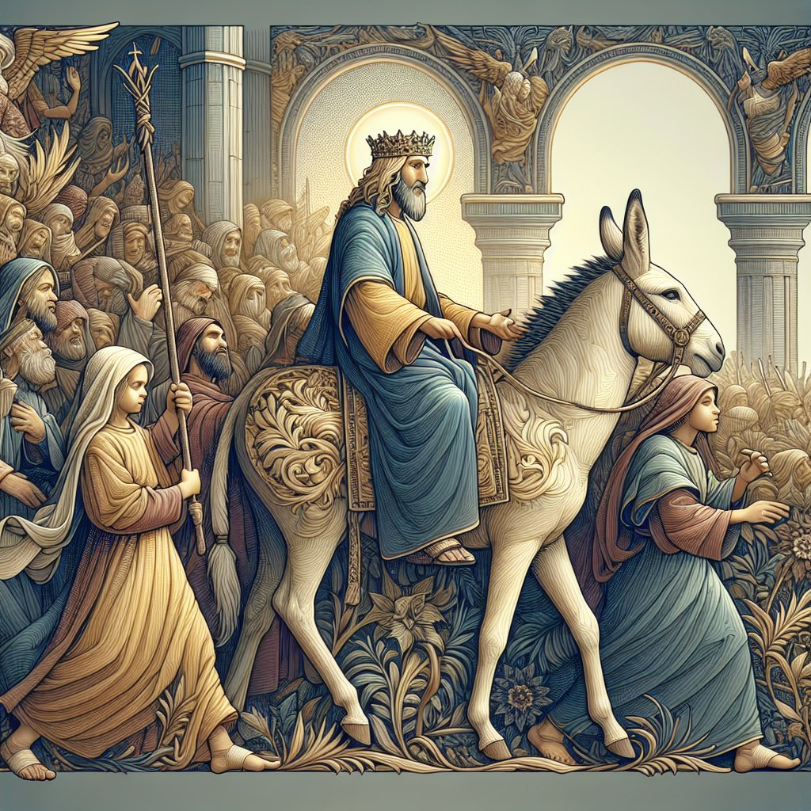
Zechariah 9:9
“Rejoice greatly, O daughter of Zion! Shout, O daughter of Jerusalem! Behold, your King is coming to you; He is just and having salvation, Lowly and riding on a donkey, A colt, the foal of a donkey.

Slide 23
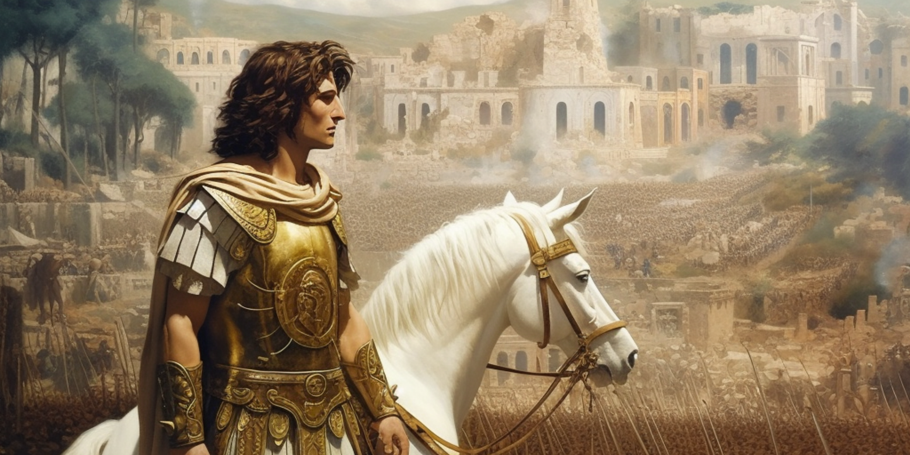
Zechariah 9:1-7
Have a prophecy about a conqueror. But it’s a different conqueror. There is a human conqueror in the opening seven verses or so, and most commentators see this is fulfilled by Alexander the Great.

Slide 24
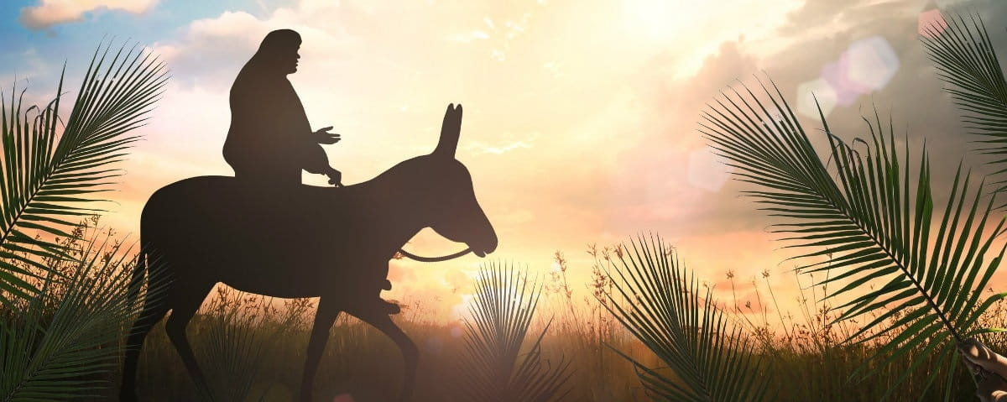
Zechariah 9:9-17
Jesus, the Messiah is subject of the prophecy

Slide 25
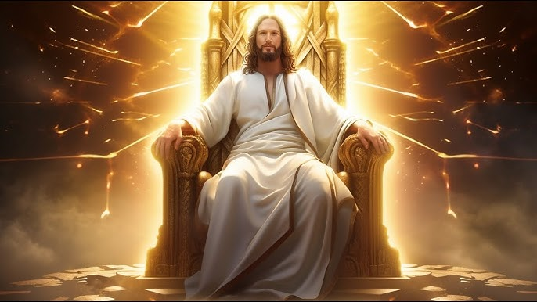
Zechariah 9:9
HE is a king

Slide 26
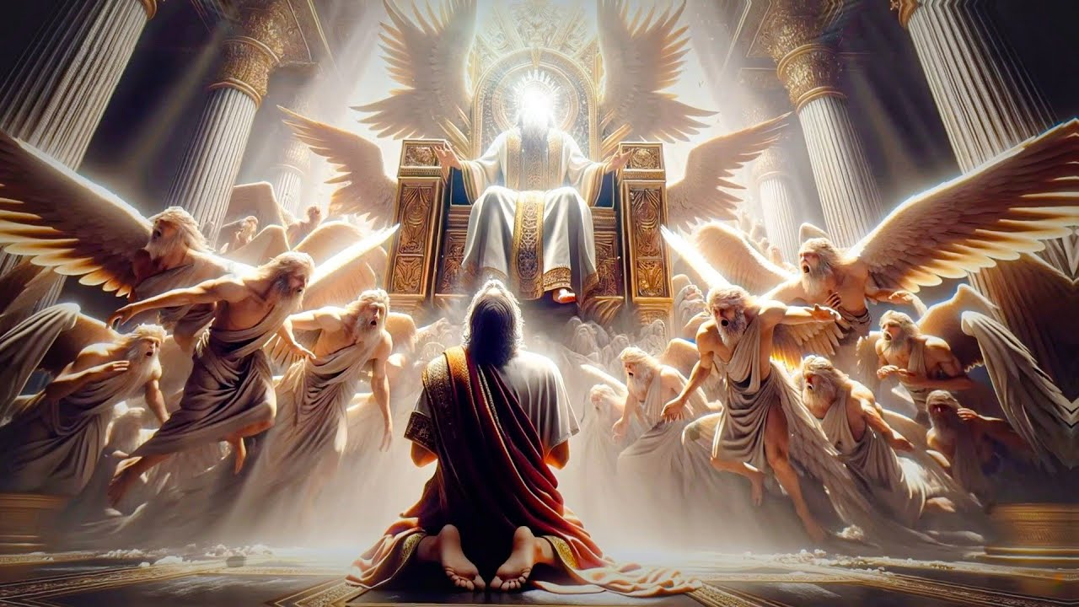
Zechariah 9:9
He is righteous & just.

Slide 27
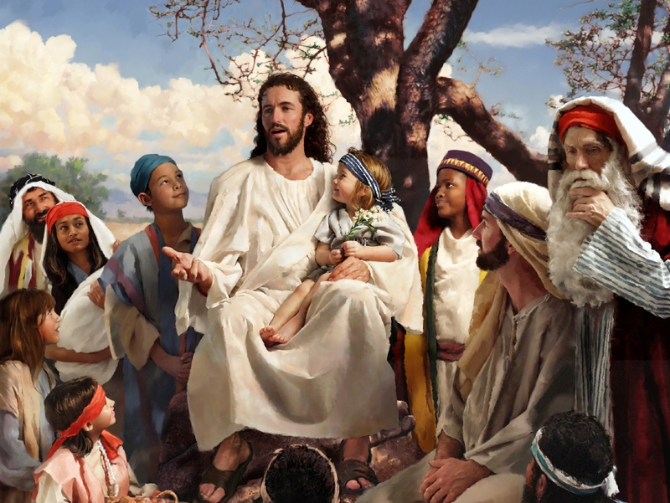
Zechariah 9:9
He is humble or meek.

Slide 28
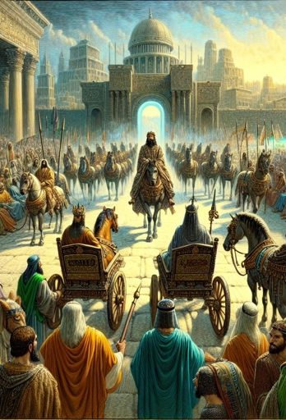
Jeremiah 17:25
then shall enter the gates of this city kings and princes sitting on the throne of David, riding in chariots and on horses, they and their princes, accompanied by the men of Judah and the inhabitants of Jerusalem; and this city shall remain forever.

Slide 29
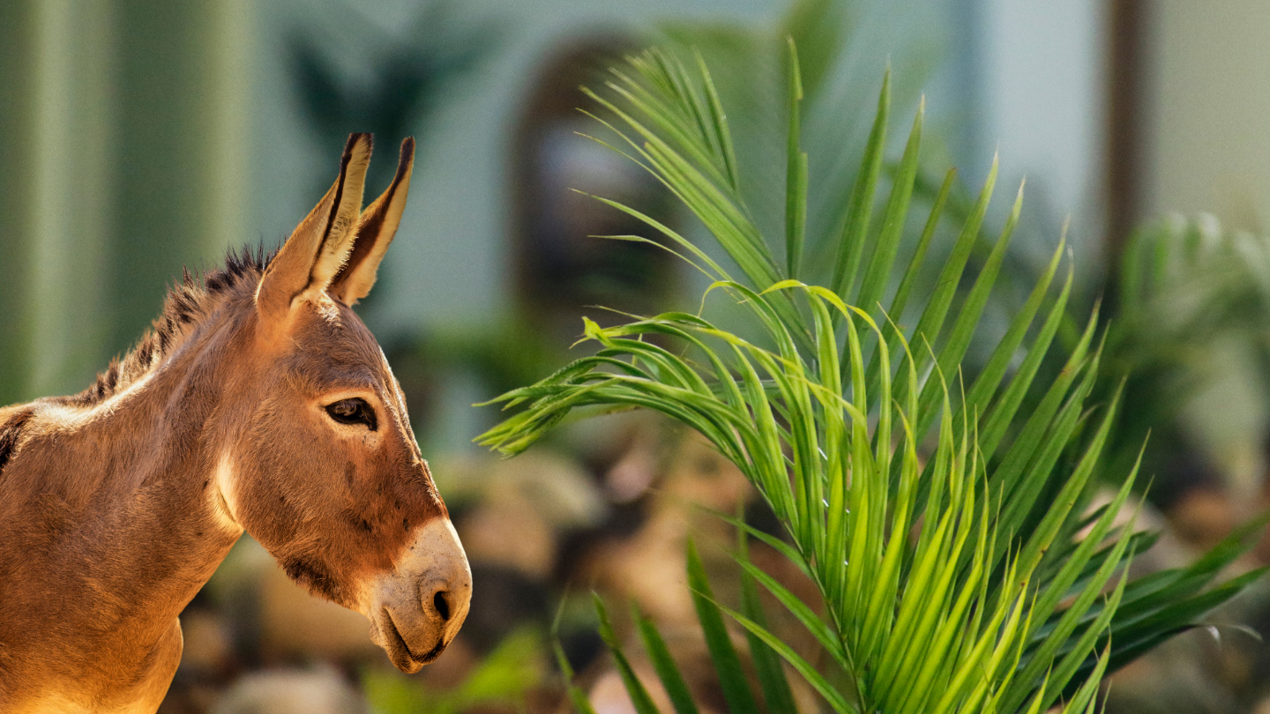
Zechariah 9:9
Fulfilling the Prophecy

Slide 30
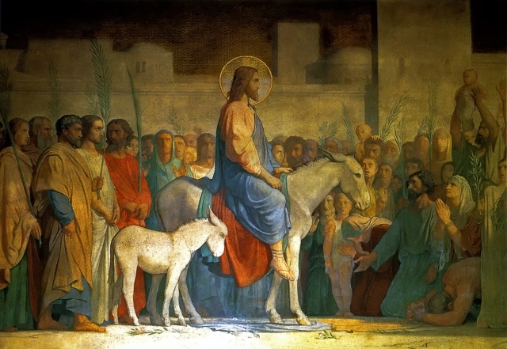
Matthew 21:6,7
So the disciples went and did as Jesus commanded them. 7 They brought the donkey and the colt, laid their clothes on them, and set Him on them.

Slide 31
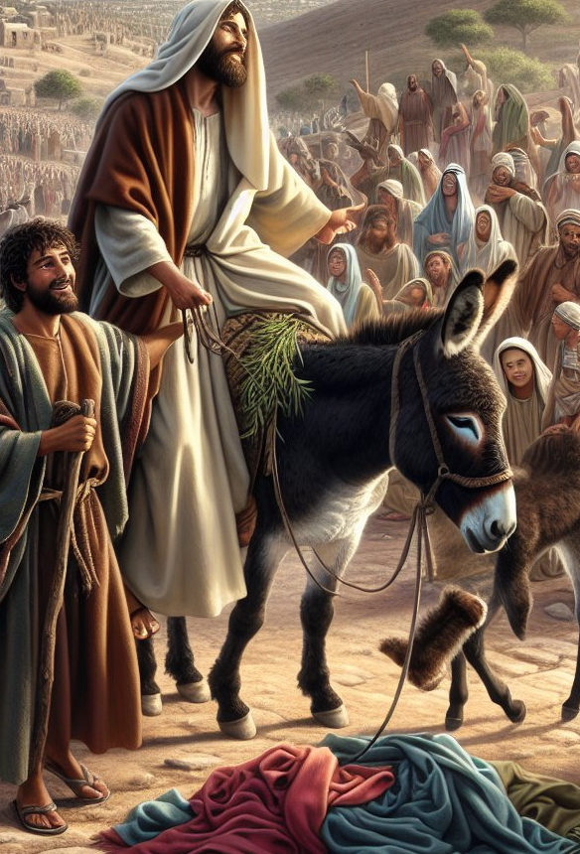
Luke 19:35
Then they brought him to Jesus. And they threw their own clothes on the colt, and they set Jesus on him.

Slide 32
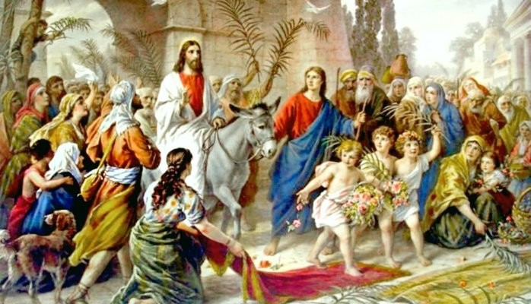
3. Praise

Slide 33

Matthew 21:8,9
And a very great multitude spread their clothes on the road;

Slide 34
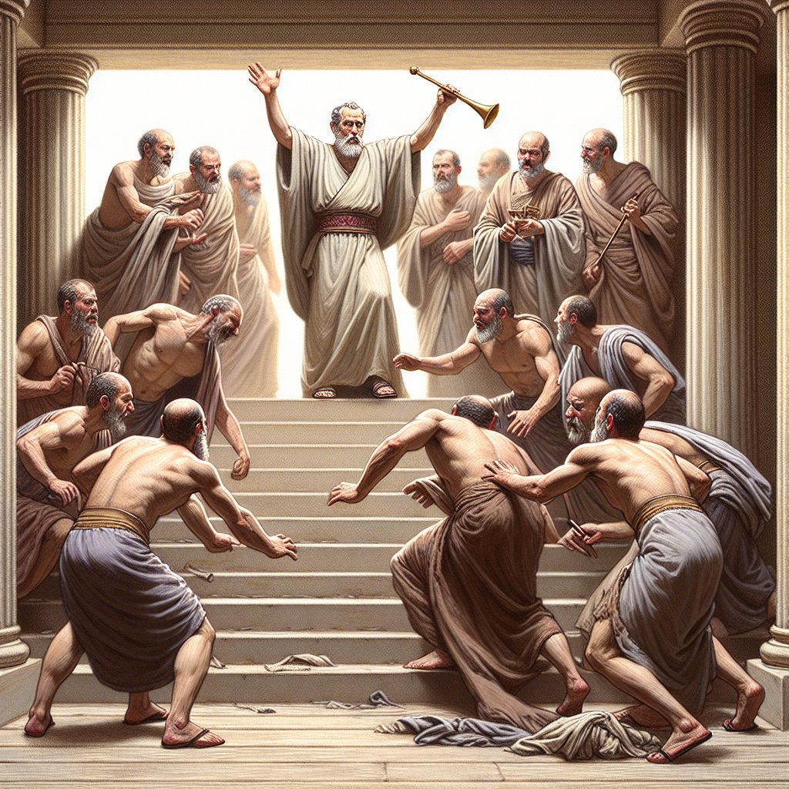
2 Kings 9:13
Then each man hastened to take his garment and put it under him on the top of the steps; and they blew trumpets, saying, “Jehu is king!”

Slide 35
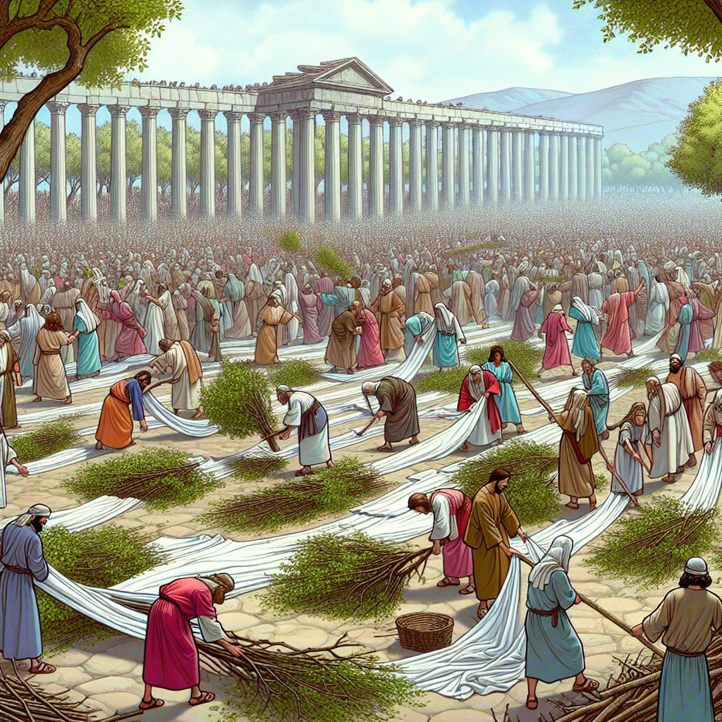
Matthew 21:8
others cut down branches from the trees and spread them on the road.

Slide 36
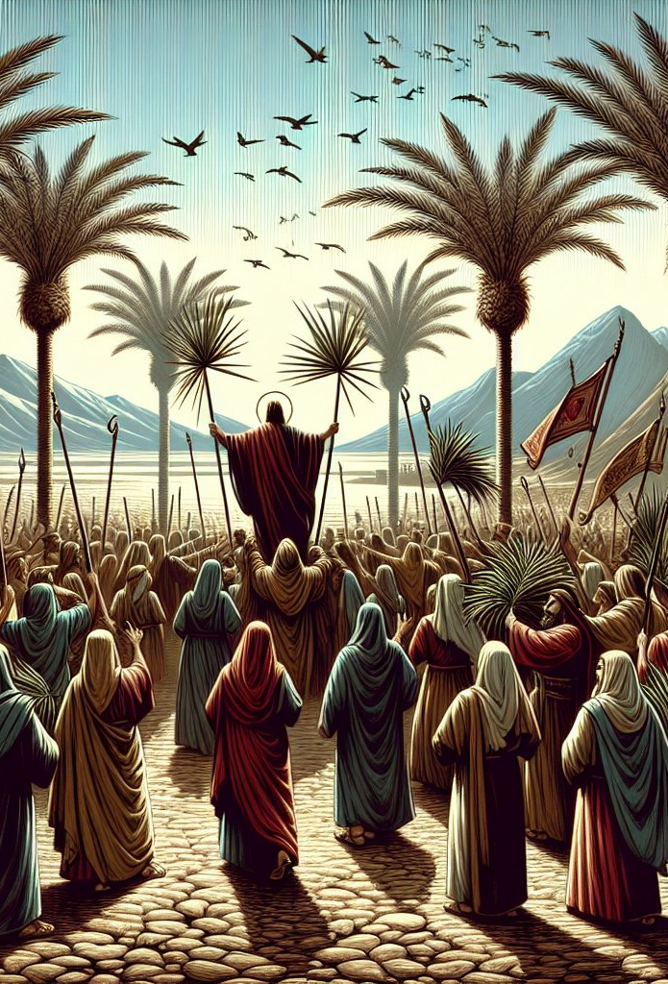
John 12:12-13
The next day a great multitude that had come to the feast, when they heard that Jesus was coming to Jerusalem, 13 took branches of palm trees and went out to meet Him and cried out: “Hosanna! ‘Blessed is He who comes in the name of the Lord!’ The King of Israel!”

Slide 37
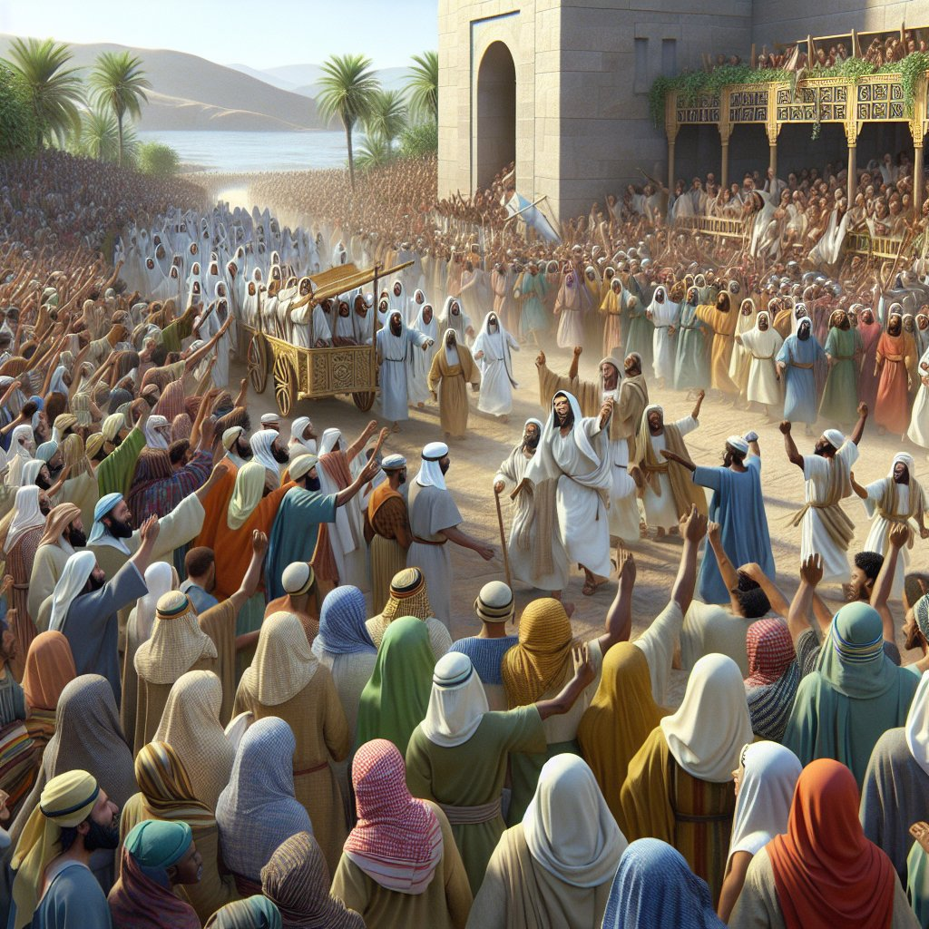
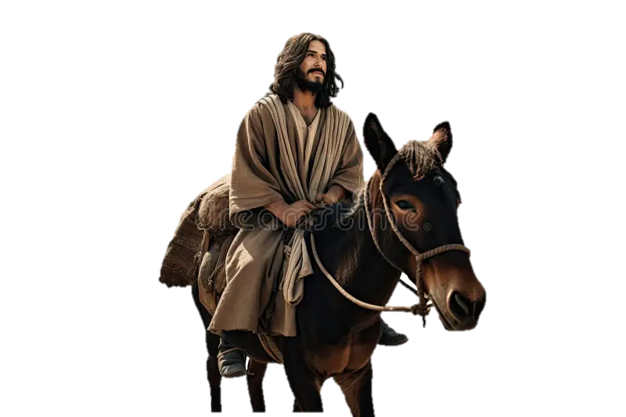
Matthew 21:9
Then the multitudes who went before and those who followed cried out, saying: “Hosanna to the Son of David! ‘Blessed is He who comes in the name of the Lord!’ Hosanna in the highest!”

Slide 38
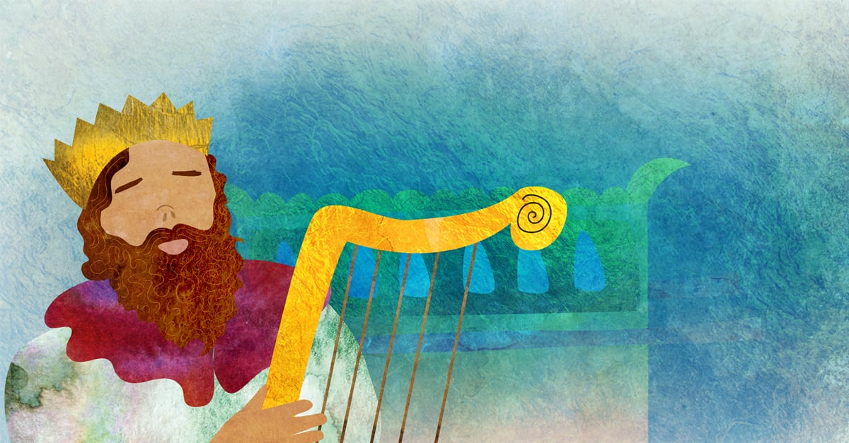
2 Samuel 7
God promised to David a son greater than Solomon. That Son of David would have an everlasting kingdom. The messianic promise is that Messiah will be a son of David in the genealogies Matthew and Luke.

Slide 39
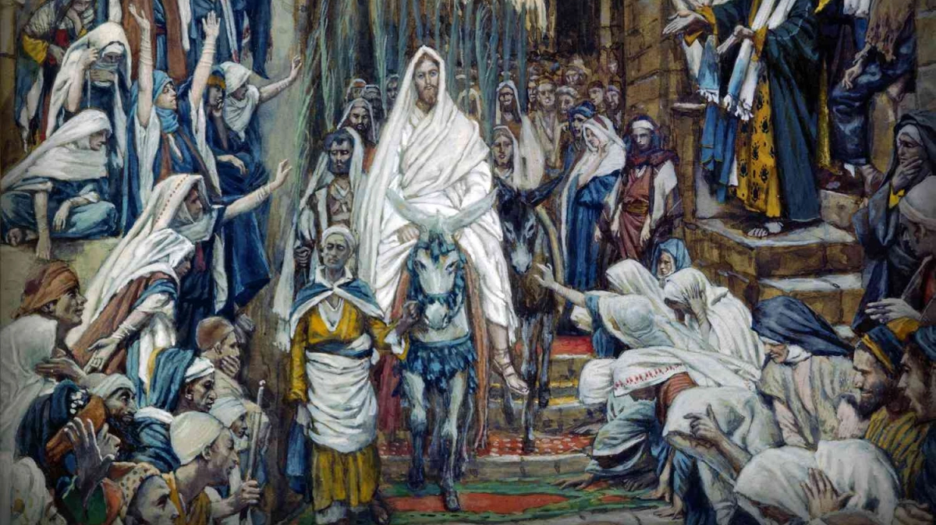
Psalm 113 to 118
The Great Hallel

Slide 40
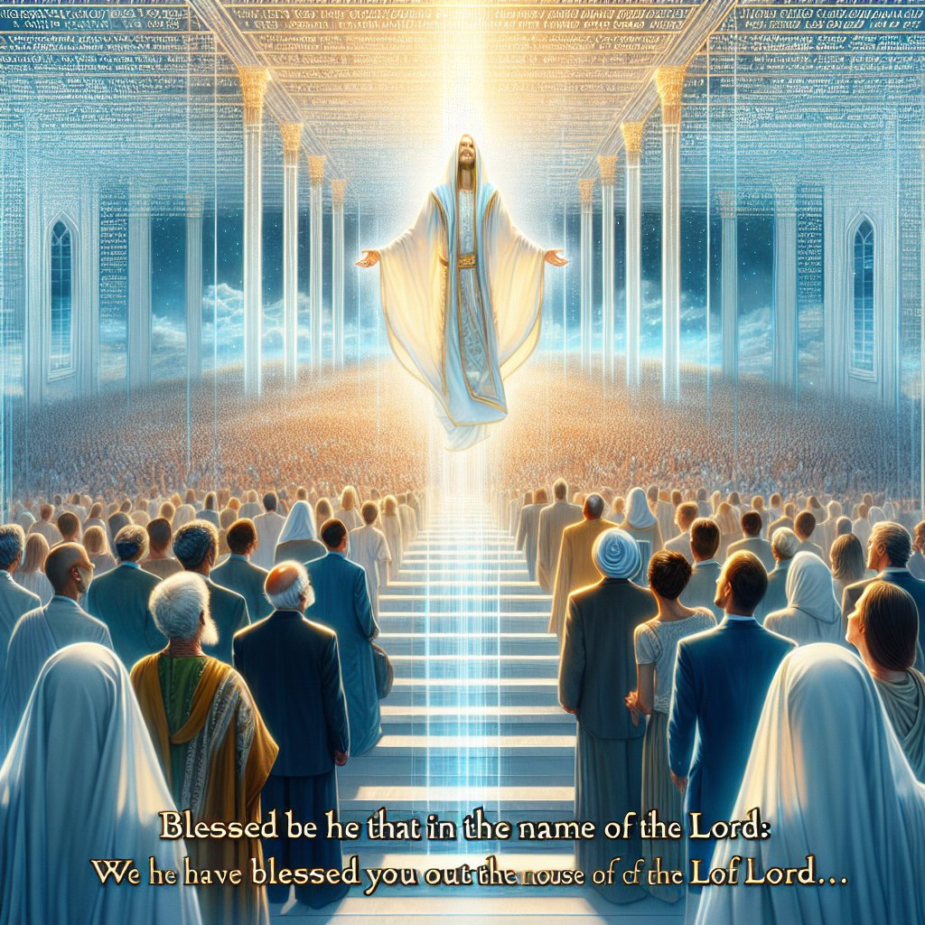
Psalms 118:26
Blessed is he who comes in the name of the Lord! We have blessed you from the house of the Lord.

Slide 41
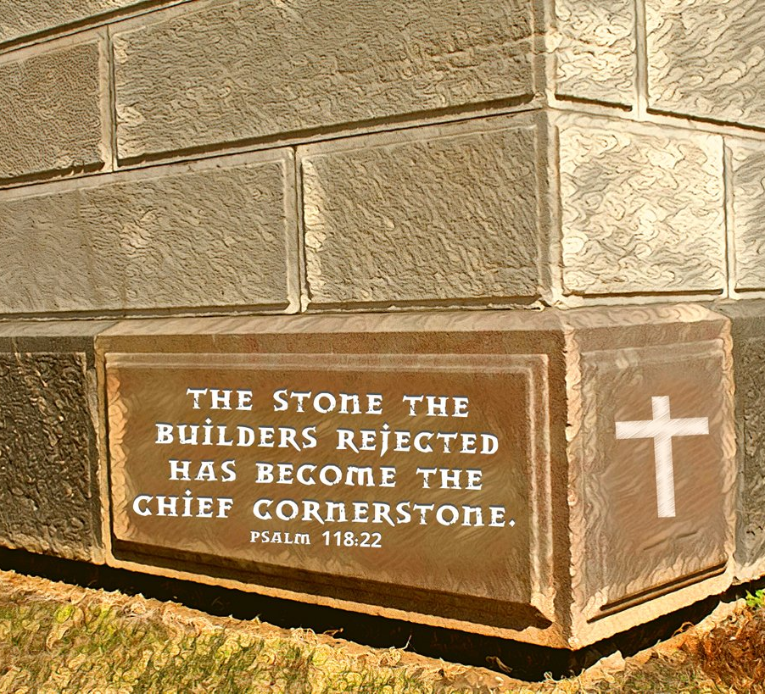
Psalm 118:22
The stone which the builders rejected Has become the chief cornerstone.

Slide 42
4. Puzzlement

Slide 43
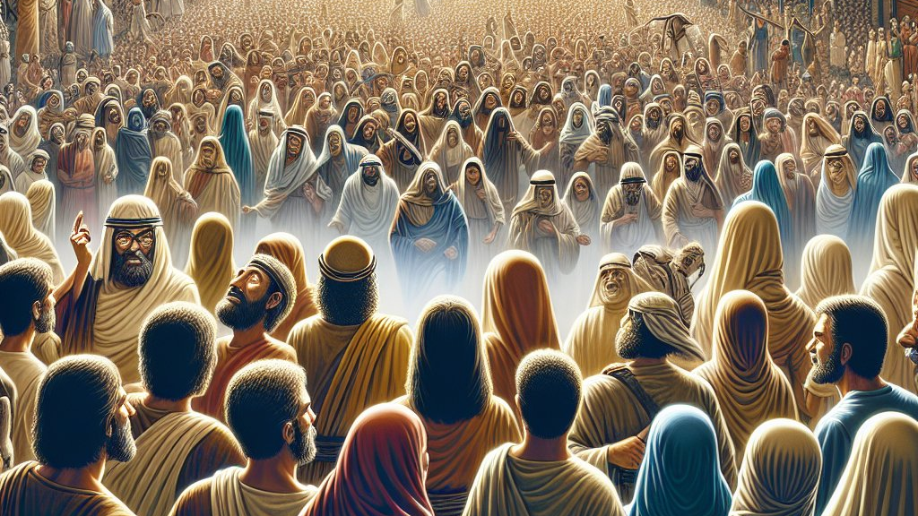
Matthew 21:10
“Who is this?”

Slide 44
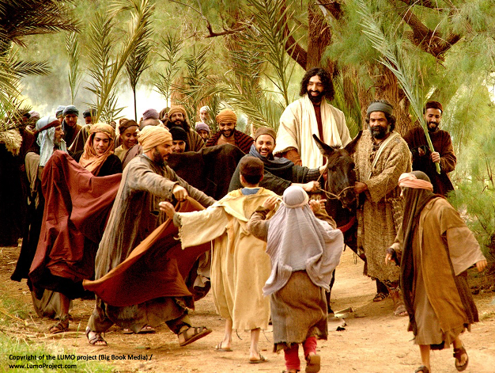
John 12:15
“Fear not, daughter of Zion; Behold, your King is coming, Sitting on a donkey’s colt.”

Slide 45
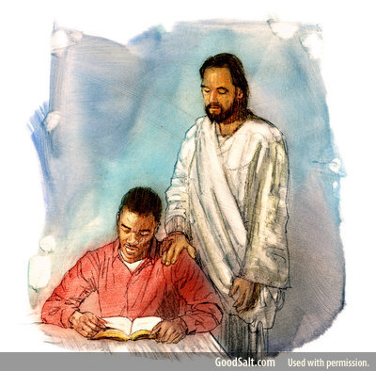
John 12:16
His disciples did not understand these things at first; but when Jesus was glorified, then they remembered that these things were written about Him and that they had done these things to Him.

Slide 46
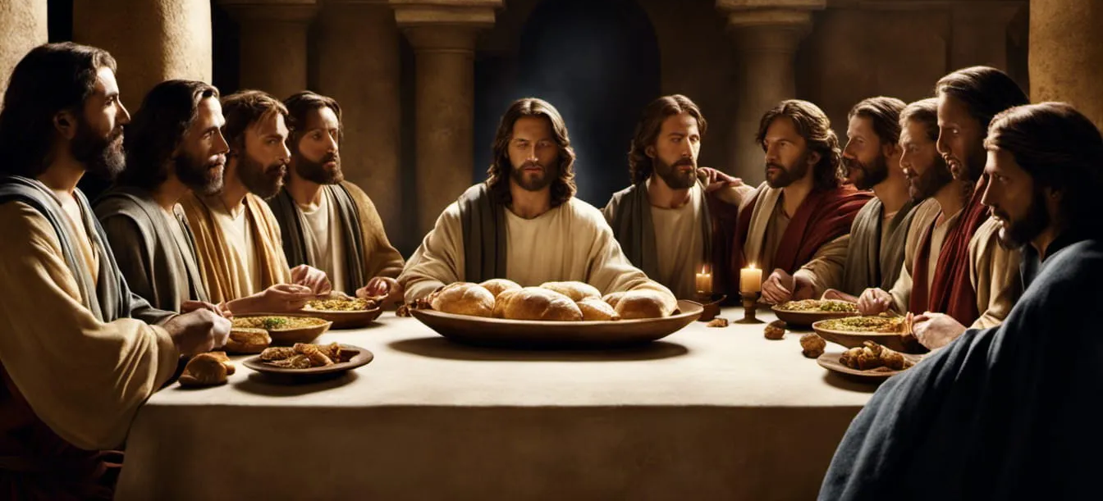
“When the Spirit comes, He will lead you into all truth, and He will teach you everything concerning Me.”

Slide 47
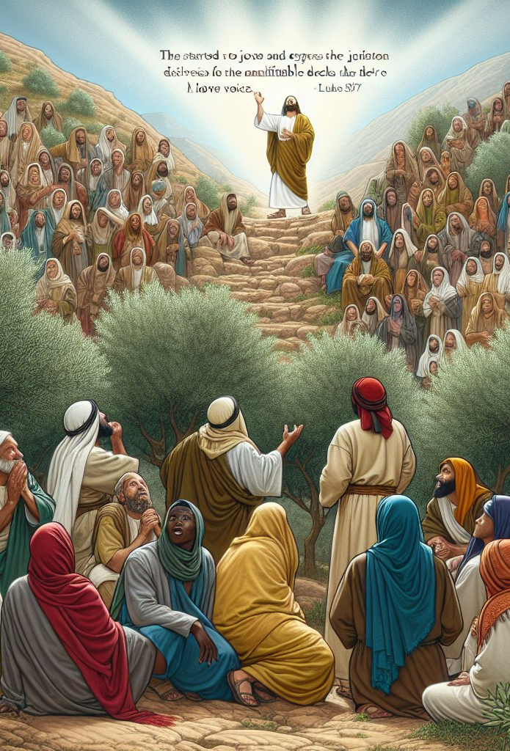
Luke 19:37
Then, as He was now drawing near the descent of the Mount of Olives, the whole multitude of the disciples began to rejoice and praise God with a loud voice for all the mighty works they had seen,

Slide 48
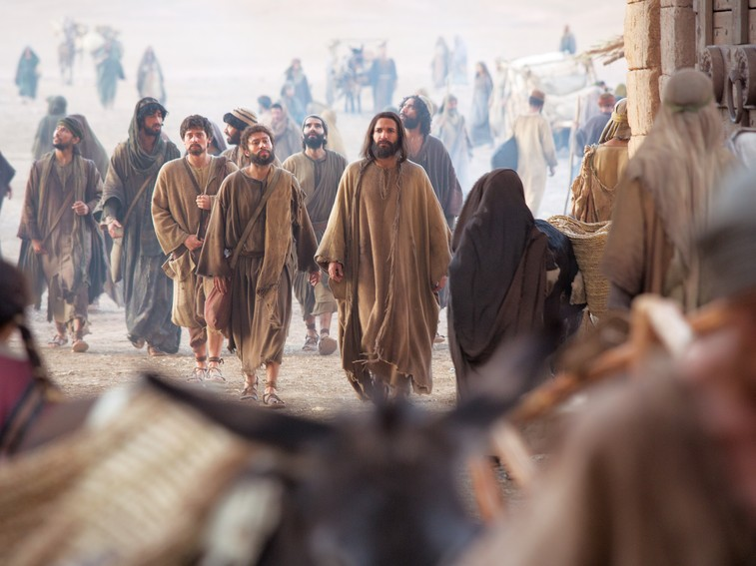
John 12:19
The Pharisees therefore said among themselves, “You see that you are accomplishing nothing. Look, the world has gone after Him!”

Slide 49
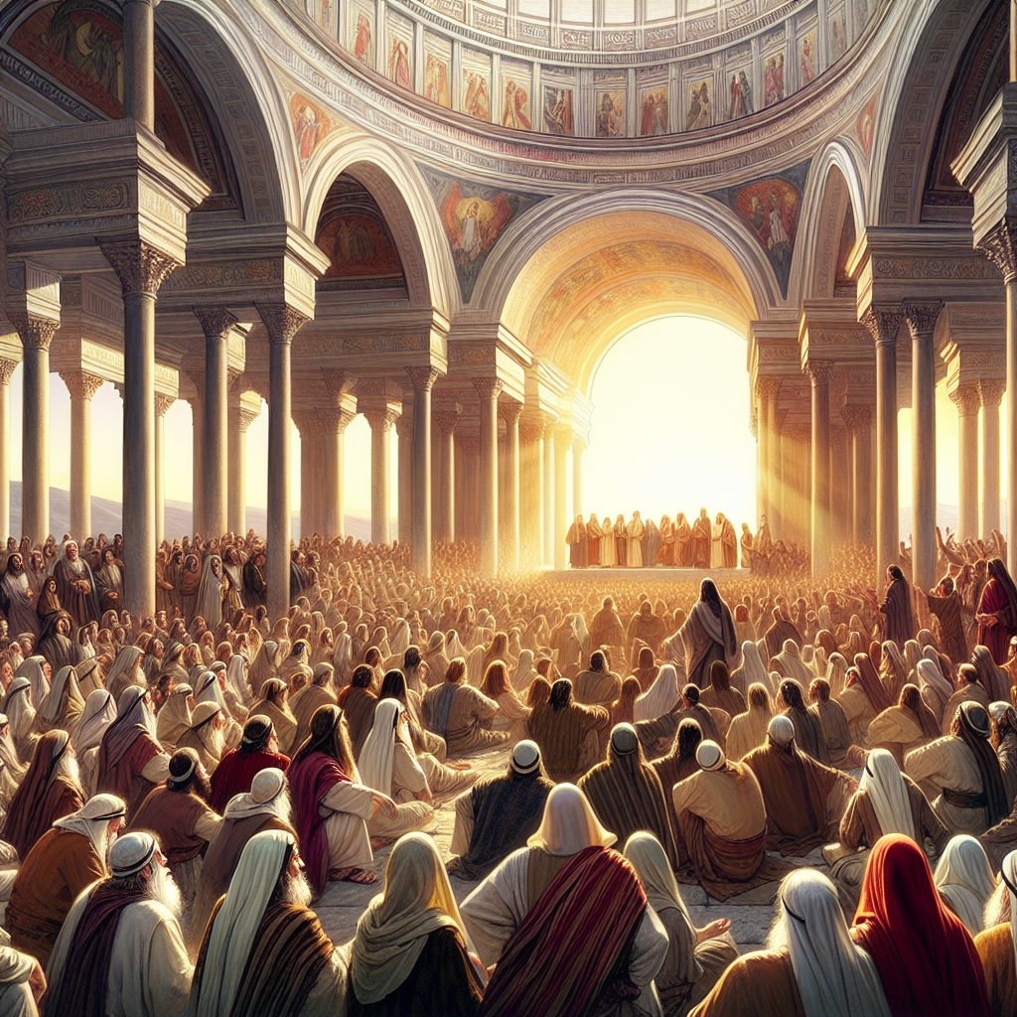
Matthew 21:11
So the multitudes said, “This is Jesus, the prophet from Nazareth of Galilee.”

Slide 50

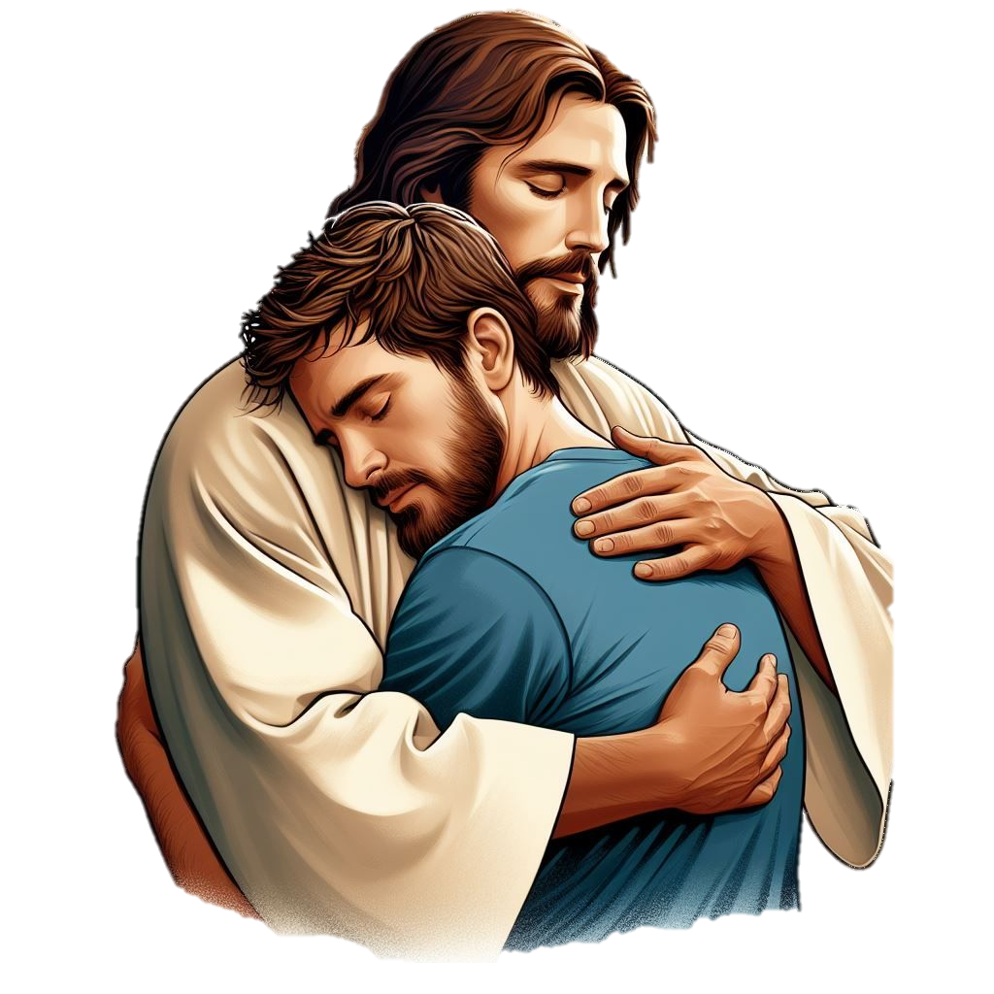
HE cannot be my King unless HE is, first, my Lamb, slain in my place for sin.

