Slide 1

06TH OCTOBER
S u n d a y

Slide 2

Matthew 21:28-32
Parable of
Two Sons

Slide 3
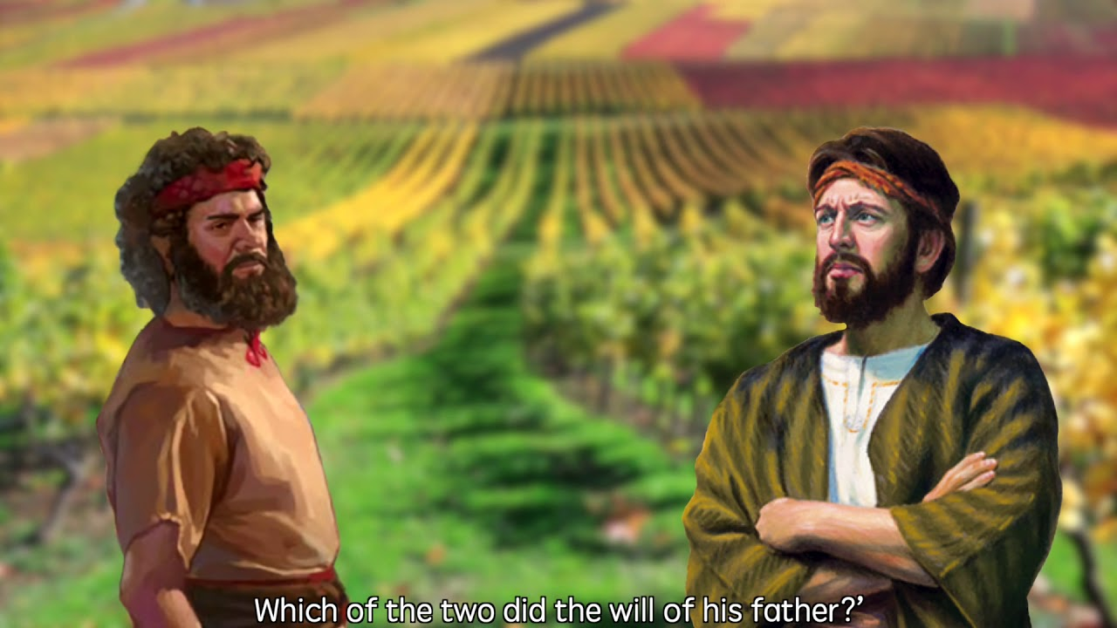
Matthew 21:28-32,

Slide 4
Jesus often responded to questions by His disciples answering them in parables.

Slide 5
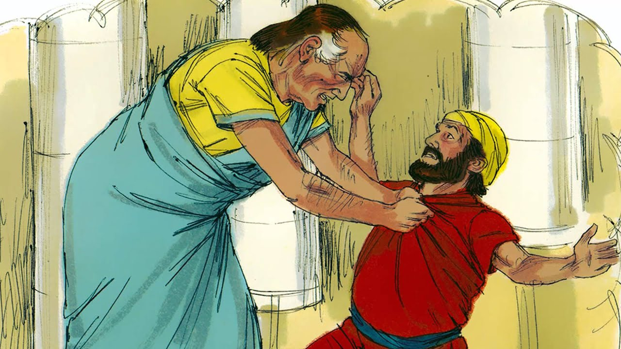
Matthew 18:21-35, "The Unmerciful Servant"

Slide 6
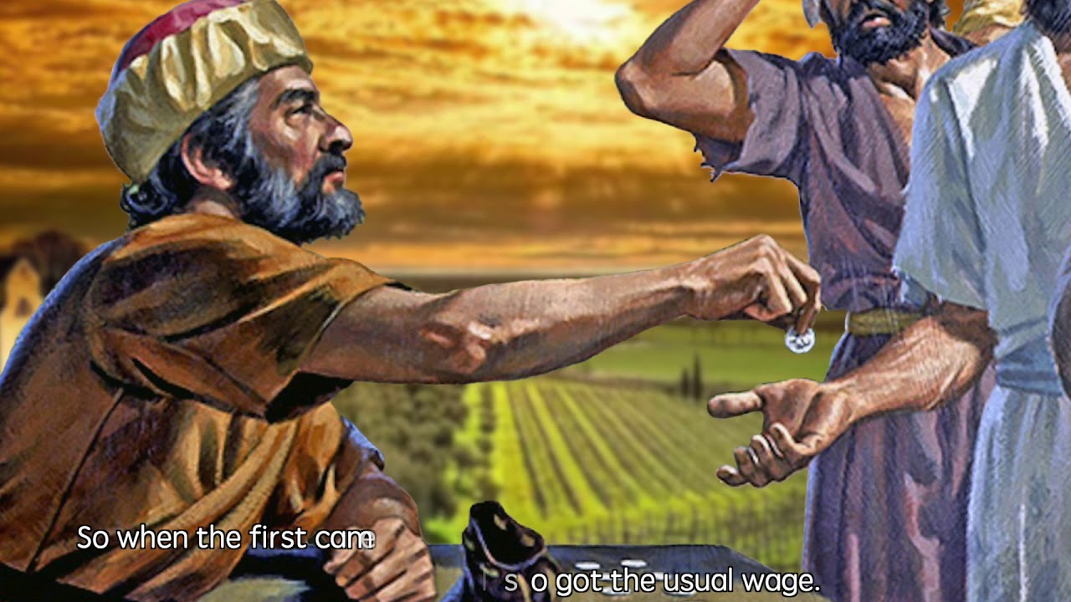
Matthew 20:1-16,

Slide 7
V 23,
“By what authority are You doing these things? And who gave You this authority?”

Slide 8
V 25,
The baptism of John—where was it from? From heaven or from men?”

Slide 9
Matthew 21:28-32,"The Parable of Two Sons"
Matthew 21:22-46, "The Wicked Vinedressers"
Matthew 22:1-14, "The Wedding Feast"

Slide 10
V 28,
“But what do you think? A man had two sons, and he came to the first and said, ‘Son, go, work today in my vineyard.’

Slide 11
OLDER SON
V 28,
A man had two sons, and he came to the first and said, ‘Son, go, work today in my vineyard.’

Slide 12
V 29,
He answered and said, ‘I will not,’ but afterward he regretted it and went.

Slide 13
The son’s response is rude and disrespectful.
In its culture this would be seen as rebellious and unacceptable.
A real contrast to the father’s affectionate address to him.

Slide 14
The word can be translated as,
➢ Regretted,
➢ Changed his mind
➢ Repented.

Slide 15
This part of the parable has some connection to Luke 15 and the parable of the prodigal son.

Slide 16
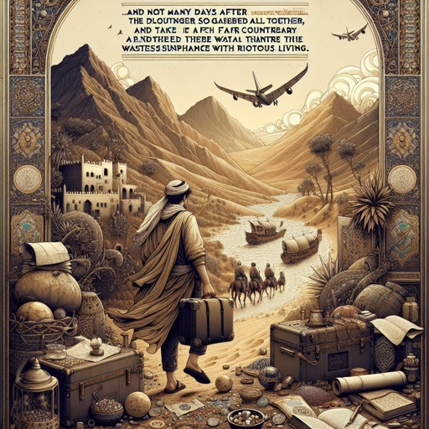
Luke 15:11-13,

Slide 17
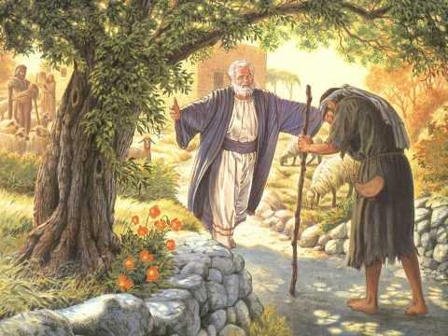
Later he repented and returned to his father.

Slide 18
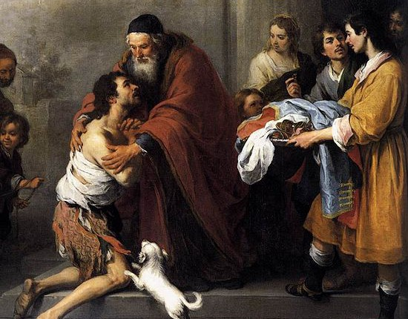
Luke 15:18-20,

Slide 19
V 30,
Then he came to the second and said likewise. And he answered and said, ‘I go, sir,’ but he did not go.

Slide 20
The word “sir” is from the Greek word ‘Kyrios’ meaning
‘lord’ or ‘master.’

Slide 21
Luke 15:28,
“But he was angry and would not go in. Therefore his father came out and pleaded with him.

Slide 22
V 31,
Which of the two did the will of his father?” They said to Him, “The first.” Jesus said to them,…….

Slide 23
From this we see that the father represents God.
Son | Response | Repentance | Result | Reflection
First | I will NOT | Yes | Worked | Obedience
Second | I will | No | No work | Disobedience

Slide 24
The first son represents the
tax collectors & prostitutes.
They said no to God initially, but when they heard the message of the kingdom, they changed their minds and began to do God’s will.

Slide 25
The second son represents the chief priests and elders.
They said yes to God, but when they heard the message, they did not act.

Slide 26
The vineyard represents Israel, the people of God.

Slide 27
The point of the parable is clear.
Those who refuse God but later repent and obey, like the first son, will go into the kingdom.
Those who say yes, but don’t obey God, like the second son will not go into the kingdom.

Slide 28
V 31,
…… Jesus said to them, “Assuredly, I say to you that tax collectors and harlots enter the kingdom of God before you.

Slide 29
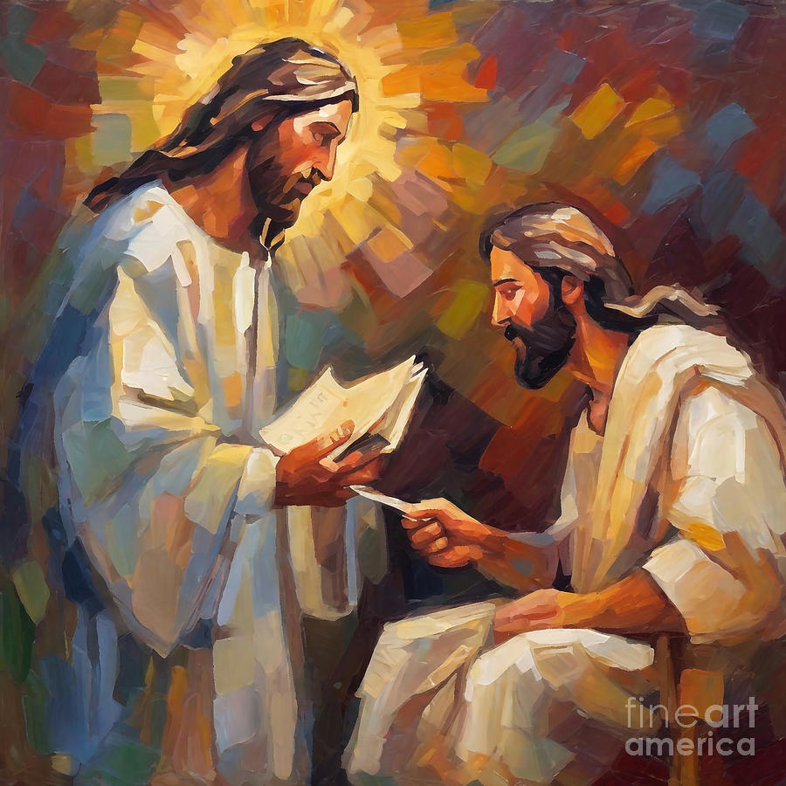
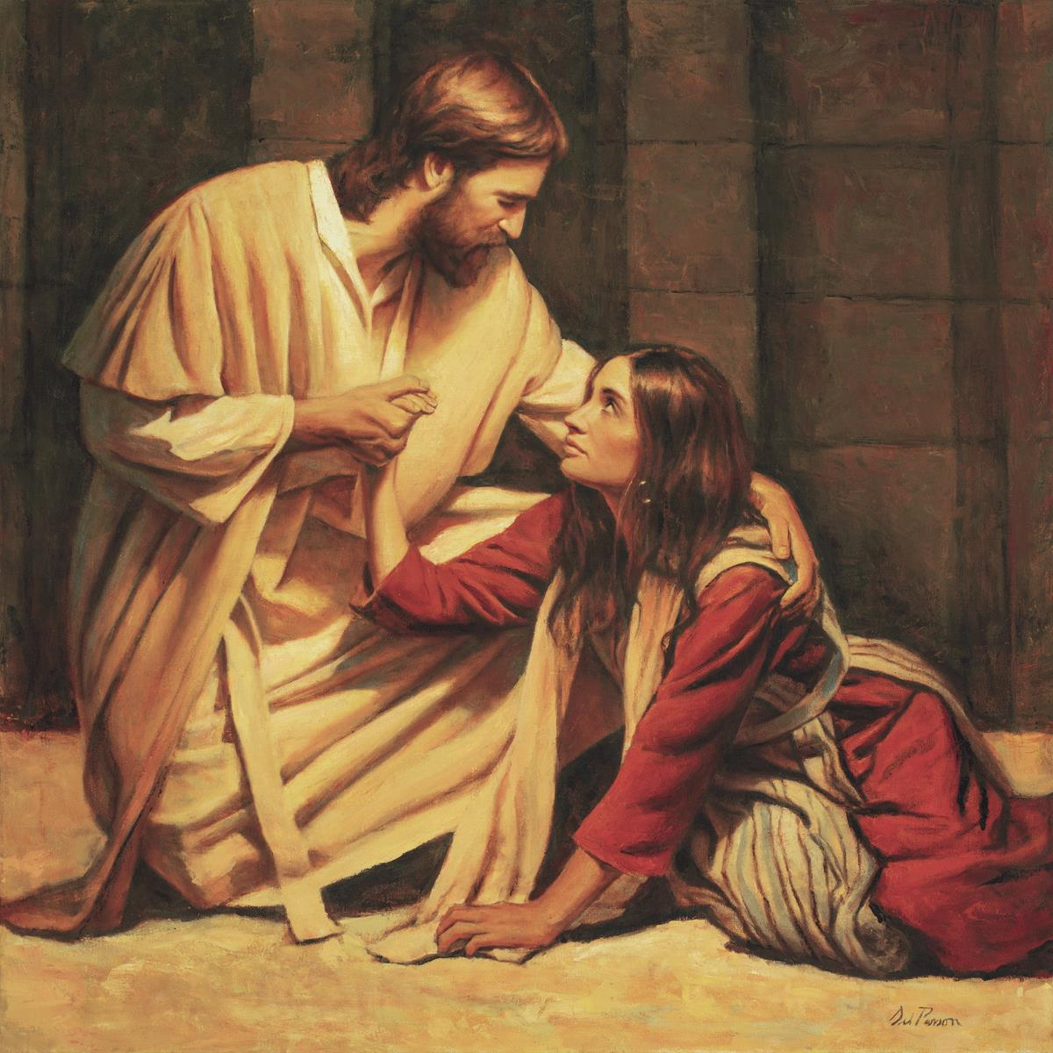
Tax collectors and Prostitute.

Slide 30
Because the religious leaders hated them the most.

Slide 31
Tax collectors:
No one likes to pay money to the government.
The tax collectors in the Bible were Jews who were working for the hated Romans.
The tax collectors cheated the people they collected from.

Slide 32
Luke 19:8,
“Look, Lord, I give half of my goods to the poor; and if I have taken anything from anyone by false accusation, I restore fourfold.”

Slide 33
The confession of tax collector Zacchaeus displayed his past dishonesty.

Slide 34
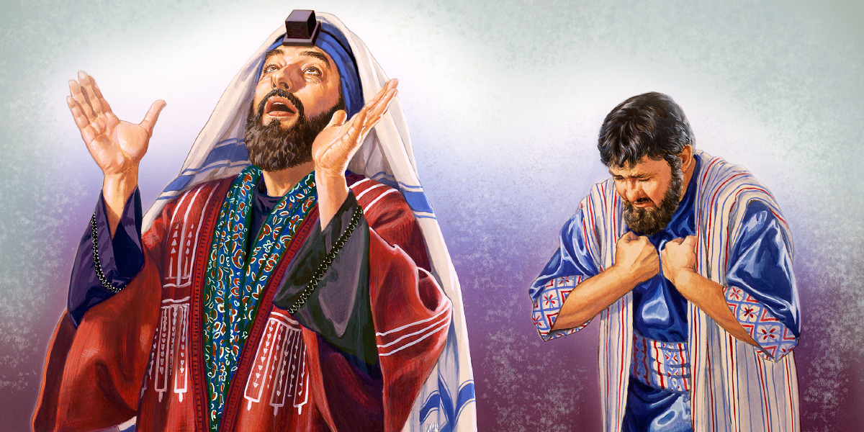
Luke 18:10-11,

Slide 35
The Pharisees communicated their disdain for tax collectors in one of their early confrontations with Jesus.

Slide 36
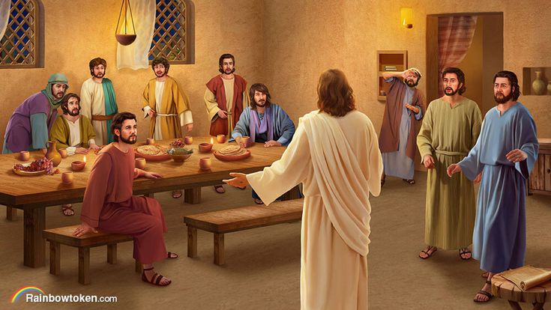
Mark 2:15-16,

Slide 37
Even Jesus gave an example tax collectors as how they ought to treat a sinning brother.

Slide 38
Matthew 18:18,
And if he refuses to hear them, tell it to the church. But if he refuses even to hear the church, let him be to you like a heathen and a tax collector.

Slide 39
Prostitutes:
Not a great profession.
The religious group they don’t want to do anything with women and with a prostitute nothing!

Slide 40
Luke 7:39,
“This Man, if He were a prophet, would know who and what manner of woman this is who is touching Him, for she is a sinner.”

Slide 41
John 8:3,
Then the scribes and Pharisees brought to Him a woman caught in adultery. And when they had set her in the midst,

Slide 42
Where is the man?
We need 2 people to commit adultery.

Slide 43
Why were tax collectors and sinners able to open their hearts and respond to the kingdom while the chief priests and elders were not?

Slide 44
The tax collectors and sinners had reached rock bottom and realized that their lives were empty and meaningless.

Slide 45
In Jesus, they found life as it was meant to be.
Jesus offered them hope, which they never had.

Slide 46
Ezekiel 18:27-28,
…….. Because he considers and turns away from all the transgressions which he committed, he shall surely live; he shall not die.

Slide 47
John the Baptist is the subject of the argument at this point between Jesus and the leaders of Jerusalem.

Slide 48
Matthew 21:25,
…. And they reasoned among themselves, saying, “If we say, ‘From heaven,’ He will say to us, ‘Why then did you not believe him?’

Slide 49
Jesus asked the question about John the Baptist.
Now Jesus answers them with John the Baptist as well.

Slide 50
V 32,
For John came to you in the way of righteousness, and you did not believe him; but tax collectors and harlots believed him; …….

Slide 51
Matthew 3:1-2,
“Repent, for the kingdom of heaven is at hand!”

Slide 52
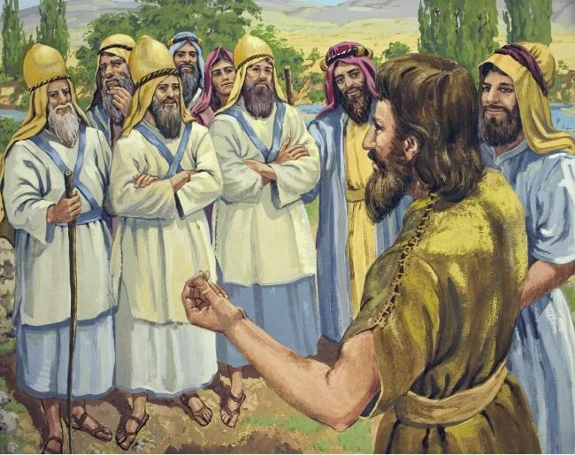
Matthew 3:7-9,

Slide 53
The Pharisees even though they had said yes to obey God, they did not believe John was from God.
So, they didn’t do what he said.

Slide 54
V 32,
when you saw it, you did not afterward relent and believe him.

Slide 55
Even after they saw others respond, they rejected him.
They would not change their minds about him and heed his message of repentance.

Slide 56
They blew it twice with John, just like they were blowing it with Jesus as they spoke with him.
The Pharisees and religious leaders disdained John because of several of his practices.

Slide 57
First, he was baptizing people in the middle of nowhere.
Baptism was usually reserved for the temple area, and the Pharisees regularly practiced washings for purity.

Slide 58
He caused a lot of issues with the Roman-placed leaders of his day. His preaching was not something they could smooth over with the Roman officials.

Slide 59
Matthew 14:1-5,
“This is John the Baptist; he is risen from the dead, and therefore these powers are at work in him.”

Slide 60
Conclusion:
How do the character traits of the two sons differ?

Slide 61
1. The character of each son is vastly different.
One son is independent, disobedient, and insolent, but after thinking about his ways, returns to carry out his responsibility.

Slide 62
The second is a big talker, full of promises but
no action.

Slide 63
2. Why does the first son regret his disobedience?
Both sons hear the same command: "Son, go work today in my vineyard."

Slide 64
Parents should not raise their children in the destructiveness of idleness.
Similarly, God commands His children to work, though we are all heirs.

Slide 65
The disobedient son represents those who have no desire to make an effort to obey God.

Slide 66
3. Why does the second son not go to work in his father's vineyard?
The second son deceitfully professes respect and obedience, but he never does his duty.

Slide 67
Many in mainstream Christianity profess to know God but deny Him in their works.
They appear pious at church, but their personal lives are riddled with sin.

Slide 68
Their efforts produce the works of the flesh rather than the fruit of the Spirit.

Slide 69
4. Since both sin, why does the openly disobedient son eventually did the will of his father?
The sons' ultimate actions reveal their difference.

Slide 70
The first son, after open refusal, repents of his sin and goes to work for his father.
He overcomes and changes from bad to good.

Slide 71
The proof of our repentance comes to light when we comply with the Father's will and do good work with the help of the Holy Spirit.
The result is the production of the fruit of the Spirit.

Slide 72
5. Why do the Pharisees not recognize true righteousness?
John the Baptist proclaimed the truth and lived it, but the Pharisees rejected John's witness and professed their own righteousness while living unrighteously.

Slide 73
In this parable, Jesus distinguishes those who generally knew the way of God (Jews) from those who did not (Gentiles).

Slide 74
The Jews initially appeared righteous, having the revelation of God and the ordinances of justice established among them.
The Gentiles were initially ignorant of righteousness, the way of God and were sinful in all their conduct.

Slide 75
APPLICATION

Slide 76
a) Are you a "doer" and not a “sayer"?
Matthew 7:21,

Slide 77
The doing of the will of God is the one thing needful.
In giving The Great Commission before His ascension to heaven.

Slide 78
Matthew 28:20,
teaching them to observe all things that I have commanded you; and lo, I am with you always, even to the end of the age.” Amen.

Slide 79
Greatness in the kingdom of God is measured in terms of obedience.
The doctrines of "Hyper grace" and "easy believism" have created a generation of "sayers" and not "doers".

Slide 80
Luke 6:46,
“But why do you call Me ‘Lord, Lord,’ and not do the things which I say?

Slide 81
They are like the second son, who says he will do the father's will, but doesn't.
This is a word to us not just the ancient leaders of Israel. We must come through on our commitments to God.

Slide 82
b) Faith in God.
Misunderstanding the doctrine of "salvation by grace through faith".

Slide 83
Many people have concluded that requiring obedience to God's command is "legalism" or "salvation by works of merit".
Yet nothing could be further from the truth!

Slide 84
We simply do that which is our duty to do, and always remain
"unprofitable servants" saved by grace.

Slide 85
Luke 17:10,
So likewise you, when you have done all those things which you are commanded, say, ‘We are unprofitable servants. We have done what was our duty to do.”

Slide 86
Titus 3:4-7,
……. that having been justified by His grace we should become heirs according to the hope of eternal life.

Slide 87
Titus 3:8,
This is a faithful saying, and these things I want you to affirm constantly, that those who have believed in God should be careful to maintain good works. These things are good and profitable to men.

Slide 88
The "religious leaders" in Jesus' day rejected the counsel of God for themselves in not accepting John's teaching for the need for repentance and baptism.

Slide 89
Even today there are many people (even "tax collectors" and "harlots") who will enter the kingdom of God before many religious people do

Slide 90
c) Don’t be self-righteous.
We need humility so we don’t become like the leaders of Jerusalem.

Slide 91
Who are the ones who will never repent?
No.
Sinner do have a chance for them to repent.

Slide 92
The ones who will never repent are those who think they don’t need to repent, who don’t see the need, who think they are in the right.

Slide 93
d) Good news for sinners!
Jesus teaches that you can change your mind!

Slide 94
You can have a change within so that you believe the message and start to obey your heavenly father.
It isn’t too late.

Slide 95
2 Samuel 12:1-13,
“You are the man! Thus says the Lord God of Israel:

Slide 96
2 Samuel 12:1-13,
“I have sinned against the Lord.” And Nathan said to David, “The Lord also has put away your sin; you shall not die.

Slide 97
Acts 13:22,
‘I have found David the son of Jesse, a man after My own heart, who will do all My will.’

Slide 98
What kind of "son" are you?
One who does the will of his Father?
Or one who says he will, but in the end does not?

